Slide 1
CEOS initiative – Forest monitoring and Vietnam DataCube
Dr. Vu Anh Tuan
WGISS-48 - Hanoi, Oct. 2019

Slide 2
CEOS initiative
Forest monitoring progress
Vietnam Data Cube

Slide 3
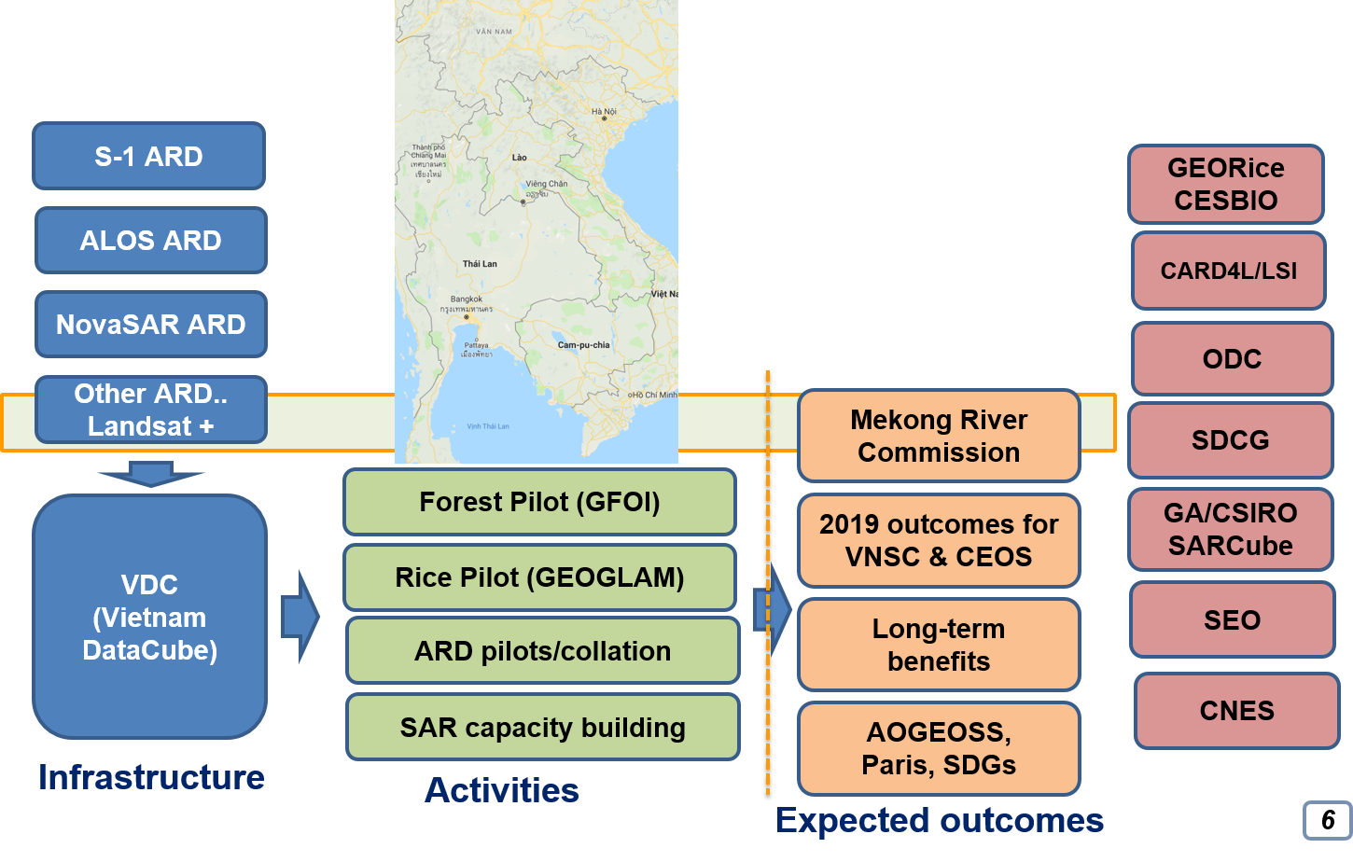
CEOS Initiative
Regional application of EO data
To integrate on-going thematic CEOS activities on a regional basis,
To demonstrate for key global programs and initiatives (e.g. GFOI, GEOGLAM) how to downscale from global to regional to local applications,
Incorporation of different datasets (space-based and in situ) from regional observing systems and inclusion of national and regional users downstream who are not directly part of the CEOS community.

Slide 4
CEOS Initiative
In 2019, CEOS Chair activities focus on two specific applications:
  Carbon Observations, including forested regions: to coordinate EO observations to support the effective monitoring and management of the forests in the region, through its Ad Hoc Space Data Coordination Group for GFOI, in support of the development of national forest monitoring and measurement, reporting and verification (MRV) systems;
  Observations for Agriculture: in line with the CEOS Ad Hoc WG on GEOGLAM, and within the GEOGLAM Asia-Rice regional network, a key focus will be addressed on the practical use of CEOS data, especially SAR for rice crop monitoring in Asia.
Focus on the Mekong basin region, which is cross boundary affected by climate change and human activity impacts
  To enhance contribution and cooperation in the region of the CEOS agencies;
  To promote the sharing of CEOS agency data by improving access and use of such data in thematic studies and applications for the whole region.

Slide 5
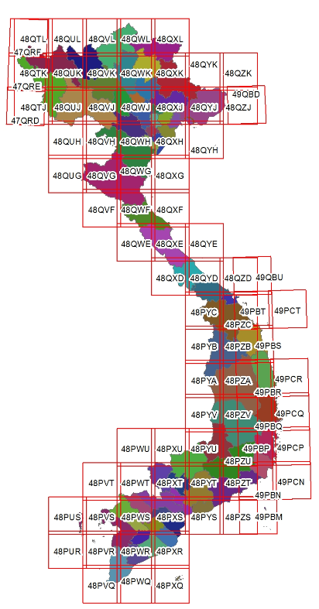
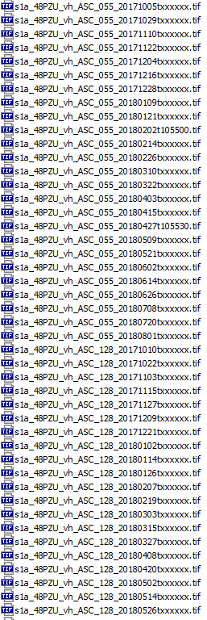
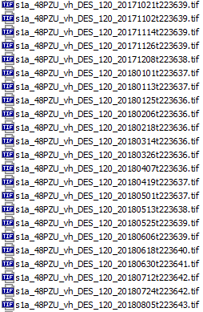
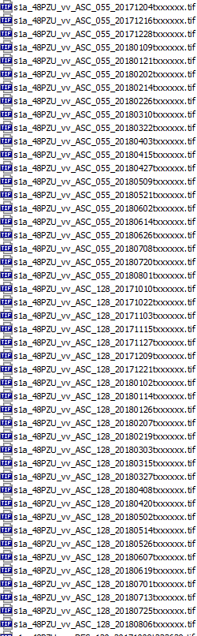

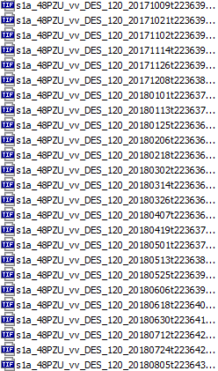
Forest monitoring progress
Objectives of forest cover change monitoring:
  Monthly forest cover change monitoring in Vietnam. The forest monitoring will be focus on “forest loss” monthly. Extension to the Mekong region.
  Yearly forest change result will be created with forest loss and forest regrowing
Data used :Sentinel-1 ARD
  85 scenes S1 ARD
  Period: 10/2017 – 08/2018
  Polarization: VH, VV
  Orbit: Ascending, Descending
85 folders
~200 files/1 folder

Slide 6
Forest monitoring progress
Forest monitoring for the Mekong
  Algorithms:
    Developed by VNSC: combination of SAR data and Optical data. Using Sentinel-1 for SAR data; Landsat and Sentinel 2 for optical data
    Developed by CESBIO: using time series of Sentinel-1 data
  In situ data: 2018 and 2019 data of central highland, Vietnam
  Validation: on-progress. VNSC created the forest monitoring product for Vietnam and using in-situ data for validation. From validated model of Vietnam, the forest map of other countries in Mekong region will be created. Validation will be helped by CNES CESBIO

Slide 7
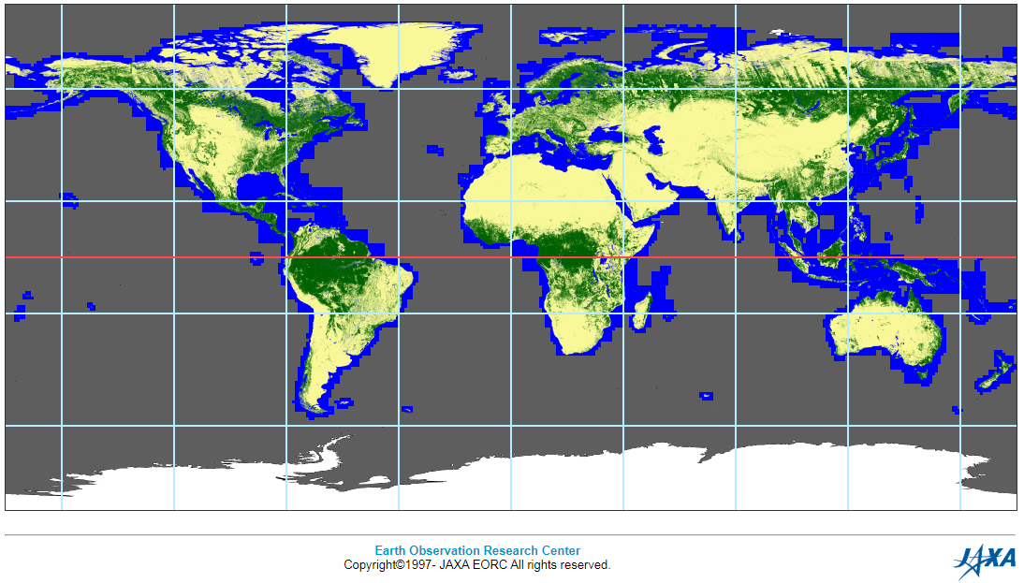
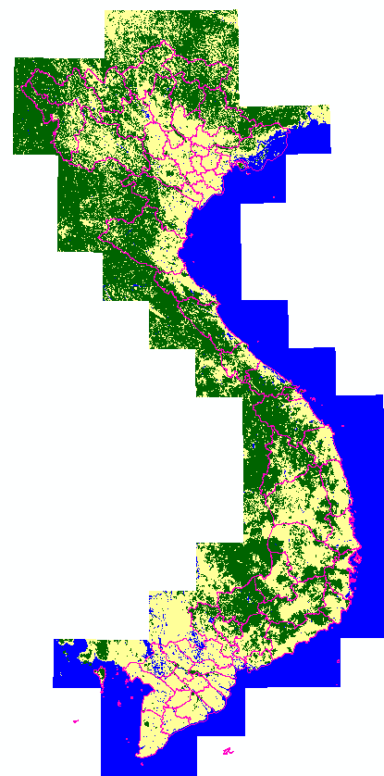
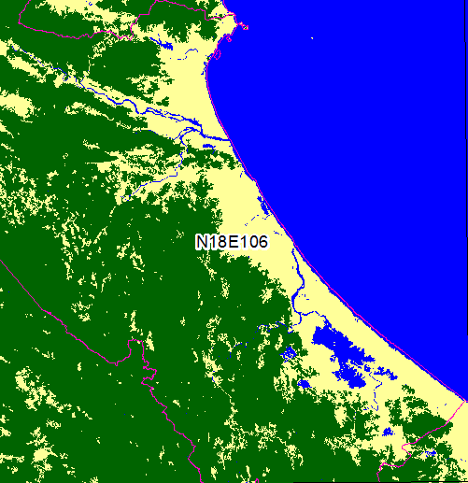

Forest monitoring progress
Algorithm
  Using Sentinel -1 data
  ARD data provided by CNES
  Using RCR (Radar Change Ratio) for forest loss detection
  Using PALSAR-2 Global Forest / Non-forest Map "2017“ (by JAXA) to remove non-forest change
  Using field data for validation (Vietnam only)

Slide 8
Forest monitoring progress
Capacity building
Participants: more than 40 young researchers (Vietnamese Academy, ministries and universities: VNSC, FIPI, National Center for remote sensing (MONRE), STI, NIAPP, VNU, Can Tho University, Da Nang University, Viettel Corporation,… & 2 foreigners - SERVIR)
Duration: 3 days (20-22 Feb. 2019)
Location: VNSC-Building A6, 18 Hoang Quoc Viet, Hanoi
Expert team
Alexandre Bouvet¹, Thierry Koleck^{1,2}, Stéphane Mermoz³, Hoa Phan¹
1. CESBIO, Toulouse, France; 2. CNES, Toulouse, France; 3. GlobEO, Toulouse, France

Slide 9
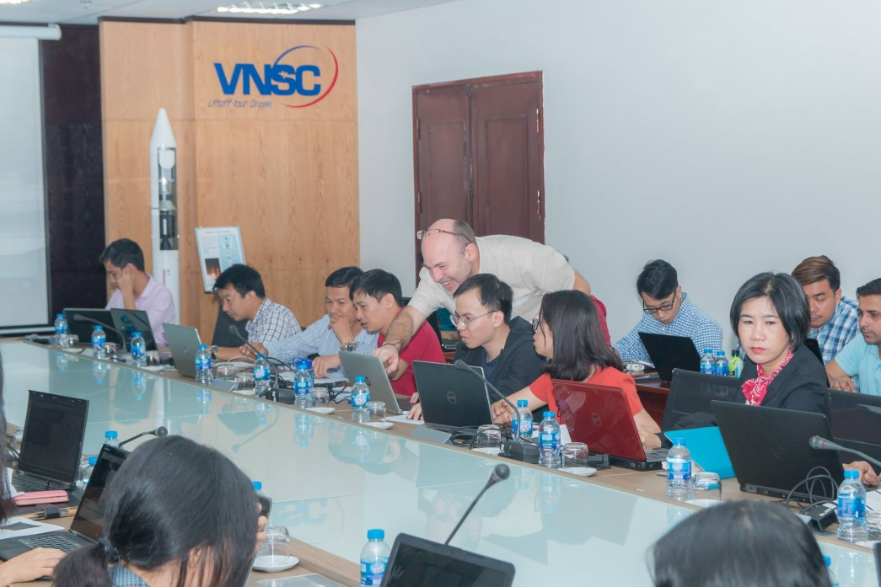
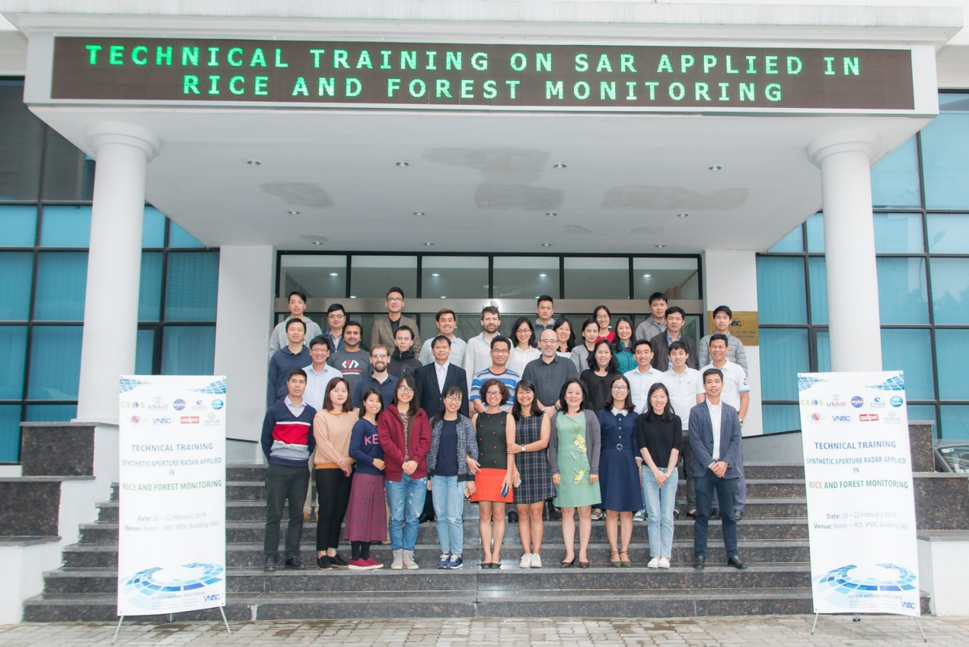


Slide 10
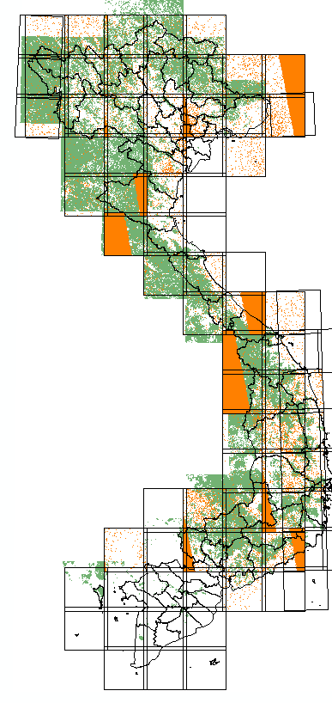
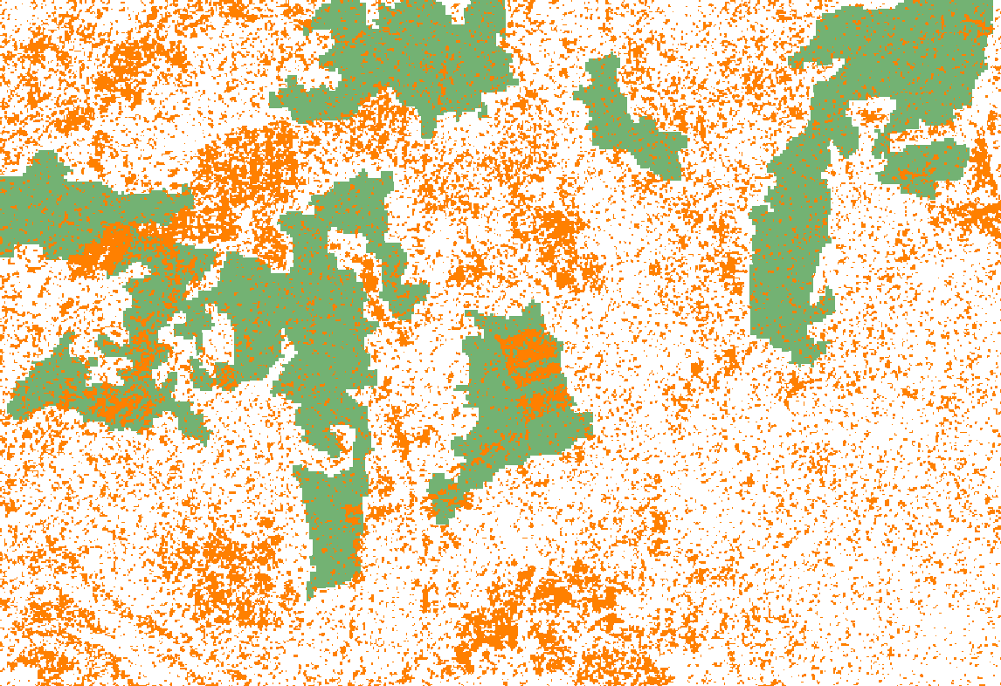
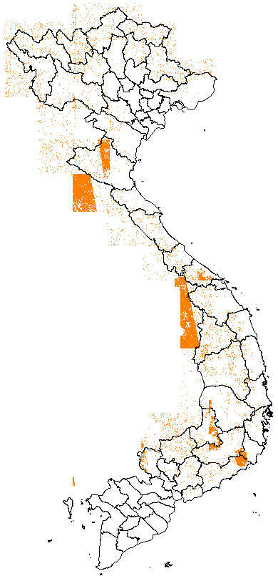
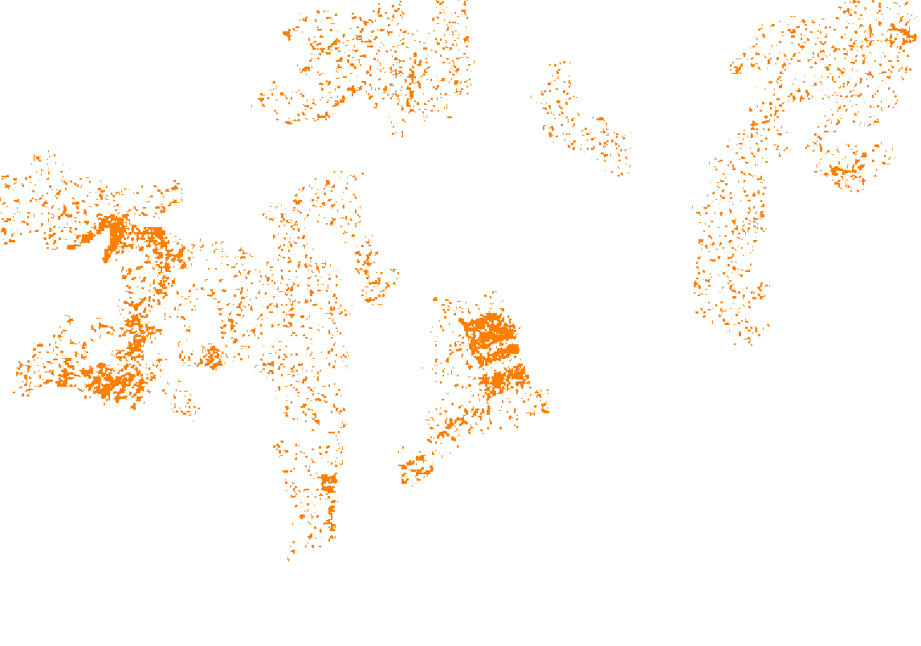
Forest monitoring progress
Result
Forest change monthly
Oct. 2017 to Aug. 2018 data
Vietnam
Forest change 2018 Feb.

Slide 11

Vietnam Data Cube
  Data collection: RS data has been provided by EC (Corpernicus program), JAXA, USGS/NASA, etc.
  Data Ingestion: in collaboration with CEOS SEO, CSIRO, CNES
  Forest monitoring: Algorithm has been developing in collaboration with CESBIO/CNES, FIPI (Vietnam).
  Rice monitoring: Algorithm has been developing in collaboration with CESBIO/CNES, JAXA/RESTEC.
  Capacity building: in collaboration with WGCapD, SERVIR MEKONG, CESBIO/CNES, etc.

Slide 12
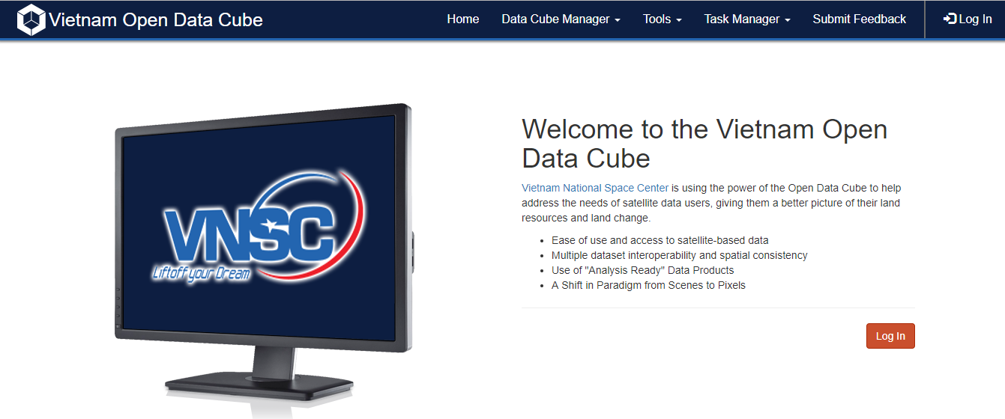
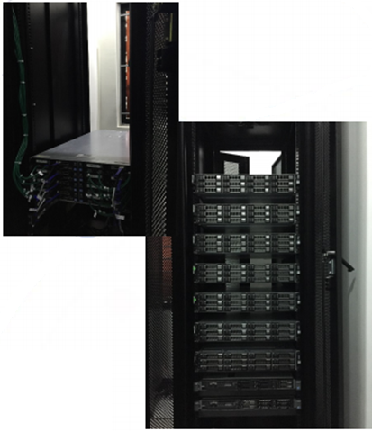
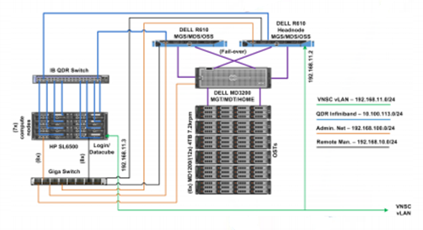
Vietnam Data Cube
1 head node, 1 login node, 7 compute nodes (each: 16 core 2.2GHz, 64GB RAM), 40Gb/s Infiniband Interconnect network
Full redundant parallel storage – LustreFS: 195TB, max read/write speed 1.9GB/s
Total storage capacity (including work, home, local): ~ 220TB
Can be expanded to hundreds of compute nodes, hundreds of TBs of storage

Slide 13
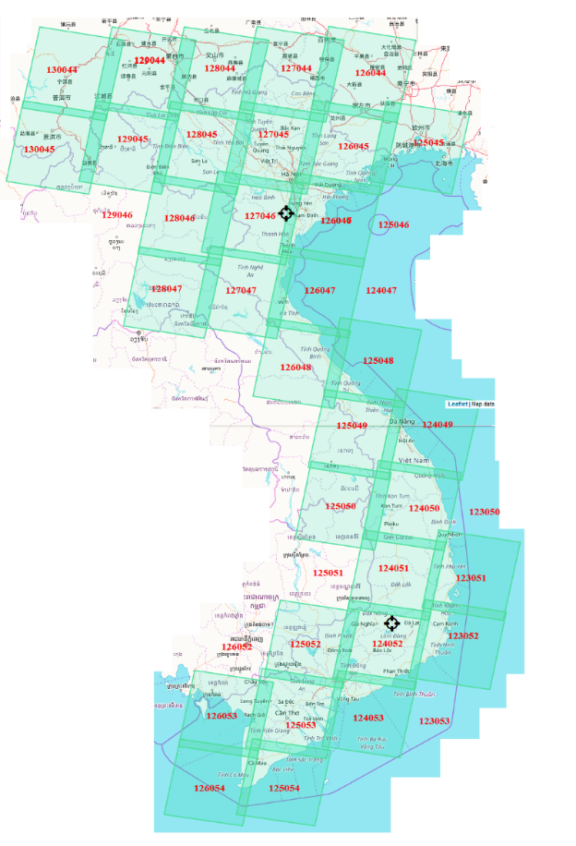
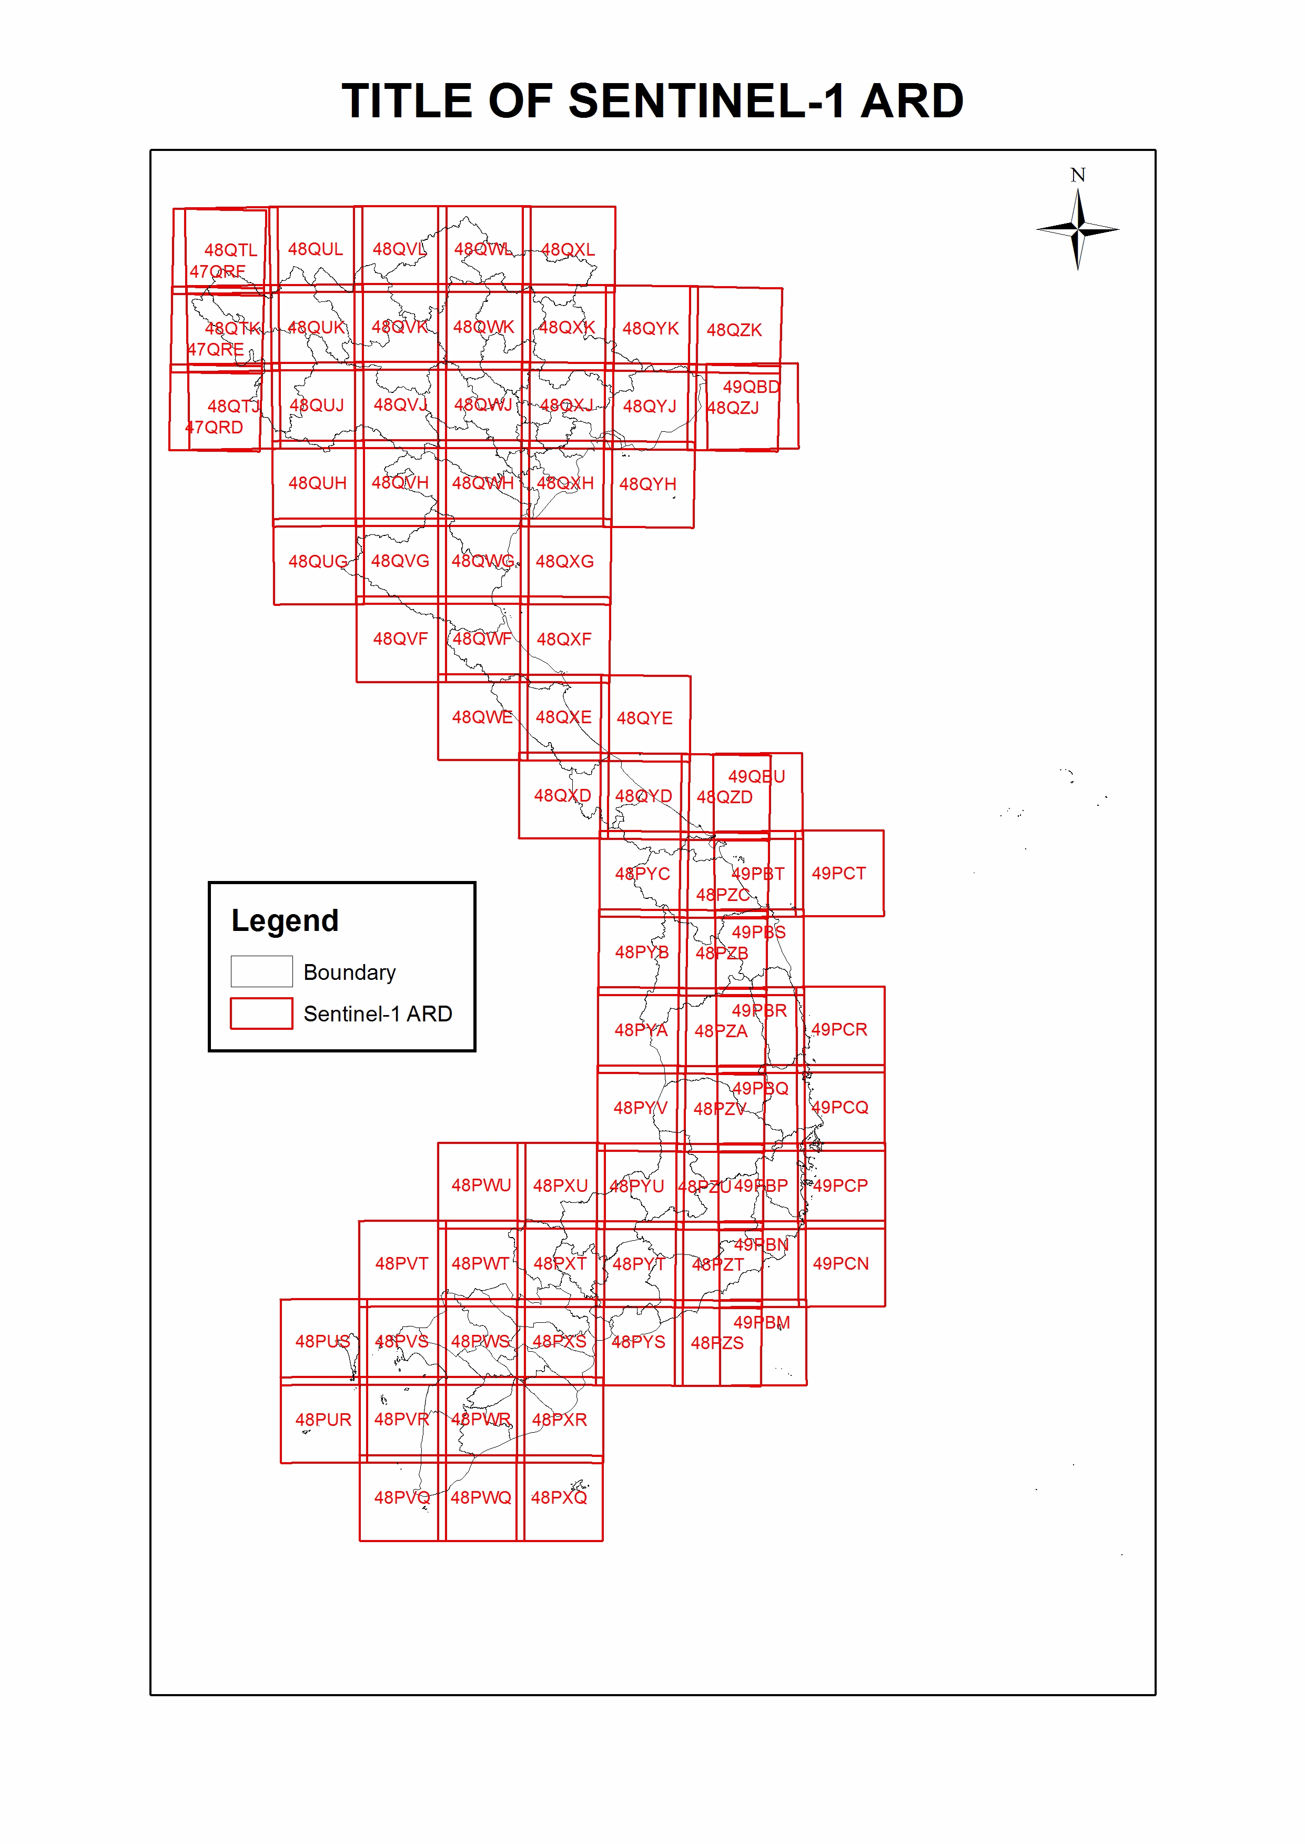
Vietnam Data Cube
Landsat ARD
Landsat (by USGS)
36453 images (Landsat 4, 5, 7, 8)
Time: from 1986 to now
ALOS-2 mosaics (by JAXA)
1507 images
Time: from November 2016 to April 2018
Sentinel-1: (from ESA, ARD by CESBIO/CNES)
S-1 images (VH and VV polarisation)
Time: from January 2015 to September 2018
Swath width: 250 km, pixel size: 10 m x 10 m
Constantly update with new data

Slide 14
Future work
Forest monitoring
      We plan to test with ALOS-2 data for 4 countries (intended 3 years, up to 2017)
      The algorithm needs to be verified to work with more steppy slope (in cooperation with FIPI)
      Transfer result to users: Ministry of Agriculture and Rural Development (Forest Protection Department), Mekong River Commission
    Vietnam Data Cube
      VNSC commits to invest for the operation cost of the system for long term
      User interface development and maintenance
      The applications of Regional Observatory can be expanded for other “hot” issues in the region such as disaster management, water management

Slide 15
Thank you for your attention!

