Slide 1
ESA Agency Report
Mirko Albani, ESA
WGISS#48 Meeting,
08-11 October 2019,
VAST/VNSC, Ha Noi, Vietnam

Slide 2

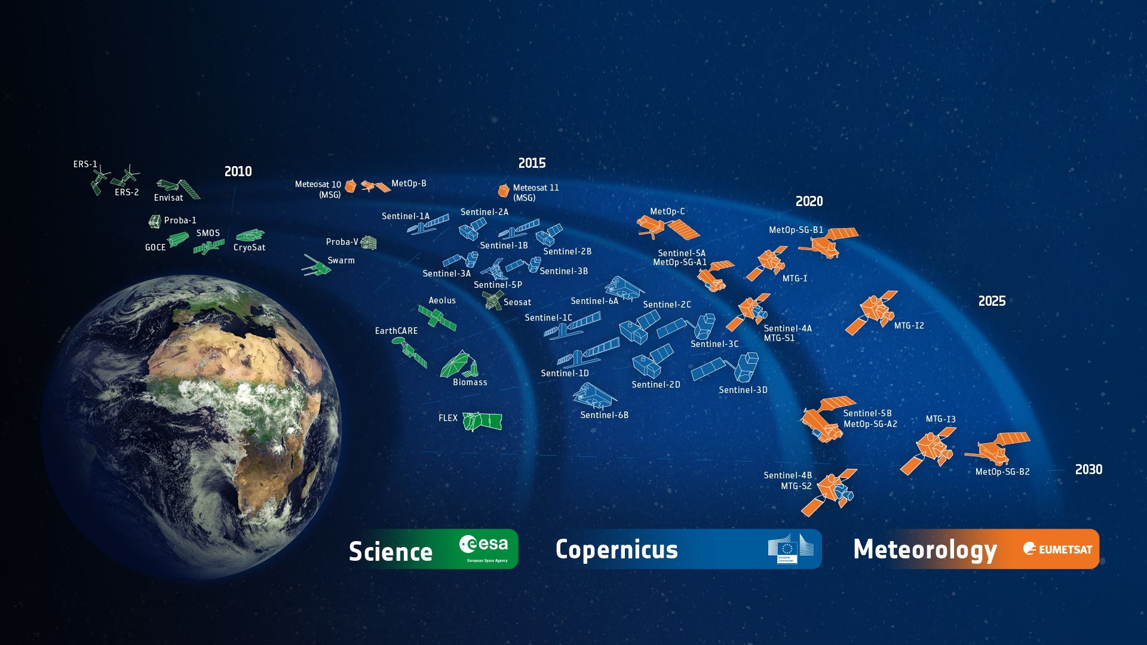






















ESA-Developed Earth Observation Missions
Satellites
25 under development
15 in operation
FORUM
ESA UNCLASSIFIED – For Official Use
European Space Agency
Notes:
D/EOP has three main lines of activities: Earth Science, Copernicus and Meteorology
Since the latest launch of Aeolus on 22 Aug. 2017, we have 25 satellites in development and 15 satellites in operation.

Slide 3

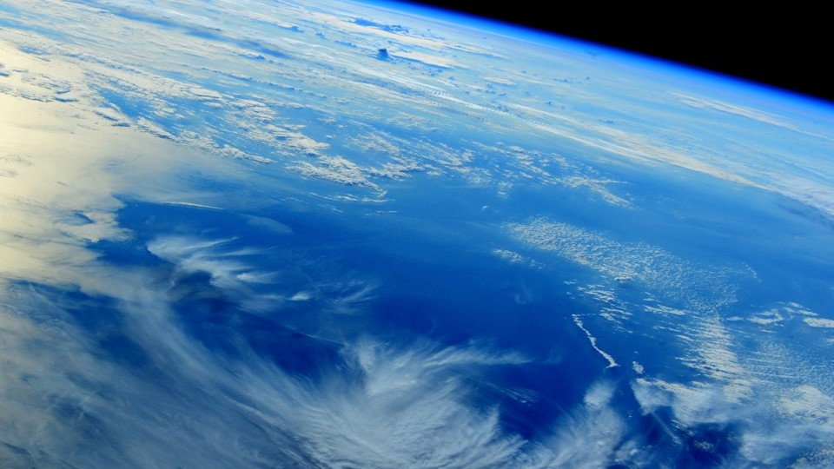
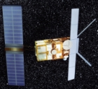
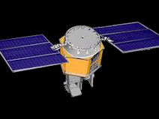
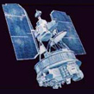
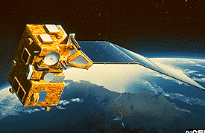
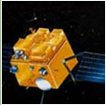
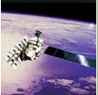
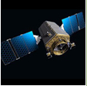
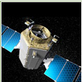




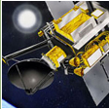
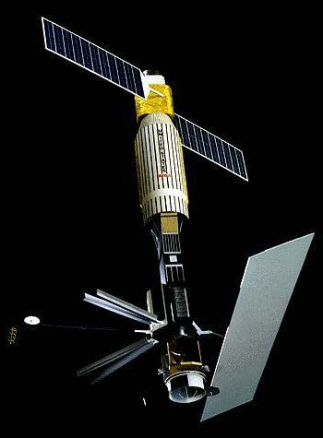
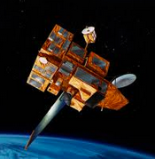
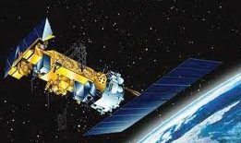
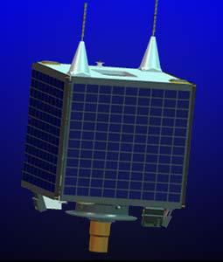

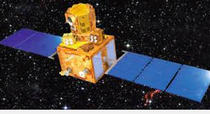
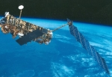
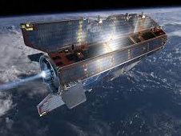



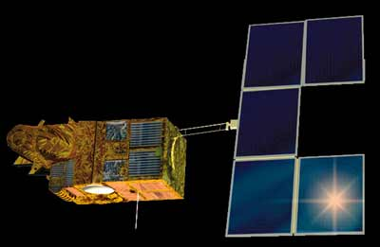
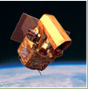


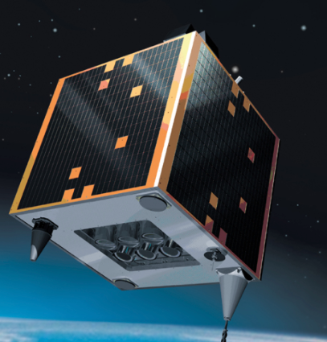






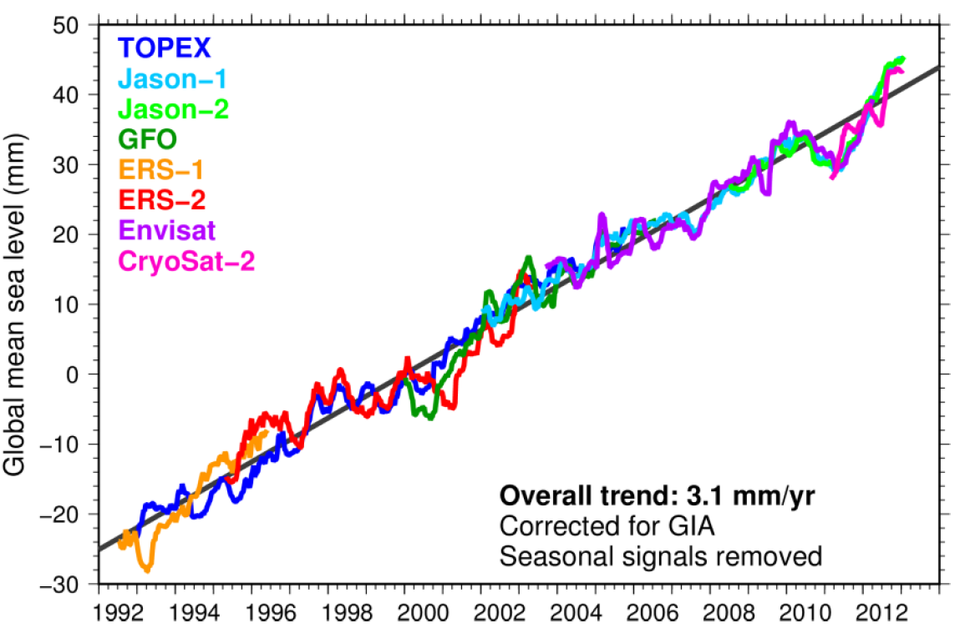
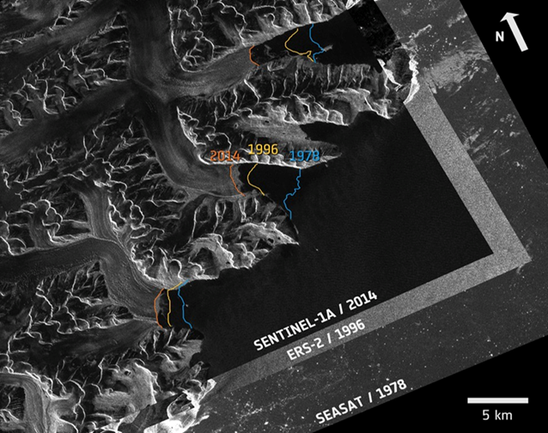
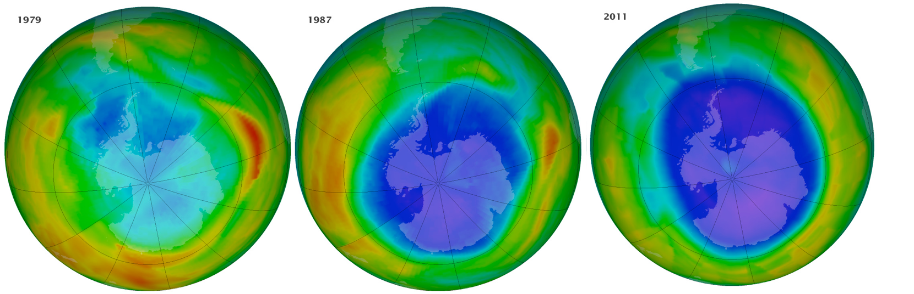
Earth Observation Heritage Missions
ESA Heritage Missions
ESA Heritage
Third Party Missions
ERS-1
ERS-2
HCMM
Nimbus 7
MOS-1/1b
JERS-1
ALOS
Kompsat-2
Kompsat-1
SEASAT
ADEOS-1
POES AVHRR 7-14
DMC-UK-1
IRS-P6
Envisat
GOCE
Quickscat
Ikonos-2
Orbview-2
DEIMOS-1
IRS-P3
SPOT 1-2-3
ESA UNCLASSIFIED – For Official Use
Notes:
These data must be preserved, kept discoverable and accessible to all users with latest tools and technologies, and continuously improved to ensure fitness for purpose and continuity with present and future missions.

Slide 4
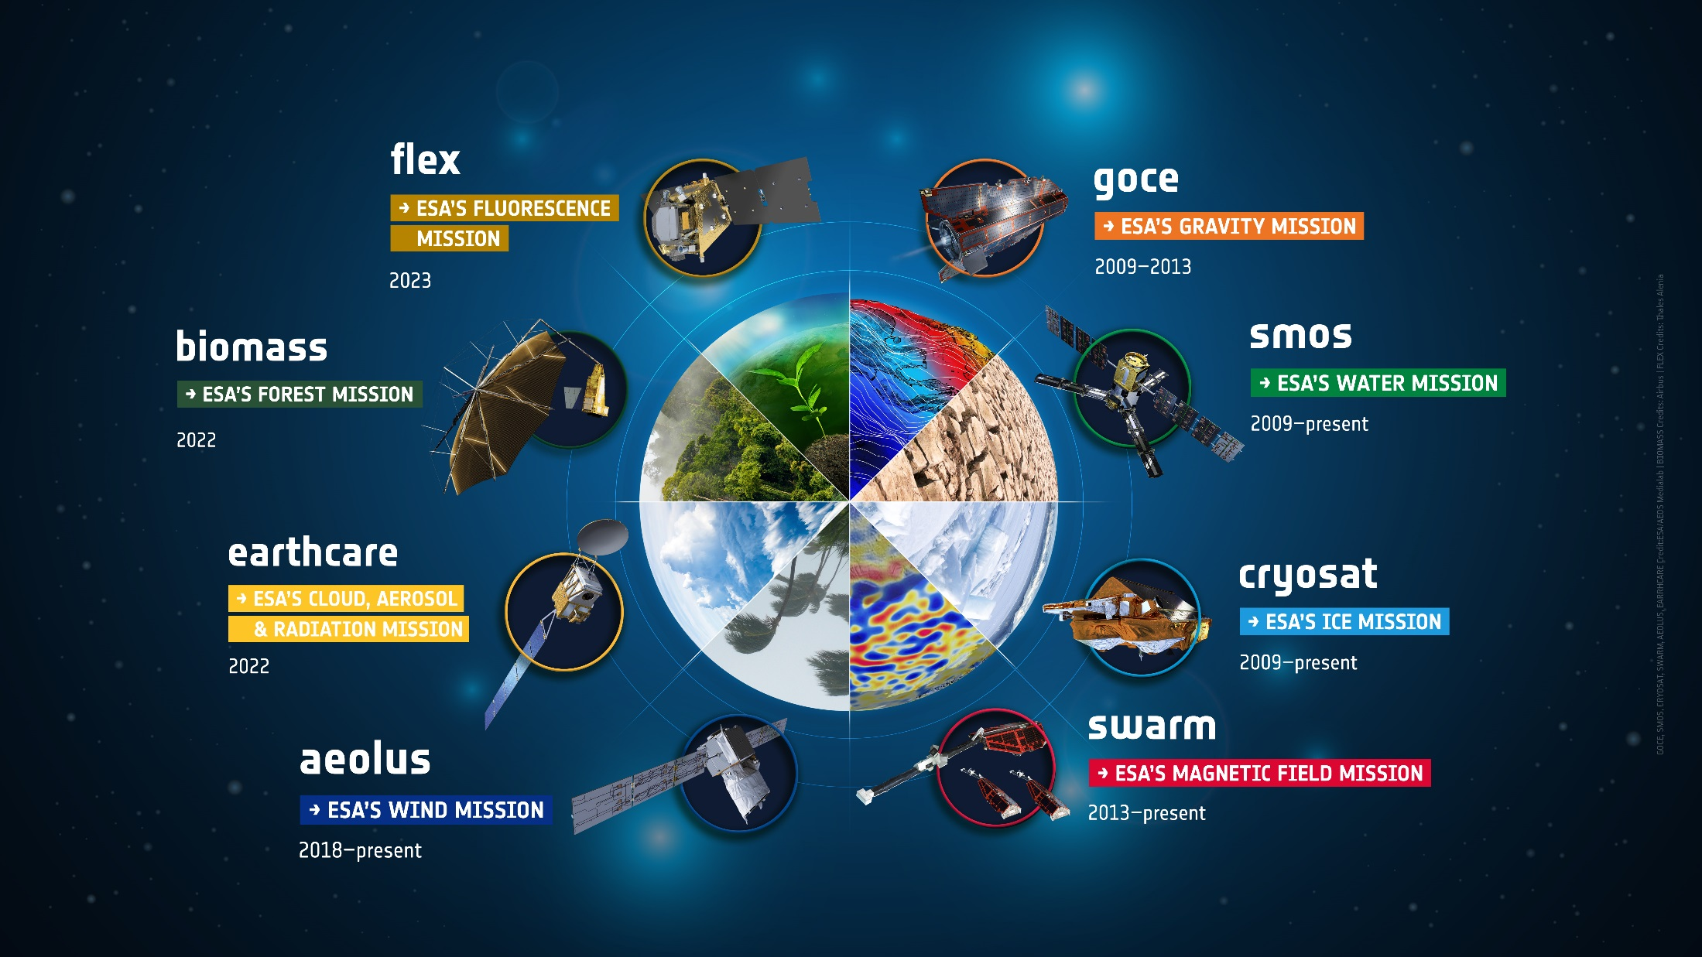
Science: Earth Explorers
ESA UNCLASSIFIED – For Official Use
European Space Agency
Notes:
The Earth science missions “Earth Explorers” allow us to understand the Earth System and its diverse aspects in more and more detail.

Slide 5
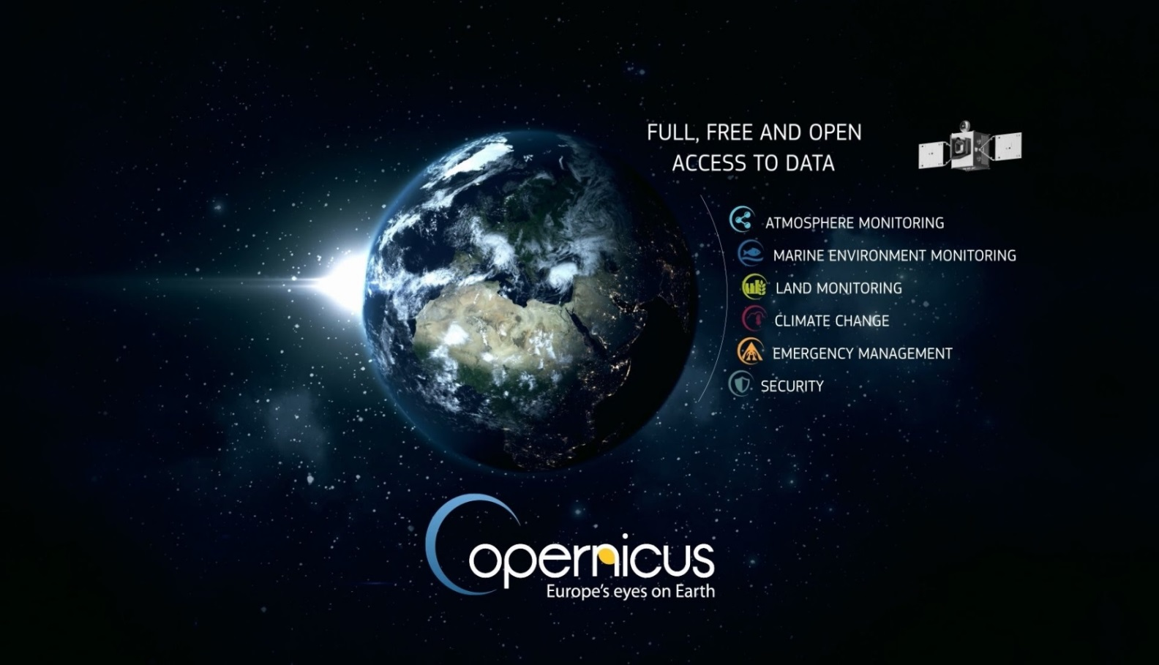
Copernicus – a new Phase in EO
European Earth Observation System
Led by the EU
EU-ESA Collaboration
European response to
global needs:
to manage the environment
to mitigate the effects of climate change
to ensure civil security
Notes:
Copernicus Main Points:
Copernicus is a System for Global Monitoring of the Environment & Security (formerly known as GMES)
Integrated “system of systems”, space & in-situ
Led & mainly financed by the European Union
Dawn of an operational phase in EO
Six Services + Full and Open Data Policy
ESA is the coordinator of the Copernicus Space Component (6 Sentinels and the related Ground Segment)
ESA is the development and procurement agency for the dedicated space infrastructure.
ESA is responsible for the definition of the overall Copernicus Space Component architecture and its future evolution

Slide 6








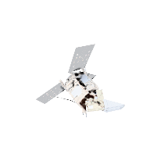
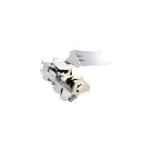
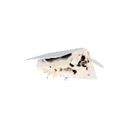
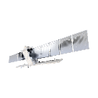



Copernicus – continue global leadership in EO
> 265.000
6 operational services
registered users
= tip of the iceberg
Land
Atmosphere
Ocean
Climate
Disaster
Security
7 satellites flying
250 TB satellite data distributed per day
S1 | S2 | S3 | S4 | S5P | S5 | S6
●● | ●● | ●● |  | ●
full, free & open data policy
preparing Copernicus 4.0
ESA UNCLASSIFIED – For Official Use
European Space Agency
Notes:
This infographic captures the key elements of the Copernicus EO system ➔ explain a few.
Copernicus is the Reference Backbone for an integrated EO observing system and, it is an excellent example of European global leadership in space.
Copernicus enables us to provide a routine health check of our planet.

Slide 7
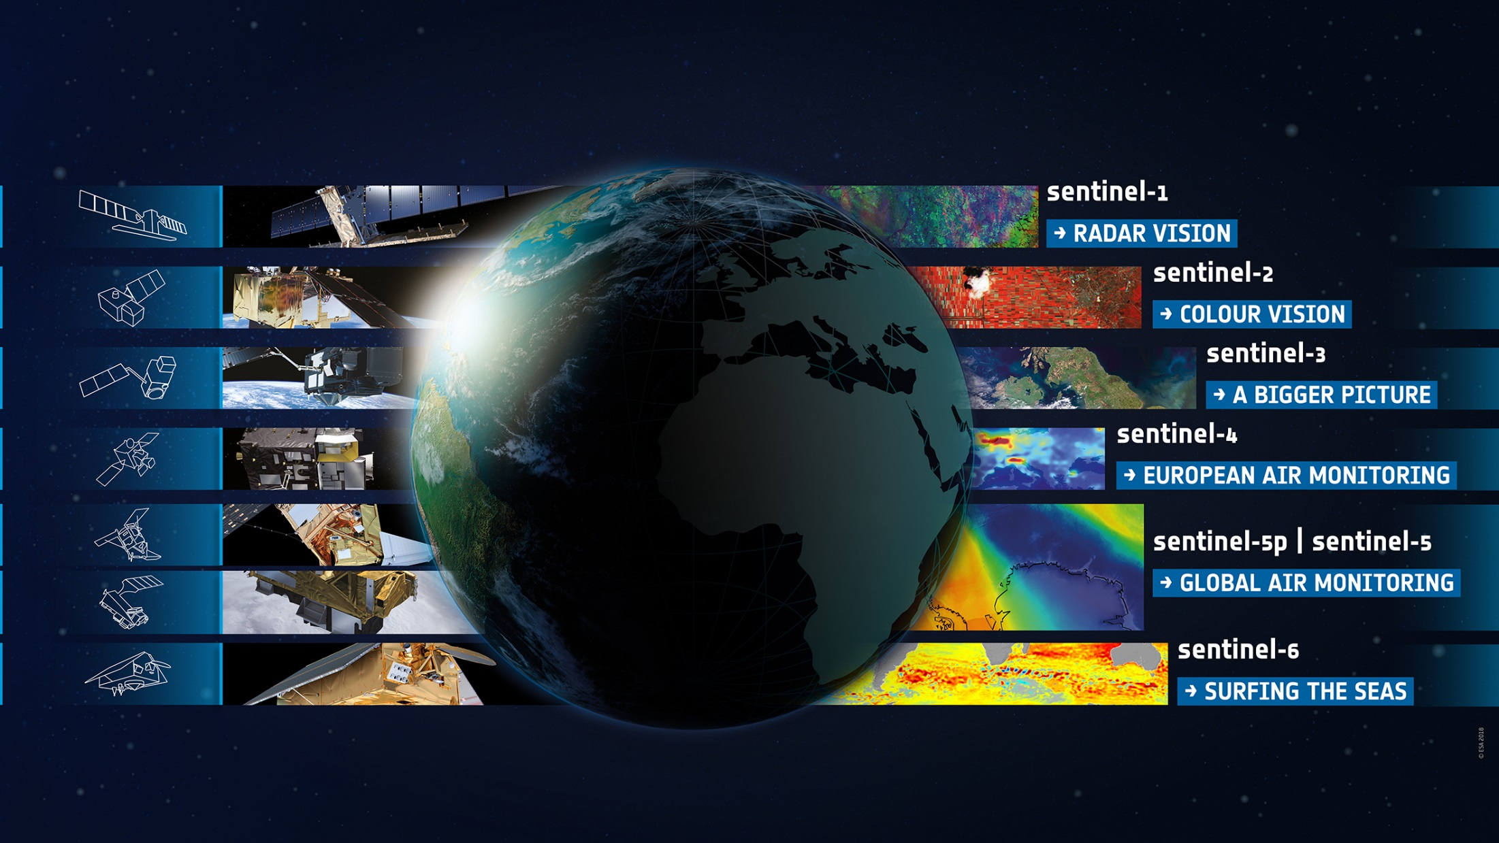
Environmental Monitoring: Copernicus Sentinels
ESA UNCLASSIFIED – For Official Use
European Space Agency

Slide 8
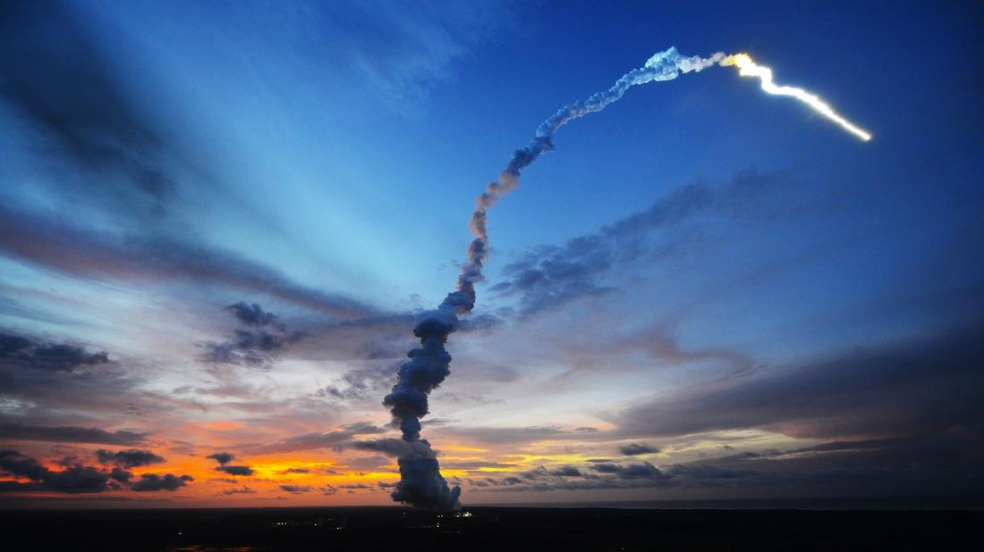
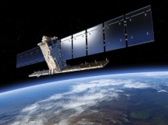
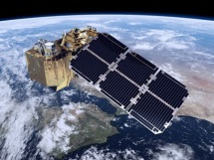
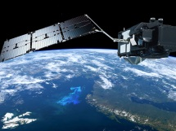
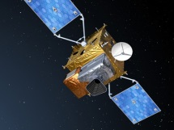
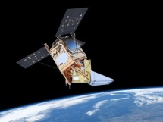
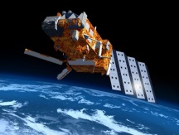
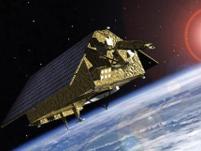
Copernicus Sentinel Status
S-1
S-2
S-3
S-4
S-5P
S-5
S-6
Radar
High Res. Optical
Medium Res. Optical & Altimetry
Atmospheric Chemistry (GEO)
Atmospheric Chemistry (LEO)
Atmospheric Chemistry (LEO)
Altimetry
A
3 Apr. 2014
A
23 Jun. 2015
A
16 Feb. 2016
A
2022
A
13 Oct. 2017
A
2021
A
2020
B
25 Apr. 2016
B
6 Mar. 2017
B
25 Apr. 2018
B
2027
B
2027
B
2025
C
2022/23
C
2022/23
C
2023
C
> 2027
D
> 2022/23
D
> 2022/23
D
> 2023
Notes:
Green = launched
Blue = under development / to be developed

Slide 9
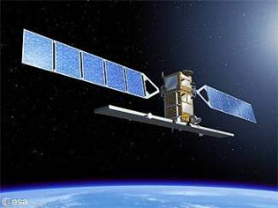
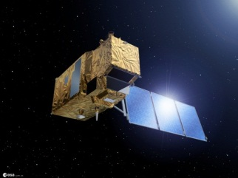
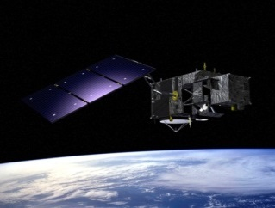

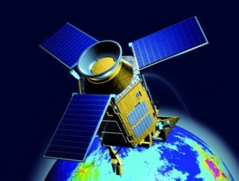
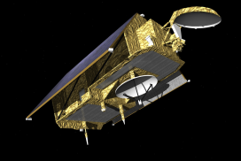







Copernicus Space Component: State of Play
FULL, FREE AND OPEN
THE SENTINELS
Sentinel Mission and Status
Key Features
SENTINEL-1:
4-40m resolution, 3 day revisit at equator
2 Sats in orbit
Polar-orbiting, all-weather, day-and-night radar imaging
SENTINEL-2:
10-60m resolution, 5 days revisit time
2 Sats in Orbit
Polar-orbiting, multispectral optical, high-res imaging
SENTINEL-3:
300-1200m resolution, <2 days revisit
2 Sats in Orbit
Optical and altimeter mission monitoring sea and land parameters
SENTINEL-4:
8km resolution, 60 min revisit time
1st Launch in 2020
Payload for atmosphere chemistry monitoring on MTG-S
SENTINEL-5p:
7-68km resolution, 1 day revisit
1 Sat in Orbit
Mission to reduce data gaps between Envisat, and S-5
SENTINEL-5:
7.5-50km resolution, 1 day revisit
1st Launch in 2021
Payload for atmosphere chemistry monitoring on MetOp 2ndGen
SENTINEL-6:
10 day revisit time
1st Launch in 2020
Radar altimeter to measure sea-surface height globally

Slide 10



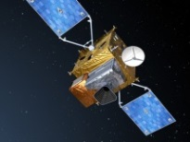


CSC: Sentinel Satellites
Sentinel 1 (A/B/C/D)
SAR Imaging
All weather, day/night applications, interferometry
Sentinel 2 (A/B/C/D)
Multispectral Imaging
Land applications: urban, forest, agriculture, … Continuity of Landsat, SPOT
Sentinel 3 (A/B/C/D)
Ocean & Global Land Monitoring
Wide-swath ocean colour, vegetation, sea/land surface temperature, altimetry
Sentinel 4 (A/B)
Geostationary Atmospheric
Atmospheric composition monitoring, pollution; instrument on MTG satellites
Sentinel 5 (A/B/C) & Precursor
Low-Orbit Atmospheric
Atmospheric composition monitoring; instrument on MetOp-SG satellites
Sentinel 6
Jason CS (A/B)
Altimetry reference mission

Slide 11

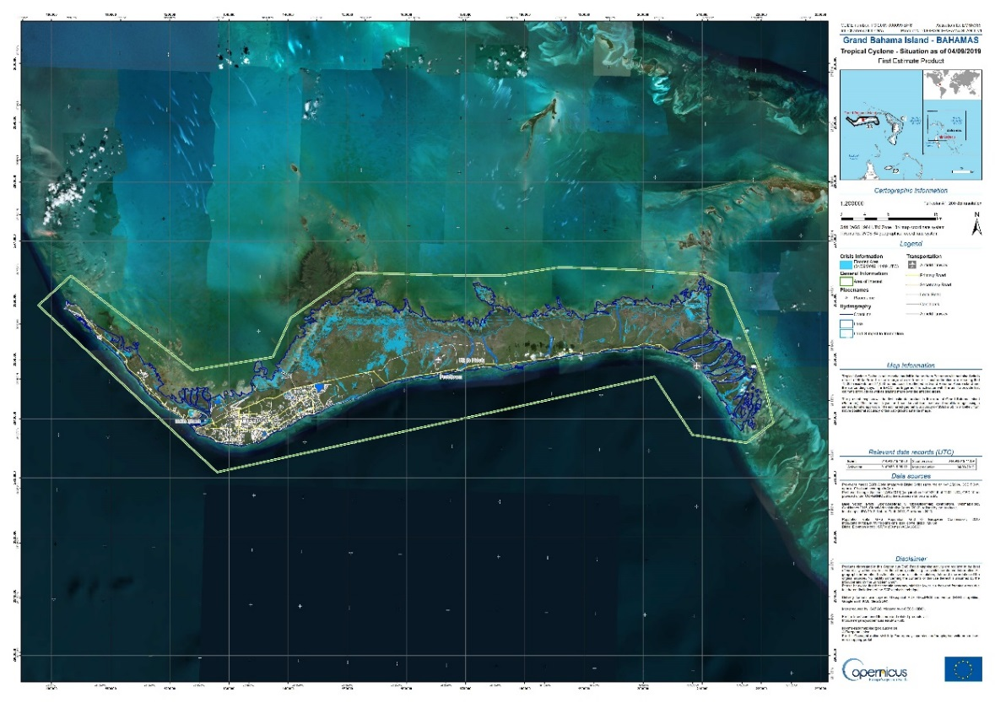
Sentinel-1 mission status
  Optimisation/tuning of the observation scenario (→ full mission capacity reached)
  Yearly Mission Review held on 24 May 2019, confirming that the overall mission is in a very good shape
  Contribution to emergency situations, in particular in response to Copernicus EMS and International Charter activations, for flood monitoring in particular
Ground deformation in Tuscany (2014-2019)
Grand Bahamas Island –
Flood map based on Sentinel-1 imagery
acquired on 4 Sep 2019 (11:09 UTC)
Impact of cyclone Dorian
Copernicus Emergency Management Service: Activation EMSR385
Authorized User: EC Services | DG ECHO
Copyright: Contains modified Copernicus Sentinel data (2019) / processed by CEMS – GAF-AG released by e-geos

Slide 12
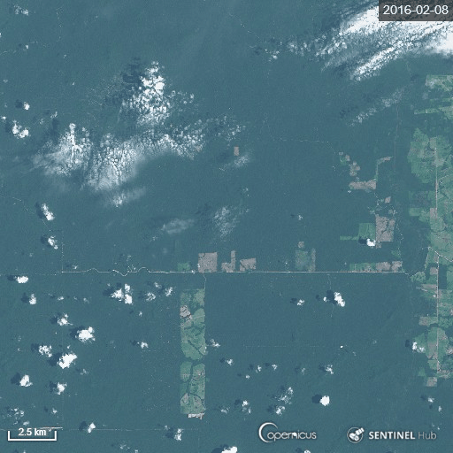

Sentinel-2 mission status
3 years of deforestation (Mato Grosso, Brazil)
  Yearly Mission Review held on 18 June 2019, confirming that the overall mission is in a very good shape
Observation scenario well beyond initial requirements ( analysis of extension to low light area in winter, i.e. Scandinavia)
Several mission improvements were performed or are on-going (incl. S2A Star Tracker alignment, OCP reset automatic recovery, improvement of Level-1C products geometry, on-demand access to archived Level-2A product, improvement of Level-2A products scene classification, development of new demonstration product Level-2F, etc.)
Copyright: Copernicus Sentinel data (2016-2019)

Slide 13


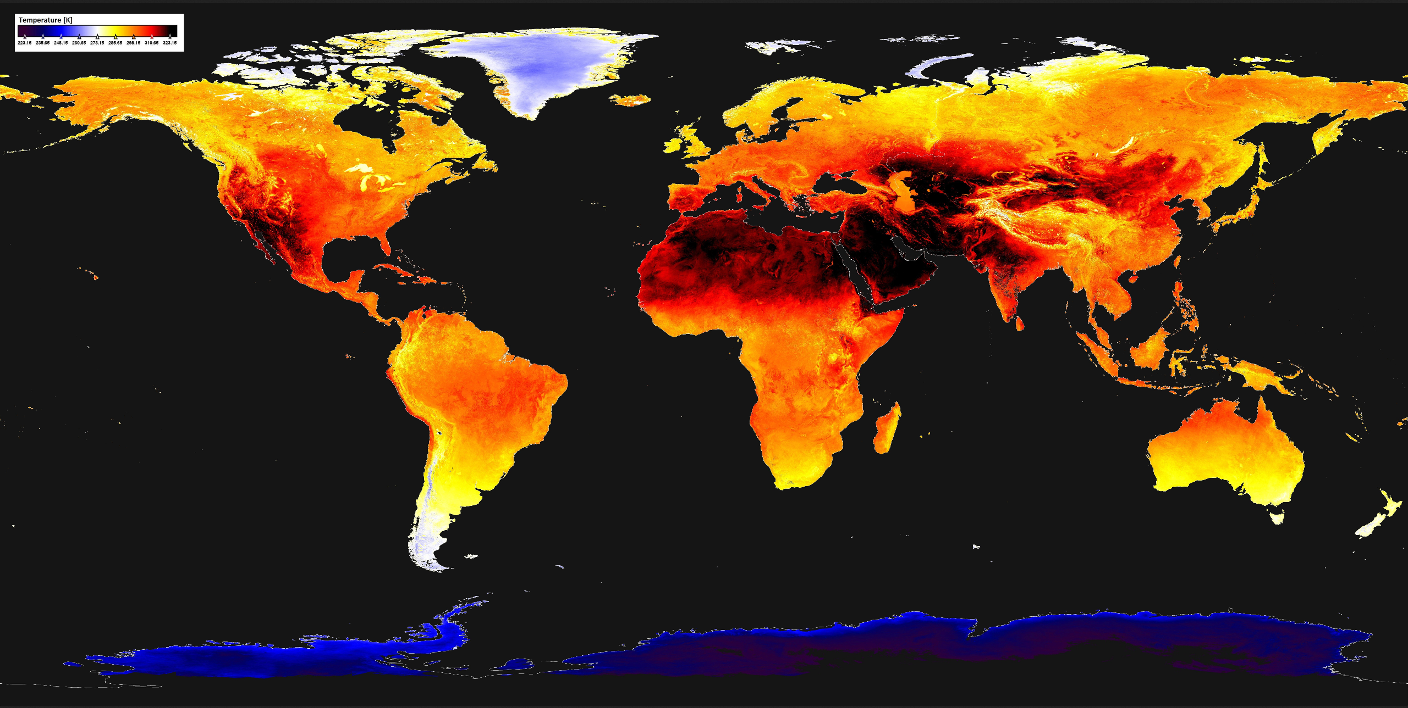
Sentinel-3 mission status
Release of Aerosol Optical Depth (AOD) & Fire Radiative Power (FRP)
→ prototype products available in Q4 2019
On-going analysis for extension of OLCI acquisition over Scandinavia in low sun light conditions
Sentinel-3 SLSTR
Daytime Land Surface Temperature [June 2019]
https://www.earthstartsbeating.com/2019/08/29/land-surface-temperature/
Copyright: Contains modified Copernicus Sentinel data (2019)

Slide 14
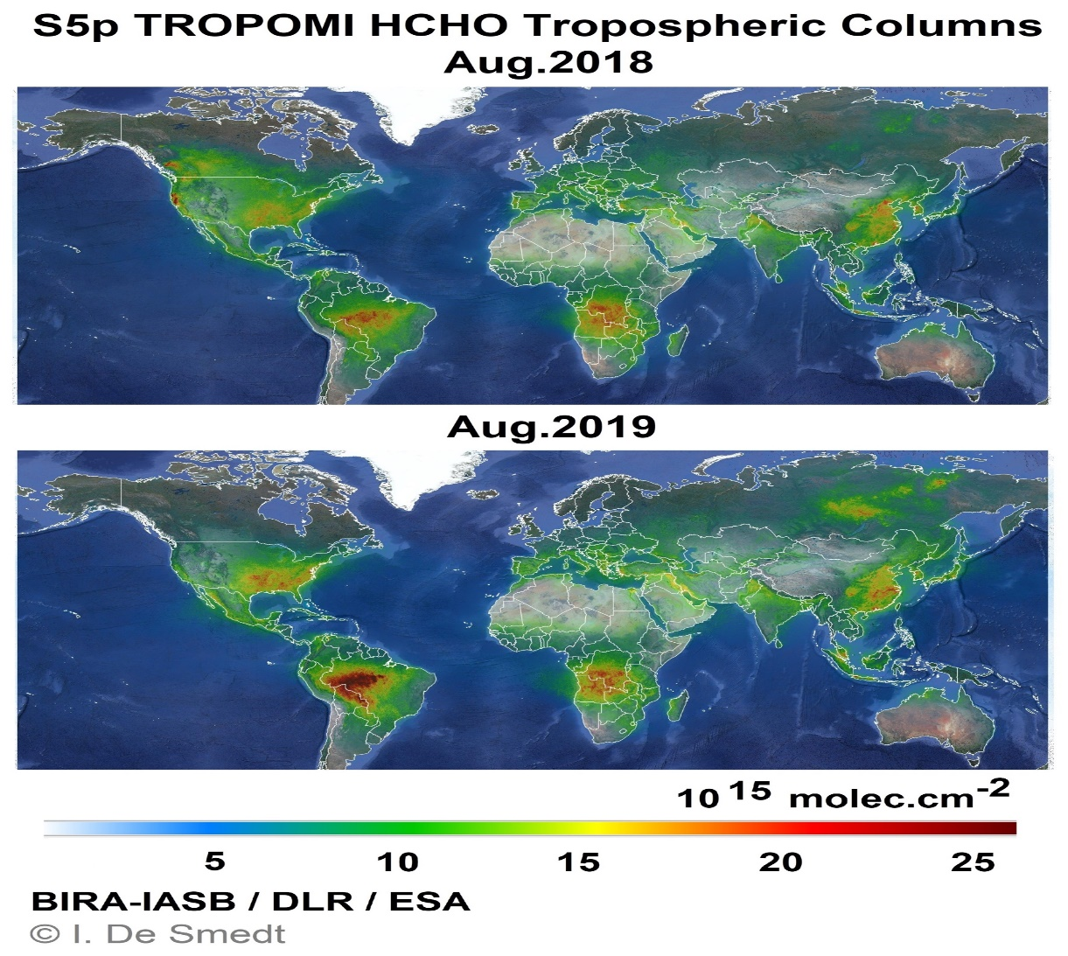



Sentinel-5P mission status
Data released progressively
since 2018:
Radiances/Irradiances (L1)
Total Columns of Ozone (O₃)
Nitrogen Dioxide (NO₂)
Carbon Monoxide (CO)
Cloud & Aerosol information
Sulfur Dioxide (SO₂)
Formaldehyde (OCHO)
Methane (CH₄)
Tropospheric Ozone Column
(trop. O₃)
Aerosol Layer Height (ALH): Sept 2019
Ozone Profiles: early 2020
Monthly average
of S-5P Formaldehyde
Note the effect of fires in August 2019 in South America and in Siberia
Copyright: Contains modified Copernicus Sentinel data (2018-2019) processed by BIRA/IASB

Slide 15
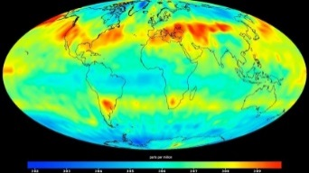





Copernicus 2.0 – New Monitoring Missions
Anthropogenic CO₂
Six High Priority Candidate Missions
Progress Status
Preliminary Requirements Review concluded successfully for all 12 Phase A/B1 studies
Consolidation of inputs for preparation of ESA ITTs for Phase B2/C/D/E1 contracts
Land Surface Temperature
Causes of Climate Change |  | Agriculture & Water Productivity
Polar Ice & Snow Topography
CHIME – Hyperspectral Imaging
Effects of Climate Change |  | Food Security, Soil, Biodiversity
CIMR – Passive Microwave
L-band SAR
Sea: Surface Temp. & Ice Concentration |  | Vegetation & Ground Motion & Moisture
Notes:
Kick-Off & Progress
Potential Sentinel expansion system study activities initiated
End-to-end performance simulation campaigns
Scientific studies in support of mission requirements definition
Pre-developments of most critical technologies.
Copernicus Long Term Scenario
20 new spacecraft
6 new mission domains: CO₂ imaging spectrometry, thermal / hyperspectral / microwave imaging, etc.
Integration of NewSpace and national mission data
Sophisticated, operational data access

Slide 16










Sentinels Data Access
Evolution of registered users on Sentinel Open Access Hub
Sentinel access through
EU/ESA Copernicus Open Access Hub
6 Copernicus services
18 ESA Member State hubs
NASA, NOAA, USGS, Geoscience Australia
Commercial hubs
Registration of users on Open Access Hub is still growing at a pace of 8000 registrations per month
More figures available at: scihub.copernicus.eu/reportsandstats
Statistics at beg. September 2019

Slide 17

ESA Principal Investigators (PI) projects - Statistics

Slide 18
ESA Principal Investigators (PI) projects - Statistics

Slide 19











Scientific Impact
Number of scientific publications based on Envisat, ERS, GOCE, SMOS, CryoSat, Swarm and Sentinel data (SCOPUS database)
Notes:
Remarkable how old missions such as Envisat (and even ERS) remain relevant until today for scientific research.
This demonstrates that EO missions have a very long scientific return on their investment, and continue to impact science long after the mission is ended.
With the introduction of operational services with Copernicus, we also see a sharp increase in the science based upon Sentinel data.
This trend will continue, especially with the deployment of the other Sentinels in development, as well as the Sentinel Expansion.
Increasingly relevant are also the synergies between science missions and operational monitoring (Variety of data is one element of Big Data).
Source: SCOPUS database, query on Title, Abstracts and Keywords, excluding conference papers

Slide 20
Thank you for your attention!

