Slide 1
ESA EO Thesauri
Andrea Della Vecchia (Randstad), Yves Coene (Spacebel)
Damiano Guerrucci (ESA)
CEOS WGISS#48
10th October 2019

Slide 2
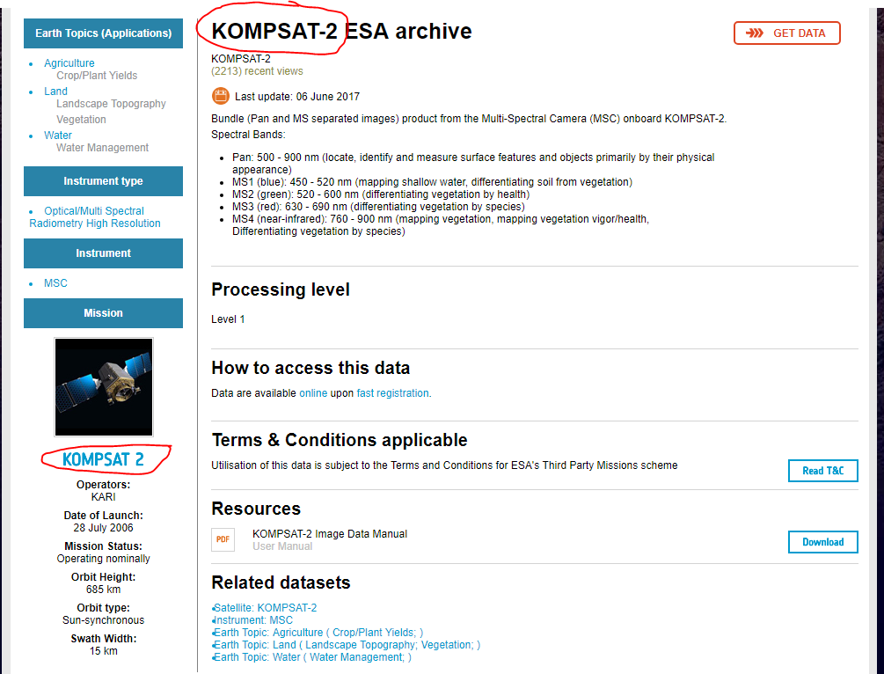
Objectives
Common Terminology to avoid naming inconsistencies about platform, instrument, instrument type and Scientific keyword
FedEO metadata entries natively ready for being exported into DIF10, according to both IDN metadata guideline and encoding
Permit metadata discovery and browse, via semantic search

Slide 3
ESA / NASA Thesauri Alignment for IDN
Automatic Procedure – Available on FedEO reference environment, on Operational environment at ESA by October 2019
Partner Metadata repository
Metadata Import
Harvester tool
Metadata Preparation
Metadata Mediator
IDN
Complementary
Information gcmd keyword
Metadata Preparation
IDN guideline for Information Content completeness and consistency (HERE)
ESA Thesauri Service
sync
FedEO Collection Catalogue
FedEO Gateway
ISO to DIF-10
DIF-10 Validator
(HERE)
DIF-10 Validation
Metadata Export
DIF-10 Encoding
IDN
repository

Slide 4
Semantic Annotation of EO Resource Metadata
Operational interface
ESA
User Community
Query and service requests
External
Data access interface
Operational Data Access
Web User Interface for pixel-based access, analysis and processing
Web User Interface for granule-based discovery and/or retrieval
……….
International EO Information Page:
- CEOS IDN
Mission oriented GUI
- SWARM
- SMOS
- Cryosat
- External
External catalogue application
……….
ESA PDGS Data Cube GUI, VIRES GUI, etc…
ESA EO Information Page:
- ESA EO Gateway
Multi Mission GUI:
– ESA EOCAT
OpenSearch
(collections and granules)
Knowledge-Base Facility
Standard services request Interfaces (e.g., restful API)
OpenSearch
(collections
and granules)
Standardised Interoperable Interfaces
Thesauri Repository
Metadata management
ESA Operational Service
Protocol for data access
(e.g., OGC, Open Datacube)
EO Data & Service Metadata Repository
Products Access Interface
Data Repositories
Copernicus Data Repositories
ESA Missions Data Repositories
External Web Interface
Standardised Interoperable Services Interfaces
External Web Interfaces
Data management
IT Resources provided as services (IaaS, PaaS, SaaS)
TPMs
HMs
EEs
S-1
S-2
S-3
S-5
User Applications
ESA User Applications
Temporary
VM – Processors
Storage
VM – Browse Images Generation
VM – DataCube Engine/API

Slide 5
Operational interface
ESA
User Community
Query and service requests
External
Current Instantiation
Data access interface
Operational Data Access
Web User Interface for pixel-based access, analysis and processing
Web User Interface for granule-based discovery and/or retrieval
……….
International EO Information Page:
- CEOS IDN
Mission oriented GUI
- SWARM
- SMOS
- Cryosat
- External
External catalogue application
……….
ESA PDGS Data Cube GUI, VIRES GUI, etc…
ESA EO Information Page:
- ESA EO Gateway
Multi Mission GUI:
– ESA EOCAT
https://datacube.pdgs.eo.esa.int/
https://earth.esa.int/eogateway
https://eocat.esa.int/sec/#data-services-area
OpenSearch
(collections and granules)
Knowledge-Base Facility
Standard services request Interfaces (e.g., restful API)
OpenSearch
(collections
and granules)
Standardised Interoperable Interfaces
https://thesauri.eo.esa.int/thesaurus/en/
Thesauri Repository
Metadata management
ESA Operational Service
Protocol for data access
(e.g., OGC, Open Datacube)
EO Data & Service Metadata Repository
https://eocat.esa.int/opensearch/description.xml
Products Access Interface
https://esar-ds.eo.esa.int/oads/meta/ASA_IMP_1P/index/ https://smos-diss.eo.esa.int/oads/meta/SMOS_Open/index/
……
……
Data Repositories
https://scihub.esa.int/dhus/
Copernicus Data Repositories
ESA Missions Data Repositories
External Web Interface
Standardised Interoperable Services Interfaces
External Web Interfaces
Data management
IT Resources provided as services (IaaS, PaaS, SaaS)
TPMs
HMs
EEs
S-1
S-2
S-3
S-5
User Applications
ESA User Applications
Temporary
VM – Processors
Storage
VM – Browse Images Generation
https://datacube.pdgs.eo.esa.int/wcs?service=WCS&request=GetCapabilities
VM – DataCube Engine/API

Slide 6
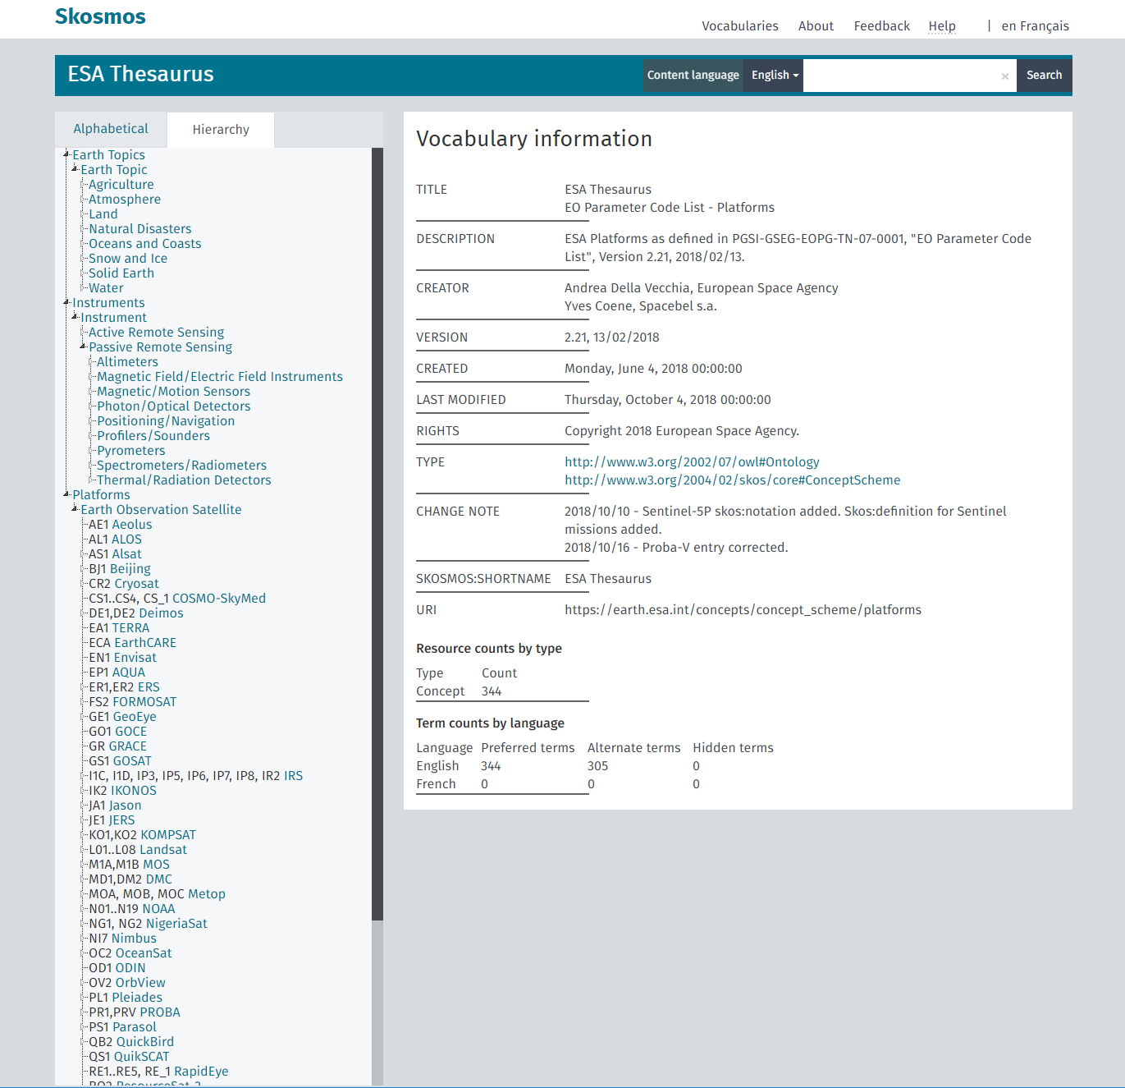
Vocabulary Server - GUI
ESA Thesauri:
Operational (October ‘19) http://thesauri.eo.esa.int/thesaurus/en/
Reference
http://fedeo.spacebel.be/thesaurus/en/?clang=en
SKOSMOS tool makes available APIs here documented http://skosmos.org/
Examples
http://fedeo.spacebel.be/rest/v1/thesaurus/data?uri=https://earth.esa.int/concept/envisat
http://fedeo.spacebel.be/rest/v1/thesaurus/data?uri=https://earth.esa.int/concept/envisat&format=application/json
http://fedeo.spacebel.be/rest/v1/thesaurus/data?uri=https://earth.esa.int/concept/meris&format=application/json

Slide 7
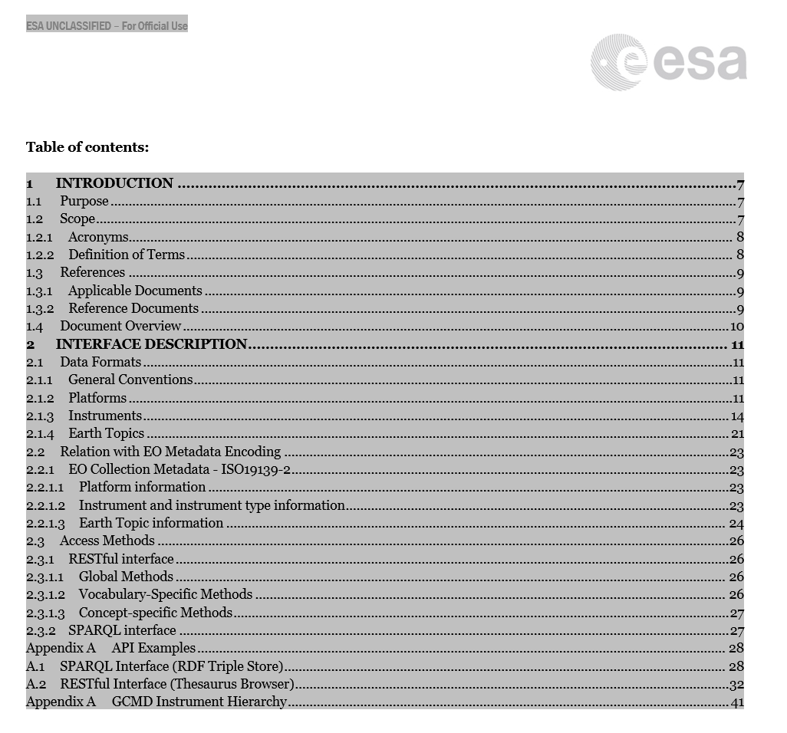
SLT Actions
WGISS-47-25 | Andrea Della Vecchia to put together a guide (e.g. video, short doc, demo) on the use of SKOS interface and tool by July 31, 2019 | Andrea Della Vecchia | 31-Jul-19 | Closed | July 17: The guide has been circulated

Slide 8
ESA Thesauri
Provide online access to Thesauri
API (OpenAPI description), wrapped in Vocabulary of Interlinked Datasets (VoID) and OSDD description
GUI (Graphical User Interface)
Similar RESTFul API capabilities as NASA GCMD
May be realised selecting an open-source solution.
Criteria: license, API, adoption, customisation options etc..
Candidate: SKOSMOS tool (http://skosmos.org/), used by UNESCO, MIT License

