Slide 1
ESA EDAP
Earthnet Data Assessment Pilot
Quality Assessment Matrix
Clement Albinet – Paolo Castracane
ESA / Ground Segment and Mission Management Department
10th October 2019, WGISS

Slide 2
ESA and non-ESA missions
(Third Party Missions – TPM)
4 types of activities with Third Party Missions (TPM) | New Space | “Old Space” | Funding
1 - Early development support of TPM (New Space) | X |  | ESA Incubed
2 - Support to TPM cal/val and routine data quality monitoring | X | x | ESA Earthnet
3 - TPM data supply to science and research purposes | X | X | ESA Earthnet
4 - TPM data supply for operational services | X | X | EU Copernicus

Slide 3
4 types of activities with Third Party Missions (TPM)
1 - Early development support of TPM (European context)
Funded by ESA InCubed programme (PPP)
2 - Support to TPM cal/val and routine data quality monitoring
Funded by ESA Earthnet programme (part of ESA mandatory activities)
Earthnet Data Quality Assessment (EDAP) pilot project
first Very High-resolution Radar & Optical Data Assessment (VH-RODA) workshop. It will be held in ESRIN from 18 to 22 November 2019 bringing together all these NewSpace companies together with the other data providers.

Slide 4
3 - TPM data supply to different science and research purposes
Funded by ESA Earthnet programme (part of ESA mandatory activities)
Some TPM well known and available since a while, e.g. Landsat, GOSAT, TanSat, but also commercial VHR missions like TerraSAR-X, Cosmo-Skymed, Pleiades, Spot-6, GRACE
Funding can be dedicated to TPM data buy (commercial VHR), but also funding part of operations (usually with science missions beyond their nominal lifetime, e.g. GRACE, e-pop, etc…)
NewSpace: Planet (SkySat and Dove), ICEYE, and Spire to be integrated soon as ESA TPM
TPM data also used within ESA science funded projects
4 - TPM data supply for operational services
Funded by EU Copernicus programme
ESA coordinates all the Copernicus Contributing Missions' activities and together with European Commission is assessing the future relation with all these assets in the 2021-2027 timeframe

Slide 5
Earthnet Data Assessment Pilot

Slide 6
What is EDAP?
The main objective of this activity is to perform early data quality assessment of existing or future missions.
It will be achieved through provision of clusters of expertise in various domains. Specific focus will also be put on capacity building in the relevant data provider with the set up and evolution of documentations, tools and procedures to allow to efficiently perform data quality assessments in the domains of expertise defined within this activity.
Duration: 2 years
Kick-Off: November 2018

Slide 7
Organisation and generic tasks
Four domains of expertise:
Optical sensor Very High, High and Medium Resolution
Low Resolution optical sensor
SAR sensor
Atmospheric Missions
Specific tasks:
Multi-mission studies (e.g. DEM impact on geometric quality)
Assist ESA in organising workshops related to data quality

Slide 8
A flexible approach
The cluster of expertise will have to provide technical reports on data quality from various missions.
Some missions and studies are already identified; some other missions and studies will be identified in the course of the project.
In the latter case, a Work Order (WO) will trigger the activity.

Slide 9
Summary of the missions addressed
VHR, HR, MR Optical | LR Optical | SAR | Atmospheric
Skysat | OceanSat-2 | ICEYE | GHGSat-D
Planet Scope | OceanSat-3 | PAZ | GCOM-C
TripleSat | OceanSat 3A | SAOCOM | GOSAT
Kompsat-3 / 3A | MOS | NovaSAR | GOSAT-2
Vivid-i / Carbonite | HuanJing-1A/-1B | GaoFen-3 | Tansat
Landsat 1-7 | GaoFen-4/-5 |  | Spire
Landsat 8
Proba-1
Dove-R
Blacksky
Superview
Vision-1
Superdove
GaoFen-6
Legend:
Activities started (today)
Activities under definition/agreement (today)

Slide 10
Common framework for mission quality assessments
To ensure, where applicable, community best practice is followed.
To ensure consistency of approach across project missions.
➔ Facilitates comparison
Principle
Framework Heritage:
“It is critical data and derived products are easily accessible in an open manner and have associated with them an indicator of their quality traceable to reference standards (preferably SI) to enable users to assess its suitability for their application i.e. its fitness for purpose.”

Slide 11
Common framework for mission quality assessments
EDAP Framework Principles:
Should describe high-level principles and activities common for assessment of all EO missions.
Starting point is to describe the “ideal” case for a given category – aspiration which may not often be met.
Grading based on mission fitness for purpose based on stated performance and application area.
Assessment itself is the “ideal” case. Some aspects of assessment may be out of scope within EDAP.

Slide 12
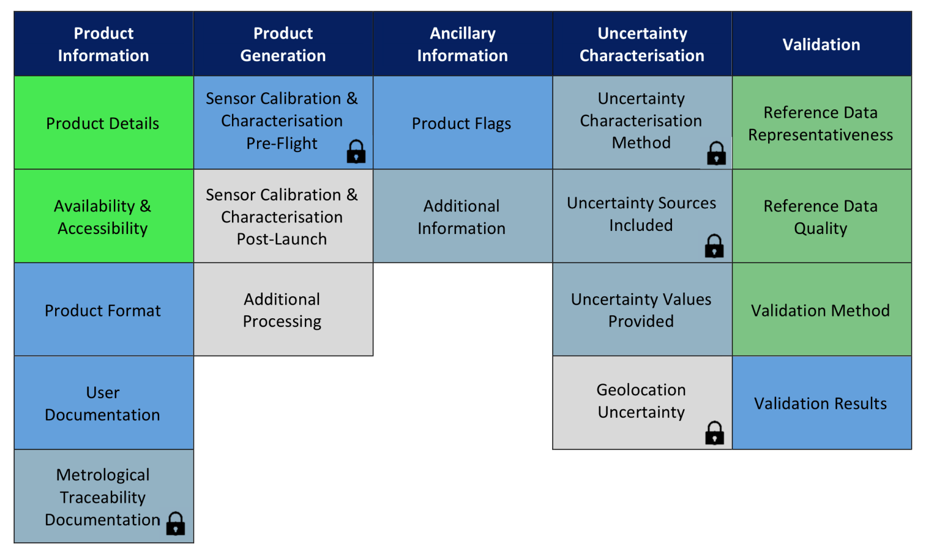
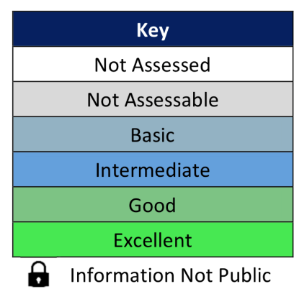
Common framework for mission quality assessments
Example of Product Quality Evaluation Matrix
Quality Assessment Guidelines document then provides criteria for how to grade each category.

Slide 13
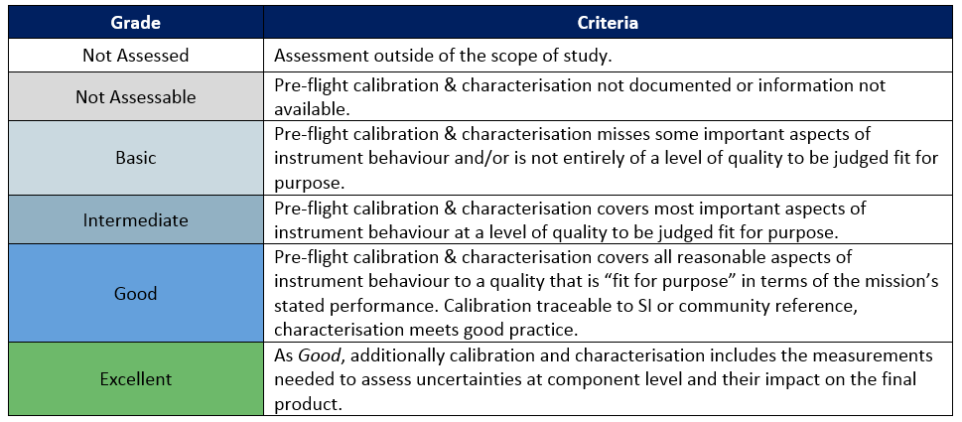
Common framework for mission quality assessments
Grading Criteria example: Sensor Calibration & Characterisation Pre-flight

Slide 14
Maturity Matrix Plan within CEOS WGCV
History/Background:
Maturity Matrix was developed within WGISS
Maturity Matrix focused on Quality was developed in Climate Change (WMO)
Need to complement the WGISS maturity matrix with Quality aspect
WMO maturity matrix is a good baseline.
Within EDAP, adaption of the Maturity Matrix more focused on purpose
Next Step:
Coordinate with international partner for finalising the approach
Discussion (telecom) with USGS, CISRO, NPL (IVOS), NASA (JPPG)
Discussion/convergence at JACIE
Presentation at WGISS (now)
Discussion/convergence at VHR-RODA (Nov 2019) in ESRIN
Finalisation of discussion and presentation at Next WGCV in Pasadena (March 2020)
Merging Matrix CEOS WGCV/WGISS Socchi (Sept 2020)
Notes:
Maturity Matrix was developed within WGISS -> focus sur data management, qualite faible
Maturity Matrix focused on Quality was developed in Climate Change (WMO) -> qualite forte, pas pratique pour edap, bonne baseline
Next steps -> on en est la
Discussion (telecom) with USGS, CISRO, NPL (IVOS) -> grand partenaires
Discussion/convergence at JACIE -> attente debriefing Vale
Discussion/convergence at VHR-RODA (Nov 2019) in ESRIN -> tous partenaire (NASA…)

Slide 15
Maturity Matrix Plan within CEOS WGCV
Data management
Data Quality
WGISS MM
WMO MM
Final MM
EDAP MM
VHR
RODA
Coordinated MM
JACIE
USGS/Other MM/input
JACIE
Sept 2019
VHR-RODA
November 2019
WGCV -46
March 2020
WGCV 47/ WGISS
Sept 2020

Slide 16
Announcement!
VH-RODA: Very High-resolution Radar and Optical Data Assessment workshop
&
CEOS WGCV SAR 2019 Workshop
18-22 November 2019
ESA/ESRIN Frascati (Italy)
Notes:
The Very High-resolution Radar & Optical Data Assessment (VH-RODA) workshop will be held in Frascati, Italy from 18-22 November 2019. The Workshop, hosted by ESA/ESRIN, will provide an open forum for the presentation and discussion of current status and future developments related to the calibration and validation of space borne very high-resolution SAR and optical sensors and data products.

