Slide 1
AVHRR (Advanced Very High Resolution Radiometer) European Dataset Preservation and Valorization Project
Stefan Wunderle¹, Christoph Neuhaus¹, Kathrin Naegeli¹, Gian Lieberherr¹
Melanie Sütterlin¹, Mirko Albani², Sergio Folco², Razvan Cosac²
¹Oeschger Centre for Climate Change Research, University of Bern, CH
²ESA-ESRIN, Frascati, Italy

Slide 2

Outline of AVHRR curation project: an overview and steps for the future
AVHRR – a valuable heritage sensor
AVHRR data holdings at ESA and University of Bern covering Europe and the Earth
Retrieval of ECVs based on FCDR – briefly three examples
The way to make the AVHRR data holdings accessible for users
Next steps to make the Data Ready for Users (in compliance with CARD4L specification ( http://ceos.org/ard/).
  European AVHRR time series
  Global AVHRR time series

Slide 3
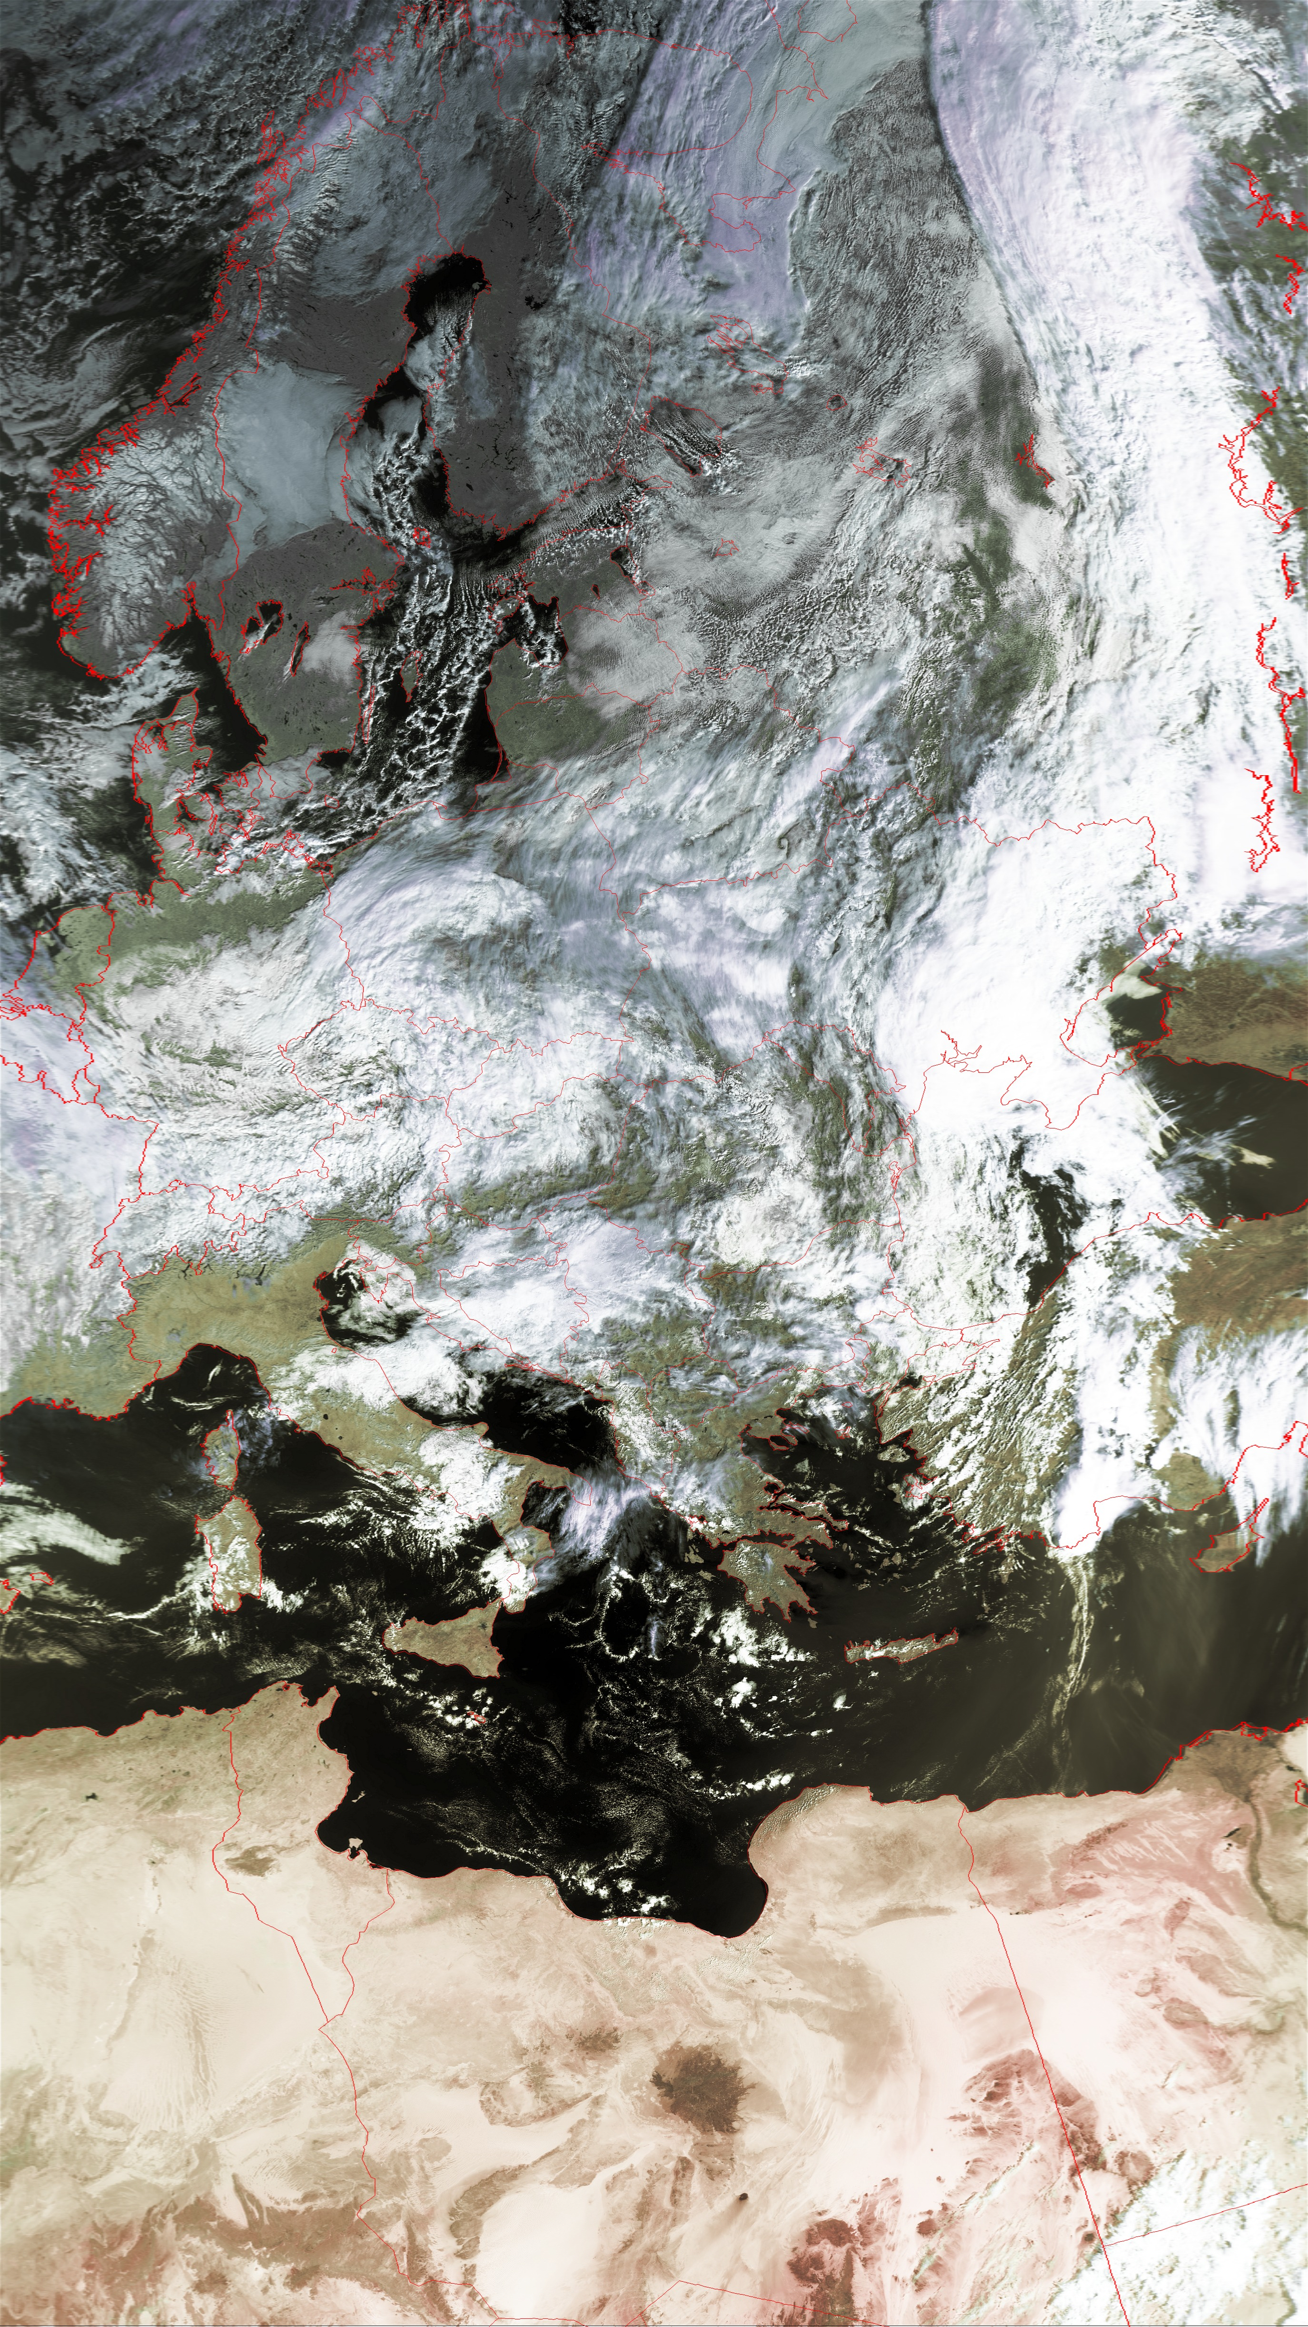
Advanced Very High Resolution Radiometer (AVHRR)
1981 – approx. 2030
Platform: NOAA and MetOp
(4) 5 channel radiometer
  1: 0.58 – 0.68 um
  2: 0.725 – 1.0 um
  3A: 1.58 – 1.64 um
  3B: 3.55 – 3.93 um
  4: 10.30 – 11:30 um
  5: 11:50 – 12.50 um
Spatial resolution: 1.1km in nadir
Swath: 2.700 km
NOAA-6 VIS, 20. January 1980
MetOp-A: Oct.5, 2019

Slide 4
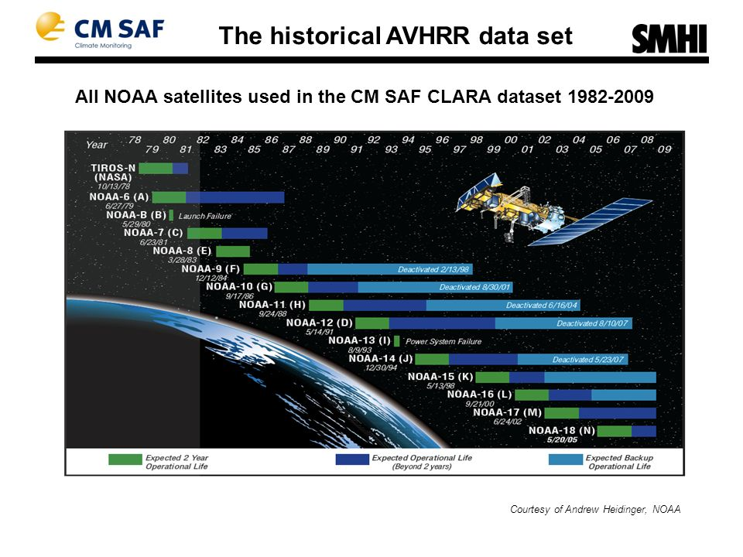
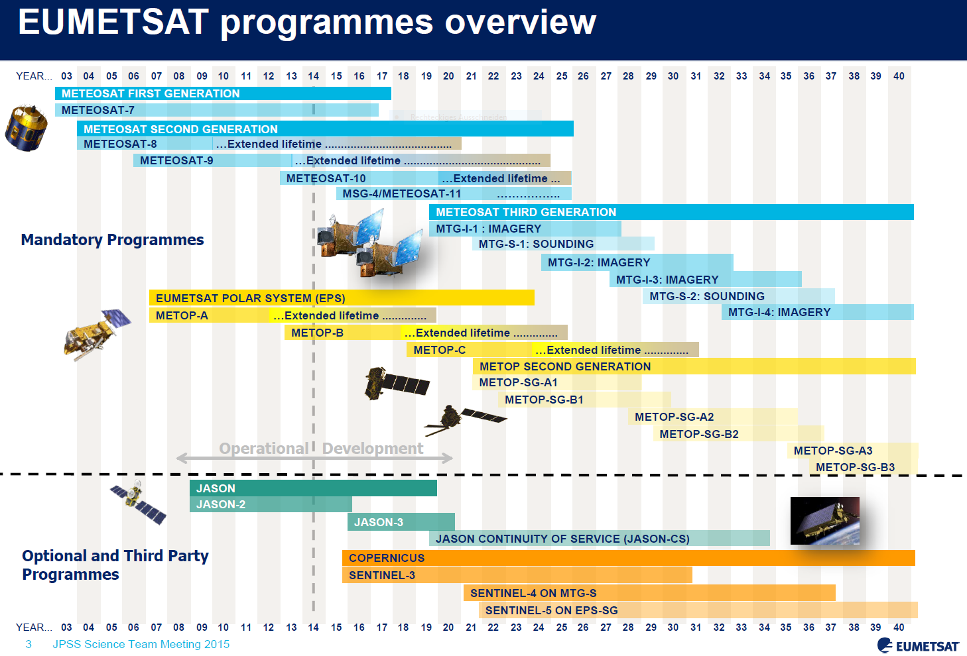
Long history of AVHRR onboard of NOAA – MetOp satellites (1981 – 2030 (extended lifetime))
Courtesy: K. Holmlund, EUMETSAT

Slide 5
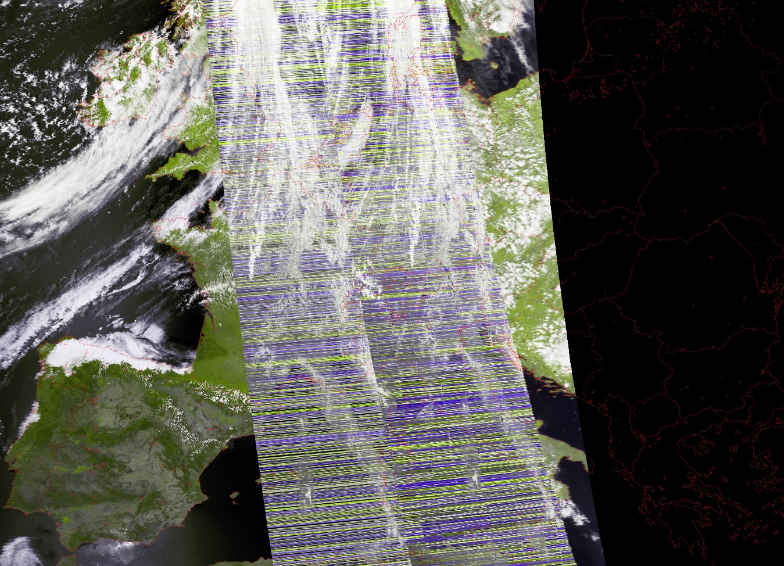
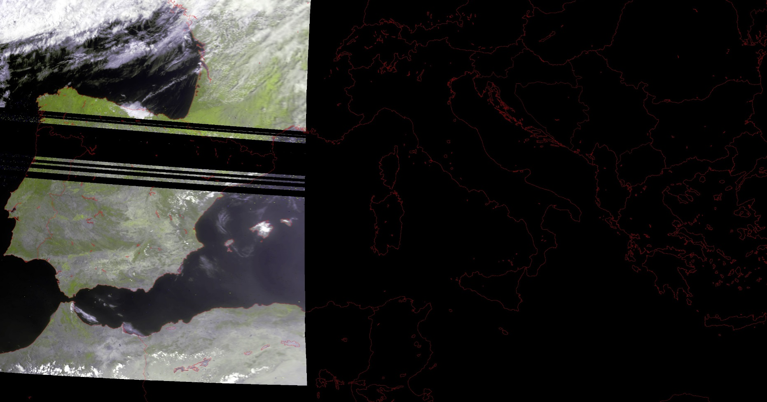
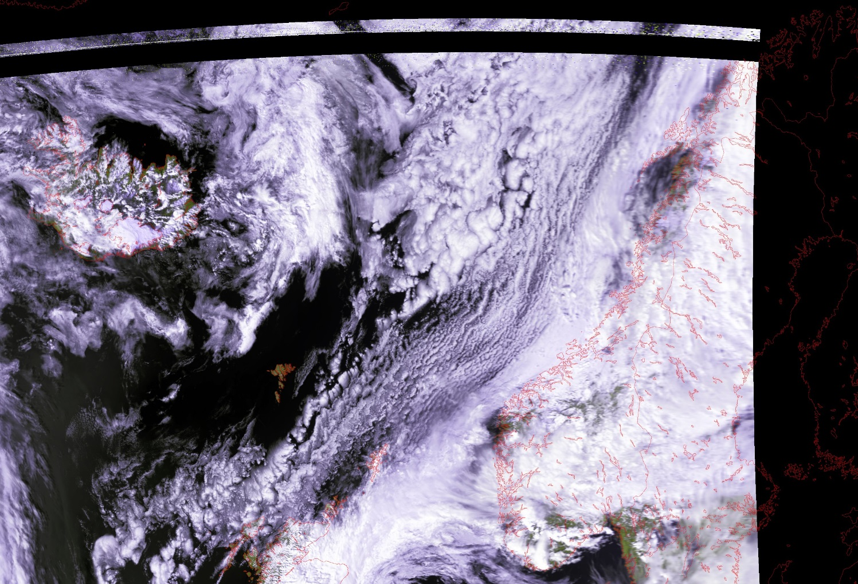
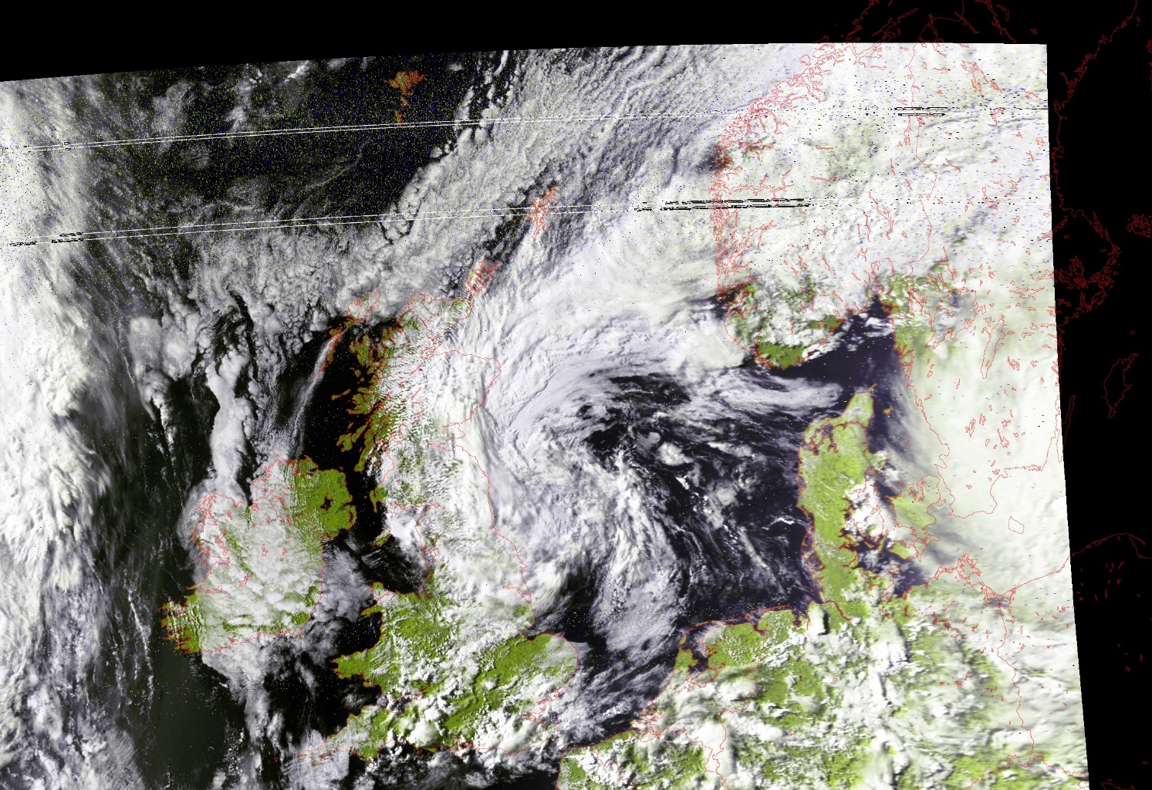
AVHRR: sleepless nights …

Slide 6
The value of AVHRR data
30 years time series is defined by WMO for climatological period to ensure sound statistical analysis – only AVHRR has such a long history.
GCOS has defined 57 Essential Climate Variables (ECVs), which has to be measured for longer time periods to describe the status of our climate. Many ECVs can be retrieved from AVHRR data.
ESA started many projects in the frame of the Climate Change Initiative, which also rely on AVHRR GAC long time series (e.g. ESA CCI cloud; ESA CCI landcover; ESA CCI+ snow).
EUMETSAT Satellite Application Facilities (SAF) generated many data sets based on AVHRR GAC data (CM SAF cloud information CLARA A3).
The Global Area Coverage (GAC) is a coarse resolution data set (3.3km x 5.5km) but with a long time series and globally available.
“spatial resolution matters” to advocate for high resolution data (Local Area Coverage – LAC) with 1.1km pixel size (in nadir).
Hence, data access to AVHRR data holdings at ESA and University of Bern should be ensured even it costs a lot of effort.

Slide 7
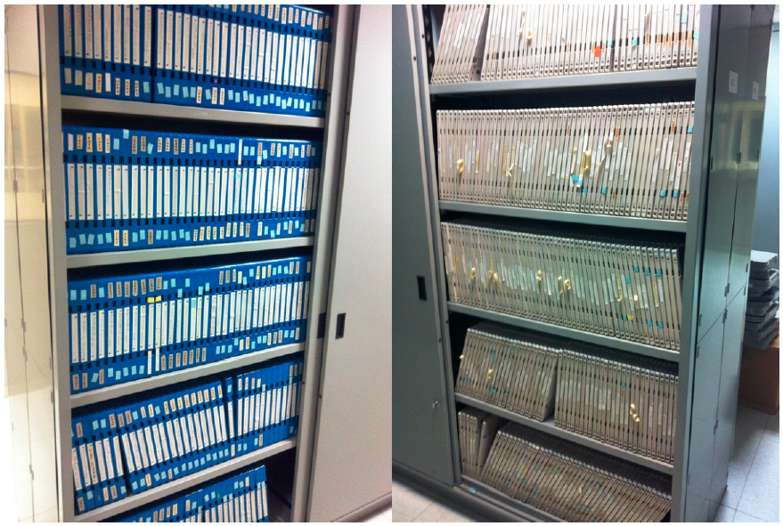
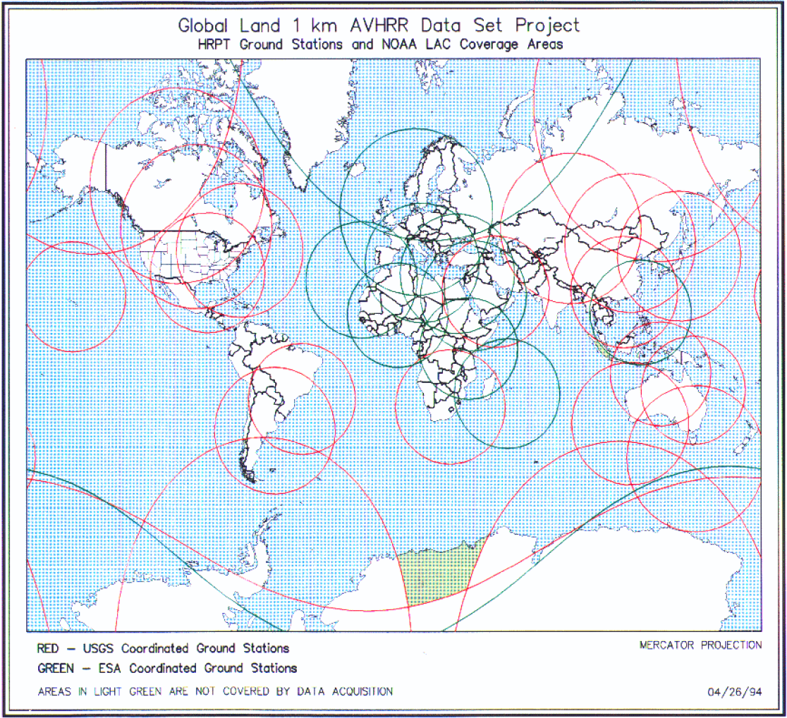
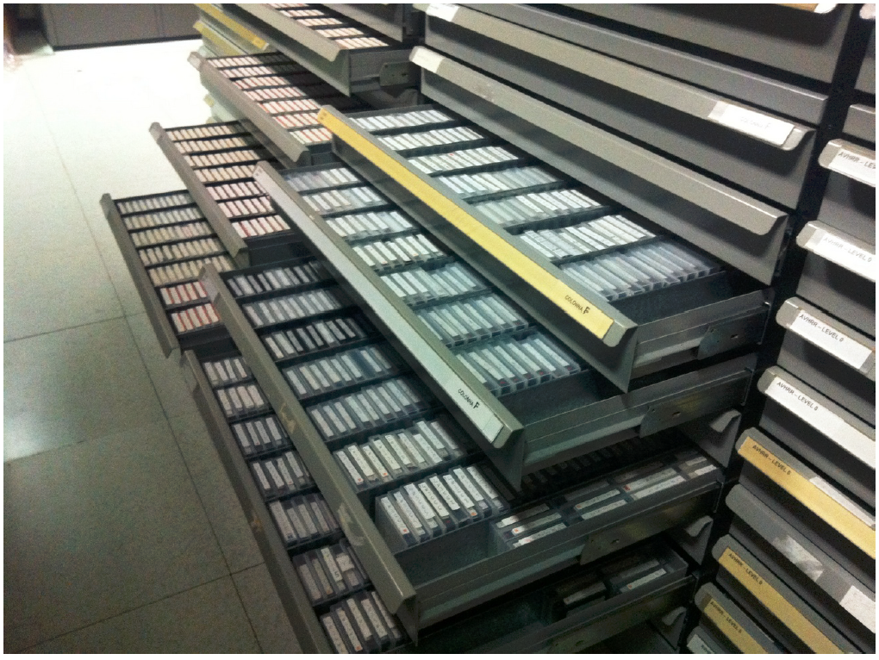
High investment of ESA to keep AVHRR data alive
Global Land 1km AVHRR Data Set Project
Long Term Preservation of Earth Observation Space Data
European LTDP Consolidation Procedure
AVHRR data archived on
optical disks in ESRIN
1: Tromsø (5.6 TB)
2: Matera (0.9 TB)
3: Maspalomas (2.8 TB)
AVHRR data archived on
exabytes in ESRIN

Slide 8
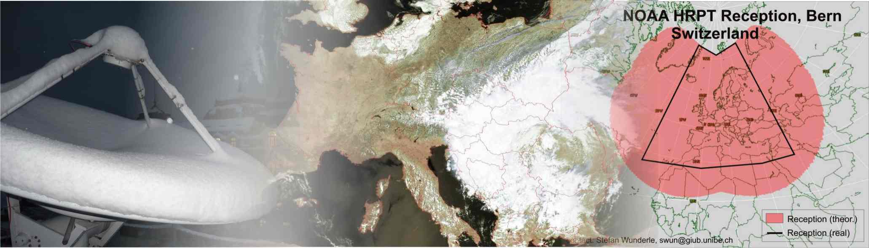
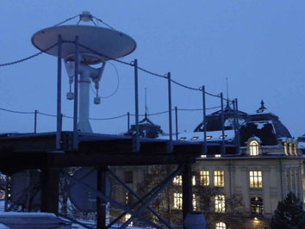
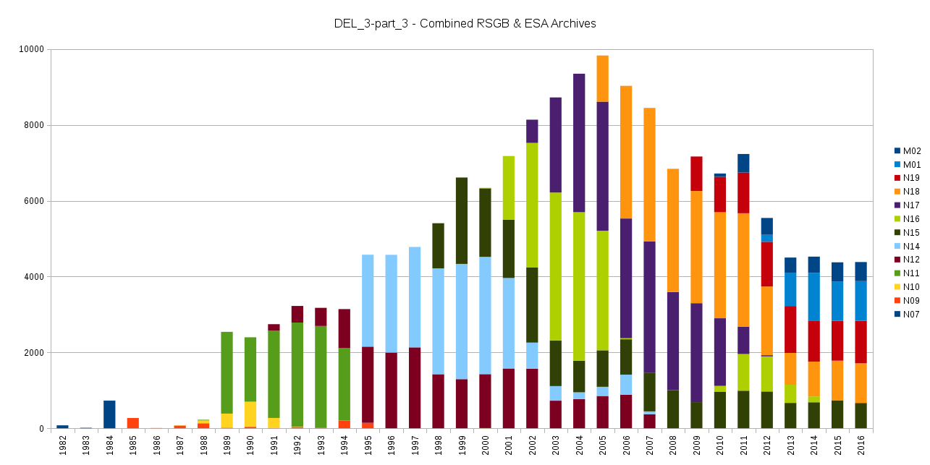
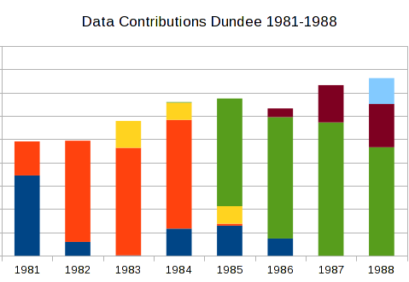
AVHRR reception, coverage and data at University of Bern (1981 – 2019)
Integration of the whole data holding of FU Berlin; Dundee data from 1981 - 1989
AVHRR HRPT antenna at
University of Bern in 24/7
operation since 2. August 2000

Slide 9
Focus of the AVHRR data set curation project
Three main objectives of the project:
  preservation of University of Bern AVHRR data set; harmonize the data and make it accessible for future generations;
  harmonize the ESA AVHRR data holdings (Europe) and make it accessible for users.
  Recommendations to valorize the global 1-km AVHRR data set
To reach the project aims seven work packages and 18 deliverables were defined.

Slide 10
Overview of work packages of the ESA-University of Bern LTDP project
Overall seven work packages and eighteen deliverables were defined to fulfill SOW
  WP_1: Inventory and gaps identification of AVHRR UniBe data
  WP_2: Consolidation procedure and reprocessing definition
  WP_3: AVHRR Master data set consolidation and reprocessing
  WP_4: Assessment of 1km global AVHRR data set
  WP_5: AVHRR European Master data set validation
  WP_6: Consolidation of AVHRR preserved data set composition
  WP_7: AVHRR master data set handbook and future scenario

Slide 11
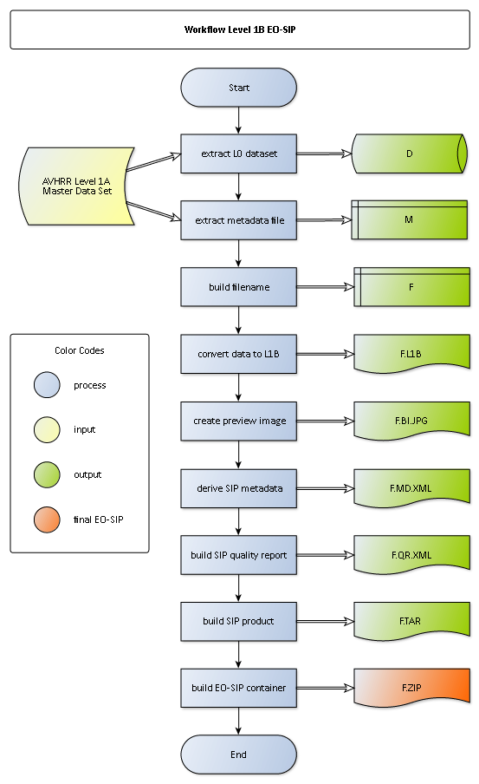
DEL-5: AVHRR master data set consolidation procedure, reprocessing
Definition of EO-SIP content and structure
Definition of NOAA AVHRR Level 0, Level 1A and Level 1B
  Recommendation from expert group: provide the Level 1B data set
Quality report
  File integrity (checksum MD5), file content, processing
Reprocessing procedure
  Different archives; inventory files
  Logical structure is to start with Level 0 → Level 1B
  EO-SIP generation

Slide 12
AVHRR EO-SIP package
(Earth Observation – Submission Information Package)
EO-SIP package structure, content and metadata attributes for the AVHRR products in scope, in line with the ESA Next Generation Multi-Mission PDGS Infrastructure, to be used for archiving and dissemination.
AVHRR EO-SIP
EO Product
Metadata Report
1 1
Quality Report (1)
SIP Information File (1)
Browse Image

Slide 13
Combined University of Bern-ESA-Dundee AVHRR archive
(more than 160.000 data sets covering Europe)

Slide 14

Essential Climate Variables (ECVs)
Domain | GCOS Essential Climate Variables
Atmospheric (over land, sea and ice) | Surface: Air temperature, Wind speed and direction, Water vapour, Pressure, Precipitation, Surface radiation budget
 | Upper-Air: Temperature, Wind speed and direction, Water vapour, Cloud properties, Earth radiation budget (including solar irradiance)
 | Composition: Carbon dioxide, Methane, and other long-lived greenhouse gases, Ozone and Aerosol, supported by their precursors
Oceanic | Surface: Sea-surface temperature, Sea-surface salinity, Sea level, Sea state, Sea ice, Surface current, Ocean colour, Carbon dioxide partial pressure, Ocean acidity, Phytoplankton
 | Sub-Surface: Temperature, Salinity, Current, Nutrients, Carbon dioxide partial pressure, Ocean acidity, Oxygen, Tracers
Terrestrial | River discharge, Water use, Groundwater, Lakes, Snow cover, Glaciers and ice caps, Ice sheets, Permafrost, Albedo, Land cover (including vegetation type), Fraction of absorbed photosynthetically active radiation (FAPAR), Leaf area index (LAI), Above-ground biomass, Soil carbon, Fire disturbance, Soil moisture.

Slide 15
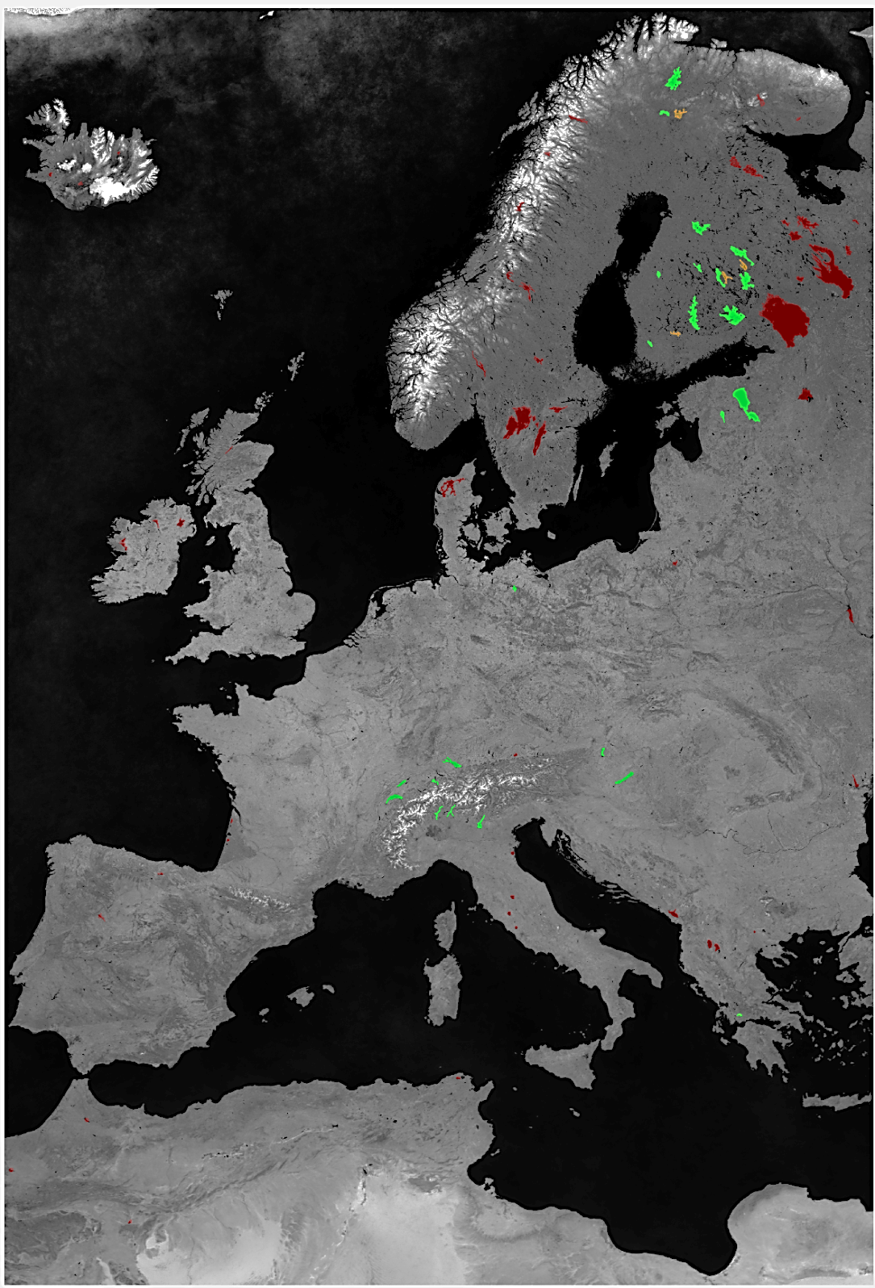
The value of AVHRR LAC data
GCOS – Essential Climate Variables (ECV)
Snow Extent – Lake Surface Water Temperature – Albedo
Goal: long time series (1981 – 2019)
Challenge: GCOS requirements
Snow Extent (SE)
Lake Surface Water Temperature (LSWT)
Albedo

Slide 16
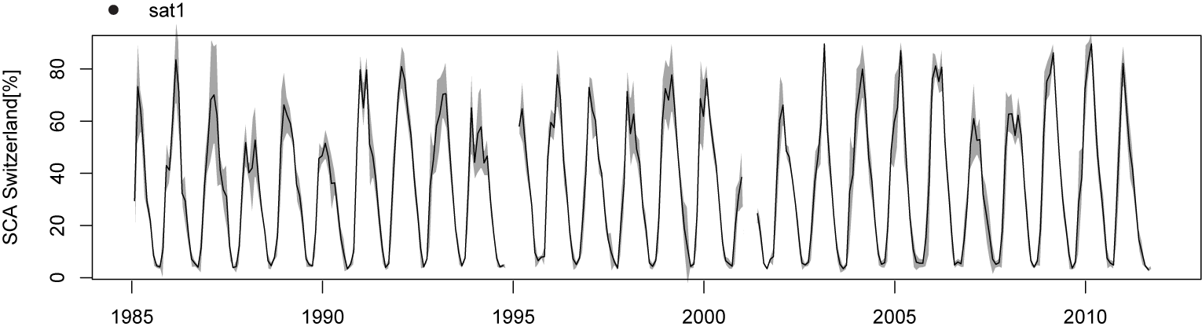
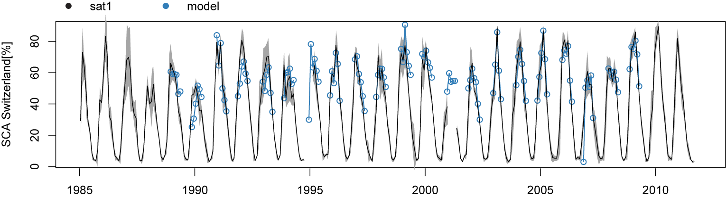
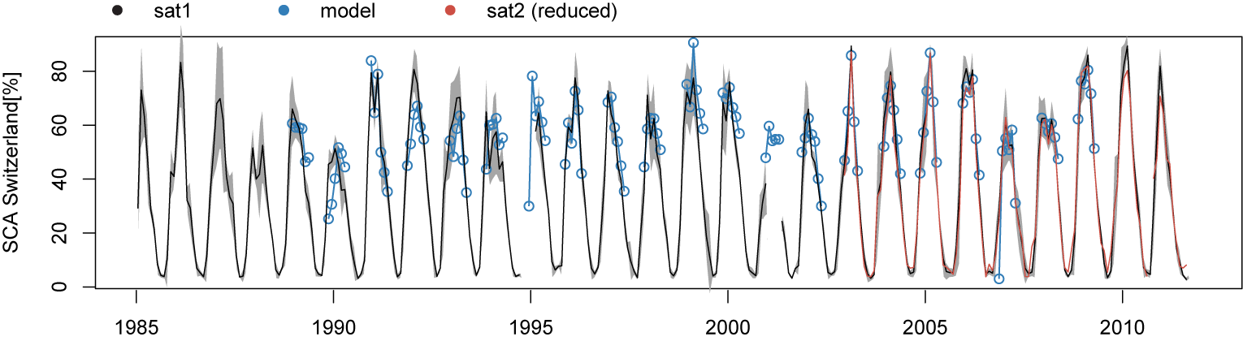
Snow cover time series based on AVHRR for Switzerland (up) and European Alps (low)
Hüsler, F., T.Jonas, M.Riffler, J.P.Musial, S. Wunderle (2014): A satellite-based snow cover climatology (1985 -2011) for the European Alps derived from AVHRR data. The Cryosphere, 8, 73-90

Slide 17
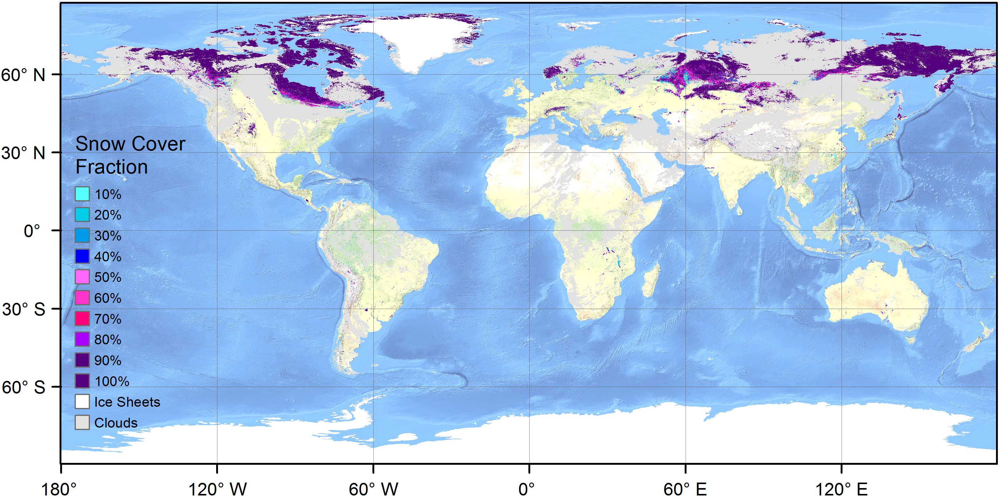
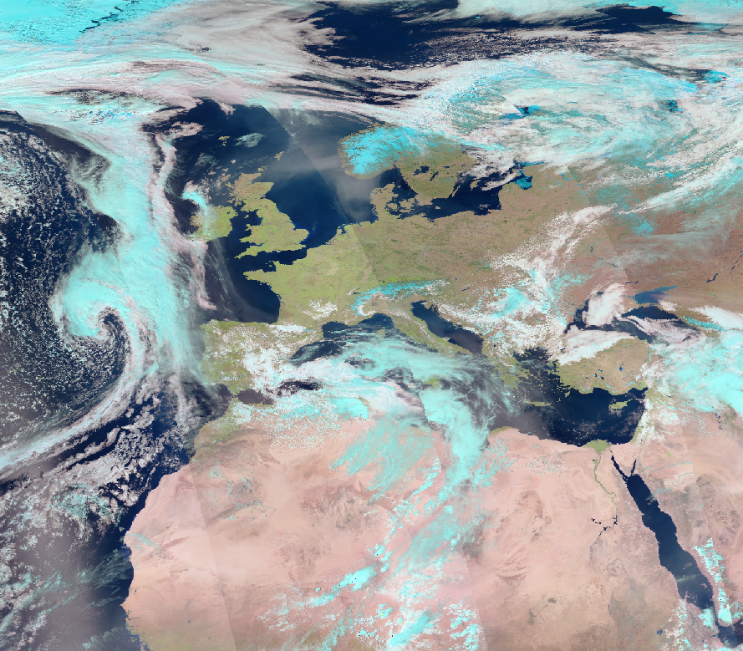
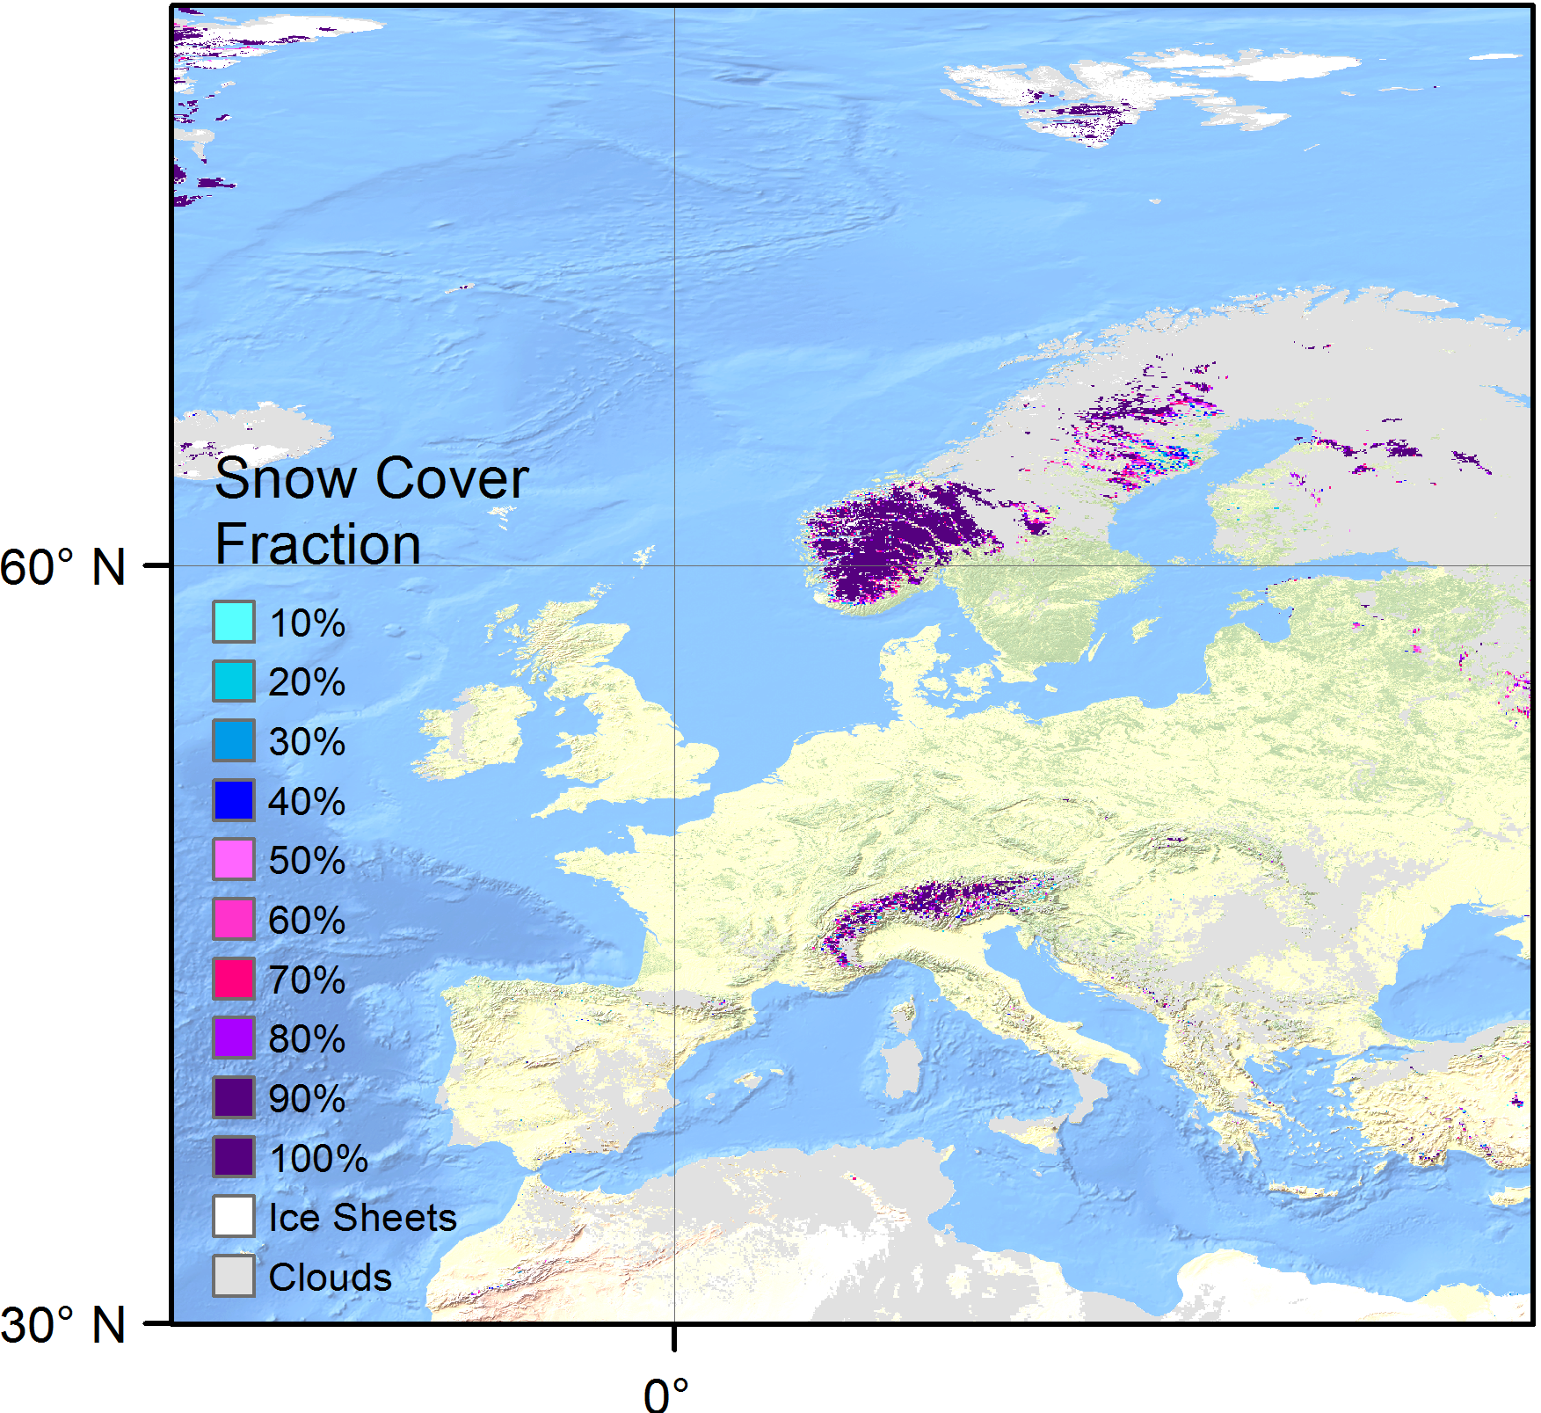
ESA Climate Change Initiative – snow project
Snow Cover Fraction derived from ESA CCI cloud GAC data

Slide 18
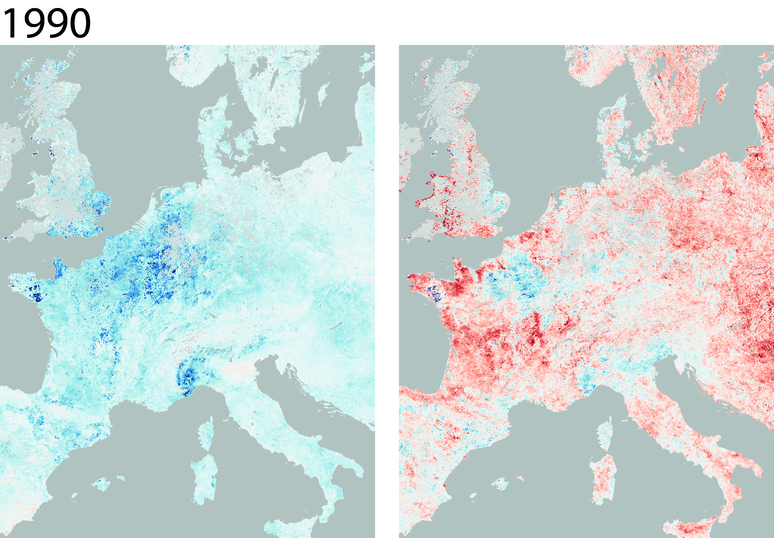
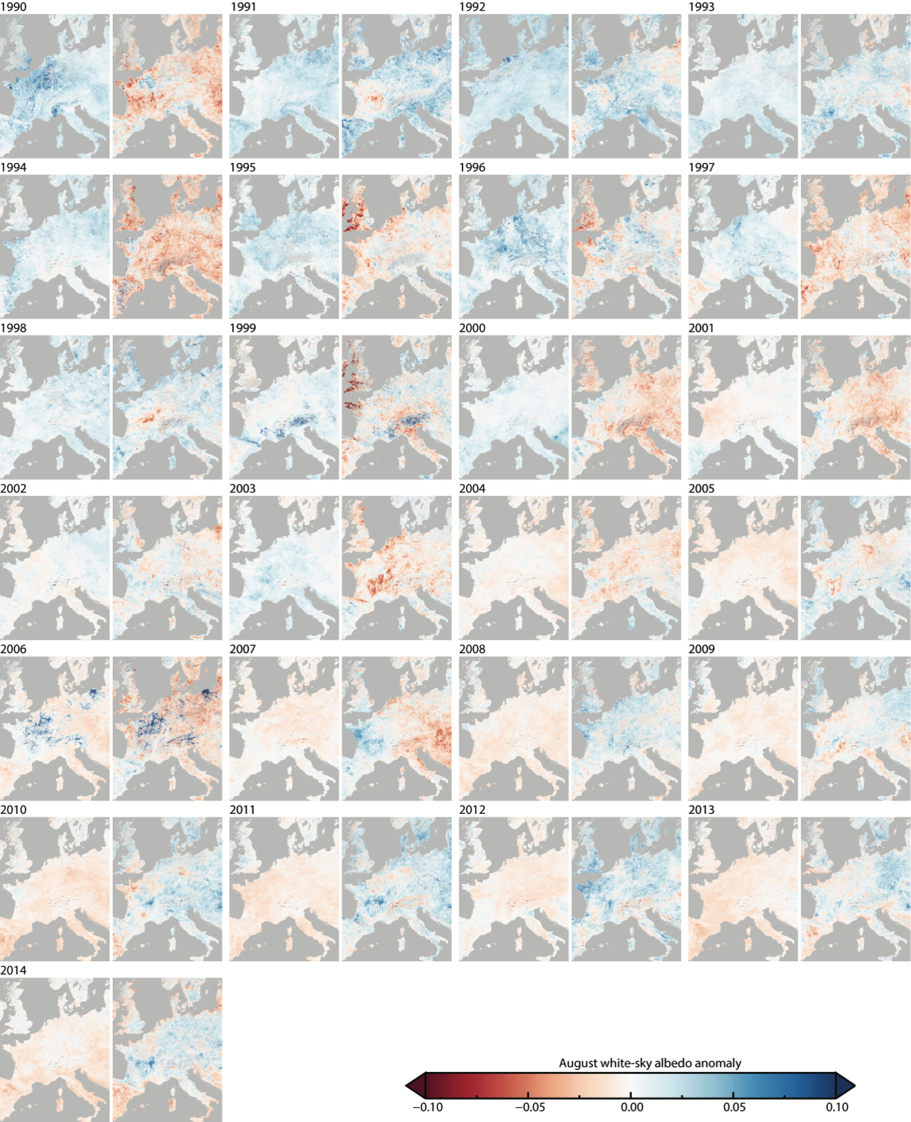
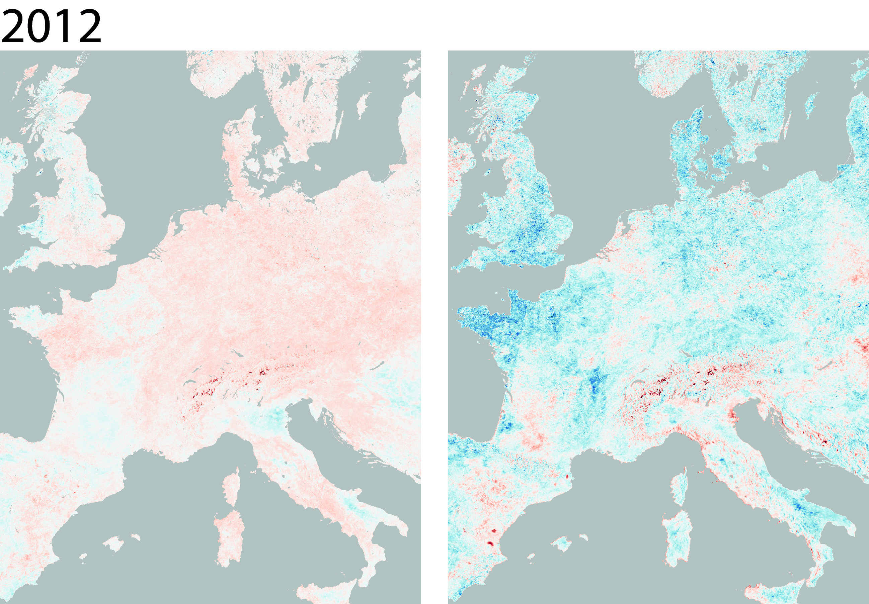
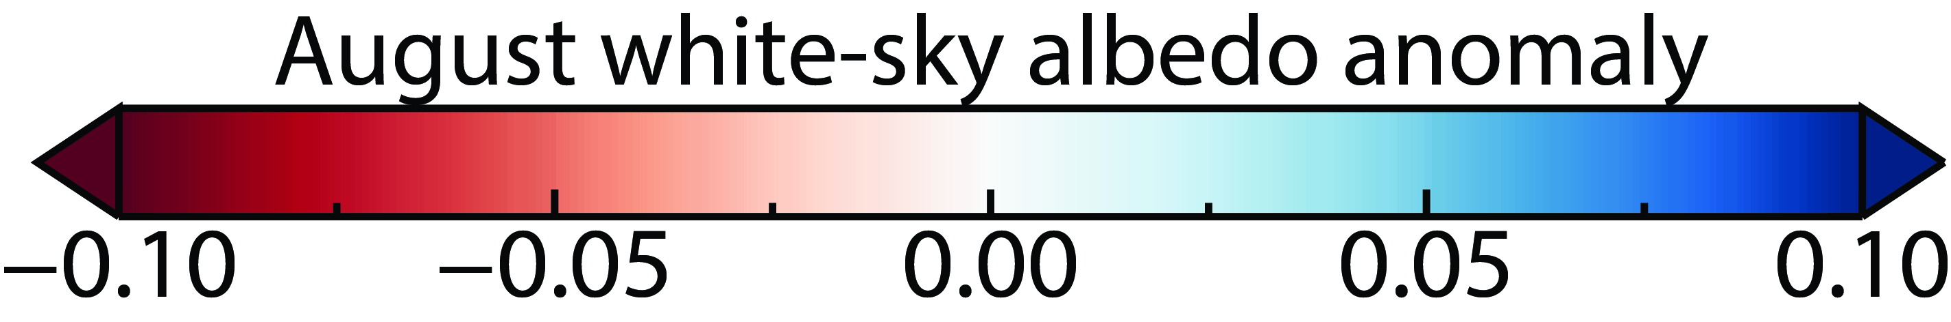
ECV – Albedo 1990 - 2014 annual August white-sky albedo anomalies
VIS (left) and NIR (right)
Sütterlin, Melanie; Stöckli, R.; Schaaf, C. B.; Wunderle, S. (2016). Albedo climatology for European land surfaces
retrieved from AVHRR data (1990-2014) and its spatial and temporal analysis from green-up to vegetation
senescence. Journal of Geophysical Research: Atmospheres, 121(14), pp. 8156-8171.

Slide 19
Lake Surface Water Temperature Derived from 35 Years of AVHRR Sensor Data for European Lakes
Lieberherr G. & Wunderle S.; Remote Sens. 2018, 10(7), 990; https://doi.org/10.3390/rs10070990

Slide 20
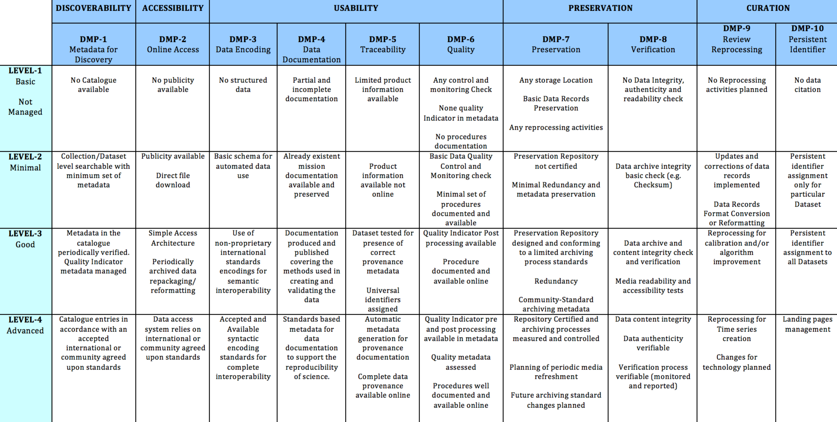
Maturity level of final AVHRR master data set based on CEOS Working Group on Information Systems and Services recommendations
Usability can be improved to generate a well calibrated and geocoded data set (FCDR)
WGISS Data Stewartship Maturity Matrix (June 2017)
Re-processing for calibration
Re-processing for time-series

Slide 21

CEOS Ready Data for Users
Data Producers
  Increase Impact: Making data easier to access and use will increase its impact and accelerate the growth of this user base. For continued relevance, data should be easy to use, access, and fit seamlessly into work flows and future data architectures – all of which are properties of CARD4L.
  Even sophisticated users of EO data typically invest a large proportion (around 80 per cent) of their effort into data preparation. This is a major barrier to full and successful utilization of space-based data.
Data Distributors
  Users are increasingly moving their workflows to the cloud. Providing a broad range of analysis-ready data products, ready to use and hosted within the same cloud makes a platform very appealing to customers.
  Data processing is costly. Pre-processed datasets eliminate this cost.
  The integration and combination of consistent and comparable data provides new avenues for analysis – greatly increasing information density
http://ceos.org/

Slide 22
Outlook and proposed next steps
Length of time series matters: expand the European ESA-archive with EO-SIP AVHRR data from University of Bern for the years 2017, 2018 and 2019 and afterwards in 3-monthly schedule.
Spatial resolution matters: Integrate the 1km-global data set into the ESA data archive and make it accessible as EO-SIP files.
  The 1km global data set (1992 – 1999) can be used to study the accuarcy of global GAC products.
  The MetOp-1km-LAC data set is globally available from 2006 – 2019 at EUMETSAT
Retrieval of ECVs require best possible pre-processing (calibration, geocoding). Pre-processing can be applied on European- and Global-1km data set

Slide 23
Lessons learnt and project challenges
Challenges of the project
  Data from heritage sensors are often degraded and archived in different formats
  Extraction of all needed information to fill the EO-SIP meta-files and quality reports
Lessons learnt
  A simple idea (preservation of UniBern AVHRR data and donate this unique data set to ESA) generated a very high work load, which was not expected.
  To start with level 0 data is a logical structure but is not always the right decision.
  There was a strong interest and support from ESA (namely, Sergio Folco and Razvan Cosac) which is highly appreciated.
  There is a very high interest by many users on the unique AVHRR data set (European and global) – so it was a very good decision to start this project.

Slide 24
Conclusion of University of Bern – ESA – AVHRR – LTDP project
All AVHRR data from University of Bern (level 0, level1a and level1b) are packed in EO-SIP container and transferred to ESA facilities.
Finally, the whole AVHRR archive at University of Bern is saved for the future and accessible for users via ESA web interfaces.
Scripts and software developed at University of Bern are transferred to ESA RSS team to generate EO-SIP files of all AVHRR data archived at ESA for advanced level of accessibly for users.
The generated EO-SIP files are validated and show a high degree of consistency (> 99%); also checked by ESA LTDP team
Global AVHRR-1km data set (1992 – 1999) pre-processed by USGS will be also included at ESA facilities.

Slide 25
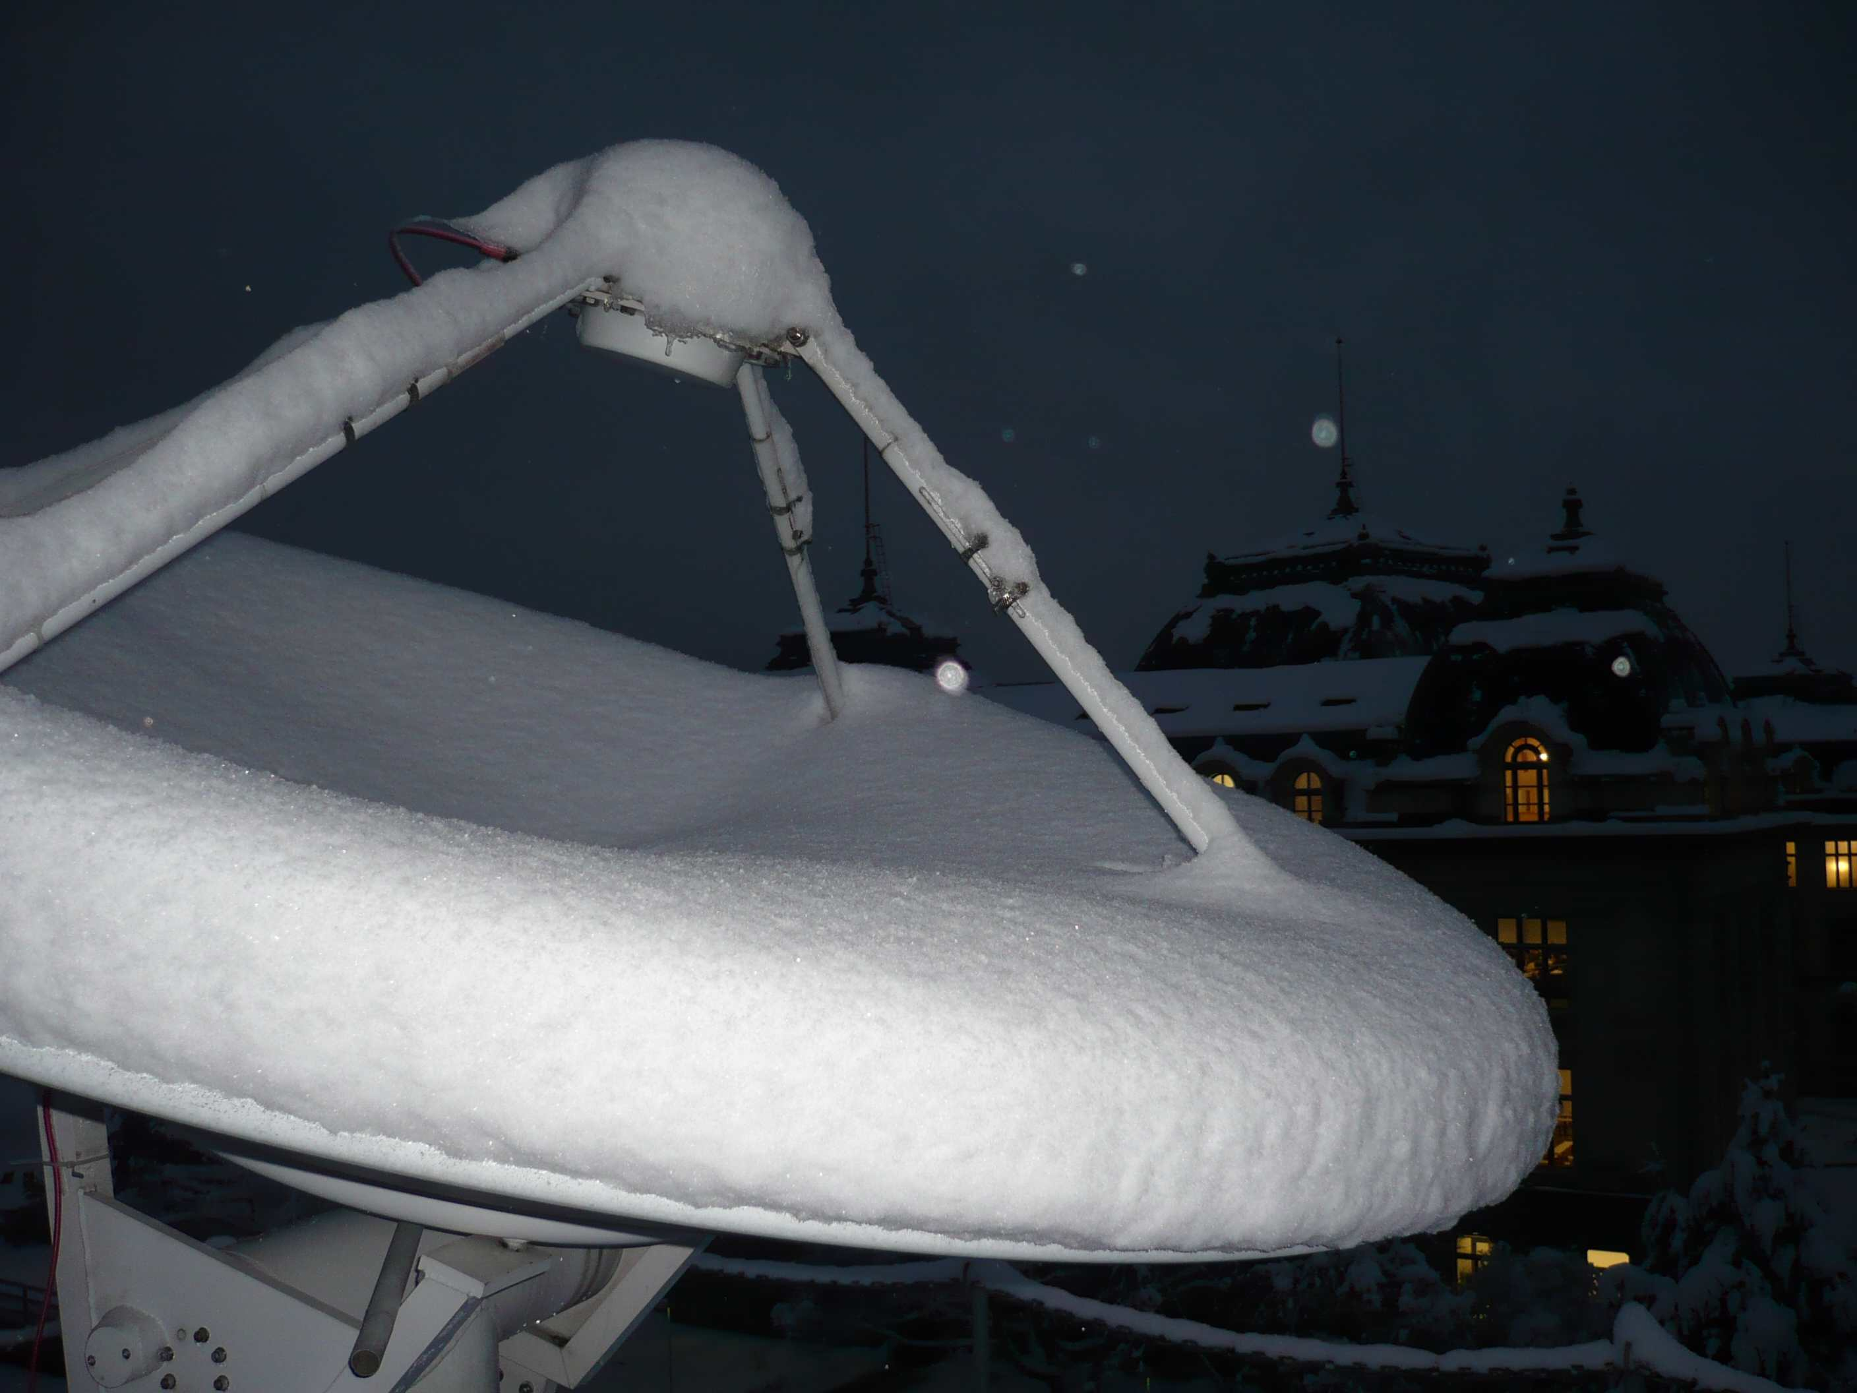
Thank you!
Acknowledgements:
Konstantin Khlopenkov
Dirk Koslowsky
Andy Heidinger
GCOS MeteoSwiss
Swiss National Science Foundation
ESA LTDP team
Dundee Satellite Receiving Station team
ESA CCI cloud team
UniBern AVHRR receiving station; winter 2013

Slide 26

Towards a Fundamental Climate Data Record (FCDR) - Availability of AVHRR data
AVHRR GAC | AVHRR LAC
global | Continental / regional | global
1981 - 2019 | 1981 - 2019 | 1992 – 1999 2006 – 2019
More than 30 years are required for a time series
to fulfill WMO / GCOS requirements and
guarantee a sound statistical analysis.
Background image: David Taylor

