Slide 1
NASA Earthdata Knowledge Base
WGISS-48 October 9th 2019
Doug Newman
NASA EED-2 Data Use Architect
douglas.j.newman@nasa.gov
Dr. Christopher Lynnes
NASA EOSDIS System Architect
christopher.s.lynnes@nasa.gov
This work was supported by NASA/GSFC under Raytheon Co. contract number NNG15HZ39C.
This document does not contain technology or Technical Data controlled under either the U.S. International Traffic in Arms Regulations or the U.S. Export Administration Regulations.

Slide 2
INTRODUCTION
Notes:
First, an introduction to EOSDIS and NASA Earthdata.

Slide 3
Rationale
‘Connect together the main elements of Earth Observation knowledge AND context in a way that is: machine-readable, human-usable and curatable’
Chris Lynnes, WGISS-47

Slide 4
Use Cases
As an earth data scientist, I want to determine the datasets used in an article/report/paper
As an earth data scientist, I want to determine the articles/reports/papers that cite a dataset

Slide 5
APPROACH

Slide 6
Graph Technologies
Implementations
AWS Neptune
Neo4J
APIs
SPARQL
Gremlin
Cypher

Slide 7
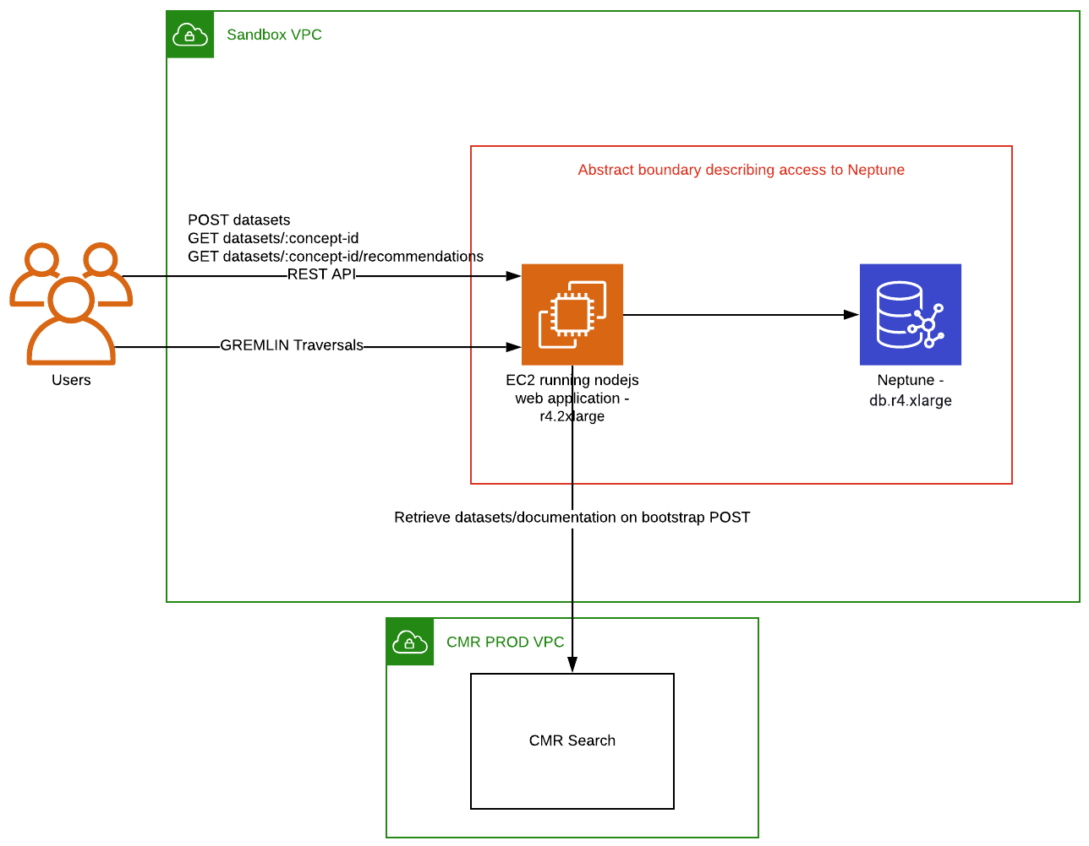
AWS Neptune + Gremlin
Amazon Web Services and the “Powered by AWS” logo are trademarks of Amazon.com, Inc. or its affiliates in the United States and/or other countries.
Apache Gremlin are either registered trademarks or trademarks of the Apache Software Foundation

Slide 8
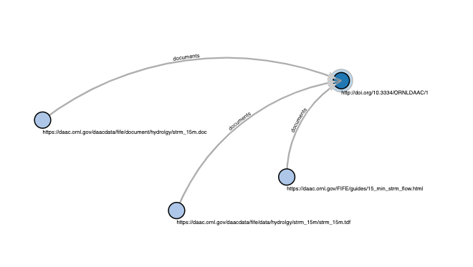
Collections and documentation
The common metadata repository contains dataset metadata records and references to their respective documentation. We used this inventory to create a graph of datasets and documentation vertices and ‘documents’ edges:

Slide 9
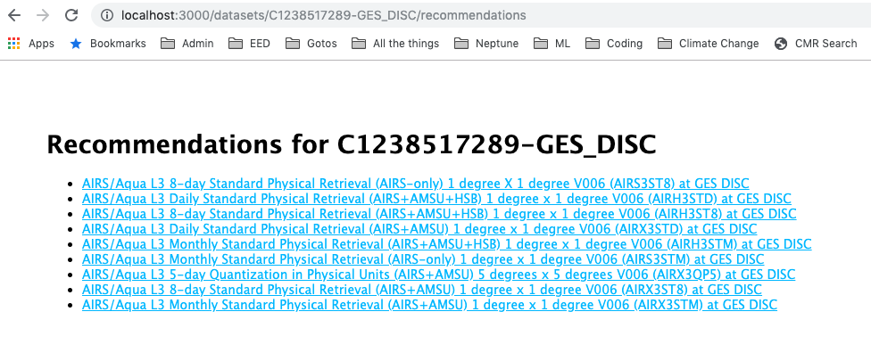
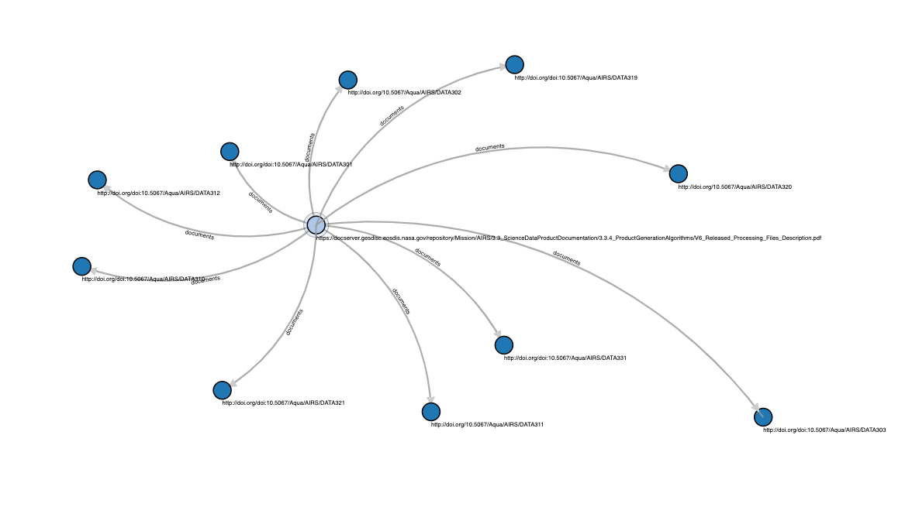
Recommendations
g.V().hasLabel('dataset')
.has('conceptid',conceptId)
.inE('documents')
.outV()
.hasLabel('documentation')
.outE('documents')
.inV()
.hasLabel('dataset')
AIRS3STD

Slide 10
CONCLUSION
Notes:
In conclusion

Slide 11
If you build it...
10 minutes looking at a visualization of two CMR concepts gave me the inspiration for the recommendation engine. Imagine what an expert could do?
Providing a read-only traversal API over a knowledge base like this could open the floodgates for novel discovery techniques

Slide 12
NEXT STEPS
Notes:
In conclusion

Slide 13
Articles
The motivation for dataset -> documentation edges was to get to articles. A lot of articles reference dataset documentation. The next step is to bridge that gap.
Google scholar
OpenCitations
Google and the Google logo are registered trademarks of Google LLC.

Slide 14
QUESTIONS?
Approved for Public Release
Notes:
Thank you for your time. Questions?

Slide 15
This work was supported by NASA/GSFC under Raytheon Co. contract number NNG15HZ39C.
in partnership with

