Slide 1

Report and Progress on WGCV Cooperation with WGISS
C. Ong/A. Kuze
CSIRO/JAXA
WGISS #48
VNSC, Hanoi, Vietnam
7-11 October, 2019

Slide 2
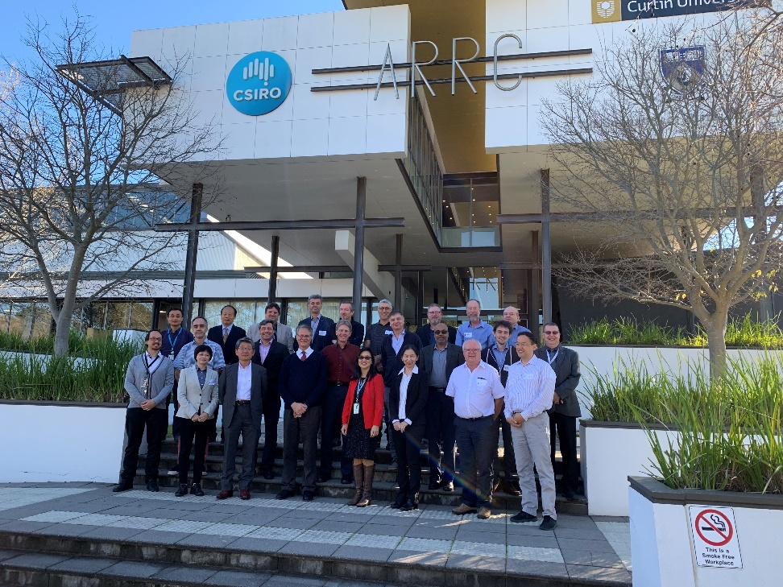
WGCV overview
WGCV includes members from CEOS agencies as well as the Chairs of six subgroups
Subgroups allow inclusion of a wider range of researchers
  Atmospheric Composition
  Land Product Validation
  Infrared and Visible Optical Sensors
  Microwave
  SAR
  Terrain Mapping
Task groups address cross-cutting topics covered by multiple sub-groups
General topics include
  Validation metrics
  Protocols
  Traceability
  Prelaunch and post-launch characterization
WGCV-45 meeting hosted by
CSIRO in Perth, Australia

Slide 3
Status of WGCV’s Contribution to CEOS Work Plan
Deliverable | Q3 2019 | Q4 2019 | Q1 2020 | Q2 2020 | Q3 2020 | Q4 2020 | Q1 2021 | Q2 2021 | Q3 2021 | Q4 2021
CV-3 (pre-flight workshop) | Strong community interest. Joint GSICS/WGCV letter signed, workshop Q2 Q3 2020. Key aspect GHG sensors. | Due date extended to Q3 2020
CV-9 (RadCalNet) | Ongoing task renewable each year |  | Ongoing task renewable each year
CV-14 (CMIX) | On track for delivery. 9 teams participating & have delivered their results over 5 evaluation datasets (Landsat-8 & Sentinel-2 scenes). Results currently being evaluated & will be published & discussed in 2nd ACIX II-CMIX WS (3-5 December 2019, ESA/ESRIN) (https://earth.esa.int/web/sppa/meetings-workshops/hosted-and-co-sponsored-meetings/acix-ii-cmix-2nd-ws)
CV-15 (L1 inter-operability) | Solar reference spectrum completed, WGCV/GSICS SI-traceable workshop, community white paper & proceedings to be published early 2020
CV-17 (Continental SR) | Report distributed to community
CV-18 (GHG ref standards) | Apr 2019 meeting discussed TCCON. Workshop planned Q1 2020. Formal invitations distributed. |  | Extension to Q3 2020 (NB. Links to GHG)
CV-19 (biomass pro) | On track to be completed
FDA-12 (CEOS product inventory) | Work in progress as part of CARD4L peer review, CV-15 & WGISS/WGCV cooperation on QI |  | Deadline extended to Q2 2020 after WGCV46 meeting in March 2020
CARB-16 (biomass SS) | On track to be completed

Slide 4
WGCV Roles in GHG Roadmap
To identify best practices in prelaunch and on-orbit calibration of GHG concentration sensors and flux product validation, WGCV will work with GSICS to define:
Identify available standards and calibration techniques to
  Calibrate space based GHG sensors prior to launch
  Calibrate and cross-calibrate GHG sensors on orbit (lunar, solar, vicarious)
Define approaches to cross validate retrieved XCO₂ and XCH₄ concentrations
  Identify available standards and techniques that can be used to cross-validate space based estimates (TCCON, AirCore …) (Rec#11)
Work with AC-VC and GSICS to define best practices and facilitate exchange and harmonization of approaches for instrument cross-calibration (Rec#10)
Identify approaches for validating surface GHG flux products and reference standards
New Activities Ongoing Activities

Slide 5
Field Surface Reflectance “Round-Robin” (S3R) inter-comparison exercise, and development of community endorsed SR validation protocols
Field Surface Reflectance “Round-Robin” (S3R) inter-comparison exercise represents a joint effort to test user-based differences in surface reflectance fiducial reference measurements used for validation of current SR satellite products, and to ensure consensus on field protocols and global SR validation protocols. It is a continuation of CV-17, including the use of drones and extending to other biomes/conditions and conducted in the framework of the ESA FRM4Veg project. These objectives shall be achieved inviting the scientific community to a “Round Robin” inter-comparison exercise and two international workshops to discuss the design of the S3R exercise and the main outcomes. In addition, the fiducial reference measurements collected during the exercise will serve to validate SR ARD products.
Objectives:
  Perform RR inter-comparison exercise of SR for:
  - Testing user-based differences in surface reflectance measurements (including instrument and operator biases as well as measurement collection procedures);
- Helping design field measurement protocols and validation methodology that are clear and can be easily applied by all users; and
- Ensuring international buy-in and consensus on the field measurement protocols and global SR validation methodology developed.
  Organize two workshops before and after RR for discussion on protocols, field experiment and outcomes
  Publish RR inter-comparison results
  Develop protocols for global SR validation (field radiometry, drones, others)
Outcome:
  Report summarising the S3R inter-comparison results
  Peer reviewed article co-authored by all participants who wish to publish the outcomes of the activity.
  SR validation protocols including field measurements and drones for CEOS WGCV LPV/IVOS endorsement.
Period: 2020 – 2021
  Experiment Call (Q2 2020)
  First Workshop (Q4 2020)
  S3R exercise (Q2 2021)
  Second workshop (Q3 2021)
  S3R inter-comparison report (Q4 2021)
  SR validation protocol (Q4 2021)
Contributing Entities: ESA, GA, NPL, CSIRO, IVOS, LPV
Funding support: ESA Earthnet (FRM4Veg project)
CV-17

Slide 6
Second Biomass Retrieval Intercomparison Exercise BRIX-2
BRIX-2 represents a joint effort between to intercompare algorithms specifically for biomass mapping using current and future spaceborne missions.
These objectives shall be achieved by making available standardised test cases (based on airborne campaign and spaceborne simulated data), inviting the scientific community to develop and apply retrieval algorithms based on this test case, and finally compare and evaluate the performance of submitted results.
Objectives:
  Provide an objective, standardized comparison and assessment of biomass retrieval algorithms developed for the BIOMASS, NISAR and GEDI missions, and fusion of these mission datasets.
  Establish a forum to involve scientists in the development of retrievals that have so far not been part of the biomass community.
  The adoption of vetted validation standards and methods to compare biomass estimates to reference datasets (e.g. field plots or airborne lidar biomass maps).
  Collect inputs from the biomass user and scientific community on data formats and characteristics towards the generation of Analysis Ready Data.
Outcome:
  The evaluation will be done by ESA/NASA, following standards from the CEOS LPV protocol. This should guarantee a fair evaluation. ESA/NASA will release a report to the participants summarising the evaluation results.
  Evaluation scripts available. This allow people to repeat the experiment and compare their results against the published ones.
  The results should easily be adapted for publication as a peer reviewed article co-authored by all participants who wish to publish the outcomes of the activity.
Period: 2020 – 2021.
  Experiment Call Q12020.
  First Workshop (Target: Q3 2020)
  Results Submission Deadline (date of first workshop + 6 months?)
  Results Evaluation Report (date TBD)
  Second workshop (date of first workshop + 9 months)
Contributing Entities: LPV, ESA, NASA (JPL, University Maryland)
With contribution from Scientists team involved in BIOMASS, GEDI, NISAR

Slide 7
New: SAR Supersites for multi-mission SAR radiometric / geometric calibration, cross-calibration & validation
Justification
  Multiple upcoming SAR missions;
  Capability to support multi-mission SAR calibration / validation would facilitate an independent verification of data quality (radiometric, geometric)
  Ongoing discussion between NASA, GA for NISAR L-band calibration, ISRO interest for S-band calibration noted with implications for NovaSAR calibration; Other interested
Objectives
  Define a set of criteria / requirements and characteristics for setting up SAR supersites (similar to RADCALNET);
  Need to cater for multiple calibration validation and observation requirements e.g. CRs, transponders, PARCs, left / right looking, temporal stability;
  A model of sustainable operations be central to SAR supersites;
Definition of the work plan with resources and timelines to be prepared by the SAR subgroup for discussion at the CEOS SAR SG Nov 2019 meeting in Frascati;

Slide 8
New: Digital Elevation Inter-Comparison
Outcome of workshop on Global Digital Elevation Model (DEM) Benchmarking - JRC/EC & geomorphometry.org
  reactivate the Terrain Mapping Sub-Group (TMSG) of the CEOS-WGCV;
  work towards a comparison of state-of-art global DEMs based on a set of harmonized metrics;
Scope and Products to be included: All datasets which have an at least continental coverage and are available under a free & open data policy, including latest versions of
  NASADEM (NASA, JPL, most recent decent of the SRTM product line, eventually also NGA’sTFRMv4)
  AW3D30 (JAXA, f&o version of the Japanese ALOS based global DEM)
  ASTER-GDEM, (METI, NASA)
  TanDEM-X90, (DLR, free version for scientific of the TanDEM-X mission)
  Copernicus DEM90 (EC/ESA, f&o version of WorldDEMTM, the commercial version of TanDEM-X procured by Airbus)

Slide 9
New: Digital Elevation Inter-Comparison
DEMIX to be performed in 4 phases
  General agreement among main contributors (data owners) on approach & scope; Call for expression of interest to further partners (commercial tbd); circulation of JRC Workshop report (in preparation) & selection of base (△x, △y, △z) & extended (slope, aspect, morphology) testing methods and algorithms; Identification of suitable test areas (at least 1 per continent);
  Cross-comparison of all participating data sets on test areas and, if feasible, identification of a reference dataset (at DGED L1). If available and where applicable cross-comparison to suitable orthorectified (reference?) imagery (Sentinel-2?); Workshop to exchange experiences from the test areas and agree on details of an eventual global roll-out;
  Feasibility testing & potential global roll out of at least base tests & determination of suitable aggregation scale for reporting;
  Calculation of agreed comparison metrics for all candidates and publication of results.
Timeline
Q4 2019 |  | Q1 2020 |  | Q2 2020 |  |  | Q3 2020 |  | Q4 2020
 | Phase I
 |  |  | Phase II
 |  |  |  |  | Phase III
 |  |  |  |  |  |  |  | Phase IV

Slide 10
New: Ocean Surface Wind Vector Standards & Metrics
Collaboration between Microwave SG and Ocean Surface Vector Wind –VC
VC-15 “OSVW Standards and Metrics” - objective: defining standards and metrics to enable cross calibration/comparison between scatterometers and wind retrieval approaches;
Agreement to removed from WP and to moved to new WP collaboration with MSSG at quarterly SIT teleconference;

Slide 11
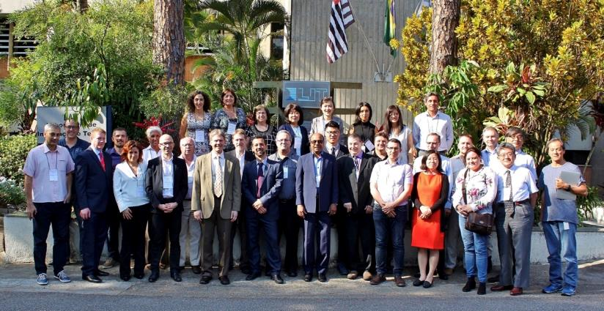
Joint WGISS/WGCV Session Reminder
Four topics discussed in April 2018 with leads identified from WGISS and WGCV
Data Formats and Interoperability in the framework of FDA
  Robert Woodcock (WGISS), Medhavy Thankappan (WGCV)
Quality Indicators in Discovery Metadata
  Michael Morahan (WGISS), Nigel Fox (WGCV)
CEOS Data Cubes and CEOS Test Sites Data Access in support of WGCV Activities
  Robert Woodcock (WGISS), Greg Stensaas (WGCV)
Standardization and Best Practices (e.g. ISO 19159-3)
  Richard Moreno (WGISS), Cindy Ong (WGCV)

Slide 12
Joint WGISS/WGCV Session Reminder
WGISS and WGCV have held joint meetings including the most recent joint session at INPE in April 2018
Discussions cover common areas and topics in the ongoing/planned WGs activities which could benefit from cooperation between the two groups
Ways to describe and share available facilities, expertise, resources, technical information and documentation
Topics of common interest with natural synergies
INPE meeting emphasized two key elements to help completion of activities in a reasonable time period
Well-defined tasks to define a way forward
Agreed to monitor progress through periodic joint calls – all to date were organized by M. Albani/M. Piepgrass

Slide 13
Joint WGISS/WGCV -Activity summary to date
WGISS/WGCV joint session at WGISS-45 with follow-on telecons
Telecon on June 18, 2018 to develop concrete tasks
  Discussed overall goals of the tasks with long-term concepts
  Developed short term actions to show progress by Fall 2018 SIT Technical Workshop
Updates were provided during WGCV-44
Telecon September 6, 2018 to discuss progress
Provided updates during SIT Technical Workshop in Darmstadt last September
Telecon February 7, 2019
Updates during WGCV-45 in Perth, March 2019
Provide updates at SIT in Miami, April 2019
Telecon July 2019

Slide 14
1) Data Format & Interoperability in the Frame of FDA
  Objective: Ensure users a seamless access and usability of data from multiple sensors including tools to use data from multiple sensors
ARD SR uncertainties case history
Data Format & Interoperability in the Framework of FDA
Data Format
Interoperability / Consistency between data / data products
Format conversion well understood & already provided by WGISS
Provide concurrent satellite & field validation data via datacube
Field data uncertainties
Satellite data uncertainties
CV-17

Slide 15
2) Quality Indicators in Discovery Metadata
Objective: Ensure quality and uncertainty information availability (discovery and access) for users
SST QI case history
Representation& inclusion of QI
Survey of SST QI
Embedding measurement Eqn
Linking stages
Readability
All main USA, EU & JP SST capable sensors available in GHRSST
QI – 1) numeric value (not comparable); 2) diff to common ref (SSES inter-sensor comparable); 3) context sensitive uncertainty
Workable uncertainties – not per pixel
Embedded measurement eqn.
QI tagged at all stages & tracked
SST QI case history

Slide 16
3) CEOS Data Cubes and CEOS Test Sites Data Access in support to WGCV Activities
  Objective: Data Cubes (or similar stacking of data over time for specific locations) test cases
Identification of tool – MEA GUI
Case histories selection – RadCalNet, ACIX, LPV Supersite
Demonstration with RadCalNet & ACIX, LPV?
Resolve challenges with consistencies between LPV supersites
Access to WGCV users as beta testers
Data Formats, processing, etc.
WGCV cal val portal & site info
CV-9, CV-14

Slide 17
4) Standardization and Best Practices
Objective: Contribution on CEOS Best Practice/White Paper
ISO SAR standards
Standard published
Engagement challenges
Data Management Principles
Maturity Matrix
Evaluation of different methods/principles
ARD metadata
Evolved into task 1?
Embedding, tagging of required QI parameters

Slide 18
Convergence of tasks 1, 2, 4
Maturity Matrix
Quality Indicators
SST uncertainties case
ARD SR uncertainties case history
Data Format & Interoperability
Data Format
Interoperability / Consistency between data
SOLVED

Slide 19
Convergence of tasks 1 & 3
Case histories selection – RadCalNet, ACIX, LPV Supersite
Demonstration with RadCalNet & ACIX, LPV?
Resolve challenges with inconsistencies with LPV supersites
Extension to other validation sites?
Data Formats, processing, etc.
ARD SR data available sites
Field data uncertainties
Satellite data uncertainties
Access to WGCV beta testers
New S3R WP
Potential use by new BRIX-2, DEMIX WPs, GHG, SAR,

