Slide 1
SEO Report to WGISS-49
Brian Killough
NASA Langley Research Center
CEOS Systems Engineering Office (SEO)
WGISS-49 Meeting (virtual) April 21, 2020

Slide 2
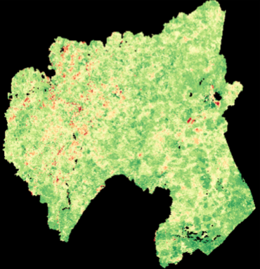
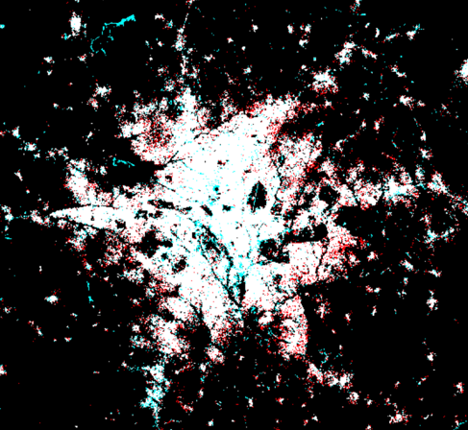
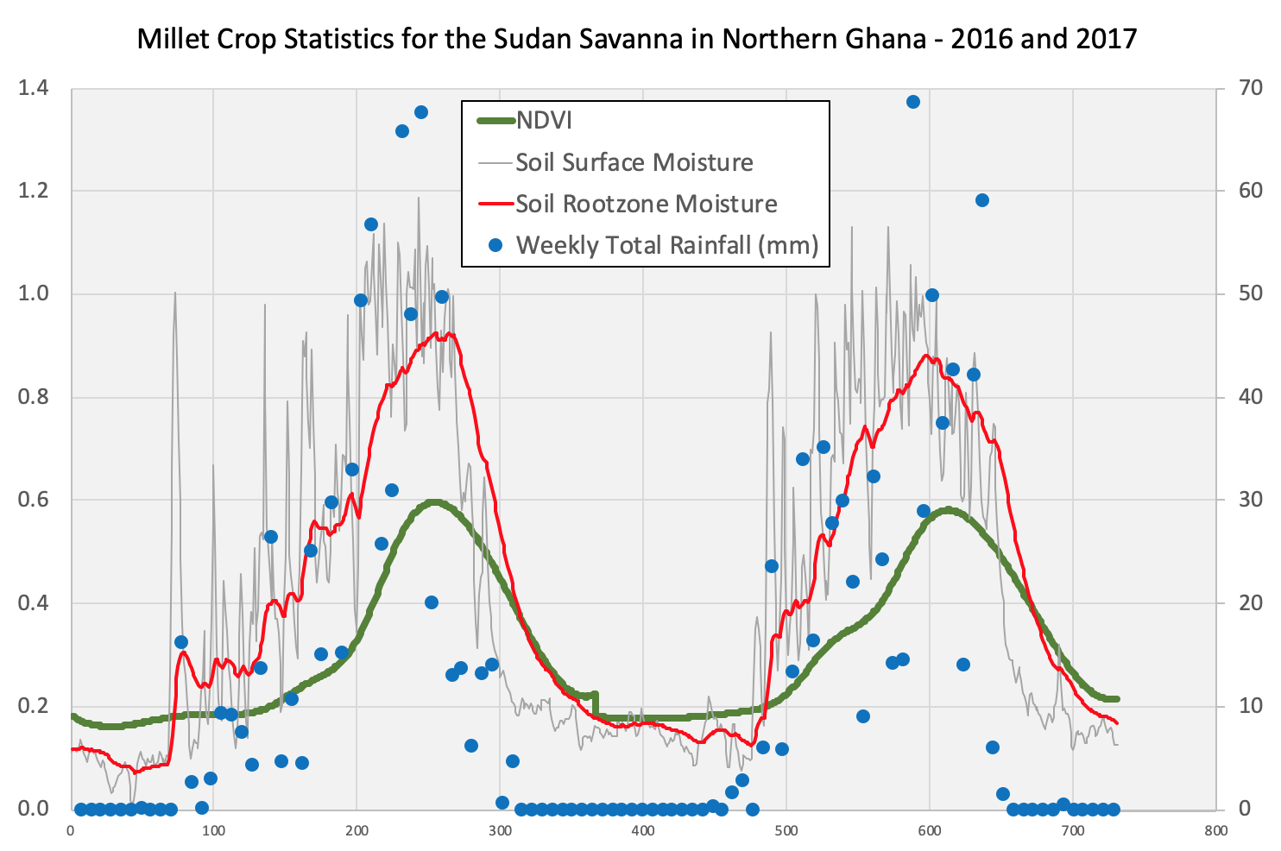
Open Data Cube
ODC is operational in 10 countries, in development in 19 countries + 49 more countries in DE-Africa, and 28 more countries have expressed interested ... the impact is 106 countries !!!
Core code development is focused on moving the initiative to the OSGeo (Open Source Geospatial) Foundation
The ODC teams recently completed a hackathon in Australia (Feb 24-28) with a focus on data interoperability
The SEO continues to work on enhancements for tools and algorithms that will support the growing number of ODC deployments around the world. An update of the Data Cube Application Library (DCAL) is planned in the coming 3 months.
COAST ... The SEO is supporting early discussions and planning and this effort may take advantage of the ODC infrastructure for data and analyses.
www.opendatacube.org
ODC GitHub: https://github.com/opendatacube
Data Cube User Interface Demo: http://tinyurl.com/datacubei

Slide 3
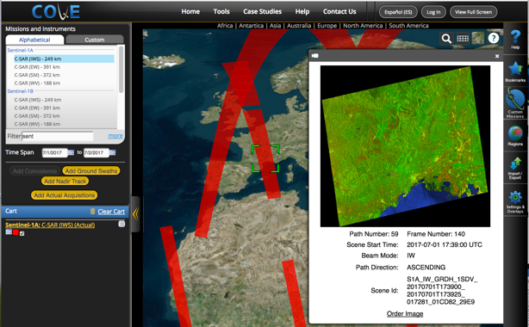
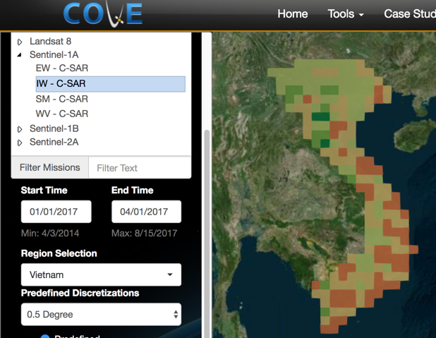
COVE Analysis Tool
The CEOS Visualization Environment (COVE) is a browser-based suite of tools for searching, analyzing, and visualizing actual and potential satellite sensor coverage.
COVE is FREE and OPEN for anyone to use! The tools includes over 130 missions and is linked to several mission archives for metadata and browse images: Landsat, Sentinel-1, and Sentinel-2.
Many updated and new analysis tools, including: Acquisition Forecaster (past and future groundtracks) Coverage Analyzer (past acquisitions and browse images) Revisit Calculator (coverage statistics) Coincidence Calculator (multiple missions) Data Browser (data filtering) Data Policy (link to portal) Country Coverage Reports (annual country-level summaries) Utilities (swath calculator)
www.ceos-cove.org

Slide 4
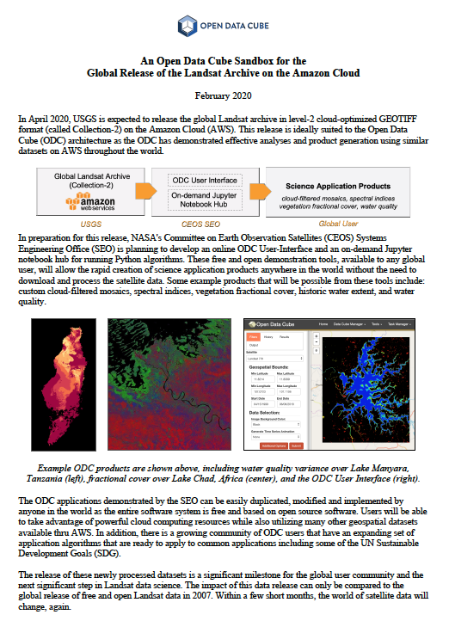
Landsat Collection-2 Sandbox
The SEO is working on a new initiative to create an online cloud-based “Data Cube Sandbox” tool to support the Landsat Collection-2 release (~June 2020)
This free/open Amazon cloud demo will allow users to rapidly run analyses anywhere in the world and demonstrate the power of Landsat ARD with several common applications (custom cloud-filtered mosaics, spectral indices, vegetation fractional cover, historic water extent, and water quality variability).
This creates a new opportunity for webinars and tutorials and may be linked to the CEOS CB-45 task (Jupyter Notebooks Webinar)

Slide 5
Update on Data Flows
GOAL: Global Landsat, Sentinel-1, Sentinel-2, and ALOS analysis-ready data (ARD) in cloud-optimized COG (Cloud GeoTIFF) format on the cloud. This will support a number of global data cube projects and provide an efficient cloud-based solution.
Landsat ... Level-2 surface reflectance data (Collection 2) on AWS-USA-West by June 2020 ... Soon please !!! Until then, the SEO is maintaining such data for Digital Earth Africa users (5 ARDC countries) by updating the archives weekly.
Sentinel-2 ... We now have global Level-2A on AWS-Frankfurt since Dec 2018. There is a desire to get older global data (Dec 2016 to Dec 2018) processed and added to this archive. Joe Flasher (AWS) confirmed that they are working with Sinergise to process older S2 data to bring the L2A global archive (on AWS-Frankfurt) up to date. Also, Element-84 (U.S. company) is converting some of this data (only Africa) to COG format and pushing it to AWS-US-West, along with Landsat. We are pushing E84 and AWS to make this happen for the entire global archive. The AWS-Frankfurt data will remain in place and the COG format data would be a separate holding.
Sentinel-1 ... Sinergise currently copies global GRD (level-1) to AWS-Frankfurt and converts to COG format since 1.1.2017. Getting that data into ARD format (backscatter intensity) is not easy, but would be a HUGE addition to the EO user community. Only Google Earth Engine does it. Why can’t we have other sources? The SEO is testing several S1 algorithms from the Sentinel-Hub and working with egeos (Italian contractor) on solutions for Sentinel-1 data cube creation.

