Slide 1
ESA Common Services Data Access Status Report
ESA-Earth Observation Program
Véronique Amans, Hayret Abdula, Giuseppe Troina, Damiano Guerrucci
21/04/2020

Slide 2
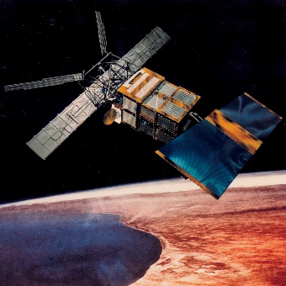
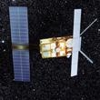
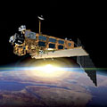
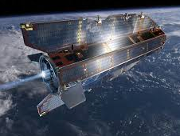
large archives of completed missions
Available data (1/3)
ers-1
ers-2
envisat
goce
ERS-1
ERS-2
ESA Heritage Missions
Envisat
GOCE

Slide 3
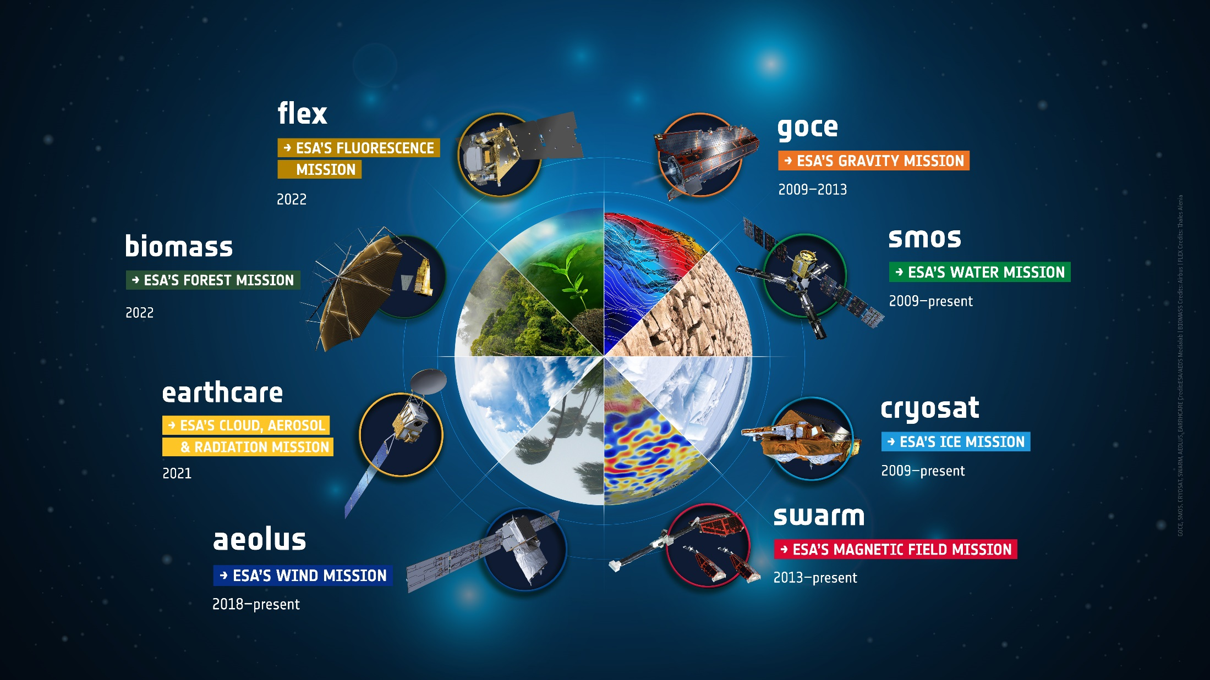
Science: Earth Explorers
Available data (2/3)
Notes:
The Earth science missions “Earth Explorers” allow us to understand the Earth System and its diverse aspects in more and more detail.

Slide 4
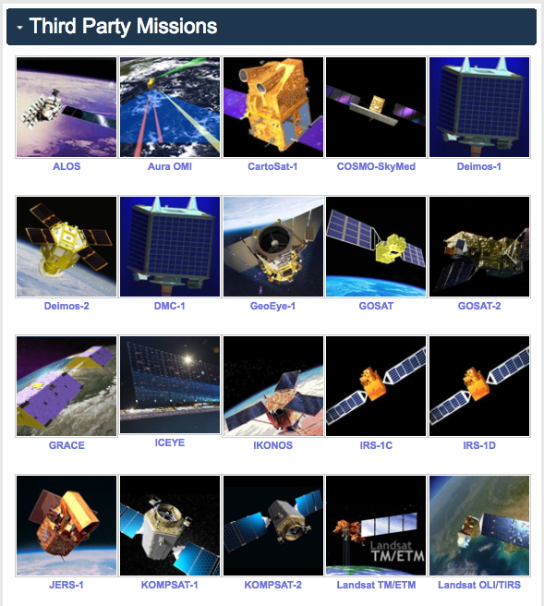
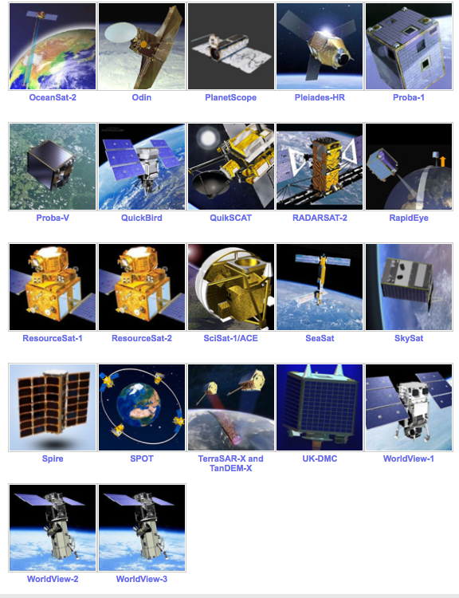
Available data (3/3)
Notes:
ESA uses its multi-mission ground systems to acquire, process, archive and distribute data from other satellites - so called Third Party Missions. The data from these missions is distributed under specific agreements with the owners or operators of the mission, following the ESA Data Policy

Slide 5
EO Data Dashboard (last 12 months)
Missions
84
18.253.512
Instruments
1080(*)
Web Pages
170
Products
192 Collections
153.400 Downloads
7.530
Help Desk Requests
1.205.945 Visitors
15%
85%
Sessions
1.692.378
Level 0
L1 and higher
Documents
1.079
(*) Current web contains >3000 pages

Slide 6
LAYERED ARCHITECTURE FOR DATA ACCESS SERVICES
Data Delivery or Exploitation
User Interface(s)
Algorithm
Product
Applications
OGC Opensearch/WMS/WMTS/WC(P)S
to access, browse and exploit EO data via M2M interface or dedicated EO Data Visualization, pre-anlaysis and datacube front-ends
Data Discovery
Metadata
Resources - Data

Slide 7
THE IMPLEMENTATION

Slide 8
ARCHITECTURE
Operational interface
ESA
User Community
Query and service requests
External
Data access interface
Operational Data Access
Web User Interface for pixel-based access, analysis and processing
Web User Interface for granule-based discovery and/or retrieval
……….
International EO Information Page:
- CEOS IDN
Mission oriented GUI
- SWARM
- SMOS
- Cryosat
- External
External catalogue application
ESA EOCAT Project Components
……….
ESA PDGS Data Cube GUI, VIRES GUI, etc…
ESA EO Information Page:
- ESA Earth Online
Multi Mission GUI:
– ESA EOCAT
ESA EO Gateway project
OpenSearch
(collections and granules)
Knowledge-Base Facility
Standard services request Interfaces (e.g., restful API)
OpenSearch
(collections
and granules)
Standardised Interoperable Interfaces
Thesauri Repository
Metadata management
ESA Operational Service
Protocol for data access
(e.g., OGC, Open Datacube)
EO Data & Service Metadata Repository
Products Access Interface
Data Repositories
Copernicus Data Repositories
ESA Missions Data Repositories
External Web Interface
Standardised Interoperable Services Interfaces
External Web Interfaces
Data management
IT Resources provided as services (IaaS, PaaS, SaaS)
TPMs
HMs
EEs
S-1
S-2
S-3
S-5
User Applications
ESA User Applications
Temporary
VM – Processors
Storage
VM – Browse Images Generation
VM – DataCube Engine/API

Slide 9
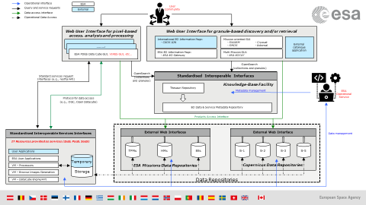
Strength of the new system
First elements of a new architecture allowing modularity and layered approach (open interface to other clients)
As such, Web and EO-Cat are only the visible part of the common services data offering
Part of a strategy to bring more and more mission in a common service context
Sharing a single naming convention and themes aggregation through ESA Thesauri
Web
Flexibility in reaching the same information with different navigation
More coherent and not overlapping contents
Mobile rendering of pages
>1000 pages, >1000 documents, >60000 reports on a single platform
Catalog
One single catalogue for multiple collection of different instruments type
Modular system with sub-systems automatically synchronised (e.g. Thesauri, catalog, Web)
Open interfaces for future extension

Slide 10
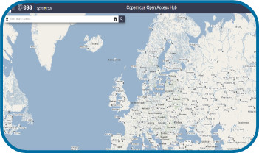
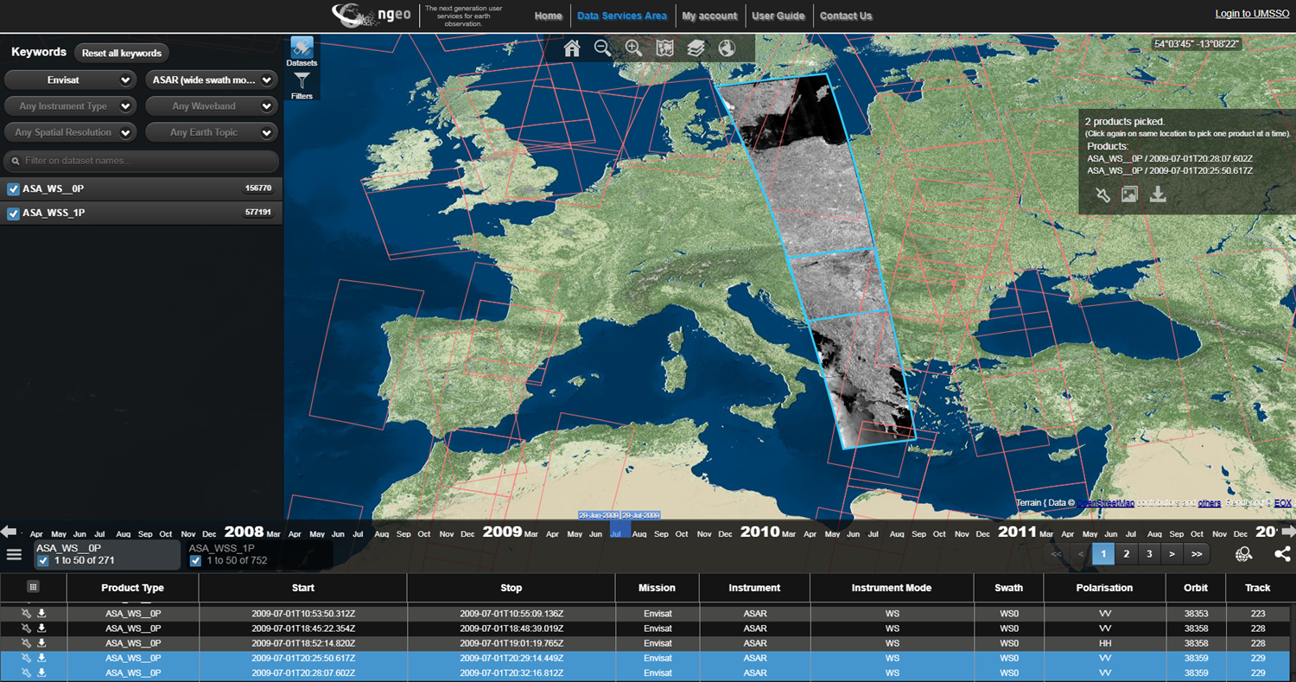
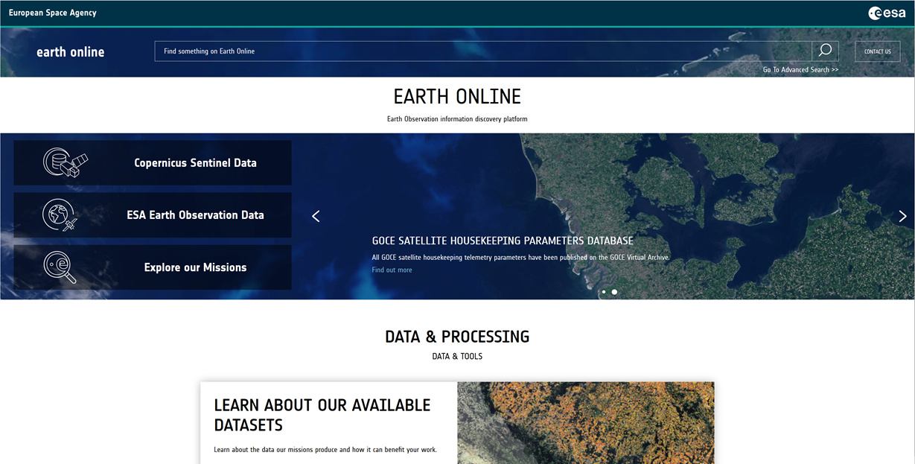
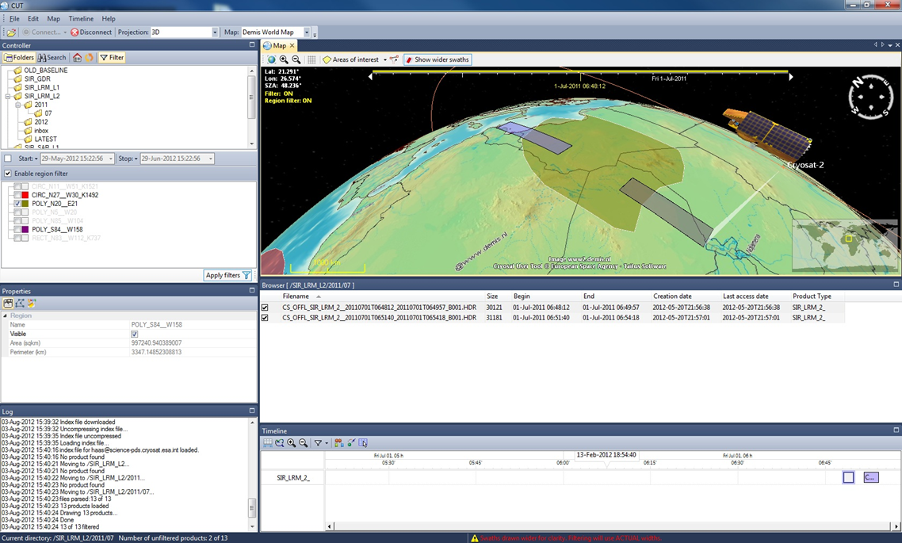
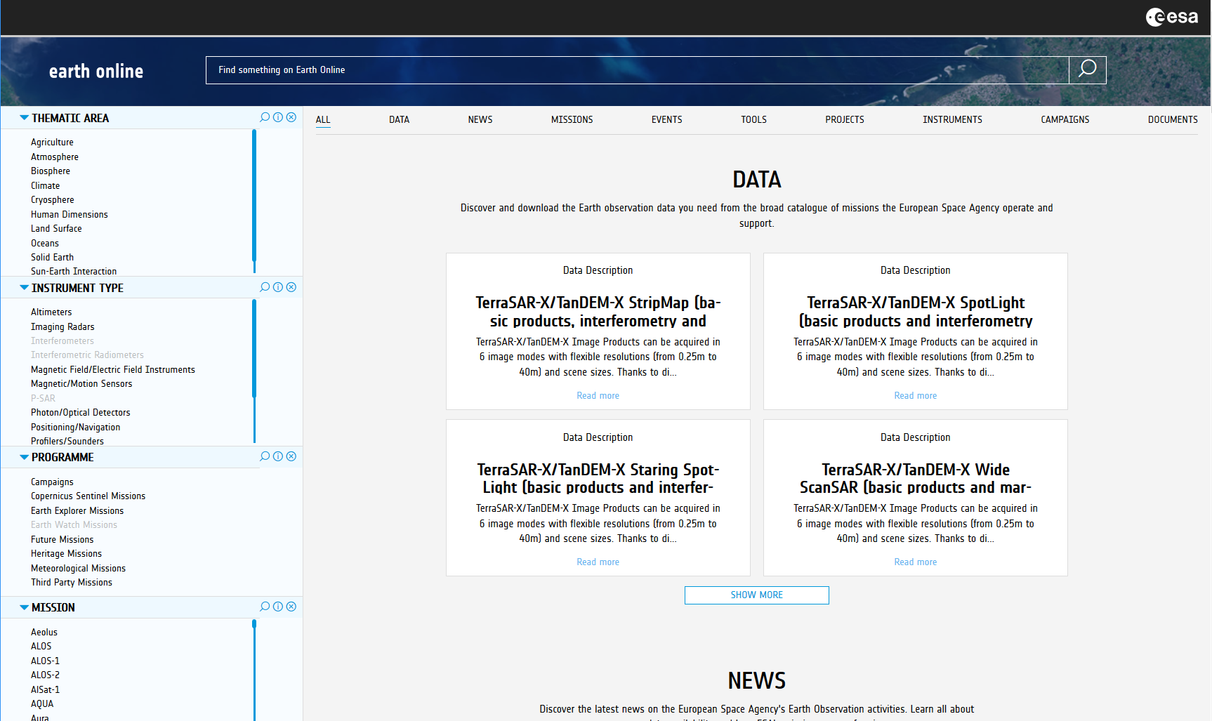
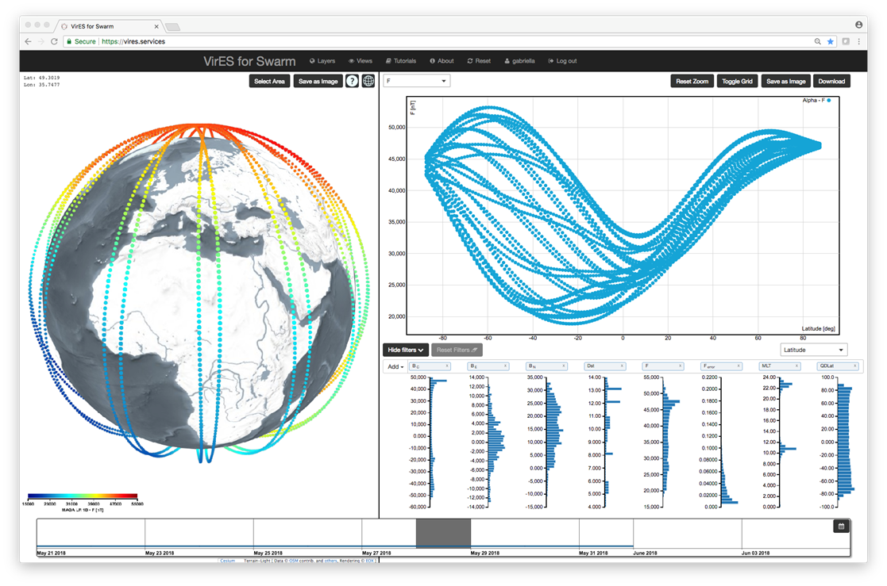
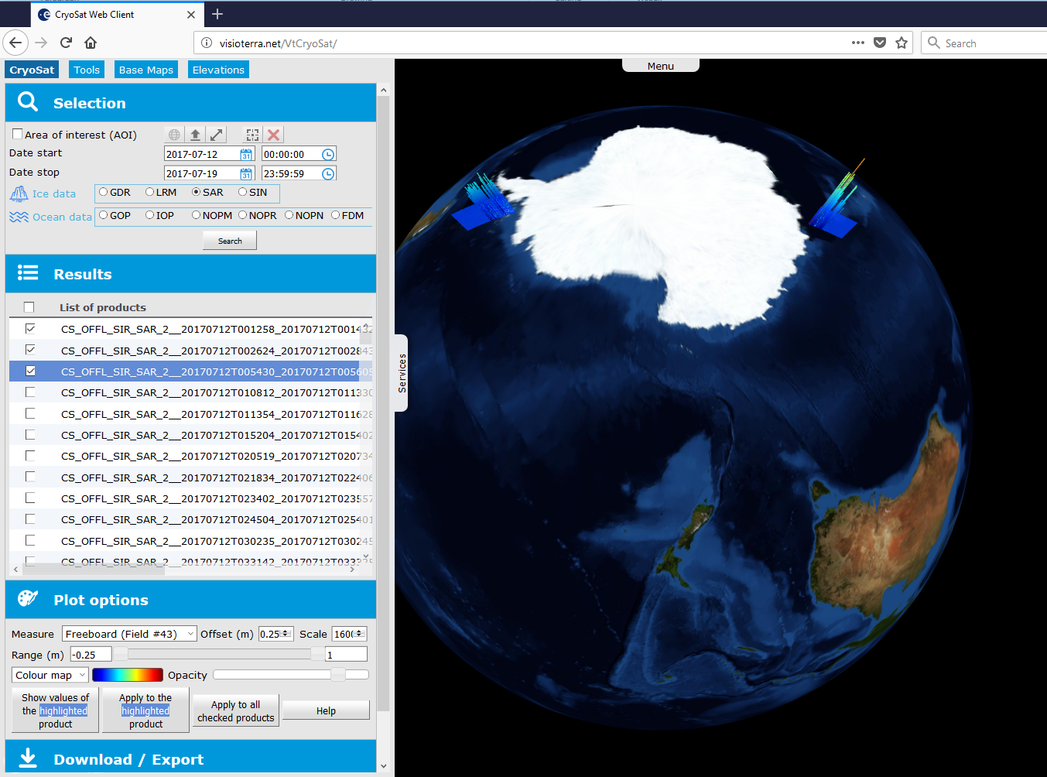
USER INTERFACES

Slide 11
Earth Online: achieved objectives
Agile development
Data catalogue integration complete
EO Thesauri integration complete
Content Owners engaged for review discussions and feedback collected

Slide 12
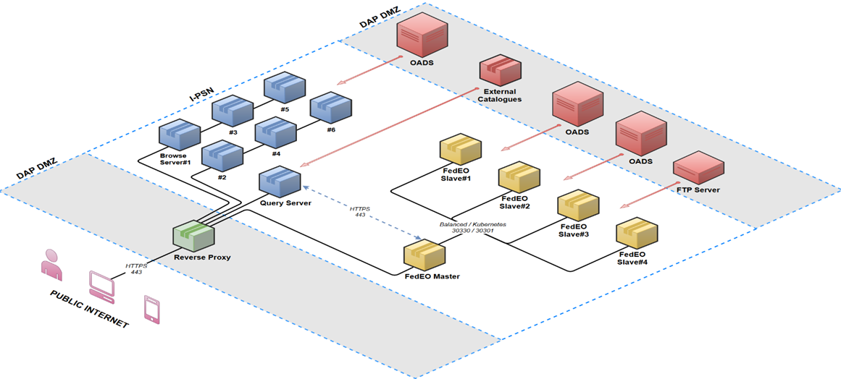
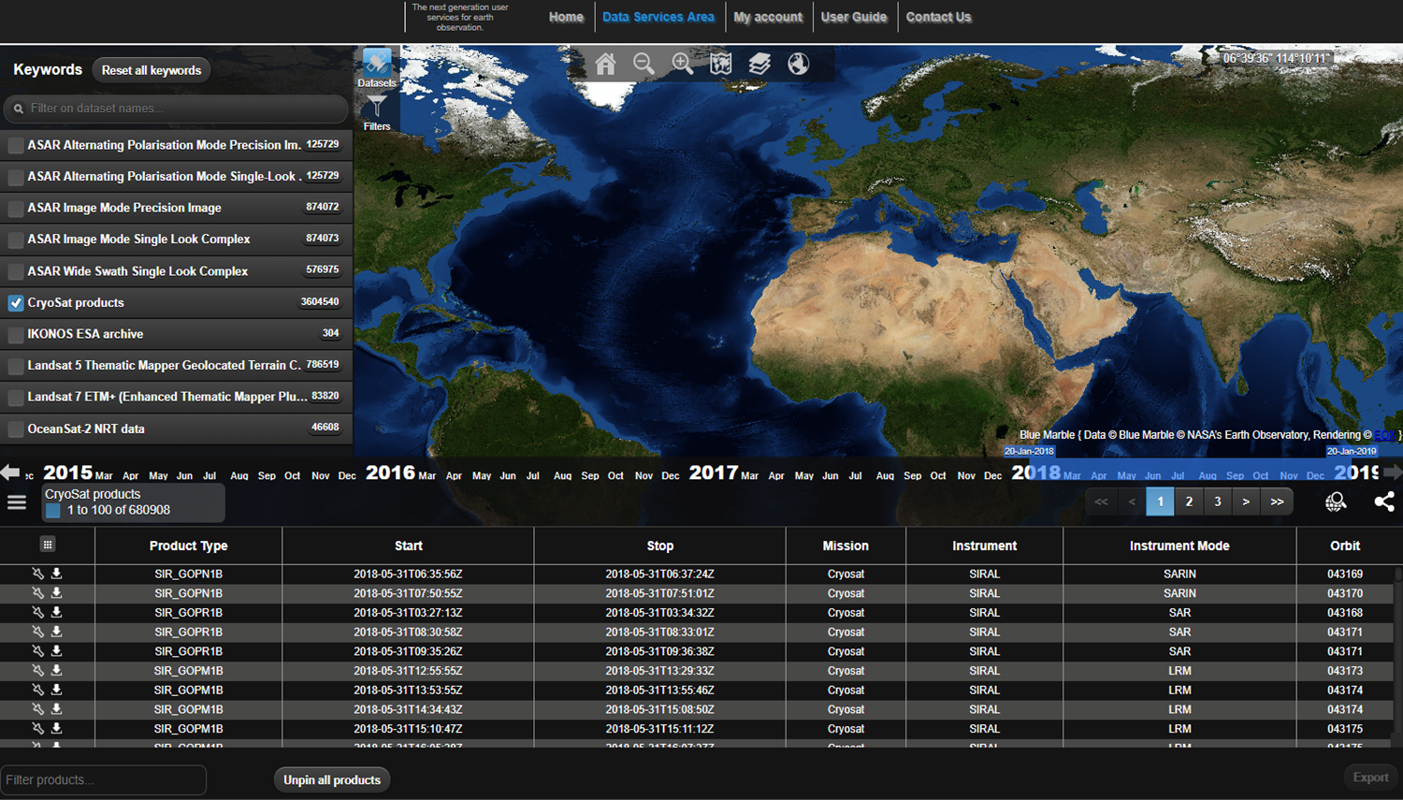
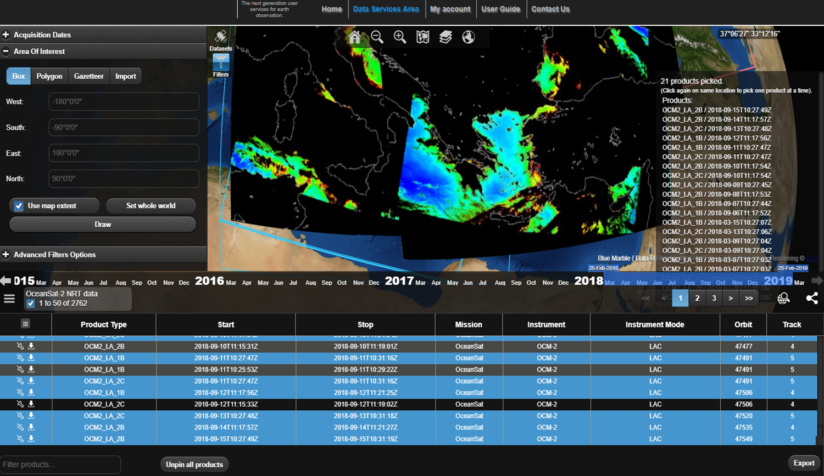
EO Catalog: achieved objectives
Modular and scalable architecture
Centralized catalogue for EO Data
User friendly access to search and retrieval
Based on standard opensearch interface

Slide 13
OPENING of NEW SYSTEM
On 27 April 2020, the new Earth Online website (earth.esa.int), will be presented in:
a redesigned graphical interface
a simplified navigation
mobile responsive design
powerful search functionality
advanced filtering by thematic areas, missions, and instruments
ESA’s data exploitation, enhanced by providing a wide range of data offers through the main catalogue — EO-CAT Web Client —

