Slide 1
ISRO-CEOS Data Cube Initiatives, Progress and Future Activities
Committee on Earth Observation Satellites
ARD and Datacube for BIMSTEC
D. Dhar & T. Shukla
Space Application Centre
ISRO

Slide 2
List of Activities
No. | Activity Name | Status
1 | Setup and Testing of Open Data Cube Core Software with IRS Datasets | Completed
2 | Refactoring & Feature addition to Open Data Cube Core for Disseminating Resourcesat Datasets | Completed
3 | Browser based visualization and Jupyter notebooks based analytics Support | Completed
4 | Atmospheric correction method development and validation to produce operational OSR dataset | Completed
5 | Automated OSR Dataset generation and internal validation | Completed
6 | OSR calibration and validation for Landsat-8 OLI and Resourcesat-2/2A Inter-operability | Various targets compared, Extensive comparison is On-Going
7 | Product Explorer and Catalog Service for Quick multi-source (RS-2/2A and L8) product visualization and download | On-Going
8 | Sample ARD processing for CARD4L Compliance | On-Going
9 | CARD4L self-assessment of Product Family Specs | On-Going
9 | Regular Interaction with LSI-VC Team to share progress and updates to PFS | On-Going
10 | BIMSTEC Datacube Generation | On-Going (Product collection and processing started)

Slide 3
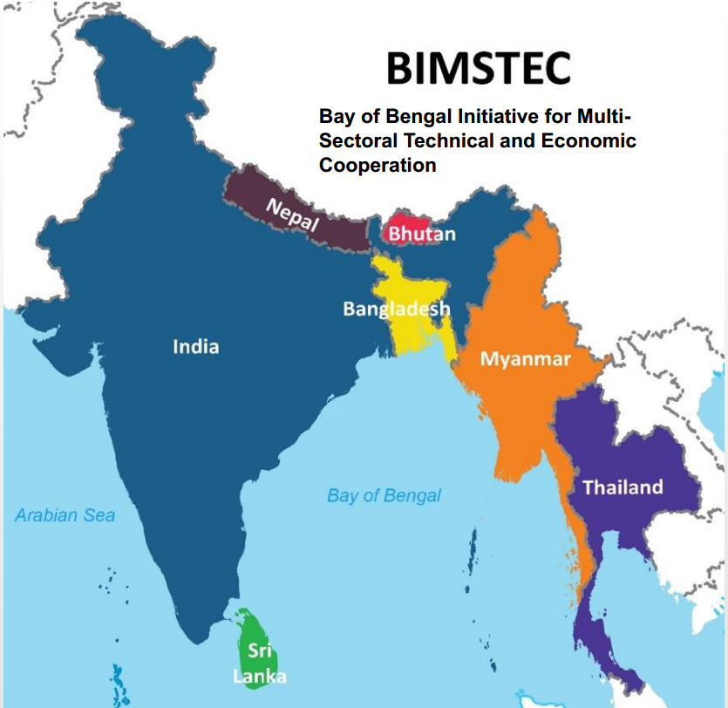
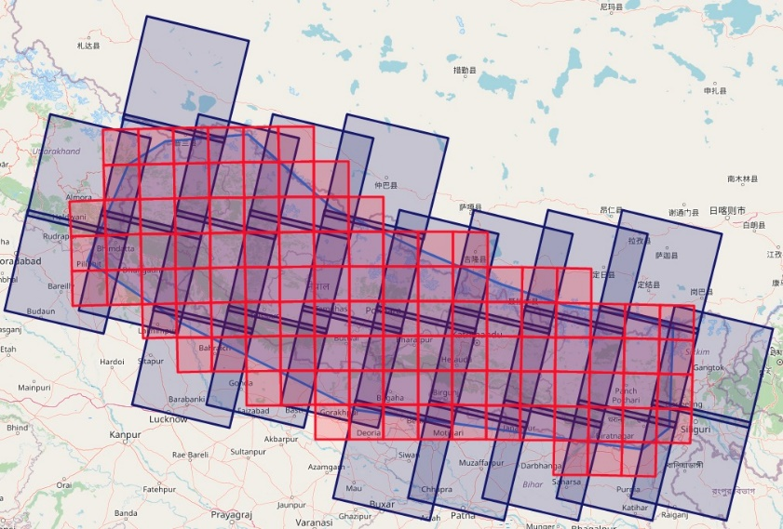
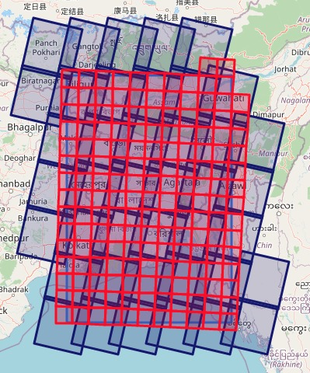
BIMSTEC DataCube
No. | Country Name | Total LISS-3 Path Row Combinations Covering country | ~Approximate Datasets RS-2 | ~Approximate Datasets RS-2A | ~Approximate Datasets IRS-P6 | Total Datasets (Approx.)
1 | Bangladesh | ~30 | 3650 | 1367 | 7299 | 12300
2 | Sri Lanka | ~12 | 1460 | 547 | 2919 | 4900
3 | Bhutan | ~10 | 1216 | 455 | 2432 | 4100
4 | Nepal | ~27 | 3285 | 1230 | 6569 | 11084
Nepal
Bangladesh

Slide 4
BIMSTEC Target Datacube Applications
Land
Water
Fractional Cover
LU/LC Detection/Change
Water Coverage
Crop Acreage
Urban Sprawl
PFZ Change Detection
Burned Area
Custom Mosaic
Coastline change
Forest Mapping/Change
Snow Coverage

Slide 5
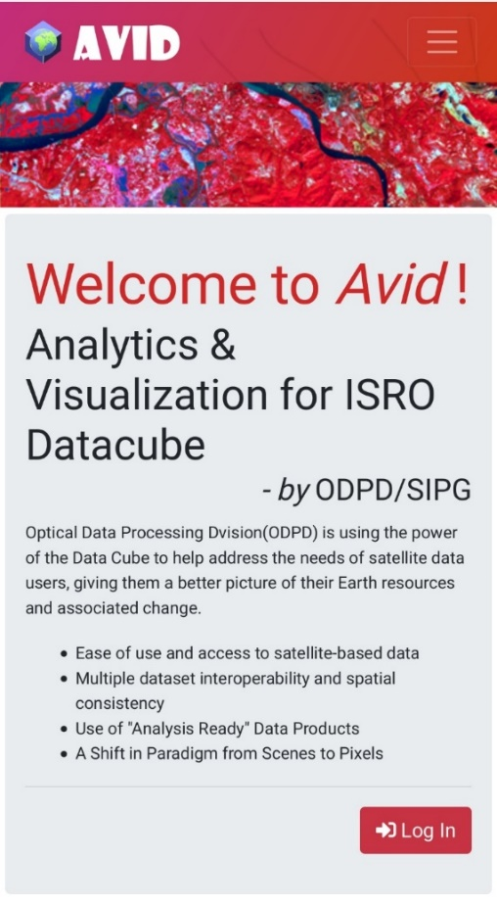
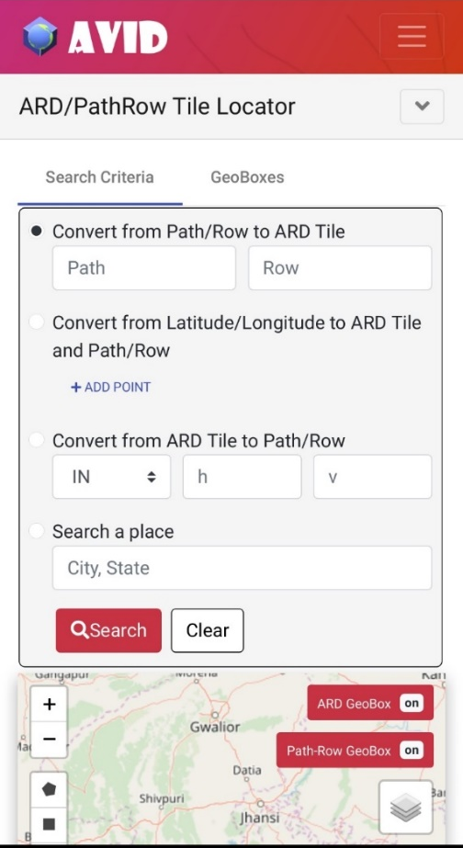
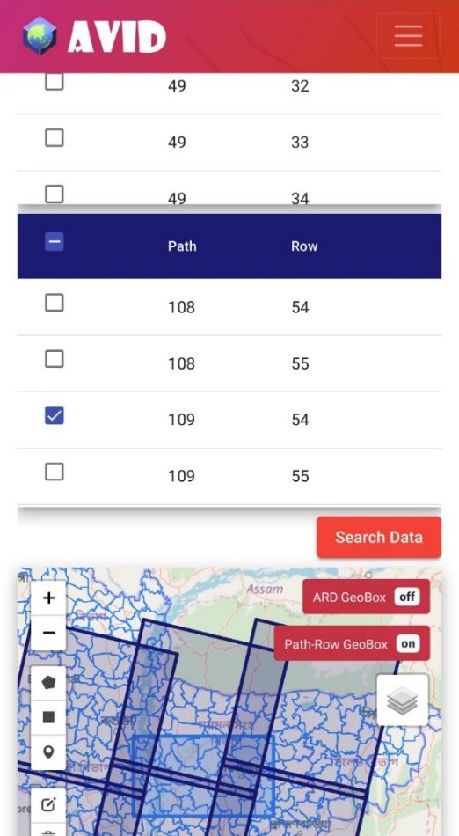
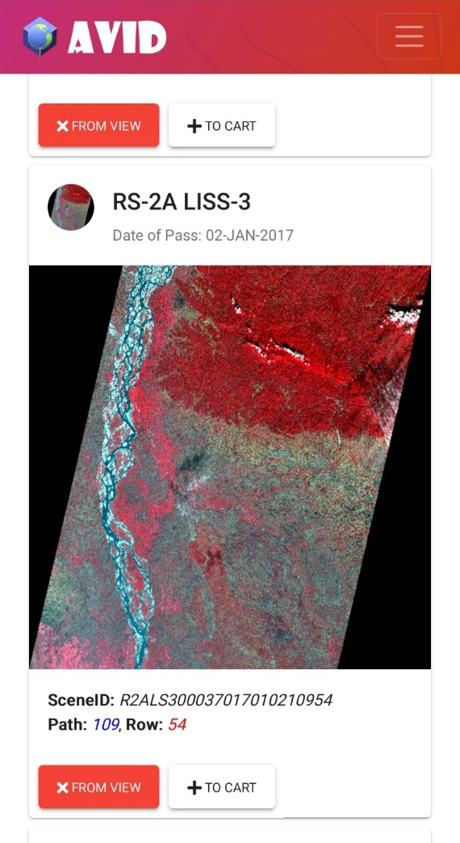
Landing Page for AVID (Analytical Visualization for ISRO Datacube)
Angular 9 is used as framework of choice for new DC UI.
Redux is used for every part in this application which stores the state of application whenever user interacts with UI. This also helps take some load of server as data from ajax calls is saved to store.

Slide 6
Task Composer Demo for AVID
Single Page for all Datacube Task has been developed so that multiple tasks can be fired and visualization on that same map.
Task details and Plot interaction is also available in this page itself.
Vega-lite grammar is used to plot visualization which allows advanced user interaction with plots.

Slide 7
Interactions with LSI-VC Team
The Idea to generate Landsat-8 OLI Datacube over BIMSTEC region along with IRS Datacube was proposed to LSI-VC team.
LSI-VC Team agreed to provide required data download and processing support for generating Landsat-8 OLI ARD over BIMSTEC. This would also provide the opportunity to generate Harmonized OSR between L8 & IRS.
LSI-VC Team provided SIPG Team updated self-assessment document for CARD4L Compliance.
OpenDataCube (ODC) team and ISRO team collaboration was discussed & put forward in motion at the latest LSI-VC telecon.

Slide 8
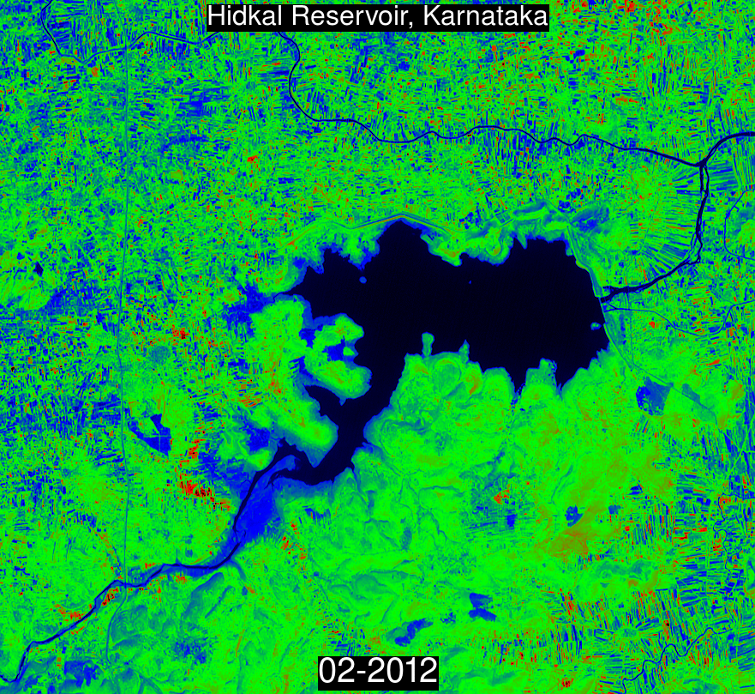
Thank you!
Animation : Time series animation from 2012 to 2018 RS2 LISS-3 of mentioned ROI

