Slide 1

WGISS Data Management and Stewardship Maturity Matrix
WGISS
Committee on Earth Observation Satellites
Iolanda Maggio – EMSS Support (ESA)
WGISS-49 Virtual meeting
21-23 April 2020

Slide 2
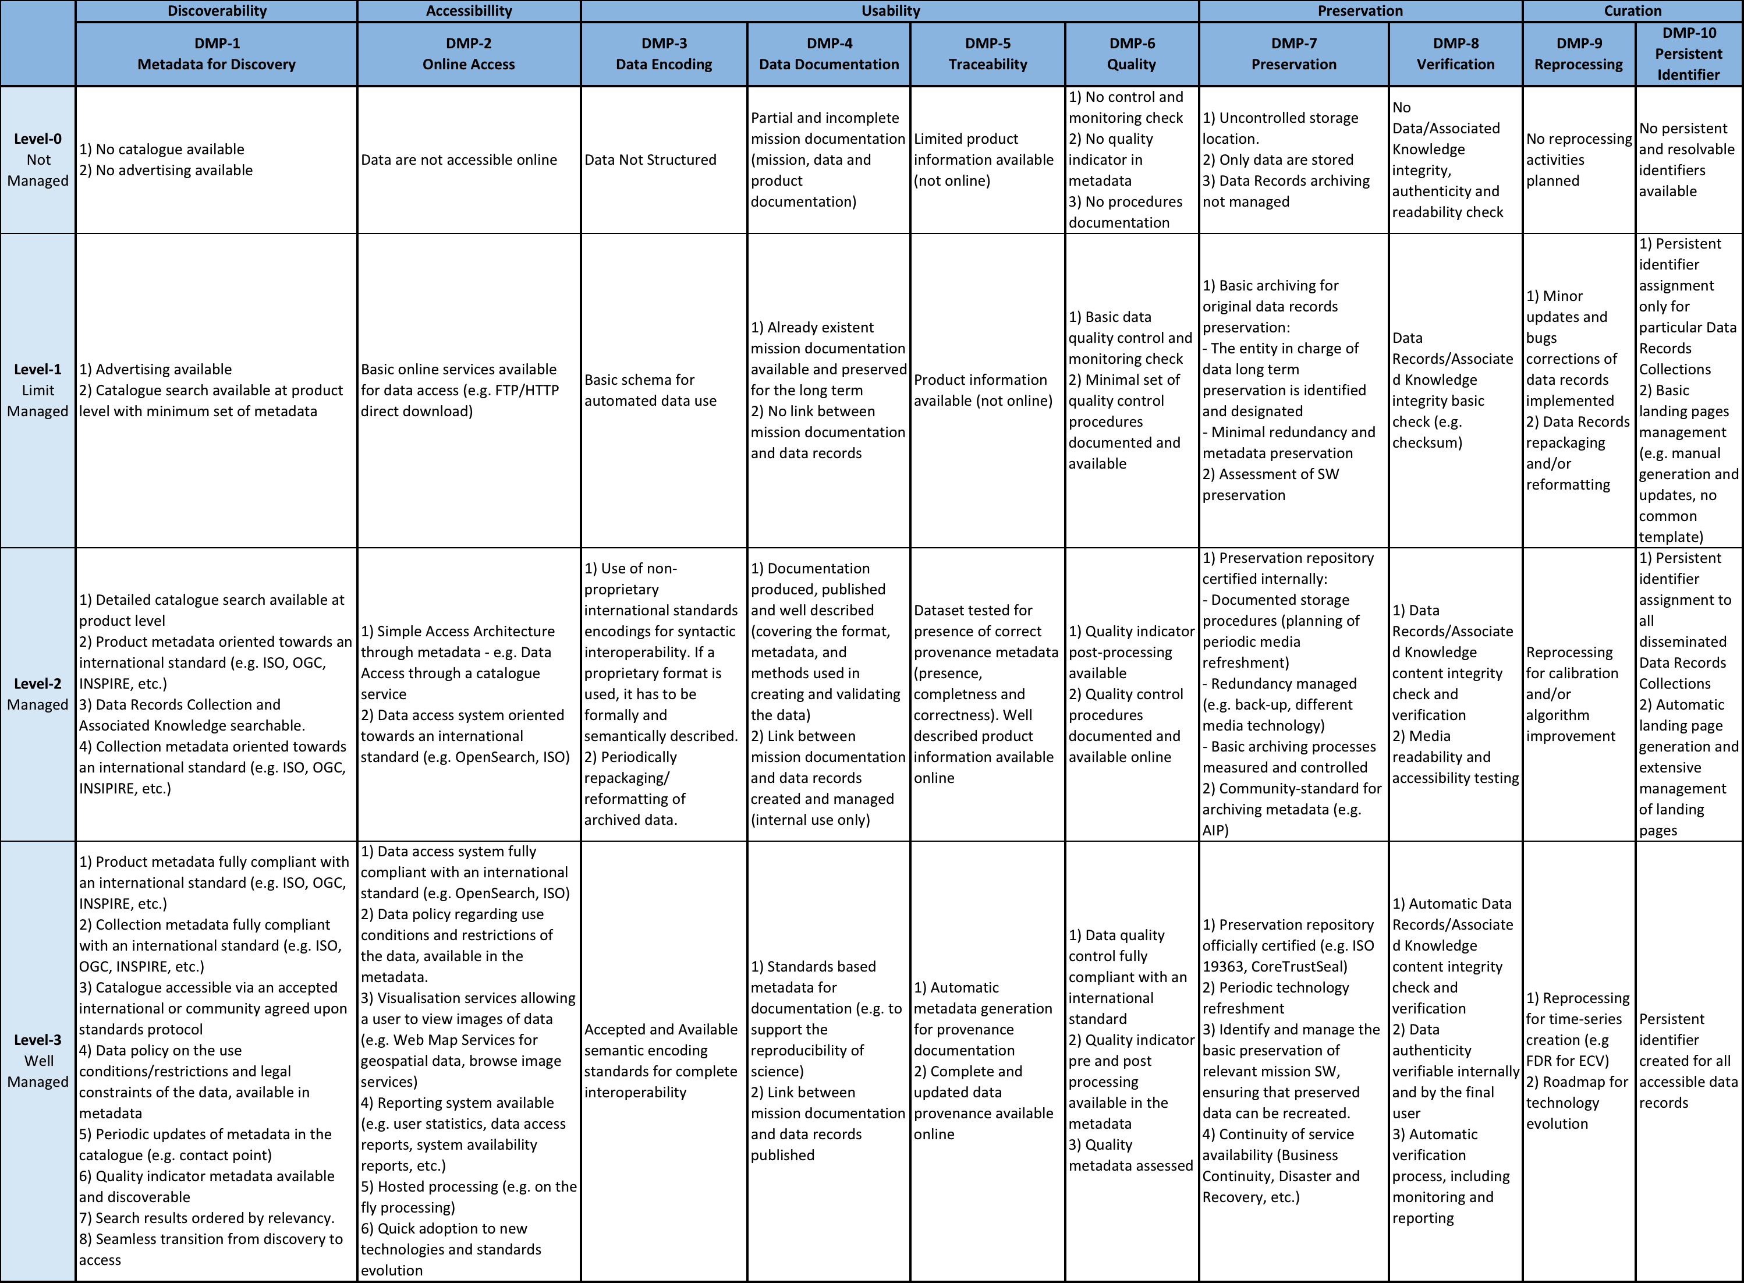
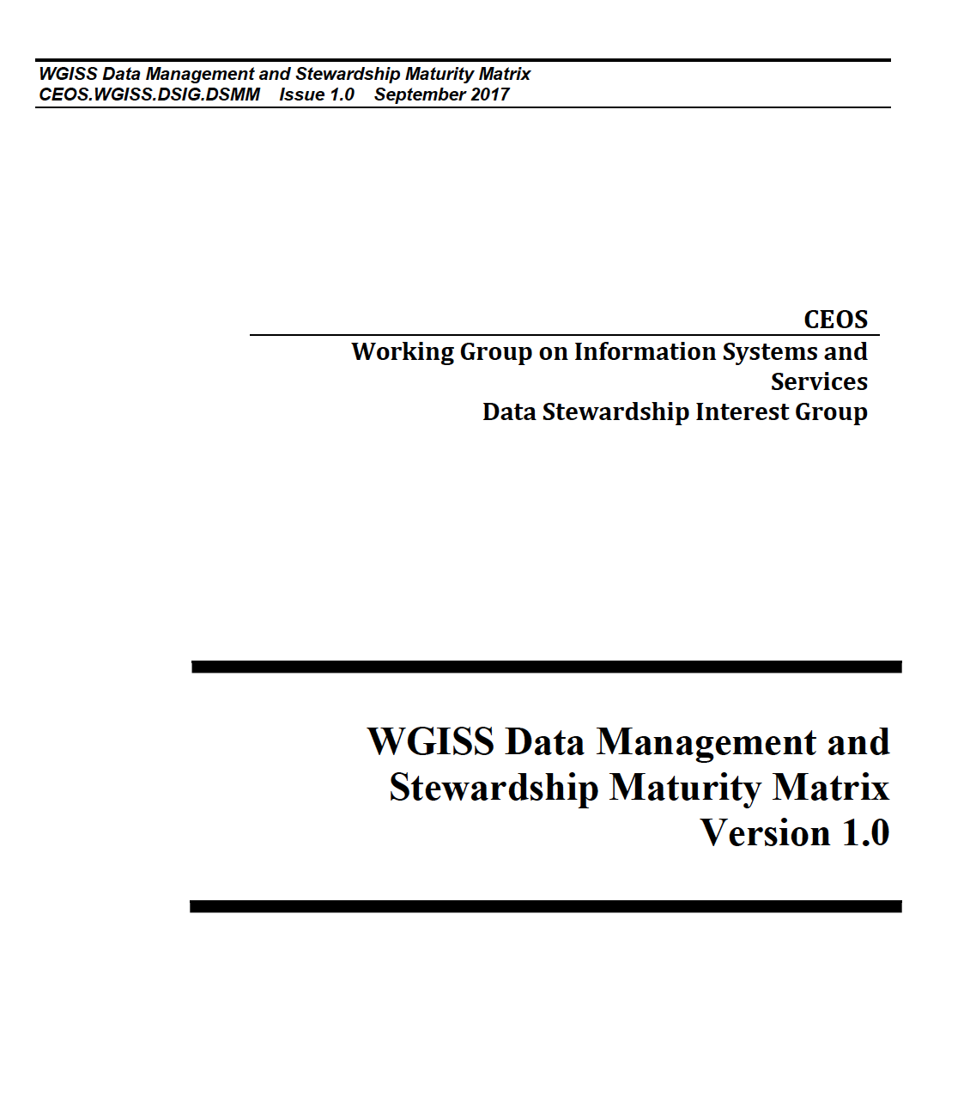
Data Management & Stewardship Maturity Matrix

Slide 3
Data Management & Stewardship Maturity Matrix – New Players

Slide 4
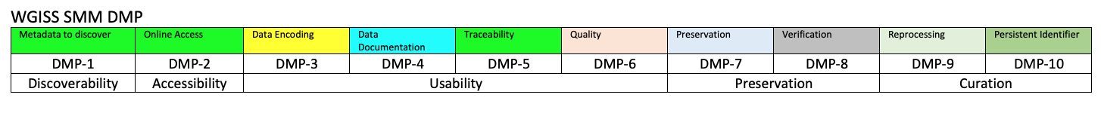
EDAP vs WMO vs WGISS
The same aspects in the different matrices are identified by the same color

Slide 5
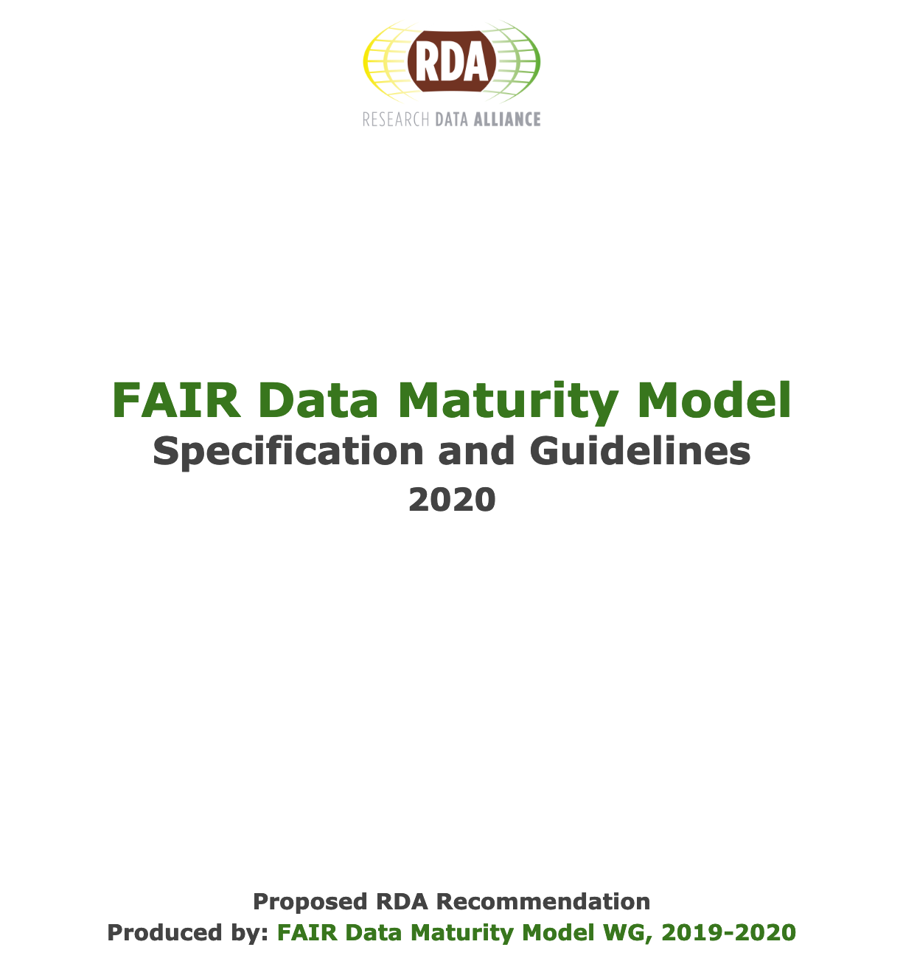
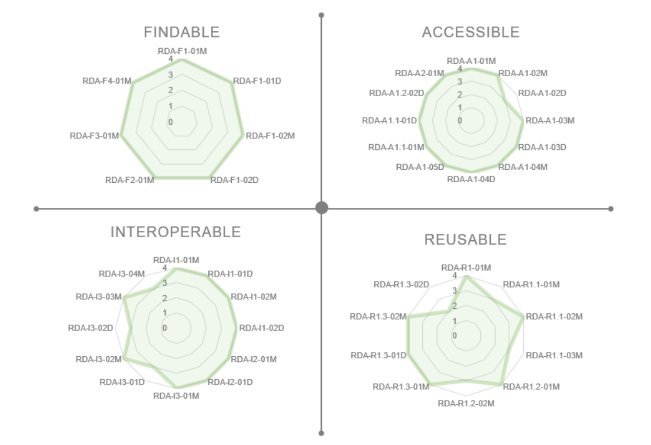
RDA FAIR Maturity Model Working Group

Slide 6
Major Changes Implemented
FROM WGCV INPUT:
Data Encoding improvement
New Data Quality components: Validation and Uncertainty
Data Preservation improvement
Data Processing/Reprocessing improvement
FROM RDA FAIR Maturity Model:
7 Findable: 5 indicators inclusion (2 already in the DMSMM)
12 Accessible: 2 indicators inclusion (10 already in the DMSMM)
12 Interoperable: 2 indicators inclusion (5 already in the DMSMM and 5 out of scope)
10 Reusable: 2 indicators inclusion (8 already in the DMSMM)

Slide 7
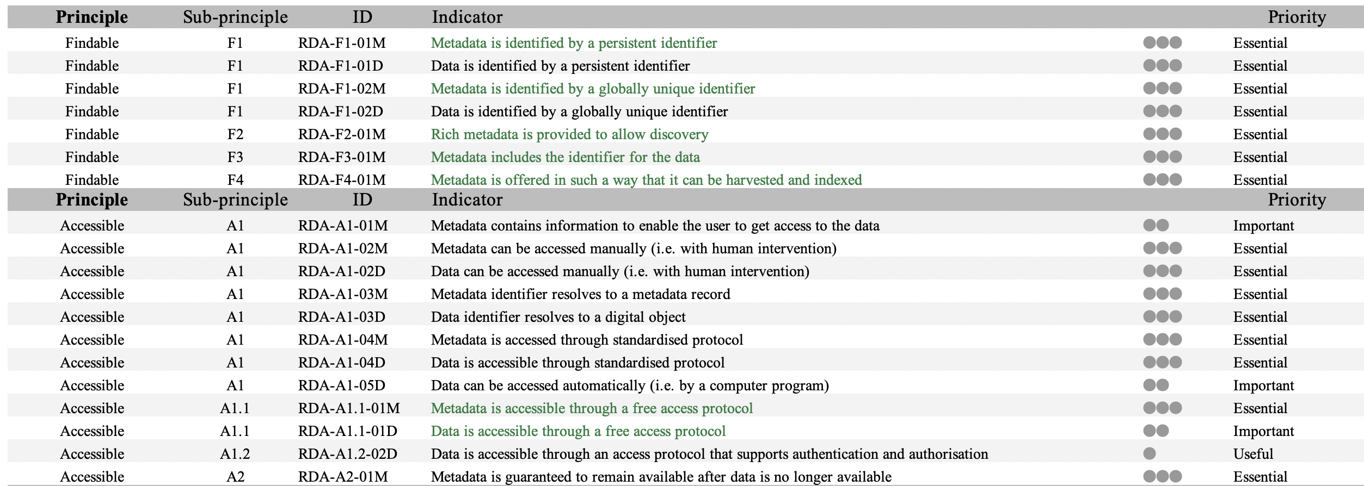
RDA FAIR Maturity Model

Slide 8
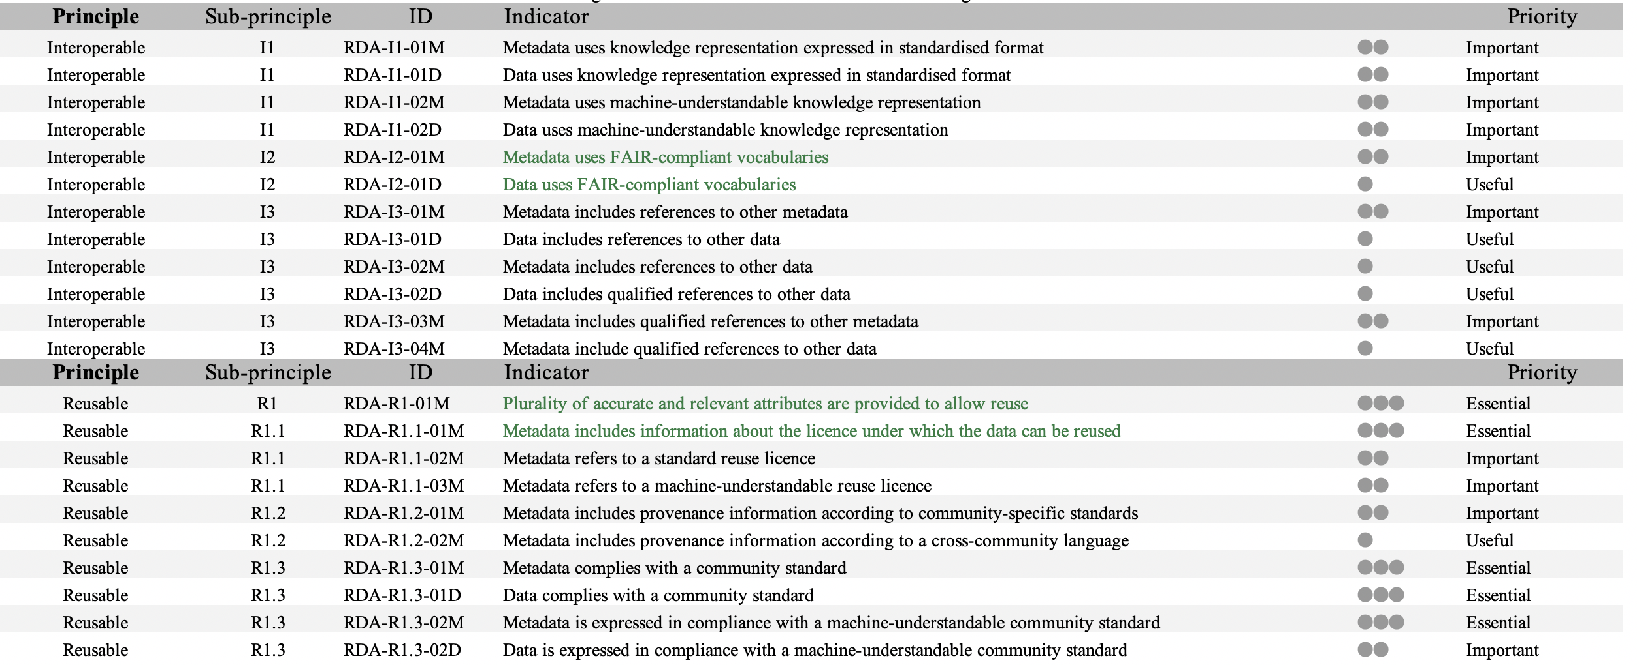
RDA FAIR Maturity Model

Slide 9
DMSMM 1.2 with Reviews

Slide 10
DMSMM 1.2
Text reduction ongoing to have a DMSMM more readable

Slide 11
Next Steps
WGISS Data Management and Stewardship Maturity Matrix 1.2 document has been circulated to WGISS exec members.
ACTIONS:
  ALL: WGISS Data Management and Stewardship Maturity Matrix 1.2 REVIEW by Mid of May
  IM: Integration of any comments and input by the End of May
  IM/PC: Find a way to define levels assigning quantitative values instead of qualitative by the End of June

Slide 12
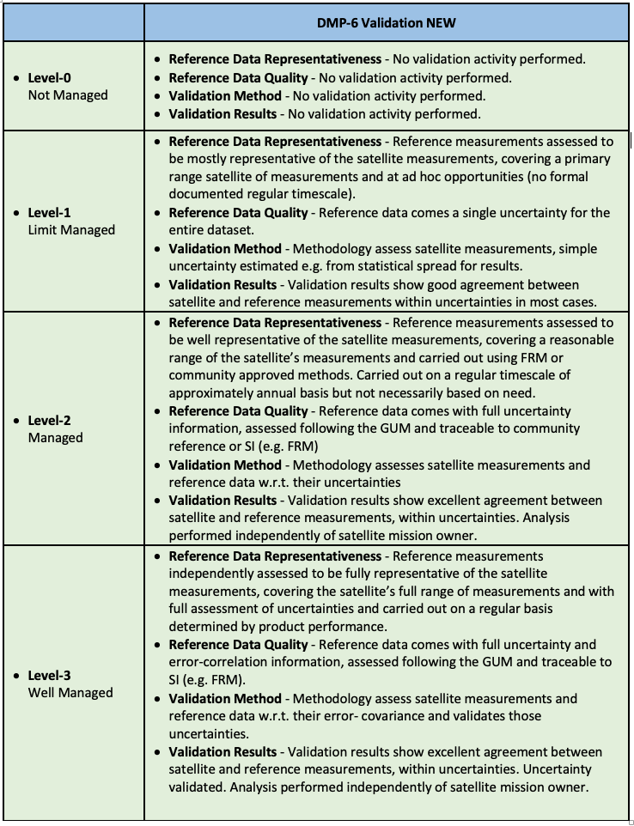
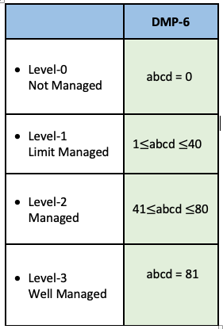
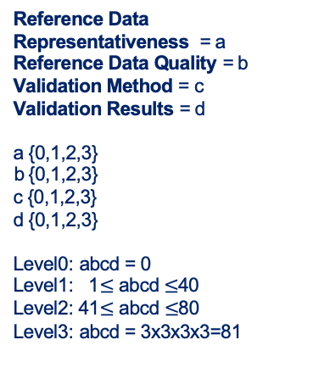
Way Forward
How to assign levels?
Level of maturity could be defined by filling a form i.e. responding to questions for single parameter
Example for DMP-6 Validation
Reference Data Representativeness = a
Reference Data Quality = b
Validation Method = c
Validation Results = d
a {0,1,2,3}
b {0,1,2,3}
c {0,1,2,3}
d {0,1,2,3}
Level0: abcd = 0
Level1: 1$≤$ abcd $≤$40
Level2: 41$≤$ abcd $≤$80
Level3: abcd = 3x3x3x3=81
Values assigned to each parameter according his level of maturity
Notes:
The idea is to find a way to define levels assigning quantitative values instead of qualitative indicators. Assuming a general topic e.g. DMP-6 (validation) depending by four paramaters, each one can assume a values from 0 to 3 according his level of maturity (e.g. Validation Results – No validation activity performed = 0, …good agreement …whitin the uncertainty = 1, excellent agreement within uncertainty. Analysis performed indipendently of the owner =2, excellent agreement within uncertainty. Uncertainty Validated. Analysis performed indipendently of the owner =3). The global level could be definited multiplying the values of the four parameters. Level will results from 0 to 81 where L0 =0 and Level3=81 and intermediate levels defined by two ranges. Note that different wheights could be assigned to the parameters and different ranges for the levels. The potential user will be, therefore, requested to fill a form responding to questions for each single parameter and this will automatically define the levels for the whole MM.

Slide 13


