Slide 1
Flood Pilot Update
Committee on Earth Observation Satellites
Guy Schumann, Remote Sensing Solutions
Andrew Molthan, NASA Marshall
Mitch Goldberg, NOAA/NESDIS
CEOS WG Disasters Meeting #14
1 September 2020

Slide 2
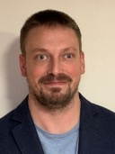
Co-Leads and Introductions
Dr. Guy Schumann, Remote Sensing Solutions
Principal Scientist at Remote Sensing Solutions Inc. His research and expertise focus around flood risk, from local to global scale, using flood modeling, prediction and remote sensing
Dr. Mitch Goldberg, NOAA/NESDIS
NOAA/NESDIS Chief Scientist
Led the NESDIS Satellite Proving Ground program to improve NOAA services
Dr. Andrew Molthan, Marshall Space Flight Center
Research Meteorologist at NASA Marshall, collaborates with NASA’s Disasters Program to help the disasters community use NASA data and tools

Slide 3
Pilot Goals
Objective A
Solicit input from CEOS partnering agencies and participants on current and upcoming efforts to map water and flood extent from diversity of LEO/GEO and SAR contributions
Objective B
Capture underlying requirements and future needs to sustain and improve upon these capabilities.
Objective C
Explore ideal combination of LEO/GEO/SAR flood mapping outputs, using representative regional events of interest to partners.
Develop and document best practices for combining and sharing flood information from multiple platforms with diversity in sensor, spatial/temporal resolution, etc.
Notes:
Objective C, second point, WGISS is an important link or vehicle & the Earth Analytics Interoperability Lab will be trialed as a data sharing platform

Slide 4
Highlights Since Last Meeting
WGDisasters Meeting in March (virtual)
During a one-day session, established case studies of interest for optimal combination of optical imaging from geostationary and polar orbit, and complementary SAR observations.
Virtual Follow-Ups
Through email exchanges, we identified regional case studies with CEOS Flood Pilot partners diverse across impacted regions and emphasized local types of flood challenges
Monthly Tag-Ups
Beginning in June, a recurring monthly tag-up to update participants and share outcomes of ongoing case study work.
Developing formal Pilot documentation required by CEOS and identifying needs for data sharing and processing platforms.

Slide 5
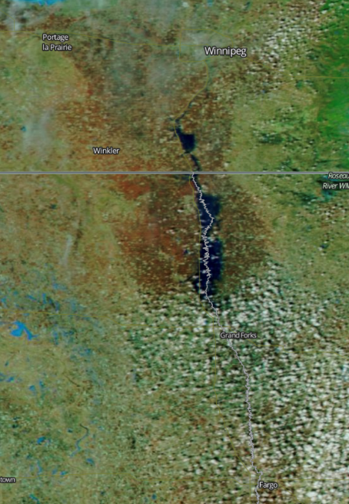
Red River of the North
Winter-Spring 2020
Seasonal, significant flooding often due to rapid snowmelt and rainfall in late winter and early spring
Unique advantages for SAR in helping penetrate cloud cover
Optical NIR/SWIR help to separate water, snow and other features
Expected Outcomes
SAR-based maps of flood extent generated through Radarsat-2 and Radarsat Constellation Mission (RCM) imaging
GEO and LEO optical imaging provided by GOES ABI and JPSS/VIIRS instruments
Additional flood mapping available from Sentinel-2 and Landsat imagers
Commercial data (Planet) exploration potential through the NASA (TBC)
Explore combinations of optical/SAR for individual daily and maximum extent mapping
Winnipeg
Fargo
NASA MODIS via Worldview
Status and Level of Effort
Data Needs, Challenges, and Risks
Leads: NRCan, NOAA, NASA
Radarsat-2 and RCM maps have been developed for recent extremes in April 2020, along with products available from ABI/VIIRS instruments
Additional mapping available from Sentinel-1
Pursuing data access through other platforms, including Sentinel-2/Landsat and Planet
Seeking other SAR data to expand frequency and polarization diversity; coherence-based approaches.
Identify in situ data for individual daily product validation and maximum flood extent through high water marks or other approaches.
Additional data collection potential
DigitalGlobe/Planet Labs imaging
Commercial SAR collections
Civil Air Patrol / other aerial imaging or information shared via social media

Slide 6
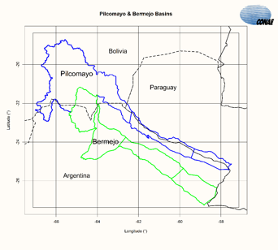
Picomayo and Bermejo Transboundary Basins
July 2020 (TBC)
Shared by Argentina, Bolivia, and Paraguay (Pilcomayo) and by Argentina and Bolivia (Bermejo) with basin headwaters in the Andes Range.
2.5M people, extreme poverty, with annual floods December to April from heavy rain in Bolivia
Expected Outcomes
SAR-based mapping of flood extent from events of interest, complemented by GEO and LEO via GOES/ABI and JPSS/VIIRS
Additional flood mapping available from Sentinel-2 and Landsat imagers
Commercial data (Planet) exploration potential through the NASA (TBC)
Collaborations among affected partners to better understand needs for data sharing, flood mapping, and response efforts
NASA MODIS via Worldview
Status and Level of Effort
Data Needs, Challenges, and Risks
Leads: CONAE
Regional Partners: Regional Commission of the Bermejo Basin (COREBE, Argentina)
SAOCOM data available for sharing but similar flood events have not yet occurred in this area during mission time.
Look for additional in situ data to help characterize success of mapping efforts.
SAOCOM data available to be shared but a major flood event has not yet occurred in this region in the SAOCOM database.
Additional data collection potential
DigitalGlobe/Planet Labs mapping available through NASA Commercial Data Buy
Interest in in-situ data from partners, topographical data, past event mapping and understanding of human factors.

Slide 7
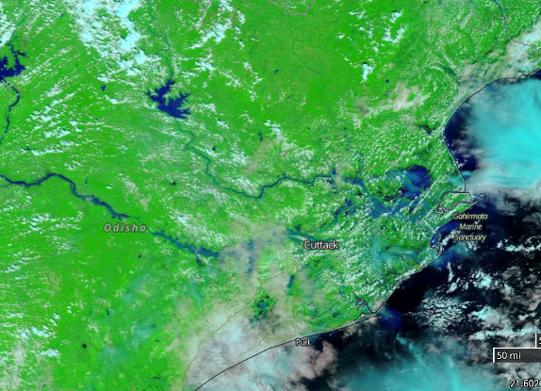
Mahanadi River Delta – Coastal Flooding
Cyclone Amphan (2020) or Cyclone Fani (2019)
A large, relatively flat and expansive basin in eastern India, the Mahanadi experiences flooding from heavy monsoonal rains, typhoons, and related storm surge
Recently impacted by Typhoon Amphan, in addition to past storm events
Expected Outcomes
Improved capability to map flood extent from combined optical and SAR; continued development of algorithms to benefit during NISAR operations period
Produce flood inundation maps, hazard maps, vulnerability maps, and combine with available flow data and other in situ observations
NASA MODIS via Worldview
Status and Level of Effort
Data Needs, Challenges, and Risks
Leads: ISRO
Region of interest and potential events have been defined, need to bring together available data sets from free and open sources or those shared (Sentinel-1, geostationary/LEO, Landsat/Sentinel-2) and others
In situ data needed for flood observations at any given time and to understand maximum extent or high water mark coverage
Looking for additional data coverage from multiple sensors including ASTER, CARTOSAT-1, ALOS DEM, CARTOSAT-2 high resolution images, Radarsat-1, 2 and RISAT-1 images and Sentinel-1 A/1B datasets
DigitalGlobe/Planet Labs mapping may be available through NASA Commercial Data Buy or other Charter assets

Slide 8
Pearl River Basin – Urban, Coastal Flooding
Late August 2018
The Pearl River Basin experiences heavy rainfall from coastal storms (cyclones, typhoons) and heavy interior rainfall events
Events have included Typhoon Rumbia and other major storms in the region
Expected Outcomes
Leverage imagery from Chinese optical remote sensing satellites
GF4, HJ, ZY, each providing resolutions of 5-30 m and multispectral bands of VIS-MWIR
Explore benefits of using GF3, a multi-polarized C-band SAR sensor offering resolutions of 5-50 m
NASA MODIS via Worldview
Status and Level of Effort
Data Needs, Challenges, and Risks
Leads: Chinese Academy of Sciences (CAS)
Regions of interest and some preliminary events have been identified in 2018, may also be able to use most recent flooding event in 2020.
Collaborations with other data partners on any available in situ data for validation, imagery collections through partners and/or the Charter
Expecting heavy use of Chinese / China Academy of Space Technology assets for optical and including SAR imaging capabilities

Slide 9
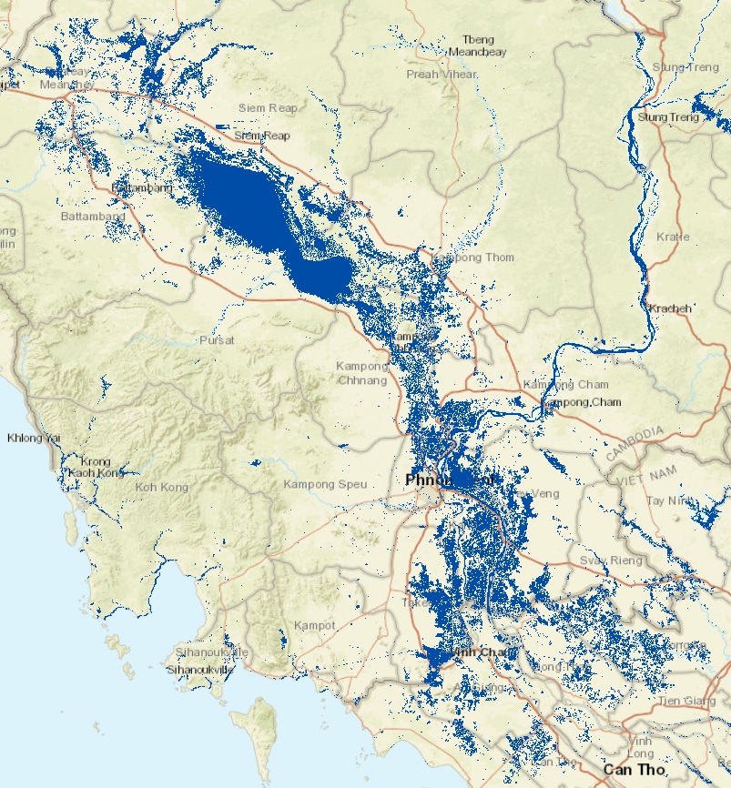
Myanmar – Automated Flood Detections
2019 Monsoon Season
Expected Outcomes
Seeking to understand flood risk at large scales and establish risk profiles via satellite archive.
Strengthen emergency response efforts.
Partner with the World Bank to enhance use of satellite-derived information in the disaster risk financing sector for SE Asia
Strengthen emergency response through parametric insurance modeling that looks to expedite pay-out based upon clear and transparent rule sets
Use multi-temporal SAR and other complementary images to improve water mapping
Status and Level of Effort
Data Needs, Challenges, and Risks
Leads: Luxembourg Institute of Science and Technology (LIST)
Past work has examined mapping the extent of permanent water bodies, separating permanent water from flood extent, and relating flood events to impacts via population and other human settlement information
Adapting InSAR coherence imagery to improve the performance of flood detections in urban areas and the urban-suburban-rural interfaces, also for regions with extensive vegetation
Increased sampling rate of imagery over the region through a multi-sensor approach (e.g. incorporate Radarsat-2, Sentinel, others) as well as combined radar and optical data
Explore additional L-band wavelengths to improve detections within vegetated regions and to prep for ESA’s ROSE-L mission

Slide 10
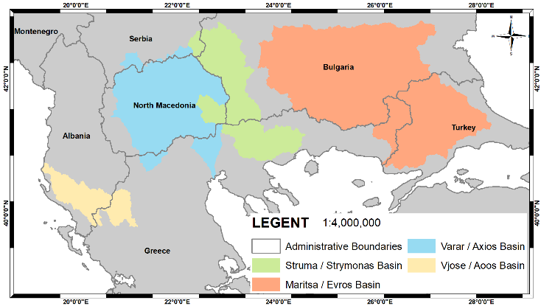
South Balkan Basins -- Transboundary
Late August 2018
Expected Outcomes
Major basins spanning political boundaries benefit from routine Earth observations and flood mapping
Improved integration of LEO, GEO and SAR with an emphasis on water and flood mapping in these transboundary basins
Capture underlying physical processes and causes contributing to major regional flood events.
Demonstrate operational utility of EO specific to hazards and risks in the region
Status and Level of Effort
Data Needs, Challenges, and Risks
Leads: Harokopio University (Greece) Earth Observation Team (HUA EO Team)
Previous work in the region has examined SAR analysis and multi-temporal approaches to extract features of interest
Multi-temporal optical and SAR images, SAR amplitude imagery to assist with mapping of permanent water versus floods.
Interferometric coherence based upon SAR (InSAR) and additional polarimetry processing, wavelength diversity.

Slide 11
Pilot Proposal to CEOS
Formal statements of CEOS Flood Pilot goals, partners, objectives, and timelines are being developed as an Implementation Plan for review by CEOS leads.
Key Milestones:
2020-21
Begin regional studies; collect data; establish relationships
2021-22
Provide derived products to users for feedback and explore refinement of monitoring strategies. Initial evaluation of pilot results to GFP and international conferences.
2022+
Develop reports from users on derived products, best practices, and evaluate results from study sites. Explore whether broader EO strategies can be developed.
Notes:
In these reports, experiences with the EAIL (WGISS) will be described.

Slide 12
Upcoming Activities
The Flood Pilot has a recurring monthly meeting among partners to discuss progress and needs for regional case studies.
Next: 21 September at 1300 UTC
WGDisasters Data Coordination Team (DCT)
Action to regional case study leads to examine data needs and inventory for work with the DCT for provision and sharing.
Data Access / Platform Contributions
Ongoing discussions with CEOS/WGISS team on potential use of data interoperability and sharing platform, cloud-based hosting and processing of data

Slide 13
Questions and Discussion
CONAE/SAOCOM Contributions
Team members are interested in learning more about SAOCOM data available for recent and upcoming events via CONAE
Thoughts or updates on data availability and sharing?
Commercial Contributions
Separately, some regional case study leads and partners are interested in commercial imaging capabilities from both SAR and optical, and how these contributions may provide routine or post-event validating information

