Slide 1
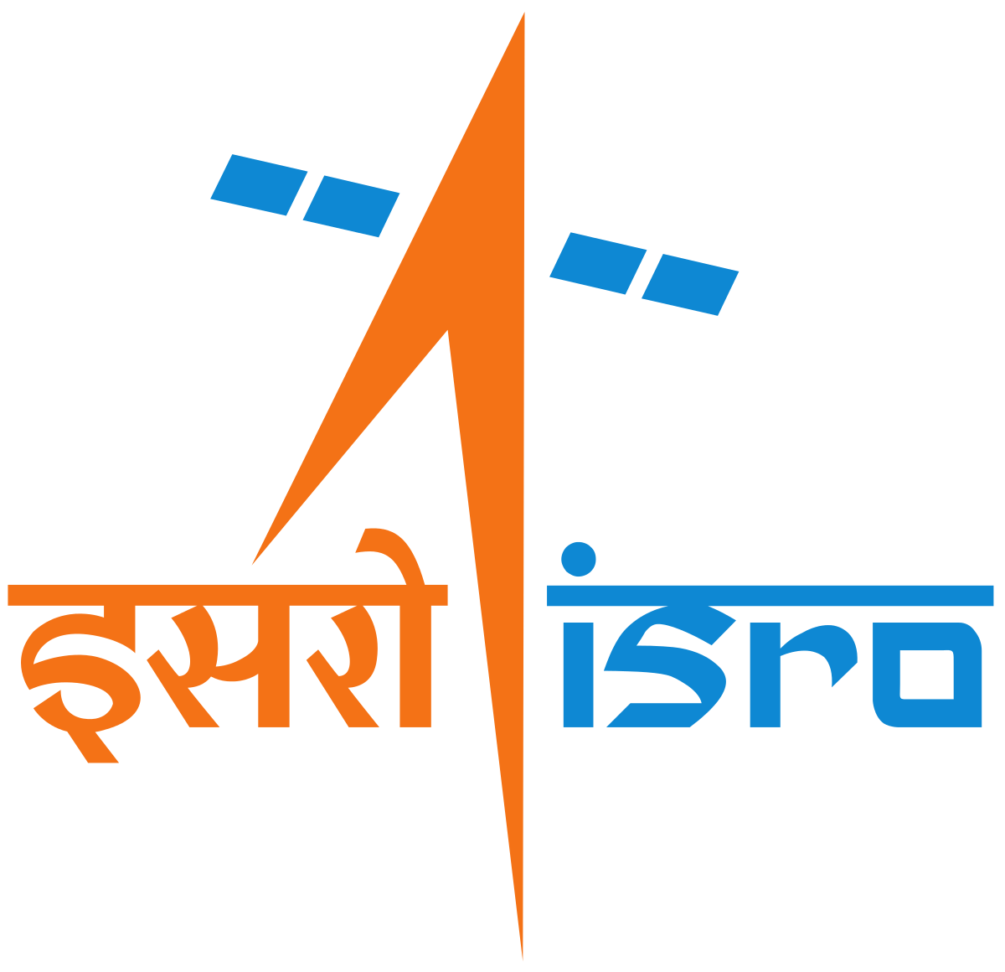
CEOS EAIL Rice Project Proposal
Shin-ichi Sobue
JAXA

Slide 2
CEOS Activities Related to Rice Monitoring
GEOGLAM
Asia-RiCE – rice monitoring component for GEOGLAM.
APRSAF Space Applications for Environment (SAFE) Rice Crop Project.

Slide 3
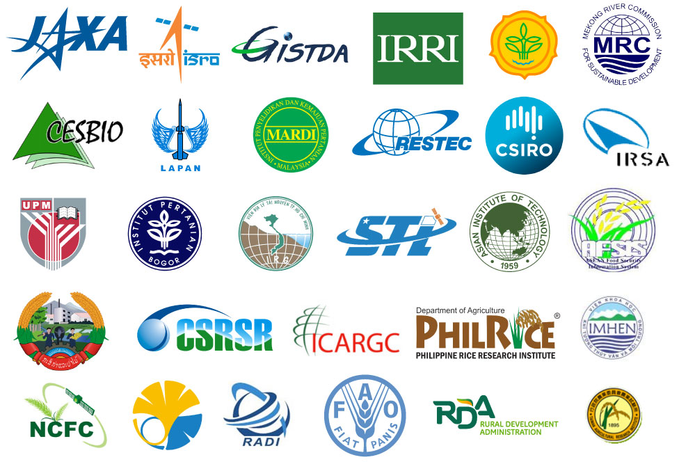
And numerous related organisations engaged...

Slide 4
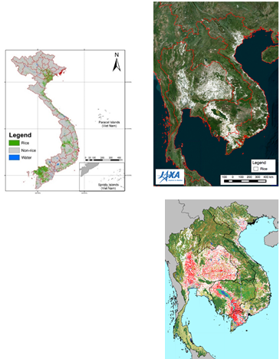
Unique challenges
Rice monitoring in Asia often uses Synthetic Aperture Radar (SAR):
Cloudy and rainy conditions during rice growing season
Variation in backscatter amplitude with polmetry through crop growth cycle → growth stage analysis
SAR presents its own challenges:
Data volume
Pre-processing and analysis difficulty
Interoperability of different SAR bands (C/L/X)

Slide 5
EAIL Opportunity
Bring together:
CEOS Earth Analytics Interoperability Lab
CEOS Analysis Ready Data for SAR
Rice crop monitoring community + tools (GEOGLAM / Asia-RiCE / APRSAF-SAFE)
To:
Explore use together in a Future Data Architecture
Answer questions on interoperability of SAR for rice
Demonstrate power of cloud-based, collaborative analysis platforms and associated data

Slide 6
Objectives
Explore interoperability of C/L/X-band SAR CEOS ARD for rice.
Provide feedback on CARD4L SAR PFS.
Port tools and scripts developed through GEOGLAM / Asia-RiCE / APRSAF-SAFE for use in the cloud.
Demonstrate utility and benefits of a cloud-based collaborative working environment to agriculture society.
Provide a platform for information and product exchange and sharing.
Put into practice data sharing agreements and mechanisms.
Develop practices for product cross-comparison and validation.

Slide 7
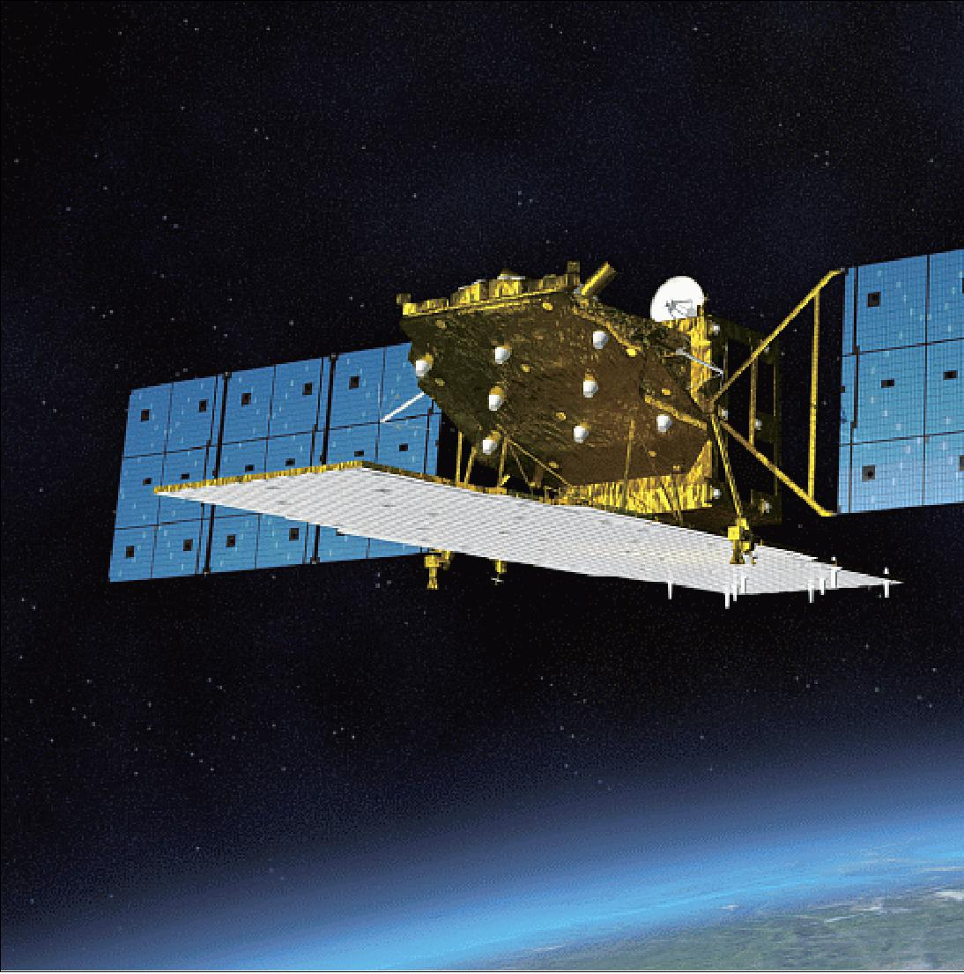
Data
ALOS-2 PALSAR-2 ScanSAR ‘ARD’ from JAXA
Sentinel-1 (Google Cloud or AWS, perhaps via Sinergise tool)
Thailand Earth Observation System (THEOS) -1 aka THAICHOTE high-resolution optical data from GISTDA
GISTDA’s rice planted area maps in Thailand (TBC)
ISRO’s EO data and rice products in South Asia(TBC)
VNSC’s rice planted area maps in Vietnam (TBC)

Slide 8
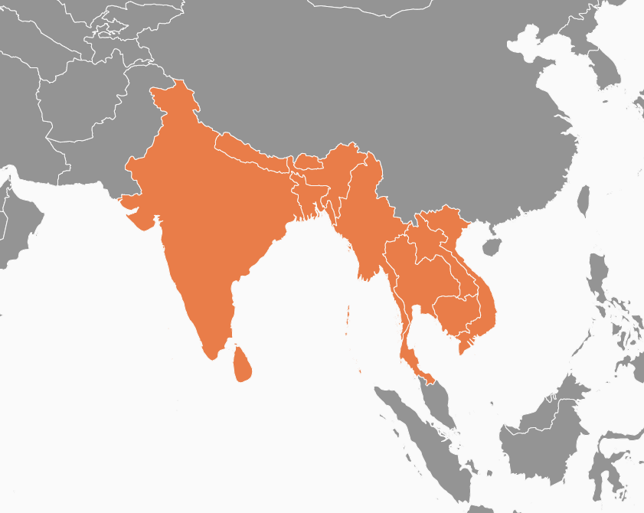
Study Areas (tentative)
Selected area for cross validation and comparison (e.g. Thailand, Vietnam, India, etc.)
BIMSTEC region (ISRO focus) - CEOS 2020 chair initiative
Lower Mekong region (VNSC focus) - CEOS 2019 chair initiative

Slide 9
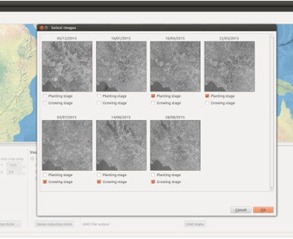
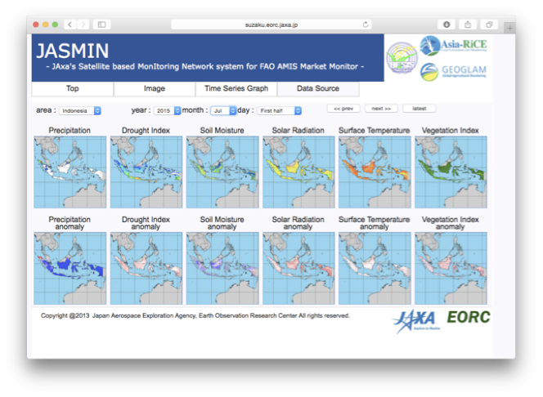
Analytics / Tools
JAXA’s INAHOR (INternational Asian Harvest mOnitoring system for Rice, crop planted area estimation software) tool.
Python-based, with Scikit-learn
SAR data i+ machine learning approaches
JAXA’s Satellite based MonItoring Network system for FAO AMIS Market Monitor (JASMIN)
satellite derived agrometeorological information
precipitation, drought index, soil moisture, solar radiation, land surface temperature, and vegetation index.
ISRO / GISTDA / VNSC / others’ tools

Slide 10
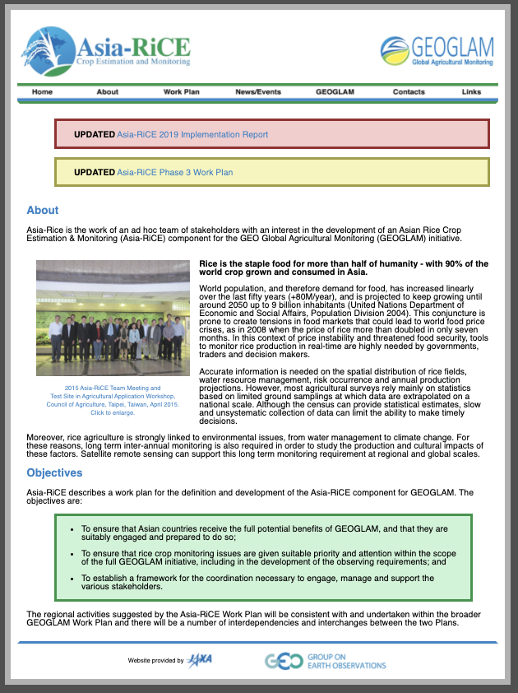
Contacts and Links
Contacts:
sobue.shinichi@jaxa.jp
ohyoshi.kei@jaxa.jp
Links:
http://asia-rice.org/
https://www.eorc.jaxa.jp/SAFE/

Slide 11
