Slide 1
NOAA Update
Data Preservation and Stewardship
Nancy Ritchey
Archive Branch Chief
NOAA/NESDIS National Centers for Environmental Information (NCEI)
Thursday, 24 Sep 2020
WGISS-50
Virtual

Slide 2
Cloud is a Key NOAA Strategic Objective
Cloud First and Cloud Smart grant US Federal Agencies broad authority to adopt cloud-based solutions
Federal Data Strategy seeks to leverage the full value of Federal data for mission, service, and the public good
Evidence Act/OPEN Government Data Act requires data catalogs and machine-readable data
NOAA’s Cloud Strategy presumes a multi-vendor/tenant commercial cloud environment architecture
Leverage requirements and business case analysis to determine suitability of cloud solutions
Recognizes the inherent risks, and calls for smart migration
Thorough and objective evaluation of viable architectural alternatives from a cost, schedule, and performance perspective
Notes:
Bold text links to documentation
There are multiple drivers for NOAA to move to the cloud

Slide 3
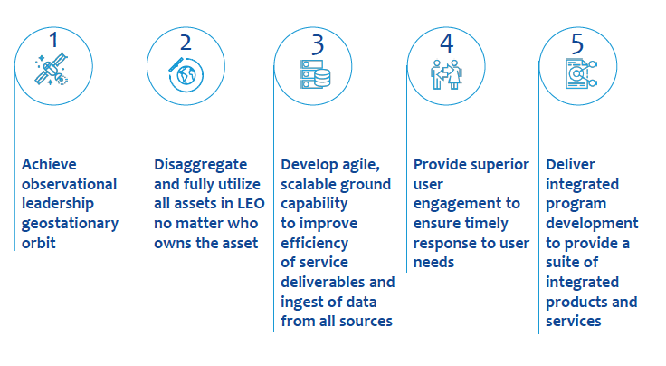
Cloud is a Key NESDIS Strategic Objective
NESDIS has developed a Cloud Strategy, completed Cloud Pilots, and continues to develop the NESDIS Common Cloud Framework (NCCF) to demonstrate the feasibility of an enterprise cloud solution to meet mission needs
Notes:
Bold text links to documentation
NESDIS has developed a cloud strategy to support NOAA’s move to the cloud. A phased approach to the cloud pilots is underway - ultimately enabling NESDIS to migrate data preservation, stewardship and production to the cloud. OneStop capabilities are being leveraged. In particular the inventory manager and the user interface for search and discovery

Slide 4
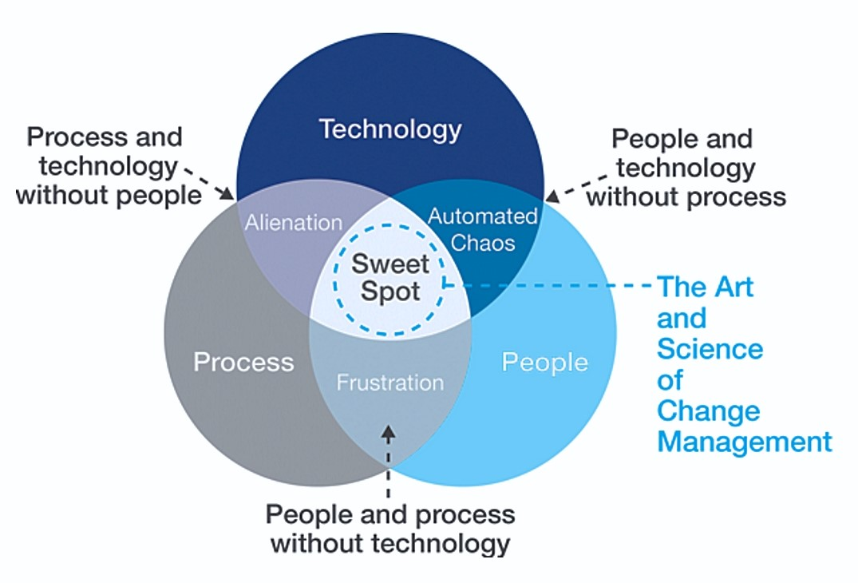
Business Readiness: People, Process, and Technology
Notes:
Readiness to migrate to new technology requires technology, process and people.

Slide 5
NESDIS Cloud Roadmap
Experimentation
Migration
Transformation
Initiation & Assessment
Proof of Concept
Staging &
Implementation
Cloud Migration
Leverage Cloud
Cloud
Optimization
Develop NESDIS Cloud Strategy
Organize IPT(s)
Kick-off Business Readiness Assessment
Develop ConOps
Design and build Pilot Projects
Update the organization
Develop phasing management plan
Prepare cloud environment
Orchestrate cloud implementation
Organize and consolidate
Migrate data to the cloud
Migrate services to the cloud
Automate cloud services
Monitor and manage cloud environment
Optimize services, architecture, and cost components
Evolve architecture based on new cloud service offerings
CLOUD PILOTS
(IPT & GOES-R LZSS)
ARE HERE TODAY
NCCF 1.0 (OSIS)
IS HERE TODAY
Notes:
We are piloting activities in the cloud, but also now performing operations in the cloud in the form of our first deployment of the NESDIS Common Cloud Framework (NCCF), which handles secure ingest of data from non-NOAA sources.

Slide 6
NESDIS Enterprise Cloud Vision
Continuous Integration
Continuous Deployment
Software and Release Management
Consolidated Ingest
Product Generation
Science and Development Sandbox
Developers
Data
Data
Metadata
Metadata
Data
Metadata Query
Data
Distribution and Access
Users
Storage
Metadata Catalog
Metadata Query
Data
Data
Configuration and Program Office
Notes:
Conceptual diagram of the enterprise cloud functionality and connections

Slide 7
Phase 1 Functional Focus Areas
Functional Areas | Scope
Security in the Commercial Cloud | Develop NESDIS Authority to Operate (ATO) methodology to meet security standards in the commercial FedRAMP Moderate cloud by tailoring up security controls
Ingest, Cataloging, and Storage | Extend NESDIS common data ingest, cataloging, and storage services and demonstrate this capability in the commercial cloud
Product Generation and Science Development | Demonstrate that industry approaches for compute and science development can be used in a common architecture to meet all current NESDIS system needs in the commercial cloud
Dissemination and Access | Prototype a NESDIS common architecture for cloud-based data distribution that meets NESDIS requirements
Notes:
The scope of the functional focus areas supported by Phase 1 of the NESDIS cloud pilot

Slide 8
Cloud Pilot Phase 1 Results
Functional Areas | Example Successes
Security in the Commercial Cloud | Created the NESDIS Cloud Authority To Operate process and checklist Documented cloud security guidance
Ingest, Cataloging, and Storage | Implemented an Ingest function that builds on the Secure Ingest Gateway Pilot (SIGP) and is source agnostic Demonstrated full data lifecycle Catalog and Storage services Scalability tests showed OneStop-Inventory Manager can easily and affordably scale to handling 100M’s of granules a day
Product Generation and Science Development | Demonstrated 10 science algorithms can be run as containers in the Product Generation environment For those 10, showed that the science teams can work with the algorithms in the Science Development Sandbox
Dissemination and Access | Demonstrated ability to serve data to existing on-prem systems and commercial cloud via the Big Data Program Demonstrate OneStop interface for data discovery/access, along with a tailored interface for internal science users
Notes:
Example results for each functional focus areas supported by cloud pilot phase 1

Slide 9
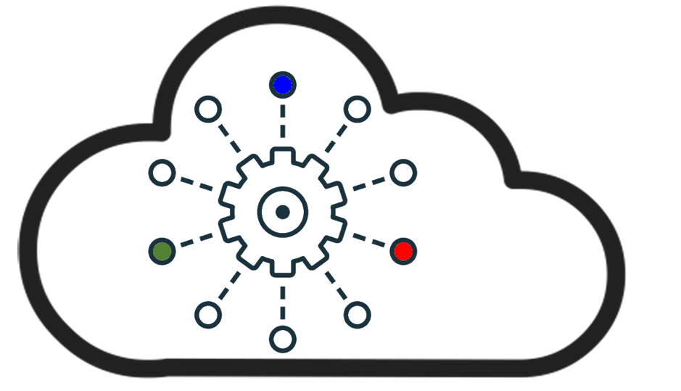
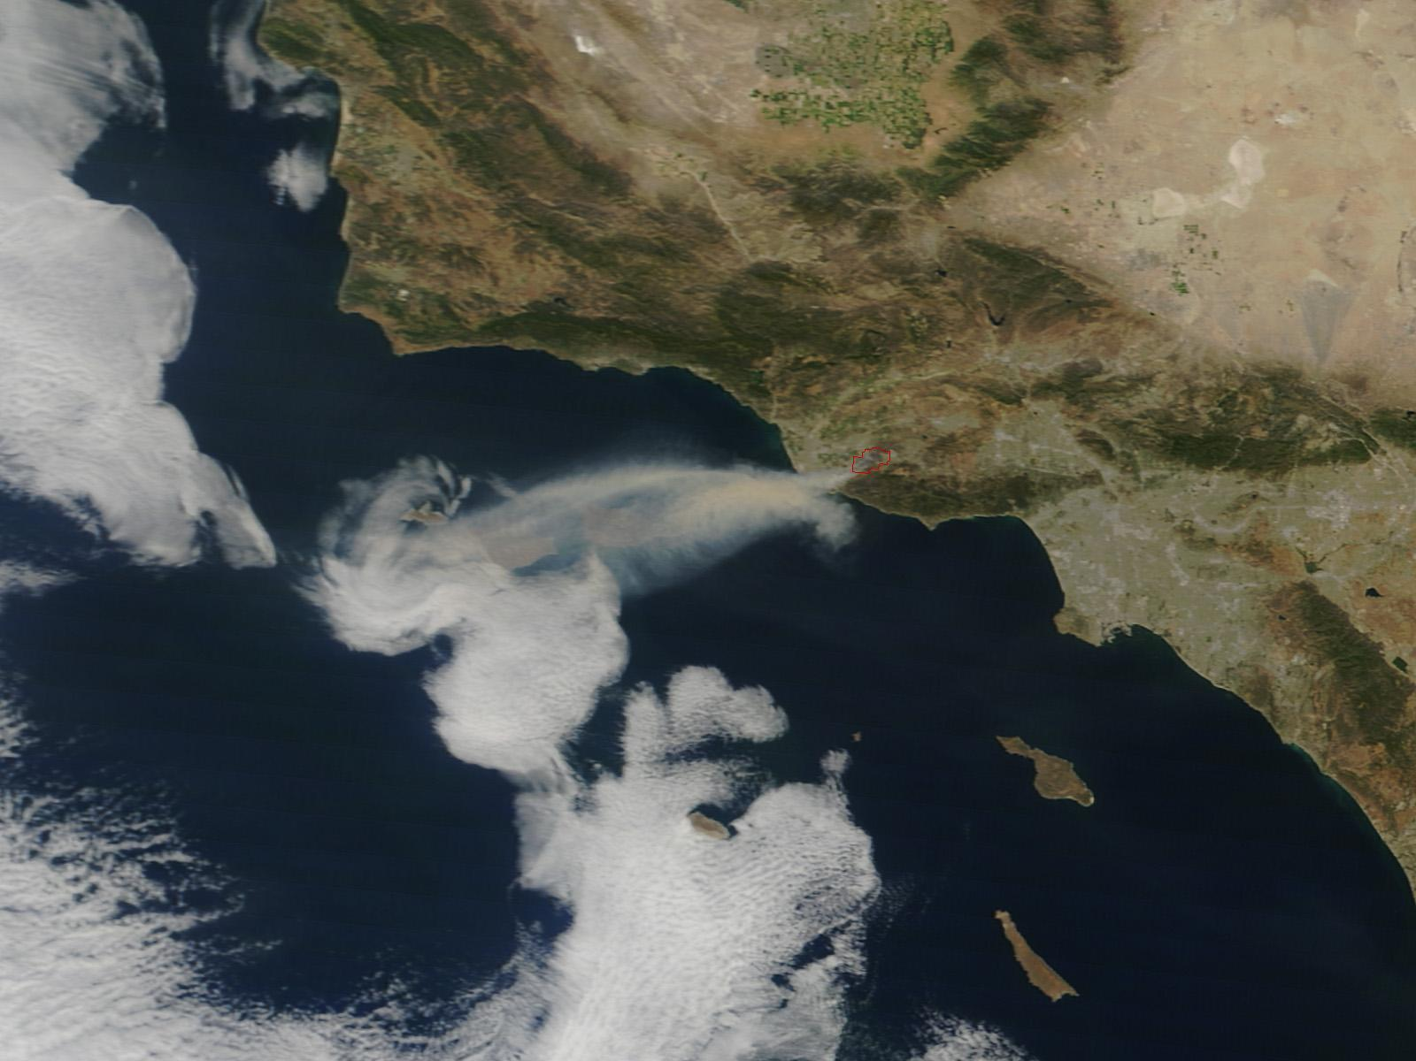
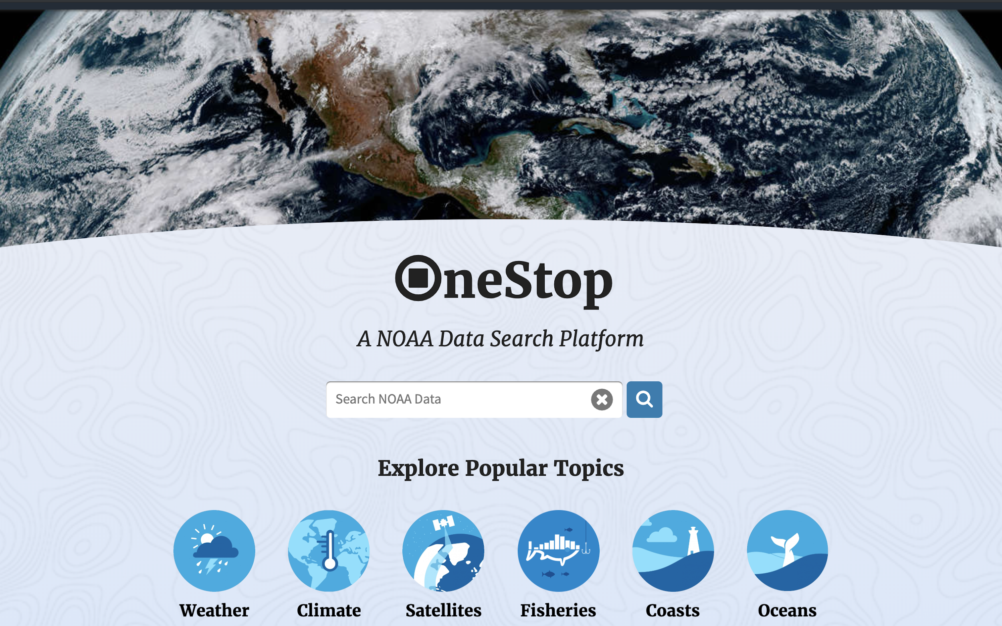
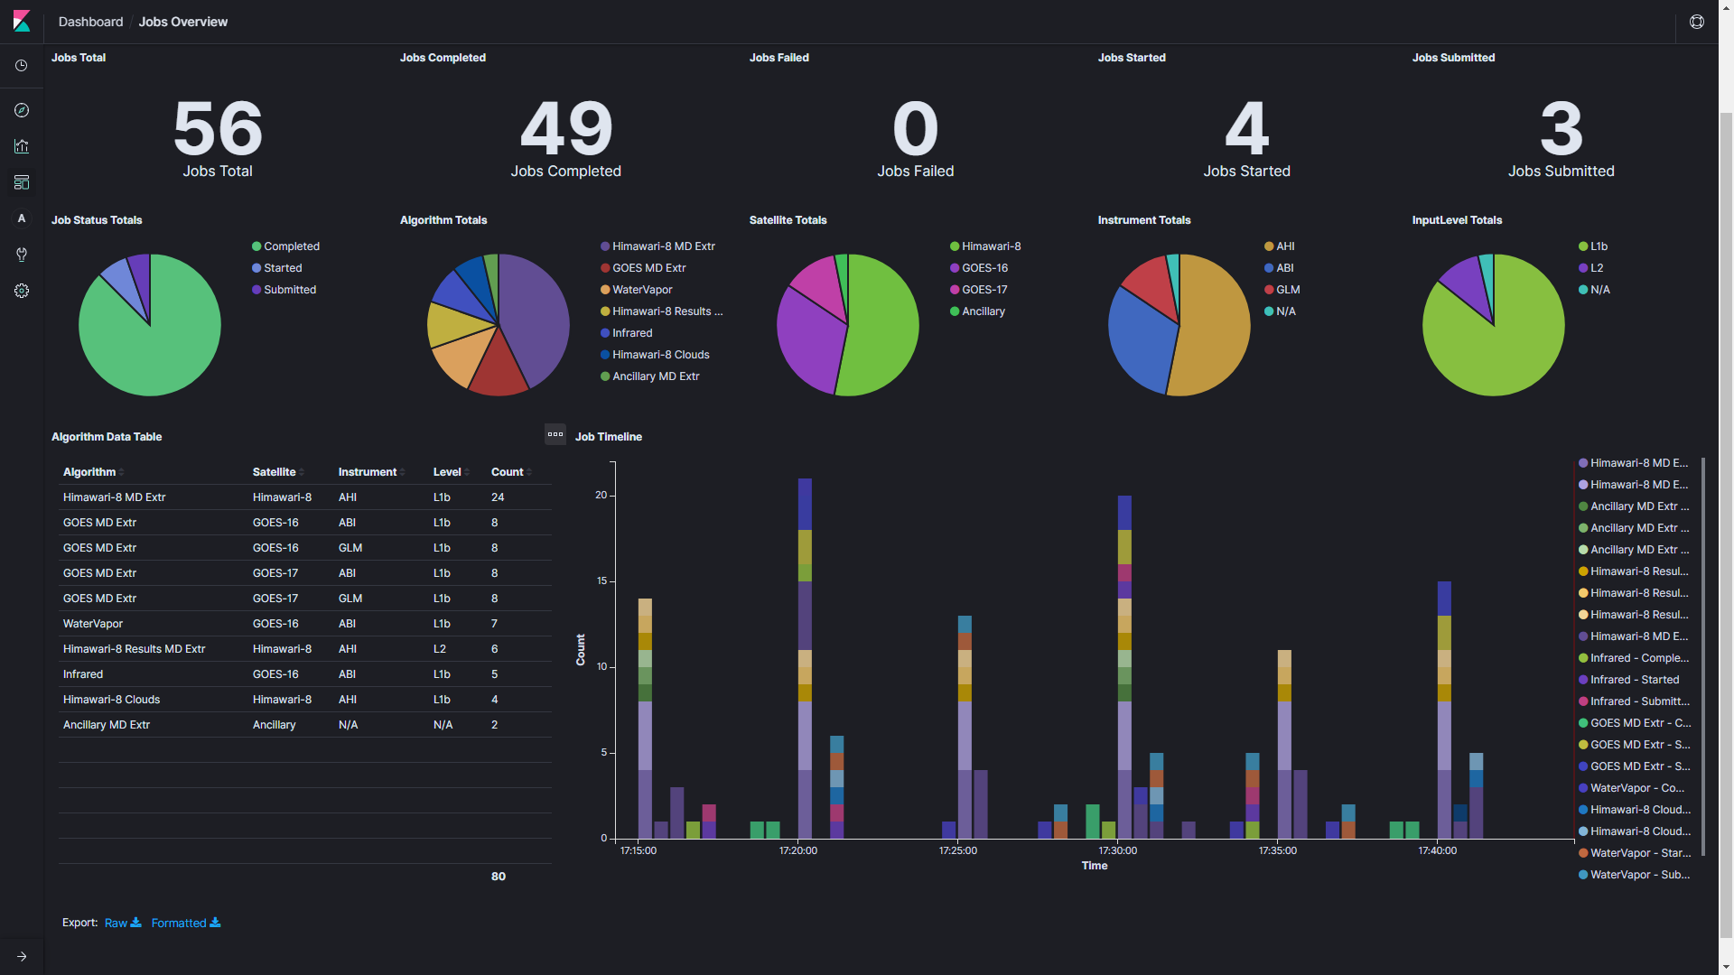
Cloud Pilot Phase 1 Successes
Multiple Products Generated
Multiple Data Streams being Ingested
Monitoring
Dashboards
All Available for
Discovery and Access
Notes:
Phase 1 cloud pilot was a proof of concept and completed in March 2020 - this slide summarizes graphically some of its achievements.

Slide 10
Ongoing Work in Phase 2
Expand upon the NCCF functionality
Demonstrate Product Distribution and Access (PDA) interface to operational user functionality
Demonstrate feasibility of OSPO Satellite Analysis Branch (SAB) visualization workflows
Expand the science development environment to additional science teams
Demonstrate the archive and metadata stewardship process
Determine the value of cloud-native optimization for NESDIS
Select a sample set of algorithms to optimize in order to quantify the return on investment for increased cloud efficiency
Investigate cloud-optimized file formats such as Zarr
Explore partnership collaboration opportunities, including: access to mission data by anomaly analysts, science instrument teams, and other potential weather science communities
Evaluate end-to-end ground architecture cloud migration benefits based on trade studies, cost-benefit analysis, transformation efforts, and enterprise risk assessment(s)
Notes:
Phase 2 pilot is ongoing and will enable and mature the NCCF, empower staff with knowledge and will develop cloud governance.

Slide 11
Focus in on OneStop
Notes:
Let’s focus on OneStop for NOAA data discovery and access

Slide 12
OneStop in a Nutshell
To improve the discovery of, access to, and usability of NOAA’s vast and diverse collection of big data
Modern, user-friendly discovery interface | Open infrastructure, standards, and best practices
Notes:
OneStop not only improves discovery of and access to NOAA data, but it also provides standards, and best practices to enable the discovery as well as inventory services and collection metadata tool suite

Slide 13
What Have We Achieved?
> 378 collections made OneStop-ready in 15 groups
Tiers of OneStop readiness (Bronze-Silver-Gold) established
OneStop metadata and data format best practices documented
Data Stewardship Maturity Model assessments conducted at scale, incorporated into ISO metadata, and used as basis for streamlined Data Stewardship Maturity Questionnaire (DSMQ)
ISO-lite granule metadata spec with millions generated
Notes:
Great achievements of OneStop that are now being leveraged in the NESDIS cloud pilots

Slide 14
What Have We Achieved?
Initial Common Metadata Editor Tool (CoMET) deployed and available for stakeholder testing
Incorporated DSMQ into CoMET
Collection Manager supporting tools (Docucomp, CEdit, Metaview, Metaserver, Pipelines, WAFs) operationalized
Training sessions Sep 2020 (completed) and Jan 2021 (planned)

Slide 15
What Have We Achieved?
CoMET and DSMQ User’s Guide published to NCEI Website
MediaCurrent Third-Party Usability Testing
Completed a second round of UI testing in late 2018
OneStop 3.0 user interface incorporates feedback and should be released by 30 Sep 2020 with over 20M granules
CoMET testing completed, feedback being incorporated into 2.0 release anticipated soon
Established initial framework for the Open Data Framework being leveraged by the NESDIS Common Cloud Framework

Slide 16
NCEI’s Open Data Framework^{2,000 ft}
Collection Manager
OneStop API/ Search Engine
External Systems
Data Managers
CEdit
CoMET
Metaserver
OneStop UI
EMMA
CoMET
Rubrics
Collection M/D
DocuComp
Index
Thin Portals
Public
C
G
Common Ingest
Data Streams
Inventory Manager
workflows
Order Fulfillment + Access Services
M/D Event Log
Storage Services
Tape
Disk
Cloud
S2N + ATRAC
Data Producers and Operators
Ingest Services
MD Services
Search Services
Storage/Access Services
Notes:
C is for Collections, G is for Granules. Thickness of lines surrounding components indicates maturity - thicker lines are more mature.
OneStop API is most mature followed by Inventory Manager and Collection Manager is

Slide 17
Summary and Next Steps
OneStop’s Open Data Framework components at different stages of maturity, some fully operational other just getting started…
Continue to integrate the components to improve operational robustness
Next UI release will include login.gov capability
Improve CoMET tools through user testing and iterative feedback
Continue Inventory Manager implementation in the cloud
Iteratively improve the OneStop discovery UI
Continue working with the NESDIS Cloud IPT to stay in sync where possible and prepare for eventual cloud migration

Slide 18
Thank You!

