Slide 1
CARD4L Aquatic Reflectance PFS
Summary
Christopher Barnes
CEOS LSI-VC, USGS/KBR
February 2022

Slide 2
Aquatic Reflectance PFS
Coordinated by: Andreia Siqueira (GA) & Chris Barnes (USGS/KBR)
  Technical Lead: Arnold Dekker (SatDek)
Development began in March 2020 with provisional endorsement at LSI-VC-10
Conditions of provisional endorsement have since been met by the following:
    Supporting peer reviewed articles were provided and transposed/included in the Reference Papers section and denoted via “Supports requirement x.xx”
    Per-Pixel Metadata (2.13 Adjacency Effects) and Radiometric and Atmospheric Correction (3.11 Adjacency Effects Correction) requirements revised to “Not Required” at Threshold in acknowledgement that the present state-of-the-art methods are too immature
Others changes of note. Five requirements moved from Target to Threshold:
1.17 - Overall Data Quality
2.7 – Land Water Mask
2.8 - Overall Data Quality
2.15 – Land Water Mask
3.6 – Ozone Corrections

Slide 3
Aquatic Reflectance PFS
Requirements summary of changes:
  1.0 General Metadata (17 Requirements Total)
    No requirement changes
  2.0 Per-Pixel Metadata (20 Requirements Total)
    2 requirements modified
      Per-pixel Assessment (from: Incomplete Testing in SR PFS; Req. 2.3)
      Sea/Lake/River Ice Mask (from: Ice Mask in SR PFS; Req. 2.8)
    10 new requirements identified
      Adjacency Effects (Req.2.13)
      Altitude (ASL) (Req.2.20)
      Bidirectional Reflectance Distribution Function (Req.2.19)
      Deep/Shallow Water (Req.2.16)
      Floating Vegetation/Surface Scum Mask (Req.2.14)
      Optically Deep or Optically Shallow Assessment (Req.2.17)
    Sky Glint (Req.2.9)
    Sun Glint (Req. 2.10)
    Turbid Water Flag (Req.2.18)
    Whitecap/Foam Mask (Req.2.11)

Slide 4
Aquatic Reflectance PFS
Requirements summary of changes continued:
  3.0 Radiometric and Atmospheric Corrections (14 Requirements Total)
    1 requirement modified
      Atmospheric Reflectance Correction (From: Directional Atmospheric Scattering in SR PFS)
    8 new requirements identified
    Adjacency Effects Correction (Req.3.11)
    Bidirectional Reflectance Distribution Function (Req.3.14)
    Floating Vegetation/Surface Scum Correction (Req.3.12)
    Other Trace Gaseous Absorption Corrections (Req.3.7)
  4.0 Geometric Corrections (1 Requirement Total)
    No requirement changes
~80% of the Aquatic Reflectance PFS requirements correspond with Surface
Reflectance PFS requirements
    Sky Glint Correction (Req.3.9)
    Sun Glint Correction (Req.3.8)
    Turbid Water Correction (Req.3.13)
    Whitecap and Foam Correction (Req.3.10)

Slide 5
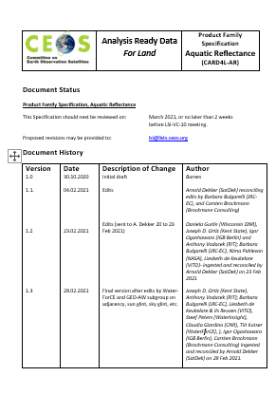
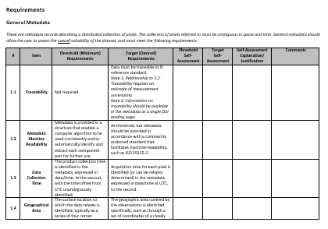
Aquatic Reflectance PFS
Next steps:
  Seeking AR PFS Version 1.0
  endorsement by LSI-VC
  Make AR Version 1.0 available from the
  CARD4L website to solicit
  community and data provider feedback
  Include AR PFS in annual PFS update cycle
  to maintain contunity across PFSs

