Slide 1
CEOS Coastal Observations, Applications, Services & Tools (COAST) Ad Hoc Team
Paul M. DiGiacomo
CEOS-COAST Co-Chair
NOAA/NESDIS Center for Satellite Applications & Research (STAR)

Slide 2
What is CEOS?
The Committee on Earth Observation Satellites (CEOS) is made up of 55 Agencies from all around the world committed to coordinating their satellite Earth observation programs and sharing data for a more sustainable and prosperous future.
CEOS leverages the work of members in a variety of collaborative endeavors including Working Groups, Virtual Constellations, and Ad Hoc Teams.
https://ceos.org
Notes:
These satellite observations are critical for environmental monitoring, meteorology, disaster response, agriculture and many other applications (take a look at these case studies) that can improve life on Earth and save lives.

Slide 3
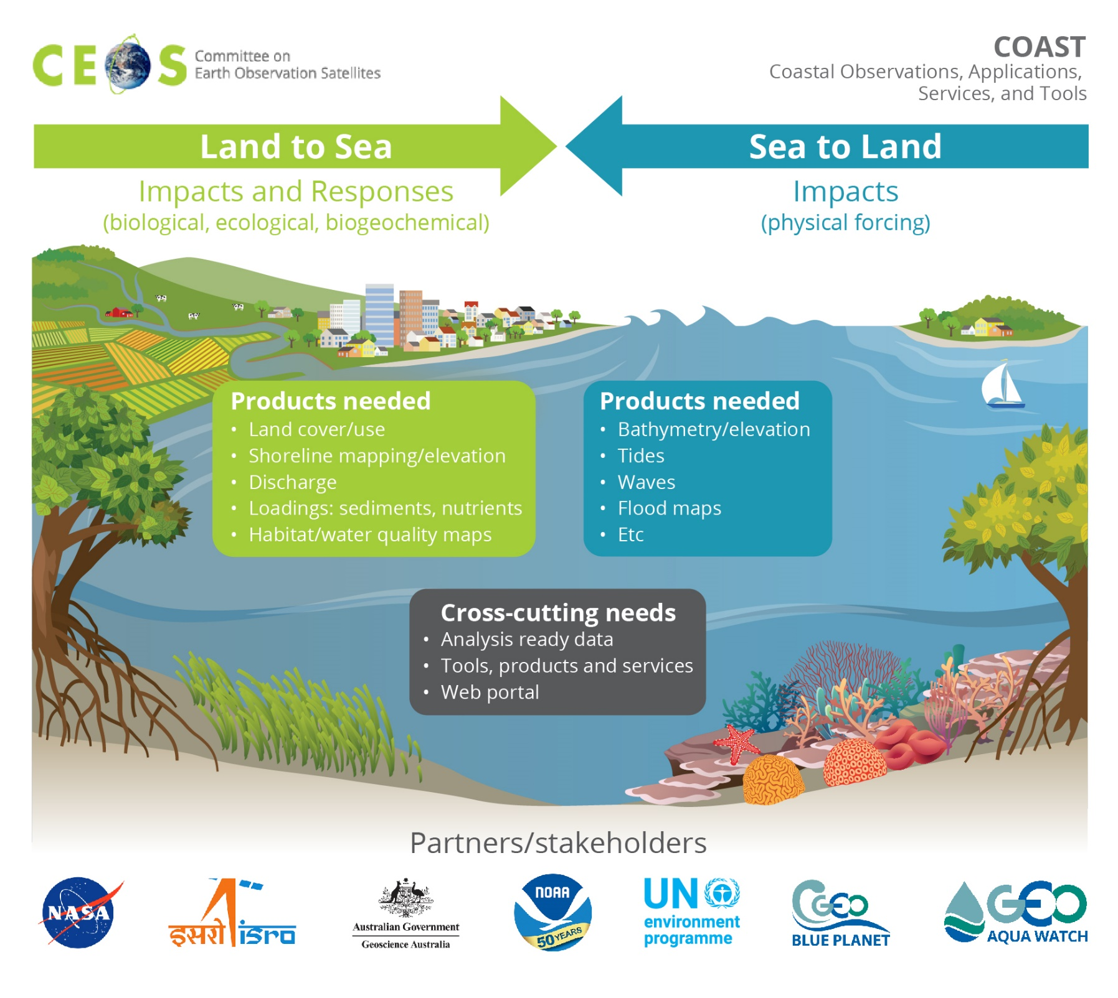

Slide 4
CEOS Coastal Observations, Applications, Services, and Tools: COAST
CEOS Coastal Observations and Applications Study Team (CEOS-COAST): Initiated at 33rd CEOS Plenary to define a CEOS Coastal Strategy and facilitate engagement with key international stakeholders
Bridging land and aquatic observations within CEOS, helping to integrate across multiple CEOS entities and domains, both thematic and technical.
Leveraging CEOS Systems, services and interoperability approaches, including the CEOS Analysis Ready Data (ARD) framework already demonstrated for terrestrial and oceanic applications.
Facilitating the broader utilization of Earth observations for greater societal benefits within coastal zones and enhancing CEOS engagement with external stakeholders such as GEO, IOC/GOOS, UN Environment, WMO and the UN Decade of Ocean Science for Sustainable Development (2021-2030).
Promoted to an Ad Hoc Team at 34th Plenary (October 2020)
COAST Study Team Approach:
Virtual monthly status meetings with ongoing work by task teams between
Collaborative offline document and project work via GoogleDocs
CEOS SIT Side Event, Technical Workshop, WGISS, Plenary Sessions, etc.
Briefings to partners and collaborators
USGCRP COASTS

Slide 5
CEOS Coastal Observations, Applications, Services, and Tools: COAST
The Group on Earth Observations (GEO) is a partnership of more than 100 national governments and in excess of 100 Participating Organizations that envisions a future where decisions and actions for the benefit of humankind are informed by coordinated, comprehensive and sustained Earth observations.
GEO is an unprecedented global collaboration of experts - a global network connecting government institutions, academic and research institutions, data providers, businesses, engineers, and scientists.
Together, the GEO community is creating a Global Earth Observation System of Systems (GEOSS) to better integrate observing systems and share data by connecting existing infrastructures using common standards.
“Full and open access to Earth observation data, information and knowledge is crucial for humanity as it faces unprecedented social, economic and environmental challenges.” Mexico City Ministerial Declaration, November 2015

Slide 6
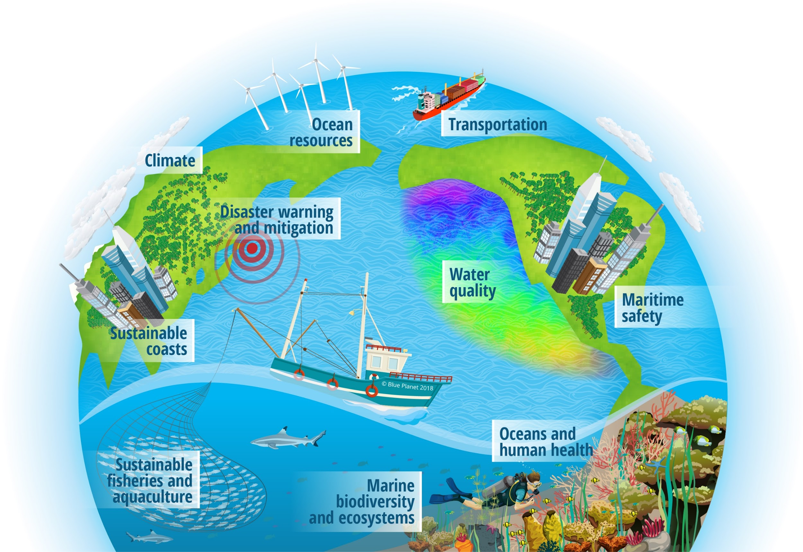
GEO Blue Planet Mission
Linking Ocean and Coastal Information with Society
Advance and exploit synergies among the many observational programmes devoted to ocean and coastal waters Improve engagement with a variety of stakeholders for enhancing the timeliness, quality and range of services delivered Raise awareness of the societal benefits of ocean observations at the public and policy levels.
https://geoblueplanet.org/

Slide 7
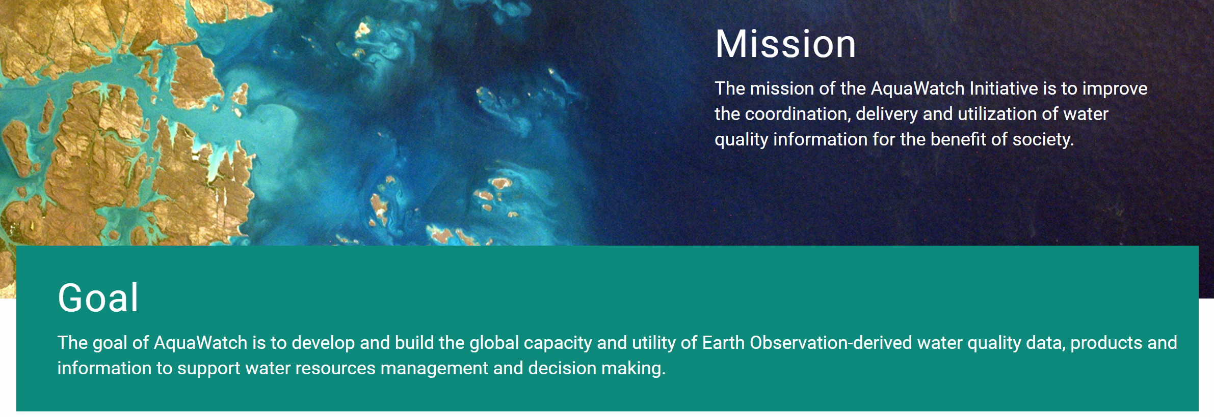
CEOS Coastal Observations, Applications, Services, and Tools: COAST
https://GEOAquaWatch.org

Slide 8
CEOS Coastal Observations, Applications, Services, and Tools: COAST
COAST Team Members:
CEOS COVERAGE: Jorge Vazquez (JPL), Vardis Tsontos (JPL)
CEOS Executive Officer: Kerry Sawyer (NOAA)
CEOS SEC Support: George Dyke, Matt Steventon (Symbios)
CEOS Systems Engineering Office (SEO): Brian Killough (NASA)
CEOS VCs: Ed Armstrong (JPL), SST-VC; Eric Leuliette (NOAA), OST-VC
CEOS WGCapD: Nancy Searby, Lauren Childs-Gleason (NASA)
CEOS WGClimate: Albrecht von Bargen (DLR-DE), Joerg Schultz (EUMETSAT)
CEOS WGCV: Philippe Goryl (ESA)
CEOS WGISS: Rob Woodcock (CSIRO)
CEOS WG Disasters: David Green (NASA), David Borges (NASA)
CEOS SDG AHT: Flora Kerblat (CSIRO)
CNES: Aurelien Carbonniere
CSIRO: Janet Anstee
ESA: Jérôme Benveniste
EUMETSAT: Estelle Obligis
European Commission: Astrid-Christina Koch, Fabienne Jacq
GEO AquaWatch Initiative: Steve Greb (Univ of Wisconsin)
GEO Blue Planet Initiative: Emily Smail (UMD), Leah Segui
GEO Secretariat: Douglas Cripe
Geoscience Australia: Stephen Sagar
ISRO: Rashmi Sharma, Raj Kumar (Co-Chair)
NASA: Laura Lorenzoni (OCR-VC)
NOAA: Paul M. DiGiacomo (Co-Chair); Merrie Beth Neely (Project Manager)
JAXA: Osamu Ochiai, Hamamoto Ko
USGS: Steve Labahn (LSI-VC), Tom Cecere

Slide 9
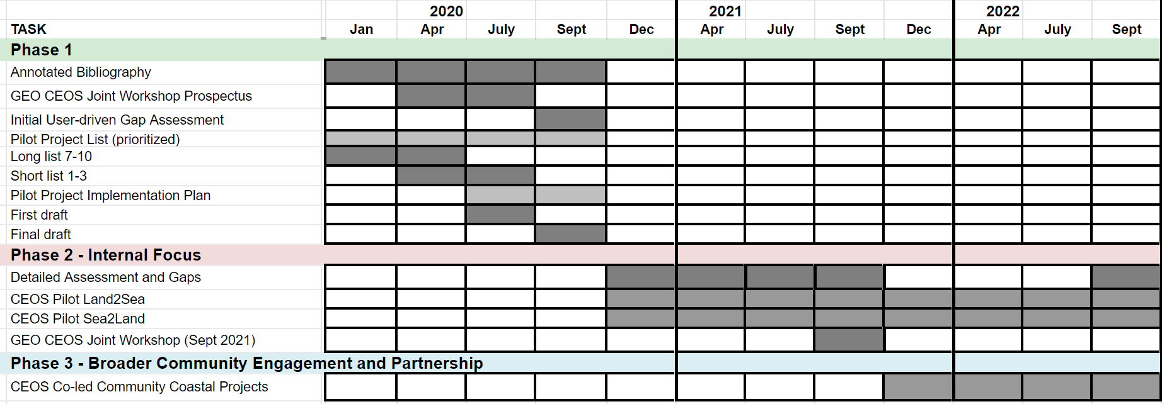
CEOS Coastal Observations, Applications, Services, and Tools: COAST
COAST Project: Phases, Milestones and Schedule

Slide 10
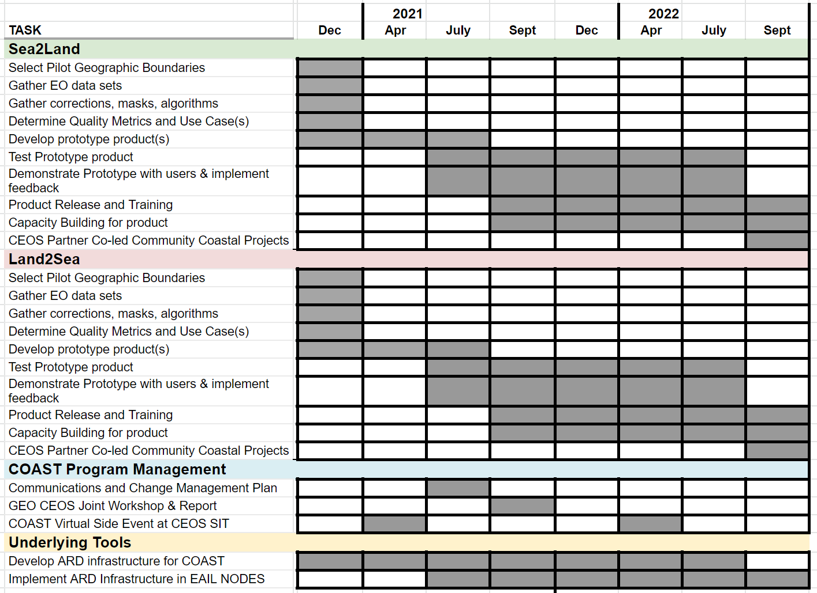

Slide 11
CEOS Coastal Observations, Applications, Services, and Tools: COAST
Summary of Available COAST Phase 1 Deliverables (as of Dec 2020)
⮚ Established - CEOS-COAST website: http://ceos.org/ourwork/ad-hoc-teams/ceos-coast/
⮚ Completed – Annotated COAST Bibliography
⮚ Completed – Compilation of COAST-related projects/activities
⮚ Pending – draft satellite data requirements inventory for SDG 14.1.1a (coastal eutrophication)
⮚ Completed - Phase 2 Pilot project components, priorities and sites identified
⮚ Completed – Criteria for Pilot Location selection
⮚ Completed – Draft of CEOS-COAST Phase 1 White Paper #1: “Sea to Land Impacts: User Needs,
Observations, and Services”
⮚ Completed – Draft of CEOS-COAST Phase 1 White Paper #2: “Land to Sea Impacts: User Needs,
Observations, and Services”
⮚ Completed - CEOS-COAST Phase 1 White Paper #3: “Cross-Cutting Tools, Systems and Services”
⮚ Completed – COAST Ad Hoc Team Terms of Reference (governing document
⮚ Pending – COAST Phase 2 Implementation Plan (available soon)
NB: On hold due to COVID: Planning for Joint GEO-CEOS COASTAL Workshop (~Summer 2021); Coordinated
data call to CEOS agencies

Slide 13
CEOS Coastal Observations, Applications, Services, and Tools: COAST
Themes:
Coastal Characterization
Shoreline mapping
Bathymetry/elevation
Flooding - WG Disasters
Turbidity and Sediment Loading
Coastal Eutrophication
Crosscutting Areas:
Continental shorelines
Small Island Nations
Resource Impacts (SAV, Mangroves, Corals, Human Health)

Slide 14
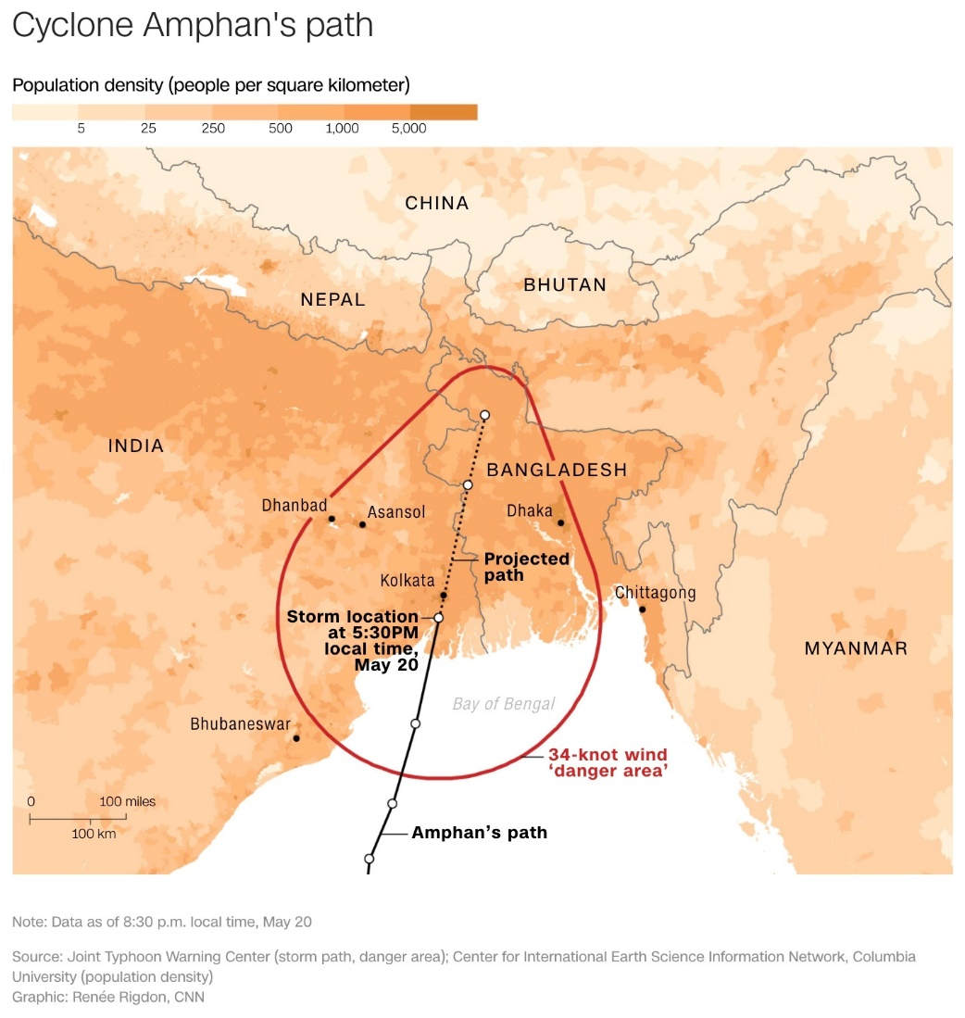
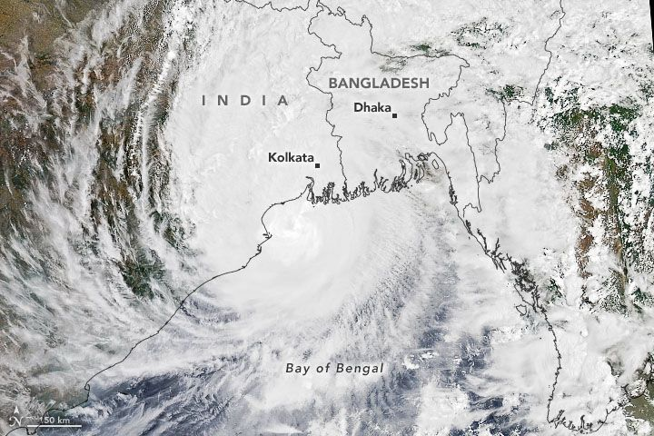
CEOS Coastal Observations, Applications, Services, and Tools: COAST
Anticipated COAST Pilot Locations
Continental:
Odisha/Bay of Bengal
Coastal Virginia/Chesapeake Bay
West Coast of Africa
Rio de la Plata region (TBC)
Small Island Nations:
Caribbean: Bahamas
Pacific: Tahiti/Kiribati/New Caledonia
Other sites/TBD

Slide 15
CEOS Coastal Observations, Applications, Services, and Tools: COAST
Themes:
Coastal Characterization
Shoreline mapping
Bathymetry/elevation
Flooding - WG Disasters
Turbidity and Sediment Loading
Coastal Eutrophication
Crosscutting Areas:
Continental shorelines
Small Island Nations
Resource Impacts (SAV, Mangroves, Corals, Human Health)

Slide 16
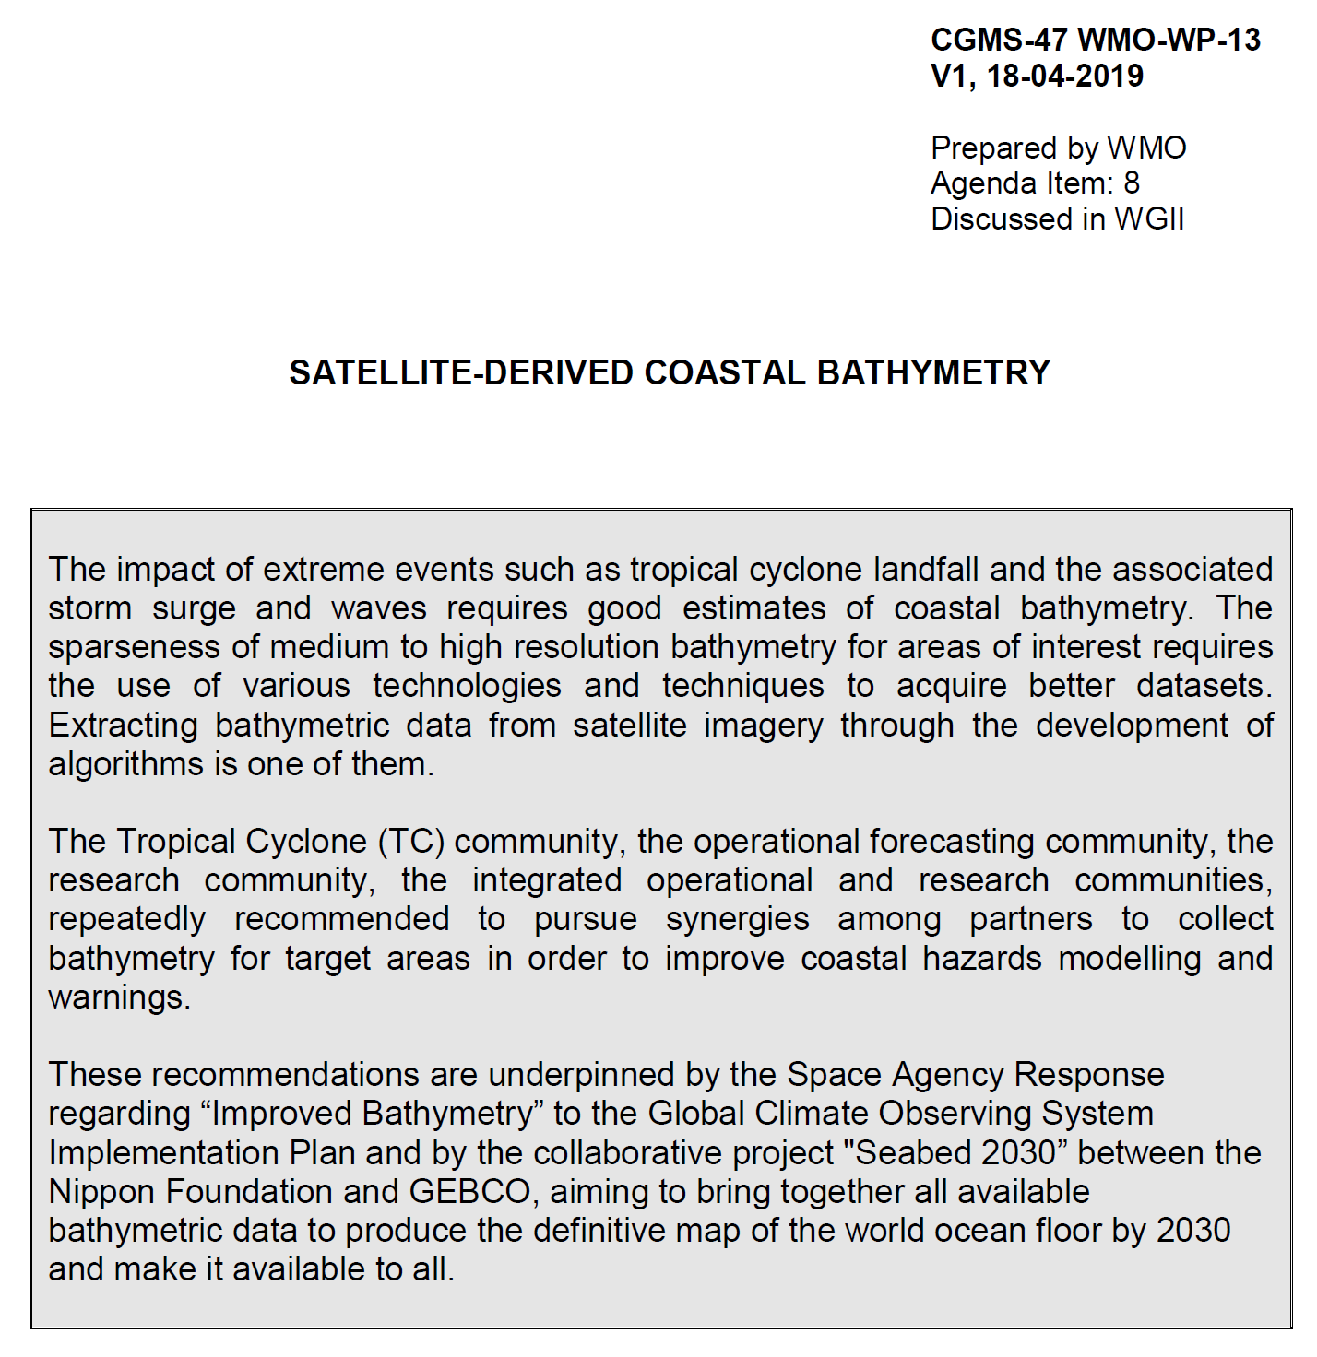
Coordination Group for Meteorological Satellites - CGMS
Pursuant to CGMS-47 WMO-WP-13: Satellite-Derived Coastal Bathymetry
Key issues of relevance to CGMS:

Slide 17
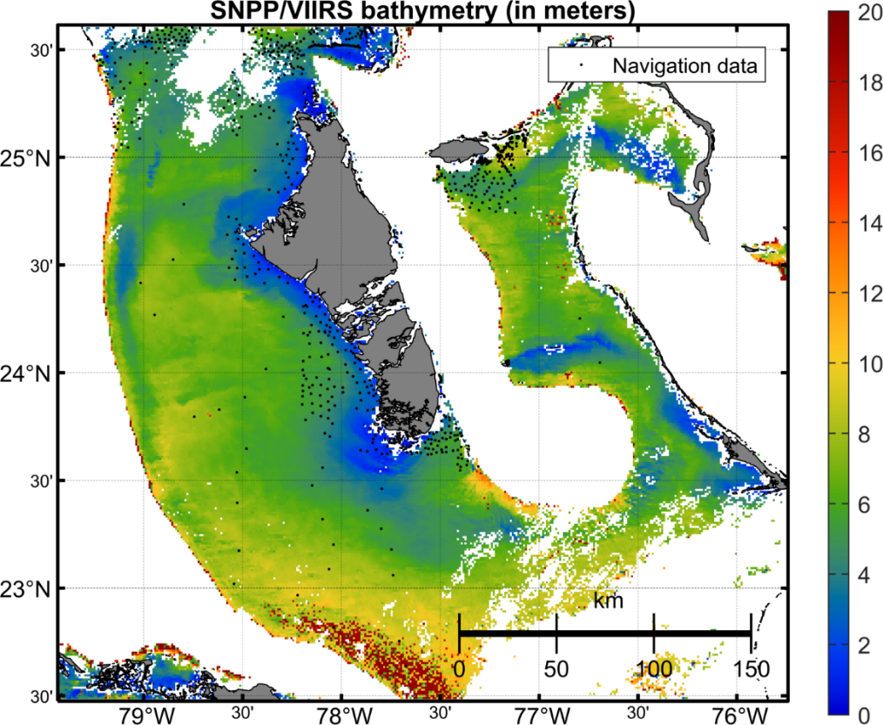
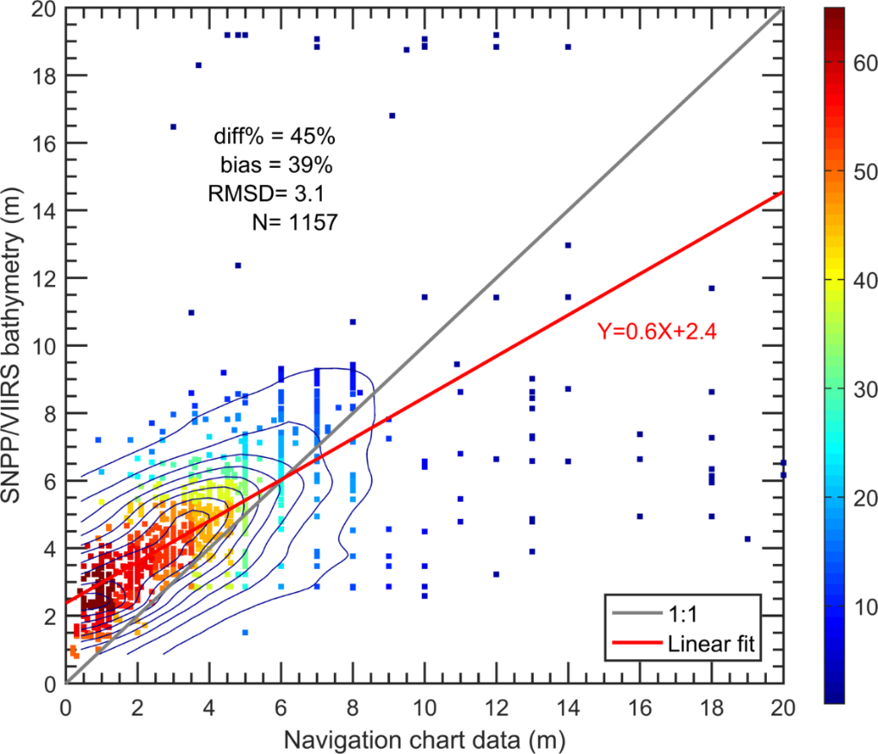
xxx
Bathymetry from NOAA Multi-Spectral Ocean Color Satellite Measurements
Depth (m)
density
Bahamas
Bathymetric map is derived from VIIRS-SNPP ocean color data, using the newly developed spectral optimization algorithm.
Validation of satellite-derived and Navigation Chart data (sampling locations are indicated in the map), showing useful data from VIIRS.
Jianwei Wei & Menghua Wang,
NOAA Ocean Color Team

Slide 18
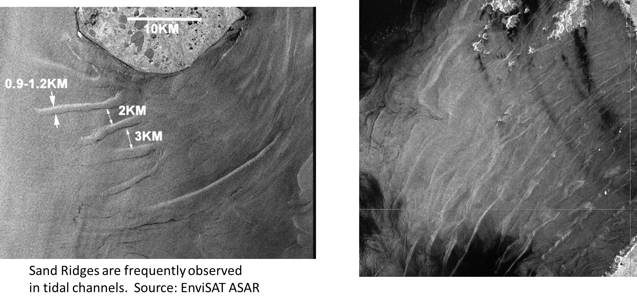
xxx
SAR Oceanography – Shallow Water Bathymetry < 30 m
NOAA Water Surface
Conditions Team
Xiaofeng Li & Sean Helfrich

Slide 19
CEOS Coastal Observations, Applications, Services, and Tools: COAST
Themes:
Coastal Characterization
Shoreline mapping
Bathymetry/elevation
Flooding - WG Disasters
Turbidity and Sediment Loading
Coastal Eutrophication
Crosscutting Areas:
Continental shorelines
Small Island Nations
Resource Impacts (SAV, Mangroves, Corals, Human Health)

Slide 20
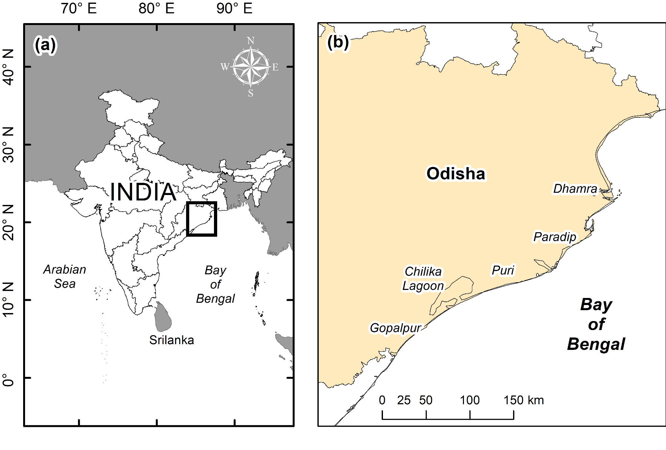
Bay of Bengal

Slide 22
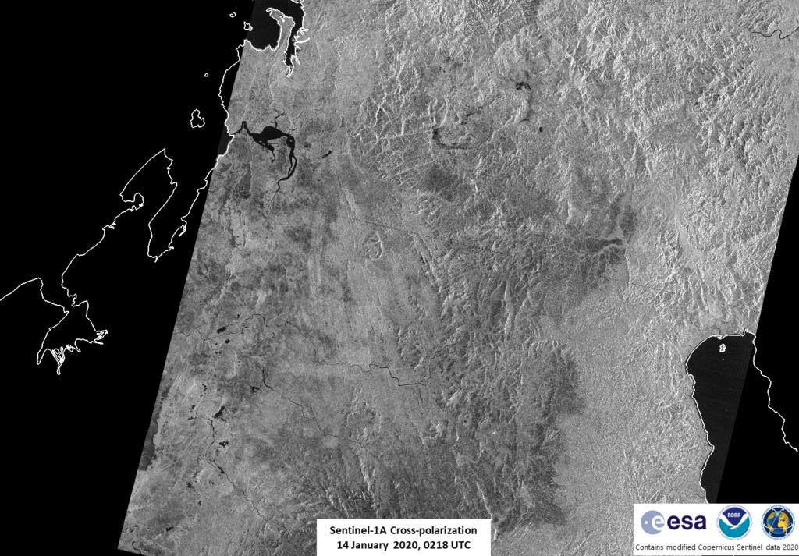
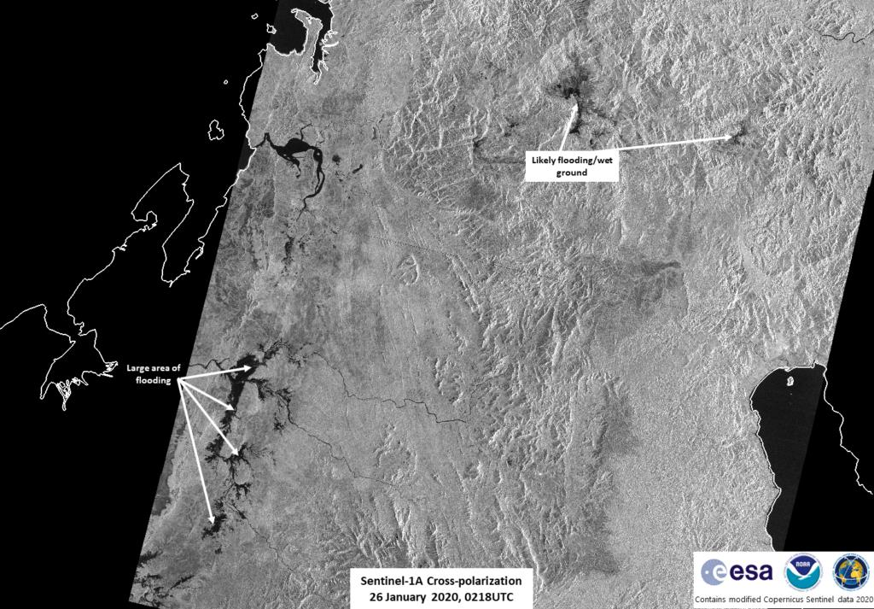
CEOS Coastal Observations, Applications, Services, and Tools: COAST
Madagascar: Comparison of Sentinel-1 A/B images from January 14 (pre-flood) & 26, 2020 showed flooding.
Data acquired by ESA/Copernicus; provided by Christopher Jackson, NOAA/STAR/SOCD, contains modified Copernicus Sentinel data 2020.
Notes:
Synthetic Aperture Radar (SAR) Products from the Water Surface Condition (WSC) Science Team Used to Inform Decision-Makers During Madagascar Flooding:
The passage of Cyclone Ava brought rain and flooding to Madagascar throughout January, resulting in that nation’s disaster response agency, Bureau National de Gestion des Risques et des Catastrophes (BNGRC), to declare a national disaster on January 28th, 2020. Several NOAA branches responded with informational assistance to the country, including informing Madagascar’s decision-makers of flooding status despite persistent cloud-cover using Sentinel-1 SAR imagery enabled by SOCD’s WSC science team (see the January 14 and January 26th comparison images below).

Slide 23
CEOS Coastal Observations, Applications, Services, and Tools: COAST
Themes:
Coastal Characterization
Shoreline mapping
Bathymetry/elevation
Flooding - WG Disasters
Turbidity and Sediment Loading
Coastal Eutrophication
Crosscutting Areas:
Continental shorelines
Small Island Nations
Resource Impacts (SAV, Mangroves, Corals, Human Health)

Slide 24
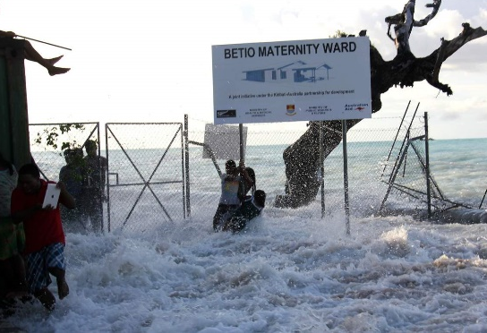
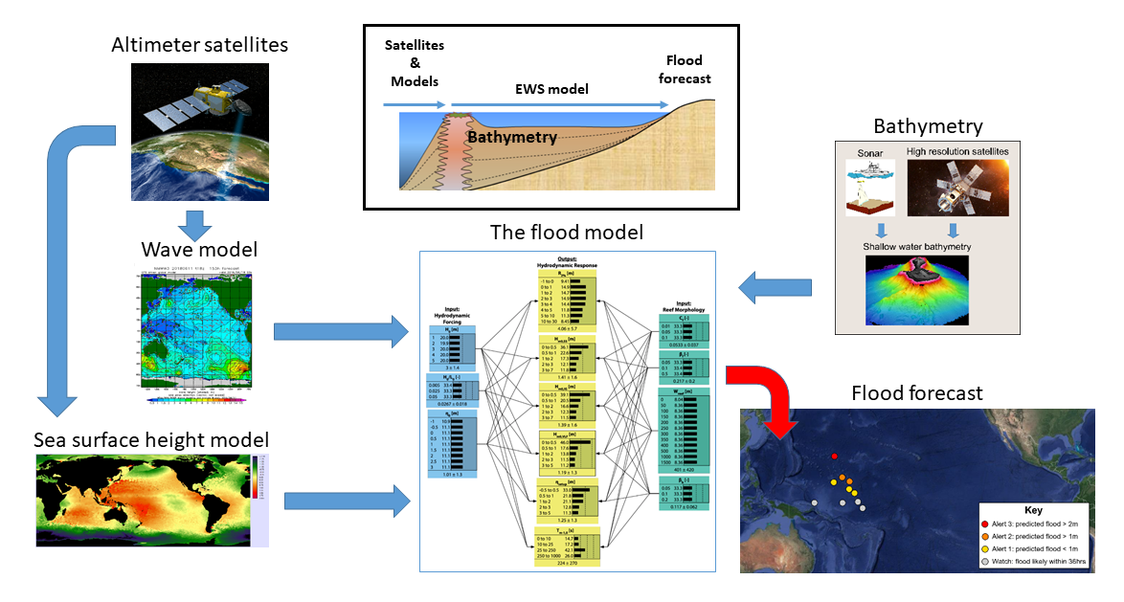
Disaster warning and mitigation: wave-driven flood events
The challenge:
Flood forecasts for reef-lined coasts are expensive, computer intensive and forecasts from sandy coasts are not transferable
Approach:
Develop Wave-driven Flood-forecasting on Reef-lined Coasts Early Warning system (WaveFoRCE)
Focus on small island developing states/nations in the Pacific and the Caribbean
Demonstration/implementation to be facilitated by the CEOS Coastal Observations, Applications, Services & Tools (COAST) Ad Hoc Team
Kiribati

Slide 25
CEOS Coastal Observations, Applications, Services, and Tools: COAST
Themes:
Coastal Characterization
Shoreline mapping
Bathymetry/elevation
Flooding - WG Disasters
Turbidity and Sediment Loading
Coastal Eutrophication
Crosscutting Areas:
Continental shorelines
Small Island Nations
Resource Impacts (SAV, Mangroves, Corals, Human Health)

Slide 26
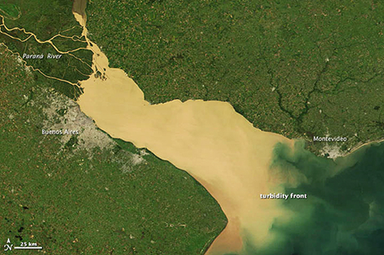
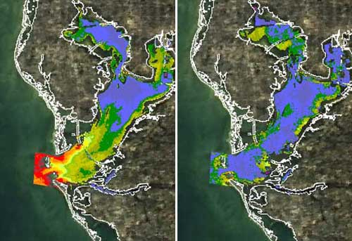
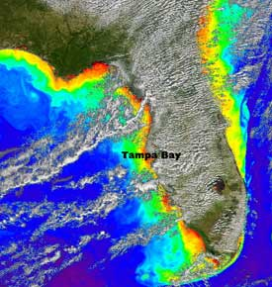
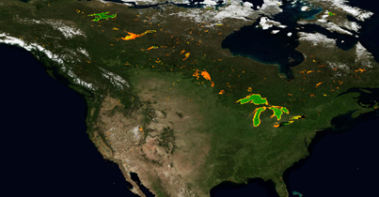
CEOS Coastal Observations, Applications, Services, and Tools: COAST
Coastal Sediment Dynamics
Images are composites of turbidity data collected in December and July, respectively, over a span of three years using NASA's MODIS instrument. Credit: NASA/USF
La Plata River. NASA image by Jeff Schmaltz, LANCE/EOSDIS MODIS Rapid Response
Copernicus turbidity products ingested into RealEarth Platform (University of Wisconsin SSEC)

Slide 27
CEOS Coastal Observations, Applications, Services, and Tools: COAST
Themes:
Coastal Characterization
Shoreline mapping
Bathymetry/elevation
Flooding - WG Disasters
Turbidity and Sediment Loading
Coastal Eutrophication
Crosscutting Areas:
Continental shorelines
Small Island Nations
Resource Impacts (SAV, Mangroves, Corals, Human Health)

Slide 28
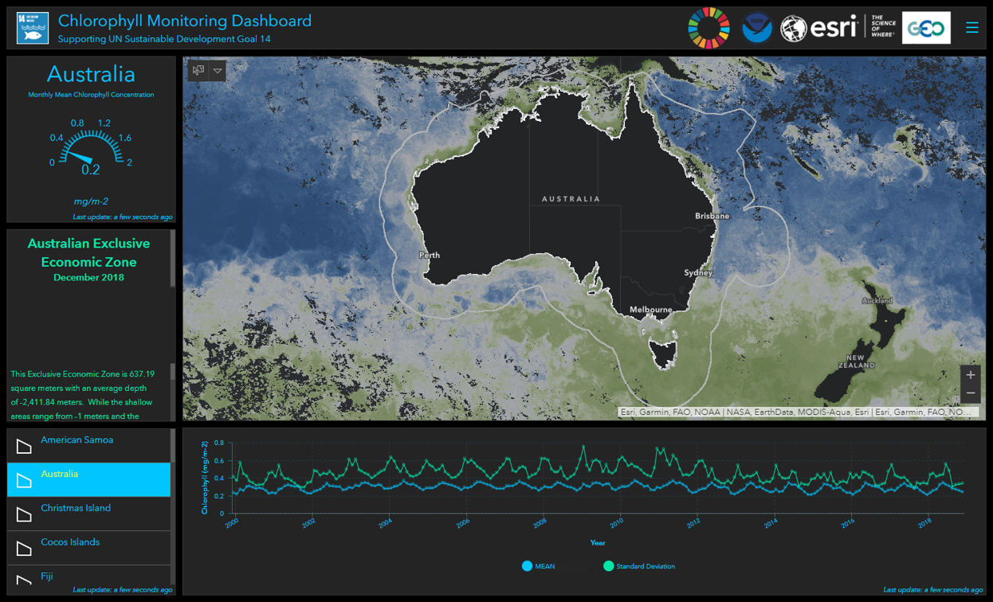
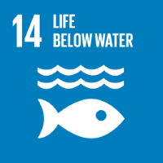
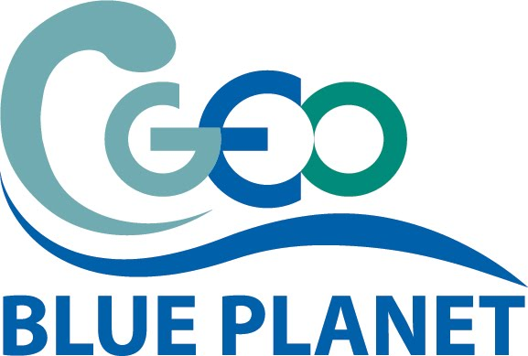
CEOS Coastal Observations, Applications, Services, and Tools: COAST
Coastal Eutrophication

Slide 29
CEOS Coastal Observations, Applications, Services, and Tools: COAST
Needs:
Shoreline mapping/coastal elevation
island elevations are a big unknown
Shore line detection- SAR/ICESAT-2
Flood maps/Flood extent- SAR/ICESAT-2
Bathymetry - optical data and SAR data
Coastal elevation and Intertidal Mapping - Optical EO data, validation (GPS, LiDAR, in-situ)
Precipitation temporal and spatial
antecedent moisture conditions (soil moisture)
DEM's
River Discharge/Dam locations and specs
Land Use /Cover datasets
Water Temperature
Salinity - river discharge/mixing models/Density gradients - plume dispersal (i.e. settling velocity) - ocean color
Tidal Data - altimetry, winds
Wave Data - statistics from Altimeters
significant wave height/direction
wave spectra
Sea Surface Height anomalies from altimeters
Wave refraction nearshore - SAR
Period of significant wave- SAR/ICESAT-2
Ecosystem Status/Change
Habitat maps
coral health - SST and solar insolation/Ocean color
SAV classification -
mangrove classification and health
coastal sediment maps - deposition and rate of accumulation
Eutrophication Indicators (ocean color products, in situ data)
Sediment loadings datasets
Point source discharges (volume and conc.)
Nutrient loadings datasets
water quality maps

Slide 31
CEOS Coastal Observations, Applications, Services, and Tools: COAST
Thank You!

Slide 32
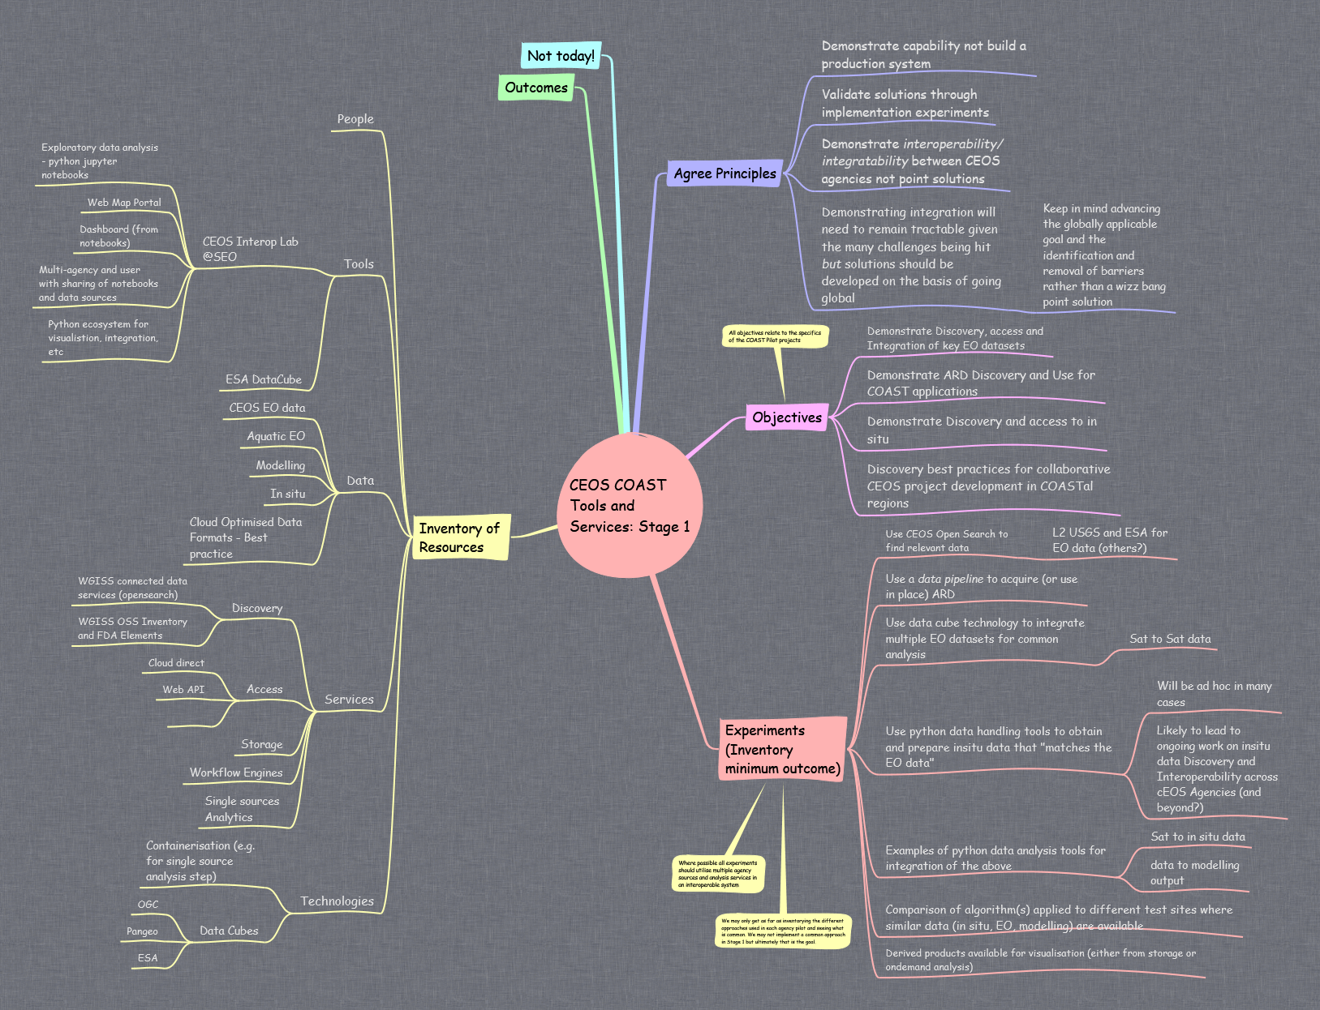
CEOS COAST Architecture Mind Map

Slide 33
CEOS COAST Architecture Mind Map

Slide 34
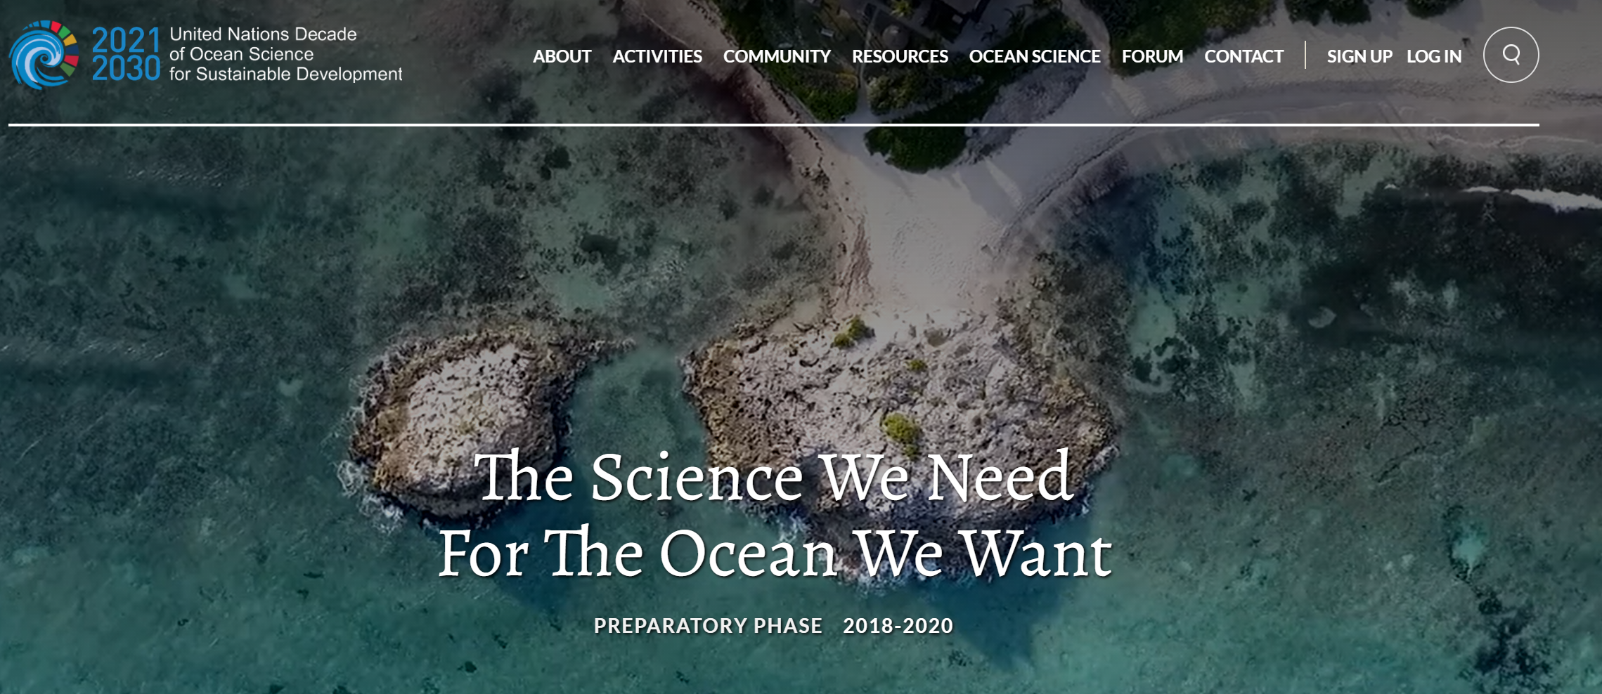
2nd International Operational Satellite Oceanography Symposium (OSOS-2) Virtual Meeting, 25-27 May 2021

Slide 35
CEOS Coastal Observations, Applications, Services, and Tools: COAST
Selection of Pilot Locations for CEOS COAST
The rating criteria for selecting pilot locations should be:
The project addresses a global societal need at the location and common (most) coastal regions
Local, Regional, and/or Global users of the pilot products have been identified (e.g., UN Environment)
Nation(s) and its people will realize demonstrable impacts and outcomes from the project
Project will be scalable to other coastal regions through tech transfer
The project location supports/fulfills an agency initiative(s)
The project location supports a GEO objective, e.g., an Initiative (such as Blue Planet)
The location will have partners (CEOS et al.) contributing data and/or other resources and interested in sustaining the work beyond the pilot phase
Sufficient data is available to make an initial product within 12 month time period
Required or supporting data format ideally can/will be ingested into the WGISS-CEOS Earth Analytics Interoperability Lab (or fit existing demonstration data input requirements)
Agency Commitment(s) of resources for task(s) and activity(ies) to make a product have been identified
CEOS COAST Team Member(s) have agreed to (co)lead the technical work of the pilot in the location
Bonus Considerations:
Another CEOS WG has a pilot in the same area for the same execution fiscal year (e.g. WG Disasters, etc.)
A CEOS agency has a project in the same area during the same fiscal year that can be leveraged (e.g. NASA SERVIR, etc.)
Another COAST (or CEOS) Pilot project can leverage the same area

