Slide 1

G20 Global Agriculture Monitoring Initiative
GEOGLAM
Toward a Holistic Articulation of GEOGLAM’s
Earth Observation Data, Access, and Utilization Requirements
Alyssa Whitcraft - GEOGLAM Secretariat
akwhitcraft@geoglam.org

Slide 2

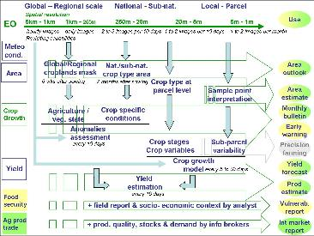
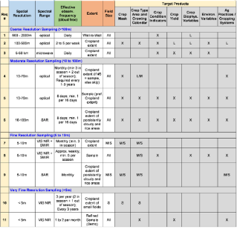
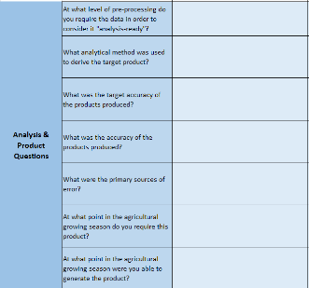
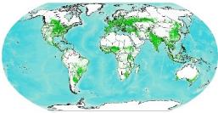
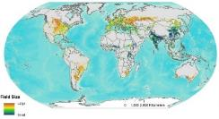
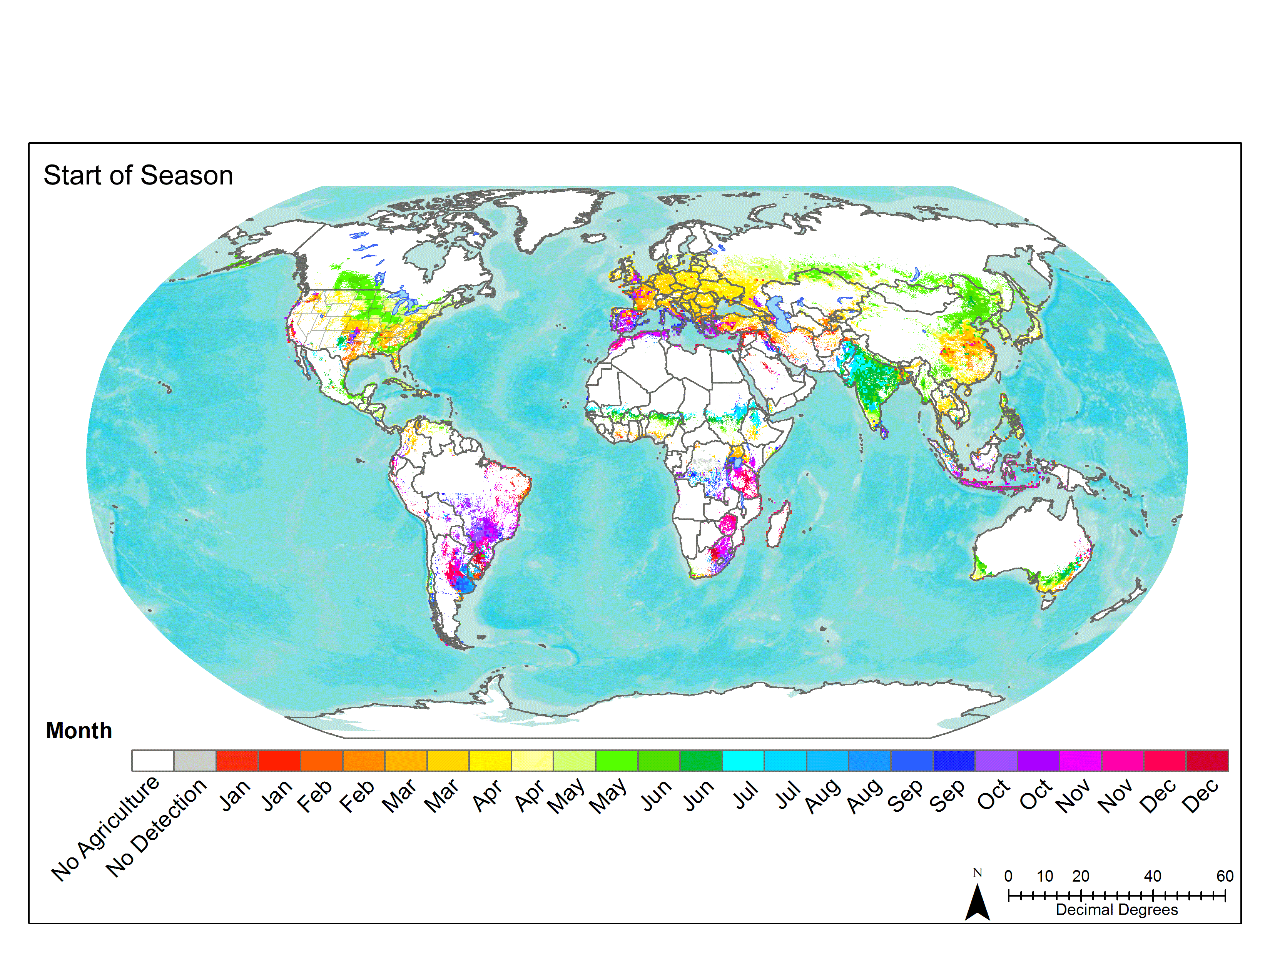
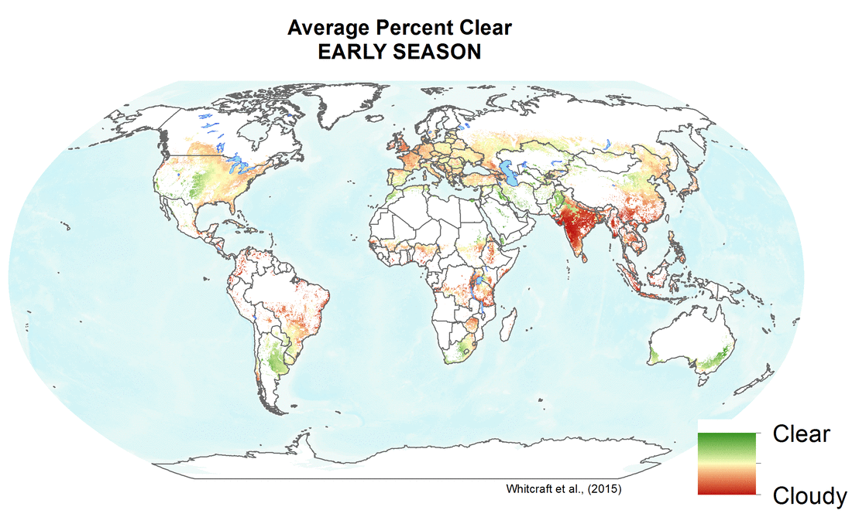
Requirements Summary: Timeline
2010 Defourny Diagram
2012-2014 GEOGLAM Reqs v1
2016-2017
R&D-driven Refresh
2017
CEOS Meeting
2018
Ispra Meeting
  Conceptual requirements
  Spatially explicit requirements by product/variable and by sensor type
  Question template to R&D sites
  New variables
  Minimum vs. preferred
  Discussion of R&D results, recognition of need for operational perspective
  State of use unknown
  Survey deployed
  National Users
  Regional Users
  Global Users
  Platforms for Use

Slide 3
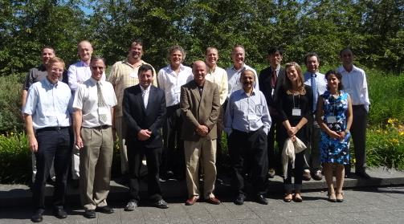
GEOGLAM CEOS Workshop on Observation Requirements
CSA, Montreal July 10-11, 2012
The original group (2012)
Tabulating the satellite observation requirements
(spatial resolution, frequency, and period of coverage)
for GEOGLAM
16 participants
Notes:
Original group – many familiar faces

Slide 4
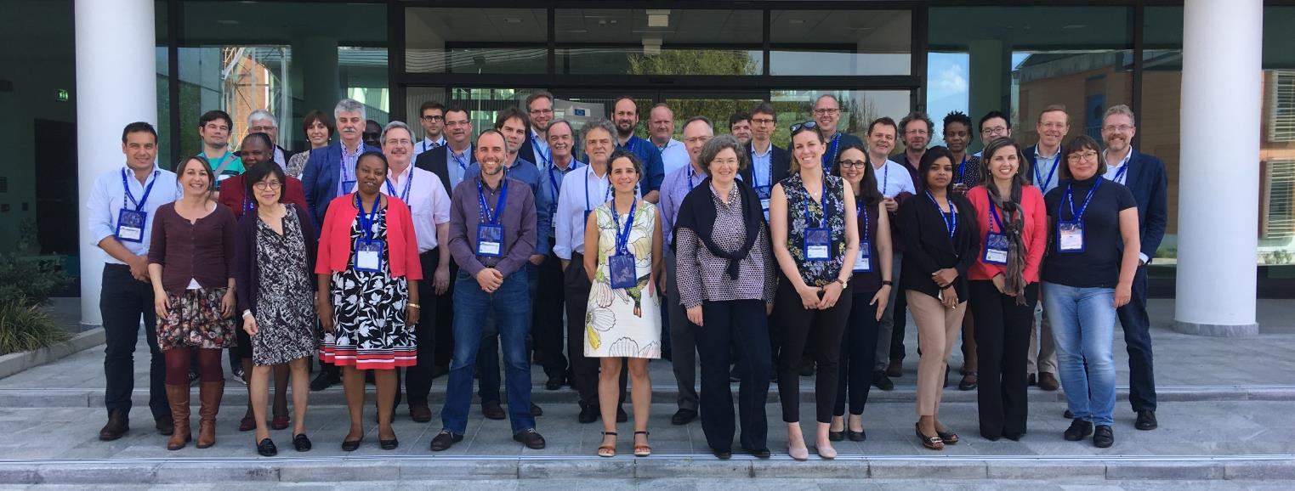
GEOGLAM Workshop on Operational User Requirements
EC JRC, DG GROW Support, Ispra 17-18 April 2018
~40 participants
More diverse, greater numbers –
representative of growing community
priorities and visibility of EO in key decision making processes

Slide 5
Four Sources of Information
Original Requirements Document (2012-2014)
Requirements Template Sent to JECAM & Asia-RiCE sites (2016)
GEOGLAM Requirements Survey (April 2018)
Ispra Requirements Meeting (April 2018):
  Presentation Templates
  Collective Discussion + breakout groups

Slide 6
1. Original Requirements Table
(2012-2014)

Slide 7
2. Requirements Template Sent to JECAM & Asia-RiCE Sites

Slide 8
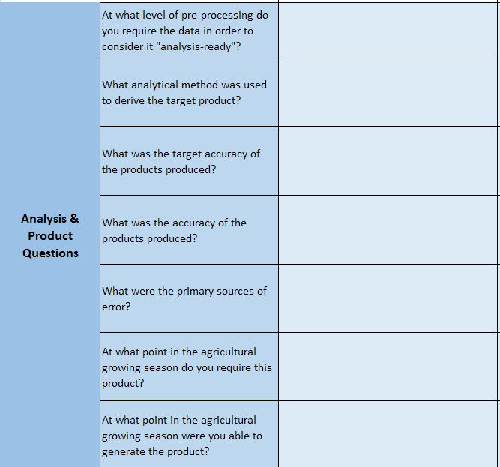
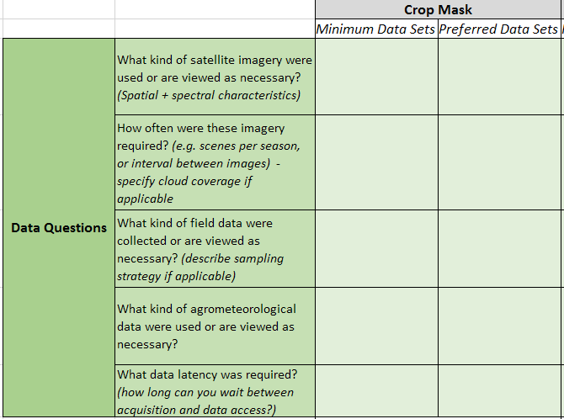

Slide 9
Response Summary – By Target Product/Variable
 | Product | Number of Responses
 |  | Small | Medium | Large | TOTAL
Version 1 of Survey (Aug – Sep 2016) Pre-Kiev | Crop Mask | 7 | 1 | 7 | 15
 | Crop Type Mask | 6 | 2 | 7 | 15
 | Yield Forecast | 6 | 1 | 4 | 11
 | Yield Estimate | 6 | 2 | 6 | 14
 | LAI | 5 | 2 | 7 | 14
 | Biomass | 4 | 2 | 6 | 12
Version 2 of Survey (Oct 2016 – Present) | Soil Moisture | 1 | 0 | 1 | 2
 | ET | 1 | 0 | 0 | 1
 | Crop Calendars / Phenology | 1 | 0 | 0 | 1
 | FAPAR | 0 | 0 | 0 | 0
 | Agricultural Practices | 0 | 0 | 0 | 0
 | Pest Management | 0 | 0 | 0 | 0
 | Emissions Monitoring | 0 | 0 | 0 | 0

Slide 10
FOR EXAMPLE…
Crop Type Mask
 |  | SMALL FIELDS |  | MEDIUM FIELDS |  | LARGE FIELDS
EO DATA |  | Minimum | Preferred | Minimum | Preferred | Minimum | Preferred
 | SPATIAL | 10 m | 2 m | 10-30 m | 10 m | 30-250 m | 10 m
 | SPECTRAL | Cloudy areas: SAR** VIS NIR SWIR | Cloudy areas: SAR VIS NIR SWIR | VIS NIR SWIR QuadPol SAR | VIS NIR SWIR (2) + Red Edge QuadPol SAR | VIS NIR SWIR SAR | VIS NIR SWIR SAR
 | REVISIT (Cloud Free) | 4 per season | 10 days | 1 SAR, 1 Optical per 2 months | 1 SAR, 1 Optical per 1 Month | 2/season to monthly | 6/season to 4x/month
 | LATENCY | 1 month | 2 weeks | * | * | 7 days | 3-7 days
Notes:
For very large fields, MODIS is OK… use 5-10 day product + a single Landsat view
*Low response from medium sized fields (n=2) on this variable skewed response
**No specificity on polarization or band
Notes:
Large field req’s are almost the same for Crop Type but VIS NIR vs. VIS NIR SWIR… not sure that was intentional or just a relic of quickly filling in the template

Slide 11
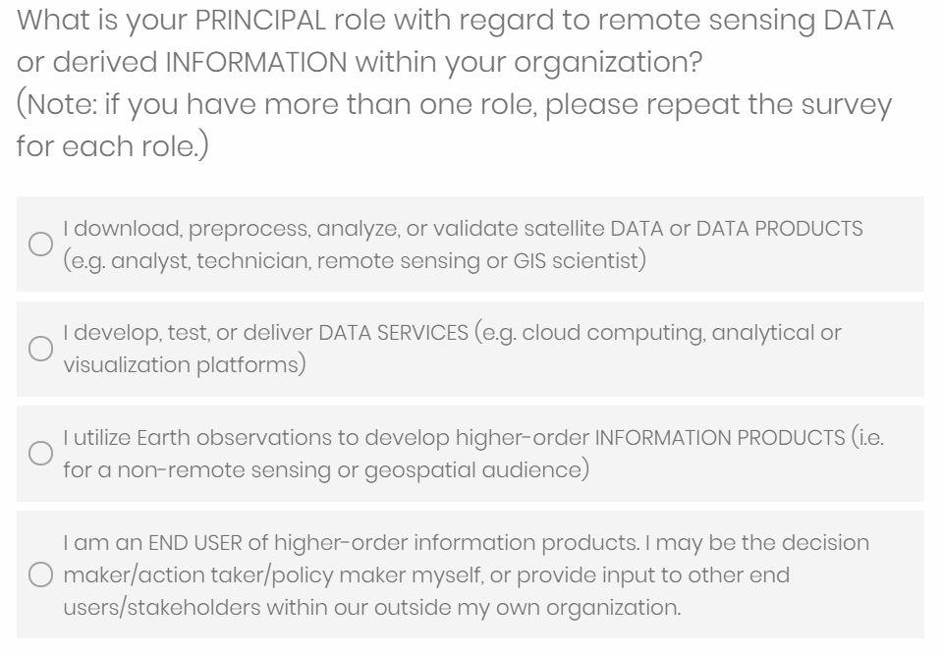
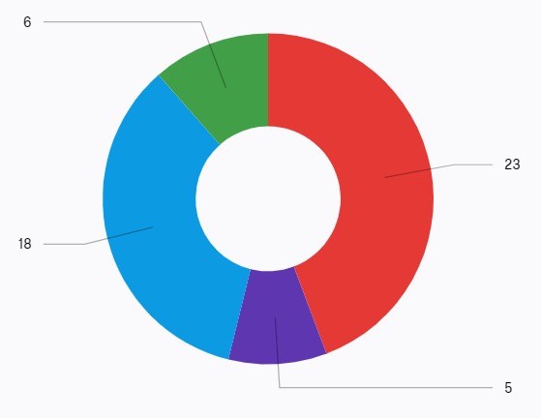
3. GEOGLAM Survey
23 RS Techs
5 ICT
18 Info Producers
6 End Users

Slide 12
Survey Demographics
“In which geographic areas do you work?”
Global = 23
Regional:
  Africa = 12
  Europe = 11
  Asia = 7
  Latin America & Caribbean = 6
  Middle East = 5
  North America = 0
  Oceania = 0
National:
  Canada = 5
  Ukraine = 3
  Germany = 3
  US = 2
  Belgium = 2
  Cambodia = 1
  France = 1
  Brazil = 1
  Australia = 1
“Developing Countries” = 2

Slide 13
Survey Demographics
Expertise (common words):
Sector (select multiple):
  40/51 = Research
  25/51 = government
  8/51 = NGO
Levels of Work (select multiple):
  47/51 = National
  40/51 = sub-national
  36/51 = multi-national region
  31/51 = county or municipal
  28/51 = field
  26/51 = global
  22/51 = community or village
Remote sensing - GIS | 32
Agriculture | 27
Data Science | 14
Other | 7

Slide 14
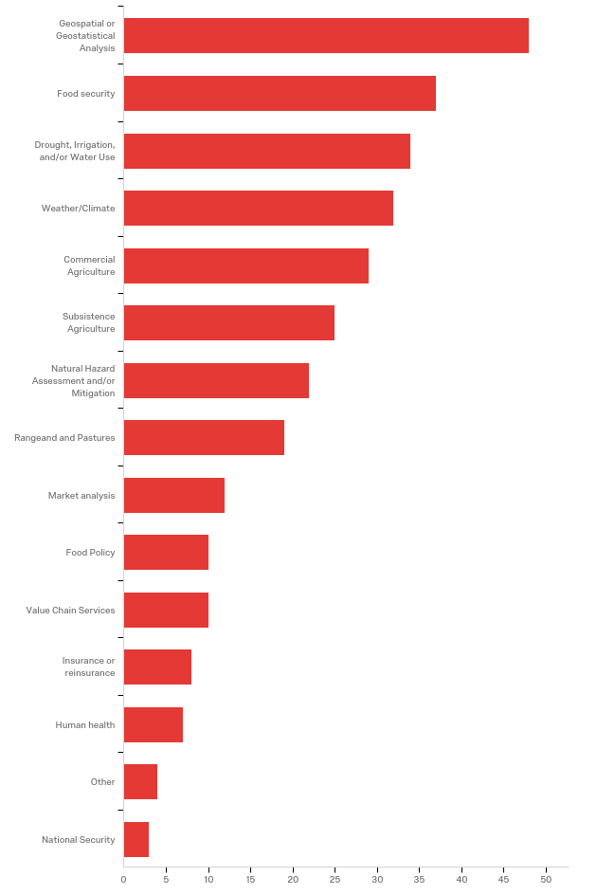
Survey Demographics
“In which thematic areas does your organization focus? (select all that apply)”
Intersection

Slide 15
4. Ispra Meeting
Power Point templates
Breakout groups
Broader discussion

Slide 16
Power Point Templates
Prompts/Questions to National, Regional, Global Users
Reports:
  Type of reports
  Frequency of reports?
  Use of EO in reports?
  Audience/End Users?
  Decisions/Actions/Policies sought to impact?
EO Data usage:
  Missions used
  What is ARD to you?
  Gaps?
  Drivers of gaps?
  Priorities for filling gaps?
  Other products desired? [toward EAVs]

Slide 17
Reports
(Count of Mentions)
Product Type and Frequency:
Season reports | 7
Monthly reports | 5
Weekly reports | 3
Scientific publications | 3
Semi-annual or annual reports | 2
Bi-Weekly reports | 1
Geospatial tools | 1
Products contain:
Area & Yield & Production statistics | 7
Data / Visualizations (maps etc.) | 6
Agroclimate data | 5
Crop Conditions | 5
Ancillary data | 4
Climatic risks | 4
Decisions/Action/Policy Impacts:
Ag production | 5
Food Security | 4
Natural resources | 2
Market Stability | 2
Water availability/Quality | 1
Ag Industry planning | 1
Audience:
Government | 5
Agricultural and Environmental Sector | 4
Industry | 3
International Audience | 2
Universities / Research Institutes | 1
Geospatial data in reports:
NDVI anomalies | 6
Climate data (rainfall, temperature, etc.) | 5
Coarse resolution imagery | 2
Landcover products | 2
ET estimates | 1
ET anomalies | 1
classified field boundaries | 1
Aircraft observations | 1
End Users/Stakeholders
Ministries / Government | 10
NGOs | 5
Farmers | 4
Ag Industry | 4
Farmer Associations | 3
Traders | 3
Media | 1

Slide 18
EO Data Usage
(Count of Mentions)
Gaps / Products that would be most valuable:
Soil moisture | 6
ET | 6
FAPAR | 6
Ag Practices | 3
Emissions Monitoring | 3
LAI | 2
Pest Management | 2
Crop Calendars | 2
High res data (10-15m) with high temporal frequency (5-10 days) | 2
Data continuity | 2
Land Use | 2
EO based yield | 1
Season climate outlook | 1
Carbon | 1
fine resolution landcover mapping | 1
Multi-polarization, High Resolution and high repeat SAR data | 1
SAR data (not C-Band) | 1
EO Data / Satellites used
MODIS (Aqua-Terra) | 8
Landsat | 7
Sentinel-2 | 7
Sentinal-1 | 5
NOAA data | 2
SMOS | 2
GOES | 1
NPP | 1
PROBA V | 1
in situ weather | 1
SPOT high res | 1
Resourcesat 2/2A | 1
RISAT-1 | 1
Radarsat-2 | 1
ALOS | 1
PALSAR | 1
SRTM | 1
VIIRS | 1
What is Analysis Ready Data:
MODIS VI Time series / composites | 4
Biophysical variables (NDVI, LAI, Et, Biomass, etc.) | 4
Radiometric and geometric corrected | 3
Landsat Reflectance Images | 1
Land Use / Land cover products | 1
Orthorectified surface reflectance or backscatter | 1
Harmonized data sets | 1
Cloud masking | 1
EO data gap reasons:
Insufficient methods | 6
Cost | 5
Technical capacity | 5
Computational capacity | 4
Coverage | 2
political barriers, etc. | 2
Access (internet connectivity/data policy) | 1
Priority for gap filling:
Yield prediction | 3
New platforms being launched | 1
SAR data analysis and Yield Modeling | 1
Piloting cloud processing | 1
New machine learning methods | 1
Big Data processing | 1
Agreement on scientific-technical cooperation | 1
Frequency of products such as daily | 1
up-to-date crop masks | 1
Taking advantage of more freely accessible data | 1
Implement policy in the Ministry for EO data use | 1

Slide 19
GEOGLAM’s Role as Curator of
Data, Products, Knowledge, and Technology
Communicating data requirements to CEOS
Developing a Knowledge Management System
Endorsing Products and Services
  “There are more and more end user near real time EO products on the market and it is difficult to be constantly updated and have a good idea about the quality of the products.” – End User
Coordination of Capacity Development Activities
  No solution with a challenge and user first identified (thanks, survey)
Connecting and optimizing functionalities and services of ICT
  No appetite for a single, unified GEOGLAM data services platform
  Rather, as a federator

Slide 20
Feedback to CEOS:
Acquisition, Access, Adoption, and Sustained Use
GEOGLAM-CEOS Coordination on Data QA/QC
  Interoperability
  Possible suggestion from GEOGLAM on “standard agricultural monitoring spectral bands”
Analysis Ready Data (ARD), Application Ready Data (ARD+) and EAVs
  Integration with LSI-VC efforts on CARD4L
  Task force between GEOGLAM and WG Cal/Val LPV to develop validation protocols for a set of “standard” EAVs
Data Continuity and Observation Priorities
  For all agricultural systems, 10-30m time series product, coherent with historical 100m+ observations
  For smallholder systems, <10m data with high temporal resolution (cloud-free weekly to biweekly)
  In addition to C-band systems (S1 and RCM), access to multi-frequency SAR systems (including X and L)
  Missions with bandwidths at 1.9, 2.0, 2.1 microns to target soil quality and organic content monitoring
  Passive microwave continuity
  ~50m thermal observations every 2-3 days
Coordination on Capacity Development Activities

Slide 21
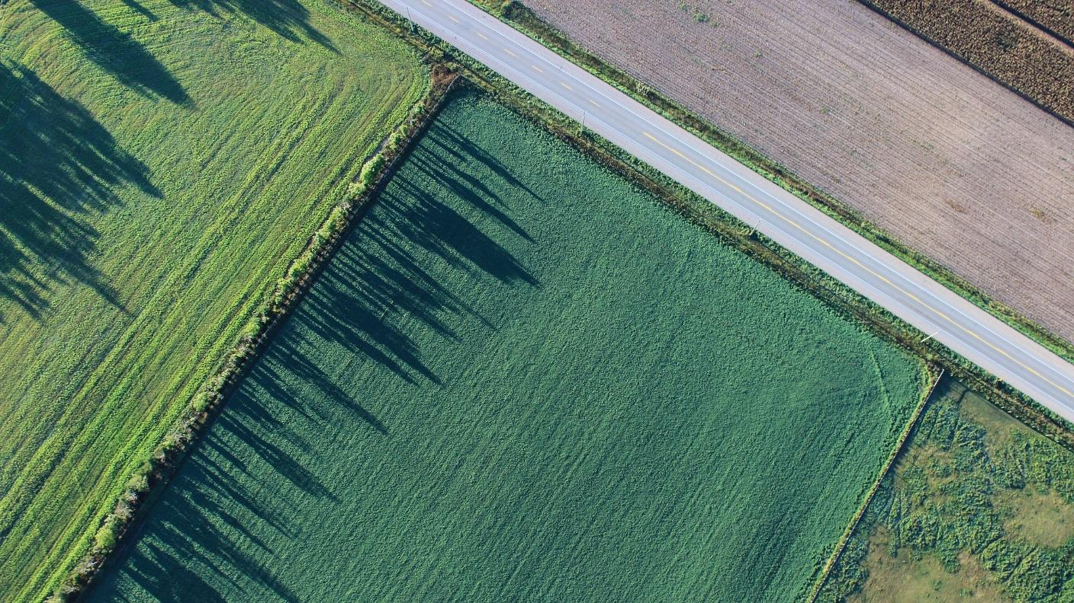
Culling Template and Survey Responses

Slide 22

EO Data: Missions & Data Type
Across “operational users” [templates], RS Techs, ICT:
  Most used now and in past (order): L7, L8, S2, MODIS Terra, S1, MODIS Aqua
    Followed by Spot-VEG, Rapid Eye, and CBERS
  SMAP scarcely used
  VIIRS scarcely used (11/23 RS technicians said “do not & will not use”)
  Popular satellites no longer used = L7 and Spot-VEG
17/21 RS Techs and 3/4 ICT respondents prefer GeoTIFF
Pre-processing levels (RS Techs can check multiple):
  14/23 = L1B
  12/23 = L2
  10/23 = L3
  Several said, “very well cloud-screened, dense optical time series”
Recall that 40/51 survey respondents identified “research” as their sector

Slide 23
EO Data: Access
Latency requirements for RS technicians [could check multiple]:
  <12 hours (7/23 respondents)
  <24 hours (6/23 respondents)
  <3 days (5/23 respondents)
RS Technicians:
  11/23 use cloud-based platform for processing/analysis
  8/23 use local hardware for processing/analysis
  2/23 use both
  Note: in theory, all things fit in the cloud.
    What drives users to choose local vs. cloud?
      [not asked – this meeting]
Where do people get their data?
GEE | FS TEP
IKI VEGA | Sentinel Hub
AWS | IPT
MDA | ESA SciHub
USGS Earth Explorer | GLOVIS
Sen2Agri | Planet
NASA

Slide 24
EO Data: Do people have what they need?
10/25 RS Techs + ICT developers had access to all the EO data they needed
Info producers identified gaps:
  Interested in EO, unsure how to incorporate into system
  EO too unreliable to implement operationally
What was missing?
  8 said “high resolution imagery” or “VHR time series” as comment
  Integrating state of the art = hard
    Need for training
    Cloud computing = opportunity, but challenge
  In situ data commonly mentioned in comments section throughout survey
  Communication of value of EO (institutionalize use)
  Interoperability, cost, cloudiness, access also mentioned
Recall, from templates:
EO data gap reasons:
Insufficient methods | 6
Cost | 5
Technical capacity | 5
Computational capacity | 4
Coverage | 2
political barriers, etc. | 2
Access (internet connectivity/data policy) | 1
Priority for gap filling:
Yield prediction | 3
New platforms being launched | 1
SAR data analysis and Yield Modeling | 1
Piloting cloud processing | 1
New machine learning methods | 1
Big Data processing | 1
Agreement on scientific-technical cooperation | 1
Frequency of products such as daily | 1
up-to-date crop masks | 1
Taking advantage of more freely accessible data | 1
Implement policy in the Ministry for EO data use | 1

Slide 25
ARD and ARD+ for
Info Producers
Recall, from templates:
Question | Extremely useful | Very useful | Moderately useful | Slightly useful | Not at all useful | Total
NDVI Time Series | 10 | 5 | 1 | 0 | 1 | 17
Raw or Pre-processed Satellite Data (e.g. Digital numbers, reflectance, radiance) | 10 | 2 | 2 | 3 | 0 | 17
Precipitation Sum | 6 | 7 | 1 | 1 | 1 | 16
Precipitation Anomaly | 6 | 6 | 1 | 2 | 1 | 16
Soil Moisture | 6 | 5 | 4 | 0 | 2 | 17
Evapotranspiration | 6 | 4 | 3 | 2 | 1 | 16
ET Anomaly | 6 | 3 | 4 | 2 | 1 | 16
Soil Moisture Anomaly | 5 | 5 | 5 | 0 | 2 | 17
Other | 5 | 3 | 0 | 1 | 0 | 9
NDVI Anomaly | 4 | 9 | 2 | 0 | 1 | 16
Temperature Anomaly | 4 | 7 | 3 | 1 | 1 | 16
Growing Degree Days | 4 | 5 | 6 | 0 | 1 | 16
NDVI Value | 3 | 8 | 4 | 0 | 1 | 16
EVI Value, Time Series, or Anomaly | 3 | 4 | 4 | 3 | 1 | 15
Vegetation Condition Index | 3 | 6 | 5 | 1 | 2 | 17
Other | 3 | 2 | 0 | 1 | 0 | 6
Temperature Sum | 2 | 5 | 7 | 1 | 1 | 16
What is Analysis Ready Data:
MODIS VI Time series / composites | 4
Biophysical variables (NDVI, LAI, Et, Biomass, etc.) | 4
Radiometric and geometric corrected | 3
Landsat Reflectance Images | 1
Land Use / Land cover products | 1
Orthorectified surface reflectance or backscatter | 1
Harmonized data sets | 1
Cloud masking | 1
Other:
ET sum
SAR coherence
LSWI
MV Composites of NDVI
Land cover and crop mask products
LAI
Biomass
Dew points

Slide 26
Capacity for Utilizing EO
80% of RS Techs, 83% of Info Producers agree, “I’m fully confident in my individual usage of EO”
100% of RS Techs, 69% of Info Producers agree, “I would benefit from professional development or training on cutting edge EO technologies.”
70% of RS Techs agree, “My institution requires additional technical support to download, process, and/or utilize EO.”
Among RS Techs:
  55% disagree with, “I prefer to perform all preprocessing of my satellite data products.”
  90% agree, “I see value in being able to download and utilize higher-order data products” → strong support for EAVs [not named as such]

Slide 27
EO Products [RS Tech Perspective]
Toward EAVs
Product | Extremely important | Very important | Moderately important | Slightly important | Not at all important | Total
Crop Mask | 17 | 1 | 2 | 0 | 0 | 20
Crop Type Map/Planted Area | 14 | 4 | 2 | 0 | 0 | 20
Yield Estimation (end of season) | 8 | 9 | 1 | 2 | 1 | 21
Yield Forecast | 7 | 8 | 2 | 2 | 0 | 19
Biomass | 6 | 9 | 4 | 1 | 1 | 21
Current year phenology | 7 | 7 | 5 | 1 | 0 | 20
Usual Crop Calendars | 5 | 9 | 4 | 3 | 0 | 21
Cropping cycles | 5 | 9 | 5 | 2 | 0 | 21
Water use (e.g. map of irrigation vs. rainfed) | 5 | 8 | 4 | 2 | 1 | 20
LAI | 7 | 4 | 6 | 4 | 0 | 21
Soil Moisture | 6 | 5 | 4 | 5 | 0 | 20
Growing Degree Days | 2 | 9 | 5 | 3 | 1 | 20
ET | 5 | 5 | 7 | 2 | 0 | 19
FAPAR | 4 | 4 | 6 | 4 | 0 | 18
Field size | 4 | 2 | 9 | 4 | 1 | 20
Other | 1 | 1 | 0 | 0 | 0 | 2
Notes:
Biomass seems lower level than the others… biomass as input? Or biomass as its own product?

Slide 28
Communicating EO Value
We are doing well, but could improve demonstration of value of EO to end users, and connections between info producers and end users:
  55% of Info Producers strongly agreed that they had “a clear understanding of the needs of those who use the information I generate.”
  89% of Info Producers & 83% of End Users agree, “EO have made an impact on decisions, actions, or policies made by my organization.”
  89% of Info Producers & 67% of End Users agree, “My organization would be worse off without EO”
But they want it:
  83% of Info Producers & 100% of End Users agree, “My work would benefit from increased use of EO”
  0% of End Users strongly agreed, “My information needs are currently being met, regardless of source.” [83% “somewhat agreed”]

Slide 29
A Quote from an Info Producer
“EO uptake is hindered by lack of skills in Big Data Analytics (large volume use at high resolution, machine learning expertise). EO data users often lack relevant programming skills (usually because their background is other than computer science). Space data management is often done by EO users, not by ICT experts, leading to sub-optimal data access. Integration with non-EO geospatial reference data is poorly developed, partly because few relevant sets are accessible as open data, partly because of missing Big Data Analytics skills. We can only have more sensors if we learn to work with the current data load effectively.”
Notes:
If GEOGLAM is going to curate data – do we need to bring in computer scientists to make it effective?

Slide 30
In Sum…

Slide 31
Some takeaways (1)
Need for common definitions [difficult to analyze responses because of how people understood words used in prompts and questions… live and learn ☺]
People are using the “workhorse” free and openly available satellites the most
  But slow to adopt new missions like VIIRS and SMAP
  SAR is a huge area of interest – best practices require improvement, capacity development = critical
Huge demand across the board for dense, high resolution optical time series [usually requested as NDVI]
  To realize this, interoperability in moderate resolution domain is critical
  At the same time, huge discrepancies in definition of “interoperability” (I mean – intercomparable through both TIME and SPACE – e.g. you could construct a coherent time series, or do a decadal change analysis using multiple missions)
Increasing communication between info producers and end users is a priority
  On value of EO in decisions
  On where/how EO can fit into reporting system
    Need for some level of “guarantee” of long-term observation availability of EO products
    Need for curation on EO data and product quality and veracity
  On how EO can meet policy mandates (and how they intersect, to minimize duplication of effort)

Slide 32
Some takeaways (2)
In situ data are a huge challenge – who could coordinate?
Integrating state of the art is hard
  For optimal data management, data users need training, but also need to have ICT experts (computer science) integrated in data management
    Cloud computing is already strongly used, but not universally. Why? – not asked.
  People often prefer webinars or short courses; but we know these are the least effective. How to handle trade off between busy schedules and effective knowledge transfer?
ARD, ARD+, and EAVs → early articulation through the survey, but a working group needed to follow up on precise definitions as well as priority products at each level

Slide 33
Top Priority Requirements (P. Defourny)
Thermal IR at 30 to 80 m on 1-3 day revisit cycle (2-7 “clear views”/wk)
  Huge impact on monitoring crop conditions and yield estimation, particularly in water limited systems
The “dream” for agricultural monitoring:
  Daily Global 10m VIS + Red Edge + SWIR (+ cloud screening bands)
  AND
  2-4 days 10-20m C-band SAR dual pol every 2 to 4 days (cloudy areas/times)
  We are getting close to that by 2022 (L9 (~2020) and S2C (2023) launches being successful) if:
  - S2A&B are maintained beyond their nominal 7-y mission and S2C&D not delayed for that reason
  - L8&9 are geometrically aligned to S2 and both S2 and L8 made compatible (already more or less OK for classification as in Sen2Agri but HLS or more to be done for NDVI sensor agnostic and Biophysical variables)
  CLOUD and CLOUD SHADOW SCREENING → remain serious concern, need to move beyond ACIX to operational solution
Increased SAR coverage over very cloudy areas during peak of growing season (esp. Africa – Sen1C planning)
  Near synchronous multifrequency observations ((roughness, rainfall, soil moisture)
Notes:
. Thermal IR at 30 to 80 m on daily to 3 day revisit cycle would change completly the monitoring of the crop conditions and the yield estimate, in particular in water limited cropping systems but also for winter kill of winter crops, and the water productivity assessment (irrigation).

Slide 34
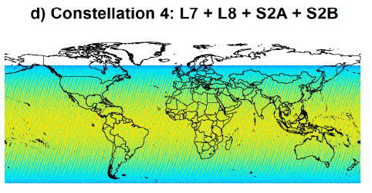
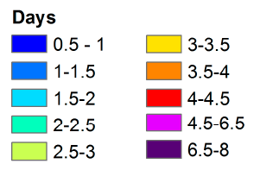
How do we prepare for 2035 a historical time series of weekly / decadal global cloud free observation ?
Sentinel-2A&B + Landsat-8&9 Solution ?
10-20-30 m for 13+ bands including SWIR
revisit of 1,5 -2,5 days for most regions
good overpass time (10:30 P.M.)
no redundancy
technical compatibility and latency (tbc)
very large bandwidth requirement
very big data handling, reprocessing feasibility?
=> Probably a too heavy solution with still too many gaps
2015
2020
2030
S-2 A B C D
L-8 L-9 L-10
Whitcraft et al. RS 2014

Slide 35
Top Priority Requirements (P. Defourny)
In case of the unavailability of the computing resources necessary to get a daily global 10m rapidly,
and the unavailability of precise orbitography in due time, the data latency will never be reduced.
A reasonable option is to have fast track processing chain (e.g. MODIS LANCE NRT) to get very rapidly a 50 to 100m daily imagery from the 10m observation (aggregation on board or as soon as it is received).
  First this could be a easiest way to build a consistent long term time series at 100m resolution (as a followup of the MODIS 250-VIIRS 375). Second, degrading a 10m to 100m provide a much sharper imager because of the PSF effect reduction. (See Annex)
Notes:
. Thermal IR at 30 to 80 m on daily to 3 day revisit cycle would change completly the monitoring of the crop conditions and the yield estimate, in particular in water limited cropping systems but also for winter kill of winter crops, and the water productivity assessment (irrigation).

Slide 36
How do we prepare for 2035 a historical time series of weekly / decadal global cloud free observation ?
A 100 m Solution from Sentinel-2A&B + Sentinel-3A&B ?
S2 100 m fast track processing line
light data handling (200 less and faster)
reduced latency because of no need of high quality orbit data
downscaling of 300 m OLCI to 100 m S2 products for gap filling
great MTF / PSF because of 10 m obs. aggregation
redundancy from 2024 onwards
reprocessing feasibility for long term collection improvement
=> A serious candidate for a sustainable long term solution
2015
2020
2030
S-2 A B C D

Slide 37
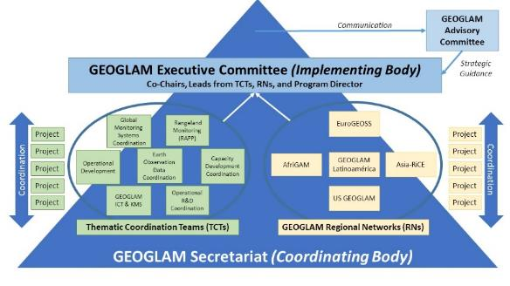
Next Steps for Thematic Coordination Team on
“EO Data Coordination and Management”
Seeking co-leadership within GEOGLAM for the “management” portion
Settle on definitions for EAVs and products
  Task force established by GEOGLAM
  Support from CEOS [see Ian’s later presentation]
Finalize new EO requirements table (drumroll, please)

Slide 38
Notes:
Coarse and moderate resolution have been redefined, as the game has changed
New variables added, broken down by priority in line with proposed EAV structure

Slide 39
* Addendum
Optical: 700-1400 nm (VIS NIR) + 1400-3000 nm (SWIR) + 8000-14000 nm (thermal)
Optimal bandwidths and channel locations to-be-articulated; 1900, 2000, 2100 broadly useful for soil classification (applications in precision management)
Passive Microwave: emphasis on continuity (SMAP, AMSR-E, SMOS, TRMM)
SAR: C-band is highest priority, followed by X and L-band
** Field Sizes (indicated in gray section)
X = All sizes
S = < 1.5 ha
M = 1.5 - 15 ha
L = > 15 ha
*** General Guidance
Latency: <3 days for most products and applications
Pre-processing levels: all to a minimum of terrain-corrected surface reflectance
Cirrus band must be included for atmospheric adjustment

Slide 40
Thank you!
Questions – akwhitcraft@geoglam.org
Thanks to all respondents and participants, and Brian Barker (UMD) for help with analysis.

Slide 41
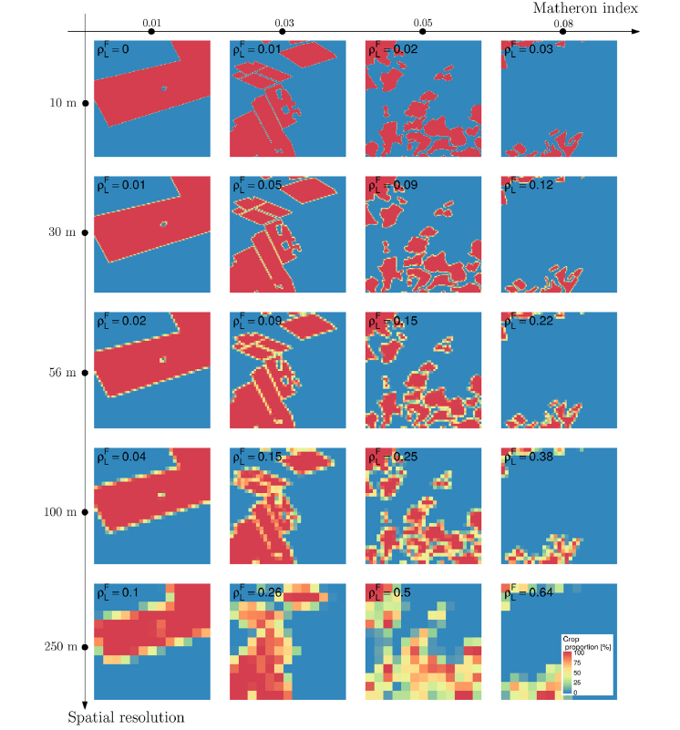
50 to 100 m resolution to go beyond large scale patterns
50 to 100 m spatial resolution most appropriate to deal with cropland / crop type spatial fragmentation
daily or twice daily observation to get several cloud free obs. per week (min. one/ week in cloudy regions)
no variation along scan line and limited BRDF effect
limited PSF dilution (maybe thanks to on-board aggregation of higher resolution observation)
10m
30m
Pixel purity as a function of spatial resolution for different cropland landscape fragmentation
(4 actual ag. landscapes in South-Africa)
56 m
100m
250m
Waldner and Defourny, RS2017

Slide 42
How do we prepare for 2035 a historical time series of weekly / decadal global cloud free observation ?
Sentinel-2 Solution ?
10-20 m for 13 bands including SWIR
daily with 4 satellites from 2024
good overpass time (10:30 P.M.)
no redundancy
very large bandwidth requirement
very big data handling, reprocessing feasibility?
=> Probably THE cornerstone for long term monitoring land from 2030-35
2015
2020
2030
S-2 A B C D

Slide 43
How do we prepare for 2035 a historical time series of weekly / decadal global cloud free observation ?
Sentinel-2A&B + Landsat-8&9 Solution ?
10-20-30 m for 13+ bands including SWIR
revisit of 1,5 -2,5 days for most regions
good overpass time (10:30 P.M.)
no redundancy
technical compatibility and latency (tbc)
very large bandwidth requirement
very big data handling, reprocessing feasibility?
=> Probably a too heavy solution with still too many gaps
2015
2020
2030
S-2 A B C D
L-8 L-9 L-10
Whitcraft et al. RS 2014

Slide 44
How do we prepare for 2035 a historical time series of weekly / decadal global cloud free observation ?
PROBA-V 100m continuity solution ?
100m for 4 bands including SWIR
morning overpass time (10:30 A.M.) (complementarity with VIIRS)
twice daily with 2 satellites
technically simple for a great consistency
redundancy
NRT (<3 h.) and up to 12-18h. for highest fidelity orbit data
China-Belgium joint venture no longer planned
=> A great opportunity to build on PROBA-V 100m lessons learnt

Slide 45
How do we prepare for 2035 a historical time series of weekly / decadal global cloud free observation ?
Commercial small sat. solution calibrating doves on Sentinel-2 ?
100m for 4 bands but no SWIR
variable overpass time
daily with 100’s satellites
technical feasibility (tbc)
consistency feasibility (tbc)
redundancy
=> A innovative opportunity based on market availability

Slide 46
How do we prepare for 2035 a historical time series of weekly / decadal global cloud free observation ?
A 100 m Solution from Sentinel-2A&B + Sentinel-3A&B ?
S2 100 m fast track processing line
light data handling (200 less and faster)
reduced latency because of no need of high quality orbit data
downscaling of 300 m OLCI to 100 m S2 products for gap filling
great MTF / PSF because of 10 m obs. aggregation
redundancy from 2024 onwards
reprocessing feasibility for long term collection improvement
=> A serious candidate for a sustainable long term solution
2015
2020
2030
S-2 A B C D

Slide 47

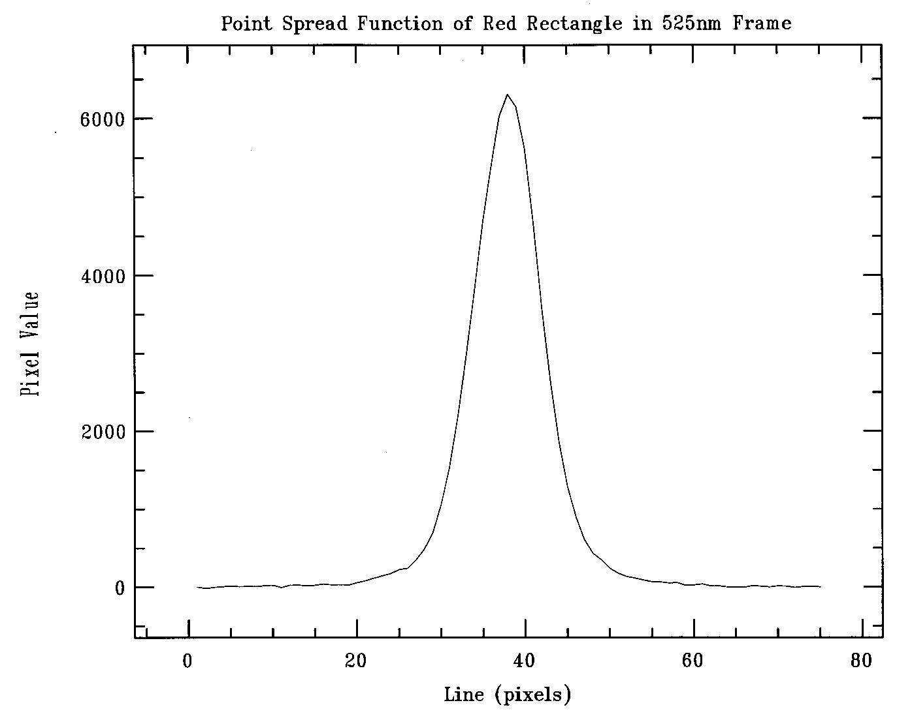
Impact of PSF / MTF
on ‘spatial resolution’
Pléiades – Perwez on 04/05/2018
simulated resolution
S2 derived like : 100 m
(from UCL – Skywin THEO project )

Slide 48

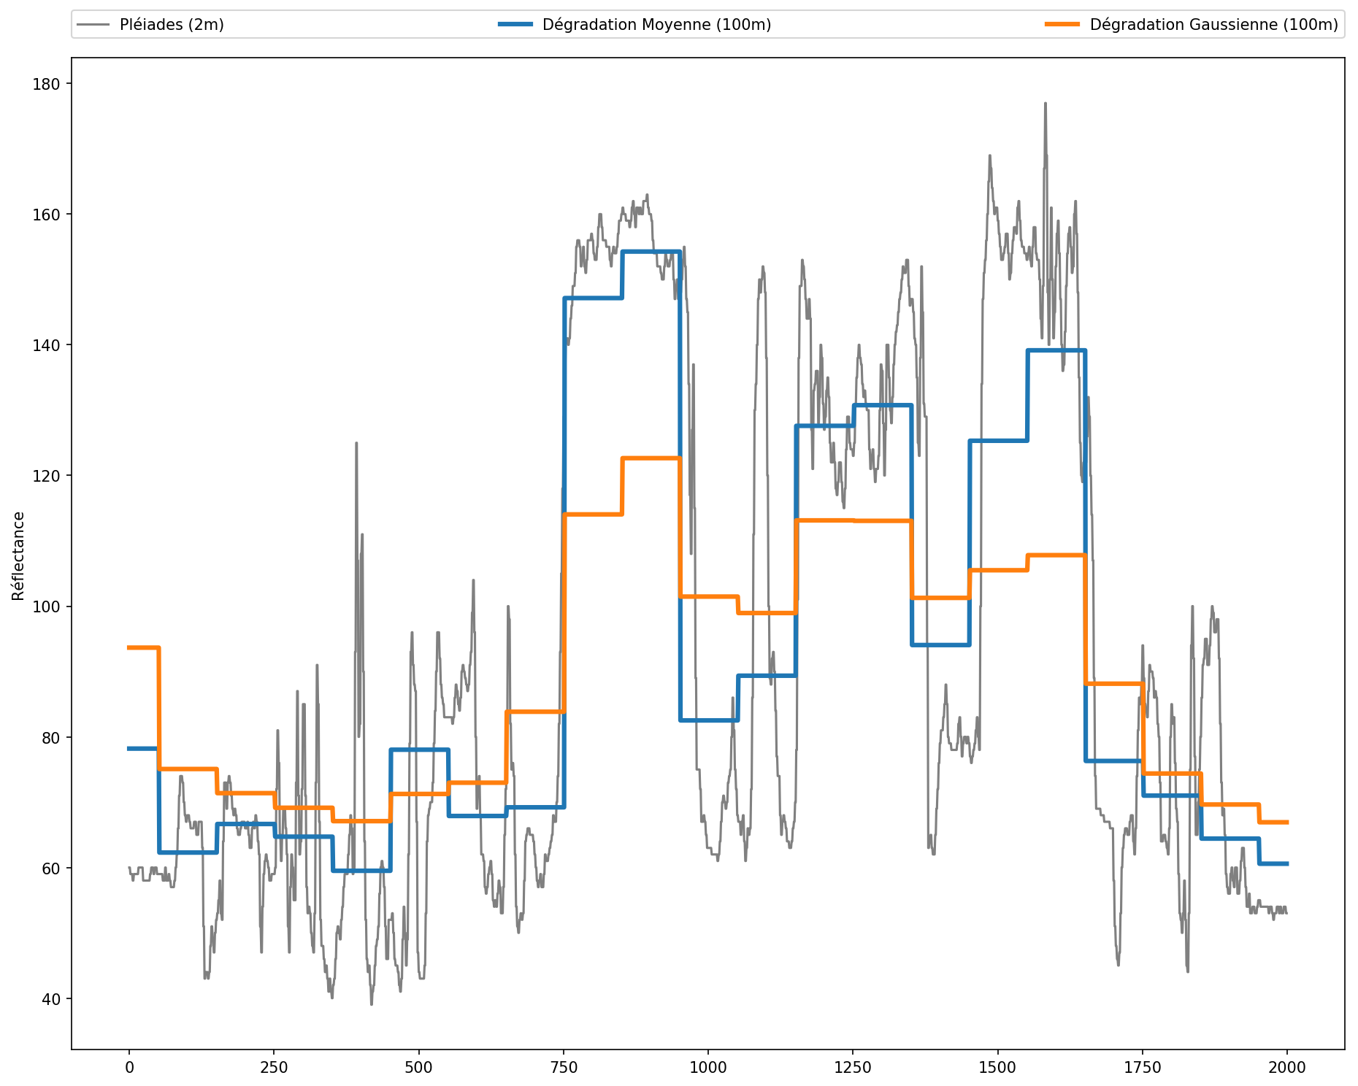
100m PROBA-V simulation
from Pléiades 4 May 2018
100m S2-derived simulation
from Pléiades 4 May 2018
Impact of PSF / MTF
on ‘spatial resolution’
Pléiades – Perwez on 04/05/2018
simulated resolution
S2 derived like : 100 m
(from UCL – Skywin THEO project )

Slide 49
Food for thought
Is the current plan for long term time series at coarser spatial and/or
poorer spectral resolution than today (VIIRS the only redundant solution ) ?
Need to define an harmonization strategy to insure an appropriate
global cloud free historical time series matching 2035 LT analysis for
all regions of the world (100-300 m) ?
Thank you for attention and your contribution to the discussion !

