Slide 1
Core Mission Status: Sentinel-1 and -2 ➔ Copernicus Ground Segment ➔ EC Global Land Service REDD
Frank Martin Seifert
EO Science and Applications Division
ESA Earth Observation Programmes

Slide 2
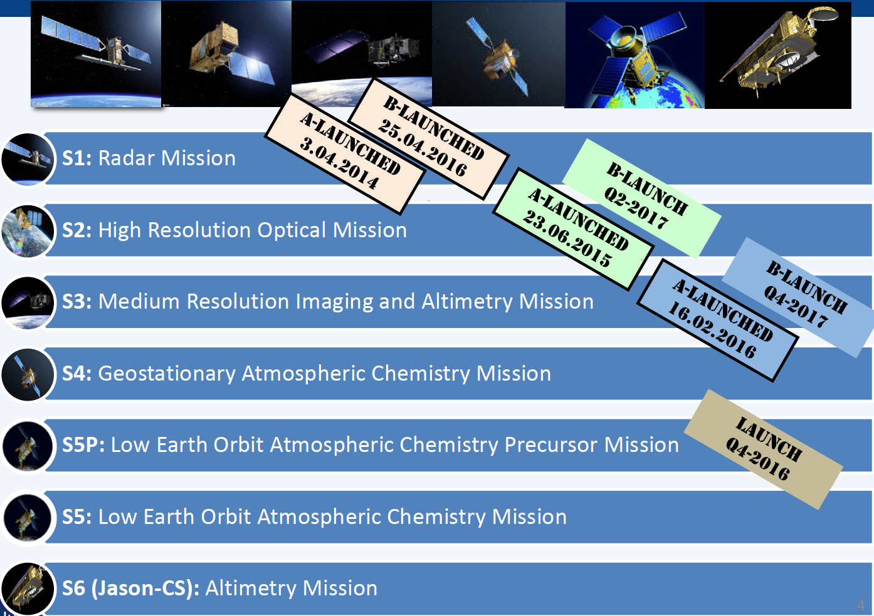
Copernicus: A New Generation of Data Sources
Copernicus is a European space flagship programme led by the European Union
ESA coordinates the space component
Copernicus provides the necessary data for operational monitoring of the environment and for civil security
Data policy: free and open access

Slide 3
Sentinel-1 Mission Operations Phases
Sentinel-1 full mission exploitation capacity based on the routine operations of the 2-satellite constellation ➔ gradually achieved
S1 Mission Routine Operations
S1 Mission
Operations
Qualification
S1A Routine Operations
S1A Operational qualification
S1A Space Segment Commissioning
S1B Space Segment Commissioning
S1A-Launch
3 April 2014
S1A IOCR
Sep
2014
1st S1A ROR
9 June
2015
S1B Launch
25 April 2016
S1B IOCR
Sep
2016
S1 Mission
ROR
~ early 2017

Slide 4
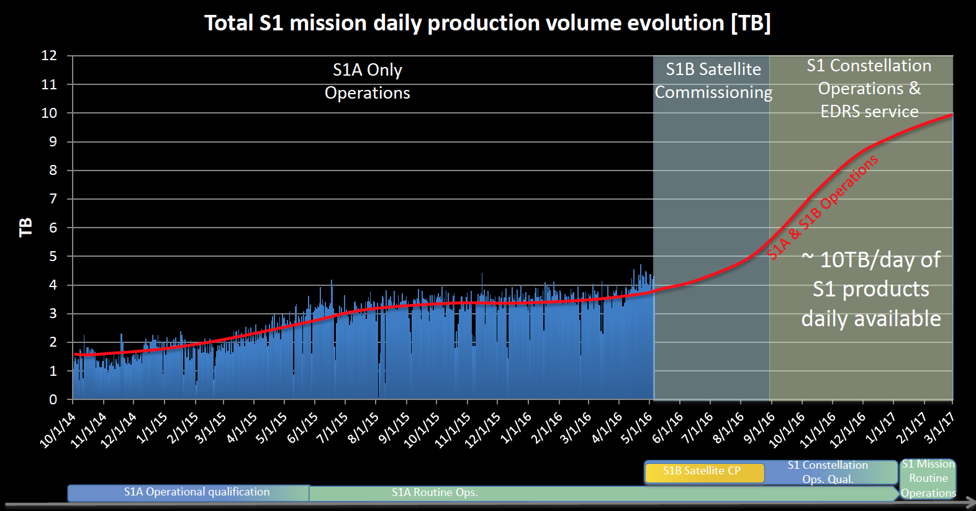
Sentinel-1 Operations Capacity Evolution

Slide 5
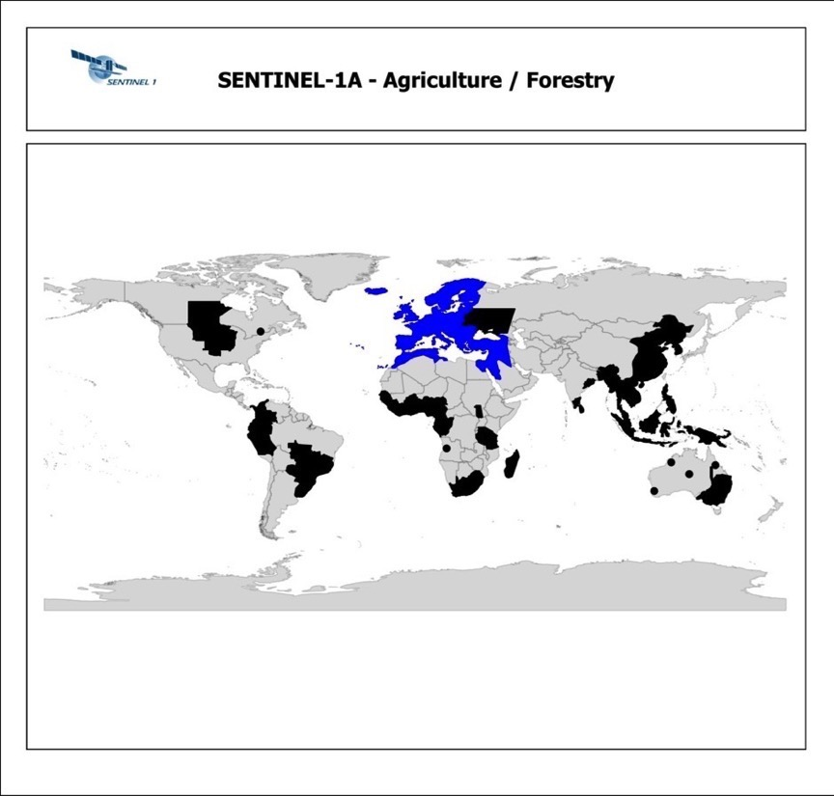
Sentinel-1 observation scenario
Agriculture and forestry priority areas
BLUE: Acquisitions in IW mode, VV+VH polarisation, every 12 days ascending and descending
BLACK: Acquisitions in IW mode, VV+VH polarisation, every 12 days in one pass
Repeat over parts of SE-Asia IW VV+VH currently every 24 days, plus complementary acquisitions in IW VV
North Andes and Tanzania covered with lower frequency (dedicated campaigns for forestry monitoring)
Agriculture focus: mainly based on requirements from
rice crop monitoring (e.g. GEOGLAM)
Forestry focus: mainly based on requirements from
GFOI
regions with high risk for illegal logging
Mostly cloudy tropical rainforests

Slide 6
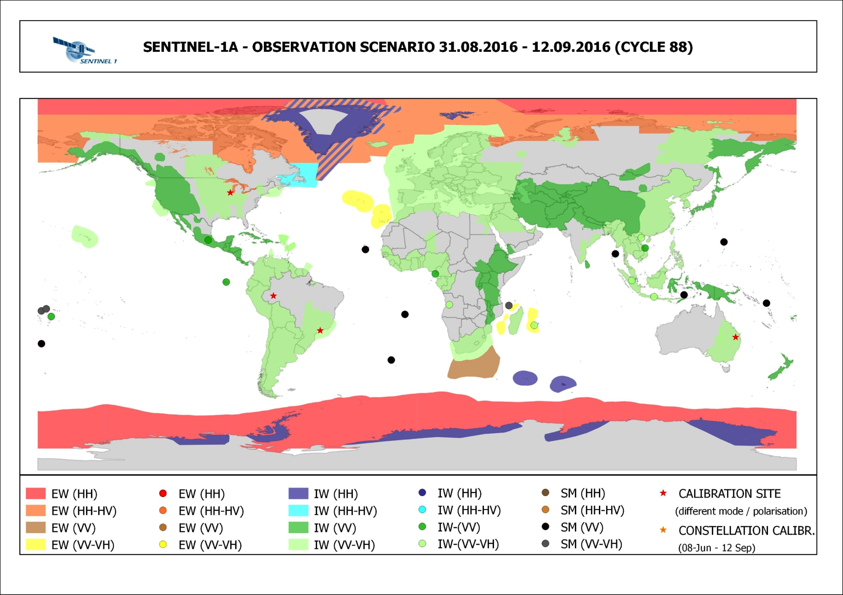
Sentinel-1 observation scenario

Slide 7
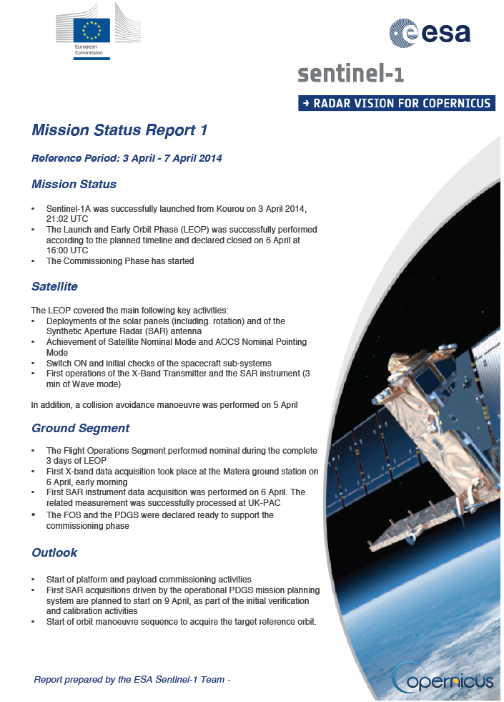
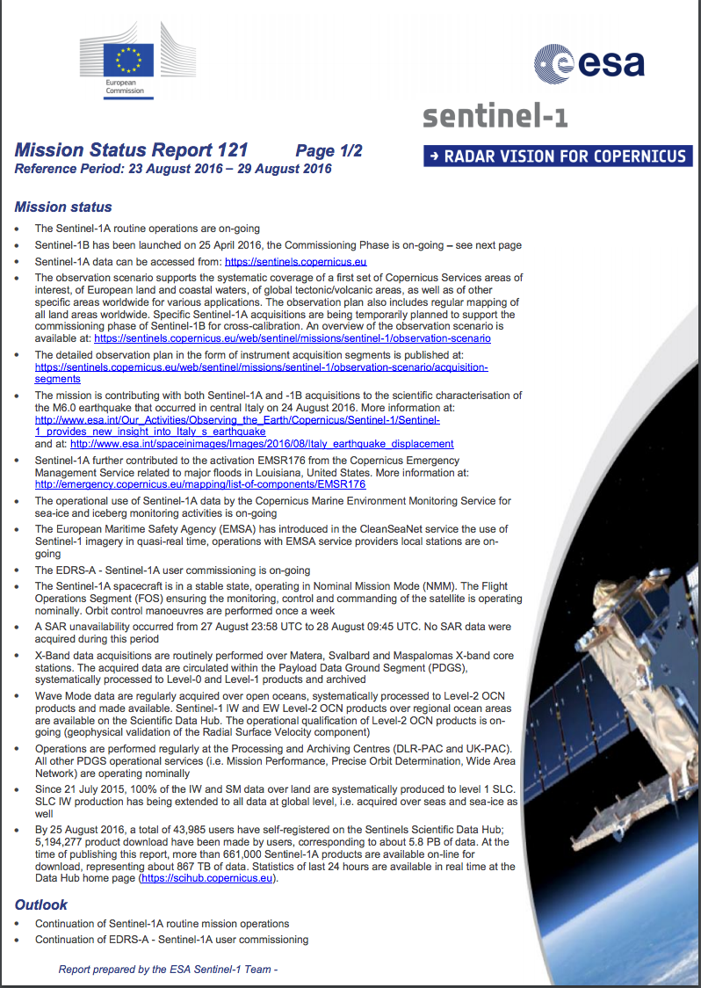
Weekly Mission Status Reports published online (121 reports issued since Launch)
https://sentinel.esa.int/web/sentinel/missions/sentinel-1/mission-status
……

Slide 8
INCLUSION OF SENTINEL-1B
- HIGH LEVEL STRATEGY FOR OBSERVATION SCENARIOS -
Increase of revisiting frequency for operational monitoring services, in particular CMEMS and maritime surveillance services
CMEMS requirement is to get a daily coverage
Sentinel-1B will basically allow increasing the revisiting frequency by a factor 2
Interferometry every 6 days for critical areas and applications, in particular:
landslide monitoring
fast moving glaciers, allowing to get more coherence between two acquisitions
In Europe, for critical areas subject to rapid ground deformation or part of the global tectonic areas (e.g. Italy, Greece), a mapping in both ascending and descending passes every 6 days is planned
European coverage increase by a factor 2 is planned to be generalised, ie 6-day cycle in both ascending and descending
… /…
Notes:
8

Slide 9
INCLUSION OF SENTINEL-1B
HIGH LEVEL STRATEGY FOR OBSERVATION SCENARIOS – (CONT’D)
… /…
Implement “complementarity” of observations between S1A and S1B, to some extent (e.g. use S1A for one set of remote volcanoes worldwide, use S1B for another set, distinct areas for maritime surveillance activities )
Increase of global land mapping frequency, in particular in support of crop and soil moisture monitoring activities that requires short revisit time…
Envisaged specific strategies to increase the global land coverage frequency, saving sensing resources:
for ice sheet campaigns (Greenland, Antarctica), use similar level of resources as done currently with S1A, but using S1A + S1B, i.e. repeat pass every 6 days, but over a half-duration period. Keep one campaign per year, possibly less for Antarctica interior, TBC
For global tectonic areas, once in FOC, the revisiting is planned to be increased by a factor 1.5 as an extension of what is achieved with Sentinel-1A
complementarity of observations between S1A and S1B
Etc.
… /…
Notes:
9

Slide 10
INCLUSION OF SENTINEL-1B
HIGH LEVEL STRATEGY –
+
The use of Sentinel-1B similarly to Sentinel-1A will basically allow to increase the observations frequency by a factor 2 overall In addition, specific strategies will be implemented to increase the global land mapping frequency, part of the so-called “zonal mapping”
Notes:
10

Slide 11
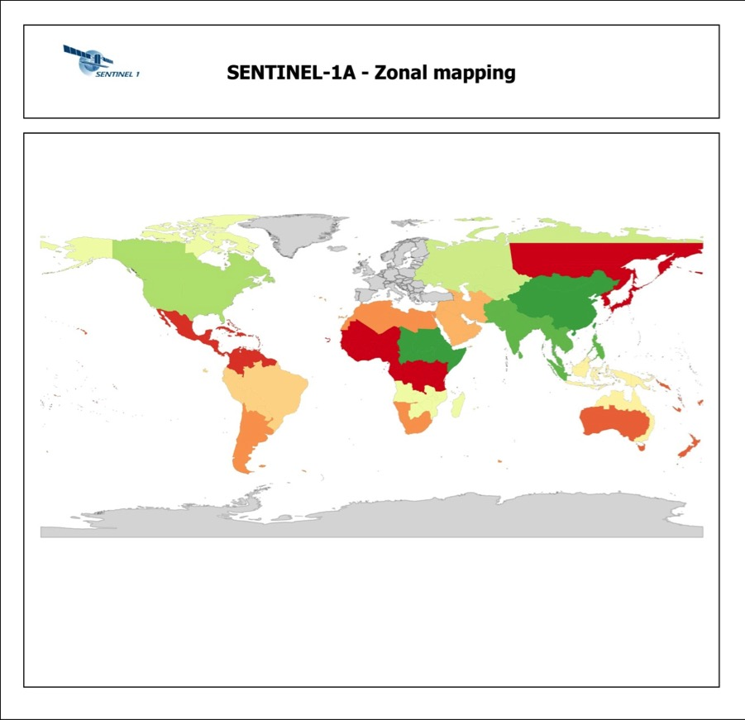
Sentinel-1 observation scenario
Zonal mapping
IW mode, VV+VH polarisation, one pass
Acquisitions following a zonal approach, prime acquisition windows prevailing regional dry season conditions
Continuous acquisition zones (e.g. Tectonic active areas) become upgraded to dual polarisation whenever they fall into a regional zonal acquisition window
Revisit per zone several times a year
Main driver: emergency reference mapping, low frequency global applications (e.g. forest mapping, land use, urban area mapping…)

Slide 12
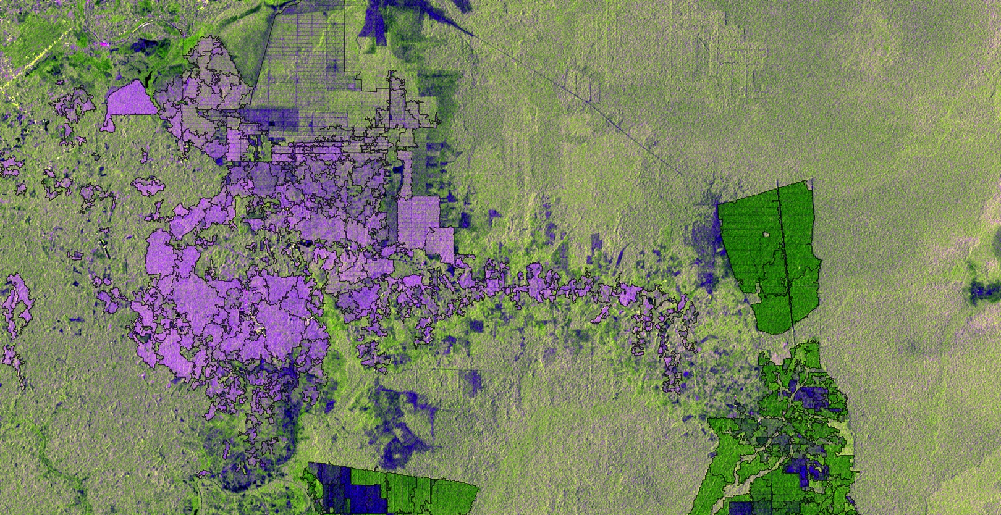
Forest Classification in Central Sumatra based on Sentinel-1 Dual-Pol Data
Logged peat swamp forest
Peatforest
Pulp plantations
Oil palm estates
Oil palm smallholders
Sentinel-1A image over Sumatra in June 2015, classification of oil palm and pulp plantations
Processing by SarVision

Slide 13
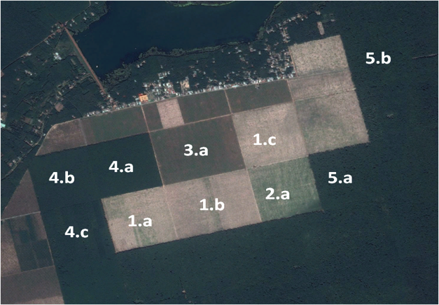
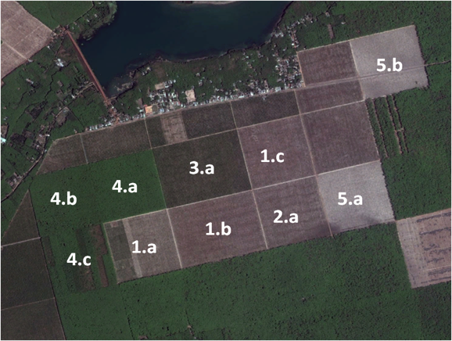
State of the art – Forestry
Real time monitoring forest logging, Vietnam
08/2014
to
04/2016
Logging dates:
5b: March 2015
5a: May 2015
? : March 2016
Contains modified Copernicus Sentinel data [2016]
15/10/2014
CNES/Astrium
18/02/2016
DigitalGlobe
Notes:
Forest planation for rubber production

Slide 14
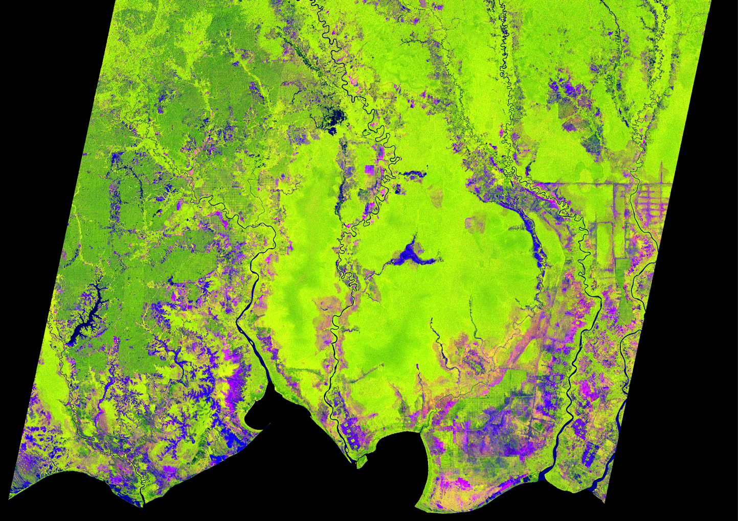
Sentinel-1 Forest at FAO
Borneo
Multi-temporal dual-pol composite of 13 Sentinel-1 images different times between March 2015 and February 2016 in 10m resolution.
Red: VV max in time
Green: VH-min value in time
Blue: VH pol StDev over time
Notes:
Southern part of Borneo: On the left in dark green you can see oil palm plantations, light green refers to forested area. in blue you can see bare soil, while pink areas have been burned or deforested within the time period. The linear patterns refer to channels that have been used to dry out the peatlands in order to make them suitable for farming and that are now a major problem due to their vulnerability to fire.

Slide 15
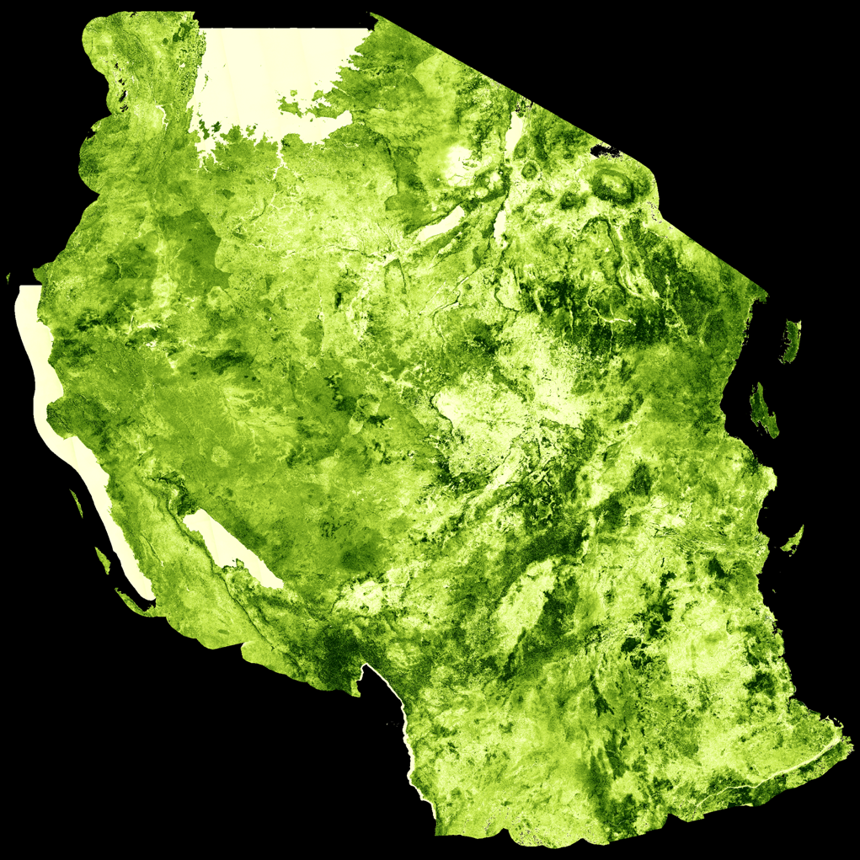
Sentinel-1 Mosaic Tanzania
Tanzania
Mosaic based on Sentinel-1 dual-pol acquisitions over 5 swathes in 10 days in 10m resolution showing the sensitivity of the signal to woody biomass in savannah areas during the dry season.
Notes:
A pseudocoloured image from the VH channel over Tanzania showing the sensitivity of the signal to woody biomass in savannah areas during dry seasons.

Slide 16
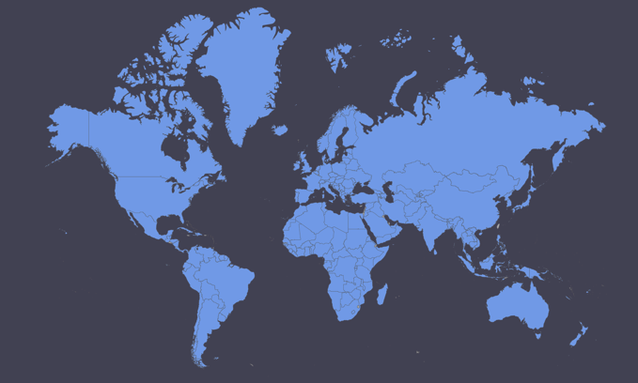
Sentinel-2 Observation Scenario
The Sentinel-2 baseline observation scenario in routine phase will systematically cover all land surfaces between 56° South latitude (Cape Horn in South America) and 84° North latitude (north of Greenland), including also
Major islands (greater than 100 km2 size), EU islands and all the other small islands located at less than 20 km from the coastline
The whole Mediterranean Sea as well as all inland water bodies and closed seas
Europe, Africa and Greenland systematically, while the rest of the world land masses with a 20 days revisit time.

Slide 17
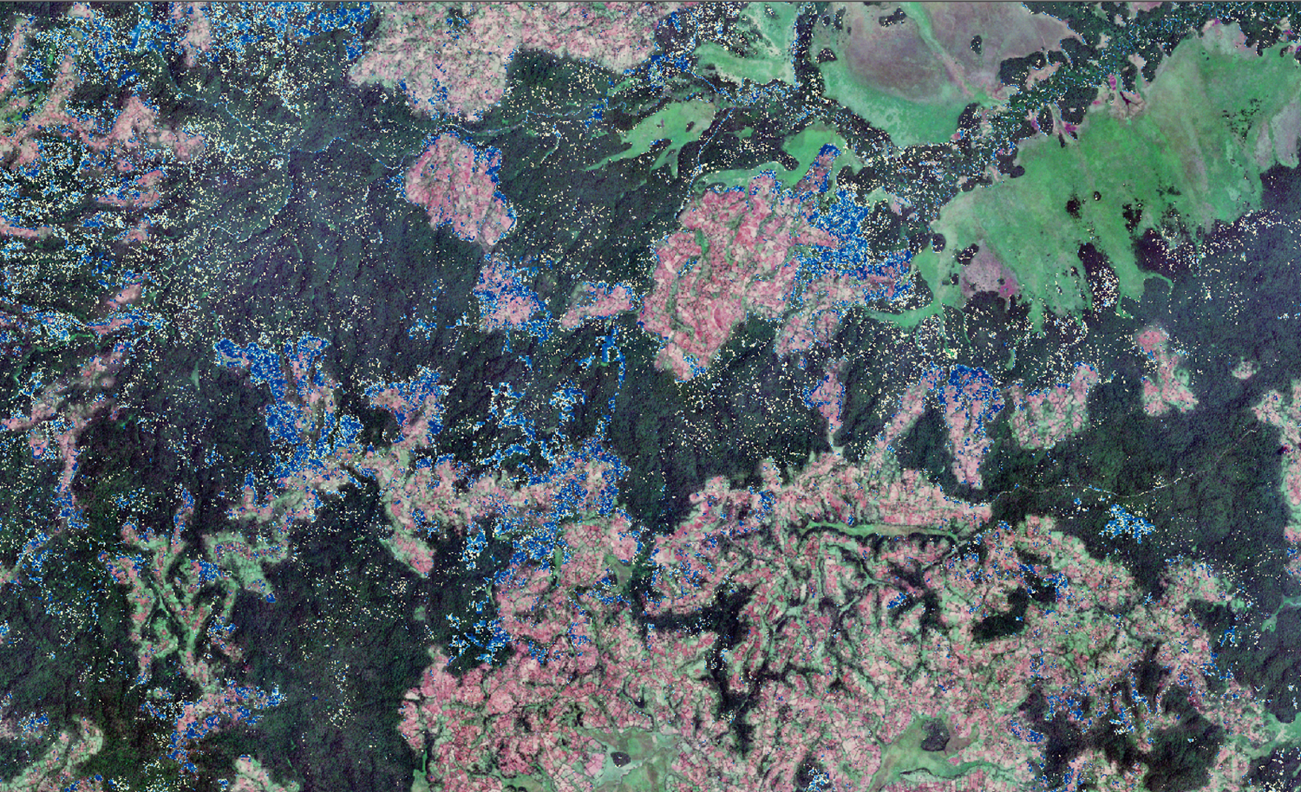
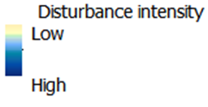
Monitoring forest cover loss L8 & S2 time series in Kafa, Ethiopia
Landsat: Reference period 2008 - 2010
Sentinel-2: Monitoring period 2015 - 2016
Sentinel-2A image: 8 March 2016
Contains modified Copernicus Sentinel data [2016]
Notes:
Based on data cube analysis of NDVI values

Slide 18
First CCI Land Cover Sentinel-2 TOA reflectance composite over Africa
Max-NDVI composite
of TOA reflectance from all available Sentinel-2 images (~7000) acquired from August 2015
to April 2016
( ~32 TByte of data)

Slide 19
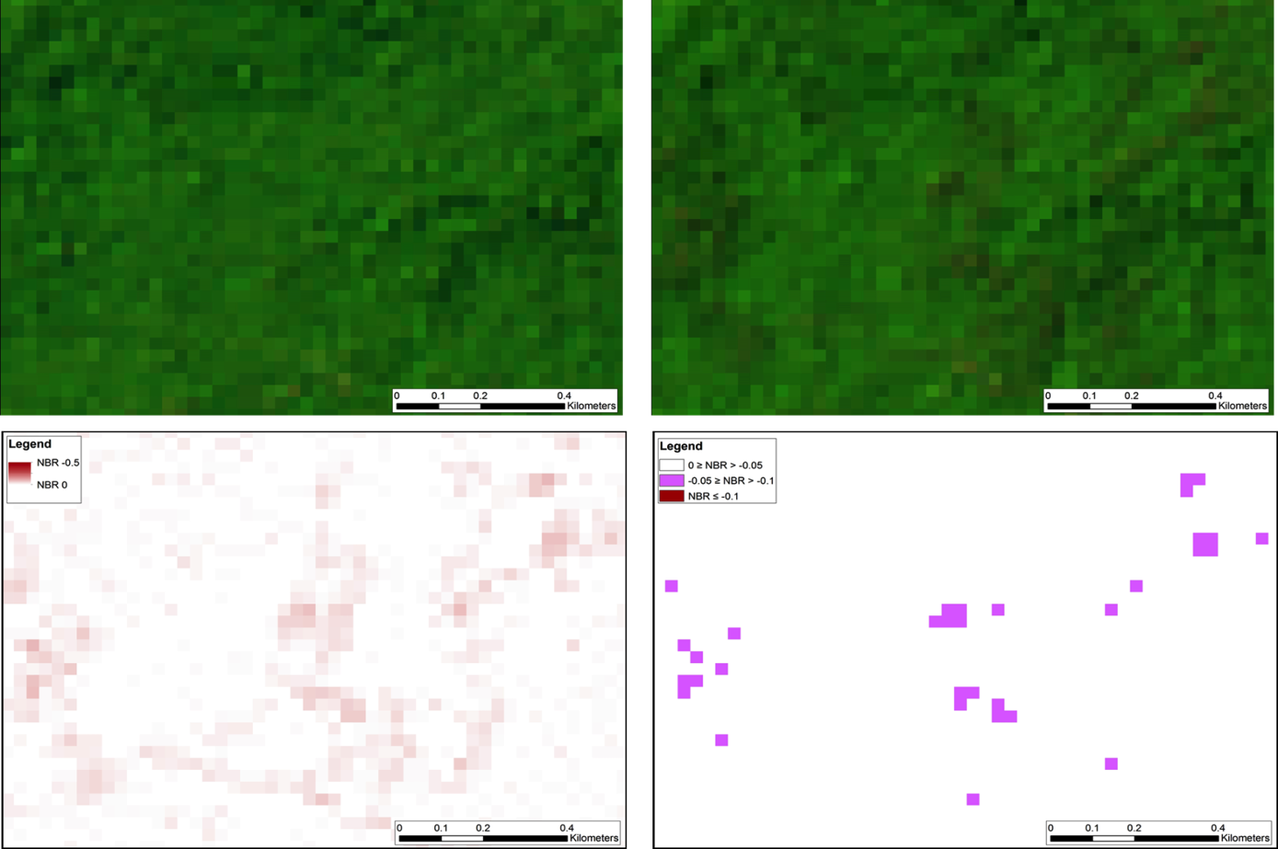
Assessing selective logging in Cambodia
Landsat 8 (30 m) 01.12.2015
Landsat 8 (30 m) 03.02.2016
ΔNBR result (30 m)
ΔNBR result (30 m) with thresholds
Andreas LANGNER, JRC @ LPS16
Notes:
Monitoring Forest Degradation for a Case Study in Cambodia – Comparison of Landsat 8 and Sentinel-2 Imagery –

Slide 20
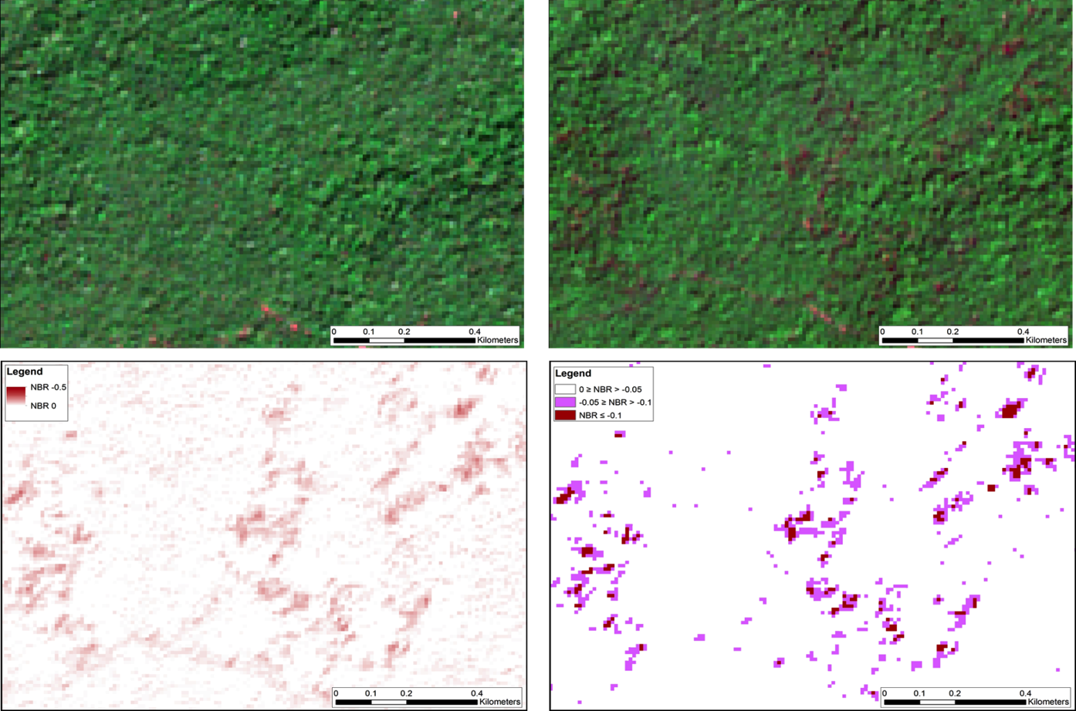
Assessing selective logging in Cambodia
Sentinel-2 (10 m) 08.12.2015
Sentinel-2 (10 m) 06.02.2016
ΔNBR result (10 m)
ΔNBR result (10 m) with thresholds
Andreas LANGNER, JRC @ LPS16
Notes:
Monitoring Forest Degradation for a Case Study in Cambodia – Comparison of Landsat 8 and Sentinel-2 Imagery

Slide 21
Sentinel-2 Mission Outlook
Continue the increase of data acquisition: 10 days revisit on all land masses is the goal before year end, using EDRS service and 4th core X-band station
Ease data access: move to TILES concept (and other enhancements); possibility to download a True Colour Image (RGB) ~ summer 2016
Reprocessing of data acquired during Commissioning Phase ~ Q3/2016
Surface reflectance (L2A) ~ pilot project summer 2016, complete L2A feasibility study, start of systematic processing asap
Complete the constellation:…Sentinel-2B launch upcoming Q2 / 2017

Slide 22
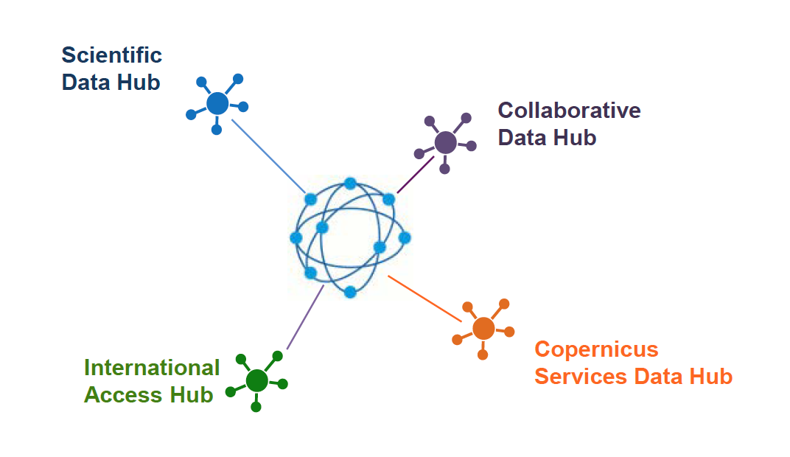
ESA Operated Data Hubs

Slide 23
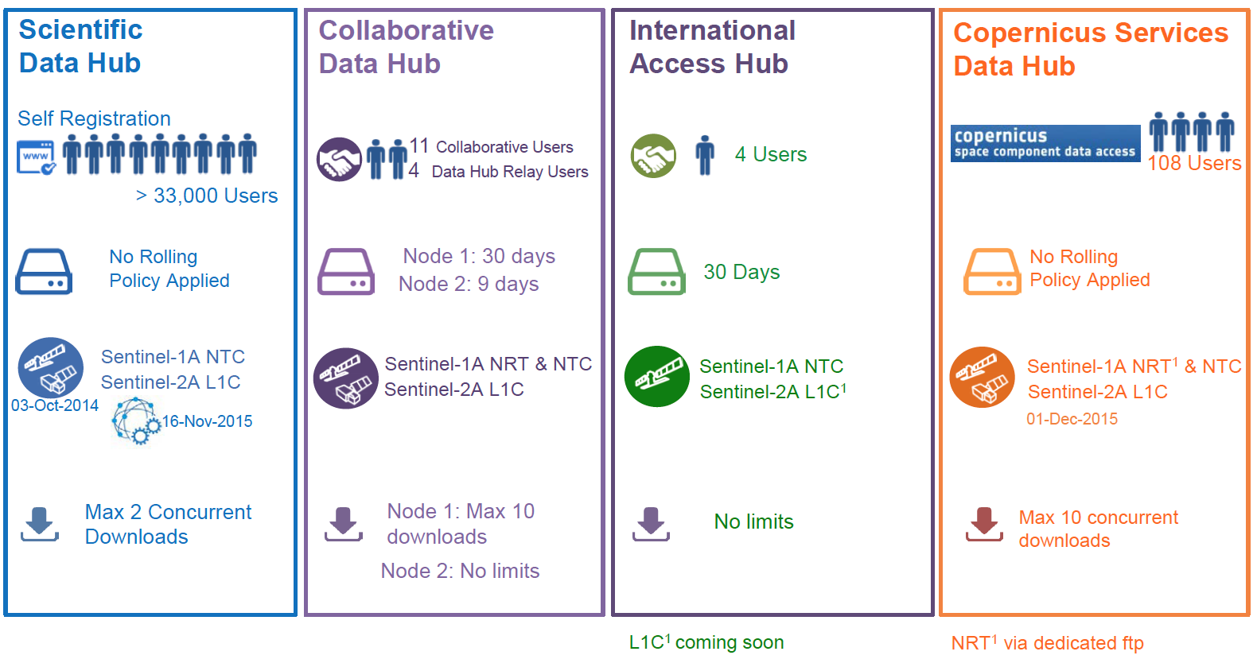
Current Operation Baseline

Slide 24
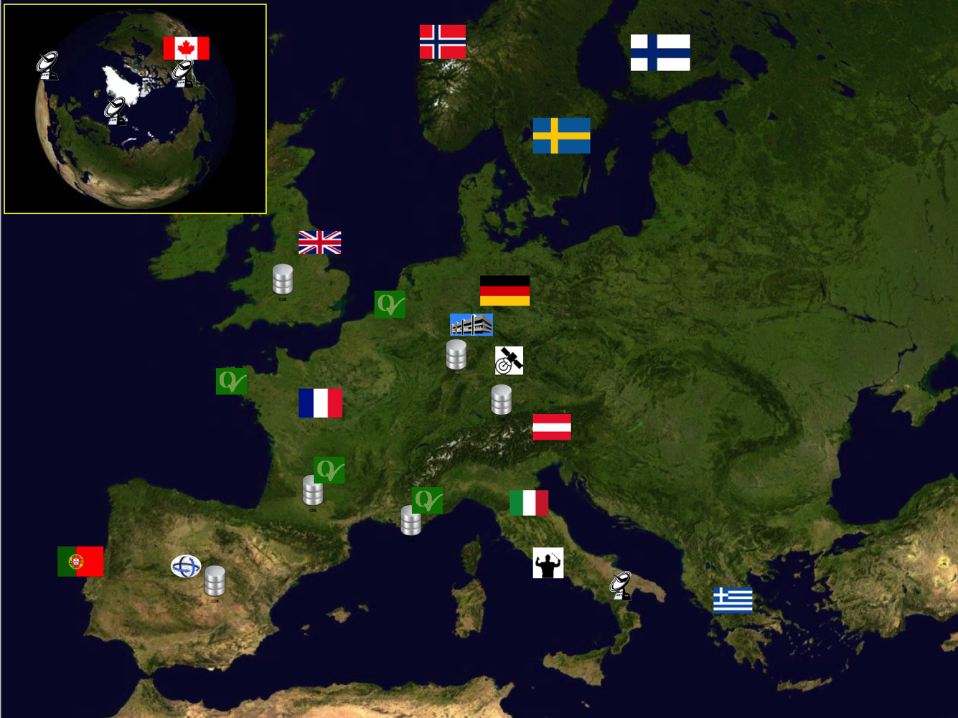
Sentinels Collaborative Ground Segment
supplementary access to Sentinel Missions data, i.e. through specific data acquisition services, specific data products, mirror sites, etc.

Slide 25
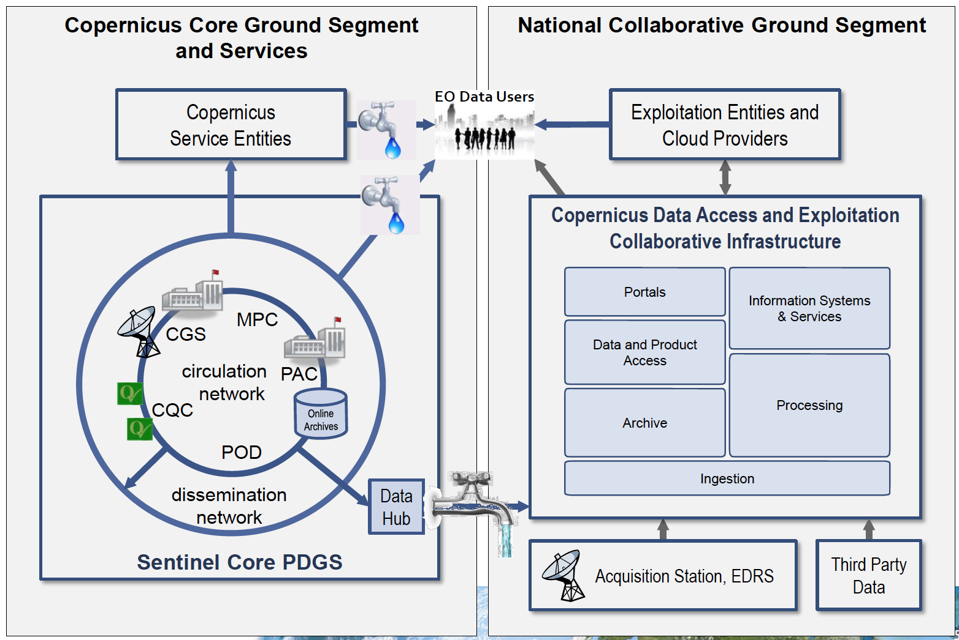
Collaborative GS Interfacing

Slide 26
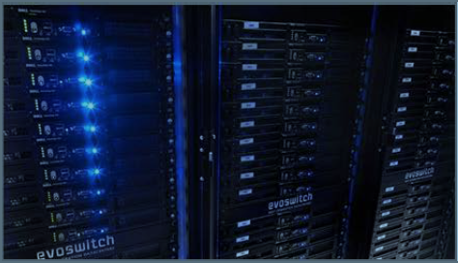
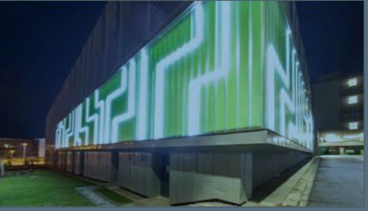
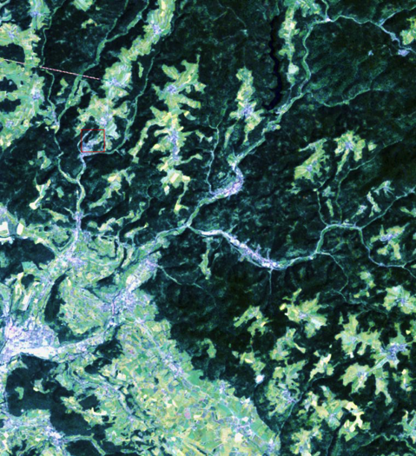
German CollGS: CODE-DE
Objectives
Provide German Users with high speed and reliable access to ALL Sentinel data and associated products
Provide German users a processing facility
Provide an access point which considers the German requirements
Increase growth in the EO application sector (commercial, scientific and public)
Extended Portfolio
Sentinel-1 and -2 products in small tiles (Germany)
Most recent cloud-free Sentinel-2 mosaic (Germany)
Temporal features as basis for thematic maps

Slide 27
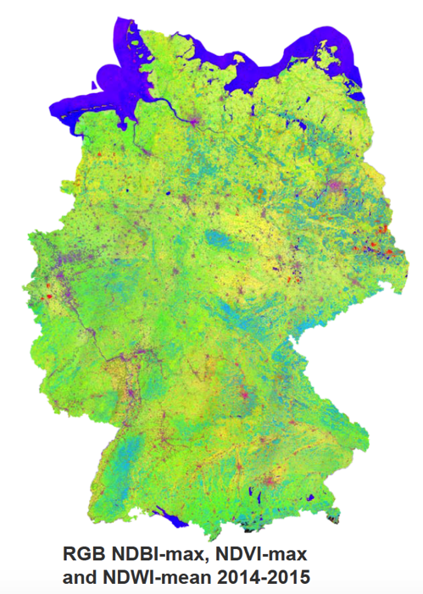
Way forward for CODE-DE
11/2016: Release of V1, Initial operations
06/2017: Release of V2, Routine operations
CODE-DE as an element of the European Integrated COPERNICUS Ground Segment 2017ff
Establishment of specialized (thematic) exemplar for REDD MRV in German partner countries (joint DLR/GIZ proposal submitted, 2017-21, funding TBD)
Coordination with and concrete contribution to GFOI
Mainly based on Sentinels and Landsat, but also TSX/TDX, …
Integration of „GFOI approved methods“, link to MGD
Roll out and capacity building in selected REDD countries (selection pending)

Slide 29
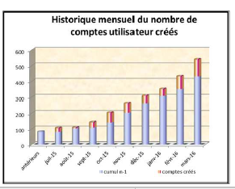
PEPS - some figures
End 2015: 5 000 downloads (8 Tb) from 200 000 products published
Now >1000 User accounts (September 2016)
Des utilisateurs issus de 43 pays différents
dont 74 % parlent français
65 % sont français
Principalement des pays européens (Italie, Allemagne, Belgique,…), USA, Canada Mais aussi Gabon, Chine, Viet Nam, Maroc, Russie, Suisse, Algérie…
52% (seulement) à des fins de recherche

Slide 30
International Cooperation 1/2
Interface to international cooperation partners is led by the EU in close coordination with ESA for technical aspects
Copernicus funding supports the related interfaces
For technical matters, a similar process (as with Participating States) applies:
Collection of collaboration proposals and requirements
Proposal technical feasibility analysis
Implementation of collaborative interfaces
The cooperation types of activities are similar to the ones with Participating States, however with special focus on:
Access to Sentinels data
Set up of mirror sites for redistribution of Sentinel core data
Complementary external support Validation activities
Reciprocity in terms of access to partner space and in-situ data

Slide 31
International Cooperation 2/2
Countries | Institutions | Summary
USA | NASA | NASA and ESA have signed a Cooperation Arrangement in February 2016. NASA intends to set-up a Sentinel data mirror site.
USA | NOOA | NOAA and ESA have signed a Cooperation Arrangement in March 2016. NOAA intends to use global Sentinel data for research purposes.
USA | USGS | USGS and ESA have signed a Cooperation Arrangement in February 2016. USGS will focus on Sentinel-2 products hosting and distribution.
Australia | Geoscience Australia | GA and ESA have signed a Cooperation Arrange-ment in March 2016. GA, in collaboration with partner entities, intends to establish a Regional Copernicus Data Access/Analysis Mirror Site ('GA Data Mirror Site') to improve access to, and exploitation of, Sentinel data in the Australian, South-East Asia and South Pacific Region.

Slide 32
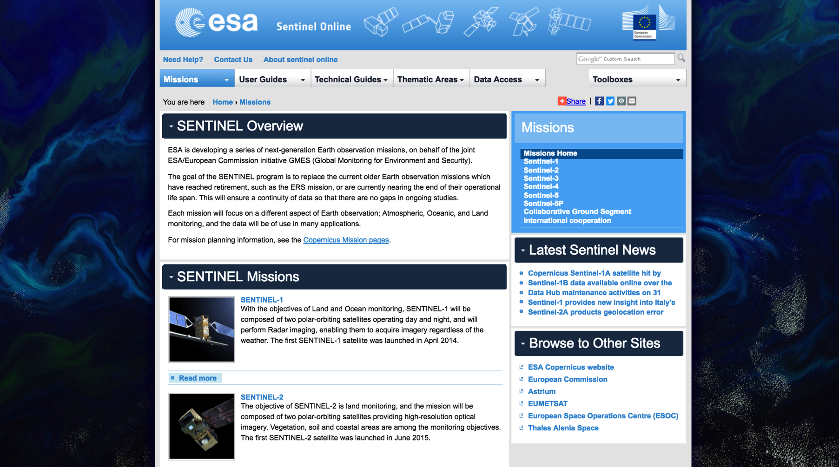
https://sentinels.copernicus.eu/

Slide 33
EC Copernicus Global Land Service
for REDD+

Slide 34
DG Climate: REDD+ User Needs

Slide 35
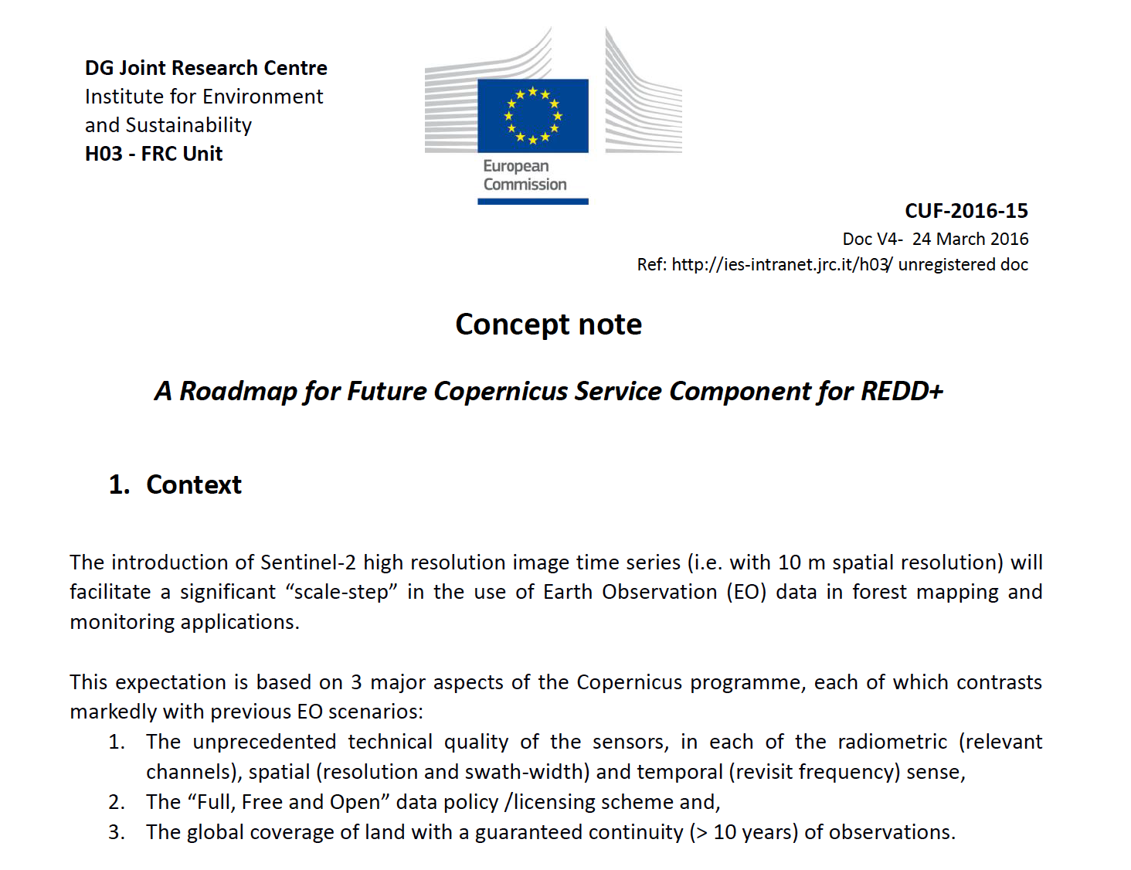
Global Land Service REDD

Slide 36
EC Global Land Service for REDD+
Comments and concerns by EU member states
Besides optical data (Sentinel-2), also SAR data (Sentinel-1) is needed systematically
Interoperability between Sentinel-2 and Landsat
VHR data for validation (optical and SAR)
Provide analysis ready data (ARD), including cloud-free mosaics
Linkages to the work of GEO (GFOI)
GFOI/GOFC-GOLD guidance should be followed and in-country user requirements
Free forest products would impact an existing commercial service provider market
No duplication of an existing reliable and efficient application
Role of JRC as service provider (?)
Lack of capacity building in the proposal

