Slide 1
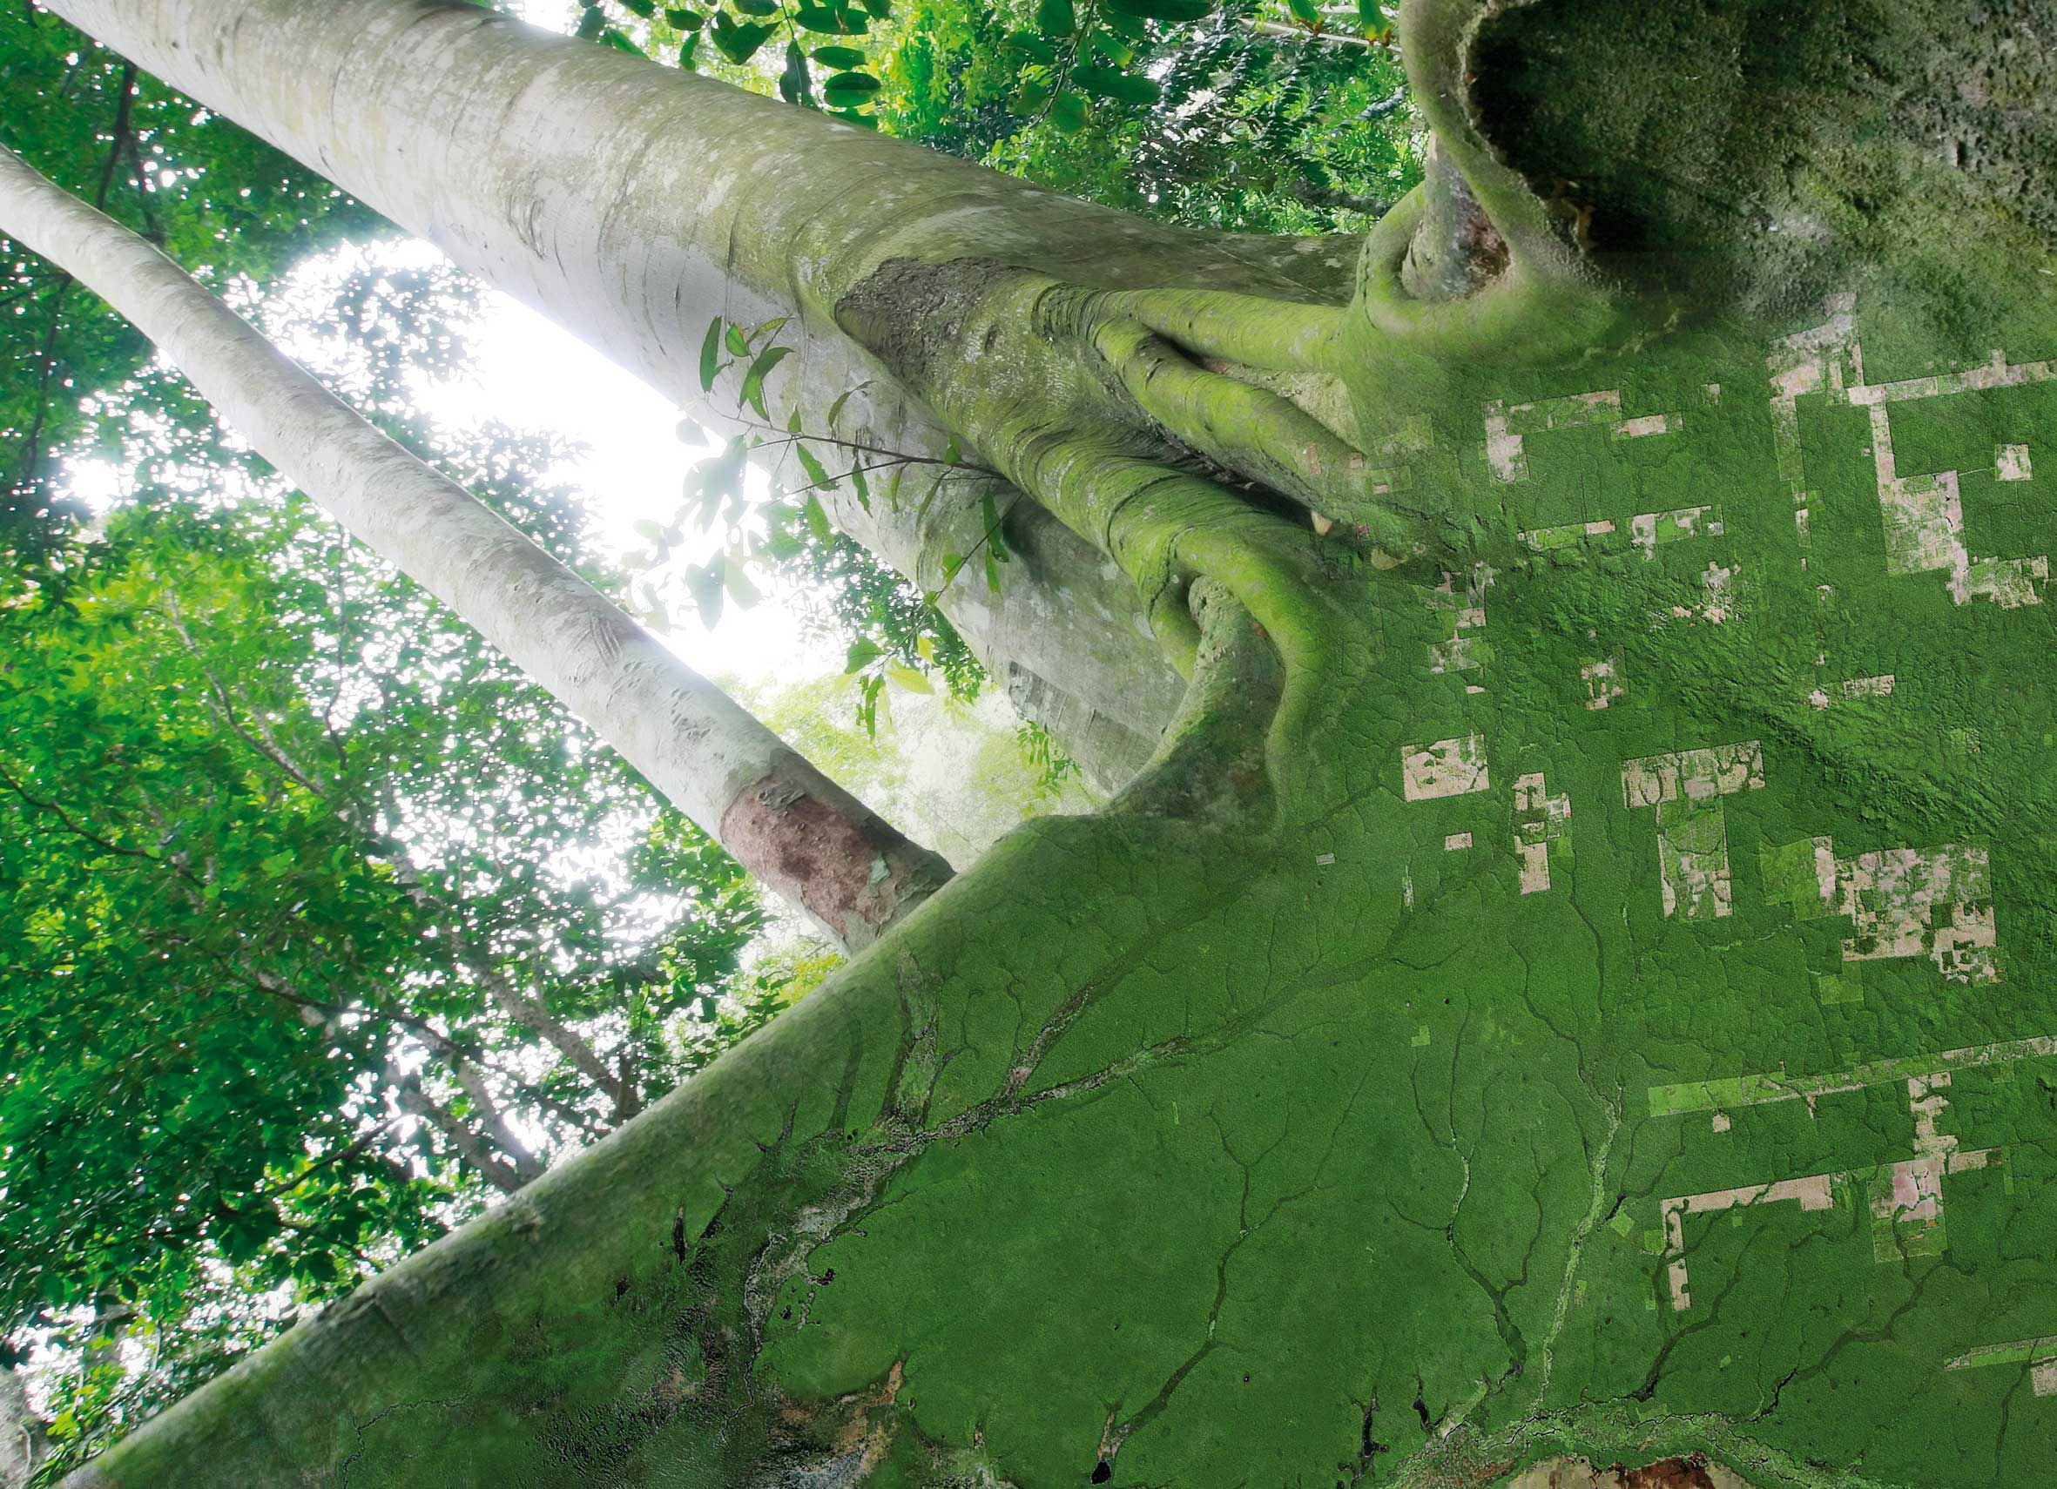



UK Example work on Global Forest
SDCG-10: Reading, 7-9 September, 2016

Slide 2
Pedro Rodriguez-Veiga, Heiko Balzter, Kevin Tansey, Ciaran Robb, Ana Maria Pacheco, Ramesh Ningthoujam
Examples from NCEO-University of Leicester
SDCG-10: Reading, 7-9 September, 2016

Slide 3

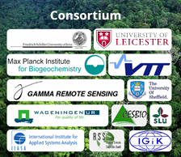
ESA DUE GlobBiomass
Improved quantitative biomass maps at regional and global scale
Provision of associated uncertainty maps
Validation including major user organisations and establishing common practices and standards
Contribution of new scientific results with respect to biomass stock and change estimation
Identification of the limitations of current data and methods to estimate biomass by historical, recent and future global Earth observation data (Sentinels, BIOMASS, SAOCOM, ALOS-2)

Slide 4
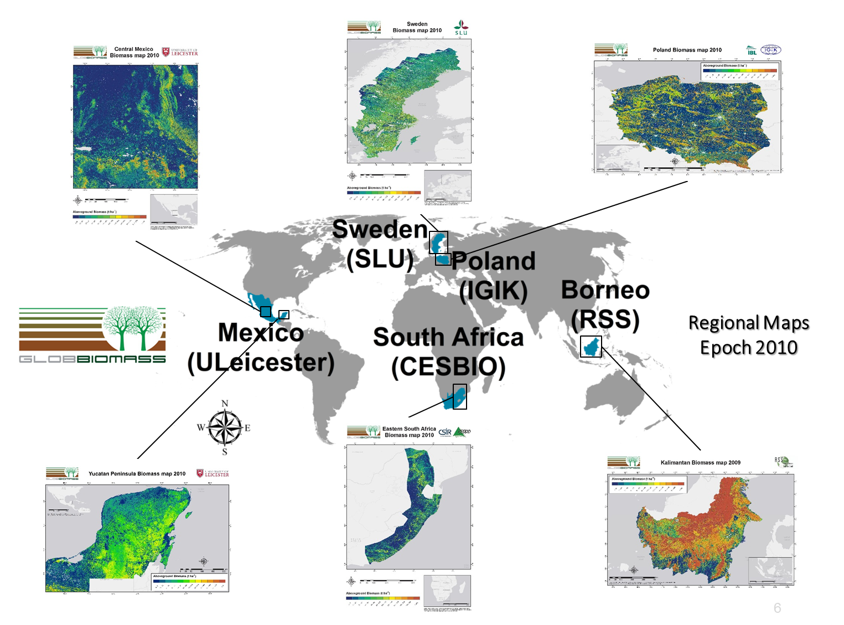
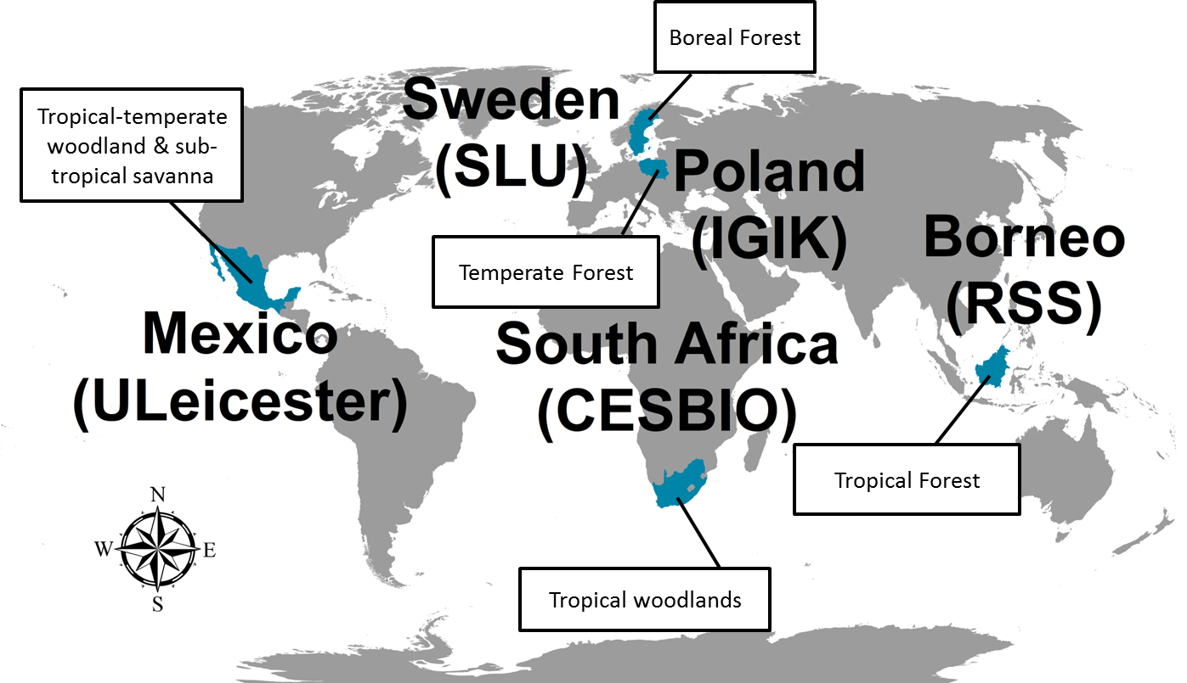
ESA DUE GlobBiomass
Produce a global map for 2010
Produce 5 regional maps for 3 epochs
  Epoch 1: 2005
  Epoch 2: 2010
  Epoch 3: 2015
Spatial resolution < 150 m
Map the uncertainty of the estimates
Biomass change maps between Epochs

Slide 5
GlobBiomass Regional Mapping
Partner/ Region | Method | Datasets
UniLeicester Mexico | MaxEnt | ALOS PALSAR dual polarization, Landsat Surface Reflectance, Landsat Percent Tree Cover, SRTM, Field data
CESBIO South Africa | WCM + MIPERS | ALOS PALSAR dual polarization, Landsat Percent Tree Cover, SRTM, Field data
IGIK Poland | Random Forest Regression | ALOS PALSAR dual polarization, SRTM, Landsat, Field data
RSS Kalimantan | Regression | ALOS PALSAR dual polarization, SRTM, Airborne LiDAR, Field data
SLU/GAMMA Sweden | kNN / BIOMASAR | SPOT 4 and SPOT 5, Field data / ALOS PALSAR dual polarization

Slide 6
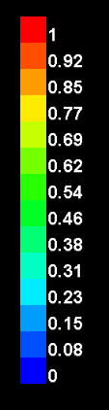
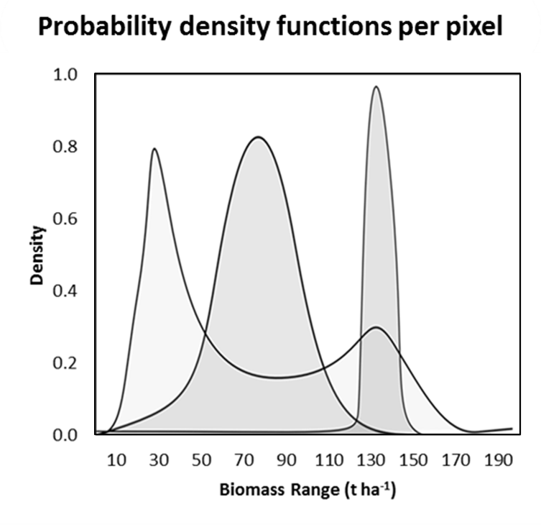
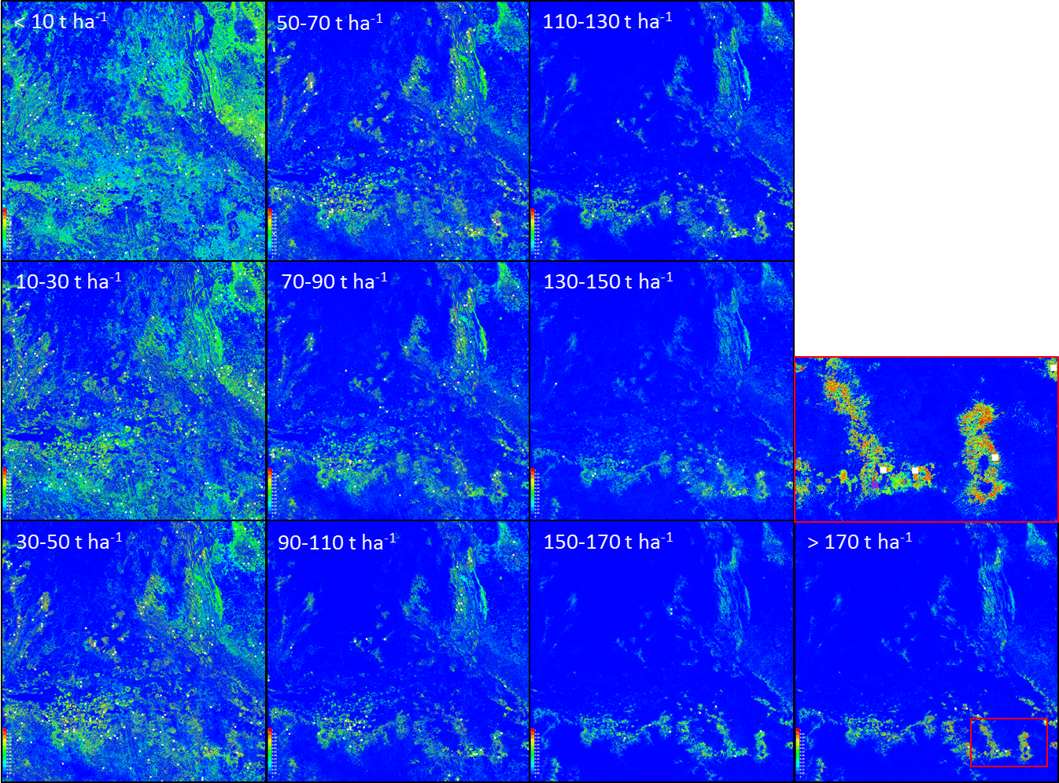
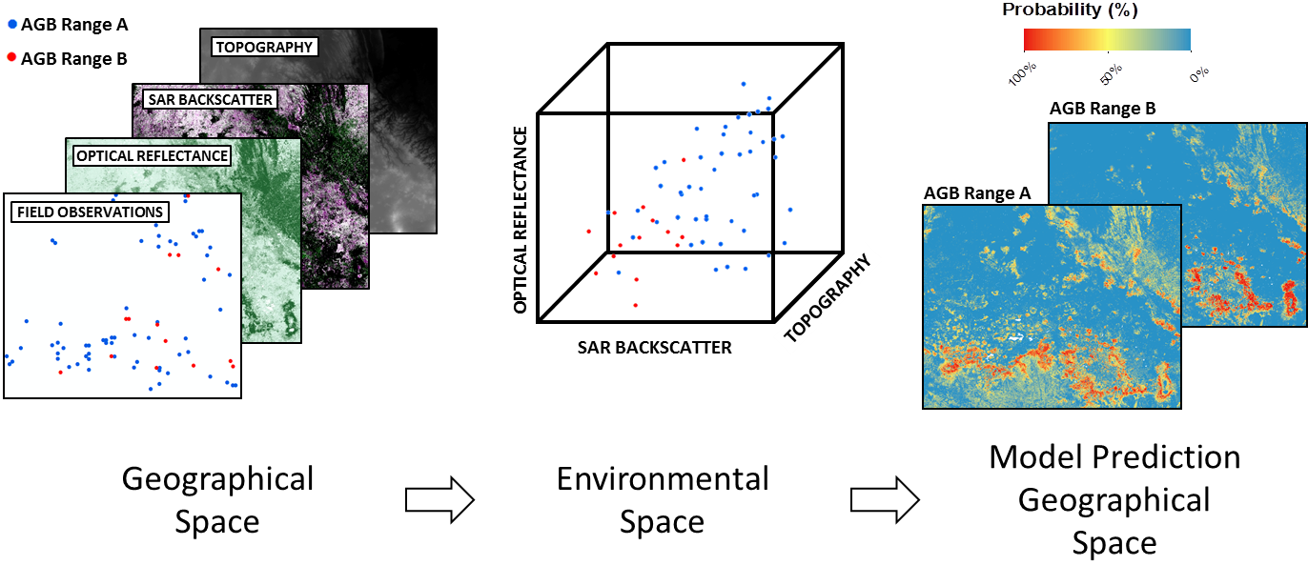
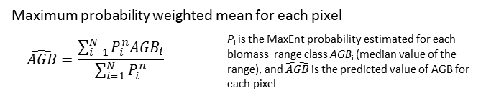
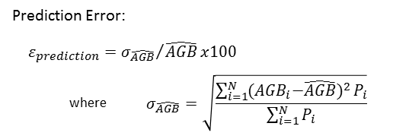

Focus: Mexico regional
Model Prediction Geographical Space

Slide 7
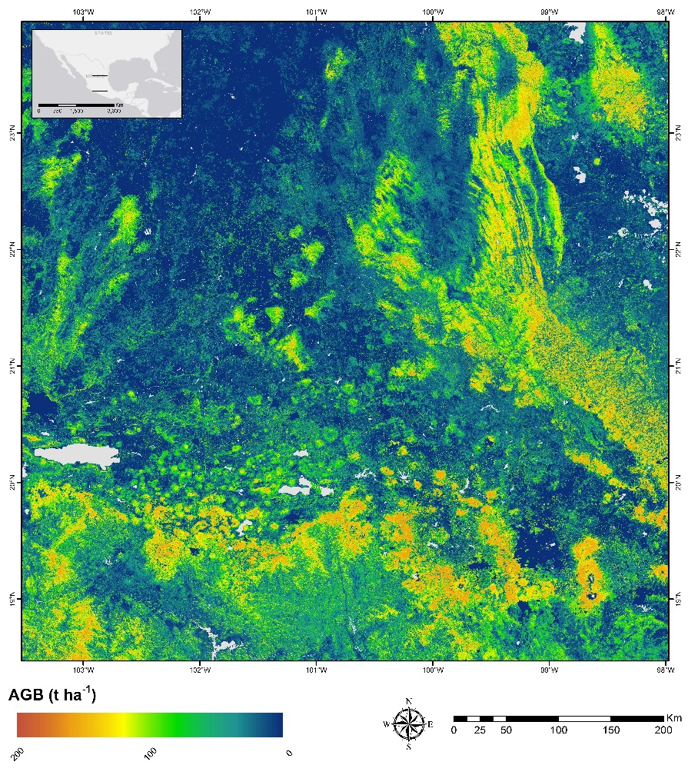
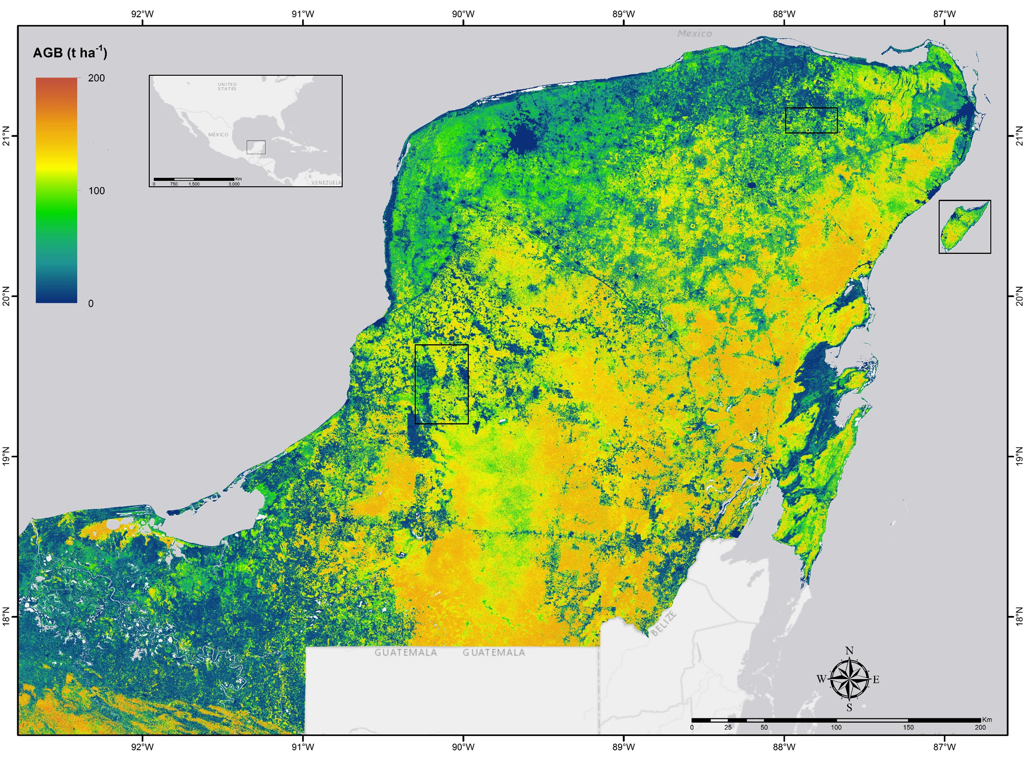
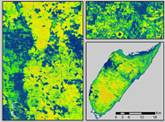
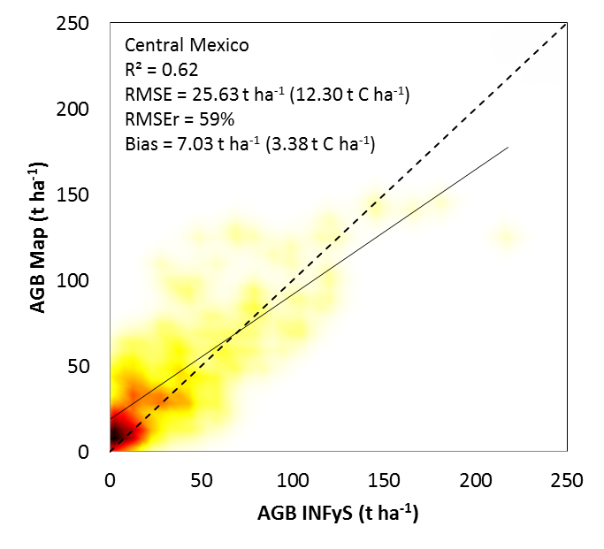
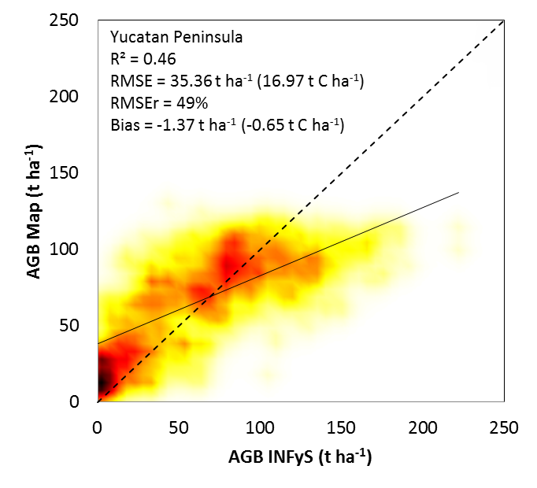
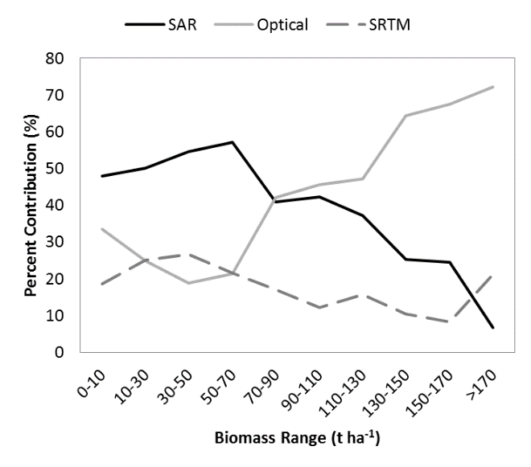
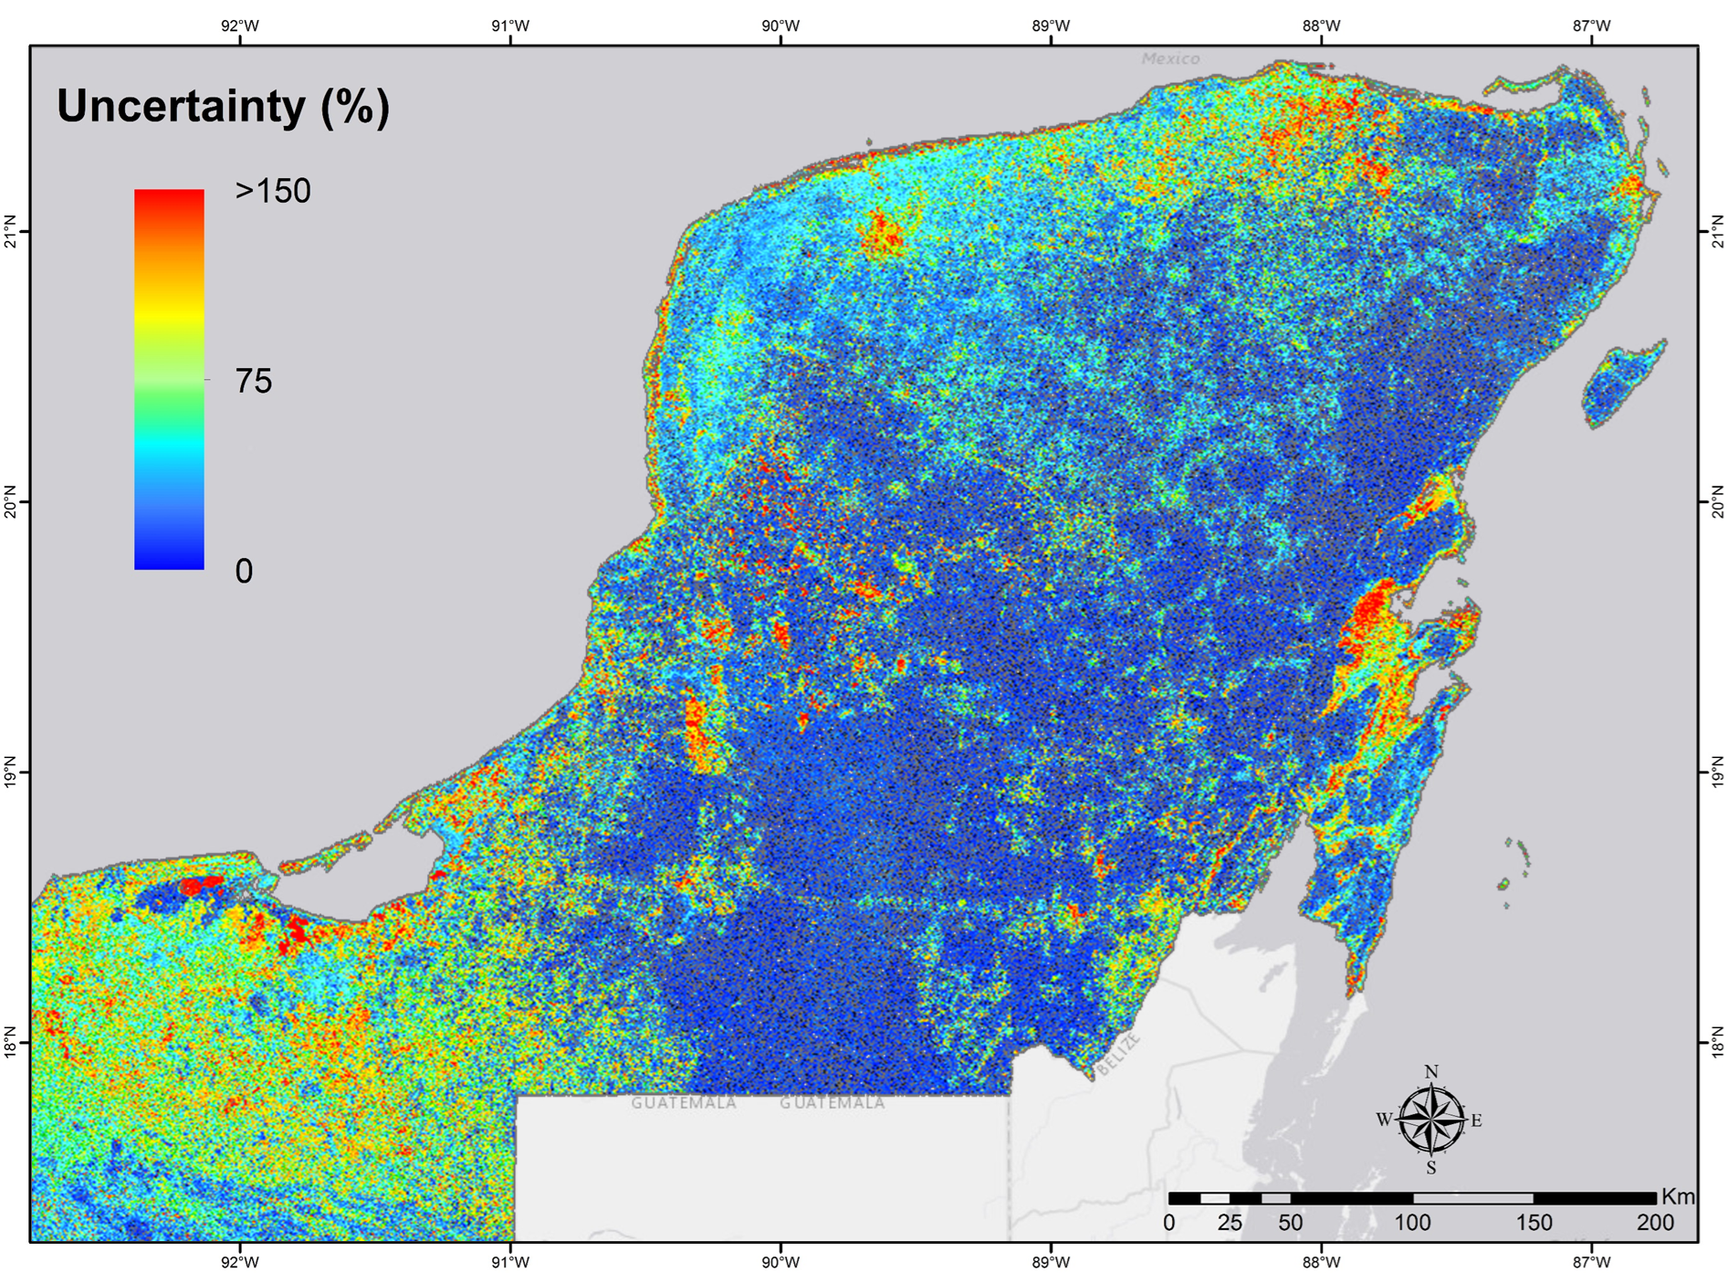
Aboveground Biomass and Uncertainty maps at 25m spatial resolution for the reference year 2010 for the regional sites of Central Mexico and the Yucatan peninsula

Slide 8
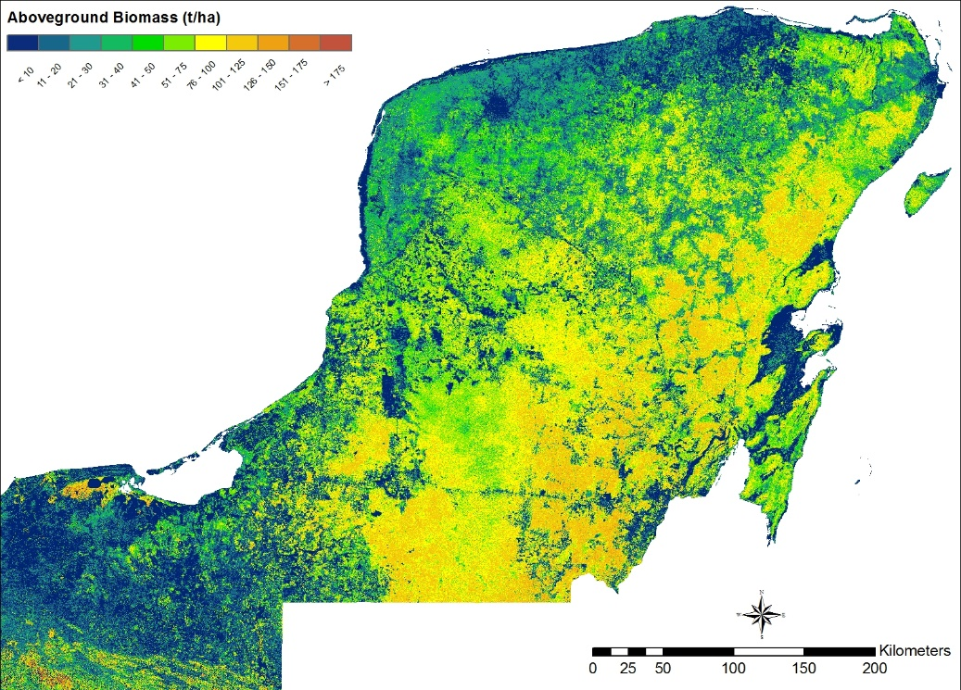
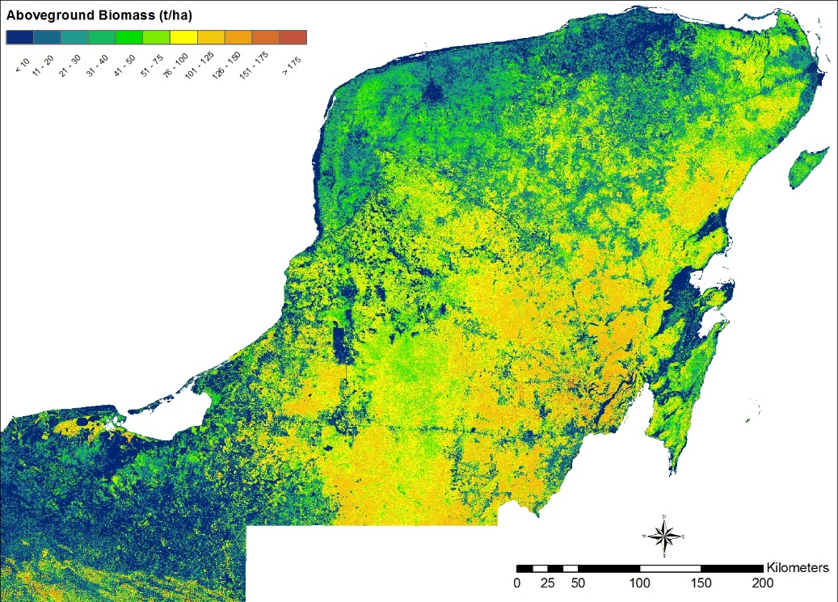
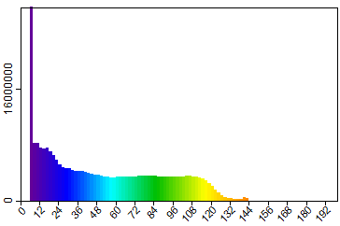
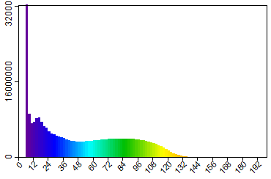
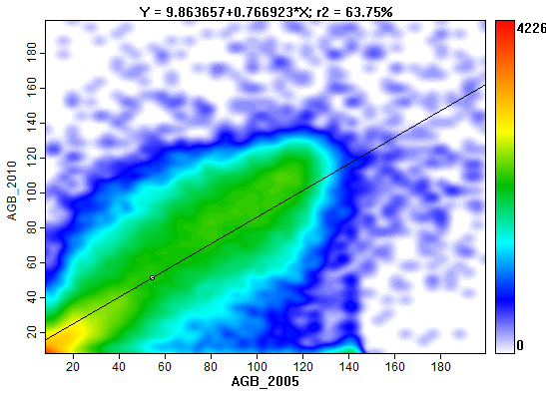
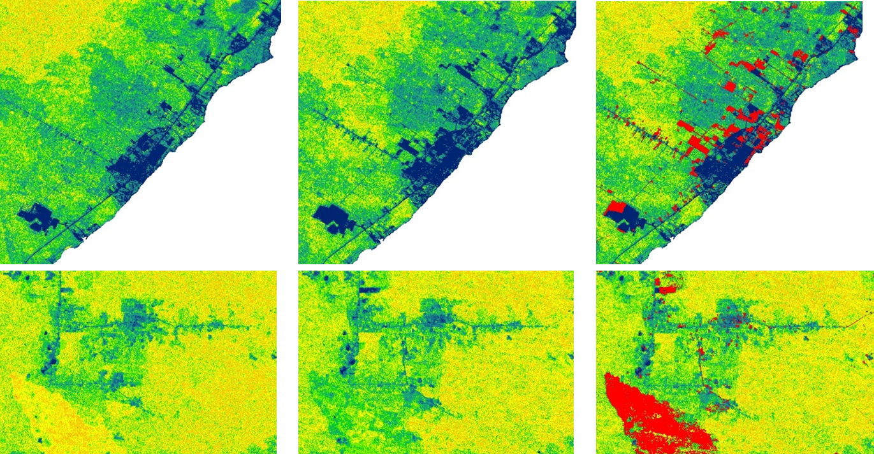
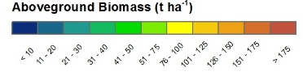
Biomass change
2005/07
2010
2005/07
2010
2005/07
2010
Bright Red: Hansen et al, (2013) 2005-2010 forest loss

Slide 9
On-going project: REDD+ Monitoring Services with Satellite Earth Observation - Community Forest Monitoring Pilot
Kenya’s economy is losing US$ 68 million annually from deforestation and aims to achieve afforestation to 10% forest cover by 2030.
To protect forest resources, capacity is needed for timely deforestation monitoring
360° communication: Users have to be able to add photos, text annotation, feedback on validation and other local information to the deforestation alerts
The Sentinel-1&2 and Landsat data (in future potentially also NovaSAR-S) enable much more frequent event detection
The edge of our product is the customisable mobile app combined with satellite-derived and user-entered information

Slide 10








Cloud based data analysis and forest cover change mapping
Satellite optical and radar data acquisition
Smartphone app deforestation alerts and forest information
Community / field based response to illegal logging and deforestation

Slide 11
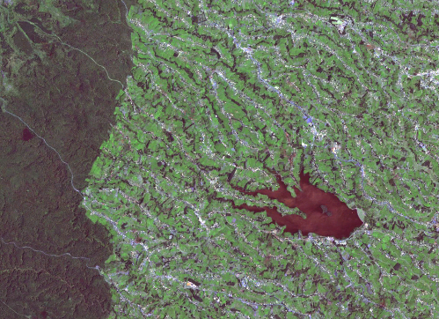
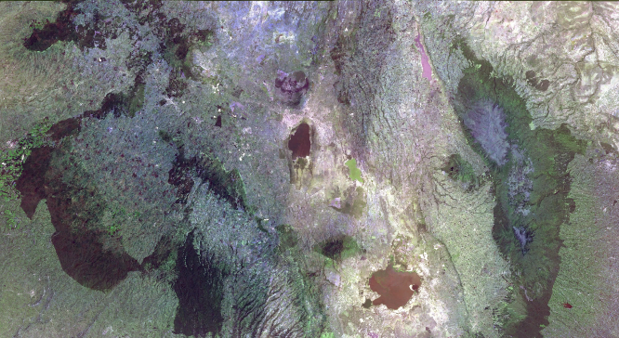
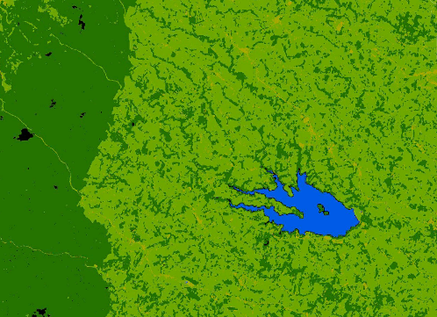
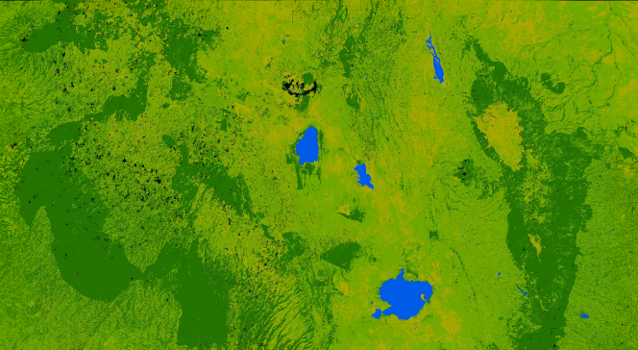
Initial results

Slide 12
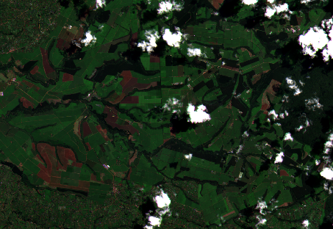
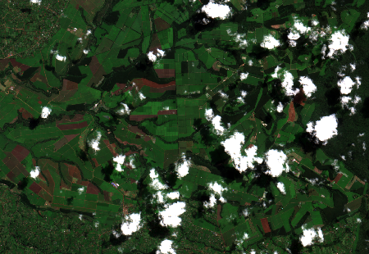
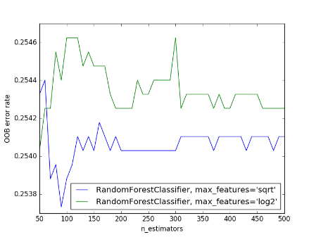
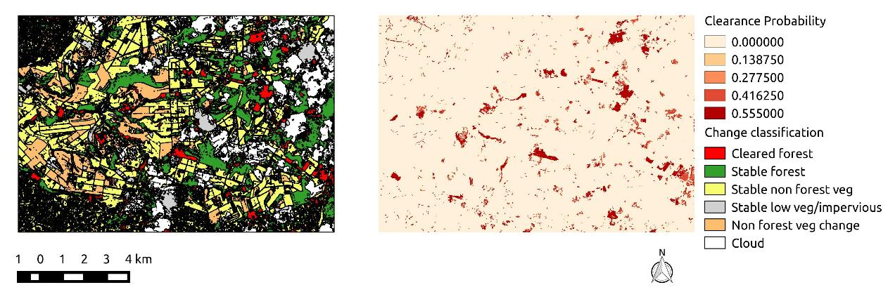
Initial results

Slide 13
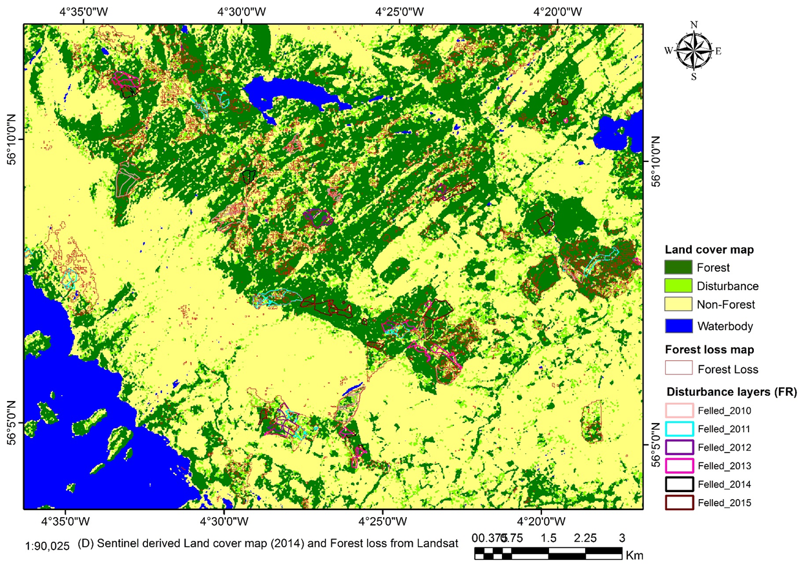
EODIP Project: Sentinel-1 C derived Forest Cover Map
Forest cover and disturbance map of Aberfoyle area in Scotland

Slide 14
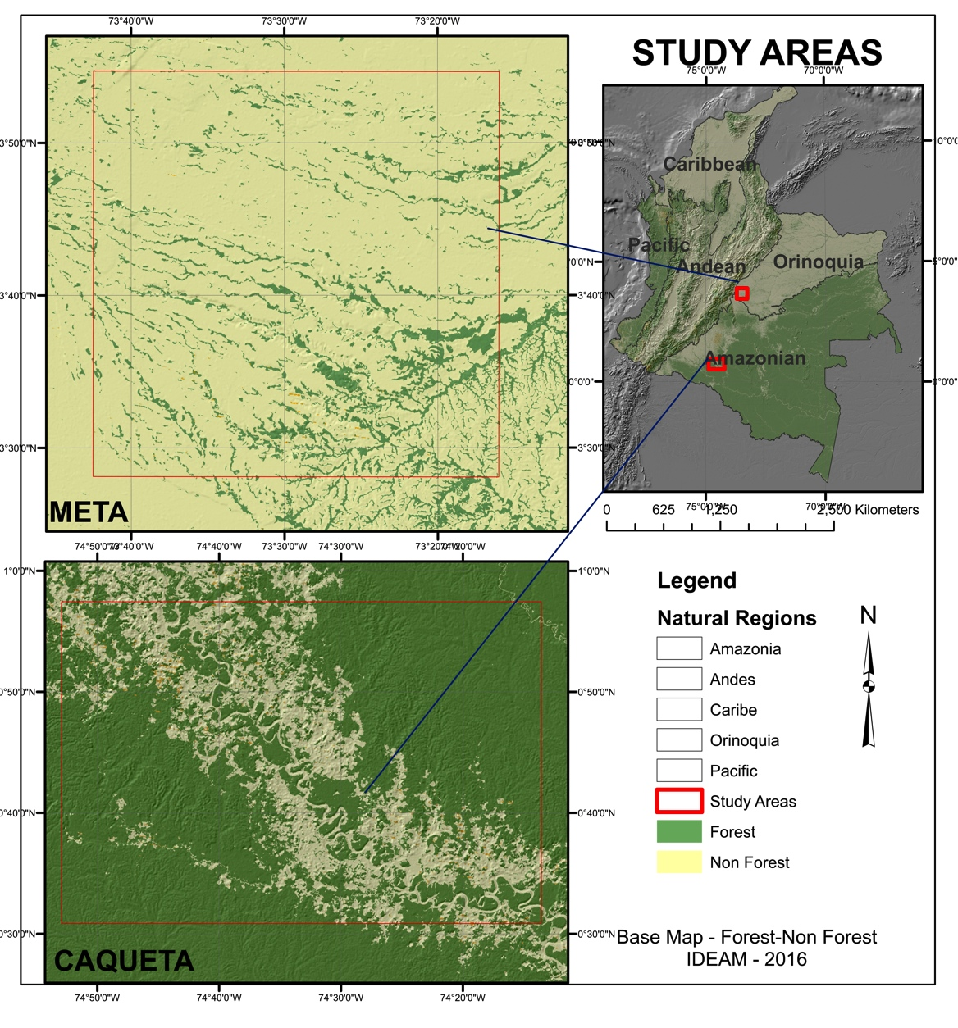
Measuring Forest Degradation in Colombia
OBJECTIVE: Explore the capabilities of SAR bands L (Alos PalSAR, Alos 2) and C (Sentinel 1A and 1B), in order to measure forest degradation in Colombia:
Understand the intrinsic characteristics of forests and its changes in structure and carbon stocks.
  Recognize patterns of forest degradation and forest regeneration to improve the carbon emissions estimates from forest loss and regrowth?
Analyse temporal series complemented with field data observations.
Specific objectives:
Notes:
Identify a method that explores the capabilities of L and C SAR types in order to measure forest degradation in Colombia under the context of REDD+. The parameters under measurement will be forest structure, the decrease of the carbon stocks due to forest degradation and the increase of forest cover due to regeneration. This research will contribute to the understanding of the intrinsic characteristics of the forest under analysis, as well as its changes in structure and carbon stocks. It will also evaluate forest vertical and horizontal structures as well as forest degradation driver patterns using temporal series of high and medium resolution SAR data sources, complemented with field data observations.

Slide 15
Thanks

Slide 16

Mapping tropical forest processes using Earth Observation data
João Carreiras & Shaun Quegan
j.carreiras@shef.ac.uk | s.quegan@shef.ac.uk
Sentinel (1 and 2) and L-band SAR (ALOS-2 PALSAR-2, SAOCOM, NISAR) imagery, together with the long-term Landsat archive, offer an unprecedented opportunity to build a pan-tropical system capable of tracking forest processes, such as:
secondary forests establishing on abandoned farmland
wildfires occurring over peatland dominated regions

Slide 17
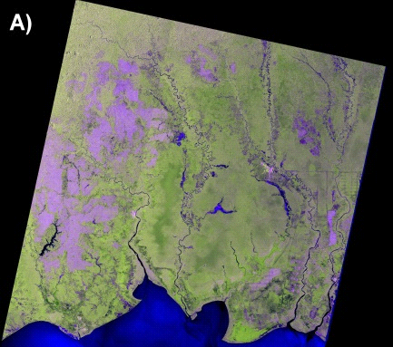
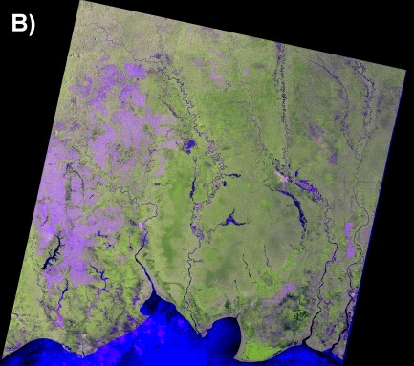
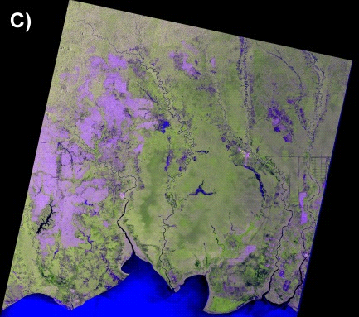
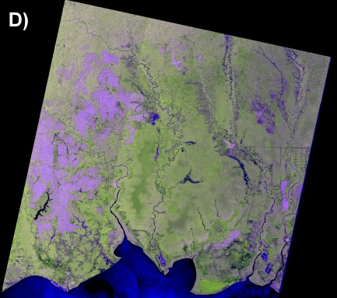
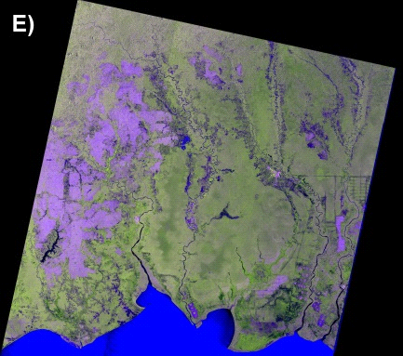
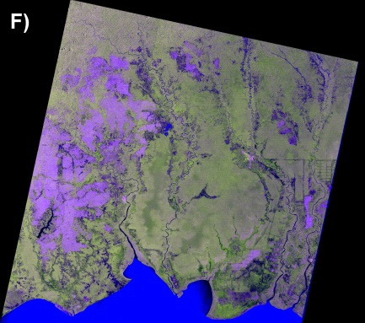
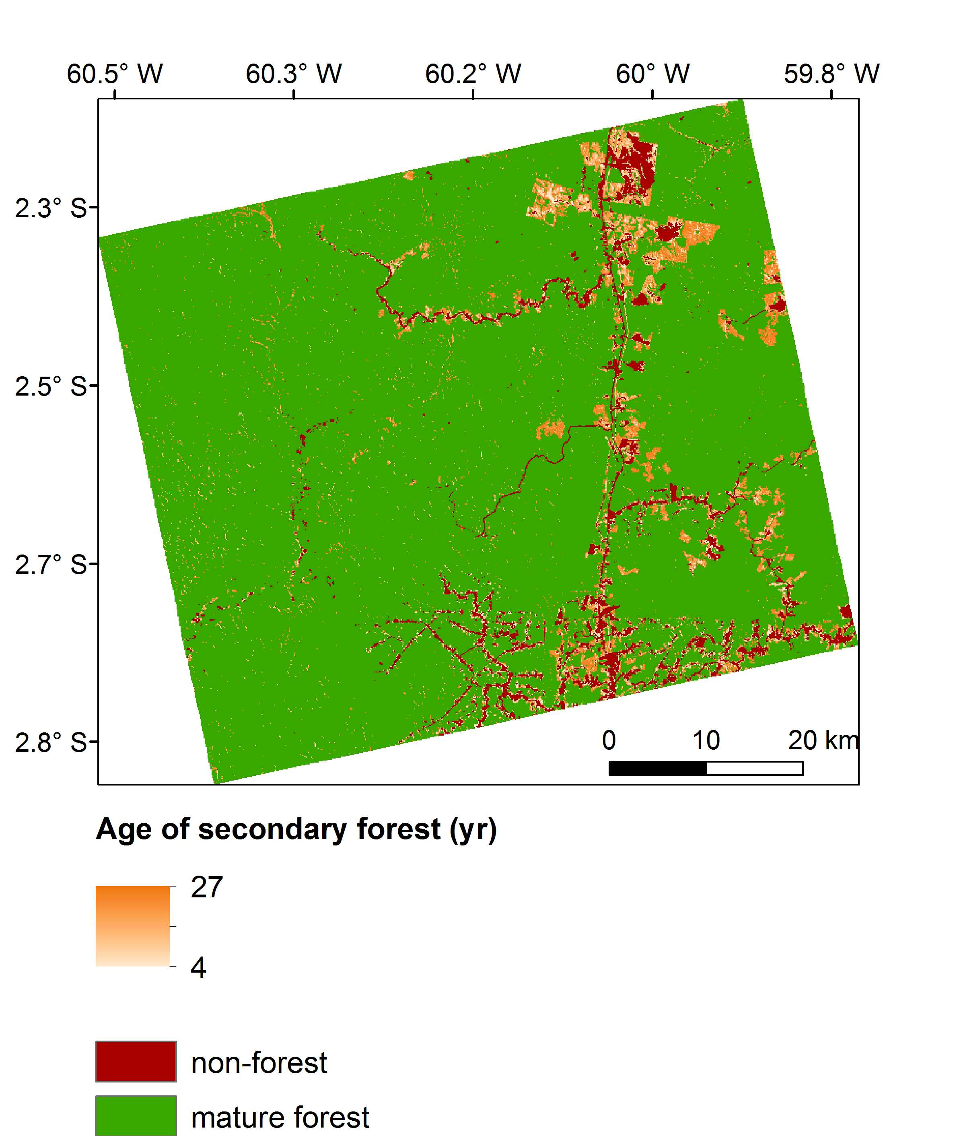
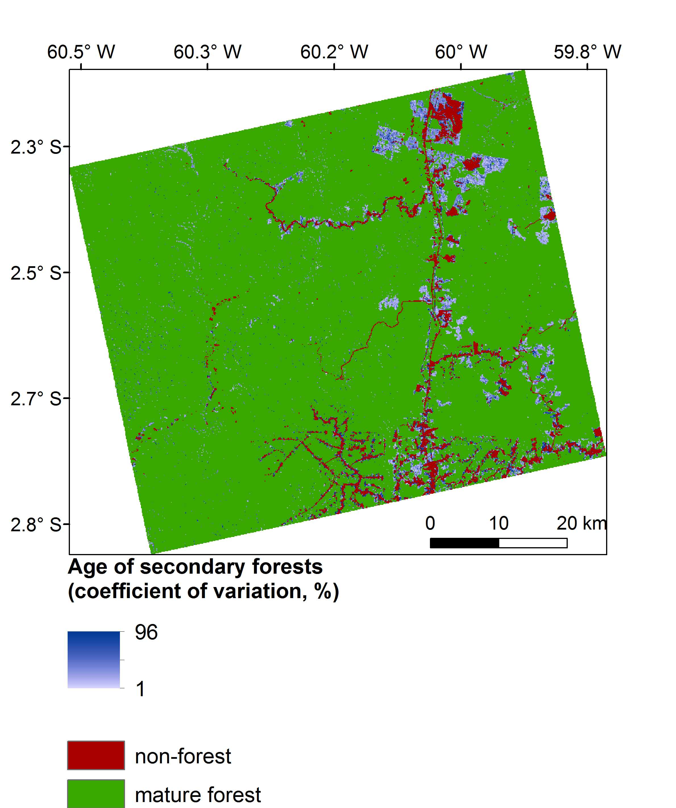
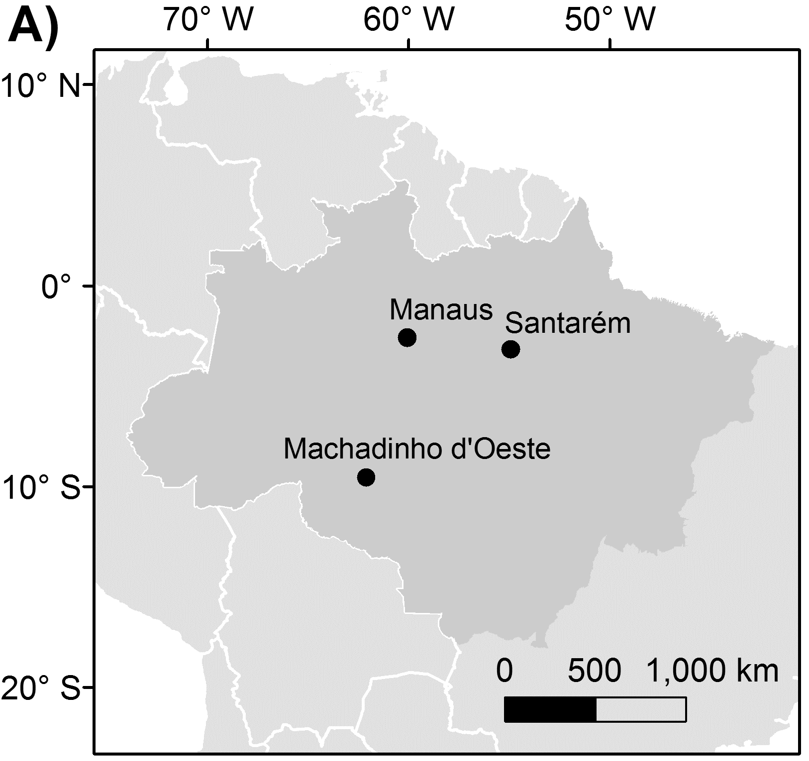
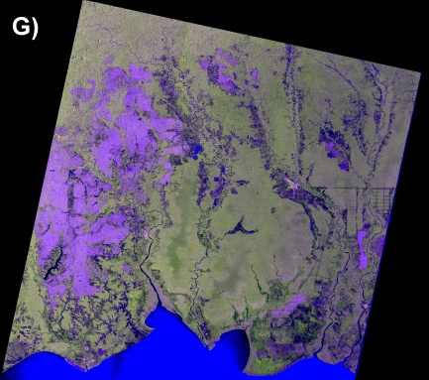
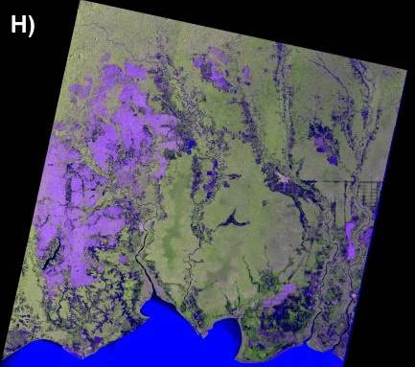
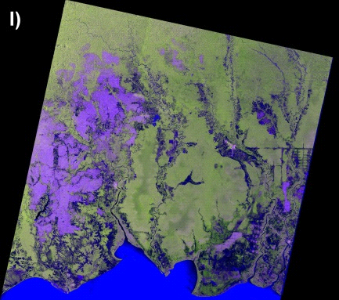
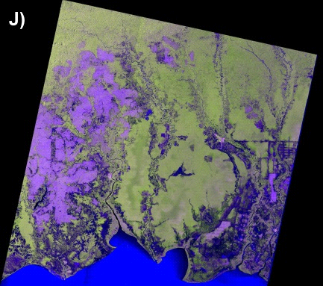
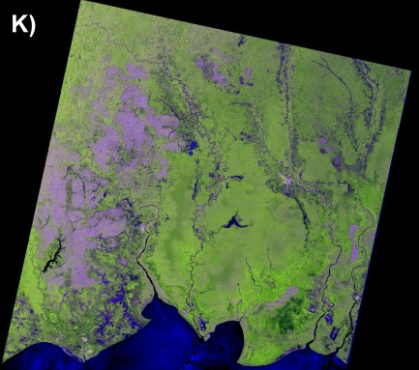
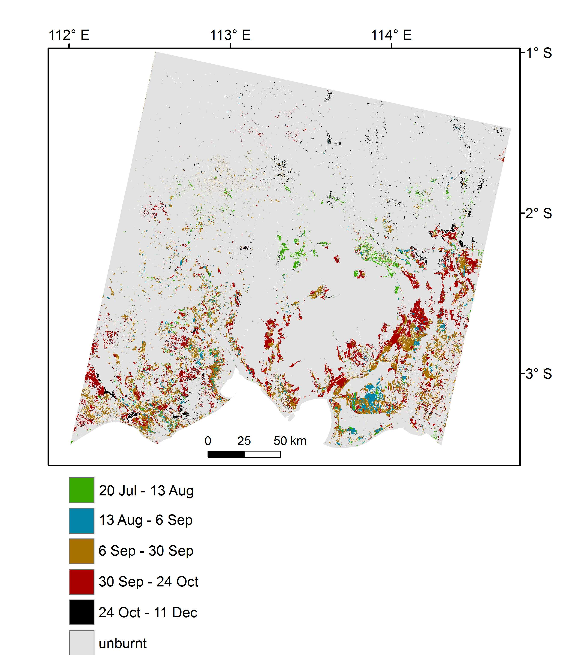
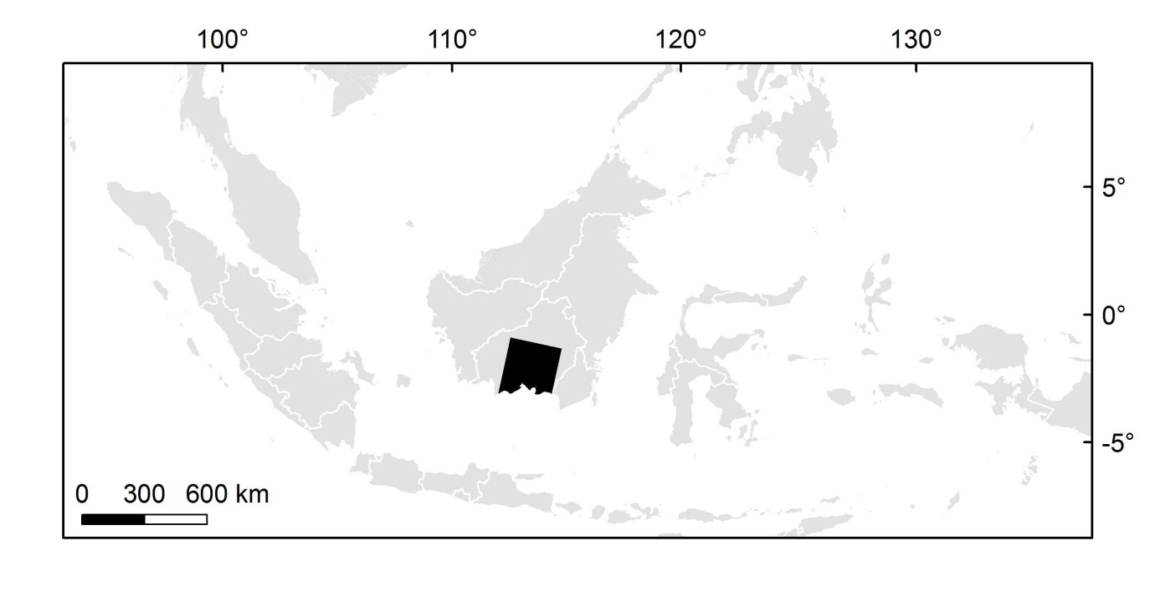



Mapping non-forest, age of secondary forest, and mature forest in the Amazon with single-date Landsat TM and ALOS PALSAR data
Mapping the 2015 burnt areas in Central Kalimantan with monthly time-series of Sentinel-1A (VV+VH) data
Manaus (2010)
R: VV (dB)
G: VH (dB)
B: VV/VH
Sentinel-1A data acquired between March – December 2015
Burnt area mapping with overall accuracy between 75-95%
11% of the study area burnt in 2015, with the majority (75%) in a 7-week period (6 Sep – 24 Oct)
Discriminating non-forest, secondary forest and mature forest with overall accuracy of 98%
Retrieving the age of secondary forests with
RMSE = 3.84 yr and bias = -0.06 yr
In combination with biomass accumulation curves, this approach offers an alternative source of information to estimate the carbon stocks and fluxes in the above-ground biomass pool of tropical secondary forests
In highly cloud-covered tropical forest regions, monthly time-series of C-band SAR data can play a unique role at estimating not only the annual burnt area extent but also its time-dependent distribution
Carreiras et al. (2016). Remote Sensing of Environment (under review)
Notes:
Left-hand side. Mapping non-forest, age of secondary forest, and mature forest in the Amazon with single-date Landsat TM and ALOS PALSAR data. Method – nonparametric Random Forests in two stages: 1) discrimination of mature forest, non-forest and secondary forest, 2) estimation of the age of secondary forests only over areas previously mapped as secondary forest.
Figure on the left. Map displaying the age of secondary forests in Manaus (2010) (orange colour ramp), and also non-forest and mature forest. The histogram shows the number of pixels by age, thus indicating that secondary forests in Manaus are dominated by older forests.
Figure on the right. Map displaying the coefficient of variation around the estimates of age of secondary forests (blue colour ramp), and also non-forest and mature forest. The histogram shows the number of pixels by coefficient of variation, indicating that most estimates were obtained with a coefficient of variation lower than 20%.
Right-hand side. Mapping the 2015 burnt areas in Central Kalimantan with monthly time-series of Sentinel-1A (VV+VH) data. Method – nonparametric Random Forests using post-fire and pre-fire data. Fire was mapped independently in each period and combined in the end to generate the 2015 burnt area map (bottom figure).
The top figure shows the S-1A data acquired on a monthly basis between March and December 2015.
The barplot shows the burnt area at each period.

Slide 18
Forest Monitoring from Earth Observation:
Examples from Aberystwyth University
SDCG-10: Reading, 7-9 September, 2016
Peter Bunting, Richard Lucas, Ake Rosenqvist, Nathan Thomas, Sizwe Mabaso, Joshua Jones and Joao Carreiras

Slide 19


Carnahan Classification Based on Height and Cover
Combination of interpolated ICESat profiles and Landsat derived forest cover.
Product at 25m resolution and is the integration of ALOS PALSAR, Landsat and ICESat. Segmentation of PALSAR and Landsat products, populate segments with intersecting ICESat footprints, interpolate ICESat profiles using PALSAR and Landsat = forest height for Australia.

Slide 20
Mapping Forest Growth Stages
Manaus,
Amazonia
Brigalow Belt Bioregion, Queensland, Australia (2009)
Maps of forest regrowth stage generated using Landsat-derived Foliage Projective Cover (FPC) and Advanced Land Observing Satellite (ALOS) PALSAR HH and HV data. All mapping is based on the response relative to that of remnant forest for different regional ecosystems

Slide 21

Global Mangrove Watch
Global monitoring system for changes in mangrove extent. Built using the Giri et al 2000 product and ALOS PALSAR, PALSAR-2 and JERS-I SAR data. Change is identified using an innovative map-to-image change method.

Slide 22










































Forest Regrowth Biomass: Amazon
1984
1986
1987
1989
1990
1991
1994
Landsat land cover history
1995
1996
1997
1998
1999
2001
2003
2005
2006
2007
2008
2009
2010
2011
Spaceborne data quickly saturates as biomass increases.
  Use forest growth model.
  3PG
Regional products over estimate regrowth forest biomass.
Modelling biomass allows regular (in time) products to be product.
  This study produced annual products.
  Allowed comparison to other products
  Allows future forecasts
Notes:
Example biomass map from Manaus (2011) and then box plots showing the range in biomass from regional products compared to our modelled result. We show that the regional products significantly over estimate the biomass for these regrowth forests.

Slide 23
Thanks
SDCG-10: Reading, 7-9 September, 2016

