Slide 1
JAXA contributions to R&D Support strategy (Element 3) – Status update
Ake Rosenqvist, Shizu Yabe (JAXA)
SDCG-10 Session #4

Slide 2
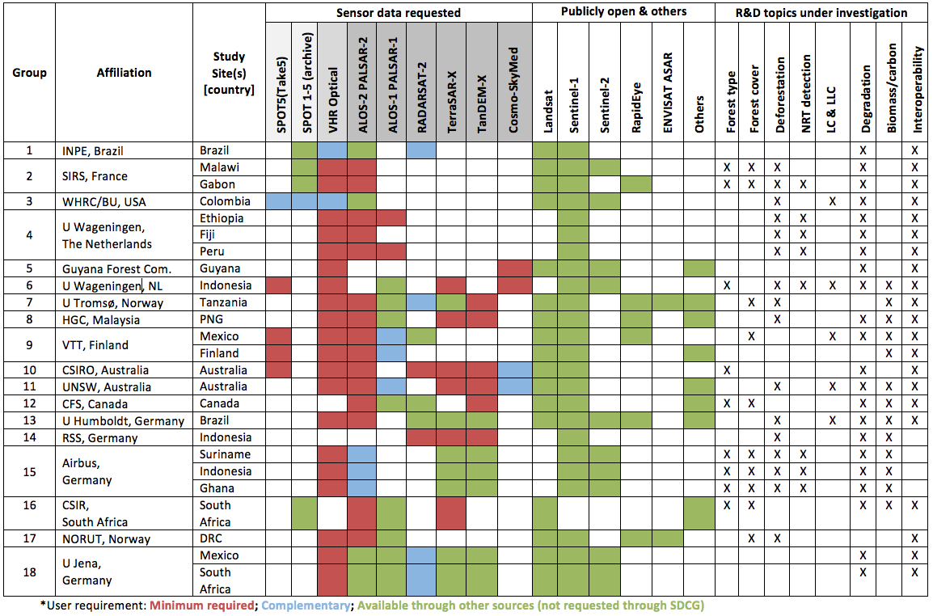
ALOS PALSAR / ALOS-2 PALSAR-2
GFOi R&D group satellite data requirements (El-3 v2.1)

Slide 3
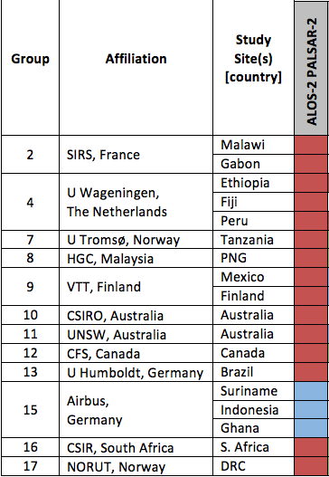
ALOS-2 PALSAR-2
Approved support: ALOS-2
12 R&D groups (all requests aproved)
Minimum Required dataset
11 groups
15 Study Sites
Complementary dataset
1 group
3 Study Sites
Total number of scenes: 400
Provision of archive data

Slide 4
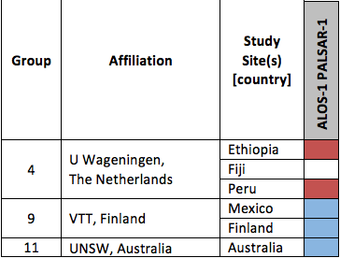
ALOS PALSAR
Approved support: ALOS PALSAR
3 R&D groups (all requests approved)
Minimum Required dataset
1 group
2 Study Sites
Complementary dataset
2 groups
3 Study Sites
Total number of scenes: 230
Provision of archive data

Slide 5
ALOS PALSAR / ALOS-2 PALSAR-2
Data provision procedures
Procedures provide data to GFOI R&D groups:
TBC
Constraints or limitations
Total number of scenes to be provided: 630 (230 ALOS + 400 ALOS-2)

