Slide 1
GFOI Space Data Services
Brian Killough / NASA, CEOS SEO
SDCG-10, Session 5
Agenda Items 32 and 33

Slide 2
Agenda – Session 6
3-Year Work Plan Tasks and Outcomes
#6: Ensured On-going Coverage
#7: Interoperable Data Discovery Tools
#8: Assembly and Delivery of Core Data
#10: Cloud-Computing Pilot Projects
#11: Model National GFOI Data Services
CEOS Data Cube Development and Demo

Slide 3
#6: Ensured On-going Coverage
Archive Characterization
The SEO has now automated the production of Landsat country reports and they are posted online for all 70 GFOI countries!
These reports will be valuable for countries to assess available scenes and cloud cover for future data ordering.
We plan to update these reports on an annual basis and keep the reports current. In addition, we plan to add content for Sentinel-1 and Sentinel-2 to the reports in 2017.
The SEO has provided additional detailed support to countries, as needed. For example, we recently performed more extensive analyses for Colombia.

Slide 4
#7: Interoperable Data Discovery Tools
The COVE Tool now includes links to archive databases from: Landsat 7/8, SPOT 1-6, Pleaides-1A/1B, Radarsat-2, ALOS-1 and Sentinel-1A. The link to Sentinel-2A will be completed after the mirror archive is in place at USGS.
The SEO vision is that the COVE tool can provide a “one-stop” location to perform coverage assessments and “discovery” of valid images.
The SEO plans to update the COVE Coverage Analysis tool in 2017 to make it more robust and “user friendly” for queries and reports.

Slide 5
#8: Assembly/Delivery of Core Data
The Global Data Flow Study is focused on this topic.
Countries can use scene-based tools (e.g. SEPAL) or new Data Cube tools as methods for utilizing data for analyses. These tools can be deployed locally, or on data hubs or clouds.
The move toward sustained Analysis Ready Data (ARD) significantly improves the efficiency and effectiveness of core satellite data. This is being worked with the LSI-VC group.
The new “GFOI Space Data Portal” will improve the capability of countries to identify and obtain needed satellite datasets.

Slide 6
#10: Cloud Computing Pilot Projects
The SEO is pursuing collaborations with SERVIR and Amazon to test the use of regional data hubs and cloud computing for Data Cubes. More in Data Cube charts ...
The SEO is testing Data Cube implementation in Colombia. More in Data Cube charts ...
The SEO and FAO identified some collaborative tasks in 2016 that will continue into 2017. More on another chart ...

Slide 7
SEO and FAO Collaboration
Brian Killough (CEOS SEO) and Erik Lindquist (FAO, Forestry) met in Washington on February 9, 2016.
Identified several cooperative tasks in the area of data management to support GFOI objectives.
Several tasks were deleted or modified due to recent changes or information.
The next chart summarizes those tasks and the status.

Slide 8
SEO and FAO Collaboration Tasks
Five SEO/FAO Tasks
Demonstrate a GEOTIFF data connection between the Data Cube and SEPAL. – MODIFIED, since we are now using NetCDF format and not GEOTIFF. A sample Data Cube was placed on Amazon in June for FAO testing.
Demonstrate that the Data Cube user interface can create a “raster brick” time series stack that is compatible with R-based tools. – Test in 2017, after futher definition
The SEO will modify the BFAST change detection code (written in R) to work directly with the Data Cube storage format and perform testing. Working with CSIRO and Jan Verbesselt. – Expect completion by mid-2017.
SEO and FAO will share Sentinel-1A processing progress. FAO plans to update their OpenSARKit. – NO significant progress to report. Colombia testing S1 data now.
SEO will investigate BRDF corrections to remove “scene edge effects” from Landsat data due to solar angle variations. DELETED, since USGS plans to include pixel-level sun angle information in future data products that will allow easier corrections.

Slide 9
#11: Model National GFOI Data Services
It is expected that the prototype in Colombia will be an ideal testbed toward a model national GFOI data services system.
It is likely the future will require both scene-based (e.g. SEPAL) and Data Cube methods to support countries.
More on the Data Cube is next ...

Slide 10
Data Cube Architecture
Analysis-Ready Data Products
Working with CEOS Space Agencies to develop plans for sustained provision of Analysis Ready Data (ARD).
Sentinel-1A and Sentinel-2A are the highest priority.
Ingestor
Testing prototype in Colombia.
Testing local, regional hub and cloud deployment.
Developing ingestors to add more datasets beyond Landsat ... MODIS, Sentinels, SPOT-5, ALOS, SRTM.
Testing integration with QGIS and ArcGIS
Data Cubes
Developing and testing prototype user interfaces for custom mosaic creation, time-series water detection, and change detection.
Evolving the Advanced Programming Interfaces (API) for improved application tool connections
APIs
User Interface

Slide 11
Latest GitHub Release: Aug 2016
SEO GitHub software: https://github.com/ceos-seo/Data_Cube_v2
Australia GitHub software: https://github.com/data-cube/agdc-v2
AWS Data Cube samples: http://democube.s3-website-us-east-1.amazonaws.com/
Recent release of code to the SEO GitHub includes:
Modified v2 Data Cube core additions – flexible ingestion bounds (can create smaller cubes), ingest UTM projections, ability to add a specific datatype
New ingestion configuration and preparation scripts for Landsat SR product
New Data Access API “wrapper” for v2
Updated custom mosaic user interface – compatible with v2, improved
New Water Detection tool (based on WOFS from Australia) and Jupyter notebook

Slide 12
Data Cube Application Status
Cloud Filtering – High priority need of most optical data users. SEO has developed a custom mosaic user interface and is working on concepts for QGIS plugins.
Change Detection – Major benefit of time series Data Cubes. Working on implementations of CCDC-YATSM (Boston Univ.) and BFAST (UMD and Wageningen). Also working with Boston Univ. on QGIS tools.
Water Management – High priority need of GEO and World Bank. Australia developed WOFS (Water Observation from Space) algorithm and SEO has implemented in Python and in a user interface tool. Plans to add Total Suspended Matter (TSM), CDOM, and Chlorophyll-A for water quality.
Agriculture – Interest from UMD in developing a Data Cube to support a new Landsat-based Crop Monitor user interface and to utilize China data.
Disasters – Interest from SERVIR team to implement the SLIP-DRIP algorithm for automated detection of landslides. Multiple integrated datasets (e.g. MODIS, SRTM) in a Data Cube could have major impact.

Slide 13
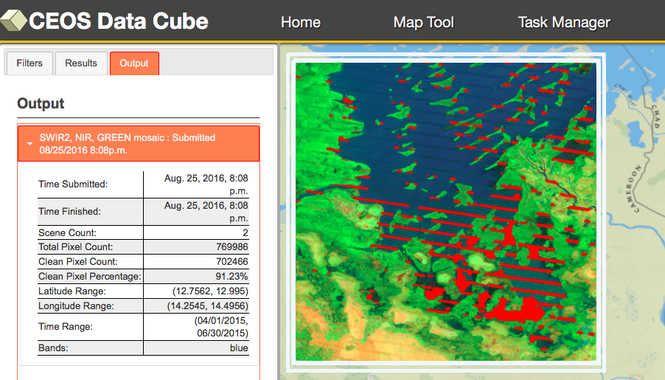
Custom Mosaic Tool
Filter Selections
Data Cube: Lake Chad
Region: Bounding Box (Lat-Lon possible) Data Product: Landsat 7
Product Type: Bands 7-4-2 (7 options)
Cloudy or Missing pixels: RED, 91% clean
Dates: 01-Apr-2015 to 30-Jun-2015

Slide 14
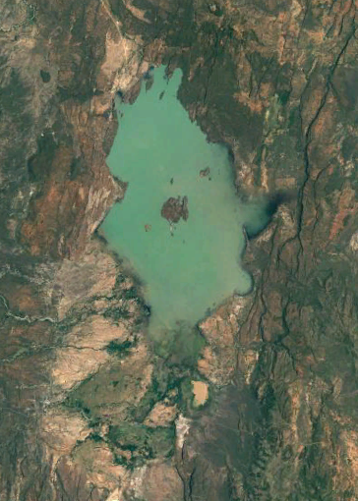
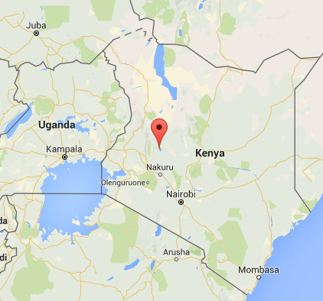
Water Detection Demo
Kenya
Lake Baringo National Park

Slide 15
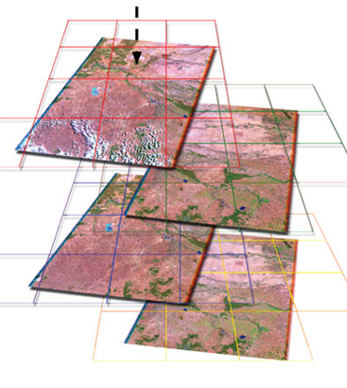
Data Preparation and Analysis
Data Preparation
Landsat 7, January 2005 to April 2016
169 original scenes (202 GB of data)
1x1 degree Data Cube “stack” with annual storage unit “chunks”
3710 x 3710 x 169 = 2.3 billion pixels total
37 GB NetCDF data volume (~ 5:1 compression)
Data Analysis
3.5 GHz Intel processor (4-core), 64GB RAM, Linux computer
Modified Australian water detection algorithm uses multiple Landsat bands for 97% accuracy
1-2 minutes for an annual analysis and ~30 minutes for a full time series (11+ years) analysis

Slide 16
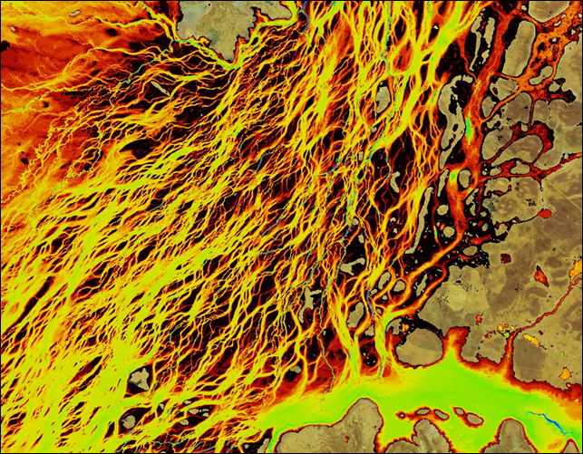
Australian WOFS Algorithm
WOFS = Water Observations from Space
Braided river network of Coopers Creek in Queensland, Australia
Blue = permanent water
Red/Yellow = infrequent flood events
CEOS has implemented the 23-step WOFS algorithm to produce results similar to those shown here
Braided river networks and flood extent is very difficult to map with traditional methods

Slide 17
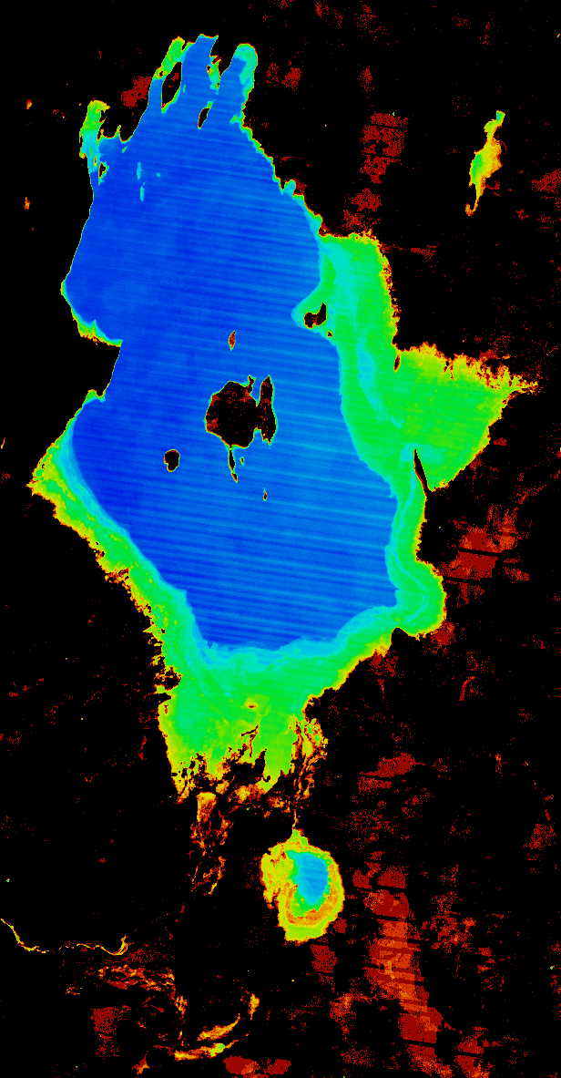
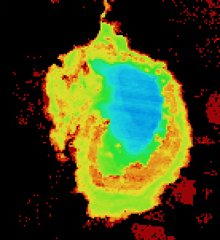
Lake Baringo, Kenya 11-year Time Series Results
The final product shows the percent of observations detected as water over the 11-year time series (water observations / clear observations).
Blue = frequent water
Red/Yellow = infrequent flood events
Flood risk can be easily inferred from the analysis results. 30-meter Landsat resolution allows detailed assessments that are far better than MODIS (250-m).

Slide 18
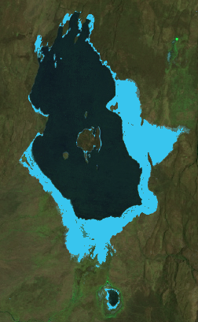
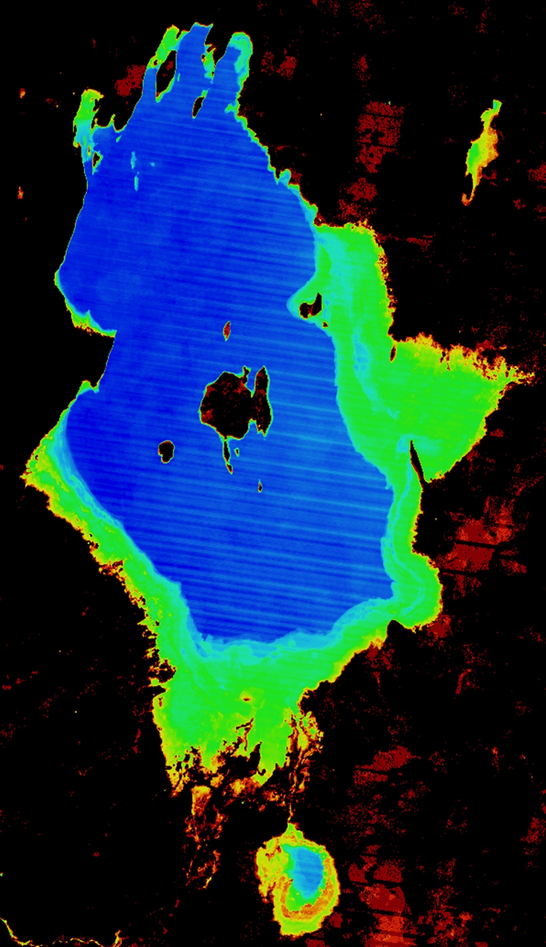
WOFS comparison with Google Earth Aqua Monitor
The Data Cube water detection results (right) were compared with the Google Earth Engine Aqua Monitor APP (left) (http://www.aqua-monitor.appspot.com)
The Aqua Monitor results, also based on Landsat data, look nearly the same! Light Blue pixels show where land has been changed into surface water over the time series (2005 thru 2015).
How is a Data Cube better? The Landsat data is “analysis-ready” and atmospherically corrected, which leads to more accurate results. The user has access to all of the pixel-level information for any portion of the time series. The output shows the existence of water at any time during the analysis period.

Slide 19
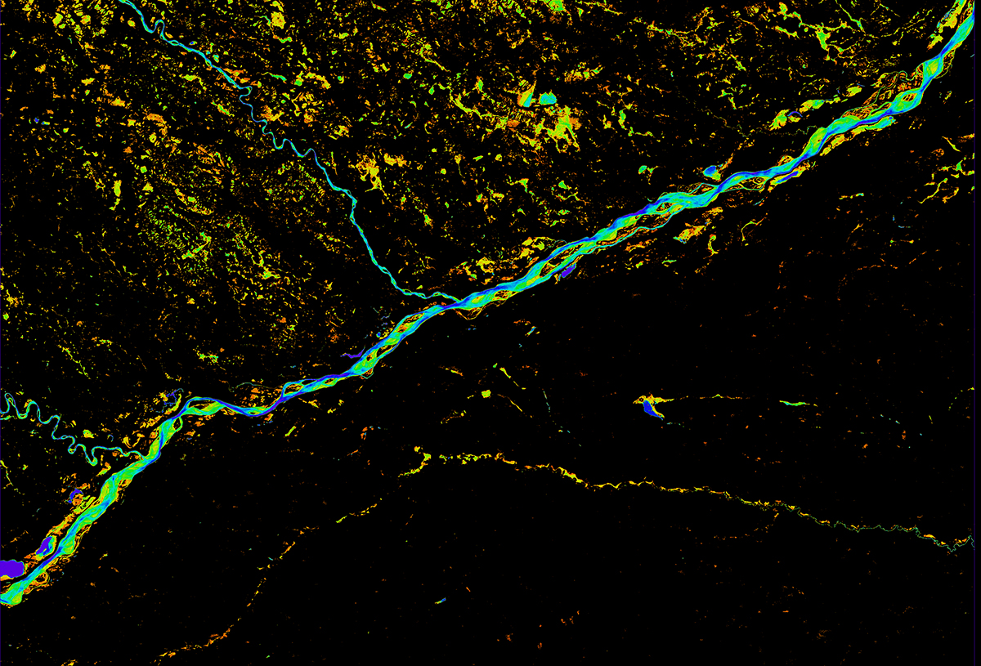
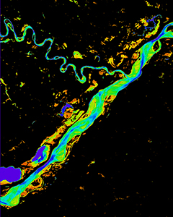
Meta River, Colombia 15-year Time Series Results
The final product shows the percent of observations detected as water over the 15-year time series (water observations / clear observations).
Blue = frequent water
Red/Yellow = infrequent flood events
Many regions do NOT have persistant water. Infrequent water above the Meta River is likely due to the annual rainy season.

Slide 20
Data Cube Prototype Status
Colombia – The government (IDEAM) and university (Andes) teams have made considerable progress in learning how to create and use Data Cubes! A complete country-level Landsat Data Cube (~25,000 scenes back to year 2000) will be ready by 2017. Land change detection and water detection are the primary application needs. Future plans will add many more datasets and applications. SEO and CSIRO are supporting.
Kenya – Recent changes in the government have caused uncertainty in the plans for a Data Cube project in 2017. Australia and Clinton Foundation have terminated their work.
Lake Chad, Africa – Considerable interest from World Bank in using a Data Cube for time series analysis of land and water in the Lake Chad region. Possible project to begin in mid-2017, pending approval. SEO is leading.
Asia Mekong – Investigating possible project with SERVIR and JAXA to serve Data Cubes to the Mekong region. CSIRO leading with SEO support.
Balkans – Recent proposal submitted to World Bank to develop a Data Cube to support multiple applications in Albania. Proposed project to begin in mid-2017. SEO is leading.
Switzerland – SEO approached by UNEP GRID Geneva and the Univ. of Geneva to develop a Data Cube pilot project. Significant computing and programming resources exist, so little effort is needed to get them started. SEO is leading.

Slide 21
3-Year Data Cube Work Plan
Provides a reference for internal and external Data Cube activities as there is great interest in FDAs and Data Cubes
Provides a reference for CEOS agency contributions and discussion by CEOS leadership regarding coordination to ensure outcomes
Informal document that is not meant for formal endorsement by CEOS
The majority of the work is managed and funded by the SEO with significant contributions by CSIRO and GA.
The SEO works closely with Australia to utilize elements of the AGDC development and communicates with USGS regarding its plans for LCMAP.
The document captures expected outcomes, task descriptions and target dates of completion.
Version-1 (Sept 2016) released.

