Slide 1
Element 3 Space Data Support to GFOI R&D
A. Rosenqvist, S. Yabe-Ogawa
SDCG-11 Session #3

Slide 2
Session 3 outline

Slide 3
Status Overview of 3-Year Work Plan Tasks and Outcomes

Slide 4
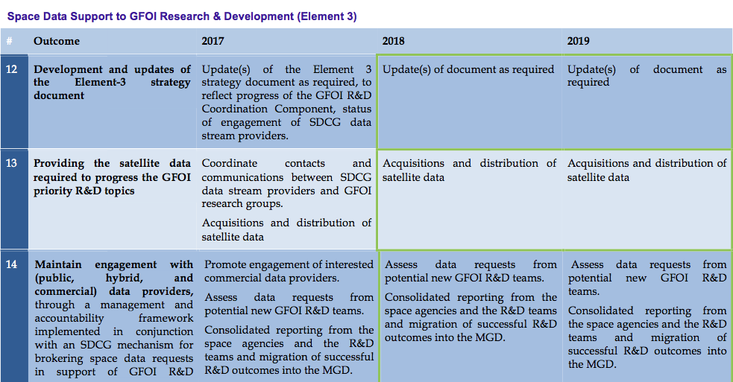
3-Year Work Plan

Slide 5
3-Year Work Plan
2017 Status: On schedule.
El-3 v2.0 endorsed by SIT-31
V 2.2 update completed prior to CEOS Plenary, Oct 2016.
V3.0 in the pipeline for SIT-32 (to be sumbitted “for info”). SDCG agencies asked to review the sections related to their missions.

Slide 6
3-Year Work Plan
2017 Status: On schedule & good progress
All SDCG agencies have completed selection of R&D teams to support
All agencies have begun tasking and/or data provision to the selected teams
(agency reporting next agenda item)

Slide 7
3-Year Work Plan
2017 Status: On schedule
Private sector engagement
AD&S (SPOT 6/7) – confirmed support but details pending (to be reported by CNES)
Planet (RapidEye + Doves) – TBC
SSLT (NovaSAR) – Support confirmed by SSTL inmarch 2016. NovaSAR launch foreseen in June 2017 and data provision ~6 months later

Slide 8
El- 3 document (v3) update

Slide 9
Element-3 doc revision
Revision to reflect
Updates to the agency data provision status (section 4)
All agencies to review and revise as required
Updates due by April 18 in order to make it into the SIT-32 version
Updates to the R&D group info (Annex A)
(Minor) updates to group data requests
Group 14 (WUR, NL) – change of study site
Group 7 (Tromsø U, Norway) – change of TSX request
Group 15 (ADS, Germany) – change of study site
Group 16 (CSIR, South Africa) – requests for additional data (Pléiades, Radarsat-2, TanDEM-X)

Slide 10
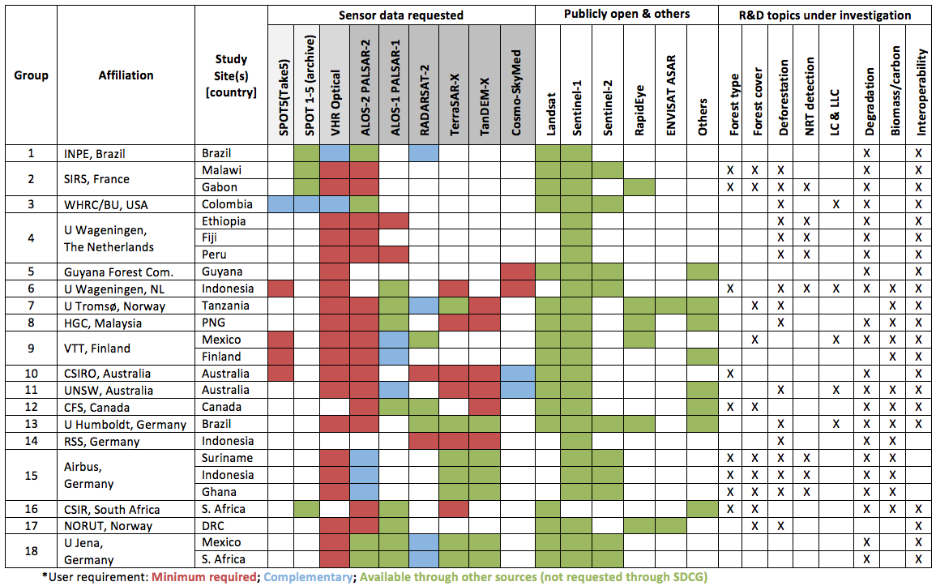
Element-3 doc revision
Version 2.1 (SDCG-10, Sept 2016)

Slide 11
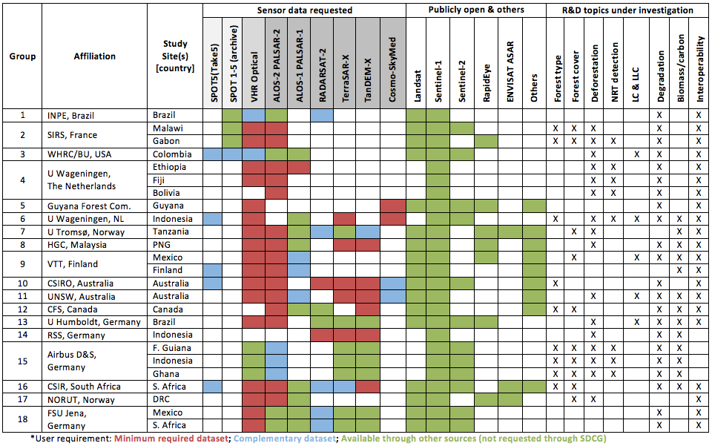
Element-3 doc revision
Revision 3.0 (April 2017)

Slide 12
GFOI R&D Coordination and R&D Programme

Slide 13
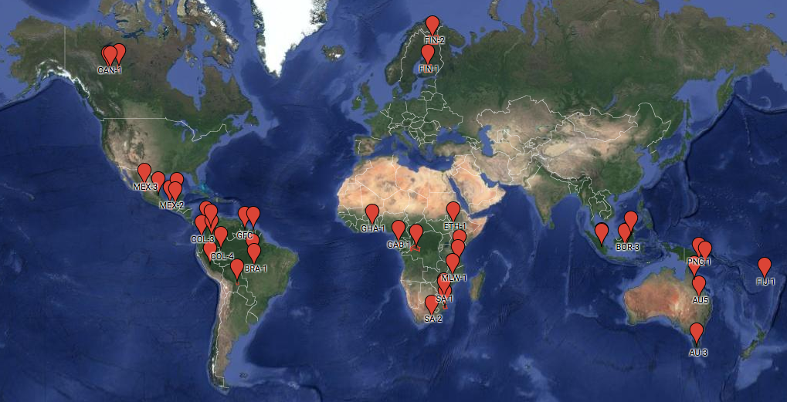
GFOI R&D Programme
GFOI R&D Study Sites & R&D teams
Currently 18 R&D teams from GFOI countries and national and int’l research organisations
Currently 32 multi-disciplinary sites, addressing multiple GFOI Priority R&D topics
Including Study Sites in former GEO-FCT National Demonstrator countries
GFOI R&D Study Site interactive map at
http://www.gfoi.org/rd/study-sites/

Slide 14
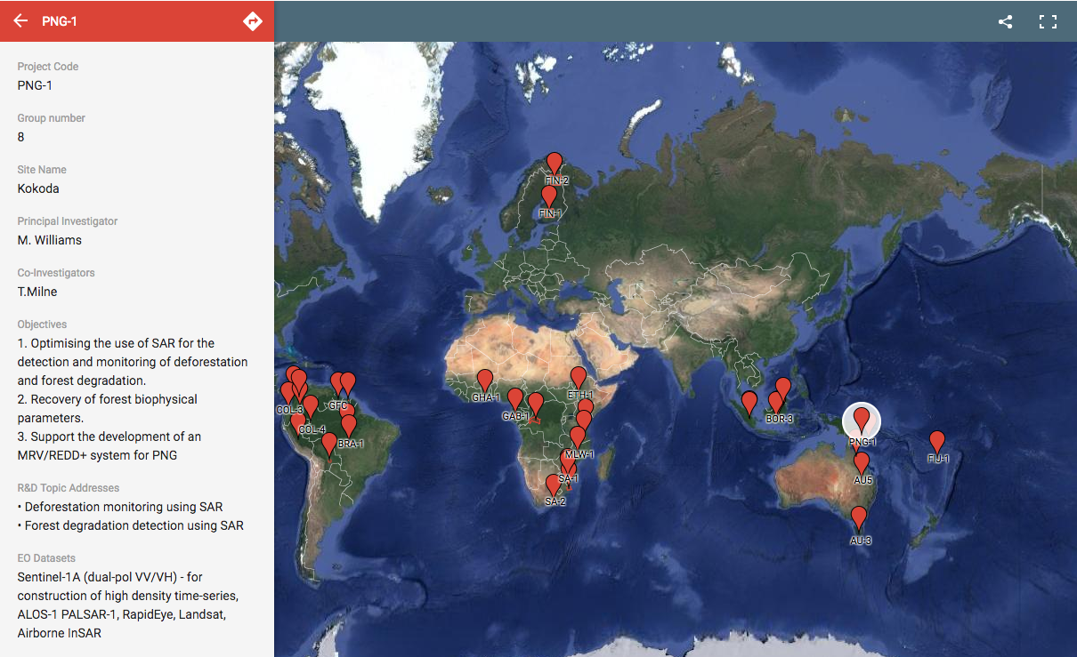
GFOI R&D Programme
Detailed Study Site info
Interactive map at http://www.gfoi.org/rd/study-sites/

Slide 15
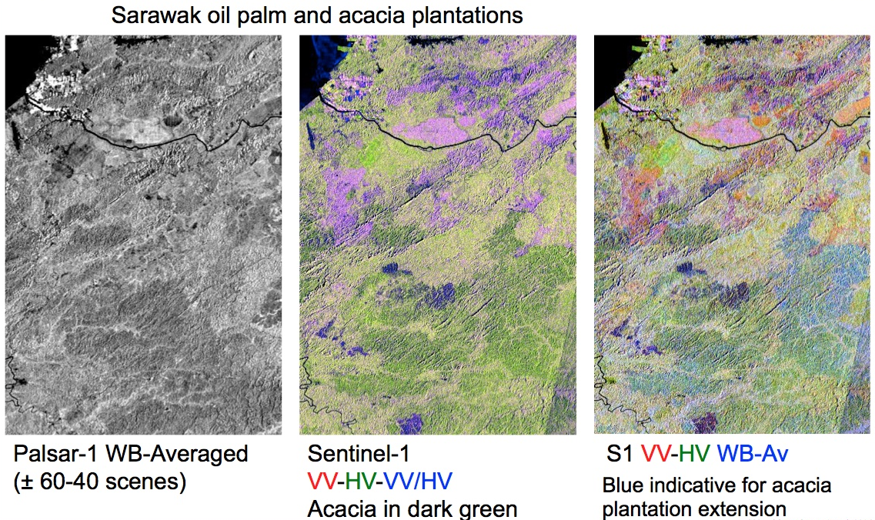
GFOI R&D Programme
Example: Sensor interoperability: L- and C-band complementarity
Courtesy of Dirk Hoekman, Wageningen Univ (Group 6)

Slide 16
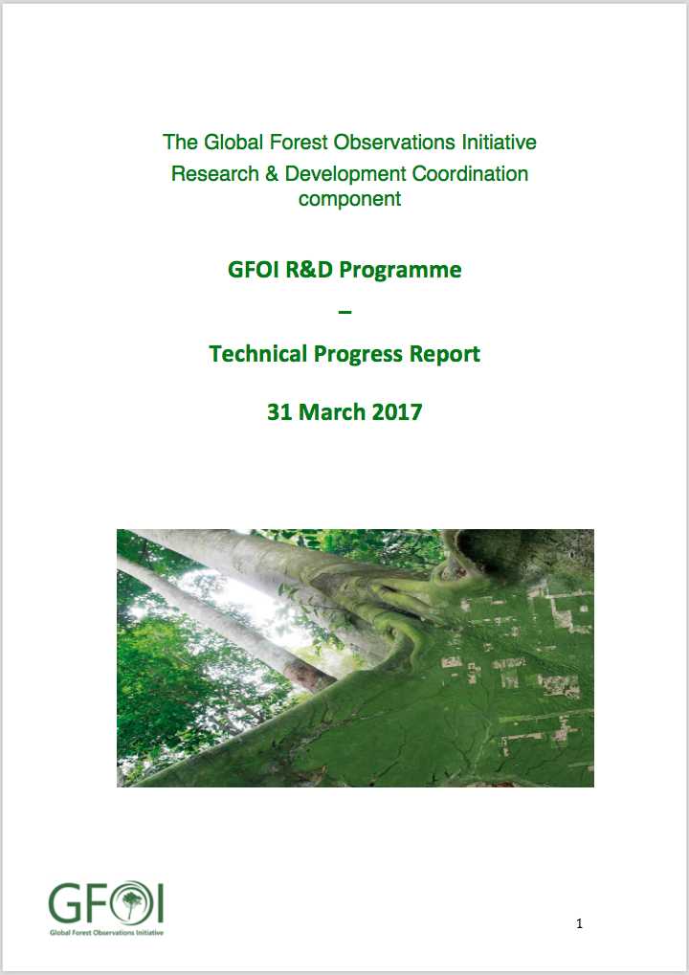
GFOI R&D Programme
Technical Progress report 2017
Released March 31, 2017
Progress reports by all 18 R&D groups
Research progress
Data access summary
Available at GFOI.org/RD
Notes:
ESA BIOMASS mission,

Slide 17
GFOI R&D Coordination
Joint SDCG – R&D Coordination session tomorrow:
Notes:
ESA BIOMASS mission,

