Slide 1
GFOI Space Data Services
Brian Killough / NASA, CEOS SEO
SDCG-11, April 10, 2017
Session 5
Agenda Items 18 and 19

Slide 2
Agenda – Session 5
3-Year Work Plan Tasks and Outcomes
#6: Ensured On-going Coverage
#7: Interoperable Data Discovery Tools
#8: Assembly and Delivery of Core Data
#10: Cloud-Computing Pilot Projects
#11: Model National GFOI Data Services
CEOS Data Cube (now … Open Data Cube)

Slide 3
#6: Ensured On-going Coverage
Archive Characterization
The SEO has now automated the production of Landsat country reports and they are posted online for all 70 GFOI countries. We plan to update these reports on an annual basis and keep the reports current.
Hard copy reports are available for Vietnam, Gabon, Guatemala, Mozambique, Nepal and Taiwan.
We have now added Sentinel-1 to the report! We will work to include Sentinel-2 by the end of 2017.
These reports will be valuable for countries to assess available scenes and cloud cover for future data ordering.
The SEO has provided additional detailed support to countries, as needed.

Slide 4
#7: Interoperable Data Discovery Tools
The COVE Tool now includes links to archive databases from: Landsat 7/8, SPOT 1-6, Pleaides-1A/1B, Radarsat-2, TSX, ALOS-1, Sentinel-1A/1B and Sentinel-2A (new). Following the WGISS meeting (last week), we have plans to add CBERS-3 and ResourceSat-2.
The SEO vision is that the COVE tool can provide a “one-stop” location to perform coverage assessments and “discovery” of valid images. It also gives the user direct links to data ordering, when possible.
The SEO plans to update the COVE Coverage Analysis tool in late 2017 to make it more robust and “user friendly” for queries and reports.

Slide 5
#8: Assembly/Delivery of Core Data
Countries can use scene-based tools (e.g. SEPAL) or the new Data Cube tools as methods for data analysis. These tools can be deployed locally, or on data hubs or computing clouds.
The move toward sustained Analysis Ready Data (ARD) significantly improves the efficiency and effectiveness of core satellite data. This is being worked within CEOS.
The new “GFOI Space Data Portal” will improve the capability of countries to identify and obtain needed satellite datasets.

Slide 6
#10: Cloud Computing Pilot Projects
The SEO is pursuing collaborations with SERVIR and Amazon to test the use of regional data hubs and cloud computing for Data Cubes.
The SEO is testing a Data Cube implementation in Colombia.
The SEO and FAO identified some collaborative tasks in 2016 that will continue into 2017.
More on these topics in the following charts …

Slide 7
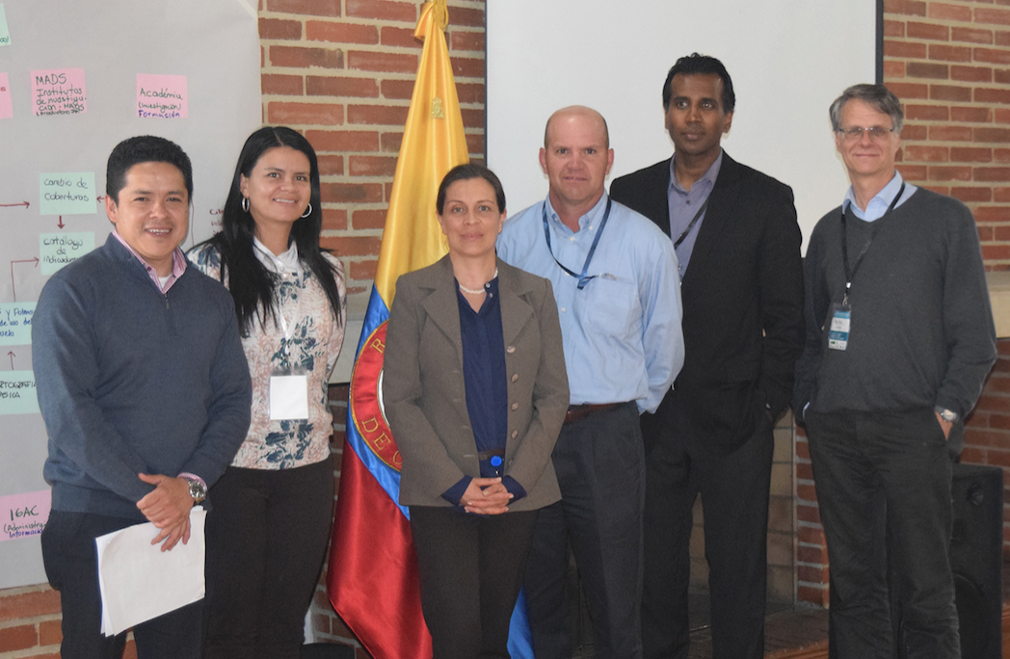
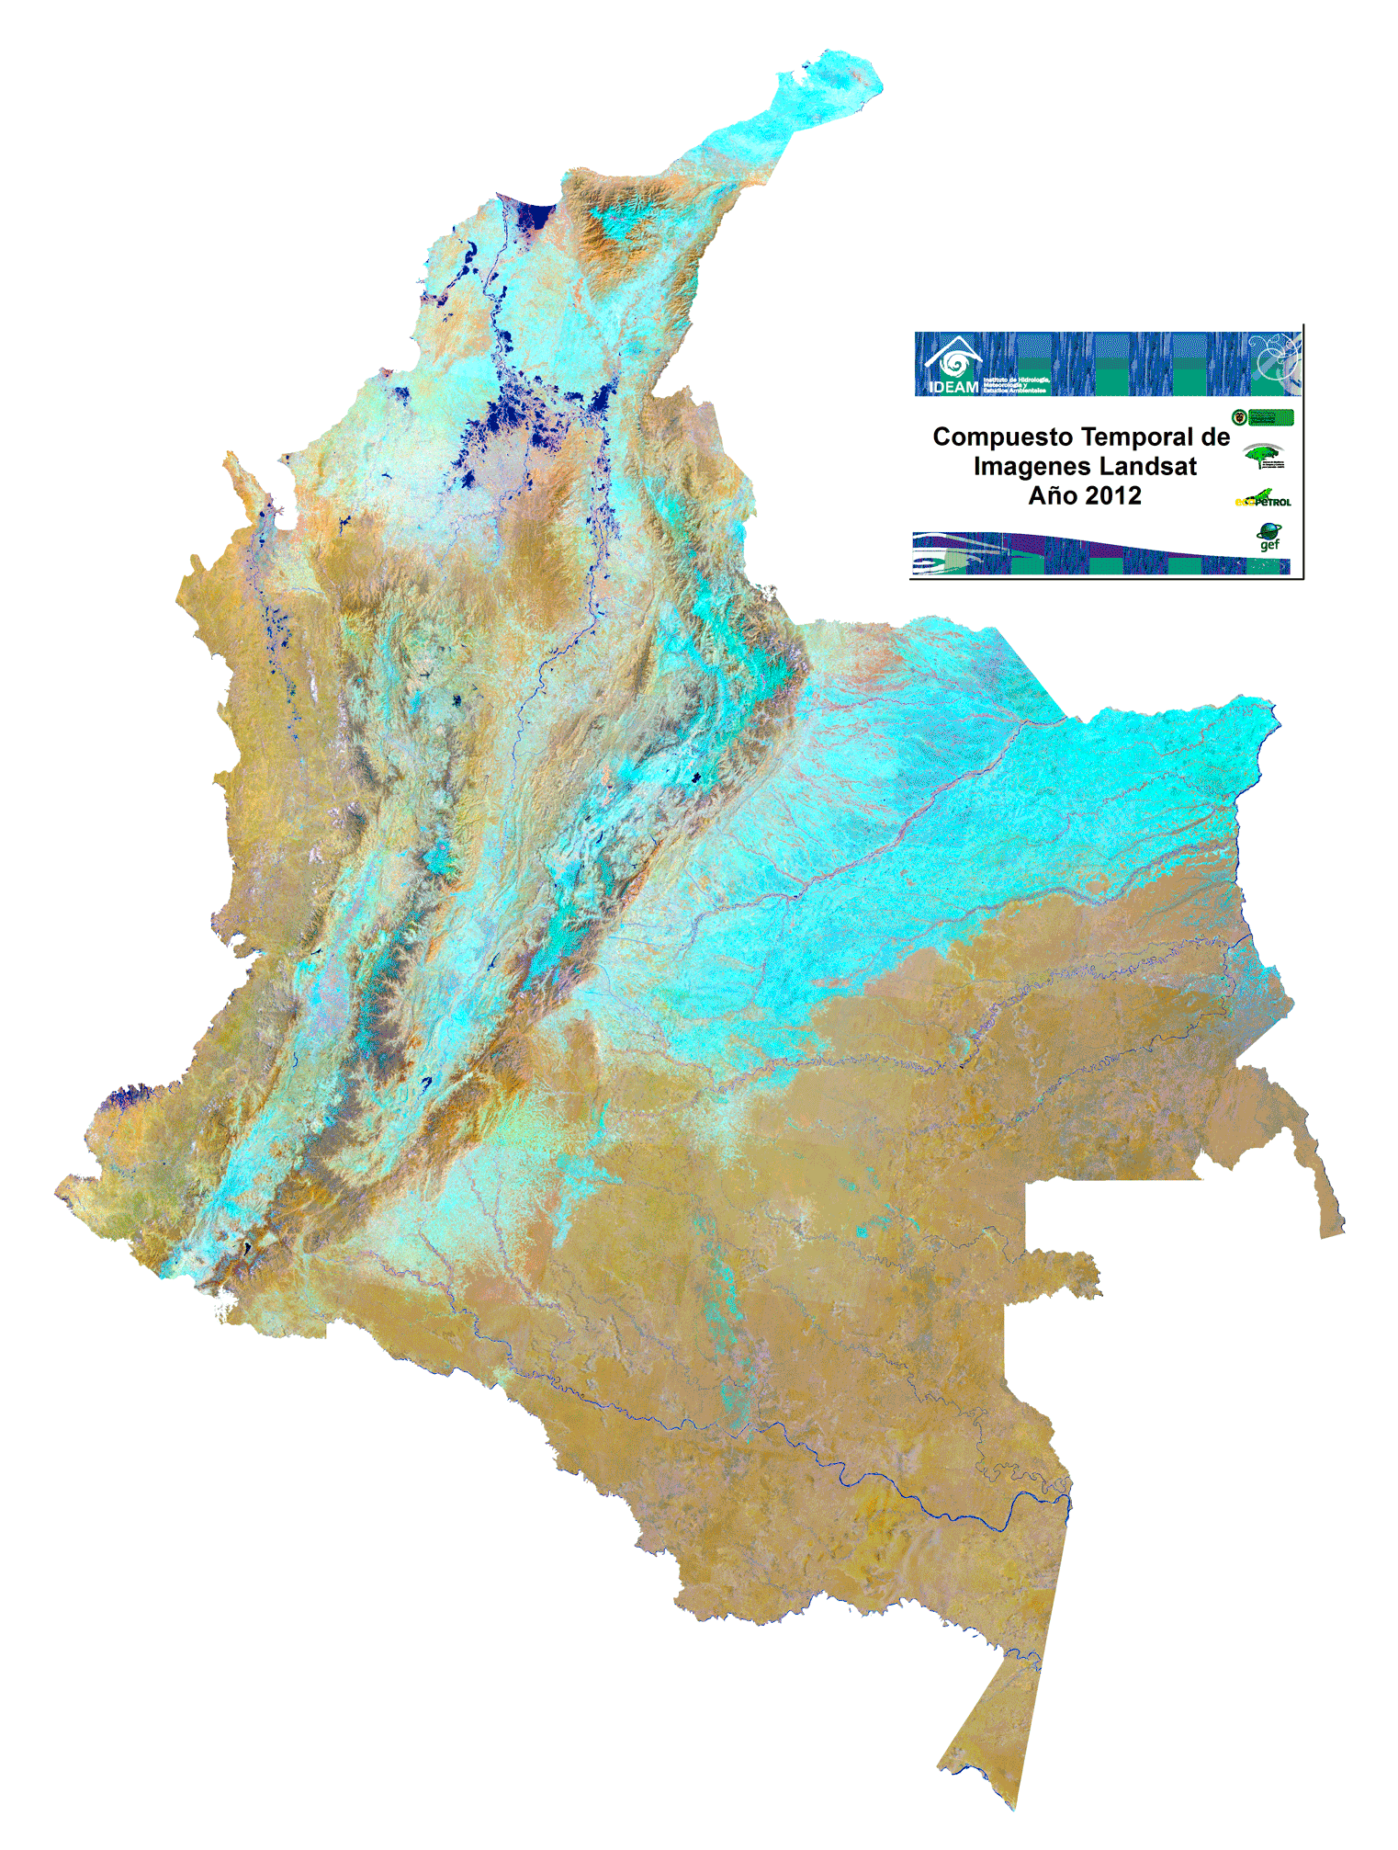
Colombia Prototype
The Government (IDEAM) and University (Andes) have made considerable progress in learning how to create and use Data Cubes!
A complete country-level Landsat Data Cube (25,000 scenes back to year 2000) was completed in Dec 2016.
Forest mapping and land change detection are the primary application needs.
Future plans to add more datasets and applications.
The SEO will continue to support IDEAM and the University of Andes in the coming year.

Slide 8
Colombia Work Items
Colombia team has issues running WOFS (water detection) due to memory overload. They would like to run WOFS on L5-L7-L8 over long time periods.
Colombia desires to merge their local UI with our application UI.
Colombia team has Landsat cloud mask issues (CFMASK). Gustavo will provide GeoTIFF (input), GeoTIFF (output) and cloud mask samples. The SEO will explore “machine learning” options.
Colombia asked for support to run the median mosaic algorithm on their Data Cube. We will also look into using the new GA “Geometric Median” mosaic.
The SEO will explore putting Colombia Sentinel-1 data on AWS. We will consider developing some statistical output products.
Colombia asked if it is possible to get NetCDF ARD for Sentinel-1 from the Alaska Science Facility (ASF). This is basically the concept of a “data cube on demand”. We are exploring that option with NASA.
The Colombia team would like us to explore WMS data cube links to QGIS.

Slide 9
SEO and FAO Collaboration
Brian Killough (CEOS SEO) and Erik Lindquist (FAO, Forestry) identified several cooperative tasks to investigate how the SEPAL tool can be connected to the Open Data Cube.
Erik has downloaded a sample data cube (NetCDF format sub-sample of one of our AWS cubes) and is evaluating its potential to support the FAO workflow. Erik will report more in his presentation.
The SEO (Andrew Cherry) has reviewed the SEPAL tool and completed a report that highlights strengths and weaknesses.
The SEO has completed its first demonstration of change detection analyses using a data cube (e.g. CCDC). We will be starting a new task with Jan Verbesselt in June 2017 to test BFAST with the data cube.
The SEO would like to get feedback from FAO on our plans for Sentinel-1 ARD.

Slide 10
#11: Model National GFOI Data Services
To date, we have not identified a “Model National GFOI Data Services” system.
FAO is continuing to work on its SEPAL tool and the CEOS SEO is working on its Open Data Cube tools.
As these two initiatives progress, the GFOI group should discuss the notion of a “model” system and what serves the community most effectively and efficiently.

Slide 11
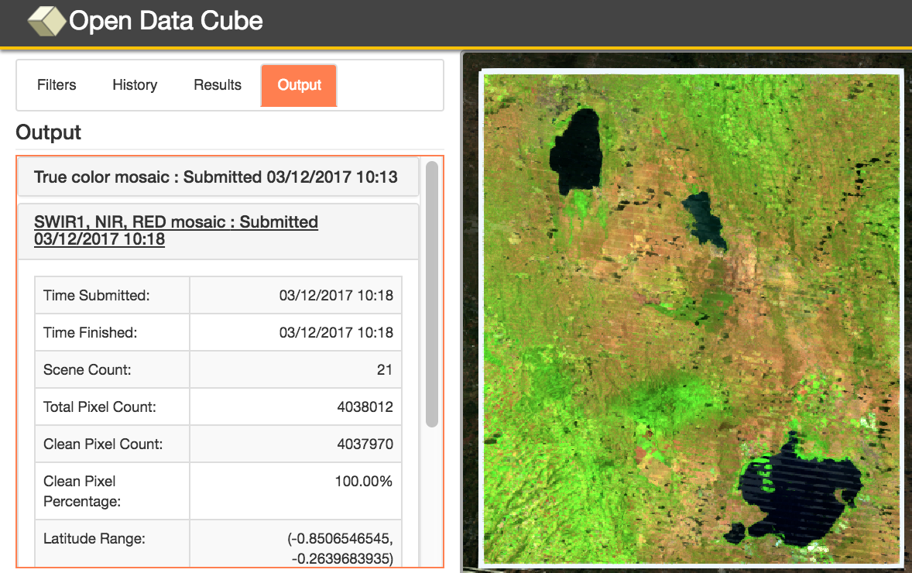
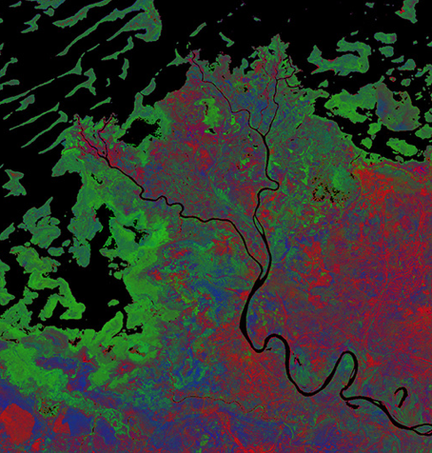
CEOS Open Data Cube
Based on an open source operational system: Australian Geoscience Data Cube (AGDC).
The Open Data Cube, is being scaled by CEOS for global use and consistency to increase the uptake and impact of growing satellite data volumes. github.com/opendatacube
Time series stacks of analysis ready data (ARD) can ease data handling and applications, enhance analyses (e.g. mosaic creation, change detection), support data interoperability (e.g. optical and radar data).
Current prototype testing in Colombia, Switzerland and Vietnam, with more planned.
Allows for local or regional deployment, automated data retrieval, data cube ingestion, connection to user interface tools and an API.
Plans for future training tools and workshops with a focus on customer service for sustained growth.
Free/Open demo available on Amazon AWS with 14 sample data cubes and 7 applications: www.tinyurl.com/datacubeui

Slide 12
Why Data Cubes?
The primary user problems are data access, data preparation, and efficient analyses
Users want to minimize the time and knowledge required to prepare satellite data
Users want free and open source solutions.
Users want to perform time series analyses
Users want to use multiple datasets together
Users want to use common GIS tools
Users want to “own” the data and keep it locally
Users want customer service and support
Our goal is NOT to sell a product or give out a tool …
Our goal is to provide a SOLUTION that has VALUE and increases the IMPACT of satellite data.

Slide 13
Open Data Cube Vision
A solution supporting CEOS objectives …
Build capability of users to apply CEOS satellite data
Supporting priority agendas (UN-SDGs, Paris and Sendai)
CEOS Agencies wanting to participate …
Through provision of Analysis Ready Data (ARD) products
Contributing to the uptake and impact of satellite data
Customers feel that they are the focus …
Training materials and easy installation/maintenance
An “Open Data Cube” brand that people know and trust
Users helping each other through an active Open Data Cube community
Scalable solution …
Supporting Data Cubes in 20 countries by 2022
Key partners (e.g. FAO, World Bank) supporting data cube projects

Slide 14
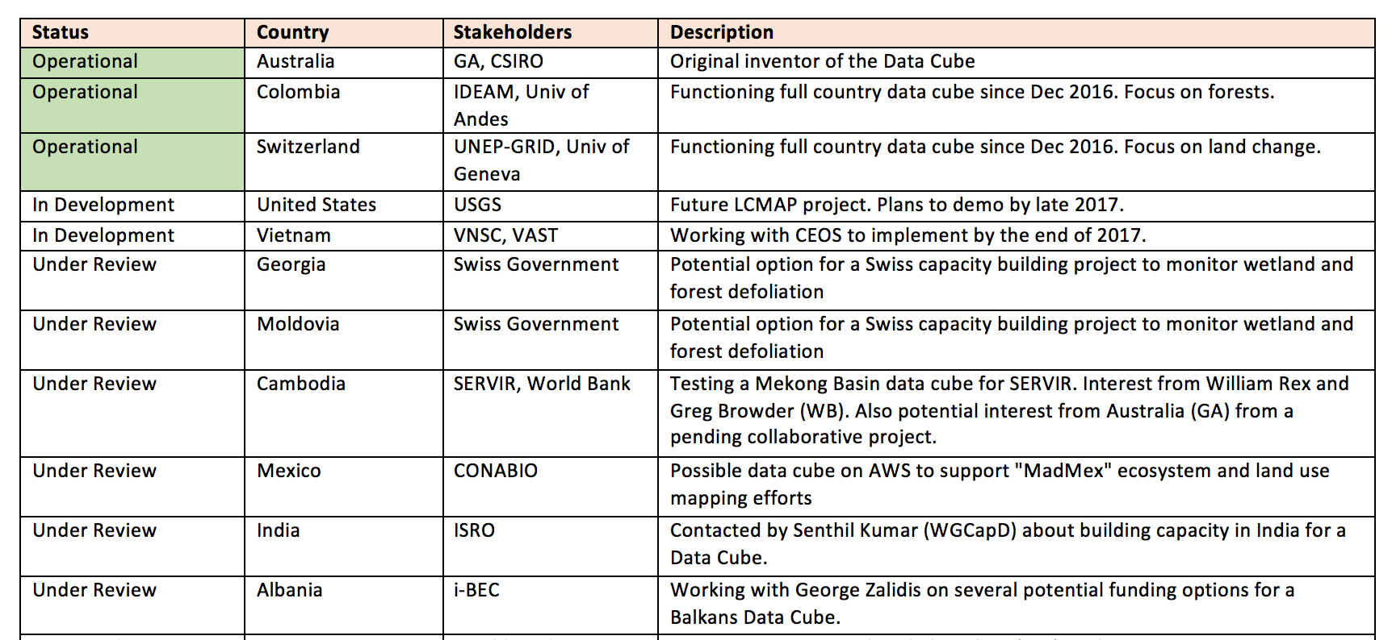
Data Cube Prototypes The Road to 20 countries by 2020
Others expressing interest: Peru (World Bank), Uganda (ESA), Taiwan, Chile, UAE

Slide 15
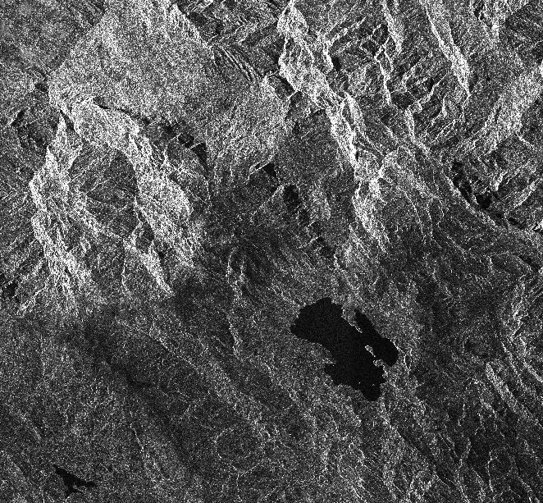
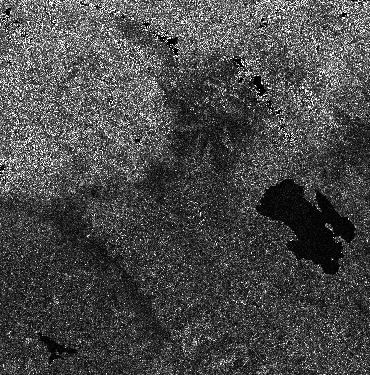
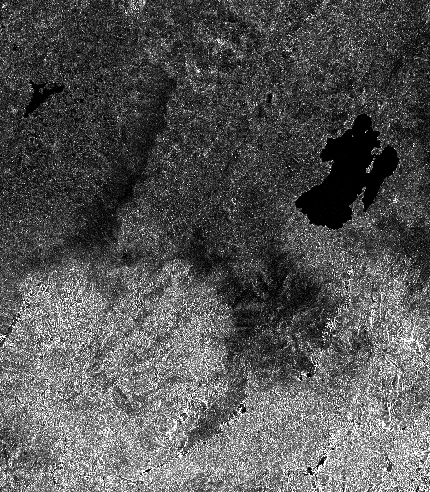
Sentinel-1 ARD Processing
Unprocessed - VH Intensity Lake: Laguna de Tota Location: Sogamoso, Colombia
Steps 1 to 6 Gamma-0, VH Intensity
Step 7 - Orthorectification Gamma-0, VH, UTM-WRS84

Slide 16
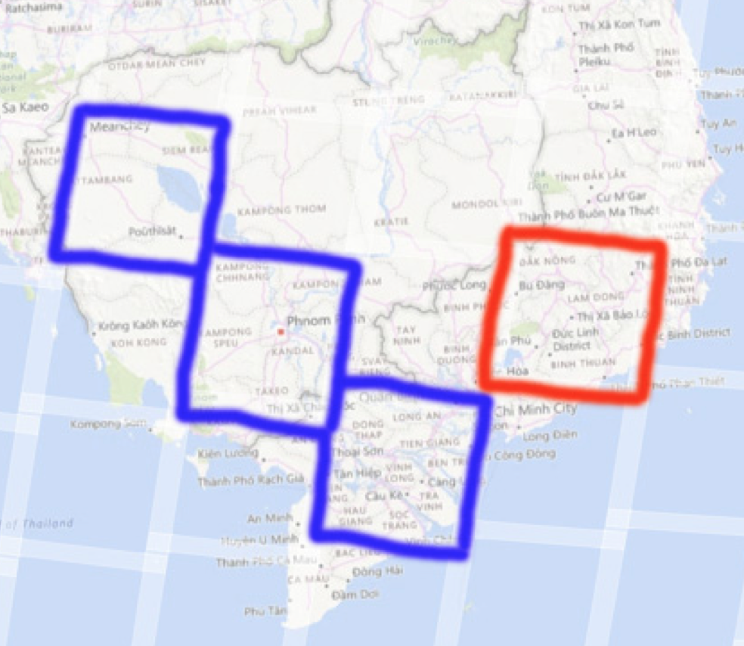
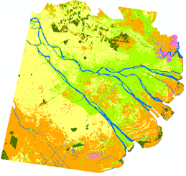
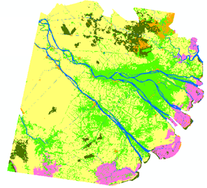
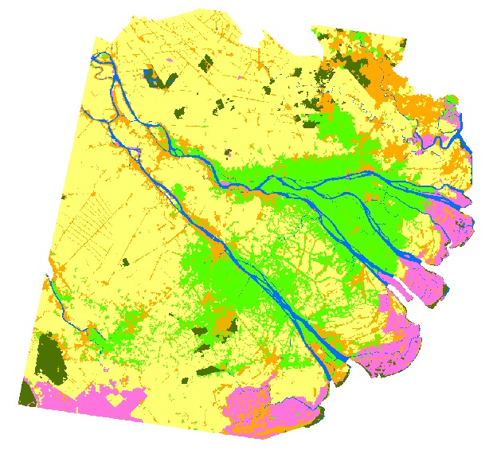
Vietnam Prototype
SEO and CSIRO are developing plans for a Vietnam Data Cube. The primary applications are rice and water management.
Two sample data cubes are under development with links to SERVIR (blue) and GFOI (red).
BLUE: Mekong Basin cube for Cambodia and Vietnam for SERVIR testing.
RED: Vietnam cube to support initial deployment training and a data interoperability study.
Datasets include: Landsat-7 (2000-2016), Landsat-8 (2015-2016), Sentinel-1 (2015-2016), JERS mosaic (1996), ALOS mosaics (2007, 2008, 2009, 2010, 2015, 2016).
1996
2005
2014

Slide 17
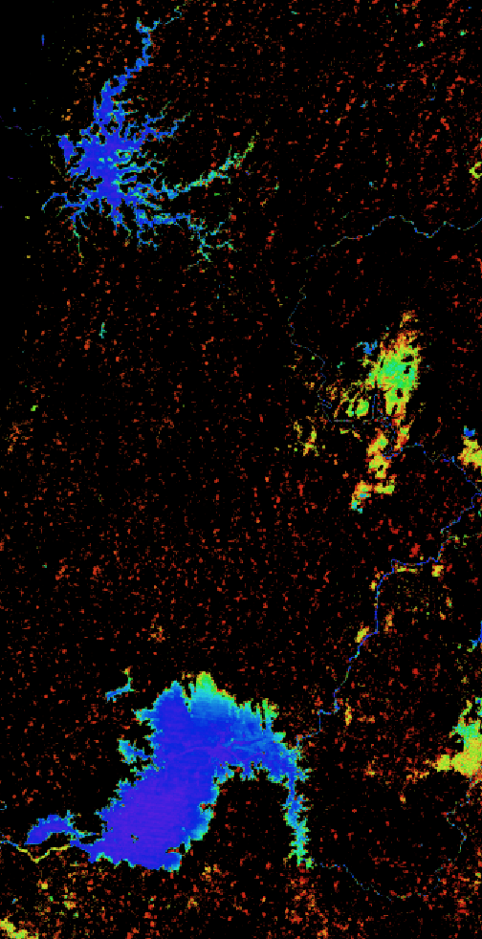
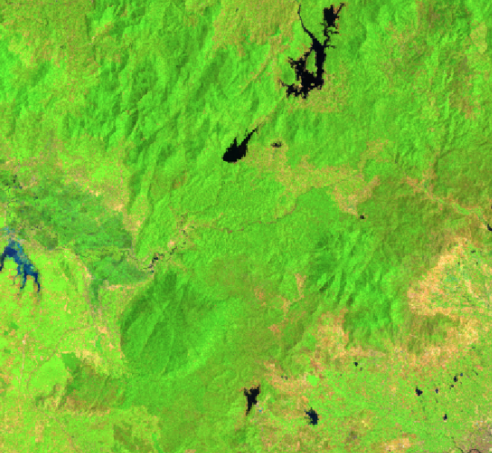
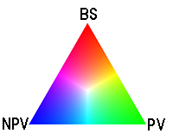
Vietnam Examples
Water Extent (WOFS) 2000 to 2016 (17 years)
Dong Nai and Binh Phuoc Regions
Ho Thuy dien Thac Mo (top)
Dong Nai River (bottom)
Landsat-8 Median Mosaic – Year 2016 Cloud-free mosaic, RGB: SWIR1-NIR-RED (top) Fractional Cover (bottom)

Slide 18
Interoperability Test Plans
Demonstrate Landsat 7, Landsat 8, Sentinel-1 and ALOS-PALSAR data interoperability in a Vietnam Data Cube.
Sentinel-1 data (10m) will remain in native EPSG:4326 (WGS 84) projection.
Landsat 7/8 SR data (30m) will be resampled from UTM to EPSG:4326.
ALOS-PALSAR data (25m) will be resampled from 25m to 30m resolution and reprojected from Lat-Lon (GRS 80) to EPSG:4326 (WGS 84) projection.
The first goal is to evaluate the spatial alignment of the 3 datasets within a nested grid data cube. Each Landsat and ALOS pixel should align. There will be nine (9) Sentinel-1 pixels within each Landsat/ALOS pixel. Preliminary assessment looks good!
The second goal is to conduct a water application analysis where we use Landsat (WOFS) compared to machine learning algorithm results for S1 and ALOS. This will be the focus of a 2017 Summer student project.

Slide 19
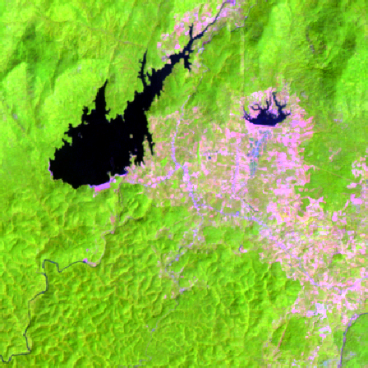
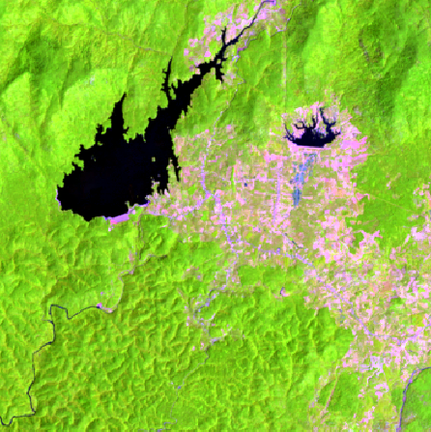
Vietnam Example - Optical
Landsat 7 Median Mosaic – Year 2015 RGB: Bands 5,4,3
Landsat 8 Median Mosaic – Year 2015 RGB: Bands 6,5,4

Slide 20
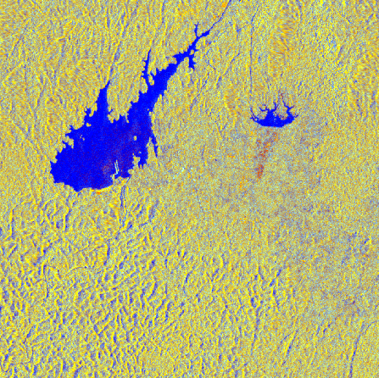
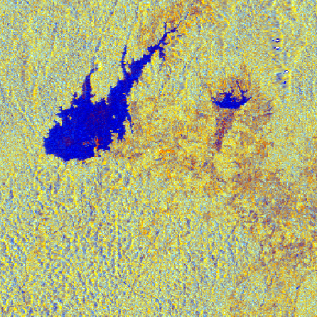
Vietnam Example - Radar
Sentinel-1 Median Mosaic - Year 2015 RGB: VV, VH, VV/VH
ALOS-PALSAR Median Mosaic – 2015 RGB: HH, HV, HH/HV

Slide 21
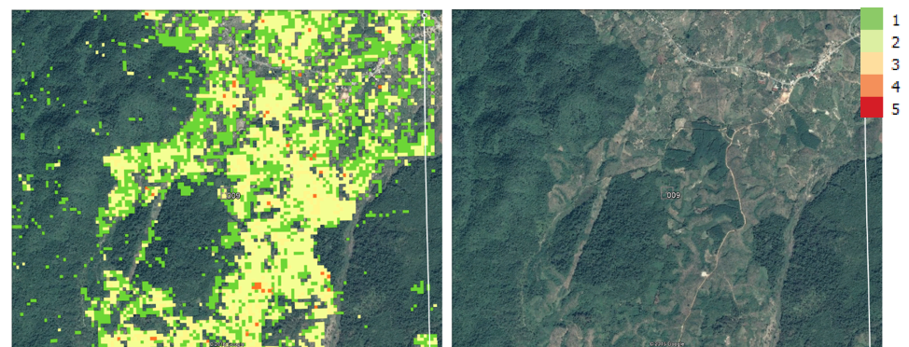
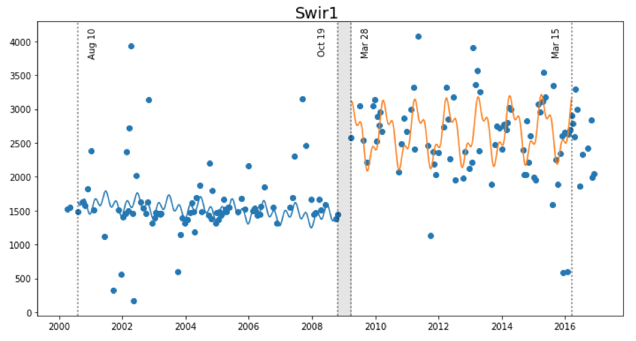
Land Change Detection
The SEO is investigating two approaches for change detection with Data Cubes … CCDC and BFAST
CCDC (Zhu and Woodcock, 2012) was converted to Python by USGS and recently tested by the SEO on the Vietnam Data Cube. We now call this“PyCCD”.
The SEO is also starting a task with Jan Verbesselt in June 2017 to convert BFAST from R-code to Python and to test on the Data Cube.
PyCCD time series model fits 7 bands to 6 weighted SIN and COS functions in order to find “breaks” that equate to potential land change.

Slide 22
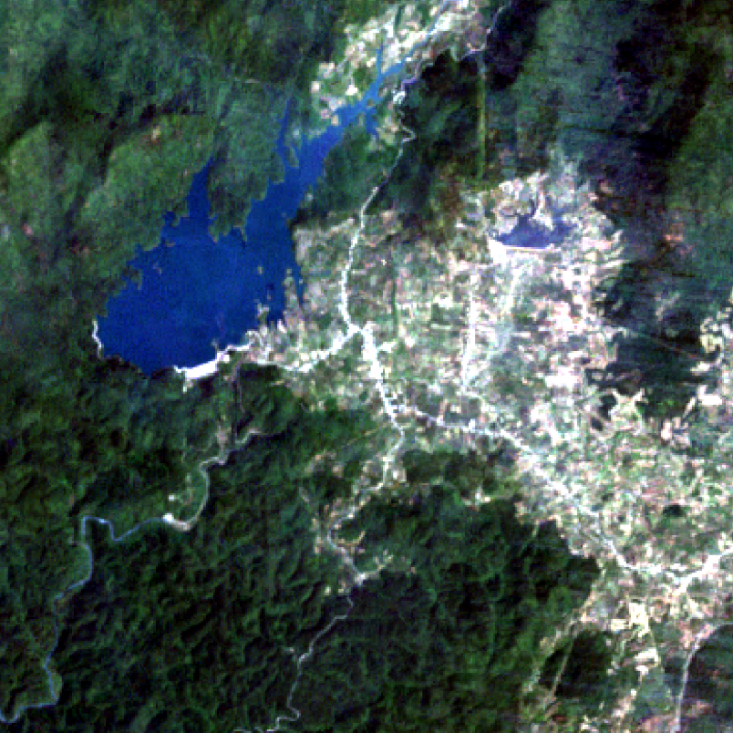
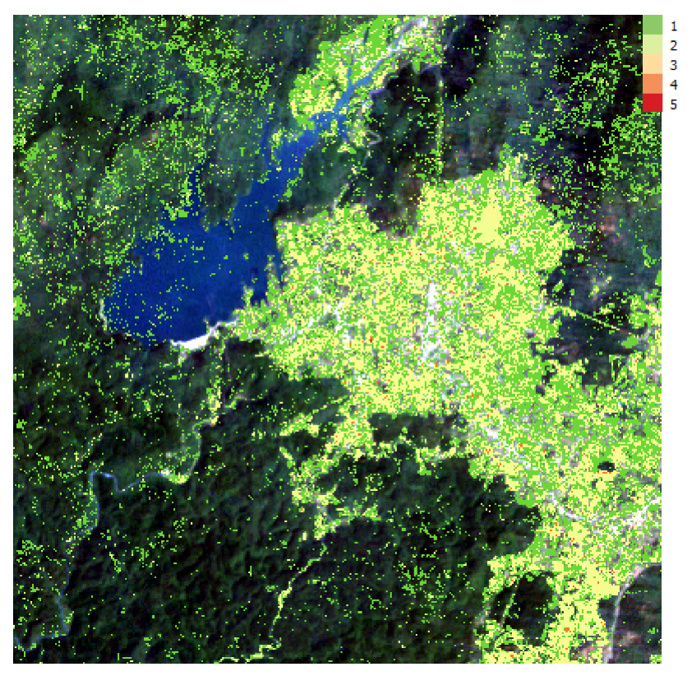
Vietnam Land Change
Bediaye, Vietnam – Data Cube Median Mosaic (left), PyCCD Results using QGIS (right)
2000 to 2016, 192 Landsat scenes, Lat = 11.19 to 11.29, Long = 107.81 to 107.91.

Slide 23
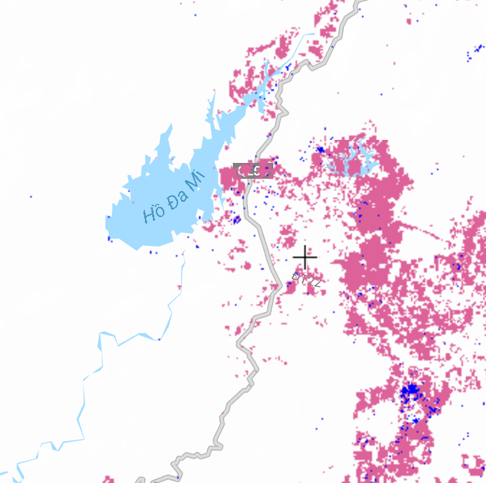
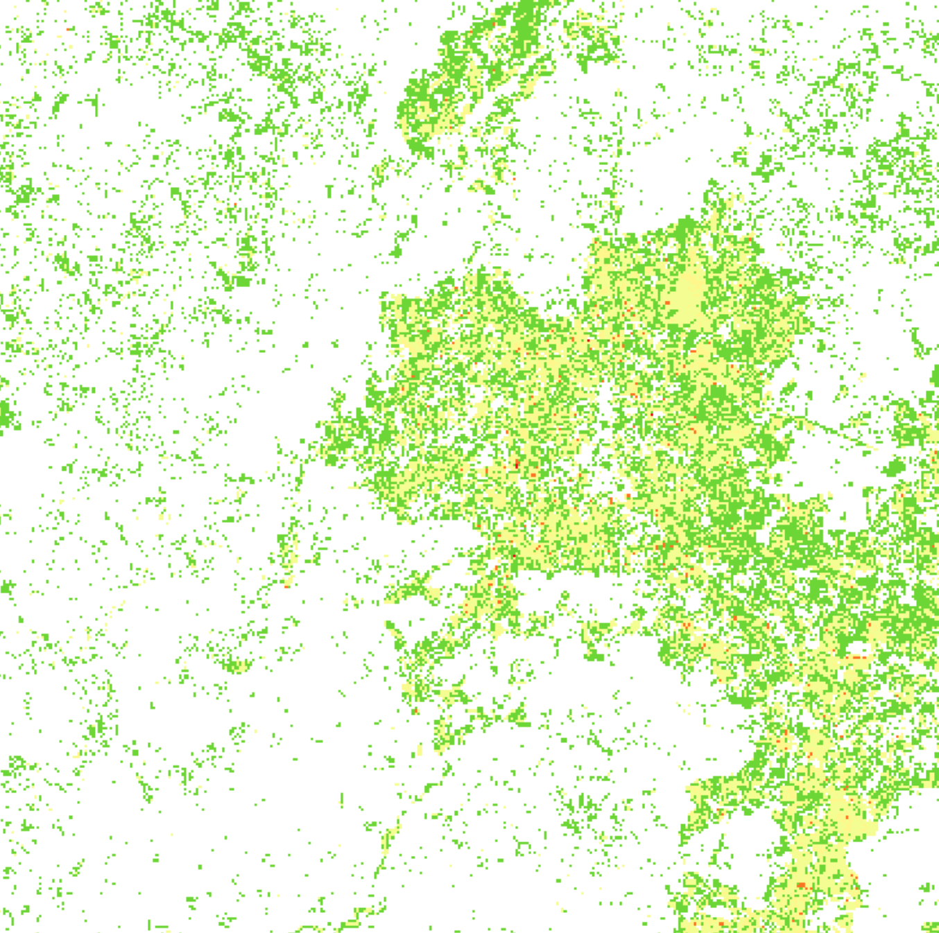
Global Forest Watch vs. PyCCD
Global Forest Watch – Forest Loss 2000 to 2015
PyCCD with a Data Cube – Land Change 2000 to 2016
PyCCD Execution: 372 x 372 pixels, 8 parallel cores, 2.3 hours (~1 msec / clear pixel) which equates to about 10 hours per clear Landsat scene.

Slide 24
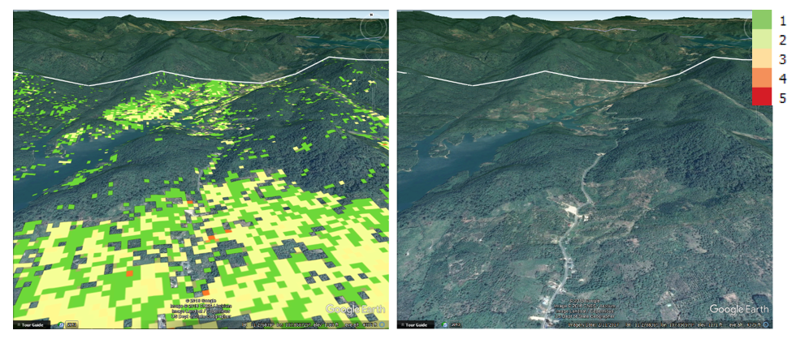
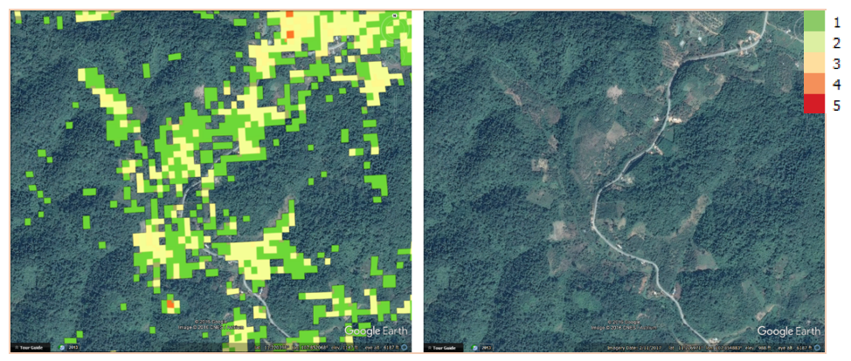
More PyCCD Examples
Deforestation
Roadside Clearing

Slide 25
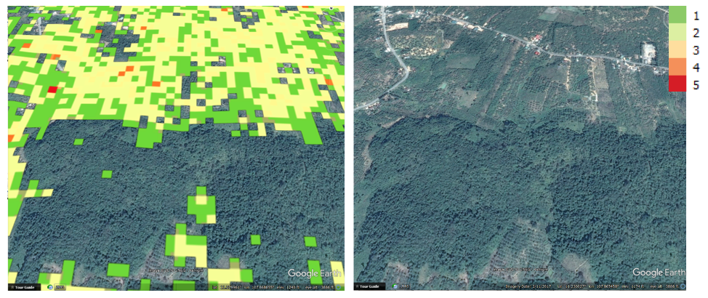
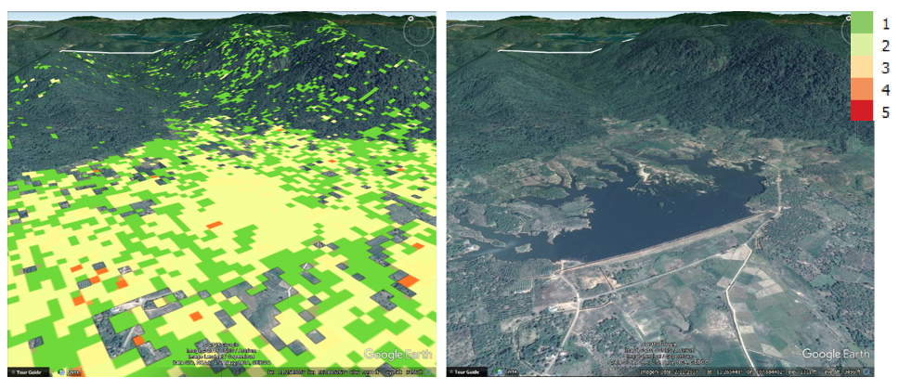
More PyCCD Examples
Possible Deforestation
Reservoir

Slide 26
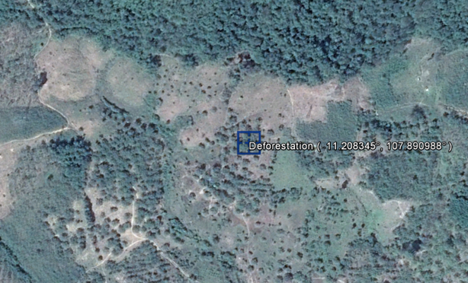
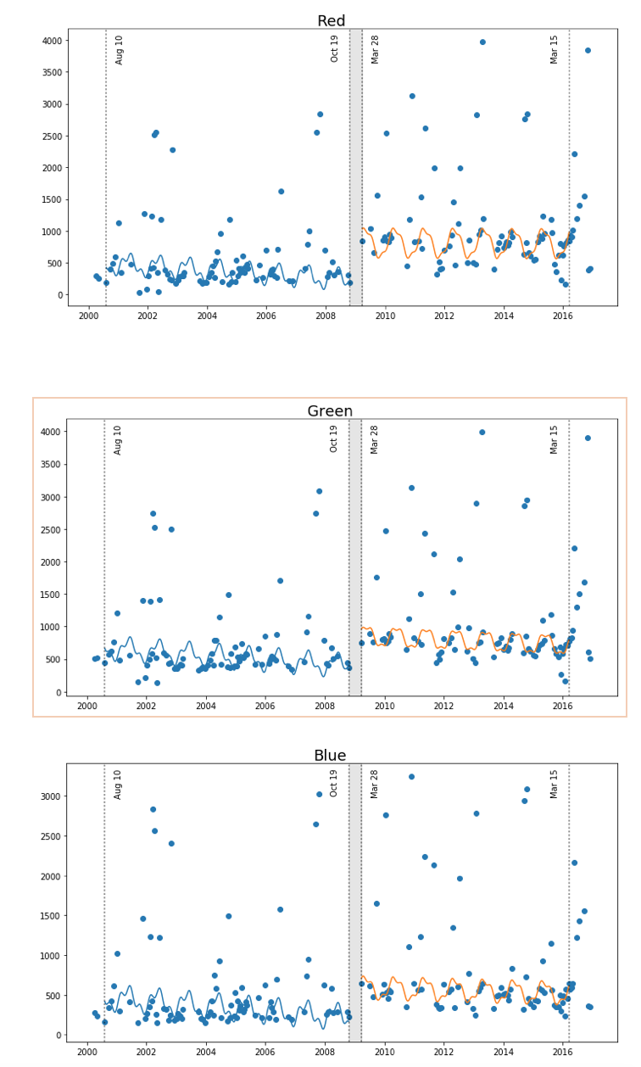
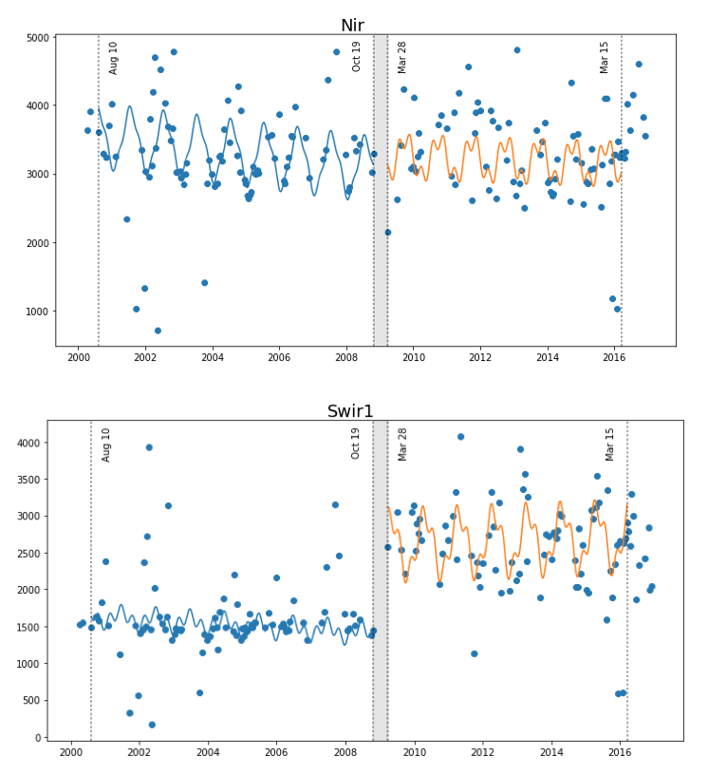
Time Series Models for Deforestation
Deforestation (single break)
Latitude: 11.208 Longitude: 107.89
Change is most evident in the SWIR bands

