Slide 1



R&D coordination component
Martin Herold, Brice Mora, Sarah Carter
Anthea Mitchell, Ake Rosenqvist,
Frank-Martin Seifert
GFOI plenary
Ho Chi Minh City, 10. April. 2017

Slide 2
R&D as part of the GFOI
Advocacy role for novel data and approaches: potential and limitations
Assessing country needs to define R&D priorities and stimulate research and funding
Data access
Country needs / capacities
R&D teams addressing priorities in dedicate projects
Space Data
Funding
Research
Capacity building
R&D
Development of training materials and joint capacity building activities
Methods & Guidance
Research synthesis (expert workshops) on key issues (countries, donors) and regular updates of guidance documents (GFOI MGD)

Slide 3
Recent/planned R&D synthesis workshops
5 R&D workshops in 2014/15/16 (www.gfoi.org/rd)
Nov. 2015: Global datasets for national REDD+ measuring and monitoring (new MGD module)
Oct/Nov 2016: Joint GFOI/GOFC-GOLD R&D workshop
  R&D working plan for next years, incl. biomass
  http://www.gofcgold.wur.nl/sites/gofcgold-gfoi_sciencemeeting2016.php
3/4 April 2017: Expert meeting on Accuracy Assessment:
  Address practical/conceptual issues with UN-REDD, FAO, FCPF, bilaterals
Special GFOI R&D session at ISRSE (South Africa)
1. Half of 2017: R&D expert meeting (likely in Oslo)
  Objectives: accuracy of spatially explicit approaches /EFs

Slide 4
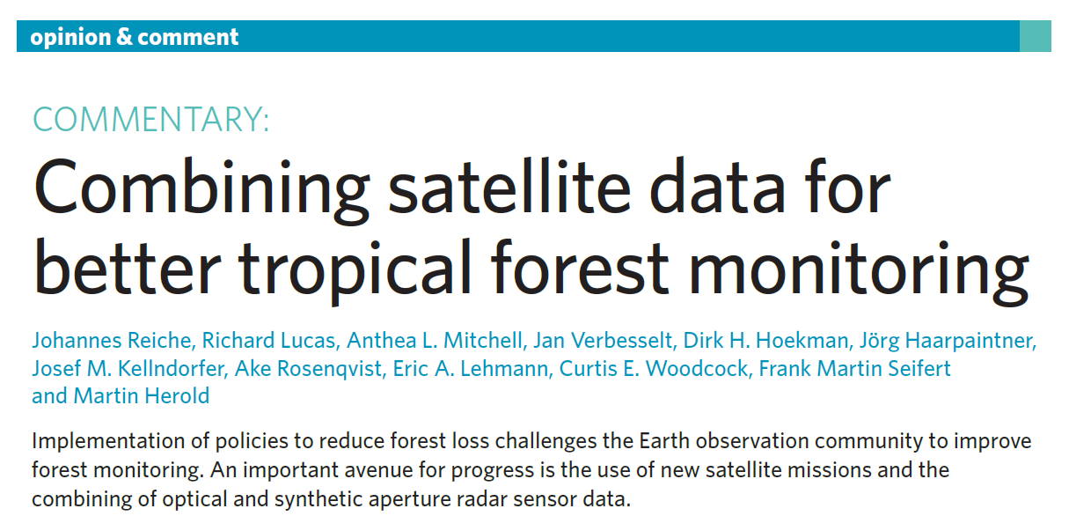
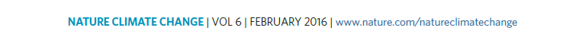
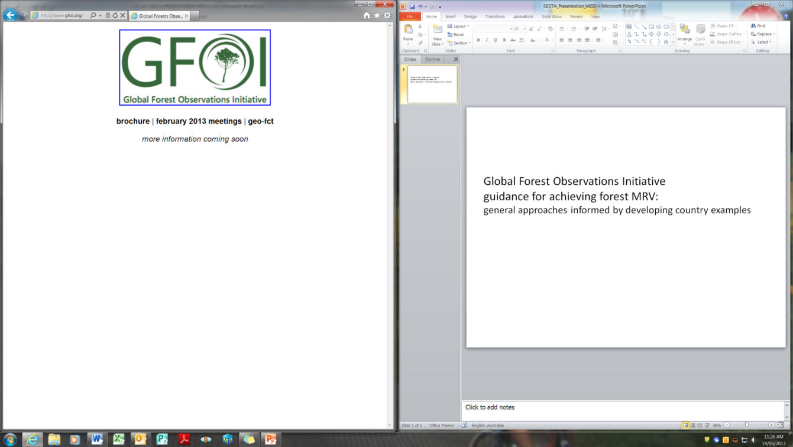

Advocacy to address key deficiencies

Slide 5
Defining priorities and stimulating research
GFOI Review of Priority R&D Topics (2013)
GFOI R&D plan (2015)
Country needs and priorities (incl. UN-REDD, FCPF)
2 page summary: (http://www.gofcgold.wur.nl/documents/GFOI-RD-Activities.pdf)
Key topics:
  Monitoring of forest degradation
  Mapping of particular forest types (e.g. peat forests)
  Data interoperability and time series analysis
  Biomass measurement and monitoring
  Uncertainties estimation
  Data model integration for estimating emissions
Several donors supporting research dedicated to GFOI: Silvacarbon, ESA, EC, ...

Slide 6
CARL framework application
Notes:
The R&D Coordination component will encourage their community to report their research using the CARL framework in order to assess progress toward operational readiness.
The Space Data Coordination Group use CARL to assess approaches to develop platforms, data access and tools that help bridge the gap between scientific and technological developments and country MRV needs.
The Methods and Guidance Document component utilise CARL in assessing and prioritising the development of new guidance on emerging operational technology/methods.
The Capacity Building component communicate the readiness level (through the development of training materials) of the method/technology that forms part of its country outreach/engagement and would encourage countries to seek to build their capacity in technologies that are considered operational (levels 7-9).
Ultimately, countries use the outputs from CARL to aid decision making concerning the adoption of various technologies/methods/tools/data sources related to National Forest Monitoring Systems and REDD+ MRV.
The Space Data Co-ordination Group, which will become the Data Coordination Component once GFOI's Phase 2 is operationalized.

Slide 7
CARL Framework
Assist in communication and assessment of readiness levels for REDD+ data, methods and tools
Collaboration between MGD and R&D components
Decision framework supported by:
Detailed description of each level
Milestones that indicate level achievement
Supporting information specific to REDD+

Slide 8


REDD+ monitoring training materials
14 modules (lectures, country examples, exercises)
3 Languages (English, French, Spanish)
Based on guidance materials
30+ authors, regular updates incl. scientific synthesis
Training the trainer workshops (regional)
http://www.gofcgold.wur.nl/redd/Training_materials.php
https://www.forestcarbonpartnership.org/redd-training-material-forest-monitoring

Slide 9

Joint capacity building for REDD+ monitoring
Objectives:
14 Modules: lectures, country examples, exercises
Training the trainers: multiplying information to develop country capacities
Demonstrate the use various REDD+ training materials
E-learning tools and webinars (upcoming)
http://www.gofcgold.wur.nl/redd/Training_materials.php
1st workshop: Asia (ENG)
Time: 11-15 April 2016
Location: Bangkok, Thailand
2nd workshop: Latin America (SPAN)
Time: 4-8 July 2016
Location: Lima, Peru
3rd workshop: Africa (ENG)
Time: 18-23 September 2016
Location: Addis Ababa, Ethiopia
4rd workshop: Africa (FR)
Time: 6-10 Febr. 2017
Location: Ivory Coast

Slide 10


R&D coordination: next steps
Model: Country needs -> R&D priorities -> support/research -> synthesis/guidance -> capacities development
R&D representation on the leads
Network of experts respond to specific (technical) issues (countries, donors): from tools to practices
CARL framework: finalization and implementation
Joint capacity building (i.e. webinars)
Future of R&D coordination in the longer term
Plenary:
  Objectives for next R&D expert workshop
  Information session

Slide 11

Information station Wednesday 12 April:
R&D topics and GOFC-GOLD training materials - Indochine Ballroom
Morning session: 11:15-12:30
11:15 – 12:00 CARL framework (Communication and Assessment Readiness Levels) for progress toward operational forest monitoring systems,
Martin Herold, Wageningen University
12:00 – 12:30 GOFC-GOLD / World Bank REDD+ MRV training materials,
Sarah Carter, Wageningen University / GOFC-GOLD
Afternoon session: 13:30-15:00
13:30 – 14:00 The latest R&D outputs, news and priority themes,
Anthea Mitchell, The University of New South Wales
14:00 – 15:00 Country R&D needs - planning future support,
Inge Jonckheere, FAO / UN REDD
Feel free to join for just one session or the whole programme

