Slide 1
JICA-JAXA
Forest Early Warning System in the Tropics
(JJ-FAST)
Masanobu Shimada^{1,3}, Mari Miura²,
Takahiro Endo⁴
¹JAXA,²JICA,³Tokyo Denki University, ⁴RESTEC
SDCG-11 meeting April 10, 2017, Ho chi Min City

Slide 2
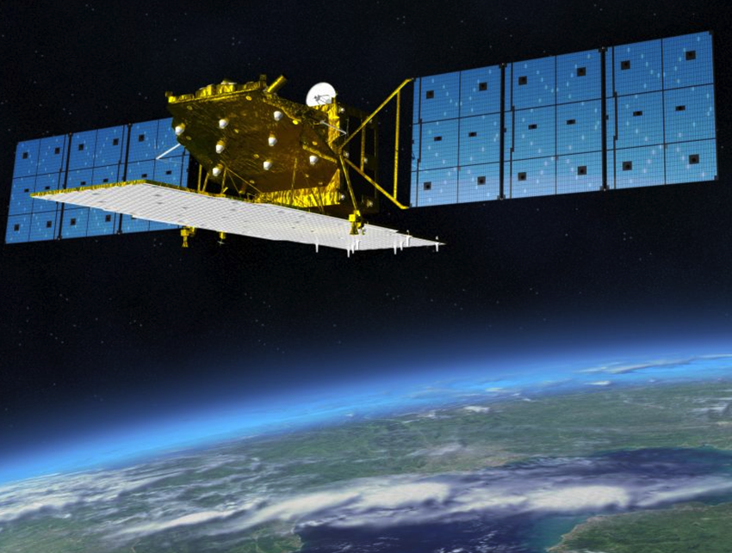
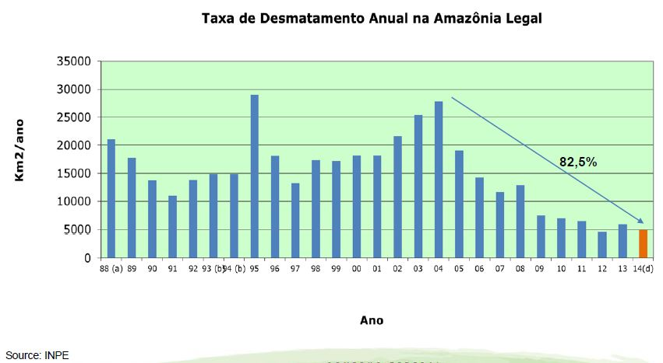
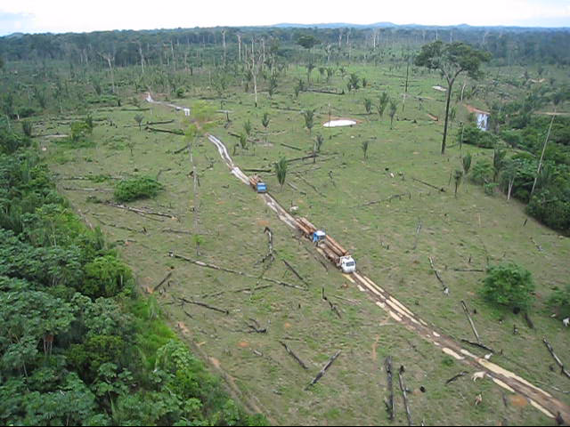
Previous operation in Brazil
Annual Deforestation in the Legal Amazon
Brazilian Government
■ Brazilian government has been tackling illegal deforestation using optical satellite images (Landsat) since 2004.
■ JAXA-IBAMA implemented the ALOS/PALSAR illegal deforestation monitoring system in 2007.
■ Challenge was deforestation detection in the rainy season.
2

Slide 3
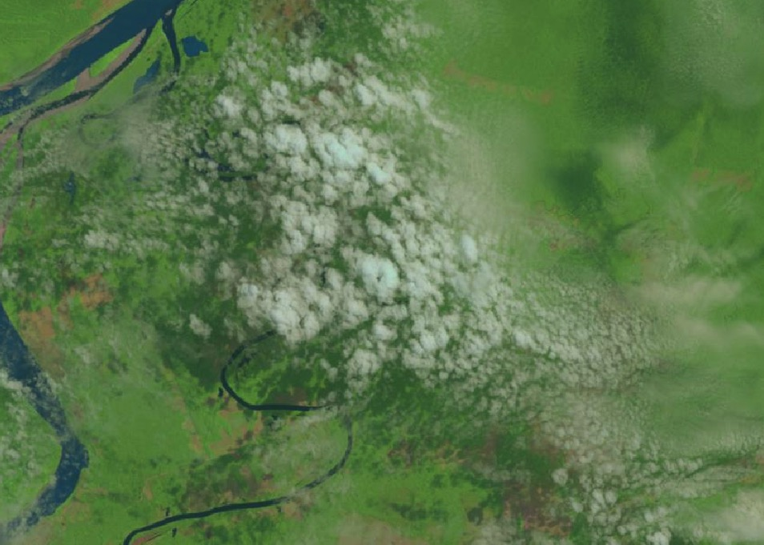
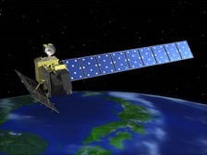
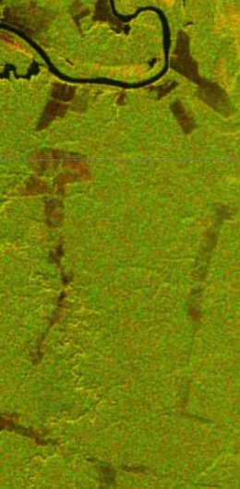
Landsat 5 Image on 2011/09/07
Forest Density Difference by ALOS
Between 2009 and 2011
ALOS
Almost a half period of a year, the Amazon Forest is covered with clouds.
The PALSAR can detect deforestation even in the rainy season or night time.
IBAMA（Brazilian Institute of Environment and Renewable Natural Resources) and DPF (Federal Police Department) implemented the project.
During the Project…
Year | Detection of Deforestation | Illegal Logging
2010 | 1,007 | 140
2011 (stopped in April) | 176 | 11

Slide 4
New Tropical Forest Early Warning System with PALSAR-2 JJ-FAST
(JICA-JAXA Forest Early Warning System in the Tropics)
JICA
JAXA
Forest Governance Initiatives coordination
System development
-Tropical Forests Early Warning System -
Joint
Development
&
Operation
International conference and seminars
Web site development to disclose the Early Warning System
Human capacity development
Concession management
by private companies
Illegal deforestation monitoring
by government agencies
Contributing to “ Improvement of Forest Governance in Tropical Forest”
Target Area: Approximately 16.6 million km²

Slide 5
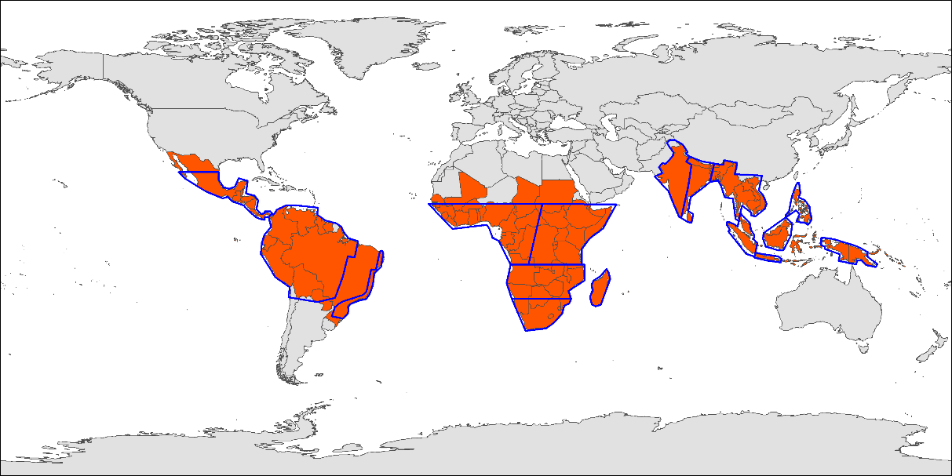
Target area

Slide 6
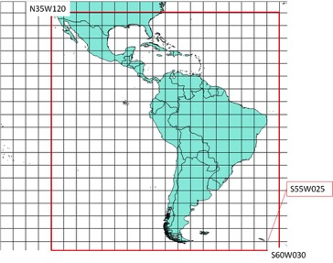
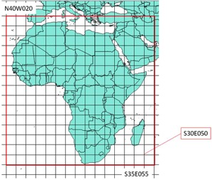
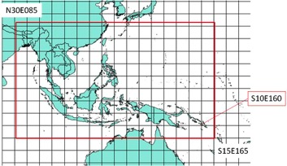
Target area (9 times a year)
2016モザイク作成範囲を以下に示す
南米
アフリカ
東南アジア
観測回帰詳細

Slide 7
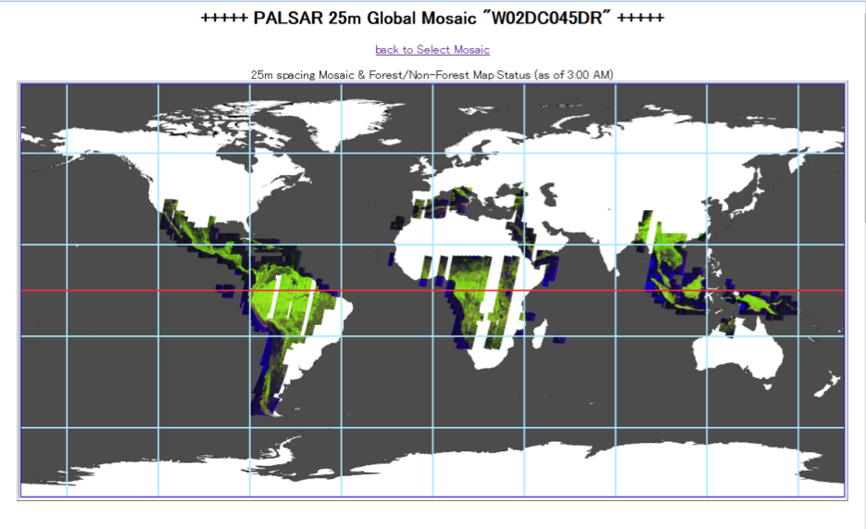
45回帰
各回帰別のScanSARモザイクを以下に示す
PALSAR-2 50m ScanSAR

Slide 8
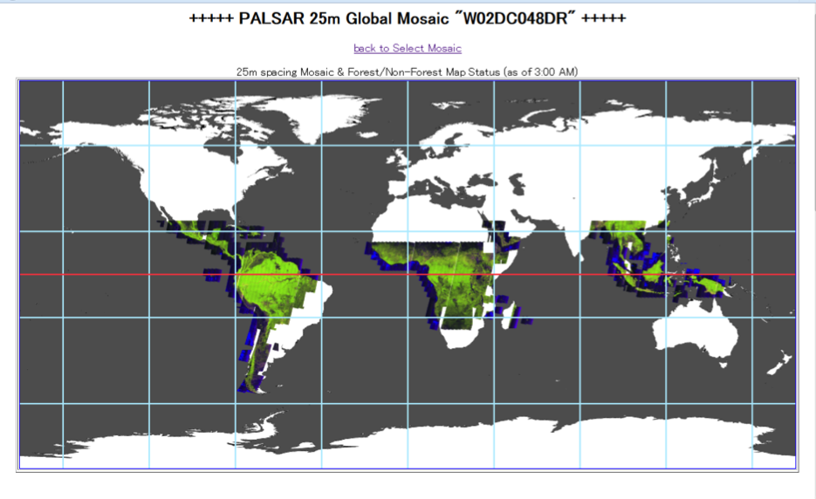
48回帰
PALSAR-2 50m ScanSAR

Slide 9
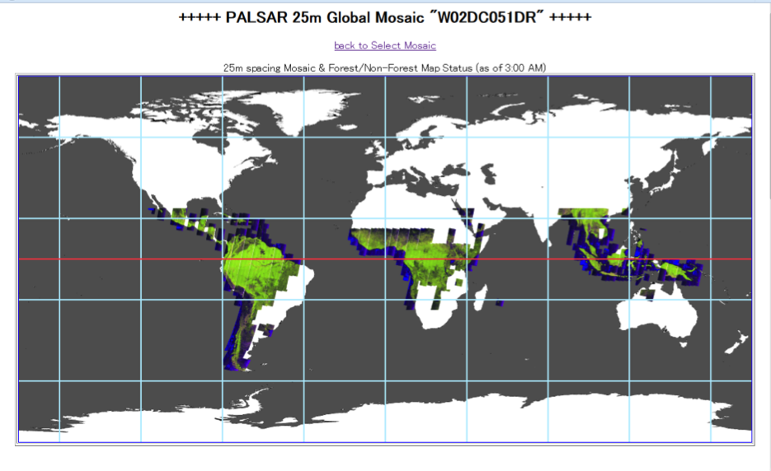
51回帰
PALSAR-2 50m ScanSAR

Slide 10
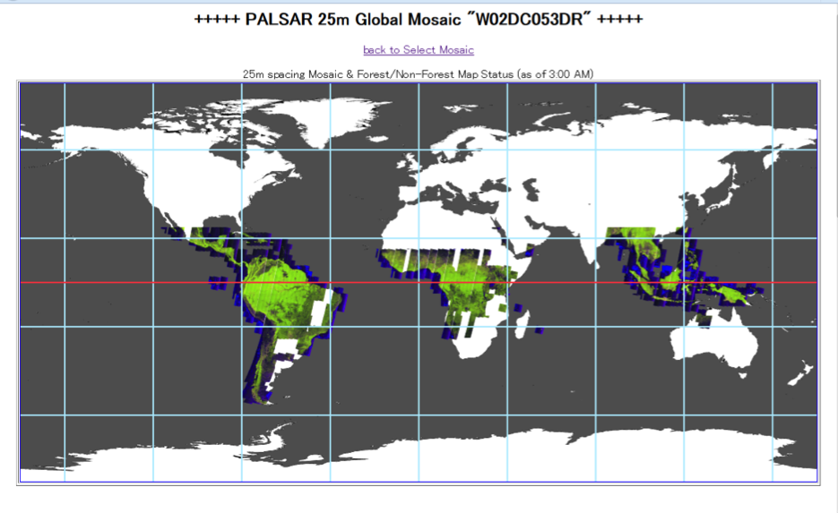
53回帰
PALSAR-2 50m ScanSAR

Slide 11
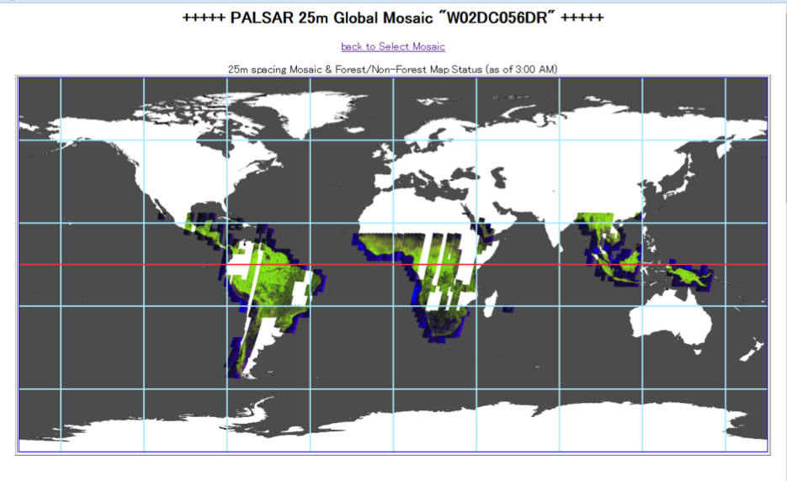
56回帰
PALSAR-2 50m ScanSAR

Slide 12
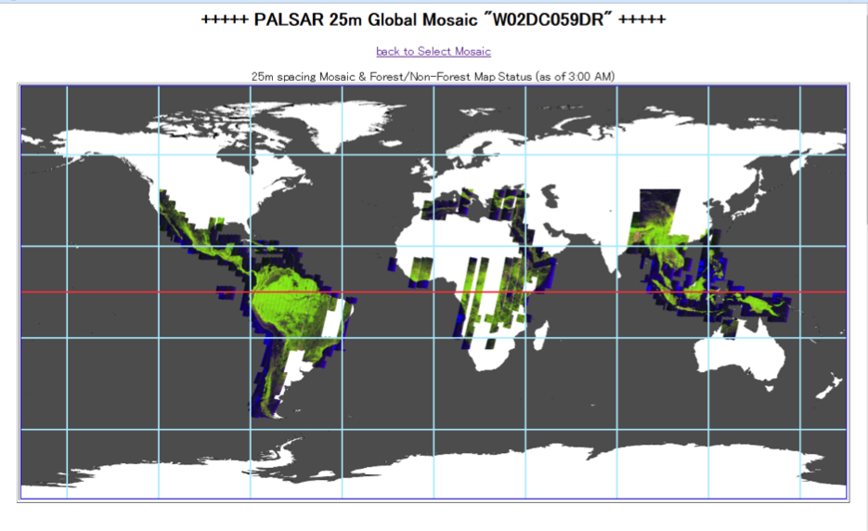
59回帰
PALSAR-2 50m ScanSAR

Slide 13
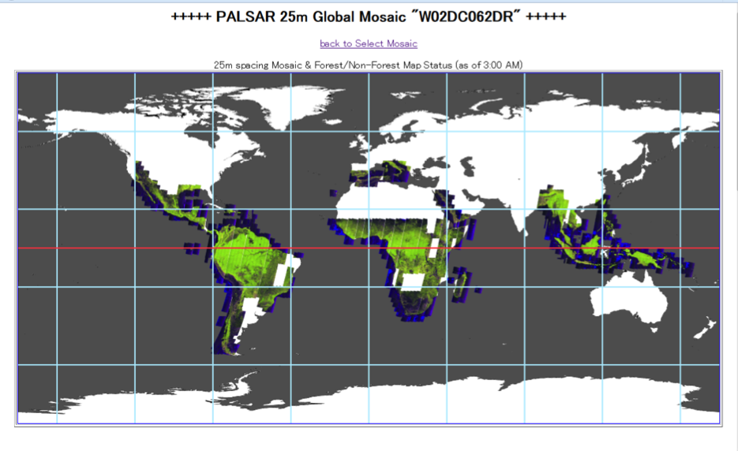
62回帰
PALSAR-2 50m ScanSAR

Slide 14

65回帰
PALSAR-2 50m ScanSAR

Slide 15
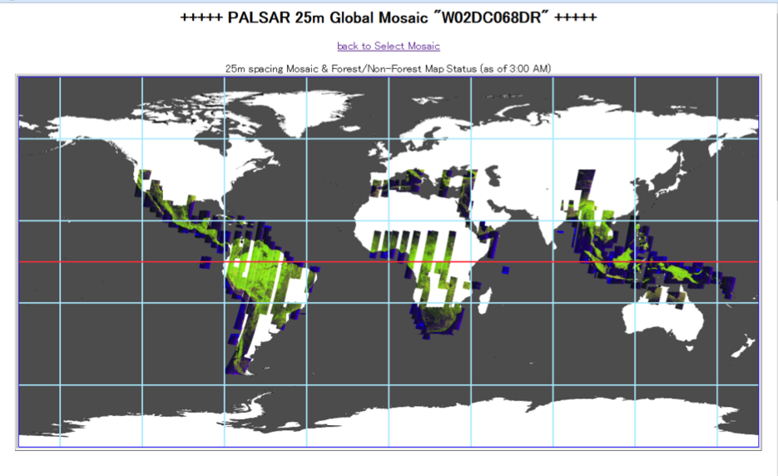
68回帰
PALSAR-2 50m ScanSAR

Slide 16
About JJ-FAST
WEB-based Quick deforestation information system using the time series PALSAR-2 ScanSAR (English and Japanese)
Target info: Deforestation polygon and timing
Method: Segmentation – differentiation based method
“Free access from PCs and mobile devices(iPad or so)” from anywhere in the world with low speed internet condition.
“Deforestation in a rainy season” is detected through SAR sensor (PALSAR-2 (L-band SAR))
Observation frequency “Every 42 days”
Latency: 3 weeks -> in future (1 week: goal)
“Cover 77 countries as of now” containing tropical forest: 80 countries in Nov. 2017
Launched in Nov. 2016 and Nov. 2017 for full operation
Spatial resolution of the Image : 50m
Minimum detection size of the polygon: 5ha (1 ha in near future)
Downloadable: deforestation polygons and their 16 bit TIFF image,
Guideline: Language (English, French, Spanish)

Slide 17
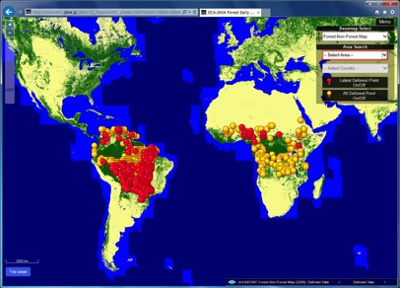
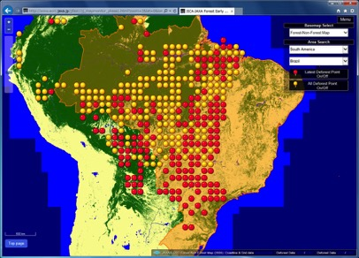
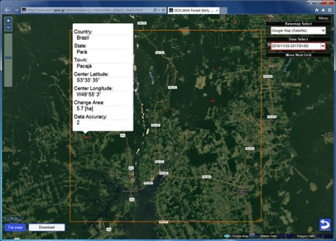
JJ-FAST web site
Display deforestation timing, size, Latitude & Longitude
Enable to down load PALSAR-2 image & polygon free of charge.
http://www.eorc.jaxa.jp/jjfast/

Slide 18
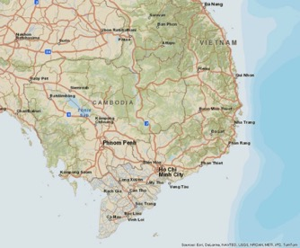
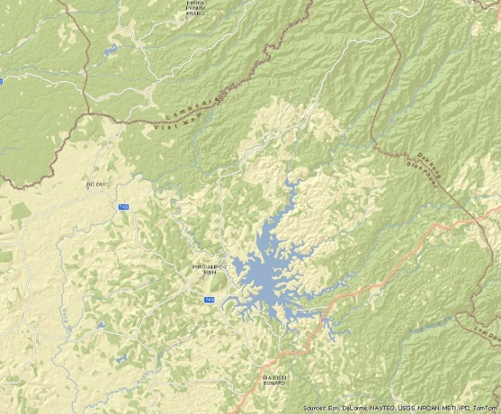
Deforestation detection
with PALSAR-2
Peripheral of Bu Gia Map National Park

Slide 19

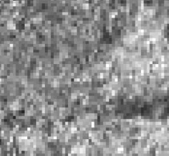
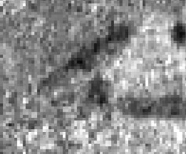
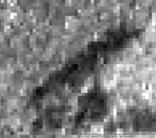
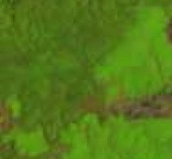
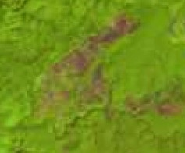
rainy season
Deforestation detection during a rainy season
Dry Season
Rainy Season
Dry Season
PALSAR-2
Deforestation
500 m
Jun. 26, 2016
Jul. 24, 2016
Sep. 4, 2016
Oct. 16, 2016
Landsat-8
28 days
42 days
42 days
500 m
Mar. 31, 2016
Nov. 10, 2016

Slide 20
Schedule
 | JFY 2016 |  |  | JFY 2017 |  | JFY 2018
 | 11 | 12-3 |  | 4-9 | 10-3 | 4-
International meeting | ▲COP22 （Morocco） | △ACTO △COMIFAC? △SADC? |  |  | ▲A meeting （Tokyo）
Target countries | Amazon | Amazon Africa |  | Amazon Africa | All 77 country
Target date | May 9, 2016 – Aug. 29, 2016 |  | March 28, 2016 – 1.5 month after a PALSAR-2 observation
Obs. frequency | 9 times/year
Min. size of detection | 5 ha |  |  |  |  | 1ha?
* Core algorithm ** Advanced algorithm

Slide 21
JJ-FAST
http://www.eorc.jaxa.jp/jjfast/

Slide 22
JJ-FAST
WEB-based Quick deforestation information system using the time series PALSAR-2 ScanSAR (English and Japanese)
JICA-JAXA-TDU-RESTEC
Deliverable: deforestation info of 5ha unit accessible even low internet speed, i.e., @REDD+ country and using iPad or so.
Resolution 5ha -> 1 ha (goal)
Access condition: Open
Downloadable:50m-FNF (Pantropical region), 16 bit TIFF images (limited area), updated 45 days at each region with latency of 3~4 weeks (shorter in future).
Service areas: ~60 countries (Nov. 2016), updated to ~80 countries (Nov. 2017-)
Guideline: Language (English, French, Spanish)

