Slide 1
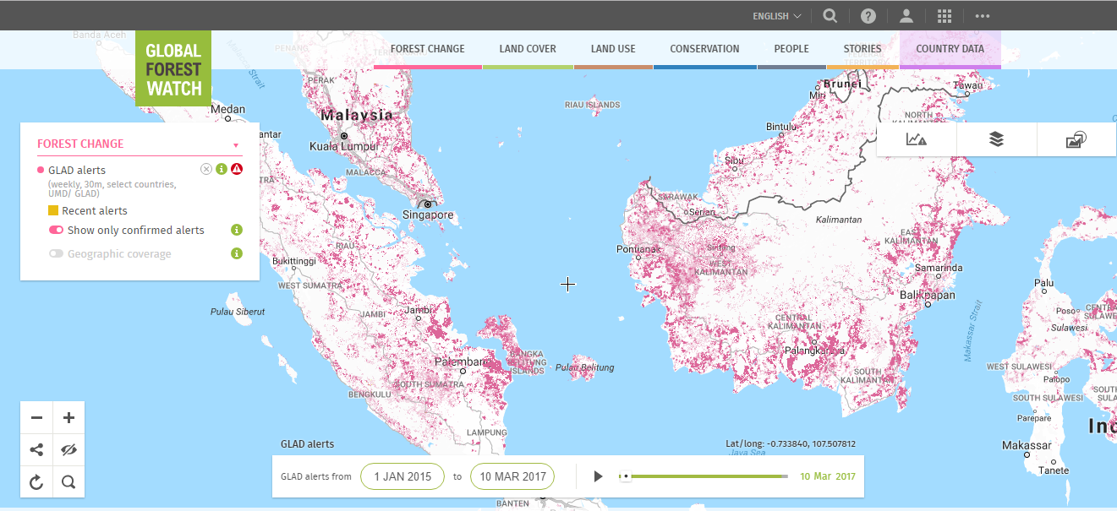
Near-Real Time Alerts

Slide 2
NEW LANDSAT ALERTS SHOW TREE COVER LOSS IN HIGH RESOLUTION
Forest clearing at the United Cacao plantation near Tamshiyacu, Peru, 2015
FORMA MODIS-based tree cover loss alerts
Updated monthly
500 meters x 500 meters
(yellow pixels represent most recent alerts)
GLAD Landsat-based tree cover loss alerts
Updated weekly
30 meters x 30 meters
Image Credit: Google Earth basemap, Data from WRI and UMD/ Google / NASA / USGS, accessed through Global Forest Watch
Notes:
The new alerts are higher resolution and more frequent than ever before. The finer resolution gives us a better idea of what’s happening, and can help target enforcement efforts.
The new alerts offer an unprecedented level of power for monitoring forests in near-real-time for three reasons:
Timeliness: The alerts are weekly (as cloud-free images are available), more frequent than any alerts every available at this scale. This makes it possible those monitoring areas to take immediate action.
Fine scale: These are the first alerts at a 30x30 m resolution, fine enough to see things that may have been missed before, like logging roads.
Ability to subscribe: Improvements in the GFW system allow users to get new alerts in their inbox more reliably than ever before. You can subscribe to any shapes in GFW (protected areas, concessions) or upload your own area. Every time there is a new alert in their area of interest, users will get an email with the number of new alerts and a link to view the alerts on GFW and download the alerts in a variety of formats (shp, kml, csv)

Slide 3
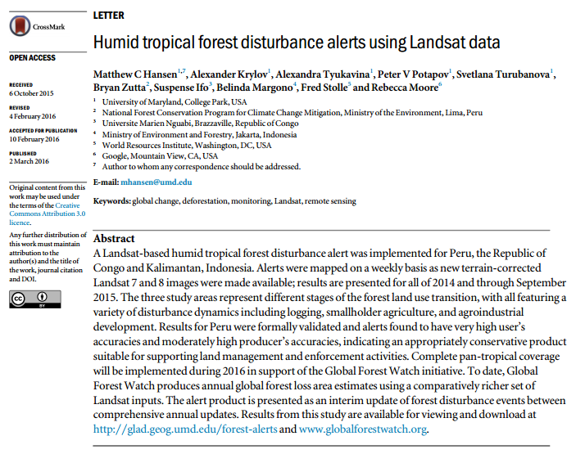

Slide 4
Countries
Peru
Brazil,
Indonesia
Malaysia
PNG
East Timor
Brunei
DRC
ROC
Cameroon,
Equatorial Guinea,
Gabon,
CAR,
Uganda,
Rwanda,
Burundi,
Russia Far East
Currently GLAD alerts temporary stopped

Slide 5
Method
New Landsat 7 and 8 images
Downloaded USGS EROS,
Assessed for cloud cover or poor data quality,
Compared to the three previous years of Landsat-derived metrics (including ranks, means, and regressions of red, infrared and shortwave bands, and ranks of NDVI and NDWI).
Seven decision trees to calculate a median probability of forest disturbance. Pixels with probability >50% are reported as tree cover loss alerts.
Alerts remain unconfirmed until two or more out of four consecutive observations are labelled as tree cover loss.
Alerts that remain unconfirmed after subsequent observations are removed from the data set
You can choose to view only confirmed alerts in the menu, though keep in mind that using only confirmed alerts misses the newest detections of tree cover loss.

Slide 6
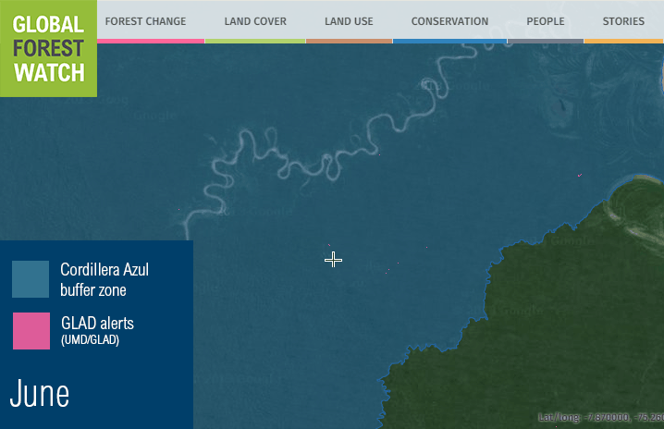
GLAD Alerts Detect Illegal Roads in Peru National park
Notes:
An animated GIF (will play automatically in presentation mode) of the new GLAD alerts. You can see illegal roads being built into the Cordillera Azul National Park in Peru. The high resolution enables us to see these previously invisible roads, and the fast refresh rate lets law enforcement respond faster than ever.

Slide 7
Notes:
Animated gif of landsat series / logging roads in Congo

Slide 8
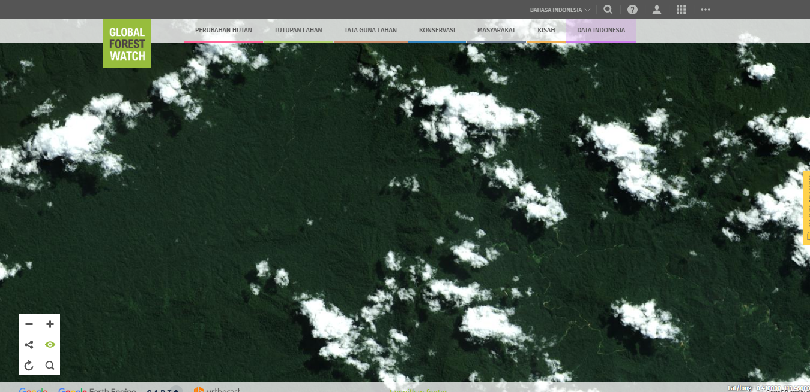

Slide 9
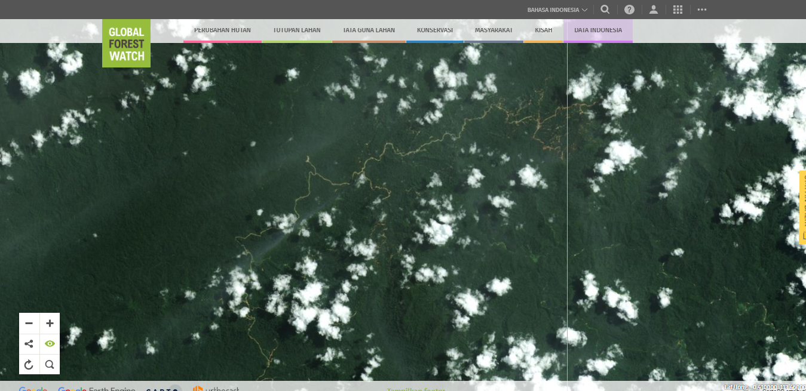

Slide 10
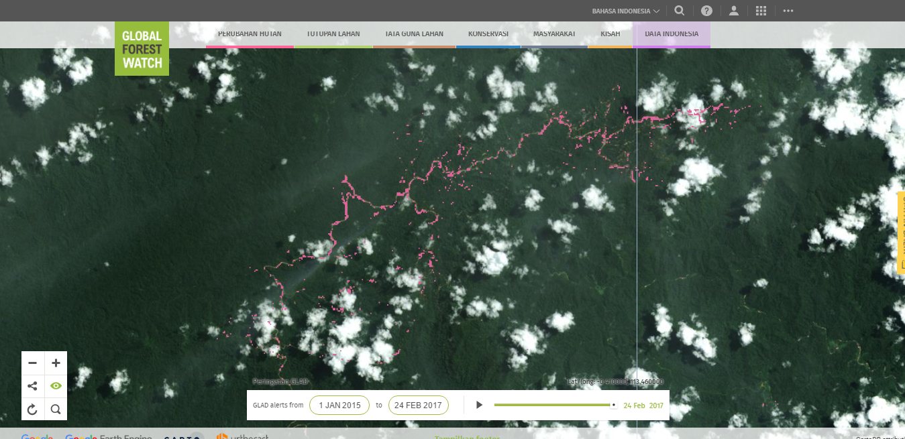

Slide 11
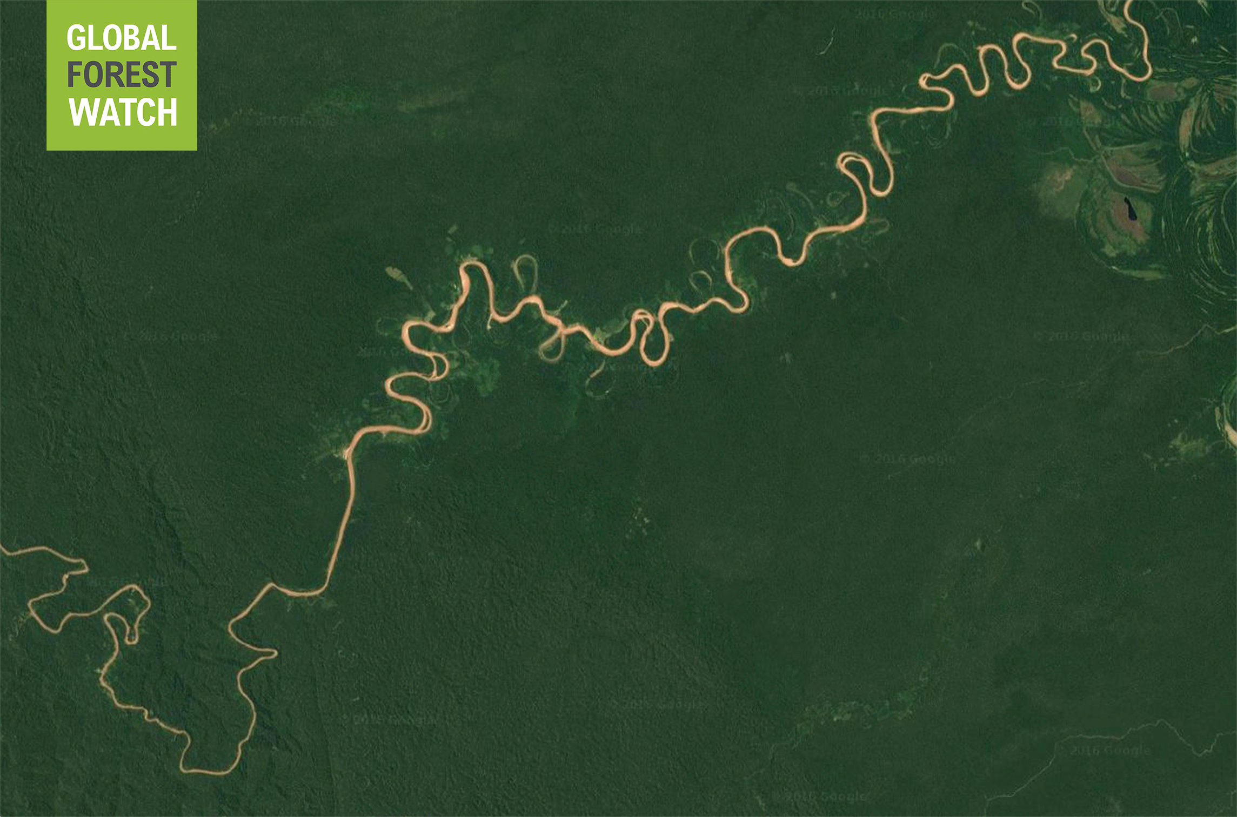
Notes:
Now, when a tree falls in the rainforest, it shows up as a pink deforestation alert on the Global Forest Watch map.
Here we can see a new logging road snaking its way into a national park buffer zone in Peru.

Slide 12
Notes:
And here see the devastating impacts of oil palm production in Indonesia.

Slide 13
Notes:
We then translate this forest monitoring data into online interactive maps and decision-support tools that are easy for users in NGOs, governments, companies, and the general public to use.

Slide 14
Accuracy
 | Accuracy | All forests | Primary | Secondary
 | users | 87 | 86 | 87
 | producers | 67 | 78 | 57
 | Tested Dataset
Validation | No-Loss | Loss
No-Loss | A | B
Loss | C | D
Producers: D/ (C+D)
Users: D/ (B+D)

Slide 15
Accuracy
Peru,
13.5 percent false positives (loss detected where none occurred)
The rate of false positives drops to 1 percent when only considering confirmed alerts.
The data has 33 percent false negatives (undetected loss where it has occurred),

Slide 16
How Near-real time is near-real time
CLOUD FREE | Brazil | Peru |  | ROC |  | Kalimantan
 |  | 2015 | 2016 | 2015 | 2016 | 2015 | 2-016
 | Percent | Percent | Percent | Percent | Percent | Percent | Percent
Last 1 week | 57.8% | 10.5% | 42.9% | 26.1% | 23.8% | 2.5% | 14.1%
Last 2 weeks | 75.0% | 16.8% | 61.9% | 37.3% | 44.2% | 6.0% | 31.5%
Last month | 88.0% | 45.2% | 75.2% | 52.2% | 53.9% | 16.7% | 52.8%
Last 3 months | 95.7% | 89.3% | 88.2% | 63.1% | 76.9% | 46.5% | 86.6%
Last 6 months | 97.4% | 98.1% | 92.7% | 76.6% | 92.0% | 80.4% | 94.7%
Since year began | 98.3% | 98.9% | 96.4% | 94.4% | 95.3% | 95.7% | 95.7%

Slide 17
Operational Radar based deforestation alerts
Johannes Reiche & Martin Herold
Laboratory of Geo-Information Science and Remote Sensing, Wageningen University & Research, The Netherlands
V02 (13.3.2017)

Slide 18
Summary
Operational Sentinel-1 based deforestation alerts:
Using at least 12 day repeat Sentinel 1 (A+B) data
Spatial resolution: ~30 m (consistent with Landsat)
Implementation framework:
Evolution @ Wageningen University & Research-WUR (methods, demonstration, calibration/validation)
Operations (large area) @ Satelligence (with WUR)
Distribution @ GFW

Slide 19
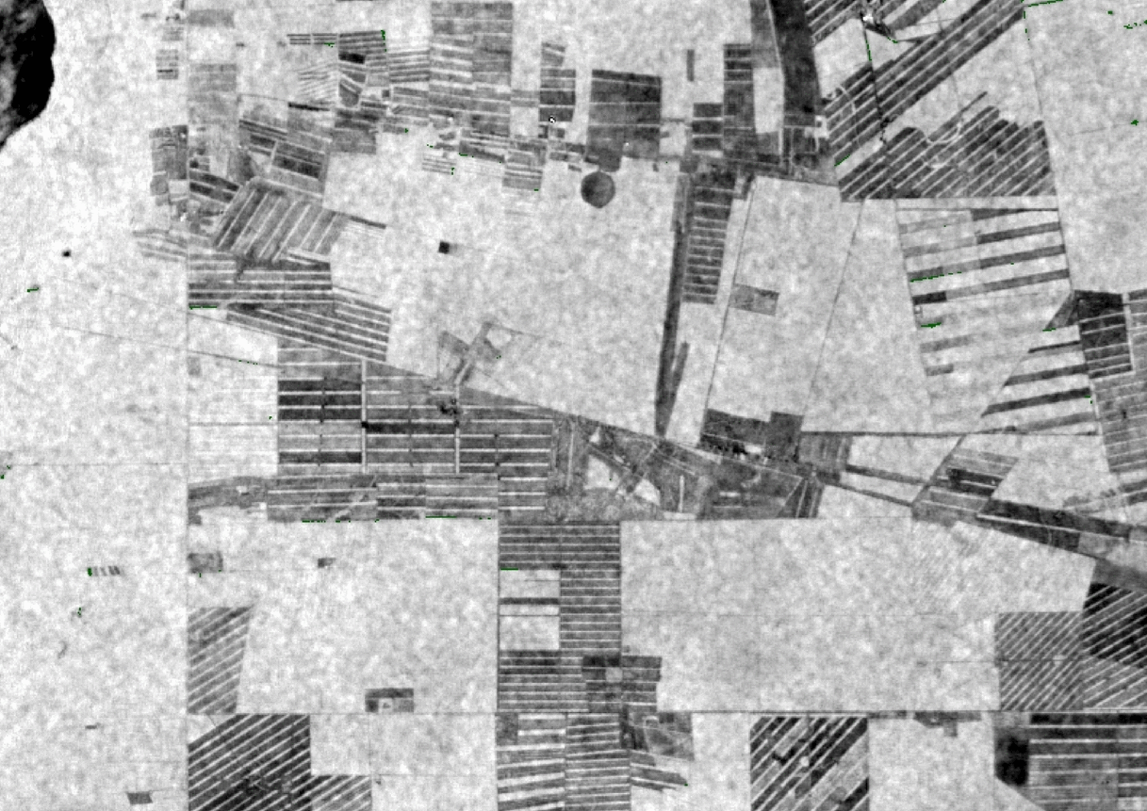
Alerting example case
Sentinel-1 time series
Flagged: 2016.4
Confirmed: d2016.22

Slide 20
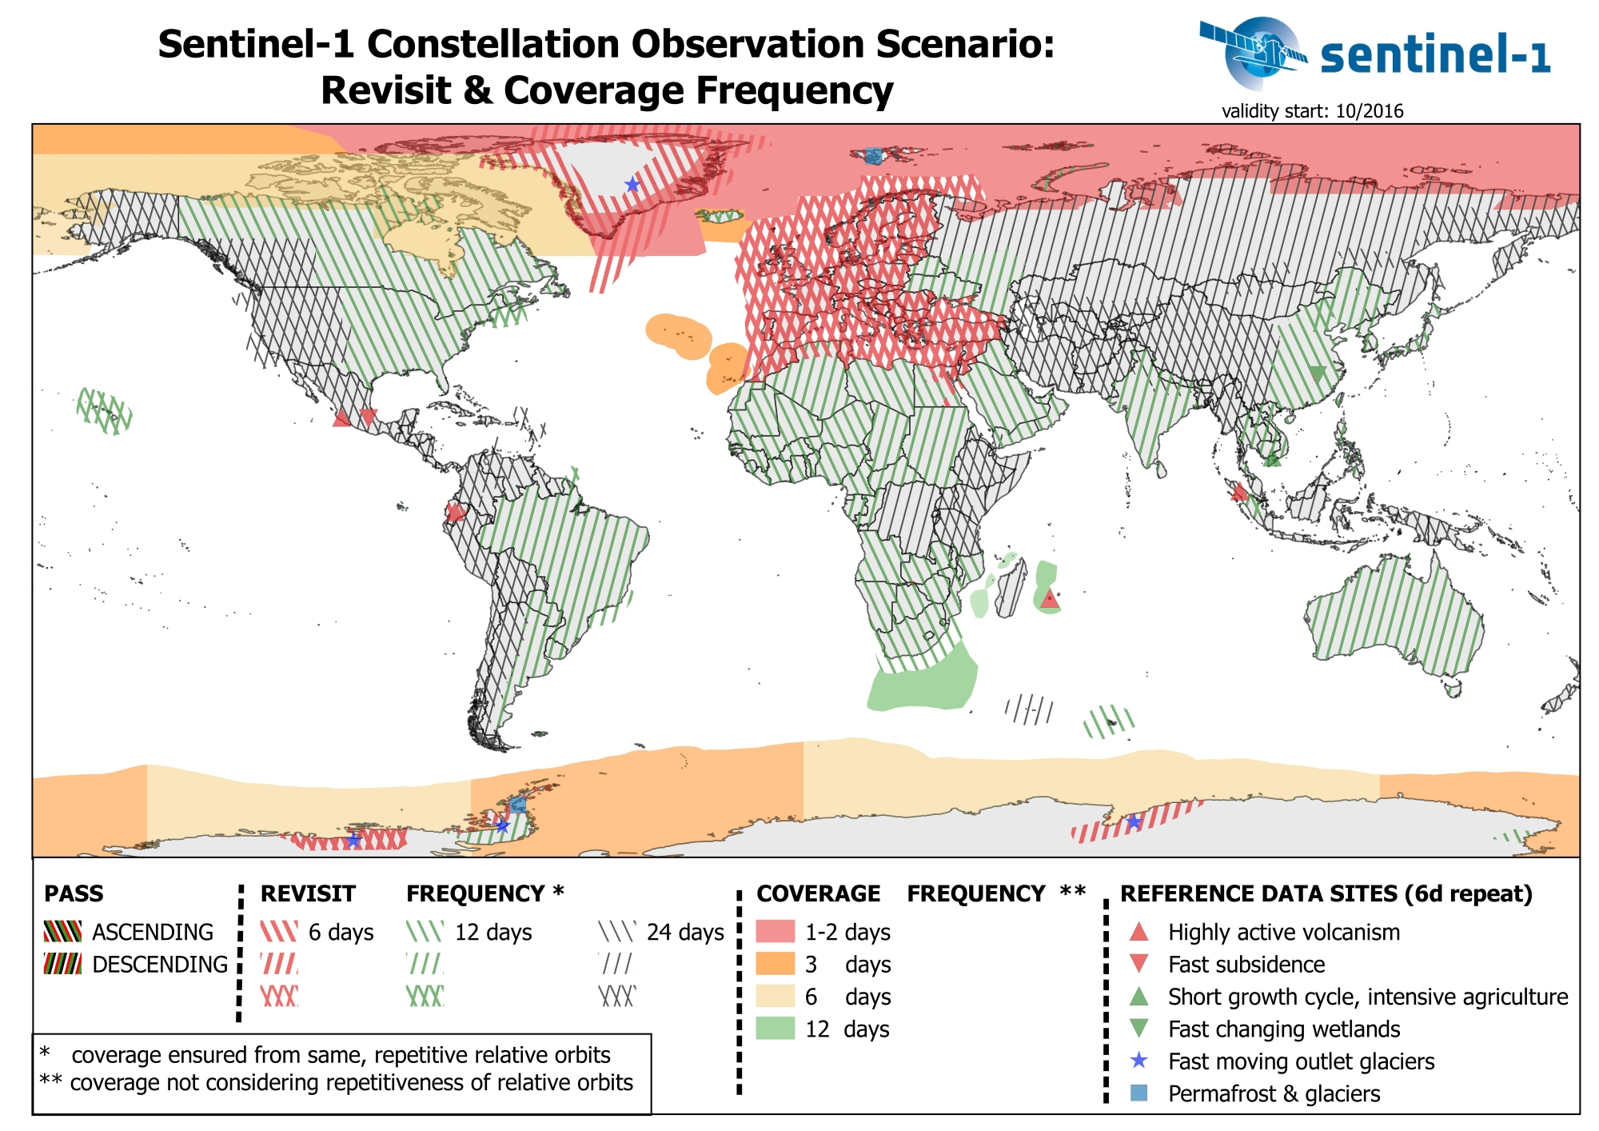
Sentinel-1 global acquisition strategy
https://sentinel.esa.int/web/sentinel/missions/sentinel-1/observation-scenario

Slide 21
Year 1 planning
Development and R&D by WUR)
S1 deforestation alert method implementation (open source)
Use GLAD format, comparison & synergy (collaboration with UMD)
Scientific paper (method and validated results, key areas in Sumatra)
Demonstration and delivery of alerts
From month 3: alerts for Riau
From month 6: alerts Sumatra
Month 6-12: validation/feedback with GFW/companies
Upscaling prototype for all of Indonesia and Malaysia ? (Satelligence)

Slide 22
Year 2 and 3 planning
YEAR 2
Evolution (WUR)
Method improvement based on feedback and interactive validation
Development of multi-sensor alerts (S1 + S2 + Landsat) to increase temporal detail and accuracy
Operations (Satelligence)
Operational delivery of alerts for tropics ?
YEAR 3
Upscaling to global - 12 day alerts

