Slide 1
Early warning: GFW user experience and lessons learned
4 September 2017, SDCG EW
Rachael Petersen, Acting Director, and Mikaela WeissE, Research Analyst

Slide 2
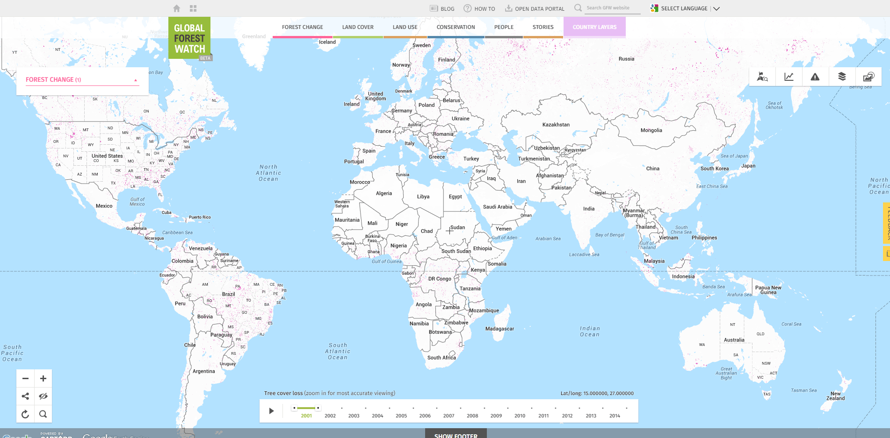
www.globalforestwatch.org

Slide 3
1.3 million users users
1,120 trained
16 governments
14 companies
www.globalforestwatch.org

Slide 4
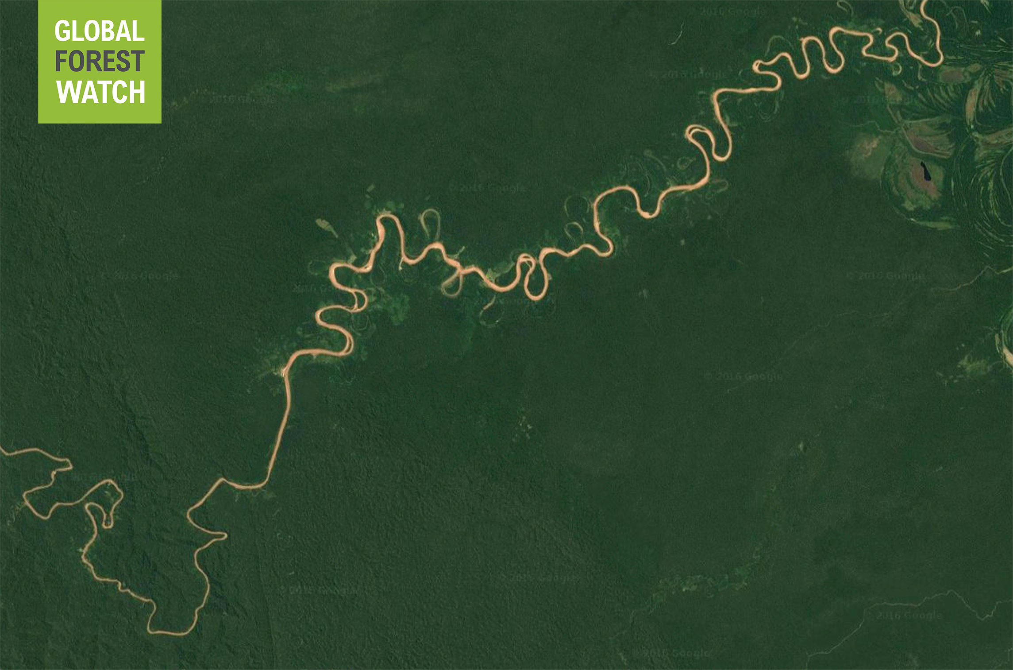
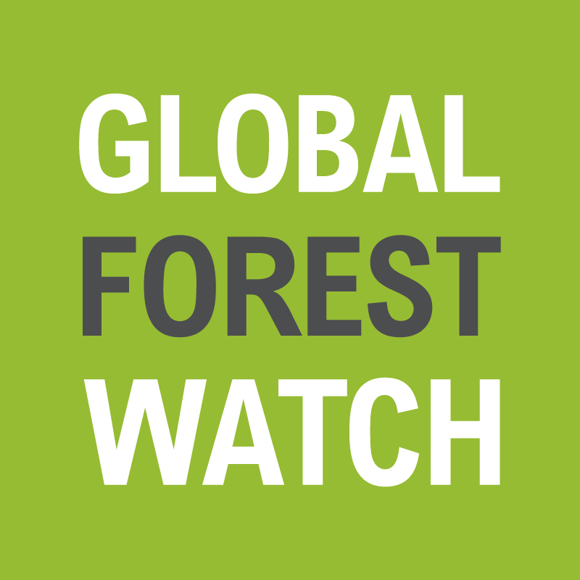
Action
Accountability
Information
Transparency
Access to near-real time information on deforestation leads to more timely and effective law enforcement actions and more sustainable management of forests
Notes:
Enhance transparency by dramatically improving the state of information and knowledge about forest landscapes worldwide.​ Harness improved information and transparency to empower key stakeholders to better manage and conserve forests on the ground.​
Global Forest Watch’s theory of change is that access to near-real time information on deforestation leads to more timely law enforcement actions and more sustainable management of forests. The case of Peru provides an opportunity to test this theory of change, given widespread uptake of the weekly GLAD alerts by government agencies for monitoring and enforcement. By systematically studying the barriers, enabling conditions, and protocols of the Peruvian alert use case, GFW can test and refine our theory of change in order to deploy strategies that will increase uptake of the alerts for law enforcement in other countries.

Slide 5
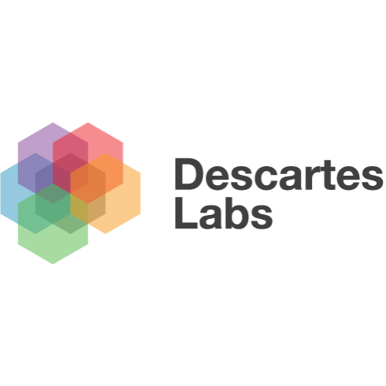
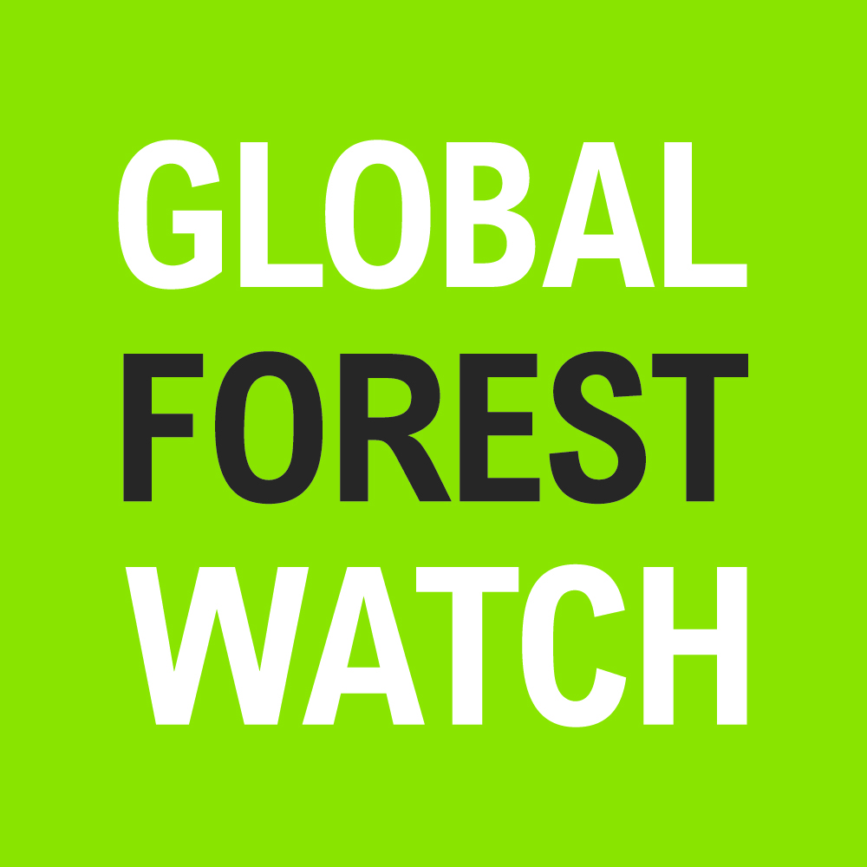
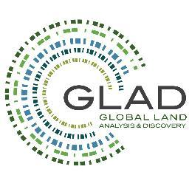
GFW: Convener, commissioner, distributor
Feedback, use cases, stories, analytics
Operational requirements
Processed data and insights
Raw data
Notes:
we need to be clear about, and proud of, our role in convening and driving RS world.

Slide 6
GFW: Convener, commissioner, distributor
Convene
Commission
Feedback, use cases, stories, analytics
Operational requirements
Processed data and insights
Raw data
Distribute data via platform, analysis and custom tools
Notes:
we need to be clear about our role in convening and driving RS world.
We can think about a data supply chain: we have the manufacturers (research partners), retailer (GFW), and customers.

Slide 7
GFW Operational EW products
 | Source | Resolution | Frequency | Coverage
GLAD alerts | UMD | 30 m (Landsat 7/8) | Weekly | Brazil, Peru; Burundi, Cameroon, CAR, DRC, Eq. Guinea, Gabon, ROC, Rwanda, Uganda; Brunei, Indonesia, Malaysia, Papua New Guinea, Timor Leste; Russia Far East
FORMA alerts | WRI, CGD | 250 m (MODIS) | Biweekly | Pantropical
Terra-I alerts | CIAT | 250 m (MODIS) | Monthly | Pantropical
SAD | Imazon | 250 m (MODIS) | Monthly | Brazilian Amazon
Guyra | Asociación Guyra Paraguay | 30 (Landsat) | Monthly | Grand Chaco
VIIRS active fires | NASA | 375 m (VIIRS sensor) | Two times daily | global

Slide 8
GFW Operational EW products
 | Source | Resolution | Frequency | Coverage
GLAD alerts | UMD | 30 m (Landsat 7/8) | Weekly | Brazil, Peru; Burundi, Cameroon, CAR, DRC, Eq. Guinea, Gabon, ROC, Rwanda, Uganda; Brunei, Indonesia, Malaysia, Papua New Guinea, Timor Leste; Russia Far East
FORMA alerts | WRI, CGD | 250 m (MODIS) | Biweekly | Pantropical
Terra-I alerts | CIAT | 250 m (MODIS) | Monthly | Pantropical
SAD | Imazon | 250 m (MODIS) | Monthly | Brazilian Amazon
Guyra | Asociación Guyra Paraguay | 30 (Landsat) | Monthly | Grand Chaco
VIIRS active fires | NASA | 375 m (VIIRS sensor) | Two times daily | global
Notes:
We have been focusing on use of GLAD alerts, since they are the highest spatial and temporal resolution alerts available.

Slide 9
How are alerts used?

Slide 10
Research Phases
EW data increases the effectiveness and efficiency of monitoring, which…
…Increases the number of response actions against illegal or unsustainable forest clearing, which…
…reduces rates of illegal or unsustainable forest clearing.
Monitoring
Early detection
Data aggregation and analysis
Verification
Investigation
Documentation
Response
Arrests
Fines or other penalties
Court cases
Protests or boycotts (CSO)
Campaigns or reports (CSO)
Investigative journalism (CSO)
Impact
Rate of deforestation
Rate of illegal logging
Introduction of new laws or policies
Hypotheses

Slide 11
Early warning user research
Accuracy: alerts accurately detect clearing.
Completeness: alerts cover relevant geographies and capture relevant biophysical changes (e.g. selective logging versus large-scale clearing)
Timeliness: alerts detect change within reasonable timescales after occurrence.
Trust/ownership: users trust the alerts.
Usability: alerts are provided in usable formats.
Cost: alerts are cost-effective to use.

Slide 12
Peru: Case study
Data collection:
12 in-person interviews
Survey: 110 responses
Participant observation/fieldwork
Early adopters:
Ministry of the Environment’s GEOBOSQUES portal
Monitoring the Andean Amazon Project (MAAP) from civil society

Slide 13
Peru: Case study

Slide 14
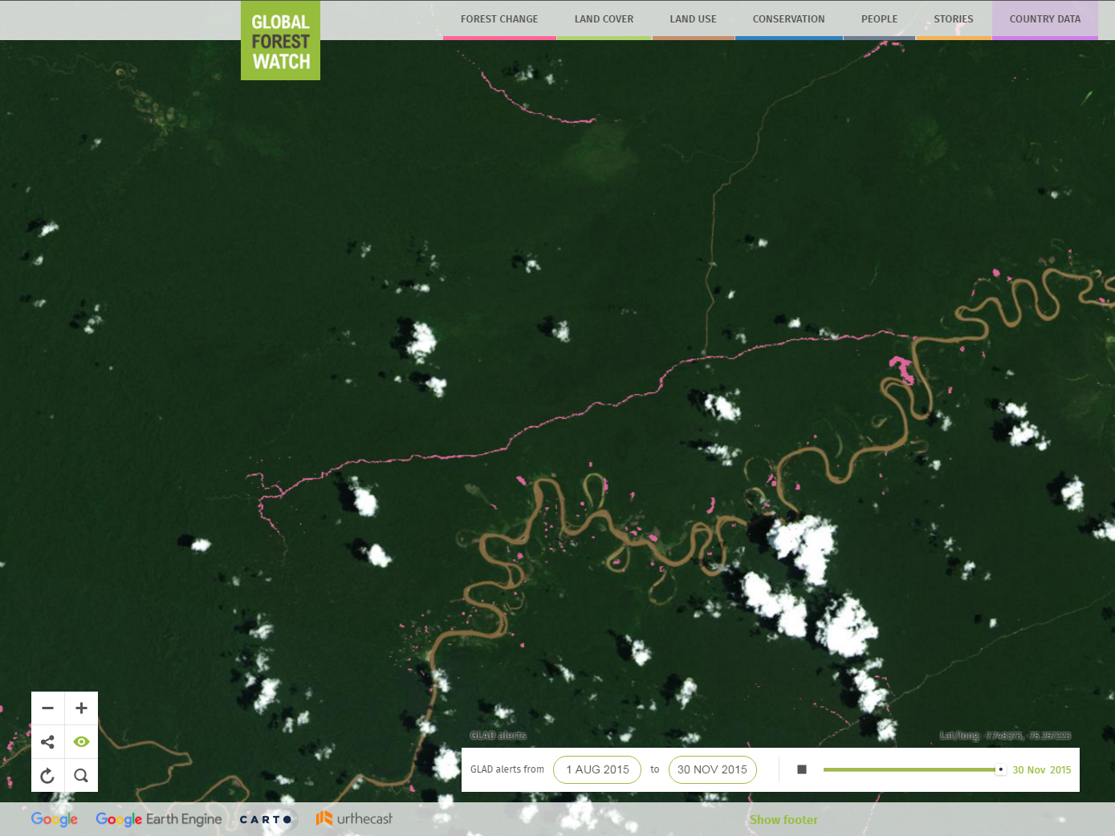
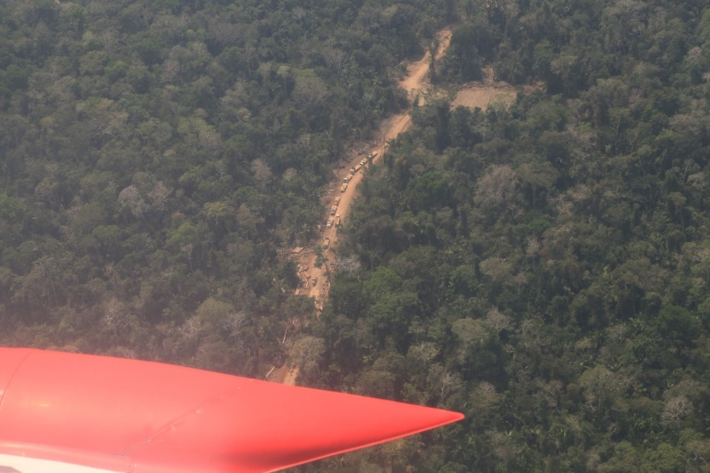
Notes:
OSINFOR uses GFW to analyze forest trends in areas they inspect, such as national parks and reserves. Last year they identified roads transporting illegally-harvested timber coming from the buffer zone of Cordillera Azul National Park. OSINFOR coordinated with several other agencies in Peru to investigate in more detail. The case was even covered in The Guardian and other national outlets. Inspired by GFW’s GLAD alerts, OSINFOR is now tracking road expansion based on Landsat imagery to brief other agencies.

Slide 16
Peru: Preliminary Findings
Accuracy: Alerts are quite accurate – some individual pixels are wrong, but clusters are correct
Completeness: Would like to differentiate anthropogenic from “natural” forest cover disturbance
Timeliness: Cloud cover prevents alerts from being updated for months at a time
Agencies rely on date of detection for legal proceedings
68% said cloud cover was a “major limitation”
Trust/ownership: GLAD alerts distributed through the Ministry of Environment. However, they recently started creating their own alerts to have more ownership over them.
Usability: Difficult for non-GIS users to access the data. Difficult to reach users in the field.
Cost: Alerts save many agencies time and costs of image interpretation – they can monitor larger areas
Notes:
Data challenges/needs:
Want to be able to separate natural-caused forest loss from human caused deforestation to ensure an appropriate response
Cloud cover is an issue:
Sometimes can’t get alerts for months at a time
Many agencies relying on the date of the alert for legal proceedings –but cloud cover issue may result in incorrect dates
Difficult for non-GIS users to access the data
Difficult for alerts to reach users in the field
Sustainability of the alert system is key

Slide 17
PERU: PRELIMINARY FINDINGS
Governance Challenges:
Lack of trust in enforcement bodies by communities and land-holders
Enforcement bodies lack sufficient funds to conduct field visits and follow up
Lack of coordination and cooperation between agencies
Corruption
“We have the information, but we don’t have resources [to follow up]”

Slide 18
PERU: PRELIMINARY FINDINGS
Government buy-in is key – GEOBOSQUES platform resulted in widespread uptake of alerts across the country
Comprehensive training and capacity building is important,
Field verification visits build trust in the data
Use of information needs to be institutionalized through formal protocols and processes
Civil society can help put pressure on governments by publicizing areas of deforestation
Alerts were most effective in organizations with field staff

Slide 19
Peru: Summary
Use of GLAD alerts has become widespread in Peru
Generally, users of the data found that the alerts provide sufficient accuracy, coverage, and timeliness to inform government action against illegal forest activities
There are technical limitations of the data, as well as problems with use and delivery of the information
However, governance and legal limitations are greater than technical limitations

Slide 20
Timeline for future EW activities
Study
Collect data for Indonesia and DRC “Rapid Response” research in late 2017
Publish Peru findings in early 2018
GLAD alerts
Scale operational alerts to pantropics by late 2017
Exploring multi-sensor approaches (WUR)
For discussion:
WRI role in user assessment
Multi-stakeholder meeting in 2018?

Slide 21
GLAD alerts
Function | Identifies areas of likely tree cover loss in near-real time
Resolution | 30 x 30 meters
Geographic Coverage | South America: Brazil, Peru Central Africa: Burundi, Cameroon, Central African Republic, Democratic Republic of the Congo, Equatorial Guinea, Gabon, Republic of the Congo, Rwanda, Uganda Southeast Asia: Brunei, Indonesia, Malaysia, Papua New Guinea, Timor Leste
Frequency | Updated every 8 days
Date of content | July 2015 - present
Satellite | Landsat 7 and Landsat 8
Hansen, M.C., A. Krylov, A. Tyukavina, P.V. Potapov, S. Turubanova, B. Zutta, S. Ifo, B. Margono, F. Stolle, and R. Moore. 2016. Humid tropical forest disturbance alerts using Landsat data. Environmental Research Letters, 11 (3).

Slide 22
GLAD alerts Methodology
“Forest cover”: > 5 m tall trees with a canopy closure exceeding 60%
An alert is defined as any Landsat pixel that experiences a canopy loss in excess of 50% cover
Alerts are based on the latest single good observation
Two types of alerts: confirmed and unconfirmed
Alerts remain unconfirmed until two or more out of four consecutive observations are labelled as loss.
Users can view only confirmed alerts in the menu, though confirmed alerts miss the most recent detections of tree cover loss.
Hansen, M.C., A. Krylov, A. Tyukavina, P.V. Potapov, S. Turubanova, B. Zutta, S. Ifo, B. Margono, F. Stolle, and R. Moore. 2016. Humid tropical forest disturbance alerts using Landsat data. Environmental Research Letters, 11 (3).

Slide 26
Limitations
Does not distinguish human-induced from natural forest disturbances, nor deforestation from forestry land use dynamics
Cloud cover can limit the availability of imagery, particularly in the wet season.
Alert dates represent the instance of detection, though tree cover loss could have taken place earlier, possibly weeks earlier, due to persistent cloud cover.

Slide 27
Accuracy
The GLAD alerts were evaluated in Peru to have 13.5 percent false positives. The majority (9.5 percent) occur on the edges of clearings. The mix of forest and other land cover at the edges which makes them prone to error in the system.
The rate of false positives drops to 1 percent when only considering confirmed alerts.
The data has 33 percent false negatives, though most of these occur in secondary forests.
The higher rate of false negatives compared to false positives also indicates that the alerts are a conservative estimate of the tree cover loss that is actually occurring.

Slide 28
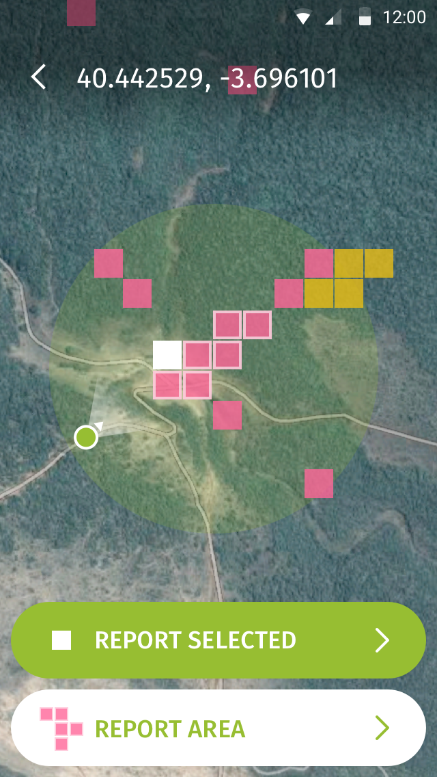
Accessing GLAD alerts via gfw
Visualize on interactive map
Select recent Sentinel-2 imagery by date and cloud cover for verification
Overlay other spatial information
Analyze alerts by drawing, selecting or uploading a polygon (e.g. protected area boundary)
Subscribe to an area and receive email notifications when new change is detected
Download alerts (shp, csv)
Access offline via Forest Watcher mobile app

Slide 30
Outreach and dissemination
Interactive online map
Forest Watcher mobile app
Direct engagement in targeted countries
Outreach to civil society, corporate, and government partners
Blog
Small Grants Fund
Emails campaigns
Product marketing

Slide 31
Future improvements and research
Geographic expansion to cover entire tropics
Continued migration and scale-up via Google Earth Engine
Incorporation S2 to improve resolution
Explore multi-sensor (Landsat+S2+S1) approaches to overcome cloud cover limitations
Automated post-facto identification of road patterns, clusters; automated filtering of alerts by ancillary criteria (such as protected areas boundaries)

Slide 32
Thank you!
www.globalforestwatch.org
Rachael Petersen
rpetersen@wri.org
Mikaela Weisse
Mweisse@wri.org

