Slide 1
Element 3 Space Data Support to GFOI R&D
A. Rosenqvist (for JAXA)
SDCG-13 Session #1 Item 1

Slide 2
Session 1 outline
Tuesday March 13, 2018

Slide 3
Status Overview of 3-Year Work Plan Tasks and Outcomes

Slide 4
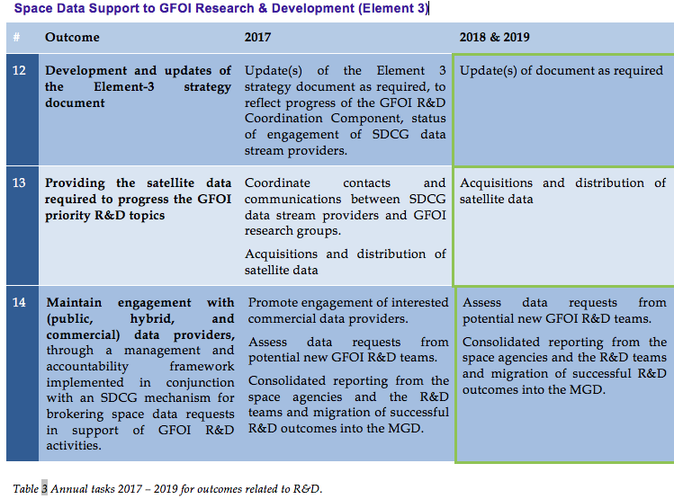
3-Year Work Plan – Element-3

Slide 5
3-Year Work Plan – Element-3
2017 Status: On schedule.
El-3 v4.0 to be submitted “for information” to SIT-33 (April 2018).

Slide 6
3-Year Work Plan – Element-3
2017 Status: On schedule & good progress
All SDCG agencies have completed selection of R&D teams to support
All agencies are in the process of tasking and/or provision of data to the selected teams

Slide 7
3-Year Work Plan – Element-3
2017 Status: Minor updates since SDCG-12
Private sector engagement
AD&S (SPOT 6/7) – No feedback from Airbus. Further efforts to engage AD&S aborted.
SSLT (NovaSAR) – Support confirmed by SSTL in March 2017. Contact point shifted to UKSA (Joanne). NovaSAR in El-3 or El-1 – to be discussed further
Also exploring special NovaSAR data provision though CSIRO.
Planet – renewed efforts to engage. Planet is present at this meeting. Will join on Thu PM?

Slide 8
3-Year Work Plan – Element-3
New 2018 Objective (added by SW)
Pursuit of a dedicated GFOI R&D fund with the main GFOI donors to address and remove the main technical obstacles to use of EO satellite and other data in reporting of countries. (Related to Carbon observing system strategy of EC CEOS Chair?)

Slide 9
Element-3 Strategy document – annual revision

Slide 10
Element-3 Strategy document – annual revision
Element-3 version 4.0 in the pipeline for SIT-33
Updates to the agency data provision status (section 4)
No updates received
New section on UKSA required (after NovaSAR launch – perhaps more suitable for v 5.0 (2019) update)
Ditto for CSIRO?
Updates to R&D group composition
Group 11 (UNSW, Australia) – withdrawn.
CESBIO, France – Invited to join the R&D programme on request by CNES. Invitation issued in June 2017. No response.

Slide 11
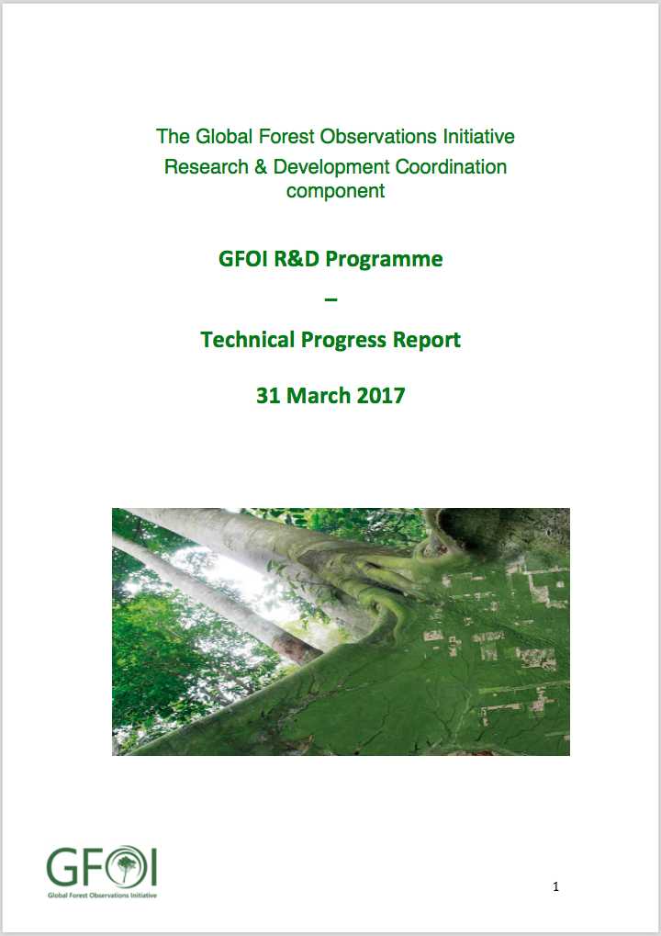
R&D reporting to CEOS agencies
R&D Group Technical Progress report to CEOS agencies
First report released March, 2017 by GFOI R&D Coordination (RDC) component
Progress reports by all 18 R&D groups
Research progress
Data access summary
Available at GFOI.org/RD
Second report due prior to SIT-33
“Light report” to be issued by GOFC-GOLD as funding for RDC component still pending
Notes:
ESA BIOMASS mission,

