Slide 1
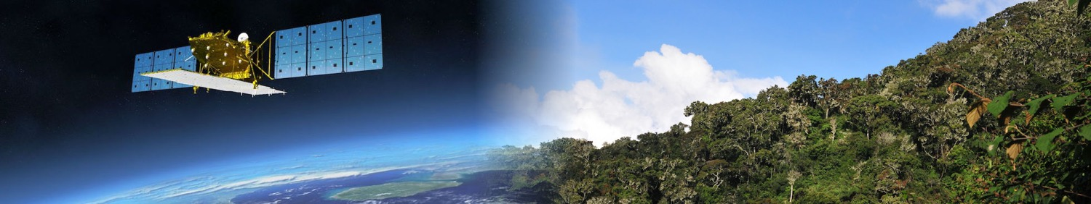

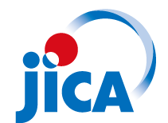

Hiroaki OKONOGI
Japan International Cooperation Agency (JICA)
15, Mar. 2018
Bogota, Columbia
GFOI Plenary 2018
Notes:
Introduction about JJ-FAST

Slide 2
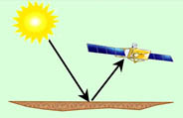
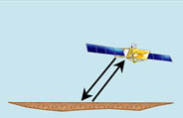
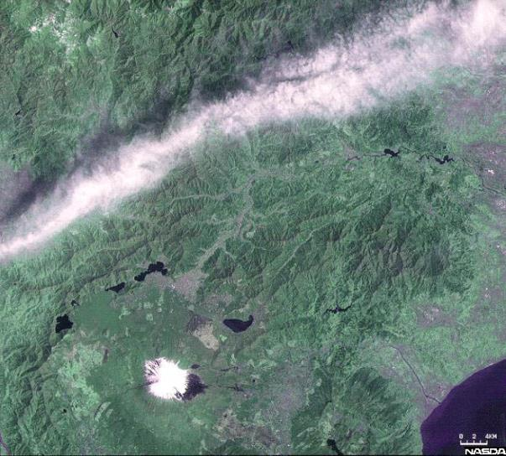
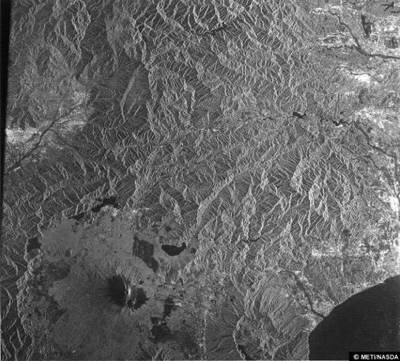
Satellite sensor (L-band SAR)
JAXA
Optical imager
Synthetic Aperture Radar (SAR)
Landsat-5/TM 1992.04.23.
JERS-1/SAR 1992.04.23.
[RSSJ, 2011]
SAR uses microwave, so it can observe both day and night regardless of cloud cover.

Slide 3
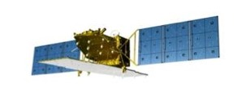
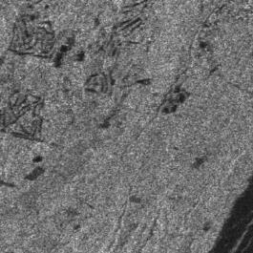
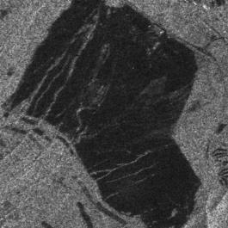
Deforestation detection
JAXA
Forest area:
Strong radar reflection
Deforestation area:
Weak radar reflection
High image contrast between “forest” and “deforestation” areas.

Slide 4
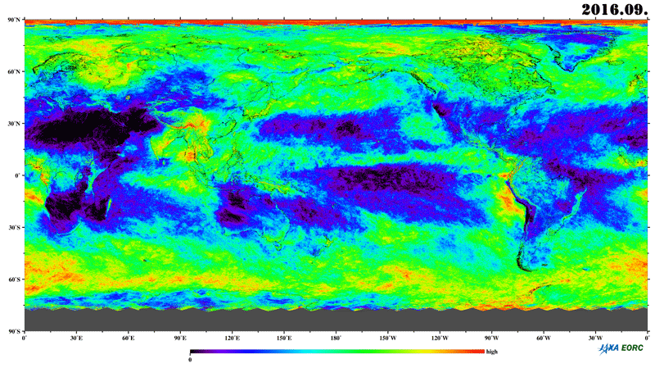
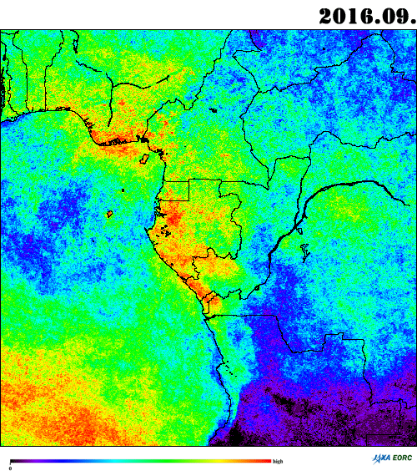
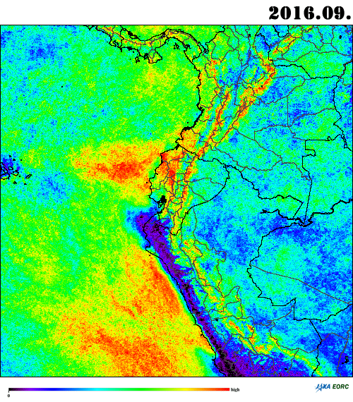
JAXA
Country | Cloud cover ratio
Ecuador | 97%
Gabon | 88%
Equatorial Guinea | 75%
Colombia | 65%
Bhutan | 63%
Indonesia | 60%
Vietnam | 56%
DRC | 54%
… | …
Global cloud-cover map
MODIS satellite data
Ratio of period with more than 50% cloud-cover (in 2015.01-2017.09).
Gabon
Ecuador
Vast rainforests are covered by cloud!

Slide 5
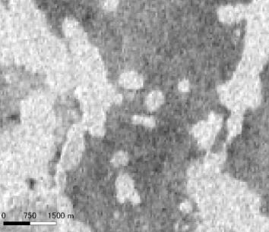
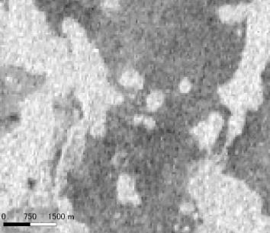
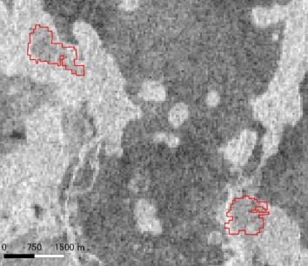
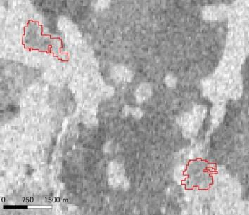
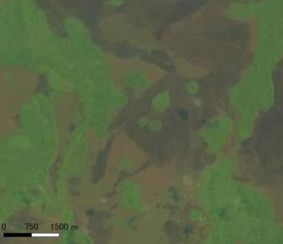
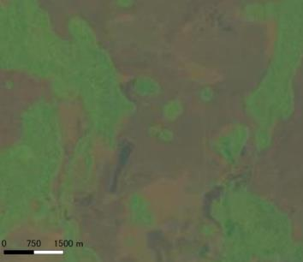
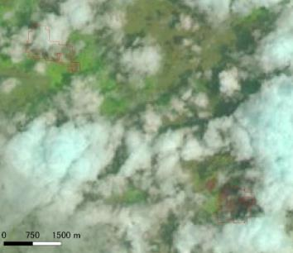
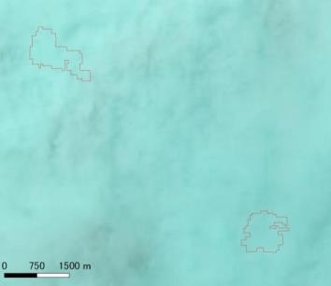
Example: Democratic Republic of Congo
JAXA
PALSAR-2
Jul. 24, 2015
Sep. 4, 2015
Oct. 16, 2015
Jan. 8, 2016
42 days
42 days
42 days
LANDSAT-8
Jul. 27, 2015
Aug. 28, 2015
Oct. 15, 2015
Jan. 3, 2016

Slide 6
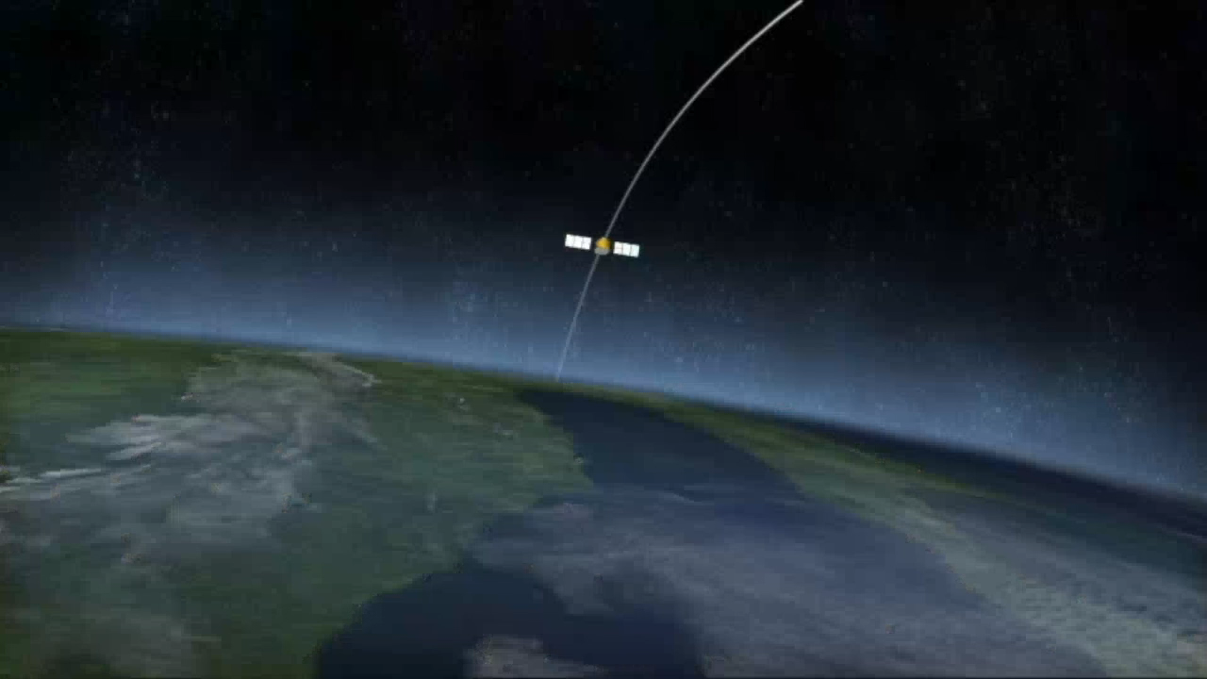
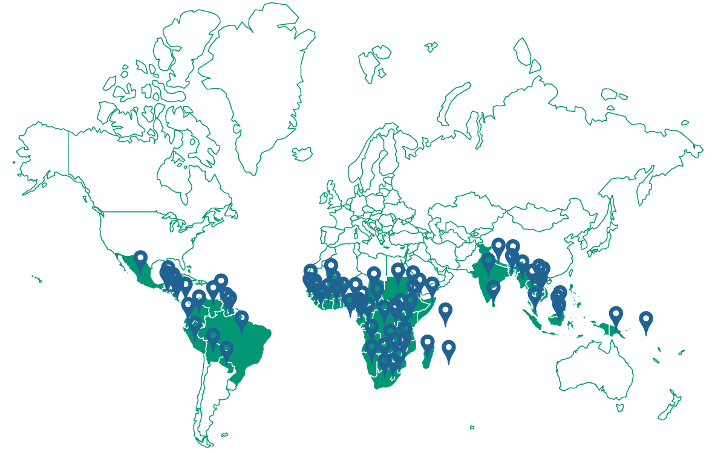
System Development
Satellite
  ALOS-2
  L-band PALSAR-2
  50m resolution
JJ-FAST
  From Nov. 2016
  For 77 countries
  Every 1.5 month
  More than 5 ha
  Low speed internet

Slide 7
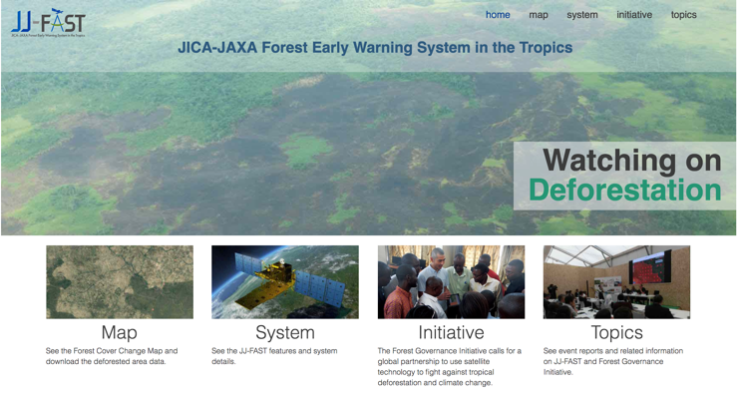
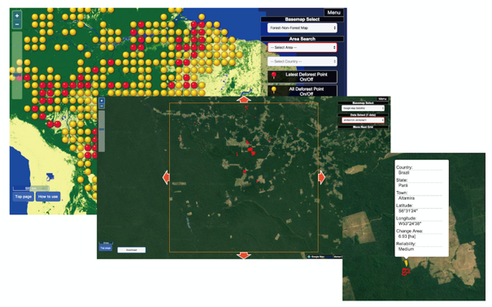
Web-Site of JJ-FAST
http://www.eorc.jaxa.jp/jjfast/

Slide 8


Verification Survey & Feedback
By JAXA team
By JICA Technical Cooperation Project
Verification at
  Brazil
  Botswana
  Gabon
  Indonesia
  Peru
Feedback system
Countries
/Project

Slide 9








Collaboration with optical satellite
 | Optical | Radar
Resolution | ○ | ✗
Cloud | ✗ | ○
Early Warning System
Control and Surveillance System

Slide 10
The algorithm is being improved
Forest map (Mask data) improvement
2 times analysis -> time series analysis
Detection larger than 5 ha -> 2-3 ha
Data collaboration between optical and radar data

Slide 11

TV program “Forest can change the World”
Scheduled to be broadcast on 27th Apr. 2018
*You can also watch through the internet from the next day.
UTC -5 | UTC (GMT) | UTC +9 (JST)
18:30-(26th Apr.) | 23:30- (26th Apr.) | 8:30-
00:30- | 5:30- | 14:30-
7:30- | 12:30- | 21:30-
12:30- | 17:30- | 26:30-
Check detail at “https://www3.nhk.or.jp/nhkworld/”

Slide 12



http://www.eorc.jaxa.jp/jjfast/
fb.me/jica.jj.fast
@JICA_JJFAST

Slide 13
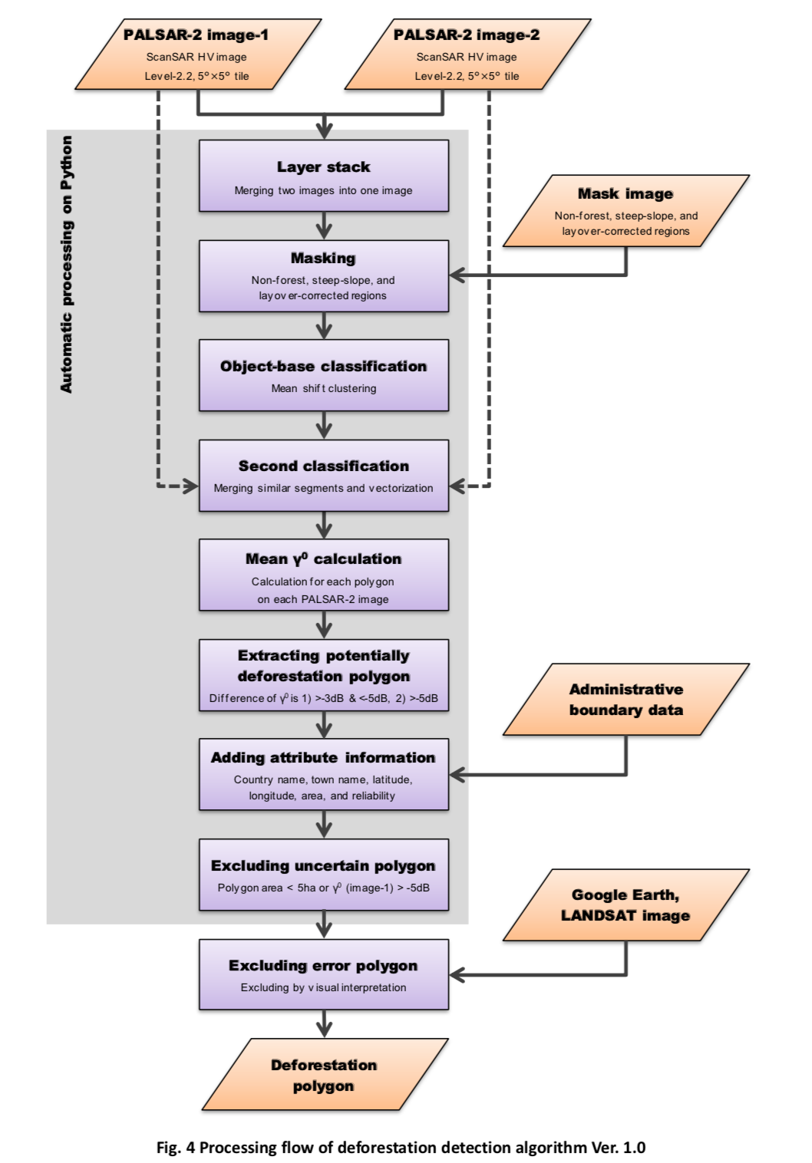

Slide 14
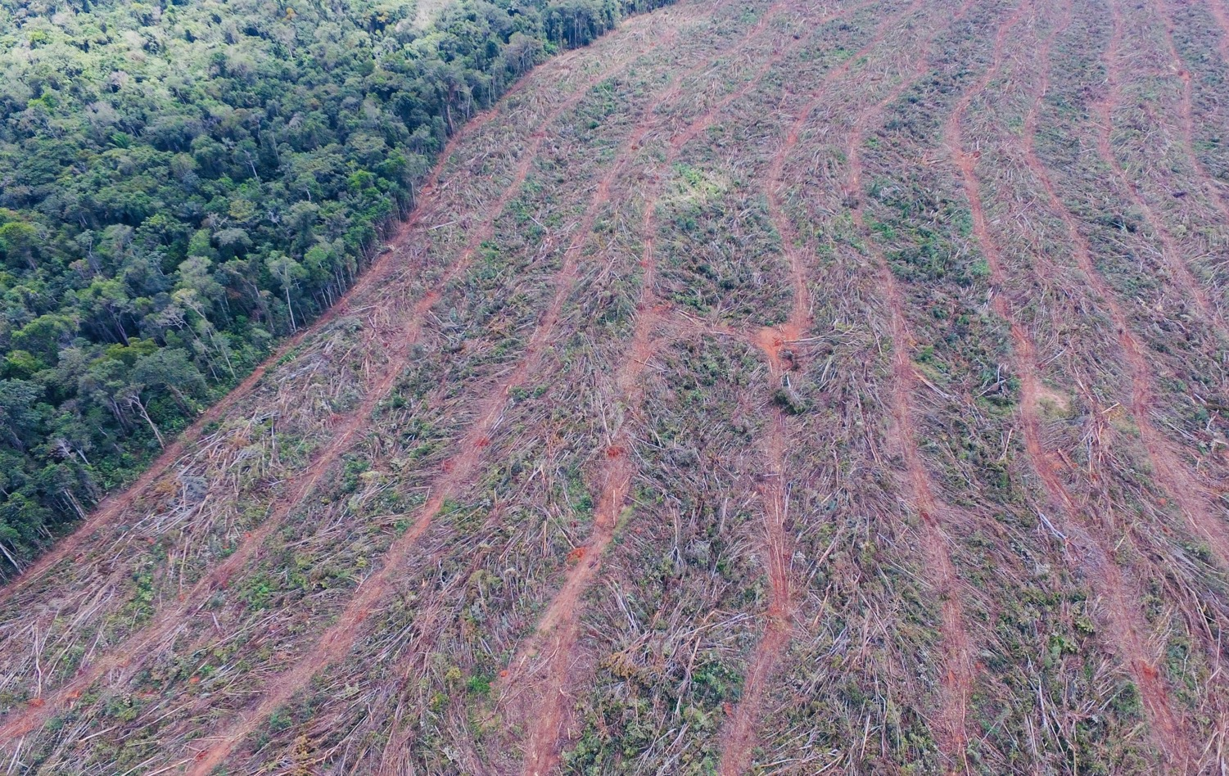
Background
129 million hectares
(1990 to 2015: FRA2015 )
Tokyo Denki University

Slide 15
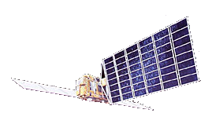

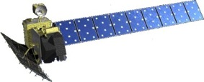
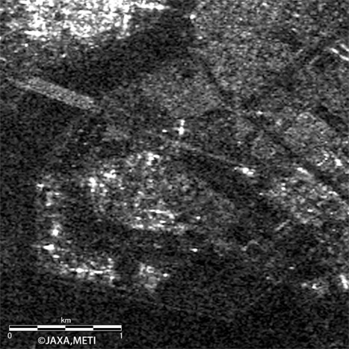
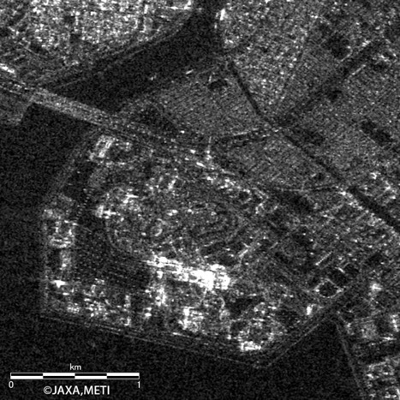
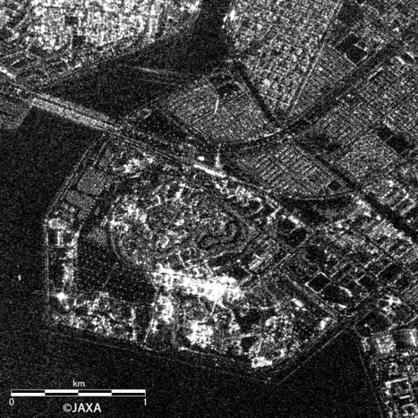
JAXA’s L-band SAR satellites
JAXA
JERS-1/SAR
ALOS/PALSAR
ALOS-2/PALSAR-2
1992.02.11. - 1998.10.12.
Resolution = 18m
2006.01.24. - 2011.04.22.
Resolution = 10m
2014.05.24. –
Resolution = 3m

Slide 16
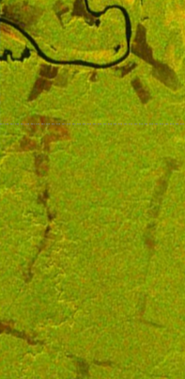
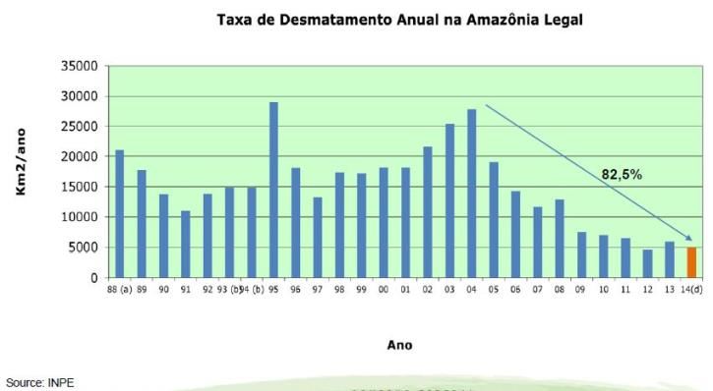
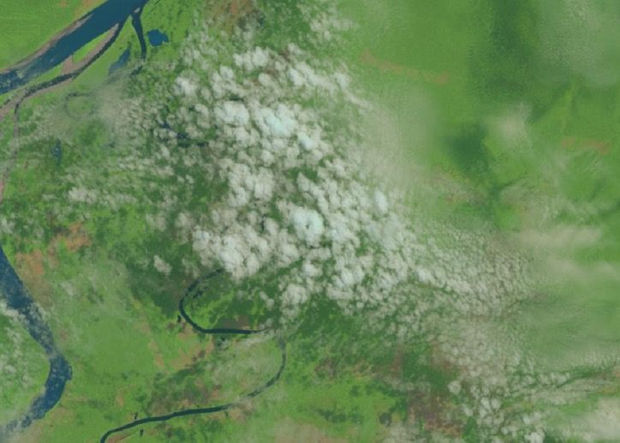
Brazil’s case from 2009-2011
Project for Utilization of ALOS Images to Support the Protection of the Brazilian Amazon Forest and Combat Against Illegal Deforestation
Forest Density Difference by ALOS
Between 2009 and 2011
Brazilian Government
Year | Detection of Deforestation | Illegal Logging
2010 | 1,007 | 140
2011 (stopped in April) | 176 | 11
Landsat 5 Image on 2011/09/07
Notes:
Brazilian government has been tackling illegal deforestation using optical satellite images (Landsat) since 2004.
Challenge was deforestation detection in the rainy season. Almost a half period of a year, the Amazon Forest is covered with clouds.
The ALOS SAR sensor can detect deforestation even in the rainy season or night time.

Slide 17
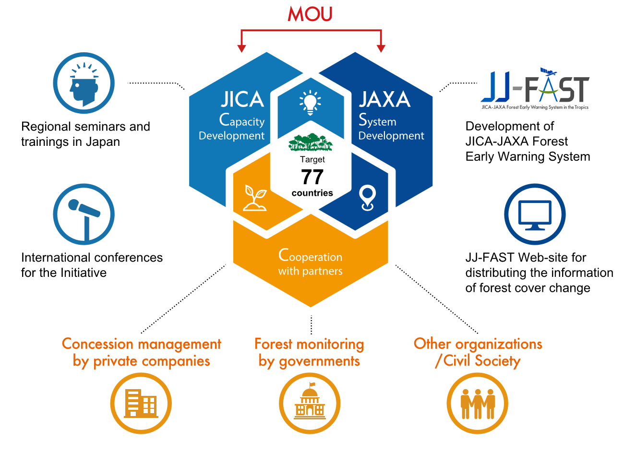
Forest Governance Initiative

