Slide 1
User Needs Assessment around Early Warning Forest Systems
The Brazilian Experience
Dalton de Morisson Valeriano
INPE – Brazilian National Institute for Space Research
Earth Observation Coordination Area
Brazilian Biomes Environmental Monitoing Program
GFOI 2018 Plennary, Bogotá,Colombia, March 12-16, 2018

Slide 2
DETER system
A mutiscale early warning system for law enforcement

Slide 3
DETER-A (MODIS 2004-present)
Selection of best set of MODIS True-Color Rapid Response Products (every working day)
Visual interpretation of deforestation and degradation activity
  Support by PRODES deforestation mask and cumulative DETER mask
Delivery of results to IBAMA* within at most 5 days after data acquisition
Delivery with open access in the internet 5 working days after delivery to IBAMA
      * Brazilian environmental law enforcement authority at the federal level

Slide 4
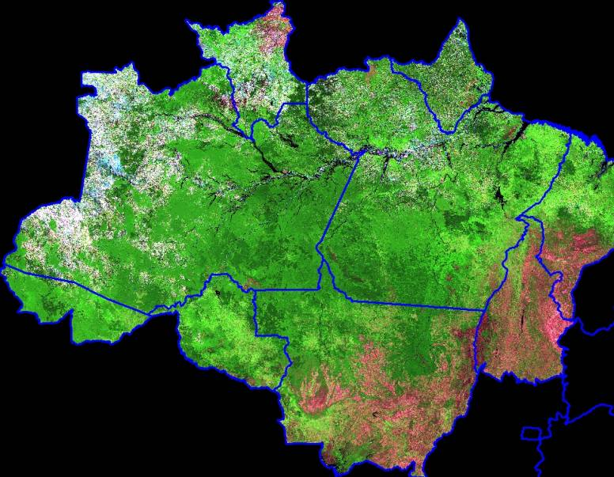
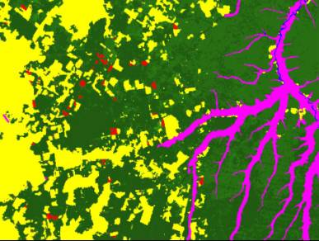
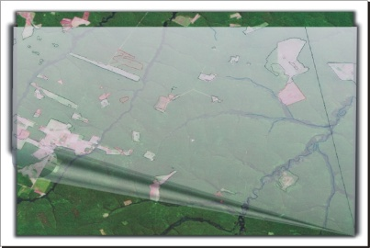
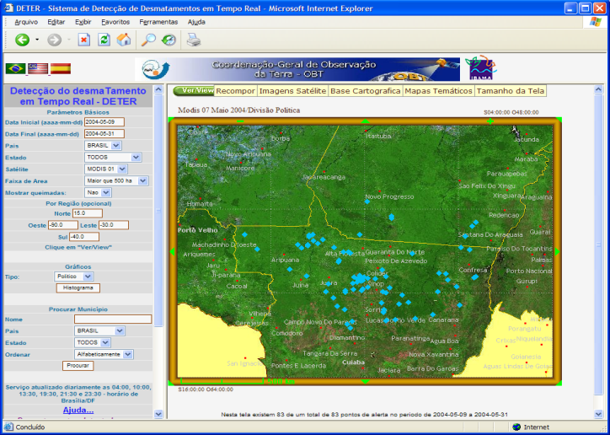


DETER
PRODES
Products: Early warning maps to enviromental authority and internet

Slide 5
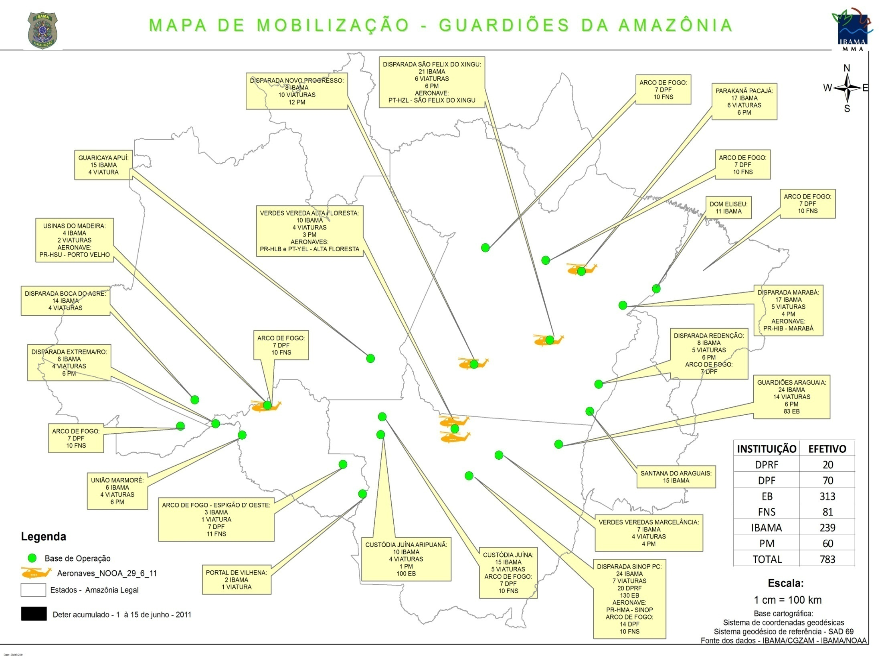

Slide 6
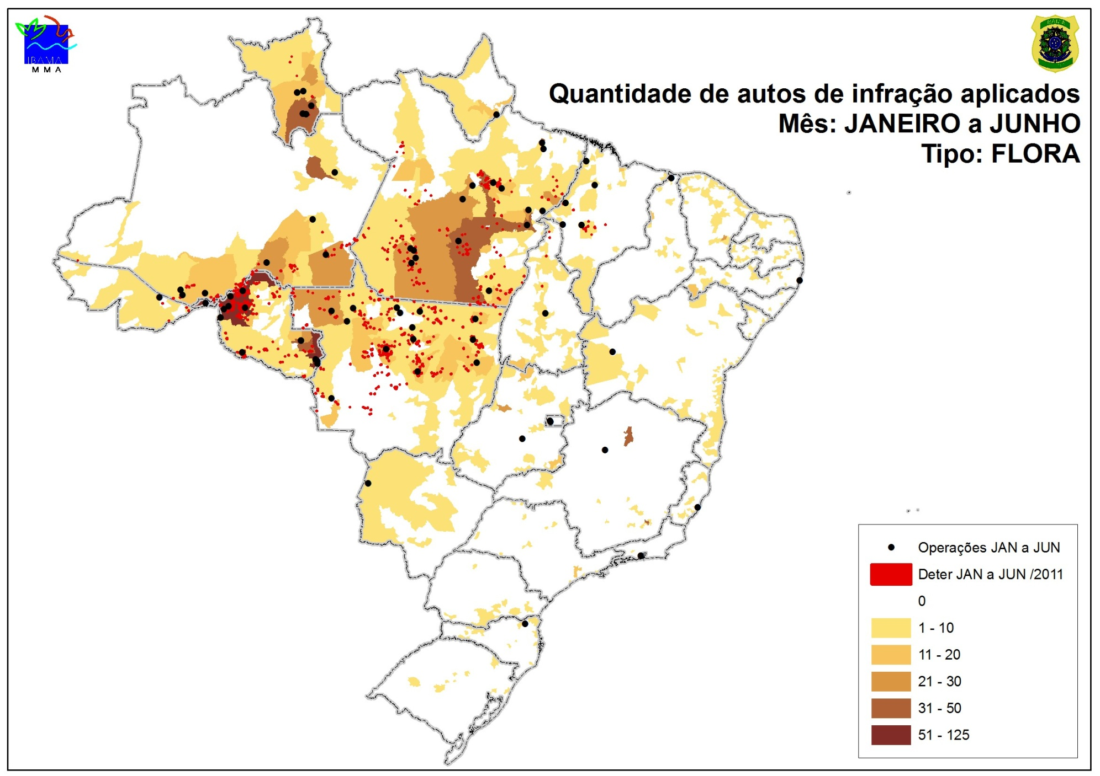

Slide 7
Limitations of DETER-A
Minimum mapping area of 25 ha
Low accuracy in area representation – no reliable aggregated statistics
Unable to reliably discriminate deforestation from forest degradation without support of better resolution data
Original internet interface was considered outdated
As deforestation pattern evolved after improved law enforcement capability, the DETER-A became “short sighted”.
Need to evolve to better systems and better internet interface

Slide 8
New Amazon Monitoring concept under development:
Three scales continuous monitoring system
DETER-A: 250 - 275 m resolution (in operation, continuation being considered)
  Very high rate of revisit (nearly daily)
  Limmited capacity to discriminate type of activity –produces warning with accurate position.
  Sensors MODIS (250m) and/or NPP (275 m)
DETER-B: 60 m resolution (in operation)
  Moderate rate of revisit (2 to 5 days)
  Capacity to discriminate and accurately map types of activities.
  Sensors ResourceSat-AWiFS (56 m), CBERS-WFI (64 m), Amazonia-1 (64 m when launchd)
DETER-C: 20-30 m resolution (developed for the past 2 years, planned operation in 2018)
  Revisit capability depending on the basket of sensors available.
  Final representation of activities for law enformecement and mulltiple use accounting
  Sensors Landsat, CBERS-MUX, ResourceSat-LISS-III
  Sentinel-2 is being considered as data source for validation purposes
Notes:
8

Slide 9
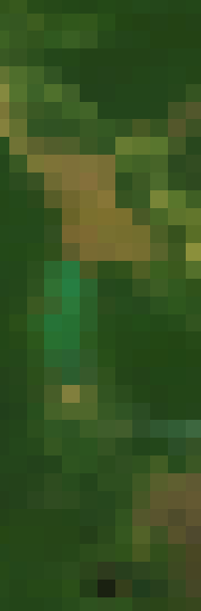
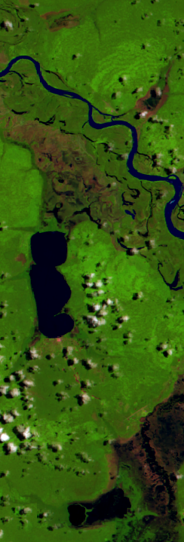
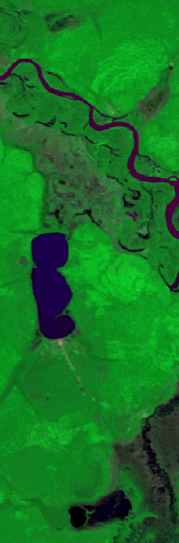
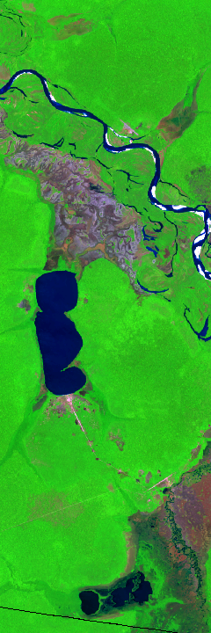
DETER-A
MODIS (Terra)
DETER-B
DETER-C
OLI (Landsat 8)
AWiFS (ResourceSat-2)
WFI (CBERS-4)
250 metros
56 metros
64 metros
30 metros

Slide 10
Activity classes mapped in DETER B and C
Notes:
10

Slide 11
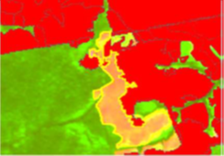
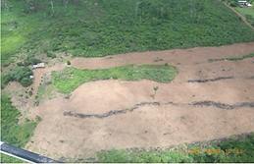
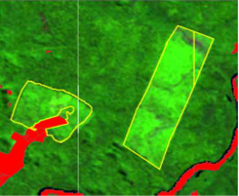
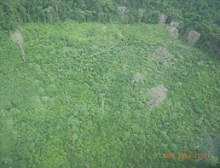
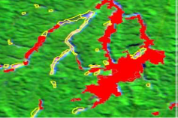
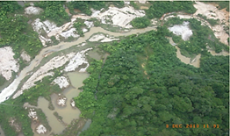
DETER-B – Classes de desmatamento e alteração na cobertura florestal
Nível 1 | Classes (nível 2) | Imagem de satélite | Imagem fração solo | Imagem de campo
Desmatamento (ALERTA) | Desmatamento com solo exposto
 | Desmatamento com vegetação
 | Mineração

Slide 12
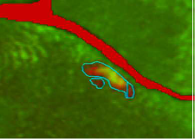
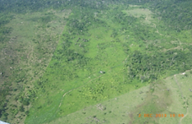
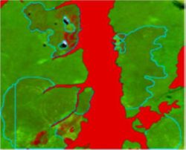
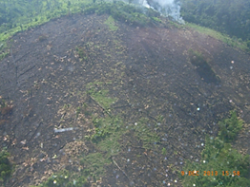
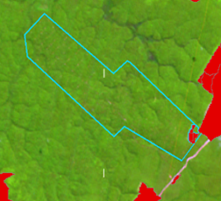
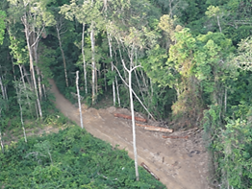
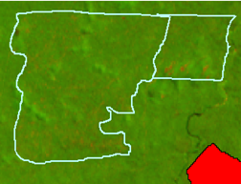
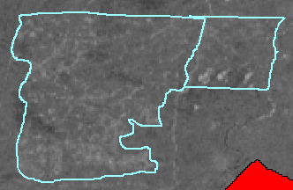
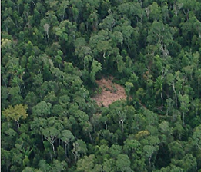
DETER-B – Chave de interpretação
Nível 1 | Classes (nível 2) | Imagem de satélite | Imagem fração solo | Imagem de campo
Degradação | Degradação (diferentes intensidades)
 | Cicatriz de incêndio florestal
 | Corte seletivo Tipo 1 (geométrico)
 | Corte seletivo Tipo 2 (desordenado)))

Slide 13
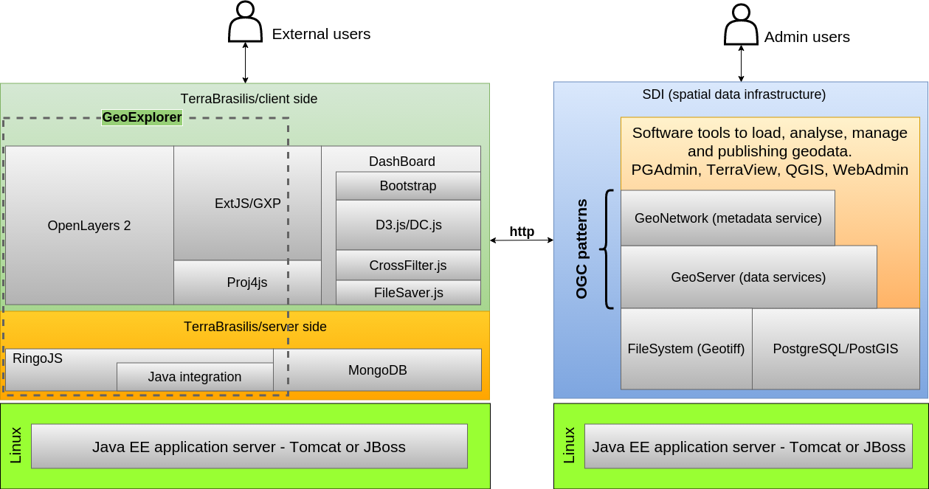
TerraBrasilis Platform – Data access and on-line consultation

Slide 14
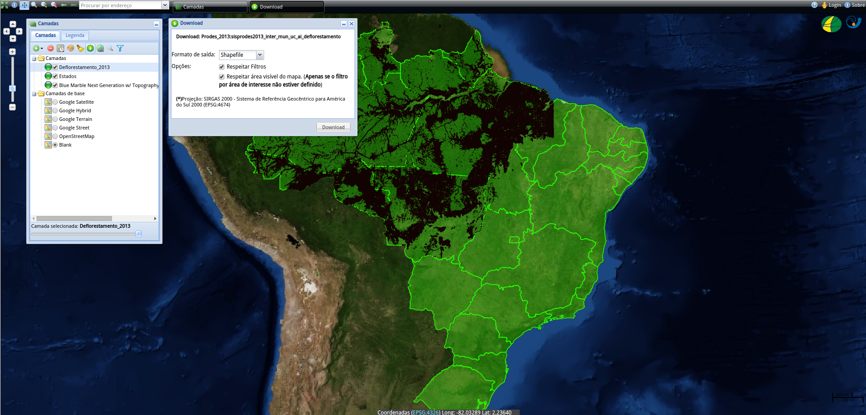
Interface for geographical data presentation

Slide 15
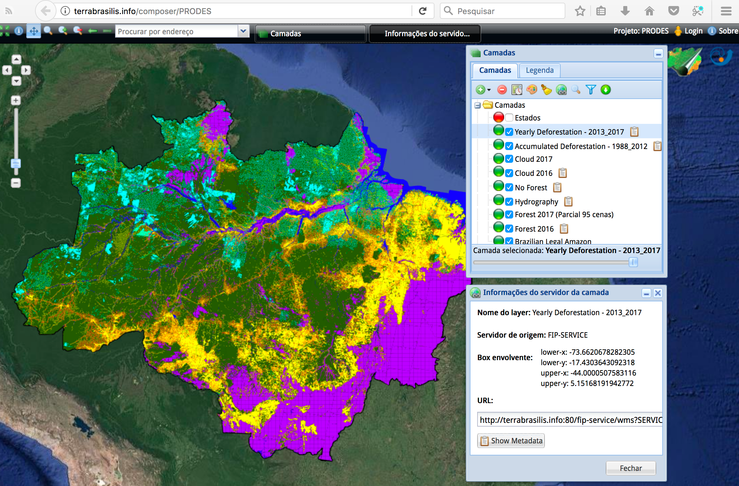
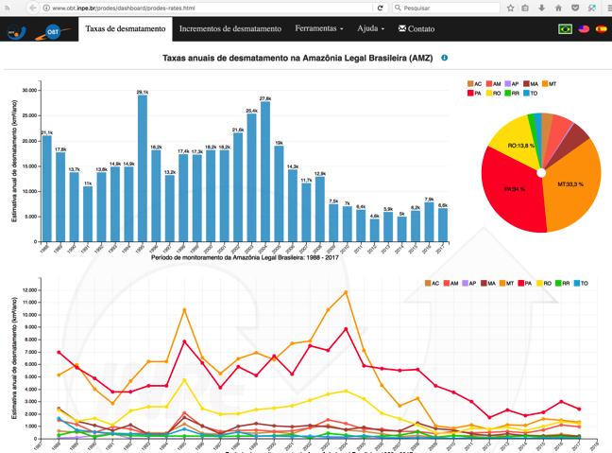

Slide 16
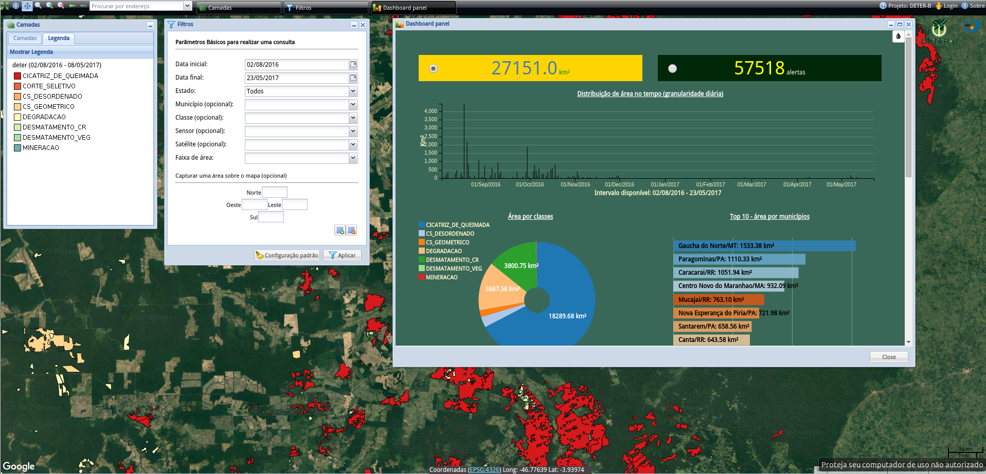
Interface for DETER-B and C

Slide 17
Suggested questions
Who are the main users of DETER, and how are they using the system?
  Federal, State and Municipal authorities use the data with different level of efficiency, all very low considering the amount of activity events delivered.
Are there any technical requirements/features that users want that DETER doesn’t provide?
  Nothing that they couldn´t do themselves as sorting out authorized from illegal activities and activity with evidence of on going development.
What have been the biggest challenges for users (technical or otherwise) in using DETER?
  Overload of work to do.
Other lessons learned around engaging with users and their needs
  Gather lots of pacience before giving someone whart they did´t ask.

