Slide 1
Landsat Mission Status
07 March 2018

Slide 2
USGS Land Remote Sensing Program
USGS Land Remote Sensing
(LRS) Program
Delivers a national and global capability to ensure broad public and scientific availability of observations of the Earth’s land surface:
  Create and preserve a long-term record of the Earth’s land surface at local, regional, and global scales
  Expand scientific understanding and application of remotely sensed data to government and private users nationally and globally
  Support decision makers and policy officials in fulfilling their public responsibilities
  Guide National decisions about meeting current and future needs in land science and land observation
  Coordinate and integrate civil Earth observation with other sources of data including commercial and National Security space systems
Fundamental goal: Ensure public availability of a primary data record about the current state and historical condition of the Earth’s land surface

Slide 3
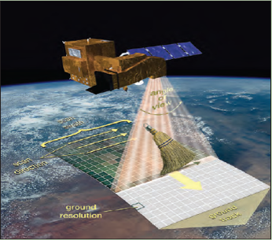
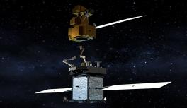
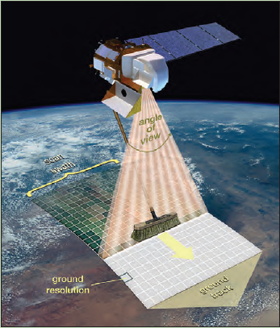
Landsat operational and development status
Landsat 7 (1999)
Collecting about 475 new scenes per day; latest fuel estimate projects operating into 2020/2021
Restore-L refueling remains a possibility
Landsat 8 (2013)
Collecting up to 725 new scenes per day; together with Landsat 7 supports 8-day revisit
Landsat 9 (late 2020 launch)
Essentially a copy of Landsat 8, but with important improvements for accuracy and resiliency
Landsat 10 (~2027-2030 launch)
Technology and requirements studies underway to support a 2018 decision point
EVERYTHING IS ON THE TABLE at this point (e.g., small sat, hyperspectral, data buys, Public-Private Partnerships (P3), etc.)
Landsat 7 (whiskbroom)
Landsat 8 (pushbroom)

Slide 4

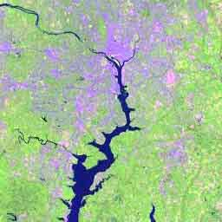
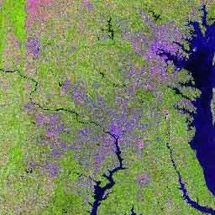

U.S. Landsat Archive Overview
(Jan 1, 2018)
OLI-TIRS: Landsat 8
  1,143,018 scenes
    ~ 3,952 TB Raw and L0Ra Data
    average scene size 1813 MB
ETM+: Landsat 7
  2,413,896 scenes
    ~ 2,242 TB Raw and L0Ra Data
    average scene size 487 MB
TM: Landsat 4 & Landsat 5
  2,560,626 scenes
    ~ 1,329 TB Raw and L0Ra Data
    average scene size 263 MB
MSS: Landsat 1 through 5
  1,312,608 scenes
    ~ 80 TB Raw and L0Ra Data
    average scene size 32 MB
Total:
  7,430,148 scenes
    ~ 7,603 TB Raw and L0Ra Data

Slide 5
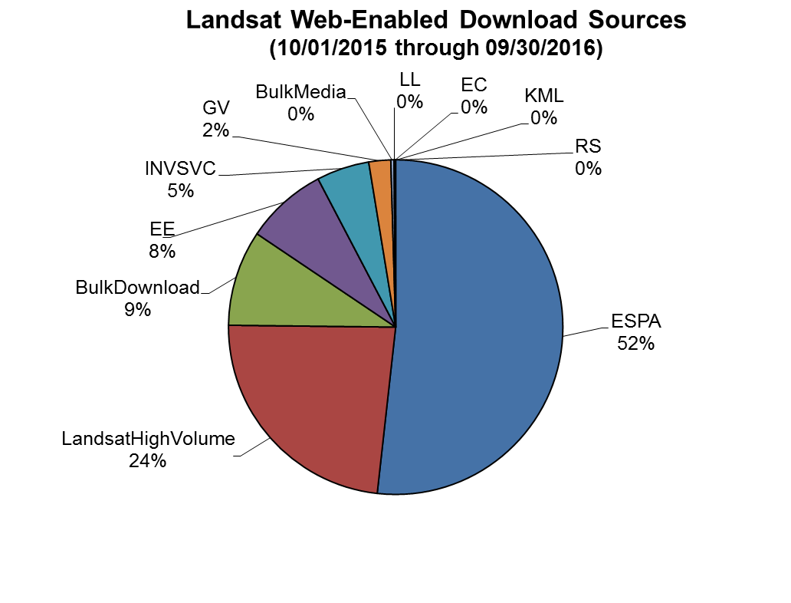
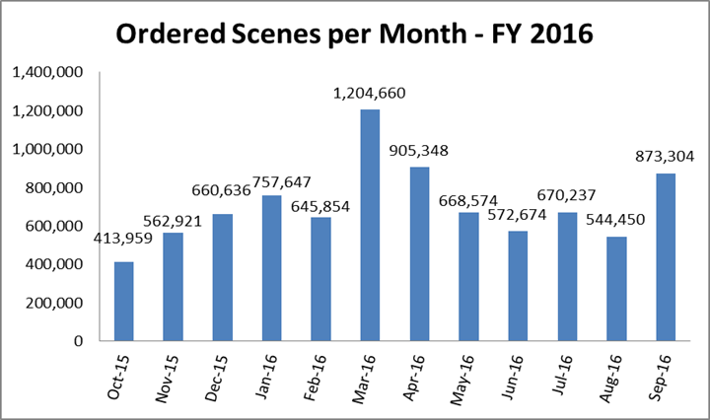
Level-2 Product Demand
Level-2 Product Demand
In FY16 USGS EROS distributed over 17 million Level-1 scenes
Over ½ of the 17 million Level-1 scenes distributed were improved to TOA/SR (Level-2) through the EROS Science Processing Architecture (ESPA)
Currently, TOA/SR is produced on-demand, but USGS is planning to produce a collection of ARD for the U.S. and the globe
Level-1 Statistics
ESPA / Level-2+ Product Distribution
ARD will be the standard Landsat product in the future
5

Slide 6
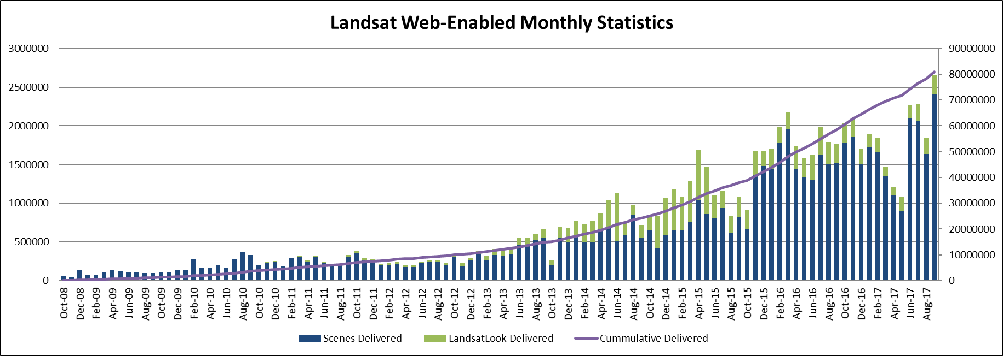
Monthly Downloads
$1.8B in annual US economic benefit OPR2013-269, USGS/DIO
Notes:
Final – circled month is reporting date used for LTWG #23 (April)
Date of LTWG #23 presentations was 9 June 2014

Slide 7
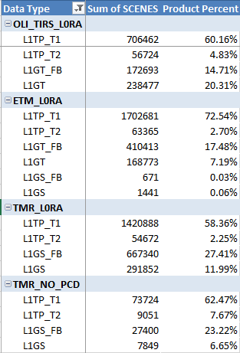
Landsat Collection 1 Status
Collection 1 processing is ongoing for newly acquired downlinks
TM No-PCD / MSS processing has now commenced Pre-Collection data is (mostly) gone
  Pre-Collection data processing was turned off on April 30th, 2017
  Pre-Collection search and download was disabled for almost all data on October 1st, 2017
  The only Pre-Collection data which can still be downloaded is Landsat 1-5 MSS, until Collection 1 MSS processing is fully complete

Slide 8
Landsat 7 Recent & Upcoming Activities
No change in Observatory status or performance
  Operating ETM+ at 105% duty cycle
On 01 February 2018 Landsat 7 surpassed 100,000 orbits
  First scene acquired on orbit 100,000 was imaged at 13:59 GMT (Path 229, Row 56) and transmitted to ASN during orbit 100,000 at 14:38 GMT
  100,000 orbits equates to 4.44 billion km (2.76 billion miles) traveled, or nearly 15 round trips to the sun
  Landsat 7 has surpassed 6,866 days on orbit (18.81 years)
L7 Mission Operations Center (MOC) is relocating from GSFC Building 32 to Building 25 in order to allow Landsat Multi-Satellite Mission Operations Center (LMOC) build-out in current L7 space
  Equipment refresh and check-out nearly complete
  Physical move anticipated to occur in March & April 2018
Restore-L Servicing Mission “re-baseline” under-way; USGS working to understand strategy

Slide 9
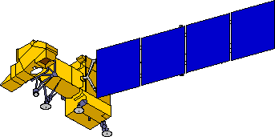
Landsat 7 Observatory Status – No Change
18+ plus years of on-orbit operations
Batteries
Electrical Power Subsystem
Performance nominal
Solar Array
Attitude Control Subsystem
Power Control Unit
5/14/2002 Circuit #14 Failure
5/16/2005 Circuit # 6 Failure
8/13/2008 Circuit #14 partial recovery
14 circuits remain operating
no impact to ops
•05/05/2004 Gyro 3 Shut Off
•1-gyro control system in development
10/18/2014 BVR failover
Enhanced Thematic Mapper +
•5/31/2003 SLC Failure
•4/01/2007 Bumper mode
Reaction Control System
1/07/04 Fuel line #4 thermostat #1a failure
2/24/05 Fuel line #4 thermostat failure; Primary heater circuit disabled
4/25/13 Fuel line #2 thermostat failure; Redundant heater circuit disabled
RF Comm Subsystem
Command and Data Handling
Subsystem
X-band System
Performance nominal
Solid State Recorder
Remote Tlm Cmd (RTC) Box
11/15/1999 SSR PWA #23 Loss
02/11/2001 SSR PWA #12 Loss
12/07/2005 SSR PWA #02 Loss
08/02/2006 SSR PWA #13 Loss
03/28/2008 SSR PWA #22 Loss
09/03/2008 SSR PWA #23 Recovered
10/12/2013 SSR PWA #11 Loss
Each PWA is 4% loss of launch capacity
Boards are likely recoverable
•09/27/2014 RTC A Failover
S-band System
Performance nominal

Slide 10
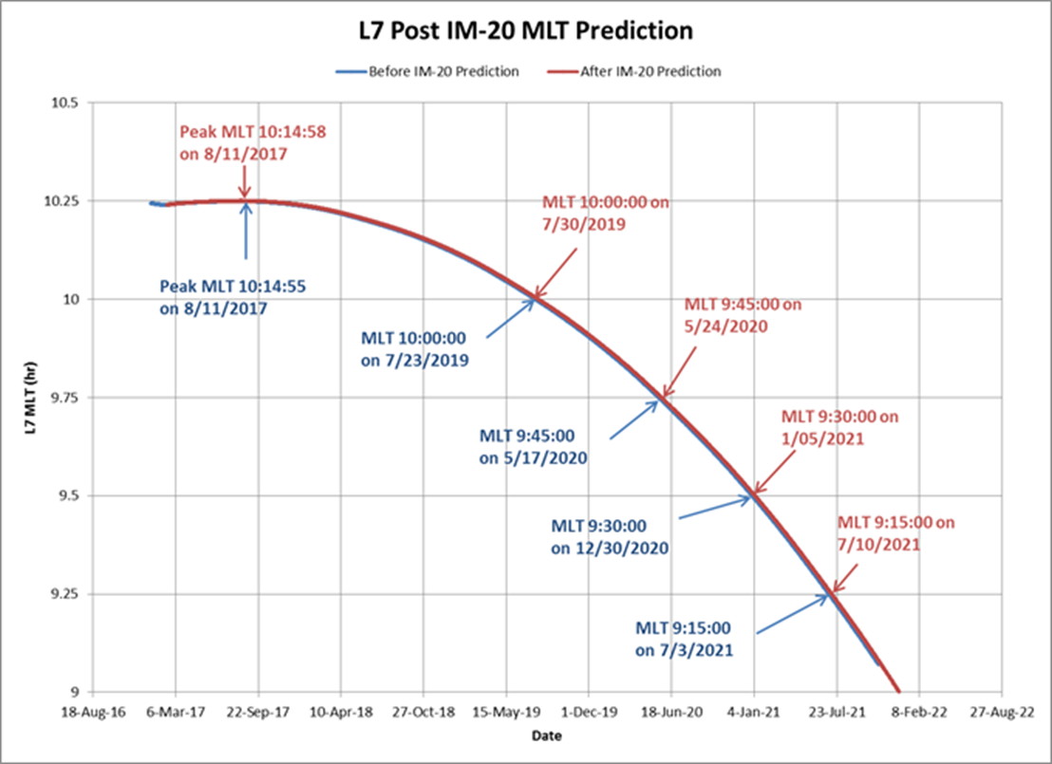
Landsat 7 Delta-I Execution Result
Landsat 7 achieved maximum MLT of 10:14:58 on August 12, 2017
Anticipated end of science mission July 10, 2021

Slide 11
Baseline Landsat 7 End of Mission Timeline
Nominal activities include
  Exit the constellation
    Lower orbit by 4km and circularize
  Achieve disposal orbit
    Lower orbit additional 4km (total 8km lowering) to 697km
    Burn fuel reserve at perigee to produce elliptical orbit that maximizes atmospheric drag
  Passivate on-board energy sources
  Eventual re-entry
~July 2021
Planned

Slide 12
Landsat 8 Recent & Upcoming Activities
L8 FOT successfully performed a “retro-burn” on 12 December 2017, to arrest L8’s westward ground track drift
  Event was a first for Landsat 8 operations and executed entirely as expected
L8 spacecraft experienced a frozen command retransmit lock flag on Thursday, 11 January 2018
  FOT manually reset the command retransmit flag, and the spacecraft was returned to normal operations within a few hours
  During a TDRS proficiency blind acquisition, the FOT sent a NOOP command to verify an active command path
  Because of the slow data rate for TDRS, the NOOP command arrived just after on-board automation issued a previously scheduled command via RTS
  As a result, the CCSDS command frame sequence number for the NOOP was a mismatch with what the spacecraft expected (e.g. a classic command collision scenario)
  By design the spacecraft shut down the normal command pathway in order to protect itself from unauthorized commands
Happy 5th Birthday – 11 February 2018
Actively supporting Landsat 9 Landsat Multi-Satellite Mission Operations Center (LMOC) development

Slide 13
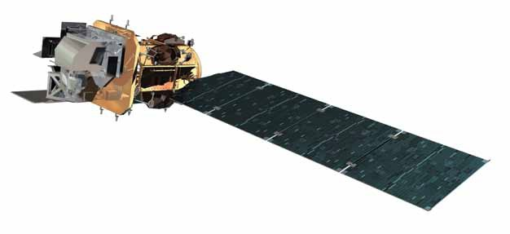
Landsat 8 Observatory Status – No Change
5+ plus years of on-orbit operations
RF Communications
Operational Land Imager
S-band System
X-band System
Thermal Control System
Propulsion Subsystem
Attitude Control System
Electrical Power System
Batteries
Solar array
Thermal Infrared Sensor
October 2014 - Side-A SSM Encoder
September 2015 – Encoder Side-B current fluctuations
January 2016 – Alternative Operations Concept B-Side
Command & Data Handling System
Solid State Recorder – File Delete (ghost file) errors
Successfully corrected in September 2015

Slide 14
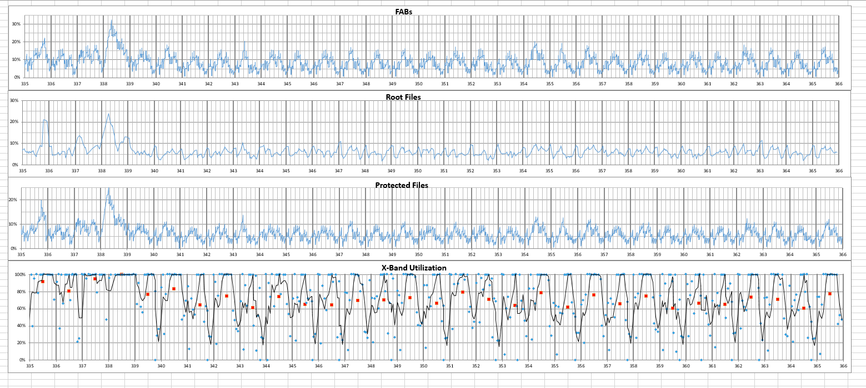
Landsat 8 SSR & X-Band Downlink Utilization
SSR memory allocation typically <20%
LGN averaging 15% margin
Routinely hits 100% use

Slide 15
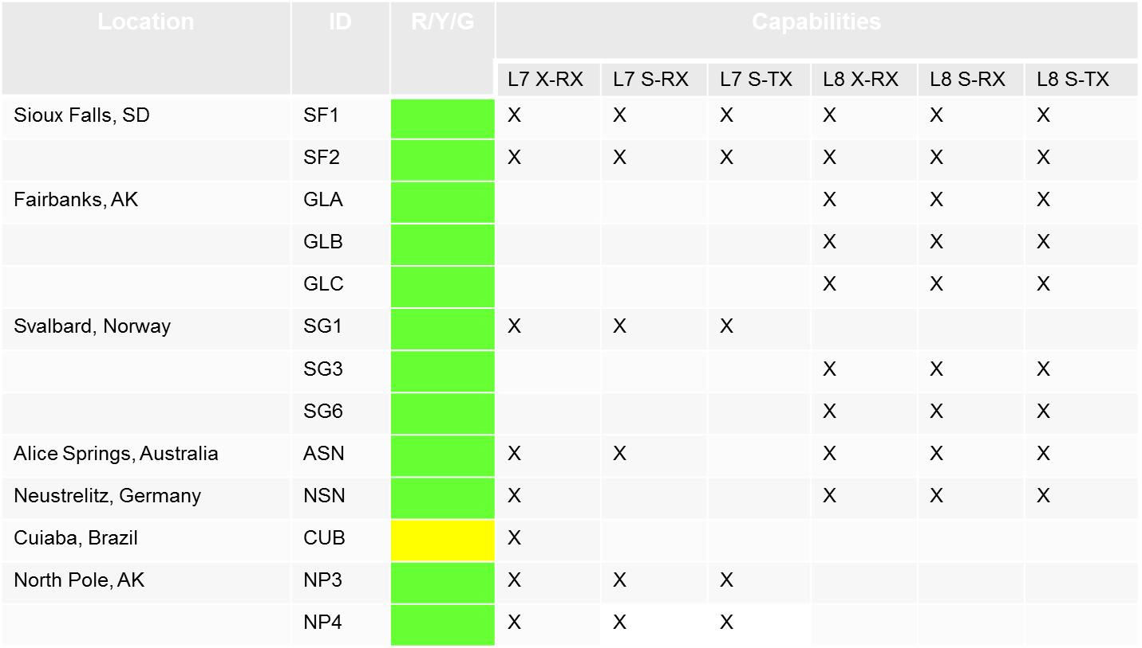
Landsat Ground Network (LGN) Status
L7 LGN:
  LGS (Sioux Falls, SD)
  NP3 & NP4 (North Pole, AK)
  NSN (Neustrelitz, Germany)
  ASN (Alice Springs, Australia)
  SG1 (Svalbard, Norway)
L8 LGN:
  LGS (Sioux Falls, SD)
  GLC (Gilmore Creek, AK)
  NSN (Neustrelitz, Germany)
  ASN (Alice Springs, Australia)
  SGS (Svalbard, Norway)
All LGN stations performing above 98%

Slide 16
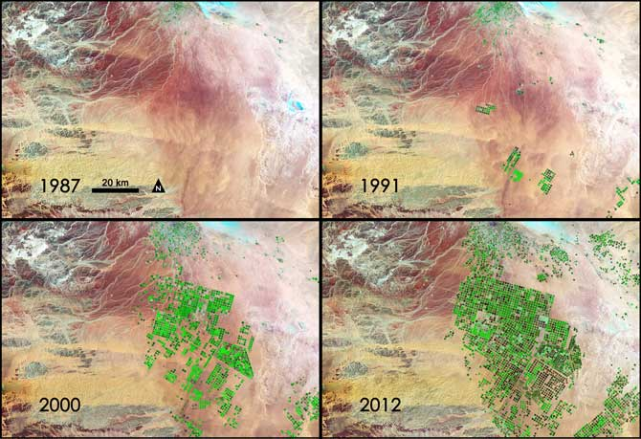
Landsat 9 Mission Overview
  Mission Objectives
Provide continuity in the multi-decadal Landsat land surface observations to study, predict, and understand the consequences of land surface dynamics
  Core Component of Sustainable Land Imaging Program
  Mission Parameters
Single Satellite, Mission Category 1, Risk Class B
  5-year design life after on-orbit checkout
  At least 10 years of consumables
Sun-synchronous orbit, 705 km at equator, 98°inclination
16-day global land revisit
Partnership: NASA & United States Geological Survey (USGS)
  NASA: Flight segment & checkout
  USGS: Ground system and operations
Launch: FY2021 (Targeting December 15, 2020), Category 3 Vehicle
  Mission Team
NASA Goddard Space Flight Center (GSFC)
USGS Earth Resources Observation & Science (EROS) Center
NASA Kennedy Space Center (KSC)
Instruments
Operational Land Imager 2 (Ball Aerospace)
  Reflective-band push-broom imager (15-30m res)
  9 spectral bands at 15 - 30m resolution
  Retrieves data on surface properties, land cover, and vegetation condition
Thermal Infrared Sensor 2 (NASA GSFC)
  Thermal infrared (TIR) push-broom imager
  2 TIR bands at 100m resolution
  Retrieves surface temperature, supporting agricultural and climate applications, including monitoring evapotranspiration
Spacecraft & Observatory I&T
Orbital ATK
Launch Services
United Launch Alliance (ULA) Atlas V 401
MOC and Mission Operations
General Dynamics Mission Systems (GDMS)
Increase in pivot irrigation in Saudi Arabia from 1987 to 2012 as recorded by Landsat. The increase in irrigated land correlates with declining groundwater levels measured from GRACE (courtesy M. Rodell, GSFC)

Slide 17
NASA-USGS Partnership
Independently-funded Agency partnership (not reimbursable like NASA/NOAA missions)
Partnership is codified in a NASA-Department of the Interior (DOI) interagency agreement for Sustainable Land Imaging with a NASA-USGS annex for Landsat 9
NASA is responsible for the space segment (instruments and spacecraft/observatory), mission integration, launch, and on-orbit checkout
  Support for anomaly resolution during operations on a reimbursable basis, if necessary
USGS is responsible for the ground system, flight operations, data processing and distribution
  Operational control/leadership of mission after on-orbit checkout and handover from NASA

Slide 18
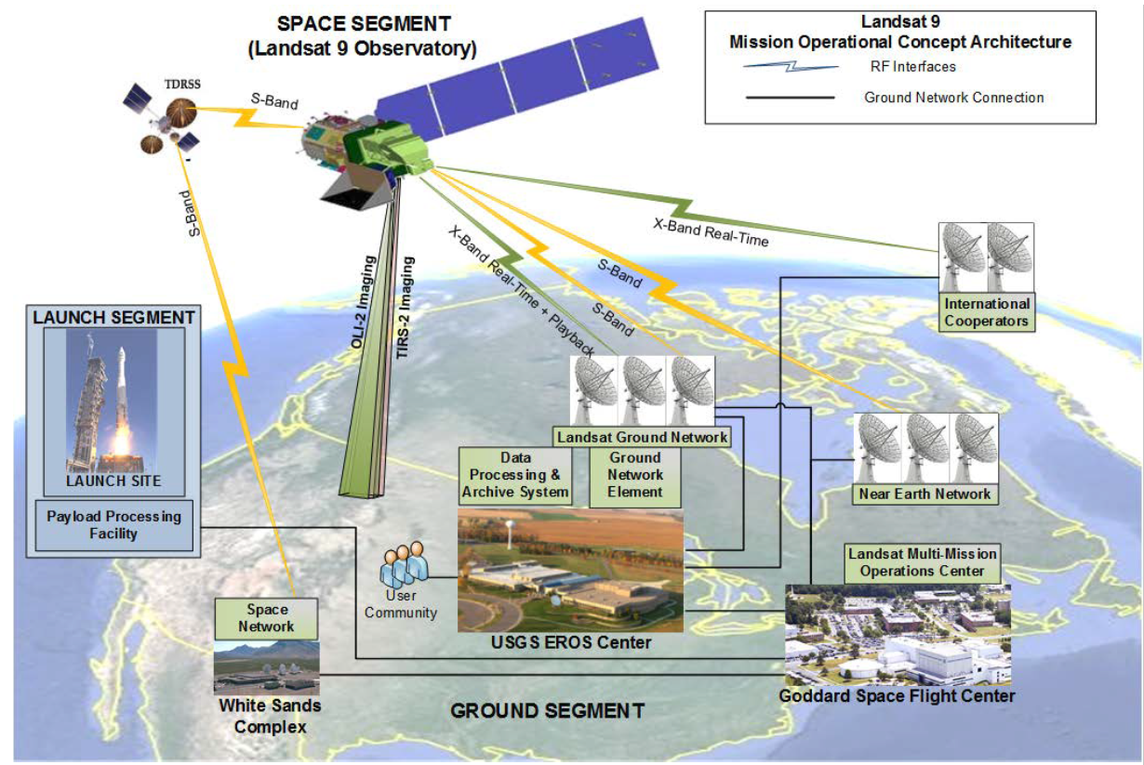
Landsat 9 Mission Architecture

Slide 19
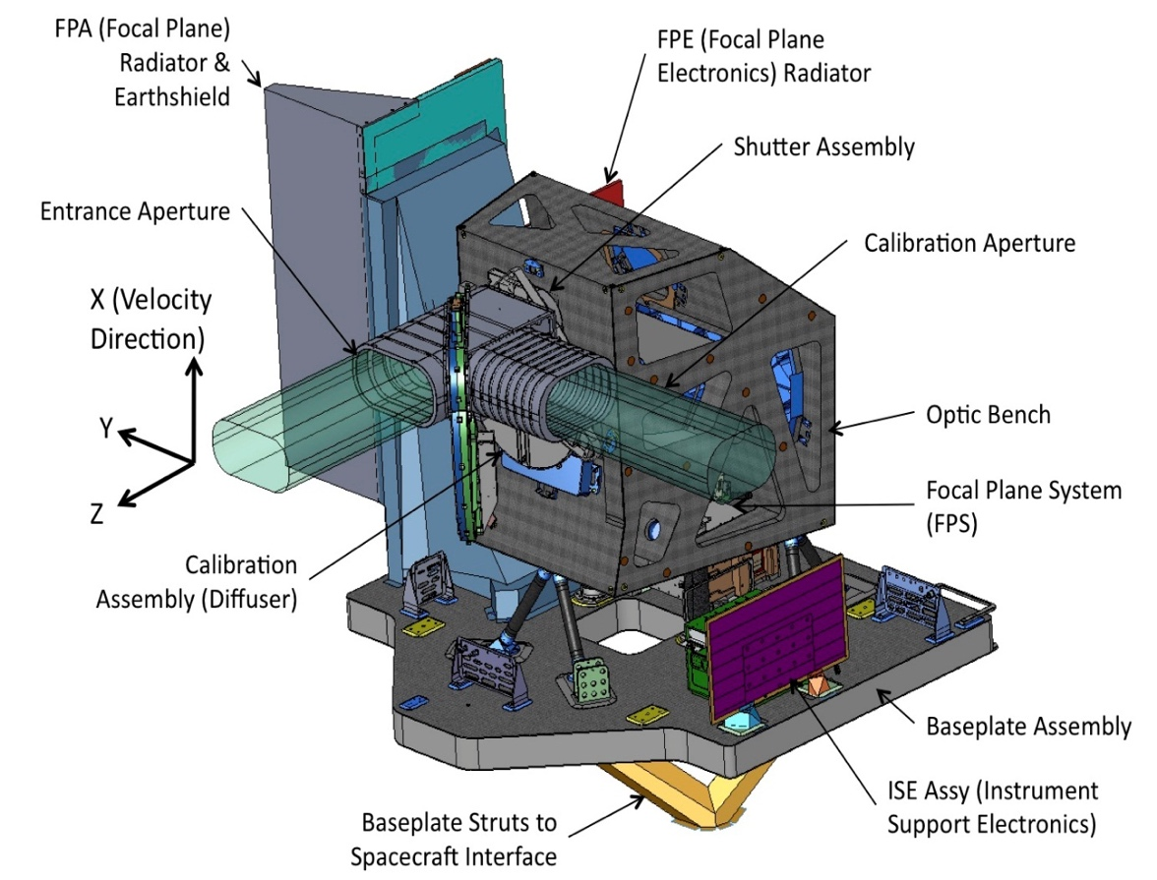
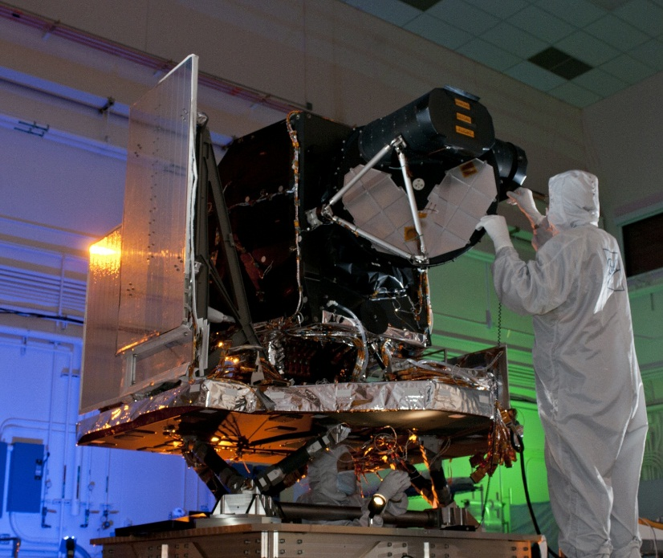
Operational Land Imager 2 (OLI-2)
OLI-2 will, to the extent possible, be a copy of OLI for Landsat 9 to maintain data continuity with Landsat 8 and to minimize cost and risk
Contract with Ball Aerospace in Boulder CO established in December 2015
OLI-2 successfully completed Critical Design Review in August 2016
Instrument in fabrication at Ball Aerospace
On target for mid-2019 delivery to spacecraft
Assembled Landsat 8 OLI at Ball Aerospace facility

Slide 20
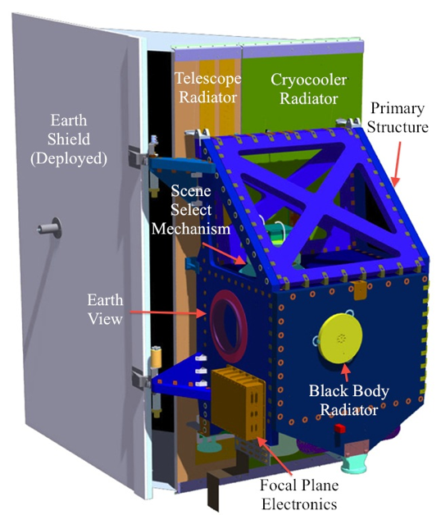
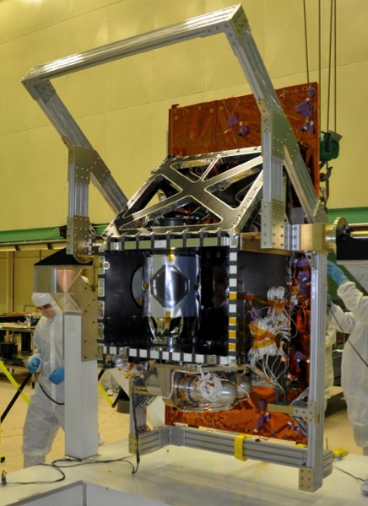
Thermal Infrared Sensor 2 (TIRS-2)
TIRS-2 will be a rebuild of Landsat 8 TIRS except TIRS-2 will be upgraded
from Risk Class C to Class B for Landsat 9
NASA GSFC TIRS-2 team formed in 2015
TIRS-2 successfully completed Critical Design Review in February 2017
Instrument in fabrication at NASA GSFC
On target for mid-2019 delivery to spacecraft
TIRS-2 Improvements
  Increased redundancy to satisfy Class B reliability standards
  Improved stray light performance through improved telescope baffling
  Improved position encoder for scene select mirror to address problematic encoder on Landsat 8 TIRS
Landsat 8 TIRS at NASA/GSFC
Notes:
20

Slide 21
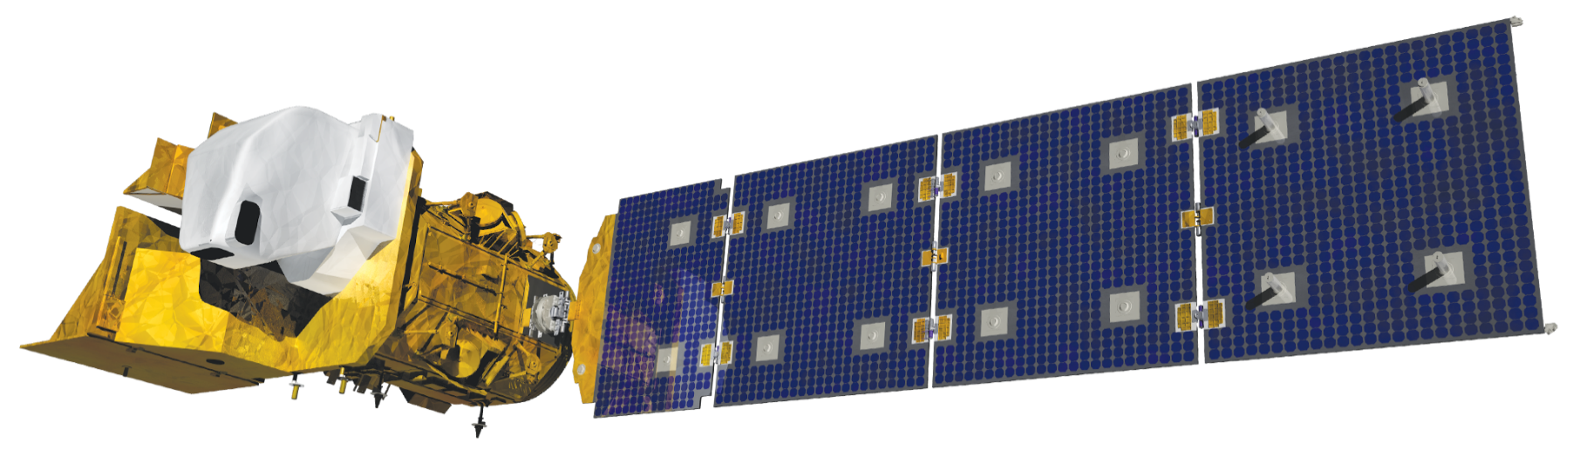
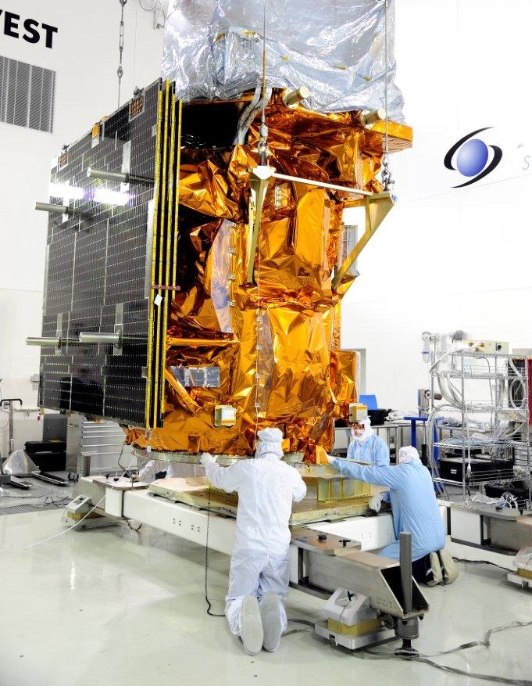
Spacecraft Bus
Landsat 9 spacecraft will be similar to that of Landsat 8, and it will also draw on component heritage from ICESat-2 and JPSS-2 missions
Contract competitively awarded to Orbital ATK in Gilbert, AZ in October 2016
Spacecraft successfully completed System Requirements Review in February 2017 and Preliminary Design Review in July 2017
Spacecraft Critical Design Review Planned for Feb 26 – Mar 1, 2018
Targeting readiness to integrate OLI-2 and TIRS-2 in mid-2019
Landsat 8 Spacecraft at launch facility

Slide 22
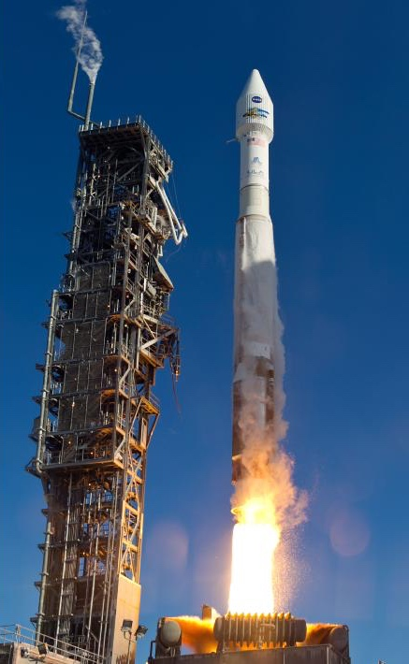
Launch Services
Landsat 9 launch services awarded to same provider as Landsat 8
Awarded October 2017 to United Launch Alliance (ULA)
Vehicle: Atlas V 401
To be launched from Vandenberg AFB SLC-3
Landsat 9 performed an early Coupled Loads Analysis with ULA to provide latest load estimates for observatory design
Routine integration/coordination between Landsat 9 and ULA underway

Slide 23
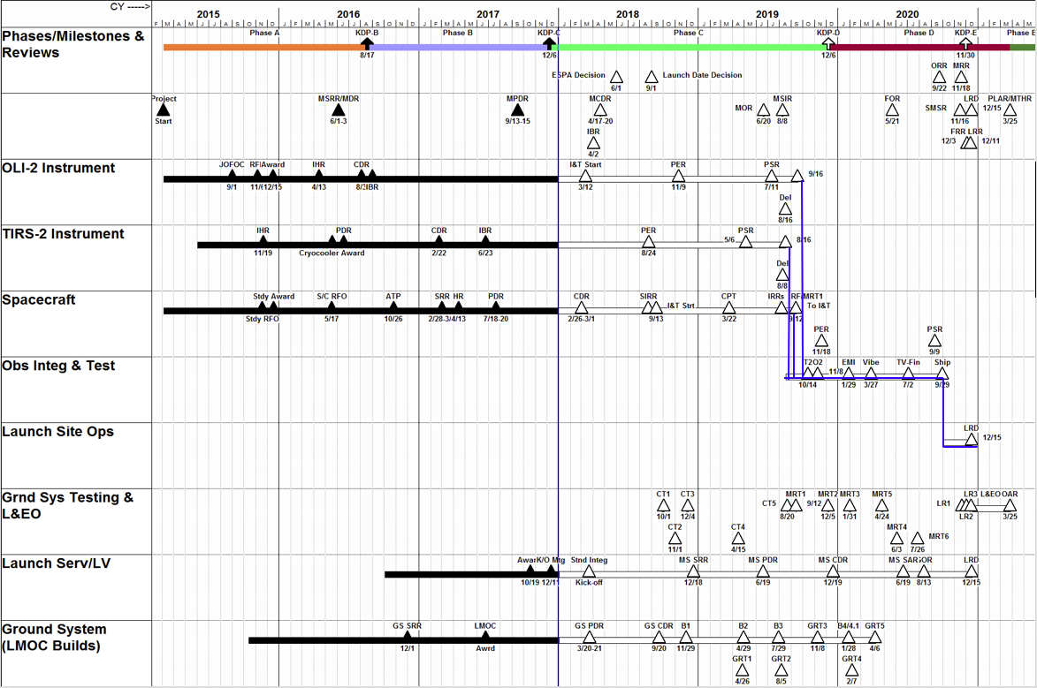
Landsat 9 Master Schedule

Slide 24
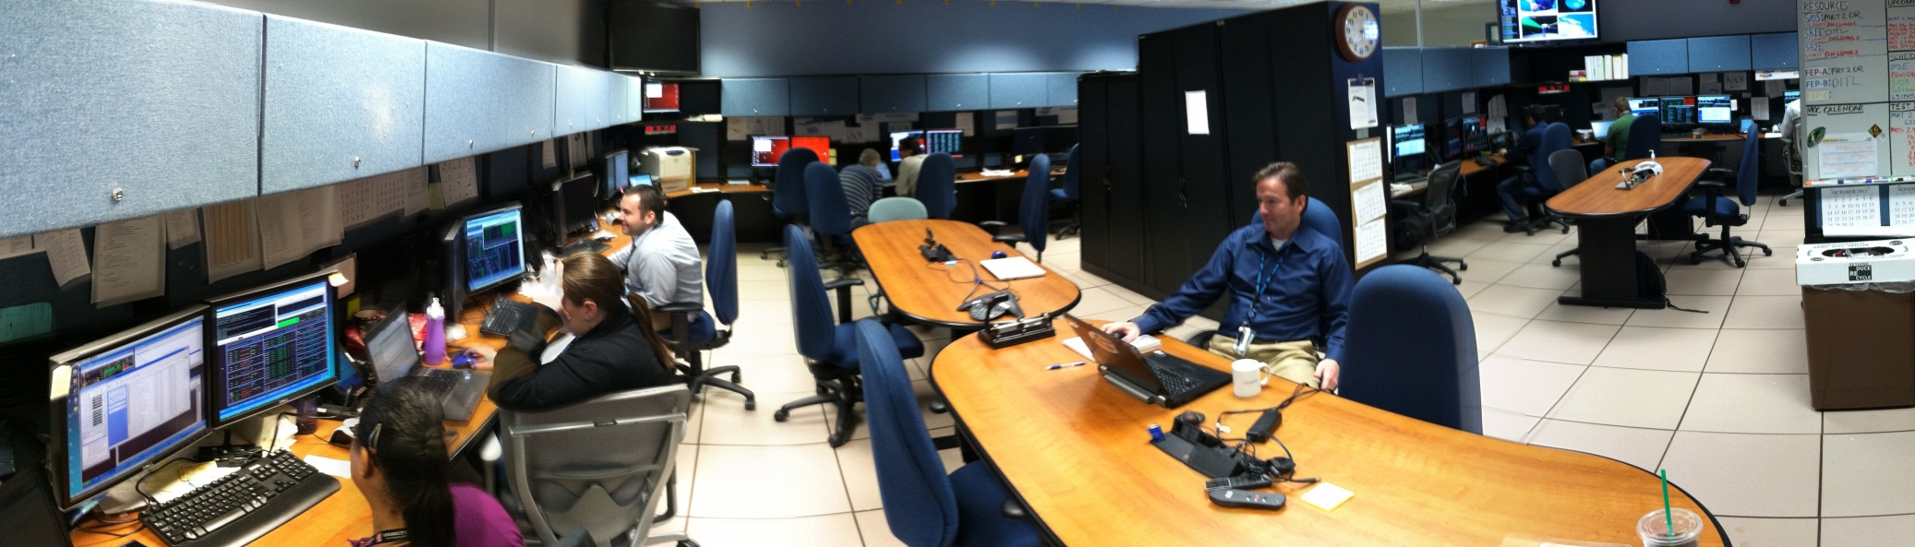
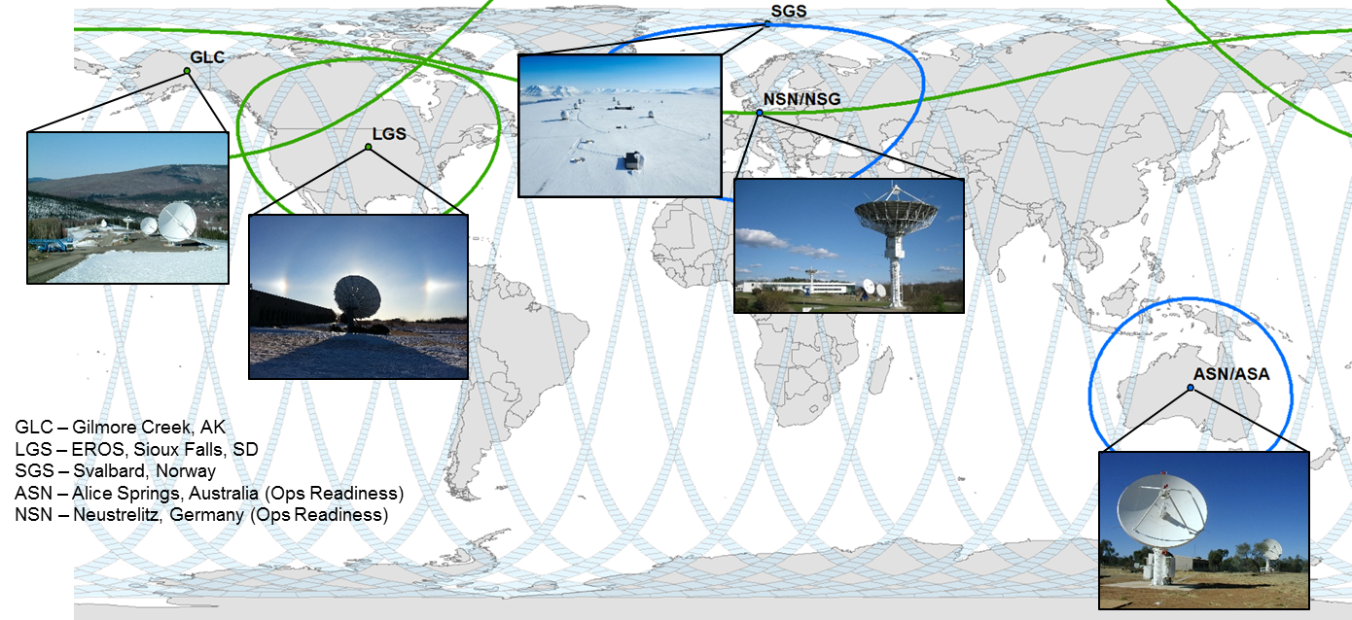
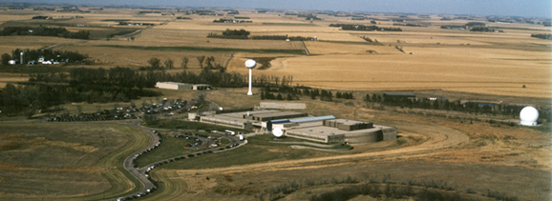
Landsat 9 Ground System
Mission Operations Center (MOC)
  Flight Operations Team (FOT) performs mission planning and scheduling, command and control, health and status monitoring, orbit and attitude maintenance, mission data management
  LMOC and bLMOC (TBR) facilities at GSFC
  Interfaces with Sspeace Netowrk (SN), Near Earth Netowrk (NEN), Flight Dynamics Facility (FDF) and Conjunction Assessment (CARA)
  Landsat Mission Operations (LMO) contract provides Landsat 8 and Landsat 9 MOC development and FOT services
Ground Network Element (GNE)
  Landsat Ground Network (LGN) stations provide X- and S-band communications with the Observatory
  LGN stations in Sioux Falls, SD; Fairbanks, AK; and Svalbard, Norway
  Neustrelitz, Germany and Alice Springs, Australia for use after commissioning
  Data Collection and Routing Subsystem (DCRS) gathers mission data from LGN stations into complete intervals to transfer to the DPAS
Data Processing and Archive System (DPAS)
  Provides data ingest, storage and archive, image assessment, product generation, and data access and distribution
  DPAS facility at USGS EROS Center
Ground System Status
  GNE PDR completed in December 2017
  DPAS PDR completed in February 2018
  LMOC PDR completed in February 2018
  Ground System PDR in March 2018
GSFC, Greenbelt, MD
EROS, Sioux Falls, SD

Slide 25

Scope changes for Landsat 9
Addition of Level-2 Analysis Ready Data (ARD) into the Ground System
  Two major releases have been outlined for Landsat 9 DPAS
    Build 1 – Fully functional DPAS less some reporting / metrics and processing / performance enhancements (priority 1 and 2 requirements)
    Build 2 – Remainder of the priority 2 and 3 requirements
  Collection 2 ARD subsystem functionality in May 2019
    Priority 3 requirements
    Available for Landsat 1-8 Operations for Collection 2
    Baseline plan is to integrate ARD into Build 2, however, in the event of issues or delays with it, the USGS may delay the ARD functionality until after build 2
Alice Springs, Australia (ASN) and Neustrelitz, Germany (NSN) ground stations added to the GS / GNE
  Agreements in place with international cooperators
  Stations utilized for Landsat 8 today
  Tested during development but utilized after mission transition
    Priority 3 (non-launch critical) requirements

