Slide 1
Core Dataset Status ALOS-2 PALSAR-2 Annual Global mosaics
A. Rosenqvist (for JAXA)
SDCG-13 Session 5 Item#15

Slide 2
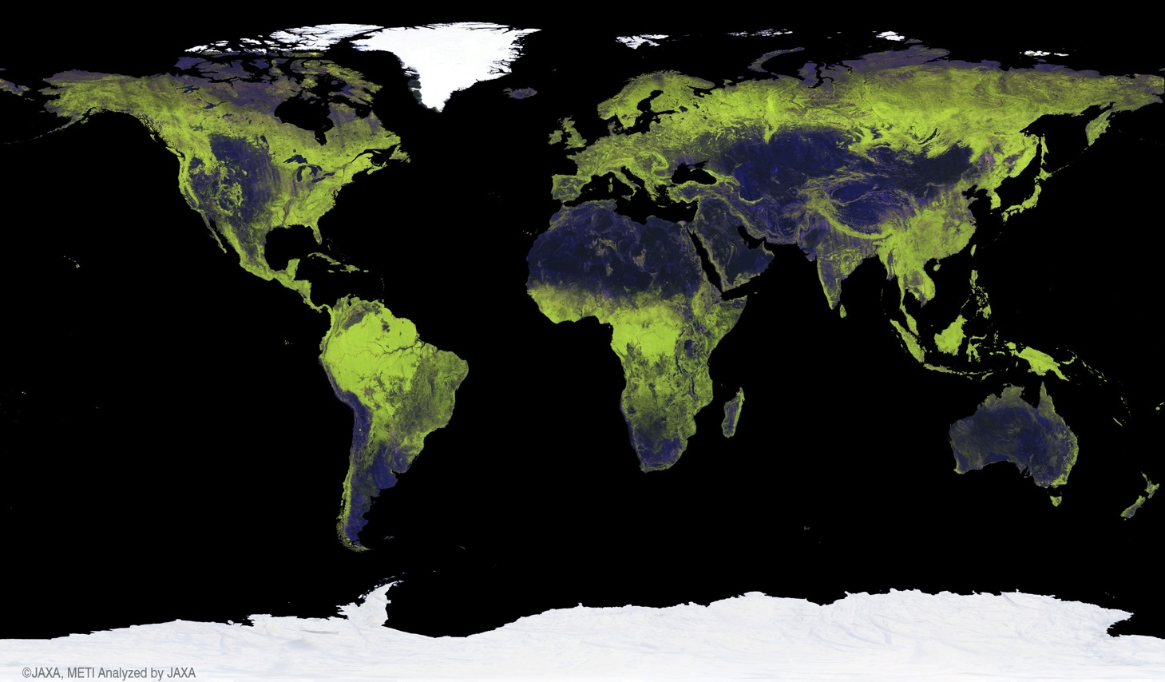
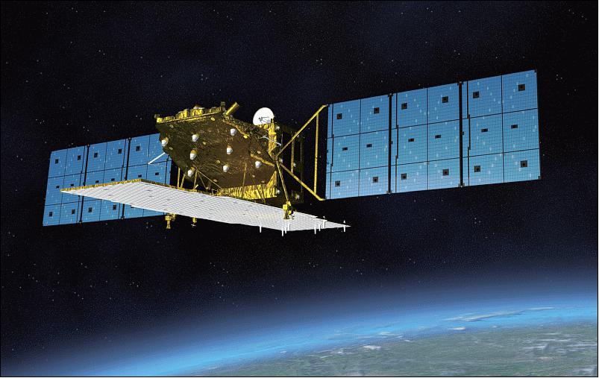
GFOI Core Data sets: JAXA Annual Global L-band SAR mosaics
GFOI Core Data Set –
25 m L-band SAR mosaics and Forest/Non-Forest maps
JAXA radar mosaic data available for public download at http://www.eorc.jaxa.jp/ALOS/en/palsar_fnf/fnf_index.htm
2

Slide 3
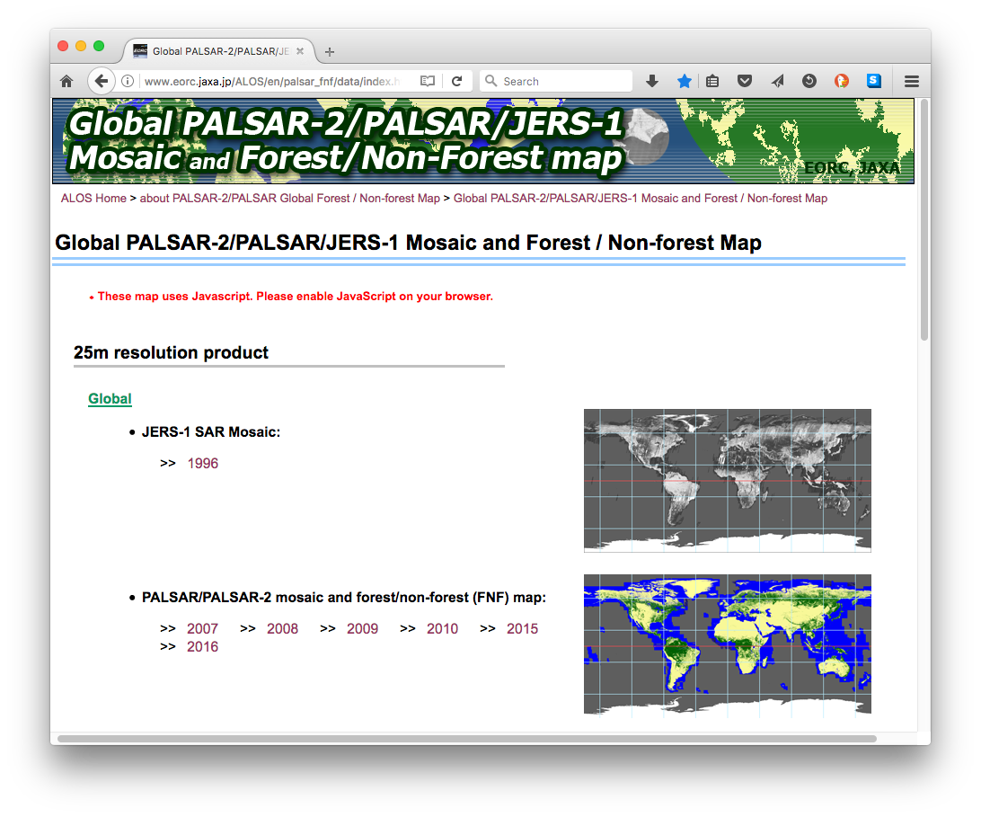
GFOI Core Data sets: JAXA Annual Global L-band SAR mosaics
GFOI Core Data Set –
25 m L-band SAR mosaics and Forest/Non-Forest maps
Global coverage
PALSAR-2 2017 (release in late March)
PALSAR-2 2016
PALSAR-2 2015
PALSAR 2007 – 2010
JERS-1 ~1996
Free download at:
http://www.eorc.jaxa.jp/ALOS/en/palsar_fnf/fnf_index.htm

Slide 4
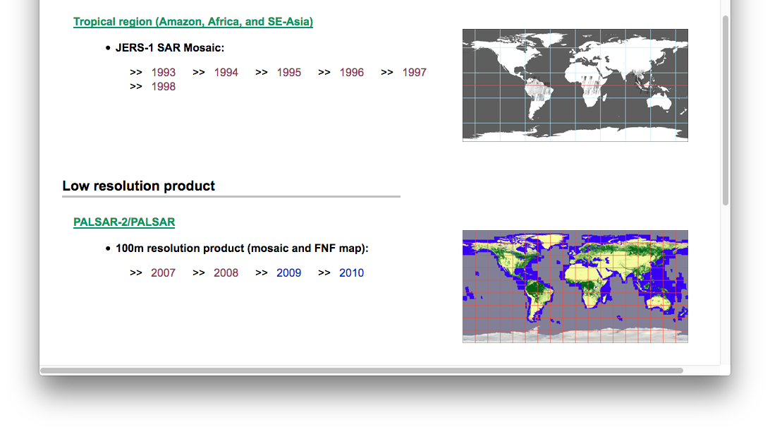
GFOI Core Data sets: JAXA Annual Global L-band SAR mosaics
GFOI Core Data Set –
L-band SAR mosaics
Regional (pan-tropical) coverage (25m)
JERS-1: 1996 – 1998
Global low resolution (100m) coverage
JERS-1: 1996 – 1998
Free download at:
http://www.eorc.jaxa.jp/ALOS/en/palsar_fnf/fnf_index.htm

Slide 5
GFOI Core Data sets: JAXA Annual Global L-band SAR mosaics
GFOI Core Data Set – L-band SAR mosaics
Ancillary data layers:
• HH backscatter (gamma-0) 16 bits
• HV backscatter (gamma-0) 16 bits
• Mask image (no-data, water etc.) 8 bits
• Incidence angle image 8 bits
• Observation date image 16 bit
http://www.eorc.jaxa.jp/ALOS/en/palsar_fnf/fnf_index.htm

Slide 6
Global Mangrove Watch
An international collaborative project established as part of JAXA’s Kyoto & Carbon (K&C) Initiative science programme.
Mapping of extent and changes in global mangrove areas based on JAXA 25 m global mosaics (changes) and Landsat optical (baseline) data
Datasets available
Global mangrove baseline extent maps for 2010 (PALSAR + Landsat)
Global maps of annual changes in the global mangrove extent
1996 (JERS-1)
2007 – 2009 (ALOS PALSAR)
2015, 2016 (& 2017) (ALOS-2 PALSAR-2)

Slide 7
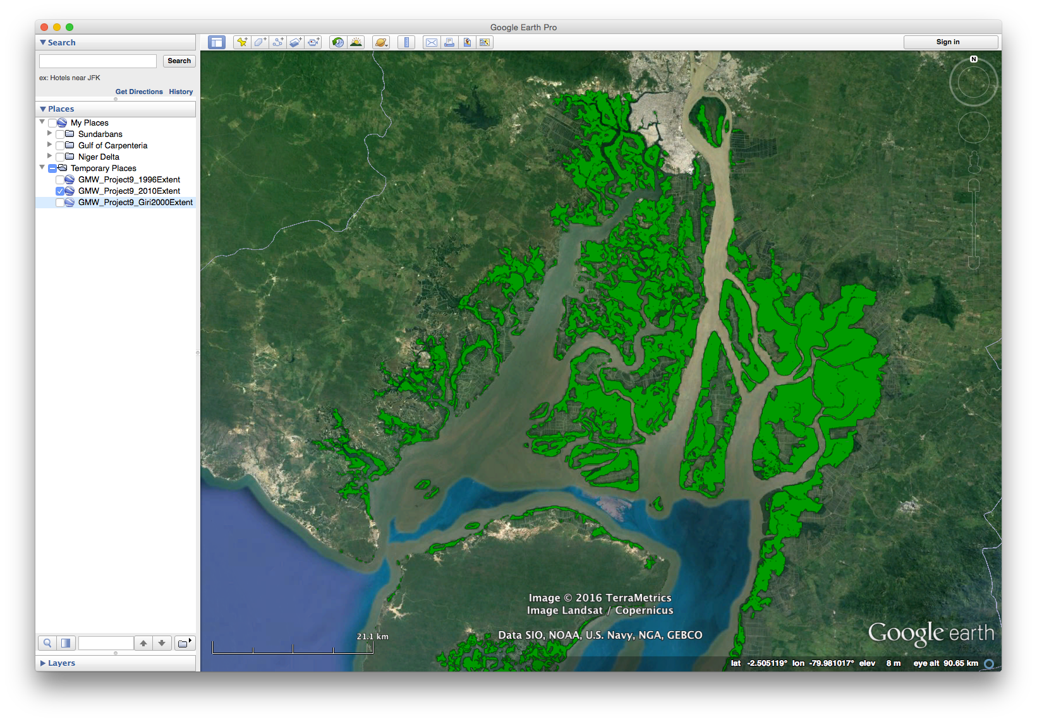
2010 global mangrove baseline
Guayaquil, Ecuador

Slide 8
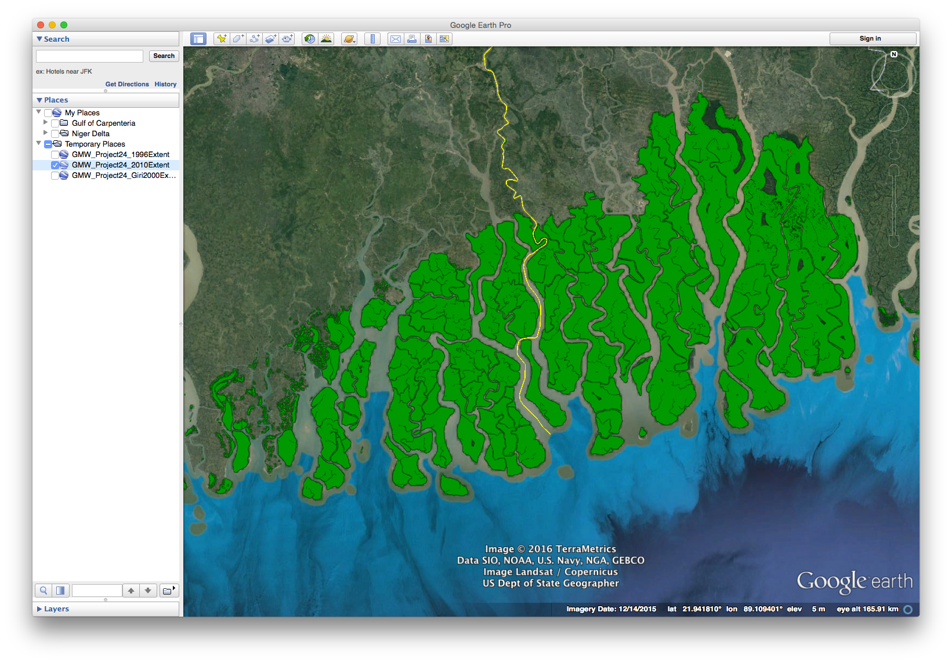
2010 global mangrove baseline
Sundarbans, India & Bagladesh

Slide 9
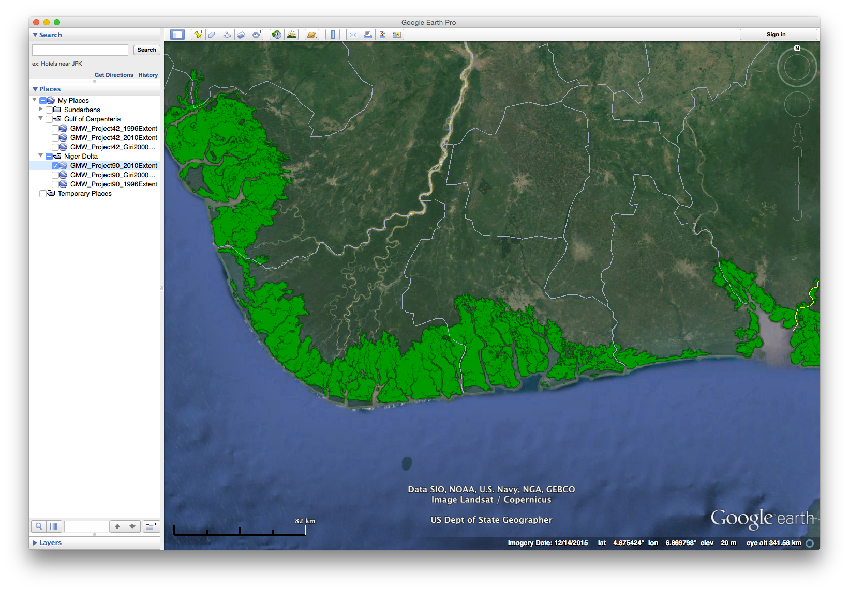
2010 global mangrove baseline
Niger river delta, Nigeria

Slide 10
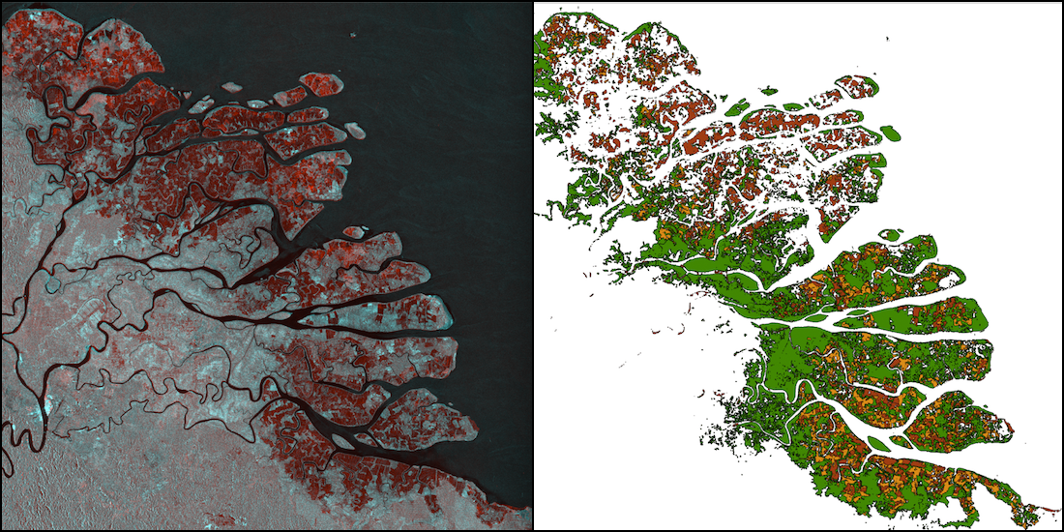
Changes over time (7 epochs)
Kahan river delta, North Kalimantan, Indonesia.
(Left) Multi-temporal SAR composite (1996 JERS-1 SAR and 2016 ALOS-2 PALSAR-2)
(Right) Mangrove extent and changes, Red – mangroves lost 1996-2007, Orange – loss 2007-2016, Green – mangrove cover in 2016.

Slide 11
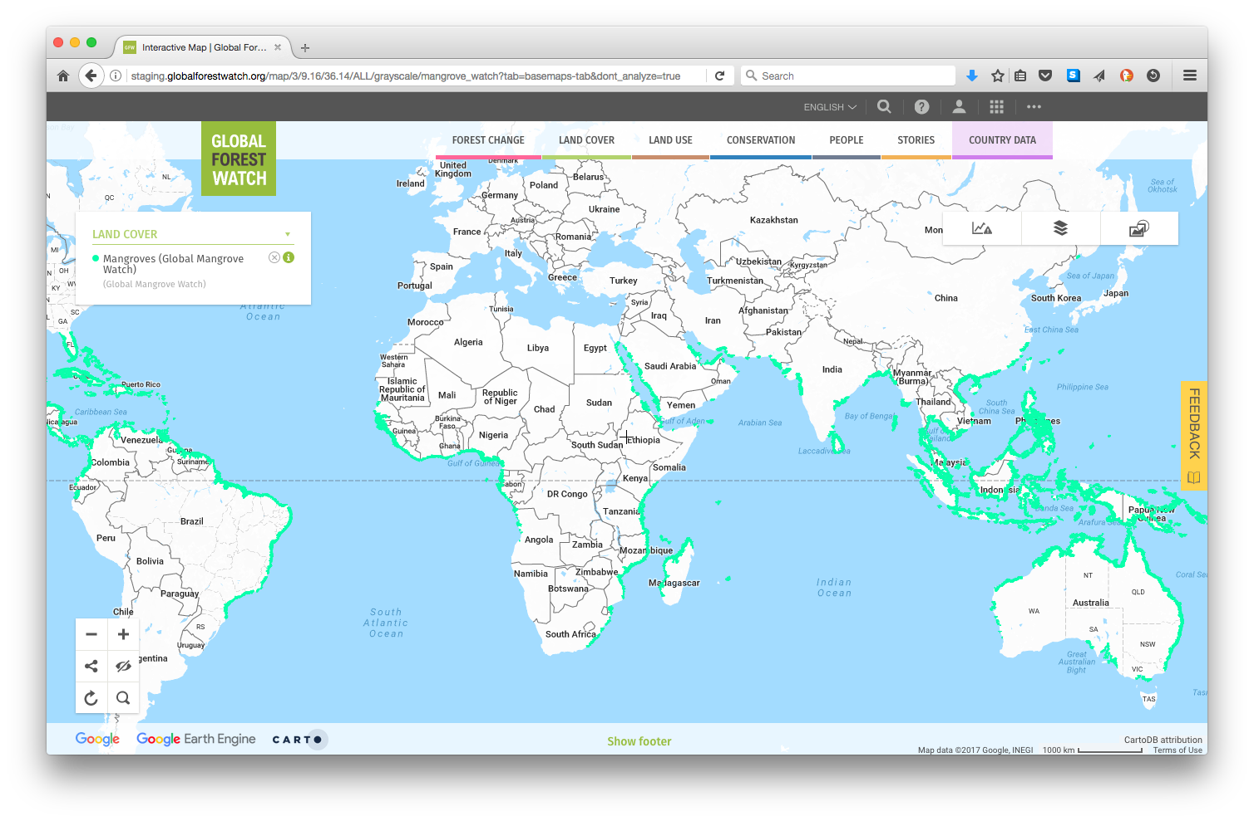
Global 2010 baseline (v1.2) online at www.gfw.org

