Slide 1
JAXA’s Open and Free Data
Satellite/ Sensor |  | Before | NOW
MOS/JERS/ADEOS/ADEOS-2/ AMSR-E/TRMM |  | ○ | ○
GOSAT |  | ○ | ○
GCOM-W and GCOM-C |  | ○ | ○
GPM |  | ○ | ○
ALOS | AVNIR-2 | ー | ○
 | PALSAR(10m) | ー | ○
 | DSM (30m) | ○ | ○
 | Forest map / mosaic (25m) | ○ | ○
ALOS-2 | ScanSAR (100m) | ー | ○
 | Fine mode (10m) | ー | ー

Slide 2
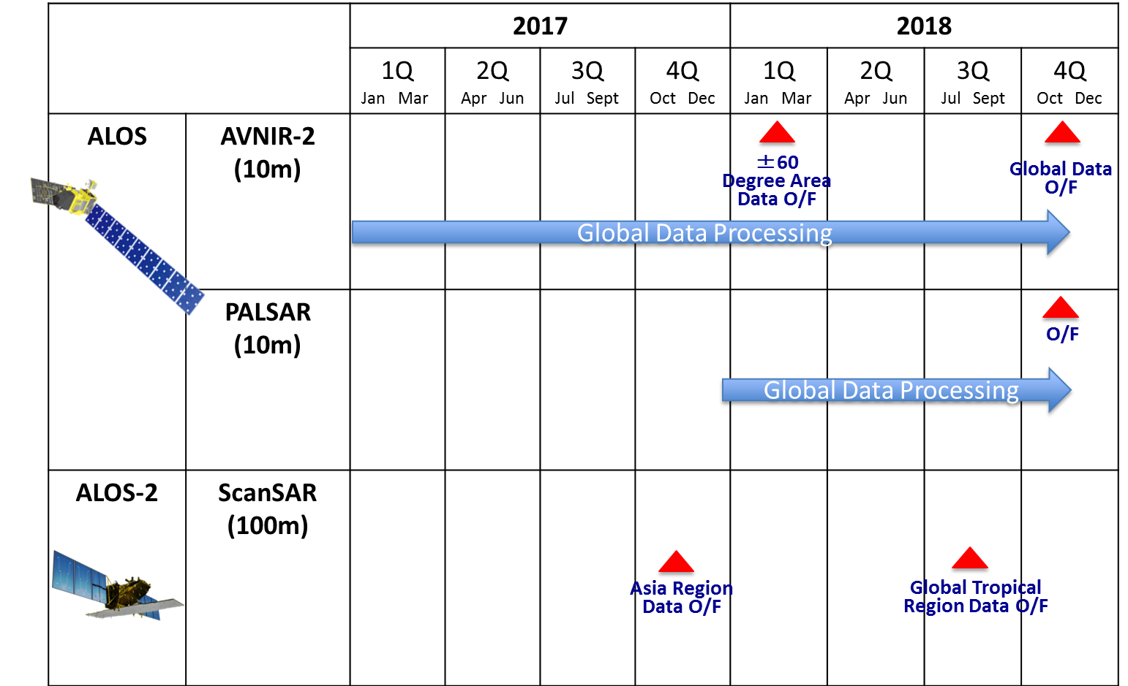
Schedule of Data Processing
and O/F Access

Slide 3
JAXA Strategy towards Forest Observation Architecture
Current Method
Complement
with Optical
Current Method
Complement
With In Situ
Optical
Landsat, Sentinel-2, ALOS-3 etc
SAR
Sentinel-1, ALOS-1/2, etc
In Situ
Forest Height/Diameter/Type
Lidar
Forest Height/Biomass
Tier1. General
Forest Carbon Stock
And Change
(Every 1-5 years)
NFMS
REDD+
MRV
10-30m resolution
Cloud Free Area
10m resolution
Global Coverage
×
＝
Tier2. National/Local
Tier3. Model and Validation
Forest Area
Carbon
(per unit)
Carbon
（National）
Near real time
Data
EW systems
(GFW, JJ-FAST, GLAD, etc)
Forest Change Detection
(Near real time)

