Slide 1
Brazilian Earth Observation Missions and Data availability, accessibility of CBERS data
Leila Fonseca
Earth Observation Directorate
National Institute for Space Research
leila.fonseca@inpe.br
GFOI Plenary 2018, Bogotá, Colombia

Slide 2
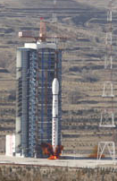
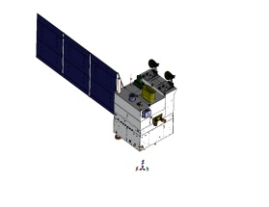
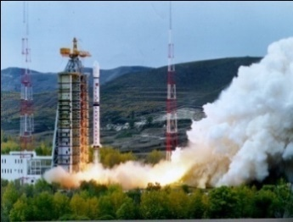
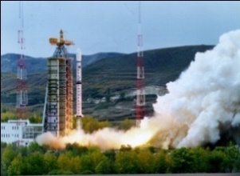
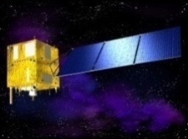
CBERS Program Overview
The China–Brazil Earth Resources Satellite program (CBERS) is a technological cooperation program between Brazil and China to develop and operate Earth Observation satellites.
The cooperation started in July 6, 1988.
China and Brazil agreed to to develop and launch CBERS-4A (2018)
1999
2003
2007
2013
2014
2019
CBERS 4A
CBERS 1
CBERS 2
CBERS 4
CBERS 2B
CBERS 3*
Notes:
CBERS Program has launched five (5) satellites
The CBERS 4A will have three imaging cameras, two of them (MUX and WFI) will be the same as those used in the CBERS-4 satellites. These cameras were built by the Brazilian national industry. The high-resolution 3rd camera (WPM) will be supplied by China. The division of responsibility and investment will continue to be 50% for each country.
2

Slide 3
CBERS-4 (launched in 2014)
Payloads | MUX | PAN | IRS | WFI
Band 1 | 0.45 - 0.52 µm | 0.51 - 0.73 µm | 0.77 - 0.89 µm | 0.45 - 0.52 µm
Band 2 | 0.52 - 0.59 µm | 0.52 - 0.59 µm | 1.55 - 1.75 µm | 0.52 - 0.59 µm
Band 3 | 0.63 - 0.69 µm | 0.63 - 0.69 µm | 2.08 - 2.35 µm | 0.63 - 0.69 µm
Band 4 | 0.77 - 0.89 µm | 0.77 - 0.89 µm | 10.4 - 12.5 µm | 0.77 - 0.89 µm
Resolution | 20 m | 5 m, 10 m | 40 m, 80 m | 64 m
Swath width | 120 km | 60 km | 120 km | 866 km
Notes:
Descrição das 4 câmeras do CBERS-4, com informações de bandas espectrais, resolução espacial e cobertura no terreno.

Slide 4
CBERS-4 – camera and instruments
Payloads | MUXCam | PanMUX | IRS | WFI-2
Manufacturer | Brazil | China | China | Brazil
Type | Pushbroom | Pushbroom | Scanner | Pushbroom
Revisit time | 26 days | 52 days (nadir operation) side looking (32 degrees) | 26 days | 5 days
Quantization | 8 bits | 8 bits | 8 bits | 10 bits
Data rate | 68 Mbits/s | 67, 100 Mbits/s | 17 Mbits/s | 53 Mbits/s
Compression |  | 2:1 pan band

Slide 5
CBERS-4A Optical Payloads (Launch by May, 2019)
PAYLOAD | SWATH | RESOLUTION NADIR | BANDS | REVISIT (days)
WPM | 92 Km | 2 m 8 m | PAN B, G, R, NIR | 31
MUX | 95 Km | 16 m | B, G, R, NIR | 31
WFI | 684 Km | 55 m | B, G, R, NIR | 5
Notes:
5

Slide 6
CBERS 1&2, 2B, 3&4 and 4A
Notes:
6

Slide 7
Amazonia Program
Develop EO Satellites with large swath and small revist period to monitor land use and land cover changes in large regions of Brazil
Amazonia 1 is the first satellite built with fully brazilian technology

Slide 8
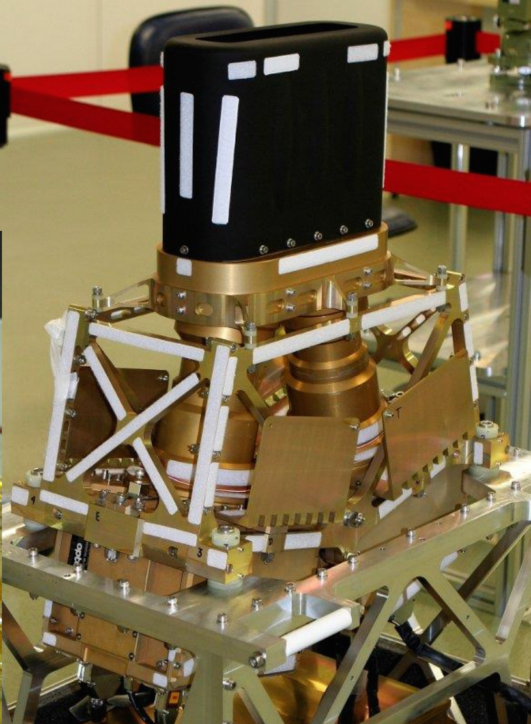
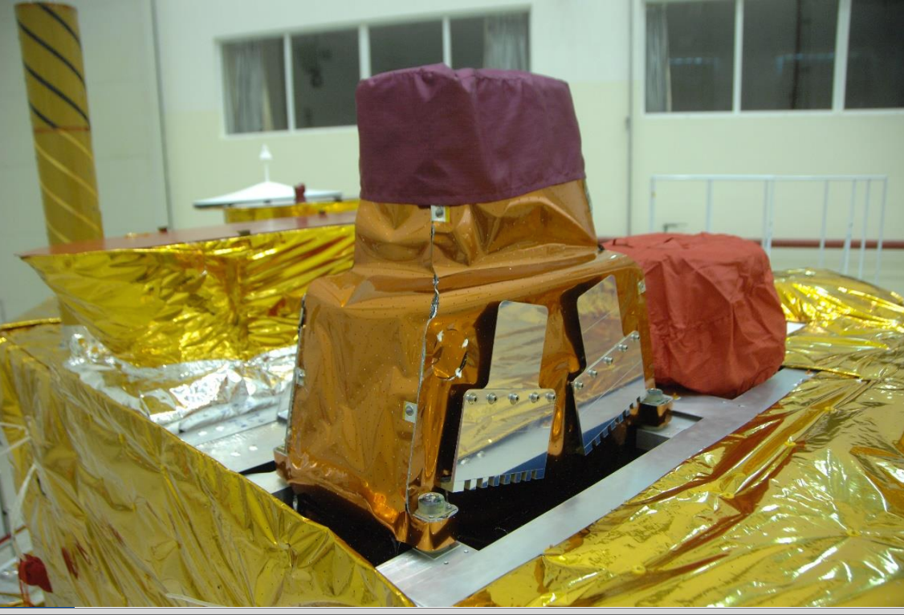
Amazonia-1 camera
Multi Spectral Camera: R,G,B, NIR
Swath: 850 Km
Resolution at Nadir: 65 m
Revisit: 5 days

Slide 9
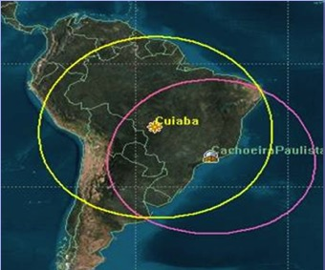
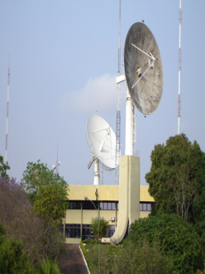
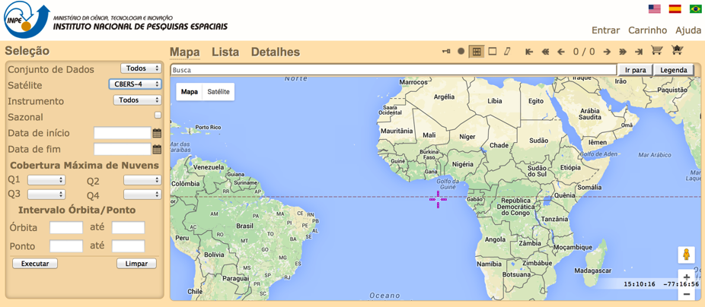
Availability and access to data
INPE provides EO data distribution under free data policy
EO data is available through INPE's catalog at no cost (http://www.dgi.inpe.br/CDSR/)
Reception, archiving, processing and distribution of satellite images: CBERS-4, LANDSAT-7,Landsat-8, Resourcesat-2, DMC, DEIMOS, NOAA-15, NOAA-18, NOAA-19, AQUA, TERRA, S-NPP, GOES-13, MetOp-B, GOES-16 (GeonetCast)
More than 1.400.000 scenes distributed at no cost in the last 5 years
Total of 1,5 Pb stored
years
Notes:
However, to accomplish the goals through these activities we need data! And INPE provides data under free data policy. INPE’s ground station receives 13 space missions and now
Brazil has been approved by NOAA as early user and started to receive GOES-16 data. We are receiving it via Geonetcast. Geos-16 preliminary, non-operational data.

Slide 10
GFOI request: CBERS availability
The Satellite Joint Mission committee has established, for energy resources saving, that the satellite would mainly image Brazil, China and parts of Africa, on a routine basis.
There is direct downlink over Hartebeesthoek Ground Station in South Africa. That means all imagery over this part of Africa shall be made available for general users from SANSA.
We do have an agreed capacity to record data for 15 minutes per orbit, such that we can potentially accommodate GFOI requests.

Slide 11
GFOI request: CBERS availability
A priority for us would be to serve the Congo Basin, with imagery acquired with the sensors WFI and MUX).
Dr. João Vianei Soares (joao.soares@inpe.br) is the Coordinator of CBERS Applications and he is in charge of any issues related to CBERS Program.
Brazil Data Cube:
Adopt CEOS Data Cube
Copernicus Cooperation was signed by Brazilian government (Regional Hub)

Slide 12
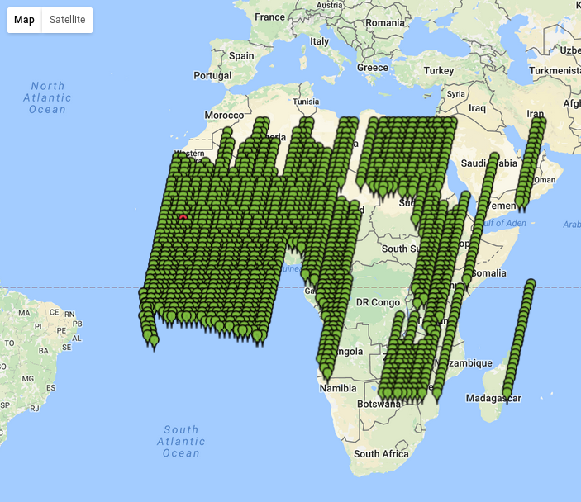
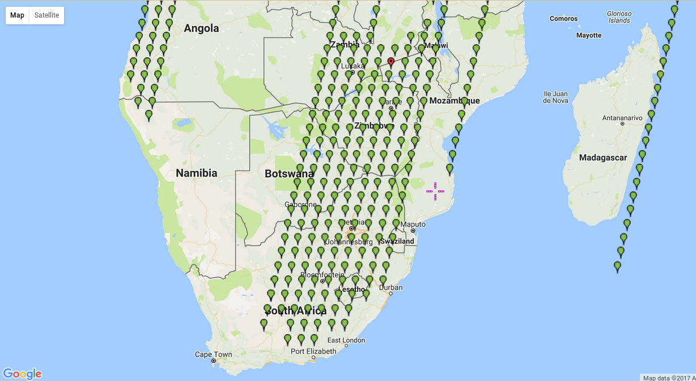
Extension of CBERS free data policy for Africa
and Hartebeeshoek Station records CBERS-4 raw data (agreemment with China)
Notes:
There is an initiative for recording CBERS-4 images in Africa We can see the CBERS-4 passages 0ver South Africa and othes countries in Africa

Slide 13
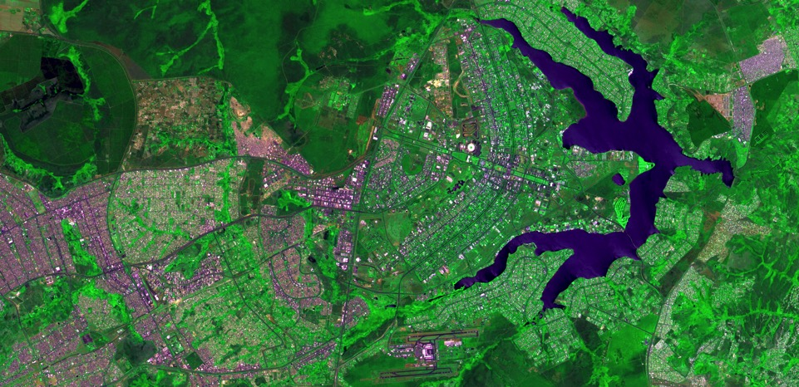
CBERS-4 PAN10, 2016-09-16, Brasilia, Brazil
Thanks!
leila.fonseca@inpe.br

