Slide 1

JAXA ALOS and MOLI development/operation
JFY (Apr-Mar)
2014 | 2015 | 2016 | 2017 | 2018 | 2019 | 2020 | 2021 | 2022 | 2023 | 2024 | 2025 | 2026 | 2027
ALOS-2 (SAR)
Nominal operation (5 years)
Post-mission operation
ALOS-3 (Optical)
Development
Nominal operation
(7 years)
ALOS-3 F/O (Optical)
ALOS-4 (SAR)
Development
Nominal operation
(7 years)
ALOS-4 F/O (SAR)
MOLI (LiDAR)
Nominal operation
(2 years)

Slide 2
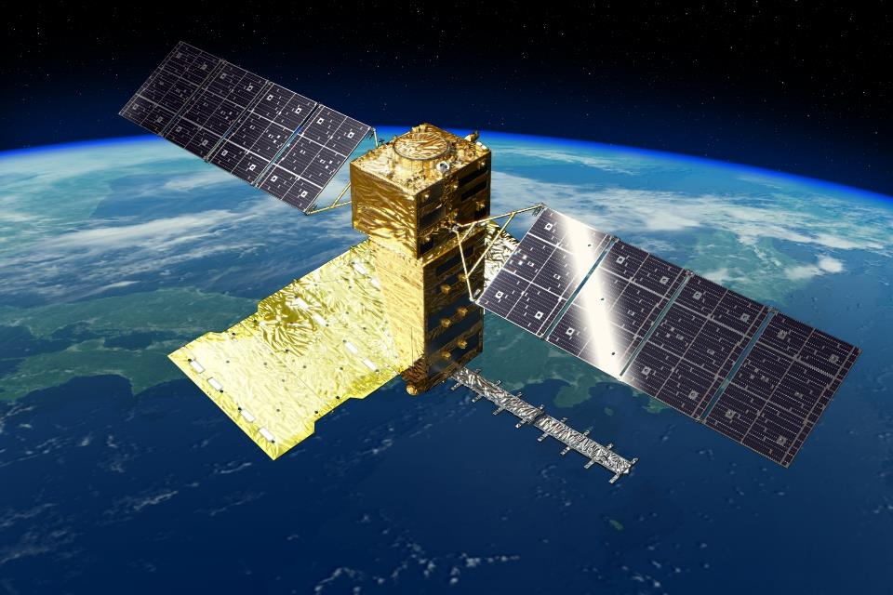
ALOS-4 status update
Takeshi Motohka
Japan Aerospace Exploration Agency (JAXA)
ALOS-4 project team / EORC
ALOS Kyoto & Carbon Initiative meeting
Jan. 30, 2018

Slide 3
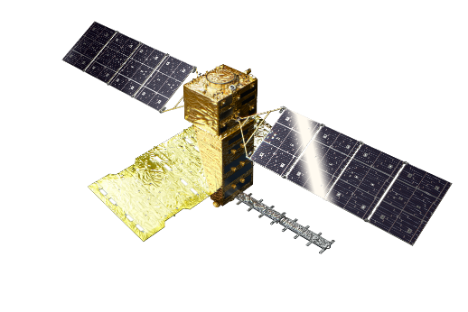
ALOS-4 System characteristics
Launch | JFY 2020 H3 launch vehicle
Orbit | Same orbit as ALOS-2 Sun-synchronous sub-recurrent orbit Altitude: 628 km Inclination angle: 97.9 degree Local sun time at descending: 12:00 ± 15 min. Revisit time: 14 day (15-3/14 rev/day)
Lifetime | 7 years
Satellite Mass | approx. 3 tons
Downlink | 3.6 Gbps/1.8 Gbps (Ka-band)
Mission Instruments | PALSAR-3 (Phased Array type L-band Synthetic Aperture Radar-3) SPAISE3 (SPace based AIS Experiment 3)
Prime contractor | Mitsubishi Electric Corporation
Y
X
Z
Solar array paddle
PALSAR-3
antenna
Ka-band DT antenna
SPAISE3
antenna

Slide 4
Compatibility with ALOS-2
Stripmap 10-m mode
same orbit,
same geometry
ALOS-4
observation beams
200 km swath
ALOS-2 observation beams
70 km swath x 3
(F2-5~7)
Incidence angle
28.4 deg.
42.6 deg.

Slide 5
ScanSAR mode
same orbit,
same geometry
ALOS-4
observation beams
700 km swath
ALOS-2 observation beams
350 km swath
(W2)
Incidence angle
19.5 deg.
26 deg.
49 deg.
59.8 deg.

Slide 6
Stripmap 10 m mode
ALOS-4
ALOS-2
Modes | Stripmap 10 m
Bandwidth | 28 MHz (split-band option: 28+10 MHz)
Resolution | 10 m x 10 m
Swath | 200 km | 100 km
Polarization (H/V linear) | 1, 2 | 1, 2 | 4
Incidence angle range | 28-56 deg. | 8-70 deg. | 8-70 deg.
NESZ | < -28 dB *
Range S/A | > 20 dB *
Azimuth S/A | > 20 dB *
Modes | Stripmap 10 m
Bandwidth | 28 MHz
Resolution | 10 m x 10 m
Swath | 70 km
Polarization (H/V linear) | 1, 2, 4
Incidence angle range | 8-70 deg.
NESZ | < -26 dB *
Range S/A | > 20 dB *
Azimuth S/A | > 20 dB *
* specifications for incidence angle 28.5-42.5 deg.

Slide 7
ScanSAR mode
ALOS-4
ALOS-2
Modes | ScanSAR
Bandwidth | 28 MHz
Resolution | 25 m x 25 m
Swath | 700 km (4 scans)
Polarization (H/V linear) | 1, 2
Incidence angle range | 8-70 deg.
NESZ | < -20 dB *
Range S/A | > 15 dB *
Azimuth S/A | > 15 dB *
Modes | ScanSAR
Bandwidth | 14 or 28 MHz
Resolution | 100 m x 100 m (multi-looked)
Swath | 350 or 490 km (5 or 7 scans)
Polarization (H/V linear) | 1, 2
Incidence angle range | 8-70 deg.
NESZ | ---
Range S/A | ---
Azimuth S/A | ---
* Specifications for 19-60 deg.

Slide 8
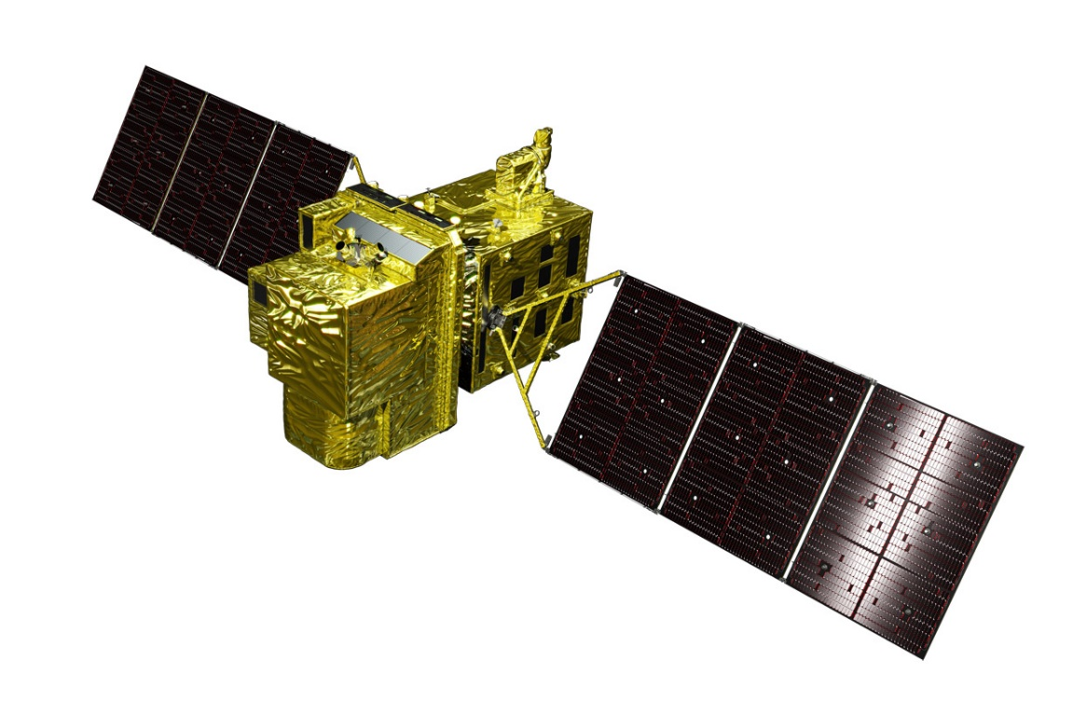
K&C Science Team meeting #24
Tokyo, Japan, January 29-31, 2018
Advanced Optical Satellite (ALOS-3)
Overviews
January 30, 2018
Takeo Tadono¹, Hidenori Watarai¹, Ayano Oka¹, Yousei Mizukami¹,
Junichi Takaku², Fumi Ohgushi², and Masanori Doutsu²
¹ JAXA, ² RESTEC
E-mail: tadono.takeo@jaxa.jp

Slide 9
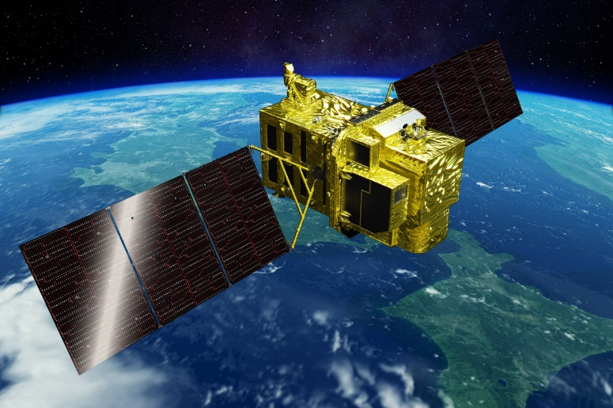
Overview of ALOS-3
Items |  | Specifications
Orbit | Type | Sun-synchronous sub-recurrent
 | Altitude | 669 km at the equator
 | Local Sun Time | 10:30 am +/- 15 minutes at the descending node
 | Revisit | 35 days (Sub-cycle 3 days)
Instruments |  | - Wide-swath and high-resolution optical imager (WISH, as a tentative) - Dual-frequencies Infrared sensor (hosted payload)
Ground Sampling Distance (GSD) |  | - Panchromatic band of WISH (Pa): 0.8 m - Multispectral band of WISH (Mu): 3.2 m (6 bands)
Quantization |  | 11 bit / pixel
Swath width |  | 70 km at nadir
Mission data rate |  | Approx. 4 Gbps (after onboard data compression: 1/4 (Pa) and 1/3 (Mu))
Mission data downlink |  | - Direct Transmission: Ka and X-band - via. the Optical Data Relay Satellite
Mass |  | Approx. 3 tons at launch
Size |  | 5 m×16 m×3.5 m on orbit
Duty |  | 10 mins / recurrent
Design life time |  | Over 7 years
Wide-swath and high-resolution optical imager (WISH)
In-orbit configuration

Slide 10
Wide-Swath and High-Resolution Optical Imager
Observation channel band allocations among optical satellites (visible to near-infrared).
Wavelength | 400 nm |  |  |  |  |  |  |  |  |  | 500 nm |  |  |  |  |  |  |  |  |  | 600 nm |  |  |  |  |  |  |  |  |  | 700 nm |  |  |  |  |  |  |  |  |  | 800 nm |  |  |  |  |  |  |  |  |  | 900 nm
 | 0 | 1 | 2 | 3 | 4 | 5 | 6 | 7 | 8 | 9 | 0 | 1 | 2 | 3 | 4 | 5 | 6 | 7 | 8 | 9 | 0 | 1 | 2 | 3 | 4 | 5 | 6 | 7 | 8 | 9 | 0 | 1 | 2 | 3 | 4 | 5 | 6 | 7 | 8 | 9 | 0 | 1 | 2 | 3 | 4 | 5 | 6 | 7 | 8 | 9 | 0 | 1 | 2 | 3 | 4 | 5 | 6 | 7 | 8 | 9
ALOS-3
Blue
Green
Red
Near-IR
Coastal
RedEdge
ALOS PRISM AVNIR-2
Blue
Green
Red
Near-IR
WorldView -2, 3
Blue
Green
Red
Near-IR1
Coastal
Yellow
RedEdge
Near-IR2

Slide 11
Observation Modes
1 | Strip-map observation | The satellite can normally perform observation covering 70 km in width and 4,000 km in along-track direction as the strip-map observation mode. To increase the acquisition frequency, the images will be taken by less than 25 deg. pointing angle in cross-track direction (GSD < 1m) when the satellite track is in oceans.
2 | Point observation | If the user has a certain ground point or an area of interest (AOI), the satellite can observe there using pointing capability within 60 deg. This mode will be used for natural disaster monitoring, for example.
3 | Observation direction changing | The satellite can observe any given point by the pointing capability up to 60 deg. in all direction against the satellite nadir. In the case of Japan, it can be activated within 24 hours after receiving the request. This will be used when the large natural disaster happens e.g. the expecting Nankai Trough large earthquake.
4 | Wide-area observation | This mode can cover in wide-ranging area of 200 km (in along-track direction) x 100 km (in cross-track direction) by satellite’s single orbital passage. This will be also used when the large natural disaster happens.
5 | Stereoscopic observation | Two ways proposes to acquire stereo-pair image: 1) in single orbit path, and 2) combining two strip-map observations by nadir view and backward view in neighboring path after three days (sub-cycle revisit orbit). The way 1) will be however not sufficient base-to-height ratio (B/H) to derive terrain information. As the advantages of the way 2), that is possible to set suitable B/H, and can acquire images over large area. However, this will depend on weather conditions i.e. cloud covers, to success stereo image acquisition within short period as a disadvantage.
1 and 5 will be used in the basic observations.
1, 3 and 5 simulated images are shown.

Slide 12
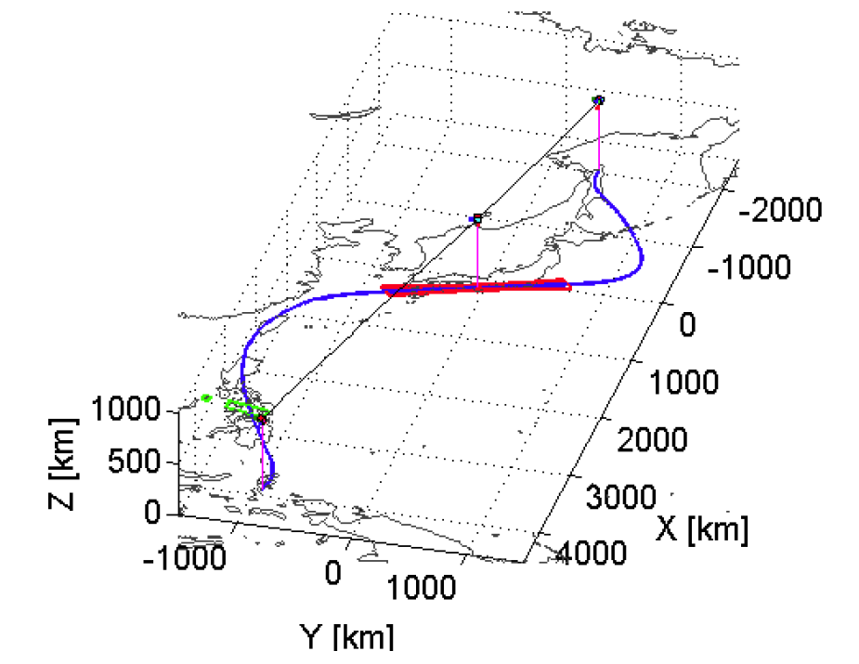
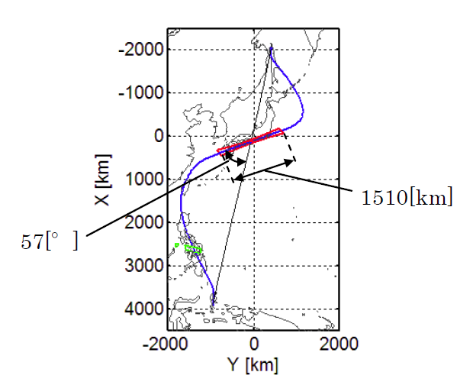
Observation Direction Changing Mode
Satellite orbit
Observation area
The satellite can observe any given point by the pointing capability up to 60 deg. in all direction against the satellite nadir. In the case of Japan, it can be activated within 24 hours after receiving the request. This will be used when the large natural disaster happens e.g. the expecting Nankai Trough large earthquake.

Slide 13
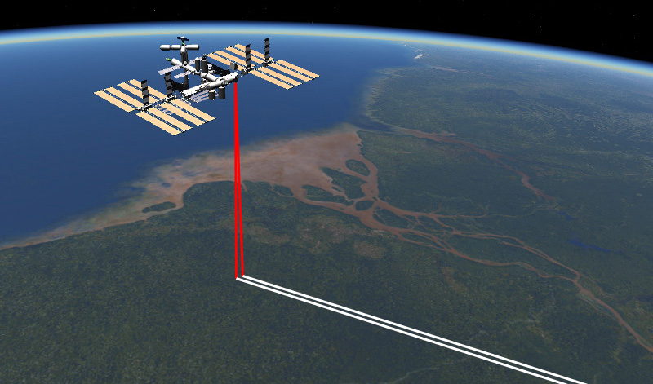
Related mission updates:
MOLI
Masato Hayashi, Tadashi Imai, Daisuke Sakaizawa,
Jumpei Murooka, Rei Mitsuhashi, Toshiyoshi Kimura
Japan Aerospace Exploration Agency (JAXA)
Science Team meeting #24
Tokyo, Japan, January 29-31, 2018

Slide 14
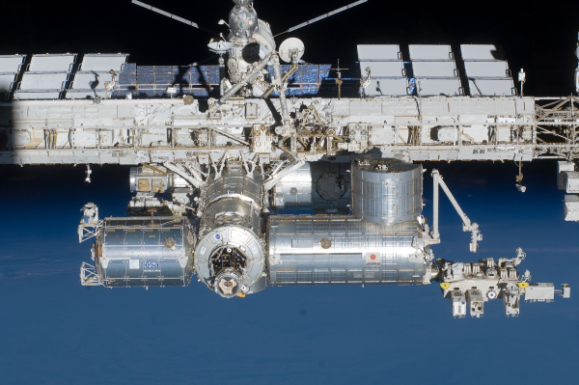
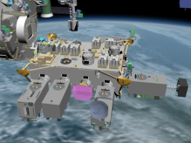
MOLI will be installed to ISS JEM in 2020.

Slide 15
M ulti-footprint
O bservation
L idar and
I mager
← Time
Reflectance
反射レーザ
Sensor | LiDAR : 2 beams, 25mφ footprint. Imager : 5.0m resolution, 3 bands, 1km swath.
Objective | To estimate forest biomass precisely and globally. To obtain spaceborne LiDAR technology for future missions.

Slide 16
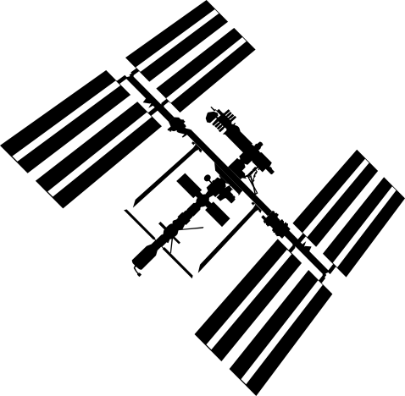
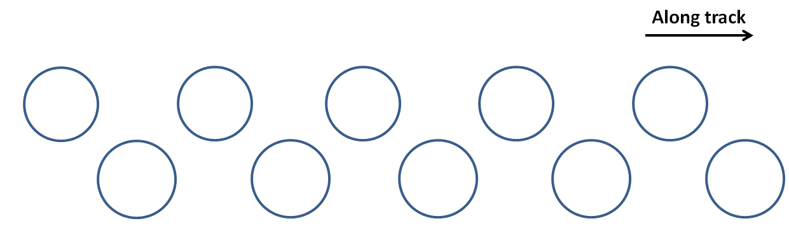
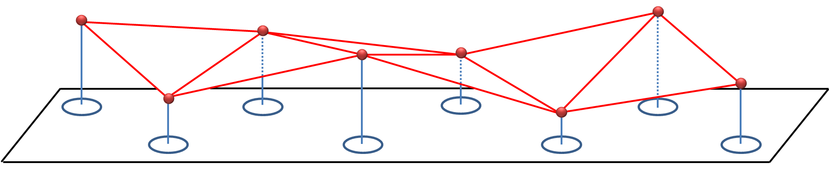
50m
15m
15m
(n)th Pulse
(n+1)th Pulse
Footprint 25m φ
Calculating
ground elevation and slope.
Multi-footprint observation.

Slide 17
MOLI products.

Slide 18
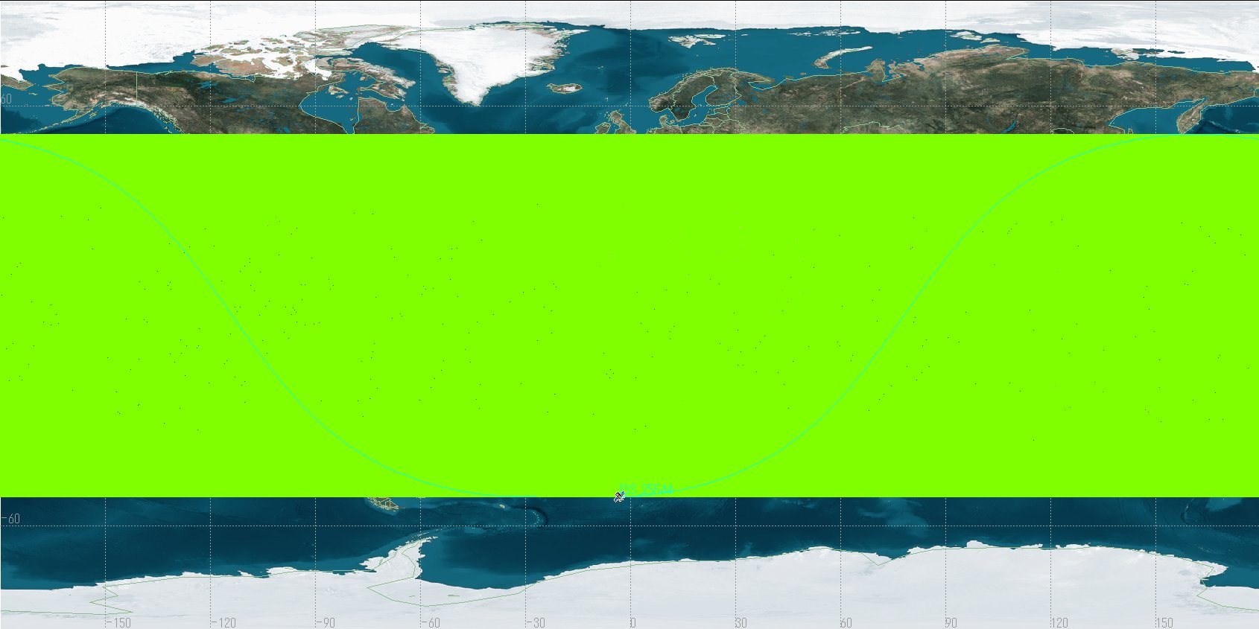
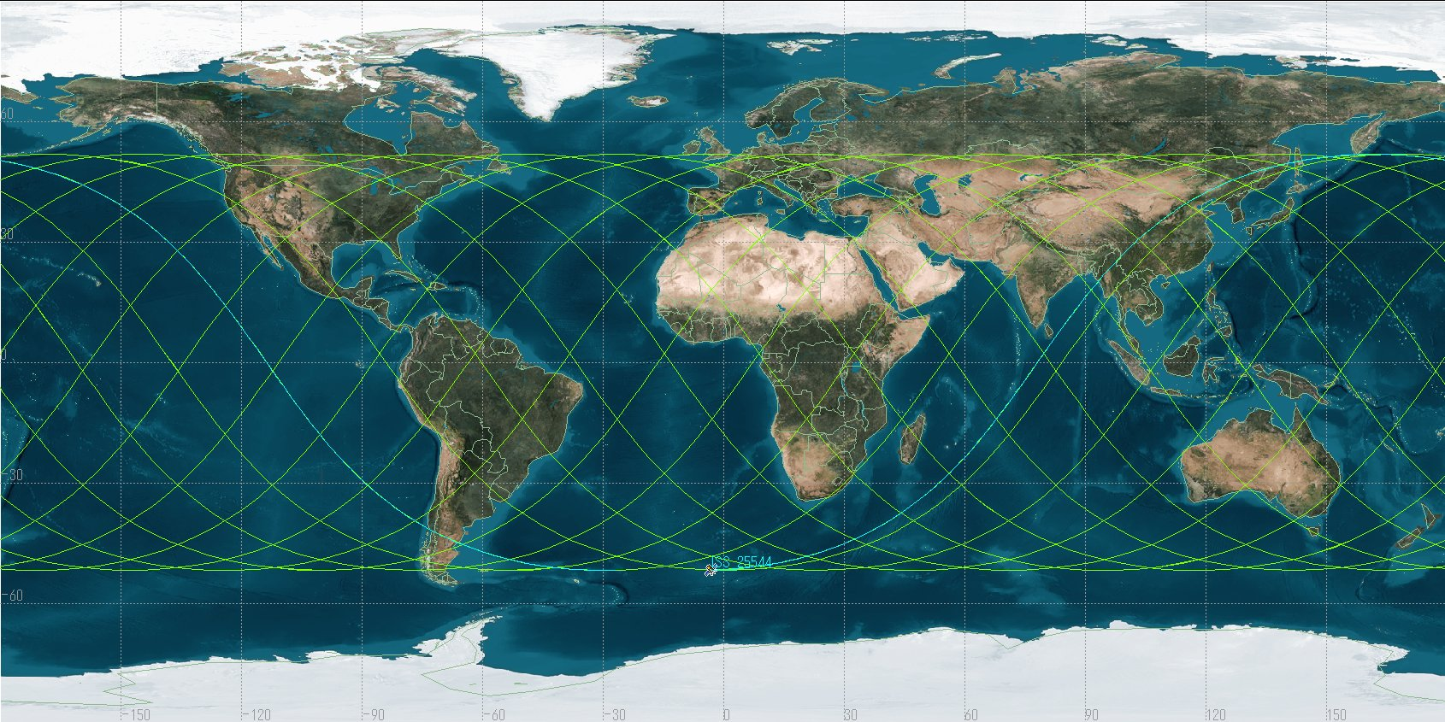
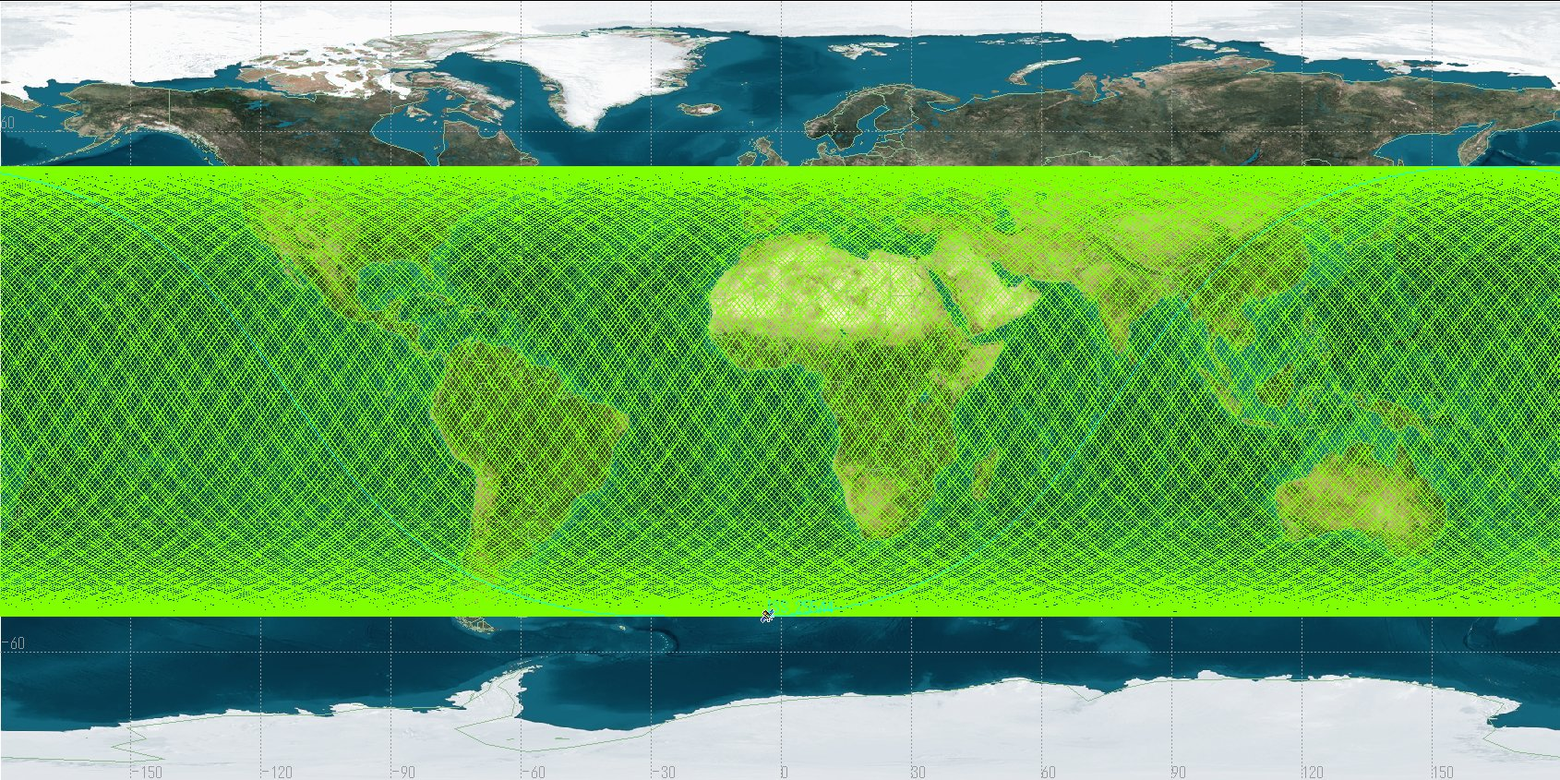
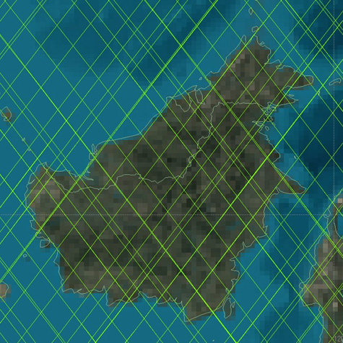

One month
One day
One year
51.6°N
One year
One month
51.6°S
3.5 km distance in average
MOLI observation area (ISS orbit).

Slide 19
Summary
MOLI will be installed to ISS in 2020.
It can provide precise values of canopy height and forest biomass, globally.
We will also provide forest biomass map created by combining with the other satellite image (e.g., PALSAR-2, 4).
We expect that MOLI will make significant contribution to carbon-cycle study and climate change measures.

