Slide 1
Global Ecosystem Dynamics Investigation (GEDI)
Mission Update
GEDI Science Definition Team

Slide 2
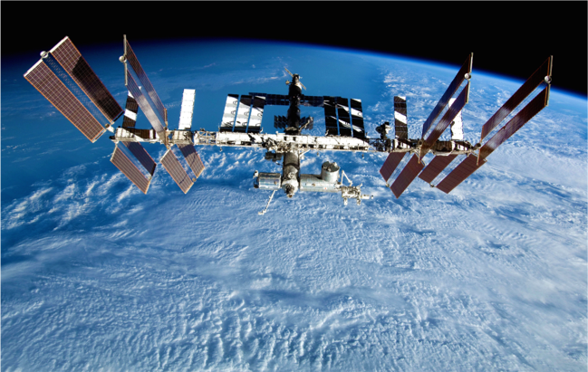
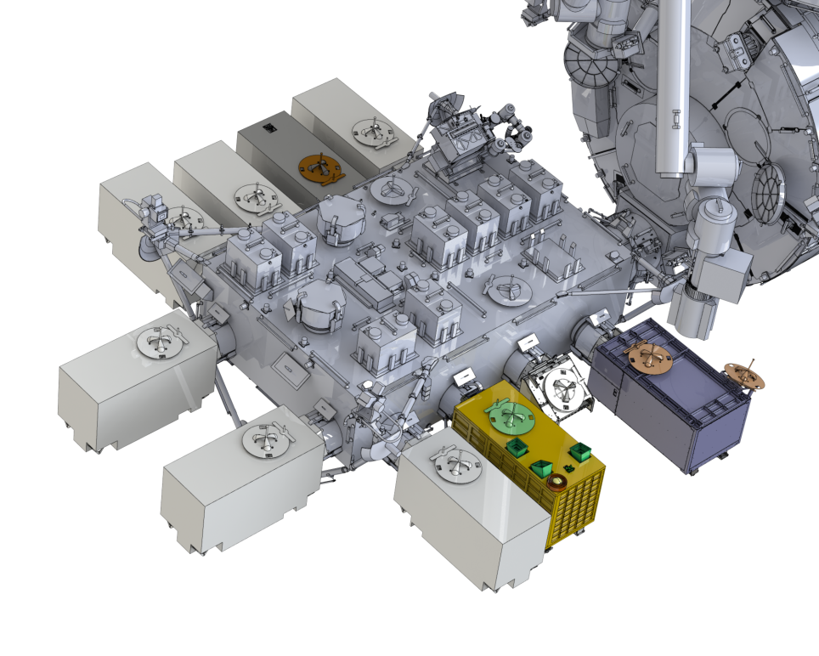
Earth Ventures Instrument (EVI)
Multi-beam waveform lidar instrument
  NASA Goddard Spaceflight Center (GSFC)
$94 M (Class C mission)
GEDI is deployed on the JEM-EF
Deployed on International Space Station
  Launch on SpaceX-18: May 2019
  Observations between +/- 51.5º N &
Nominal 2 year mission length

Slide 3
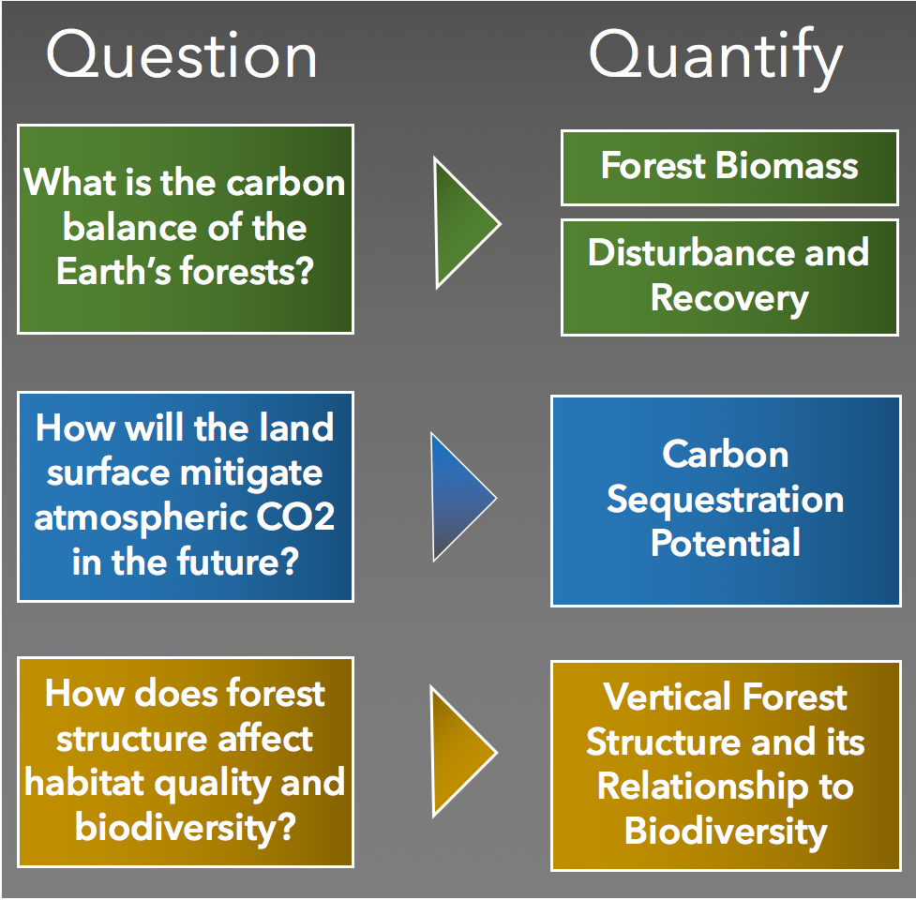
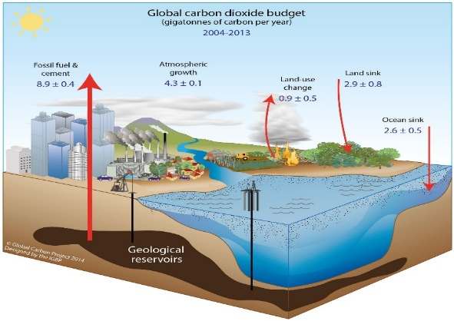
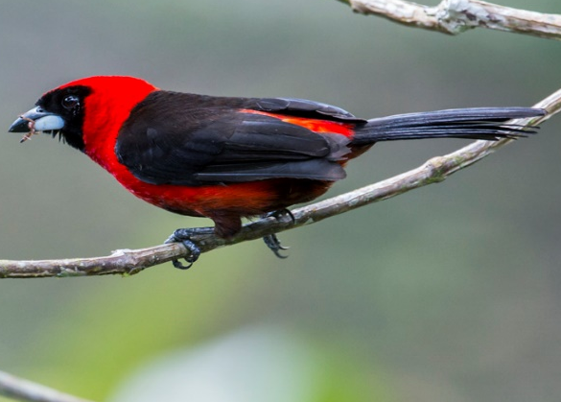
Science Questions and Objectives
GEDI Goal: Advance our ability to characterize the effects of changing climate and land use on ecosystem structure and dynamics
Carbon Cycle
Biodiversity

Slide 4

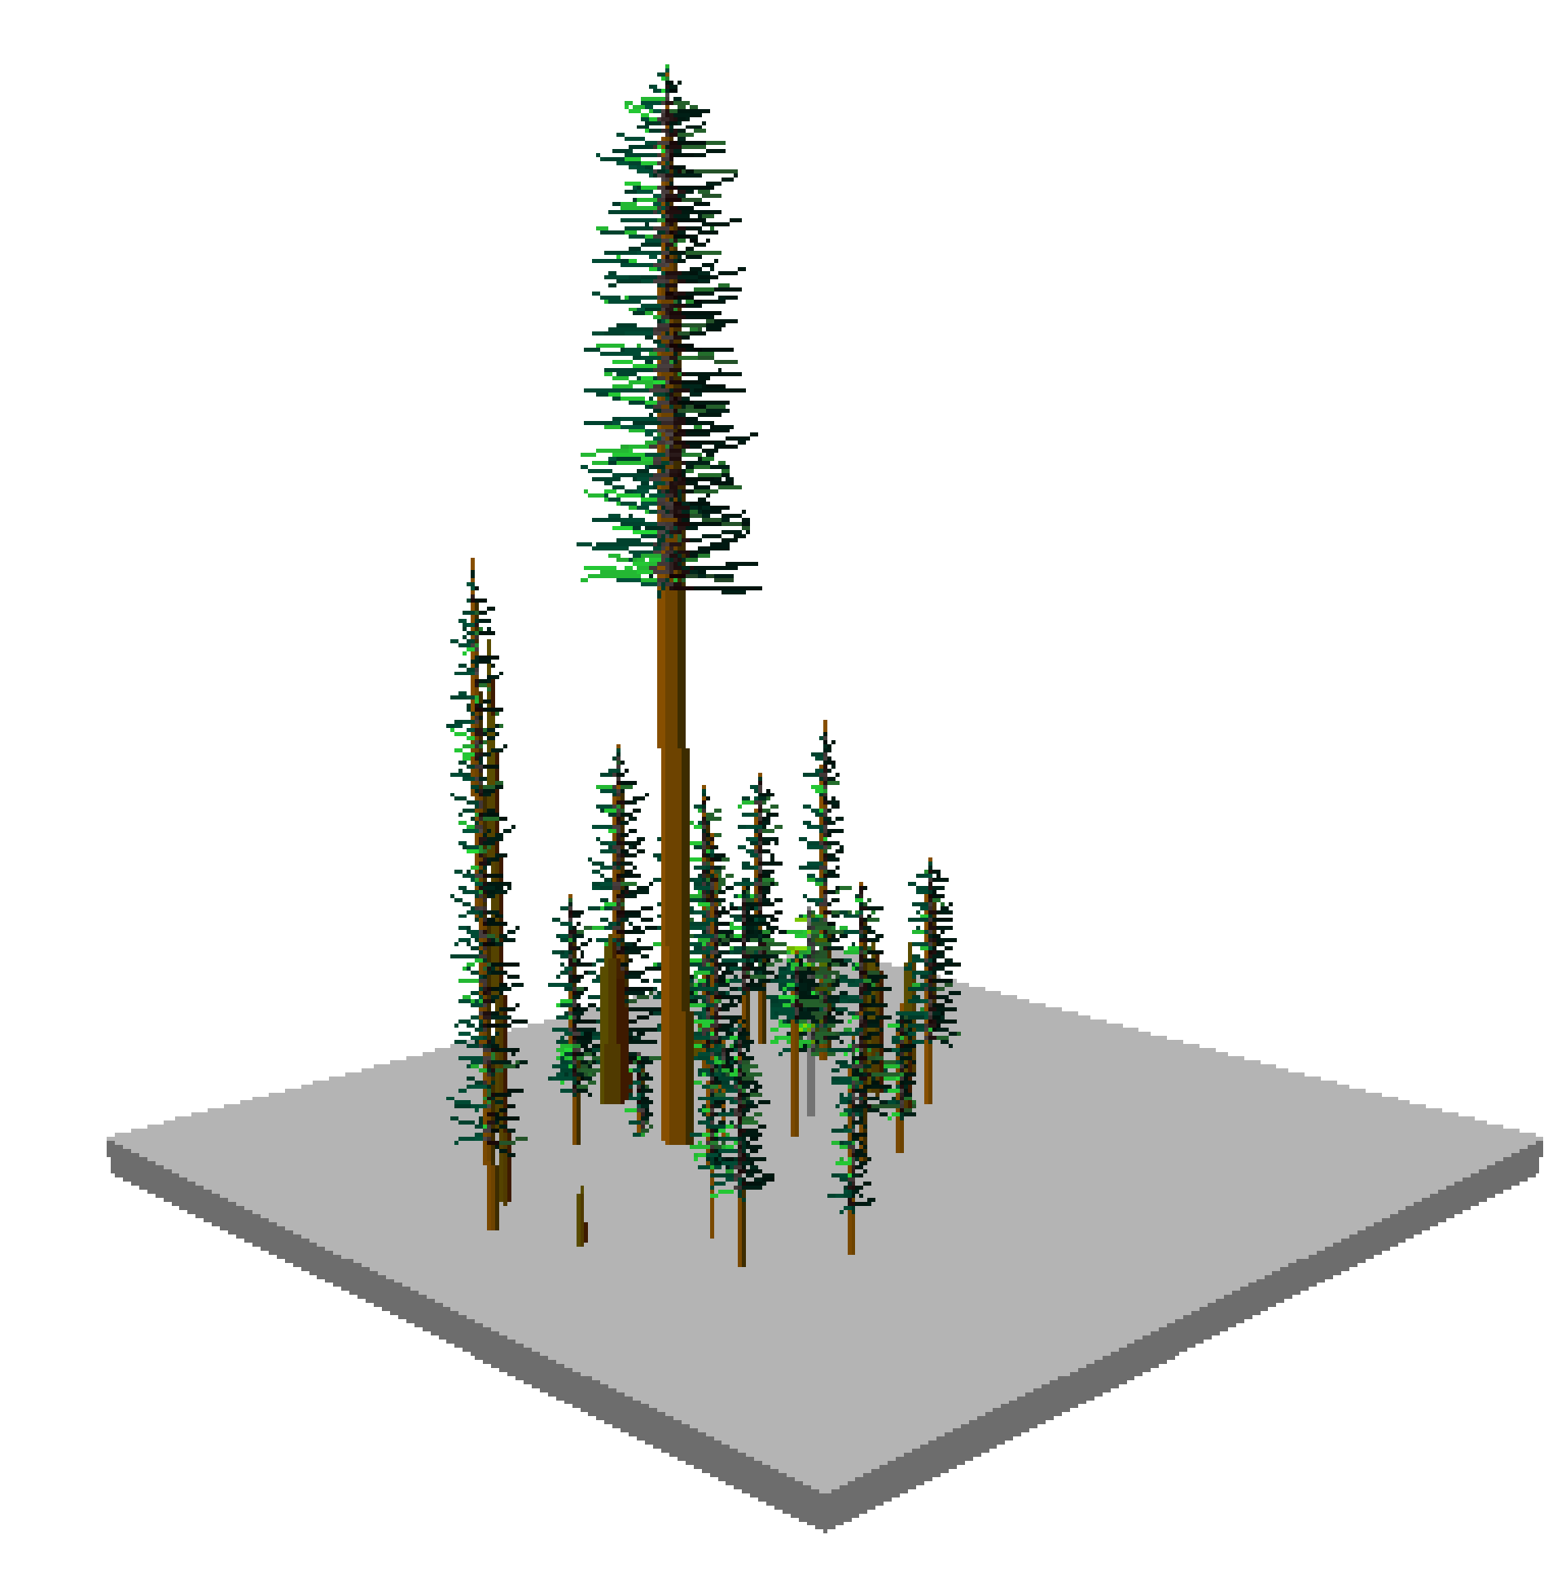
GEDI Lidar Measurements
GEDI’s sole observable is the lidar waveform which provides ground elevation, canopy height, cover and various profiles and metrics.
25 m
GEDI makes 12 billion observations of forest and land surface structure over its nominal two-year mission

Slide 5
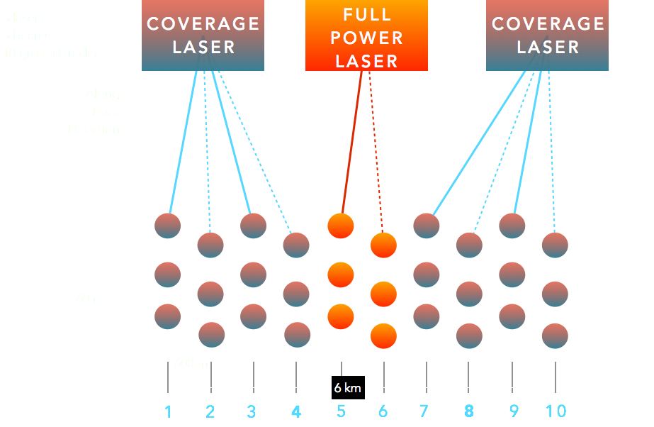
GEDI Observations
GEDI uses 3 lasers to produce 10 transects of lidar waveforms.
Each footprint provides the complete vertical structure of the canopy.
Dithering can be turned off for contiguous, along-track coverage.
5.4 km

Slide 6
Baseline Requirements
Gridded Biomass
Acquire lidar canopy vertical profile data required to estimate aboveground woody carbon density for the Earth’s global tropical and temperate forests within the ISS orbital coverage at ≤ 1 km resolution. At the end of two years after on-orbit checkout, at least 80% of the 1 km cells will meet an accuracy within 20% standard error, or 20 Mg/ha whichever is greater, subject to instrument availability.
Acquire transects (that is, near contiguous, along-track laser footprint observations) of tropical & temperate forest canopy vertical profiles from the top of canopy to the ground. Instrument performance must be sufficient to acquire profiles in conditions of up to about 95% canopy cover for all beams. Additionally, at least one laser beam must have sufficient power to acquire profiles in conditions of up to about 98% canopy cover.
Record, validate, publish, and deliver science data records (L0-L1B) and validated data products and model outputs (L2-L4) to the DAAC designated by NASA for use by the scientific community.
Transects
of Vertical
Profiles

Slide 7

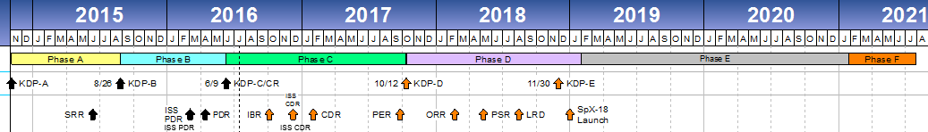
Current Mission and Engineering Status
GEDI successfully passed key milestones:
  Confirmation Review and Critical Design Review (CDR)
Currently in Phase C
All Algorithm Theoretical Basis Documents (ATBDs) have been created and externally reviewed
Integration & Test has begun
On schedule towards launch on May 2019 on Space-X 18 (SPX delay)
  Retired many risks in spring
Formulation
Design and Fabrication
Integration and Test
Science and Mission Operations
Wrap-Up
KC#24

Slide 8
Summary
GEDI mission on track and instrument scheduled for launch in May 2019
We are entering an era of accelerated observations needed to model the Earth’s carbon cycle
GEDI is paying careful attention to developing and implementing sound statistical frameworks for error propagation and fusion with SAR
A coordinated cal/val strategy is required for the upcoming confluence of SAR and Lidar missions
  CEOS Land Product Validation Subgroup Biomass Focus Area
    https://lpvs.gsfc.nasa.gov/Biomass/AGB_home.html

