Slide 1
SAOCOM Mission Status
Laura Frulla
(by Ake Rosenqvist)
Notes:
1

Slide 2
SAOCOM Mission Main Driver
SAOCOM Mission Main Driver
To support agriculture, hydrology-including floods, and
emergencies
To generate operative soil moisture maps
To exploit SAR interferometric capability

Slide 3
SAOCOM Mission General Features(1/2)
mission | constellation of two identical satellites (SAOCOM 1A/SAOCOM 1B) located at 180° one from each other
payload (each satellite) | full polarimetric L band SAR-1,275 GHz
mission lifetime | 5 years
orbit | sun synchronous nearly circular frozen polar
commissioning | 6-9 months
altitude | 620 km
inclination | 97.89°
local time of asc. node | 06:12 am
time for one orbit | 97.2 minutes
repeat cycle | 16 days (1 satellite)/8 days (constellation)
orbits per cycle | 237
cycles per year | 23
Notes:
SAOCOM is launched by SAPCE X at Vandenberg (California).
El PER (pre-environmental review) y el PSR (pre shipment review) están planificados para agosto/2017 y mayo/2018 respectivamente. No lo puse porque no cierra con la fecha de lanzamiento. Te lo comento para que lo sepas solamente y lo tengas como información. La fecha de lanzamiento puesta es la oficial firmada con Space X, en realidad vamos a estar lanzando en junio 2018 (aprox).
GSQR: ground segment qualification review
3

Slide 4
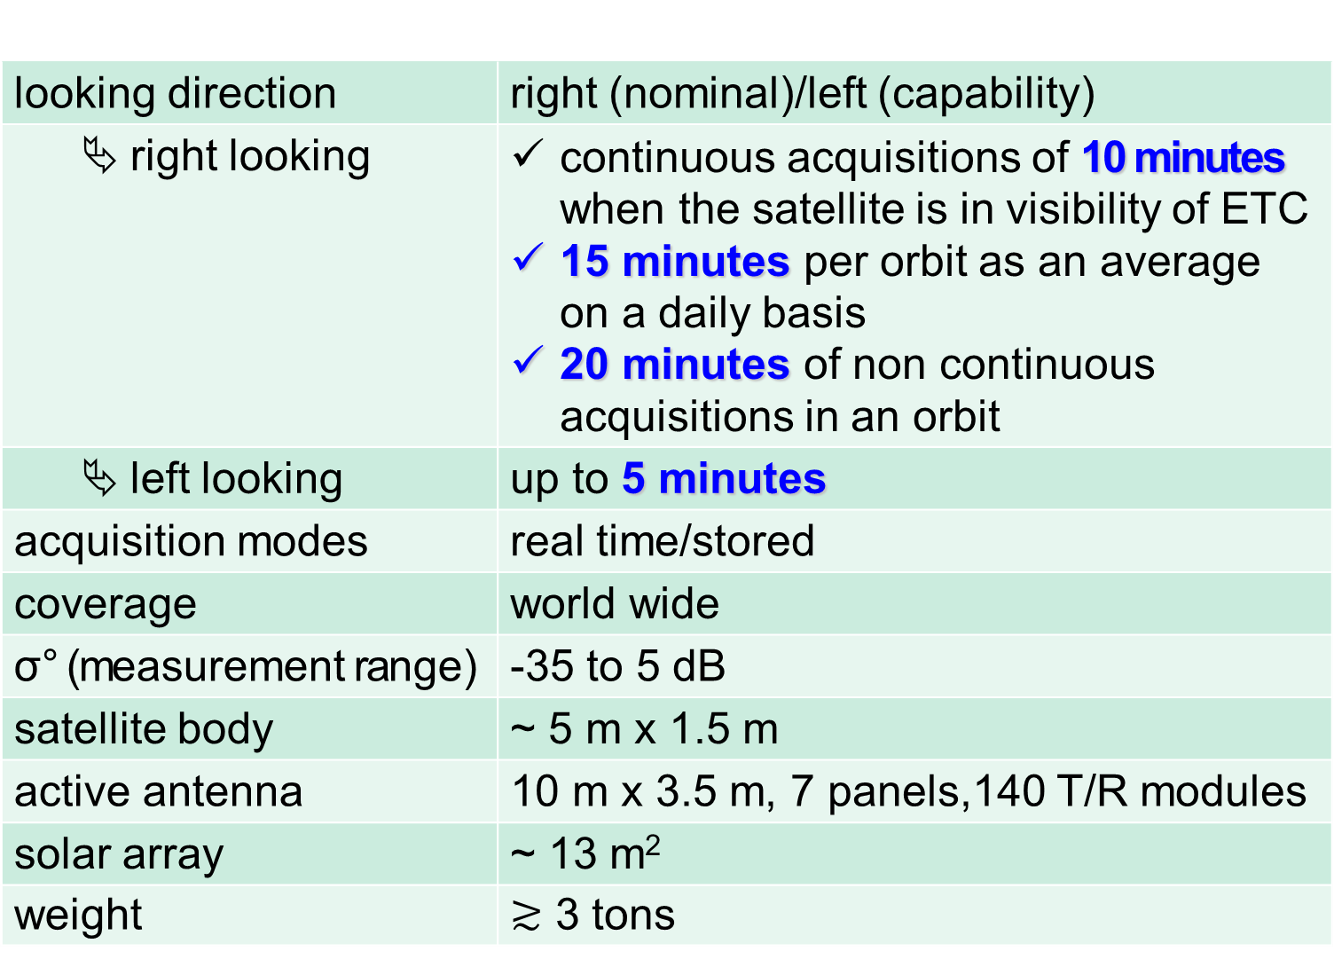
SAOCOM Mission General Features(2/2)
looking direction | right (nominal)/left (capability)
right looking | continuous acquisitions of 10 minutes when the satellite is in visibility of ETC 15 minutes per orbit as an average on a daily basis 20 minutes of non continuous acquisitions in an orbit
left looking | up to 5 minutes
acquisition modes | real time/stored
coverage | world wide
σ° (measurement range) | -35 to 5 dB
satellite body | ~ 5 m x 1.5 m
active antenna | 10 m x 3.5 m, 7 panels,140 T/R modules
solar array | ~ 13 m²
weight | 3 tons
Notes:
4

Slide 5
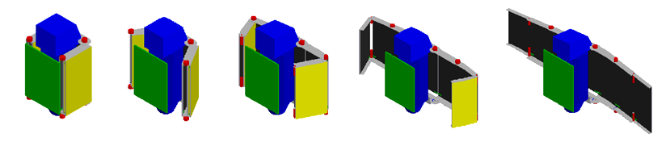
SAOCOM 1A: Antenna (Frontal Face) and Deployment

Slide 6
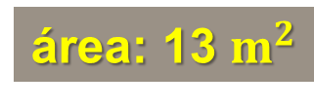
Solar Array
área: 13 $m^{2}$

Slide 7
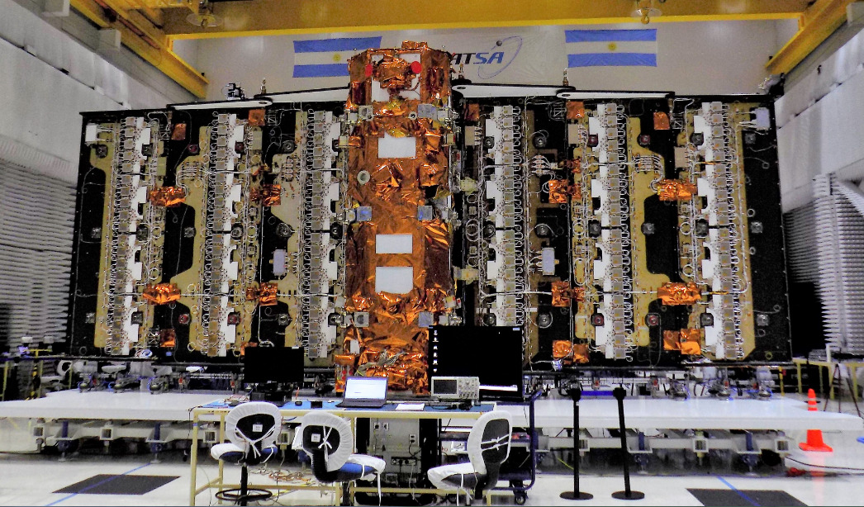
SAOCOM 1A – September 2018

Slide 8
SAOCOM Nominal Modes Features
acquisition mode | polarization mode | swath width | spatial resolution | minimum incidence angle range
StripMap | SP: HH or HV or VH or VV | > 40 km | < 10 m | 21° - 50°
 | DP: HH/HV or VV/VH | > 40 km | < 10 m | 21° - 50°
 | QP: HH/HV/VH/VV | > 20 km | < 10 m | 20° - 35°
TOPSAR Narrow | SP: HH or HV or VH or VV | > 150 km | < 30 m | 25° - 45°
 | DP: HH/HV or VV/VH | > 150 km | < 30 m | 25° - 45°
 | QP: HH/HV/VH/VV | > 100 km | < 50 m | 20° - 35°
TOPSAR Wide | SP: HH or HV or VH or VV | > 350 km | < 50 m | 25° - 45°
 | DP: HH/HV or VV/VH | > 350 km | < 50 m | 25° - 45°
 | QP: HH/HV/VH/VV | > 220 km | < 100 m | 20° - 35°
 | CL-POL: RH/RV or LH/LV | > 350 km | < 50 m | 25° - 45°
Notes:
We have the circular polarized mode as technological with right or left circular in the transmision and linear H&V in the reception.
The modes involve:
different swath widths from ..
Different spatial resolutions from …
Different incidence angle ranges from …
8

Slide 9
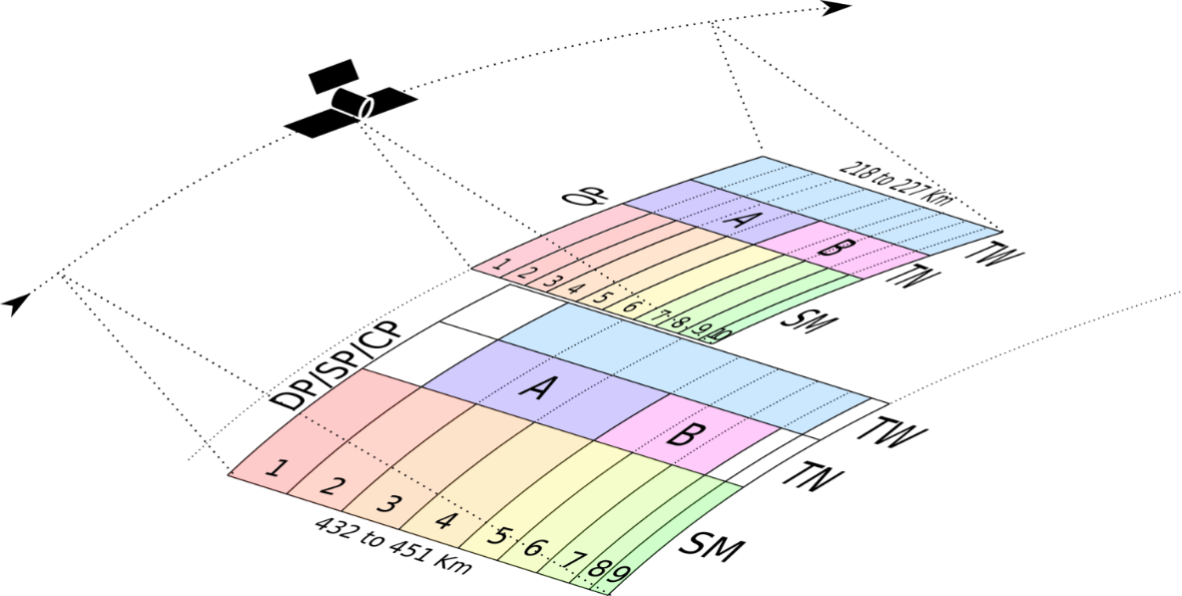
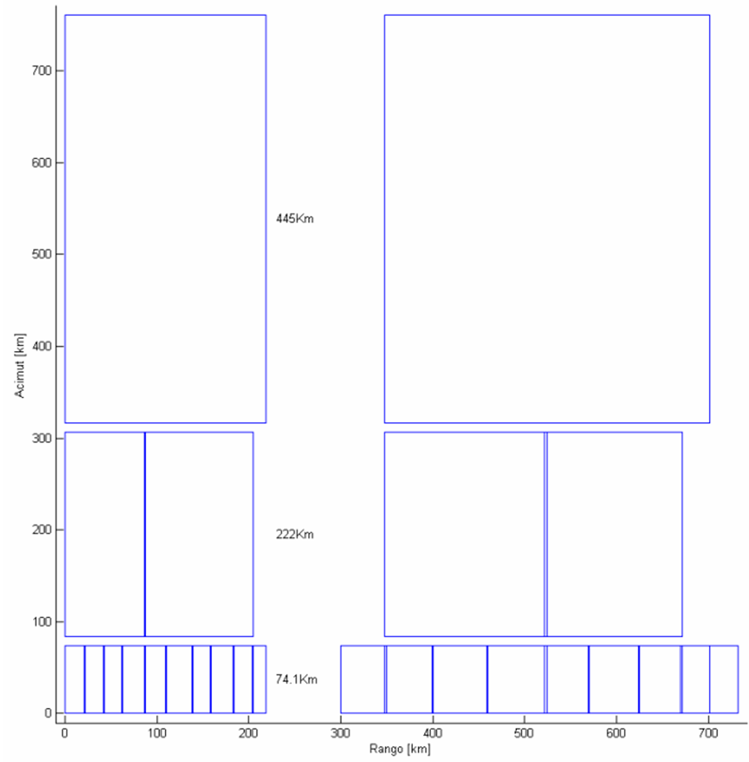
Standard Product Sizes and Relative Positions
QP
SP, DP, CLpol
445 km
TOPSAR Wide:
twice longer than
TOPSAR Narrow
TOPSAR Wide
TOPSAR Narrow
TOPSAR Narrow:
three times longer than
StripMap
222 km
220 km
440 km
StripMap
1
3
5
7
9
1
3
5
7
9
2
4
6
8
74 km
2
4
6
8
10
Notes:
Solo para que sepas por si te preguntan:
To make an image request the user has to register (only one time) in order to be identified by the system and has the following two possibilities:
visiting the catalogue (and then register to introduce the request),
or prior to be registered, getting into the “user request” option
The user will be able to select the area of interest with the following possibilities:
Selecting one point and a radious
Selecting the four coordinates of the area of interest (e.g. upper left, lower left, lower right and upper right geographical coordinates)
Drawing any poligon covering the area of interest.
Independantly of the situation considered we need to fix a standard product in order to know how many products we are distributing to the user. In this sense we defined the standard products (in lenght and width) that are shown in this slide.

Slide 10
Products Processing Levels and Delivery Conditions
  RAW data products (data stream),
  Level 0 products (Annotated RAW data-AR)
  Level 1 products
    Level 1A: Single Look Complex-SLC,
    Level 1B: Detected Image-DI,
    Level 1C: Ground Ellipsoid Corrected-GEC,
    Level 1D: Geocoded Terrain Corrected-GTC
  Higher level products
    on Main Driver basis
Data Delivery:
  the signing of a License of Use in accordance with the use modality
  an agreement between the Institution and CONAE can be held
Notes:
10

Slide 11
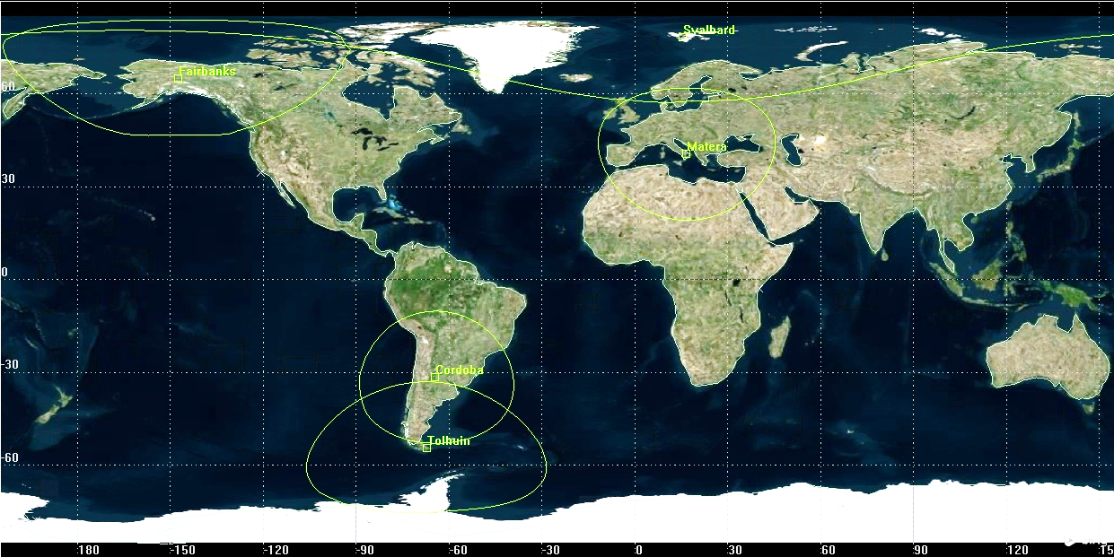
Data Download Capabilities
Main CONAE Rec. Station
CONAE Rec. Station
image request through the web:
  catalogue
  selection from the different acquisition possibilities

Slide 12
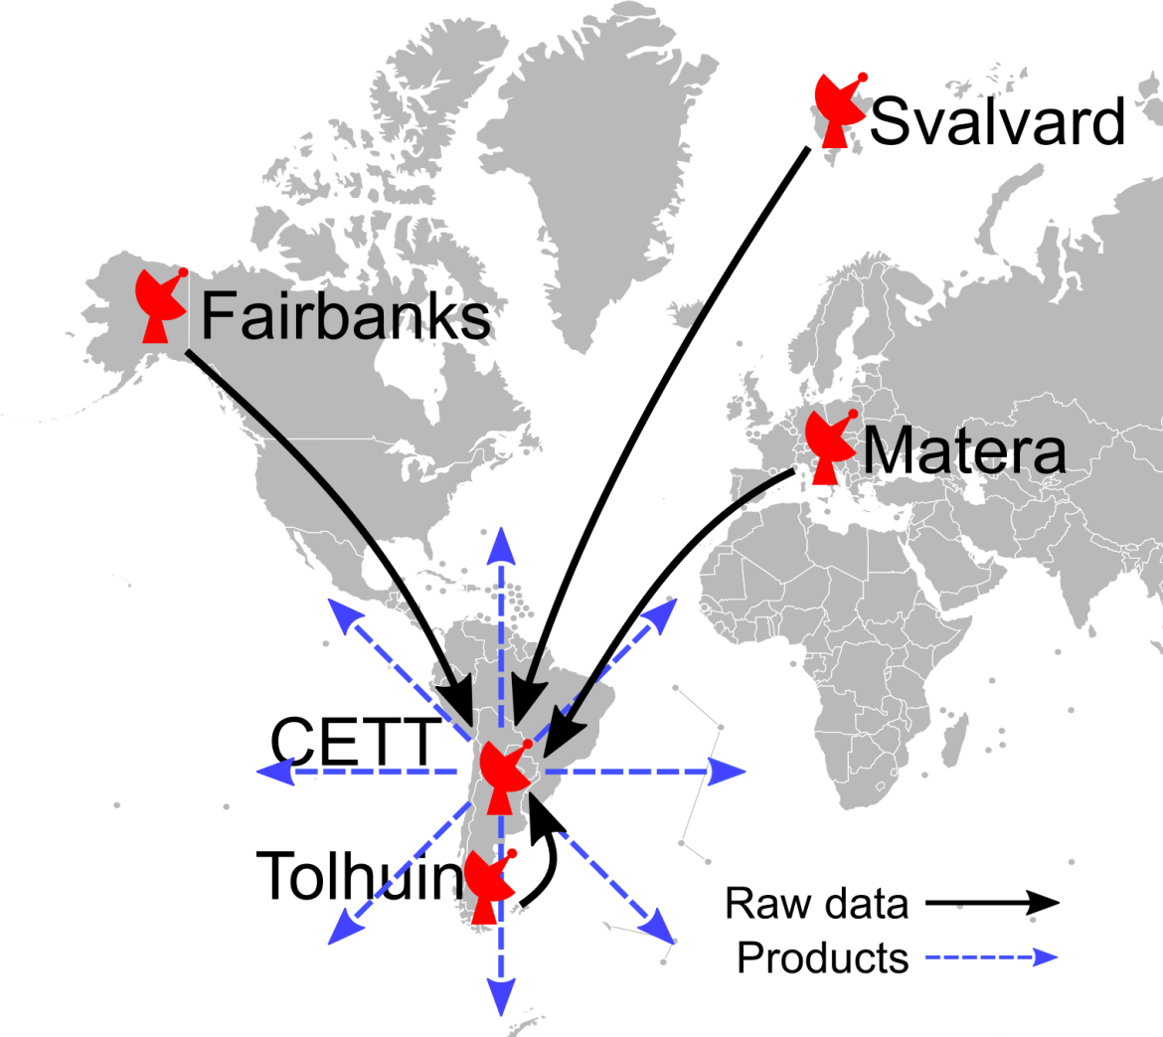
Data Reception and Distribution
racks for data
reception and
transfer
processing and
distribution at
CONAE main
Receiving Station
in Córdoba

Slide 13

Mission Acquisition Strategy
Baseline mission
  (fixed acquisitions)
  Soil moisture over Pampas-Strategic Applications
Calibration purposes:
  the rain forest
  specific point targets
  one transponder
Foreground mission
  (variable acquisitions)
  User requests (national and international)
  ASI interest / exclusivity areas
Background mission
  (useful data base)
  Over Argentina:
  emergencies
  maritime
  forest biomass
  the mountain chain at the West (the Andes): plates and glaciers movement
  Outside of Argentina:
  forest biomass
  polar/ice regions

Slide 14


Integrated Mission Acquisition Strategy (IMAS):
Global Background Mission
Stripmap Dual polarisation [10m(rg) x 5m(az); 1-look@gr. range]
3 beams required for regional gap-free coverage
33.7° ~ 38.3° inc. angle
38.2° ~ 41.3° inc. angle
41.2° ~ 44.6° inc. angle
TOPSAR Narrow Quad-polarisation [10m(rg) x 50m(az); 1-look@gr. range]
Both beam combinations (A&B) required for gap-free coverage
17.6° ~ 27.3° inc. angle (SQP beams 1-5)
27.2° ~ 36.6° inc. angle (SQP beams 6-10)

Slide 15
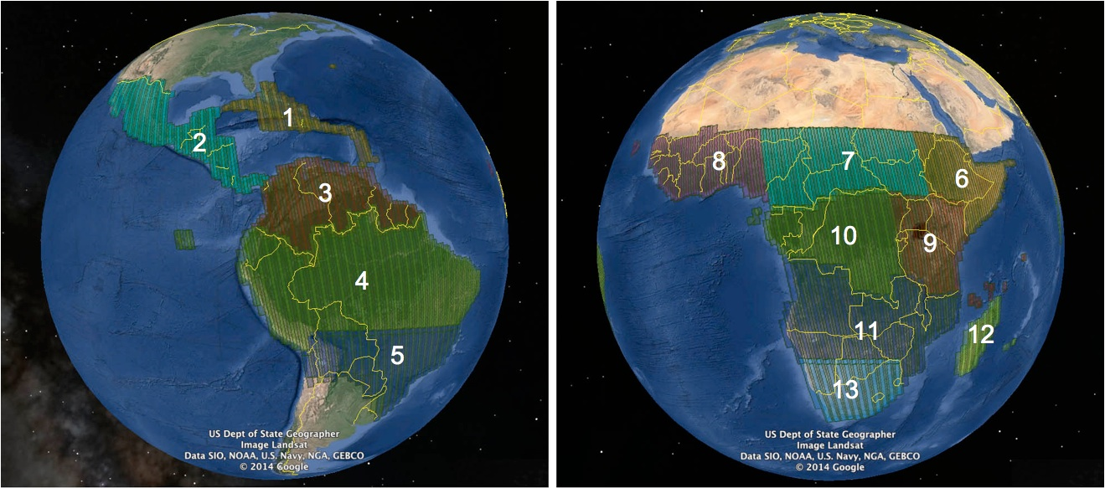
Integrated Mission Acquisition Strategy (IMAS):
Global Background Mission
Annual observations in Stripmap Dual-pol (SDP) mode (3 beams)
Annual observations in TOPSAR Narrow Quad-pol (TNQP) mode (2 beams)
Central & S America SDP+TNQP Africa SDP+TNQP

Slide 16
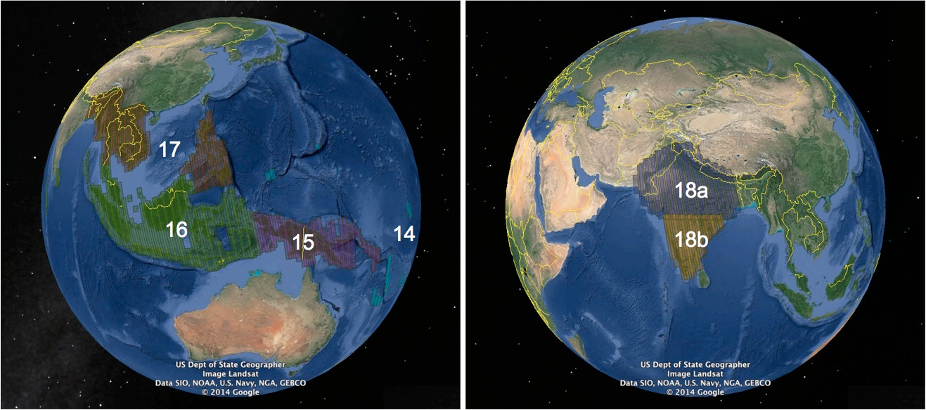
Integrated Mission Acquisition Strategy (IMAS):
Global Background Mission
Annual observations in Stripmap Dual-pol (SDP) mode (3 beams)
Annual observations in TOPSAR Narrow Quad-pol (TNQP) mode (2 beams)
SE-Asia & Oceania SDP+TNQP South Asia TNQP + SDP

Slide 17
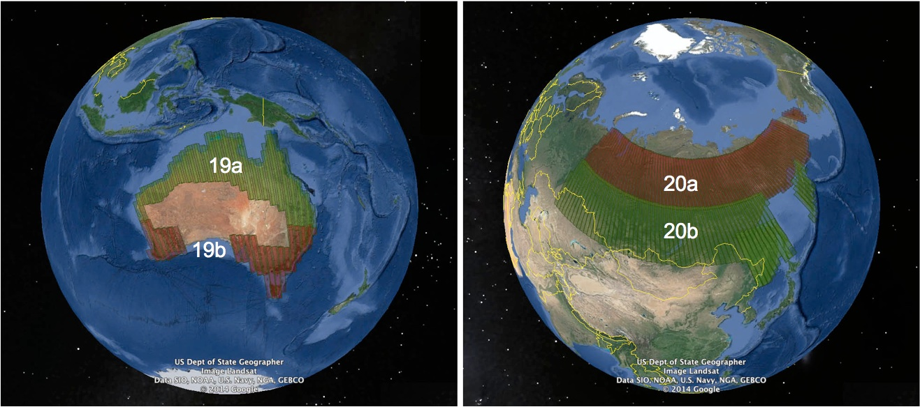
Integrated Mission Acquisition Strategy (IMAS):
Global Background Mission
Annual observations in Stripmap Dual-pol (SDP) mode (3 beams)
Annual observations in TOPSAR Narrow Quad-pol (TNQP) mode (2 beams)
Australia TNQP + SDP Siberia TNQP + SDP

Slide 18
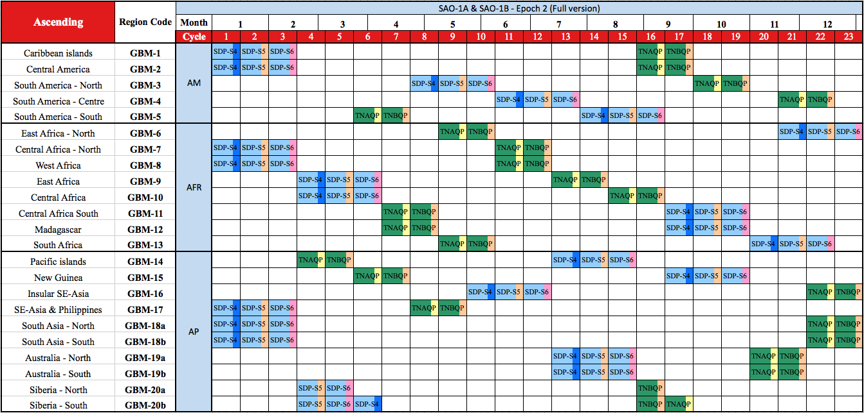
Integrated Mission Acquisition Strategy (IMAS):
Global Background Mission
Stripmap Dual-pol
TOPSAR Narrow Quad-pol
Epoch 1: SAO-1A
Epoch 2: SAO-1A = SAO-1B

Slide 19

Thank you
lfrulla@conae.gov.ar

