Slide 1


NISAR Update
Paul Siqueira³, Bruce Chapman¹, Josef Kellndorfer², Sassan Saatchi¹, Marc Simard¹, (NISAR Ecology Science Team)
¹ Jet Propulsion Laboratory, California Institute of Technology
² EarthBigData, LLC
³ University of Massachusetts, Amherst

Slide 2
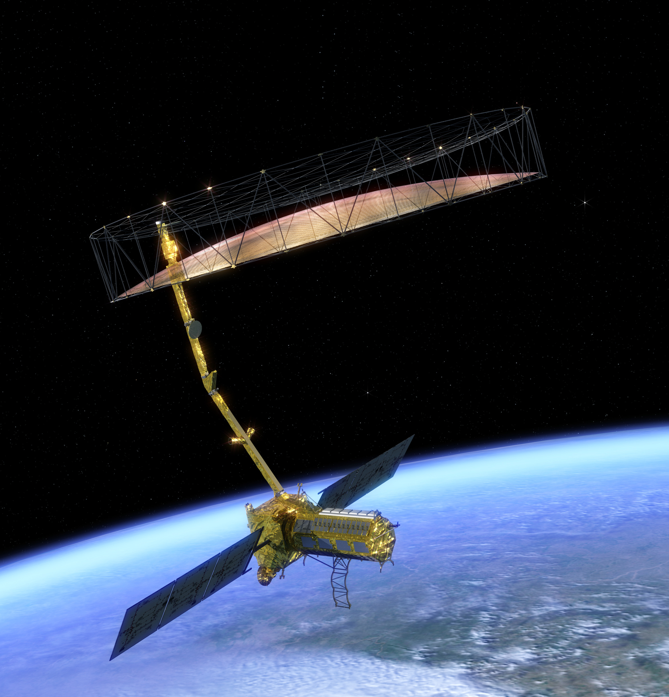
NASA-ISRO SAR : NISAR
Partnership between NASA and ISRO
L-band and S-band SAR
Polarimetric (standard mode: HH and HV)
Bandwidth: from 5 Mhz to 80 MHz (standard: 20MHz, 40 MHz)
Split spectrum to correct for ionosphere
All data will be made available free and open
Wide swath SweepSAR mode (240 km), global L-band coverage at 12 day repeat
Data acquired ascending and descending
24 Tbits/day downlink
Launch in ~ late 2021
Notes:
Its funded through to launch, entering phase D later this year.

Slide 3
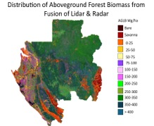
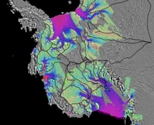
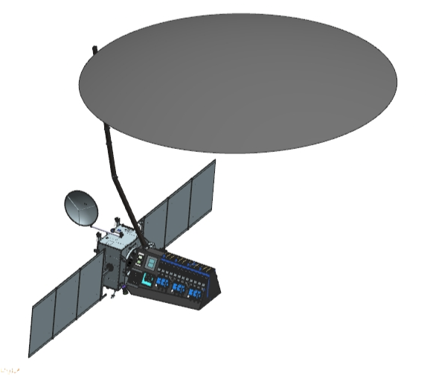
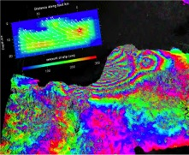
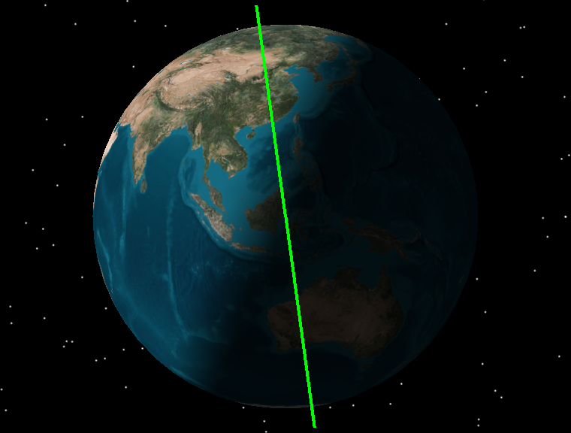
Key Scientific Objectives
Understand the dynamics of carbon storage and uptake in wooded, agricultural, wetland, and permafrost systems
Understand the response of ice sheets to climate change and the interaction of sea ice and climate
Determine the likelihood of earthquakes, volcanic eruptions, and landslides
Ecosystem Structure
  Biomass disturbance; effects of changing climate on habitats and CO₂
Cryosphere
  Ice velocity, thickness; response of ice sheets to climate change and sea level rise
Observation Geometry
Solid Earth
747 km
33º
  Surface deformation; geo-hazards; water resource management
47º
Earth surface
6 AM / 6 PM
>240 km

Slide 4
NISAR BIOMASS requirement
Measure aboveground woody vegetation biomass annually at the hectare scale (1 ha) to an RMS accuracy of 20 Mg/ha for 80% of areas of biomass less than 100 Mg/ha.
This requirement must be validated after launch.
This is a NASA requirement on the L-band SAR.

Slide 5
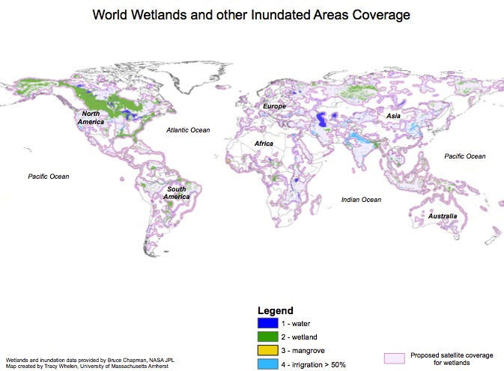
NISAR Inundation requirement
Map inundation extent within inland and coastal wetlands areas at a resolution of 1 hectare every 12 days with a classification accuracy of 80%.
This requirement must be validated after launch.
This is a NASA requirement on the L-band SAR.

Slide 6
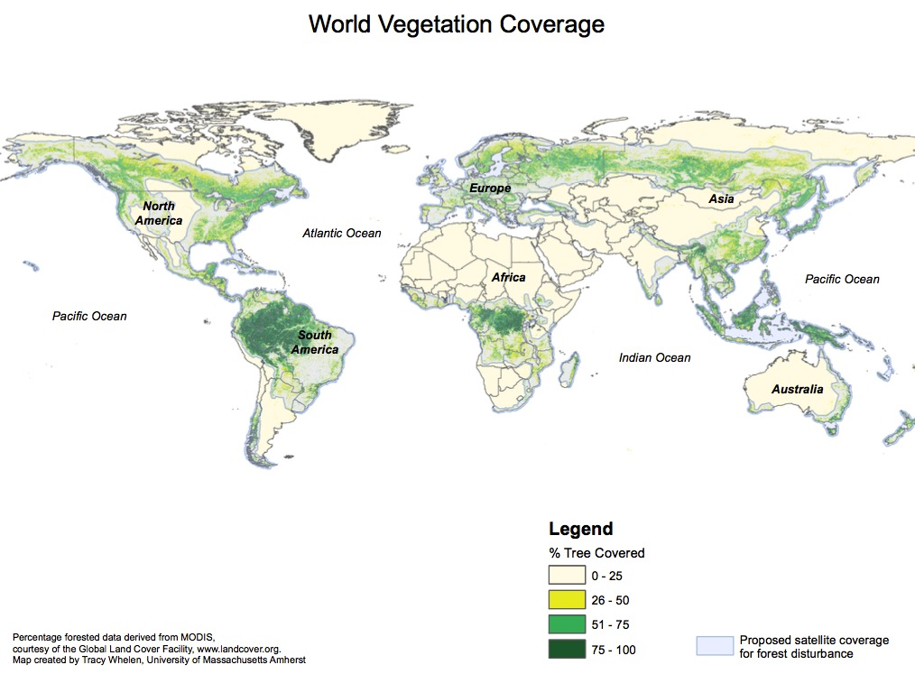
NISAR forest disturbance requirement
Measure global areas of vegetation disturbance at 1 hectare resolution annually for areas losing at least 50% canopy cover with a classification accuracy of 80%.
This requirement must be validated after launch.
This is a NASA requirement on the L-band SAR.

Slide 7
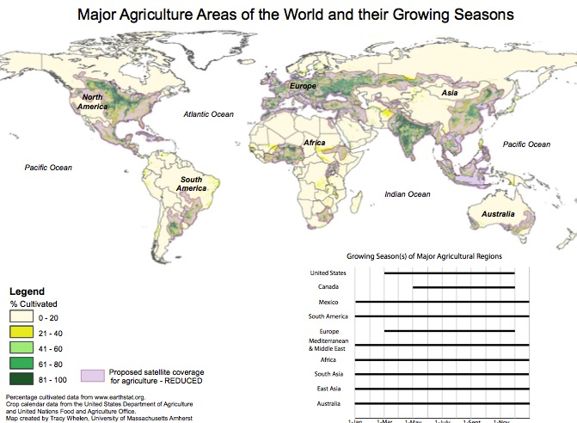
NISAR Agriculture crop area requirement
Measure crop area at 1 hectare resolution every 3 months with a classification accuracy of 80%.
This requirement must be validated after launch.
This is a NASA requirement on the L-band SAR.

Slide 8
Summary
NISAR will collect an extensive time series of L-band dual-pol data
  Twice every 12 days (ascending and descending)
  Global
  High resolution (12 m x 8 m) or better
NISAR is a critical component of a three-pronged approach to measure global biomass (with ESA BIOMASS AND NASA GEDI Missions).
Forest disturbance, even in heavily cloudy areas, will be detectable through the extensive and complete time series.
NISAR will observe seasonal inundation and crop area dynamics globally, also dependent on the extensive and compete time series.

