Slide 1
SESSION 5 & 8 (Thu/Fri): CEOS strategy for GFOI Phase 2
SDCG-13: Bogota, 15-16 March, 2018

Slide 2
Phase 2 of GFOI – whats it about?
Joint assessments of country needs and collaboration to address them
Complementary and consistent CB activities
IPCC- and UNFCCC-compliant country guidance for REDD+ reporting
Expanded data support to put more emphasis on access, uptake and application and the relevant tools
Coordinated R&D activities to support above by dedicated activities
Expanded participation and leadership

Slide 3
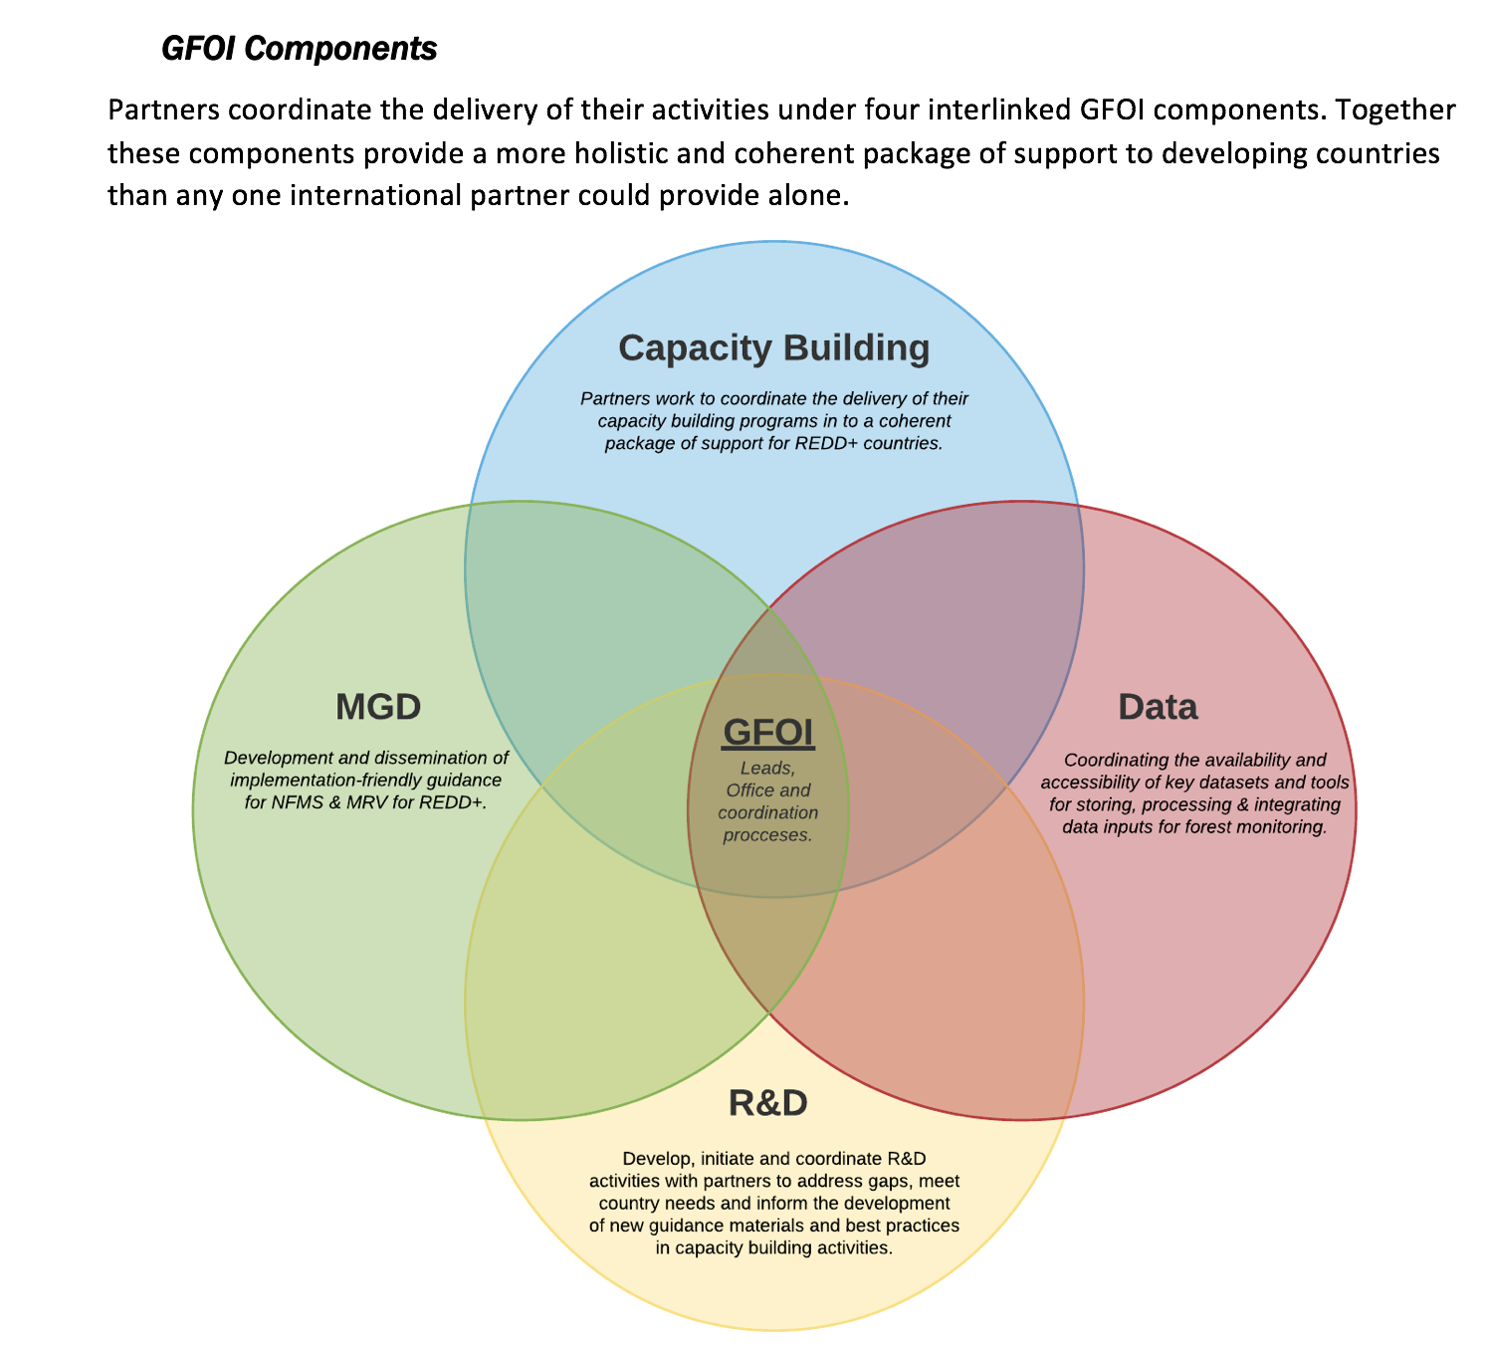
Phase 2 of GFOI

Slide 4
CEOS-specific themes – for discussion
GFOI has brought CEOS closer to thematic user community – and CEOS wishes to continue to grow that relationship: ‘DUAG’ mechanism?
Expanded participation brings in major forest donor governments and provides opportunity to ensure EO aspects benefit (UK and DE both have active space agencies)
Better ROI for GFOI R&D programme data suppliers. Phase 2 needs more specific, prioritised programme of funded R&D activities. Need to evolve current model towards dedicated and funded activities.
World Bank membership provides engagement opportunities related to CEOS IFI strategy

Slide 5
CEOS Provisional objectives
CEOS wishes to continue to grow that relationship via the Data Component mechanism – gaps in data and tools. With necessary links to CNA process and the CB, MGD and R&D components. Data component part of GFOI Plenaries.
User feedback and testbeds for CEOS pilots on new data architectures (like GFOIcubes) and Analysis Ready Data
Active contribution to GFOI EW activity as unique role for EO, and with specific recommendations to GFOI R&D programme
Expanded participation in GFOI Leads Team brings in
major forest donor governments and provides opportunity to ensure EO aspects benefit (UK and DE both have active space agencies)
World Bank and engagement opportunities related to CEOS IFI strategy
ESA as advocate for the R&D component
Better ROI for GFOI R&D programme data suppliers. Phase 2 needs more specific, prioritised, focused programme of funded R&D activities – defined top down and from CNA. Proposed strategy note ASAP.
Maintenance and assured continuity of the global baseline coverage, with forthcoming discussion on new space missions e.g. Space-based Lidar and P-band SAR which would be complement with In-Situ measurement on AGB

Slide 6
CEOS Provisional objectives (1/2)
CEOS wishes to continue to grow that relationship via the Data Component mechanism – gaps in data and tools. With necessary links to CNA process and the CB, MGD and R&D components. Data component part of GFOI Plenaries.
User feedback and testbeds for CEOS pilots on new data architectures (like GFOIcubes) and Analysis Ready Data
Active contribution to GFOI EW activity as unique role for EO, and with specific recommendations to GFOI R&D programme
Expanded participation in GFOI Leads Team brings in
major forest donor governments and provides opportunity to ensure EO aspects benefit (UK and DE both have active space agencies)
World Bank and engagement opportunities related to CEOS IFI strategy
ESA as advocate for the R&D component

Slide 7
CEOS Provisional objectives (2/2)
Better ROI for GFOI R&D programme data suppliers. Phase 2 needs more specific, prioritised, focused programme of funded R&D activities – defined top down and from CNA. Proposed strategy note ASAP.
Maintenance and assured continuity of the global baseline coverage, with forthcoming discussion on new space missions e.g. Space-based Lidar and P-band SAR which would be complement with In-Situ measurement on AGB

Slide 8
GFOI wants from CEOS ... assumed
Execution and maintenance of the GFOI Space Data Strategy
Multiple annual coverage and evolution of supply
Country-specific supply and tools
Data for R&D activities
Data Component Lead and Manager?
Role of SDCG in Data Component?
Other players?
Support for FDA aspects of country needs in Phase 2
ARD, CDC, other systems
Address gaps identified by country needs assessment process (’DUAG’)

Slide 9
GFOI wants from CEOS ... Leads Team
Continued maintenance of the global baseline and incorporation of new sensors as they emerge
Maintain moderate resolution supply as priority
Advocacy for supply of hi-res data for validation etc
Wall-to-wall data to improve biomass estimates
Promotion of data availability, understanding and application
Greater focus on tools and uptake
Moving processing of data away from the local. To the cloud, with analytics
How do we connect space data with Capacity Building?
Focus on links from space data to development activities

Slide 10
CEOS wants from GFOI ...
Forest community interface and structured requirements – how will GFOI meetings and country engagement reflect our goals?
Data Component Meetings foreseen as the instrument
CNA process and CB/MGD/R&D links to be defined
Channel for increased uptake and application of satellite EO
Integration of EO into MRV systems
Through new application e.g. GFOI ALERT
Thematic counterpart to feedback on CEOS FDA directions
Analysis Ready Data (ARD) ➔ LSI-VC action
CEOS Data Cube, Thematic Exploitation Platforms (TEPs), GFOI SEPAL, etc
GFOI-Cube with MGD-compliant analytics; GFOI DataCube community ?
Framework for IFI connection
Mechanism for forest-specific R&D funding and management

Slide 11
Space Data – where are we up to?
Global coverage accomplished - multiple core data streams in operation and ensuring the necessary EO data supply for the next decades. Needs maintenance to reflect mission status
Emphasis turns to data uptake and application – consistent with Phase 2
Pilot activities ongoing – Data Cube for Colombia and now Vietnam
SDCG EXEC pursued inclusion of Early Warning as a GFOI activity – basis for the long-promised cooperation with WRI/GFW and strong EO role
Keen also to see GFOI framework for real R&D funding & coordination to address technical obstacles around use of EO
USGS exited from SDCG – impacted confidence? New UKSA Co-Chair.
SDCG SEC capacity much reduced, but thx JAXA, NASA, CSIRO, ESA for 2018 ops.
CEOS Plenary/SEC action on Co-Chairs to review resourcing options (and M.O.)
Ongoing rationalisation of GFOI in CEOS structure: LSI-VC, GEOGLAM, SDCG ➔ 2nd trial meeting in Sep 2018

Slide 12
SDCG 3-Year Work Plan
The substance to inspire and direct continued participation of CEOS agencies
Substance necessary to help answer Plenary questions on resourcing and sustaining SDCG
SDCG SEC drafted 3-year outcomes for discussion this week
For new readers, 3 element data strategy
global baseline
country specific services (data, tools – essence of Phase 2)
R&D support
Following slides summarise early draft outcomes per element

Slide 13
WP: Element 1 - Global Baseline
Multiple annual global coverages from 2017 onwards of the world’s forested areas with provision for coverage for the foreseeable future by inclusion of GFOI requirements in the basic observation scenarios of the core data streams.
Efficient and effective global flows of data to accommodate in-country development of GFOI-recommended Forest Map products.
Commitment of core data stream providers to include GFOI requirements in the definition of consistent information products including ‘Analysis Ready’ products.

Slide 14
WP: Element 2 – Space Data Services
Ensured on-going coverage customised for all of the priority countries, and the development of semi-automated tools for the generation of national core data stream archive characterisation, as required.
Progress pilots investigating fundamental issues around the provision of cloud computing-based storage, processing and presentation of GFOI products as the basis for national MRV consistent with the Methods and Guidance.
Establish and grow a community of GFOI countries engaged in CEOS pilots for technical exchange of information on use of MGD-compliant Data Cubes, algorithms etc – including Colombia, Switzerland, Vietnam, Honduras/Taiwan and others.
Establish and grow a community of GFOI countries to provide feedback on the utility for the forest monitoring community of CEOS Analysis Ready Data and advocate for the necessary adaptation and supply of data to meet GFOI needs. Establish a programme of application pilots and feedback with volunteer countries and reporting bodies.

Slide 15
WP: Element 2 – Space Data Services
Further develop IFI links for CEOS through exploration of shared interests with the new GFOI Lead from World Bank. GFOI Space Data Services will be defined and delivered in collaboration with The World Bank, FAO and other Leads, and prioritised based on the needs identified through GFOI consultation via the Data Component meetings and processes.
Integration and promotion of space data within the GFOI Methods and Guidance, including agreement on the derivation of GFOI standard products using space data. This should take account of the broader CEOS strategy with the IPCC TFI guidelines etc.
Satellite data discovery, access and application tools for all core data streams – as prioritised by the country needs assessment process within GFOI which CEOS should be an integral part of.
Contribute to the definition and development of a GFOI ALERT module for early warning applications and guide and support the role of space data therein.

Slide 16
WP: Element 3 - R&D Support
Implementation of the Element-3 strategy document endorsed at SIT-30 and SIT-31.
Providing the satellite data required to progress the GFOI priority R&D topics outlined in the GFOI R&D plan to pre-operational or operational status, in coordination with the R&D Coordination component, and in support of improvements to the Methods and Guidance.
Pursuit of a dedicated GFOI R&D fund with the main GFOI donors to address and remove the main technical obstacles to use of EO satellite and other data in reporting of countries.
Maintain engagement with public, hybrid, commercial data providers and NGO brokers, through a management and accountability framework implemented in conjunction with an SDCG mechanism for brokering space data requests in support of GFOI R&D activities.

Slide 17
WP: Country Engagement & Component Coordination
Delivery of a coherent customer experience for GFOI countries via efficient coordination among the GFOI Space Data component, the GFOI Methods and Guidance, Capacity Building, and R&D components, and the GFOI Office.
Space data support and services provided to all priority countries including coordination and integration with the Methods and Guidance and the GFOI Office.

Slide 18
Discussion points - meetings
Continued user engagement means participating at GFOI Plenary – but need all SDCG attend? This week was very encouraging …
OR, are we better to attach SDCG meetings to core CEOS meetings (like April SIT) than GFOI Plenary?
More token attendance at GFOI Plenary
Written input and feedback through selected representatives
Alternatively, much more pro-active mode to derive max. value from GFOI Plenary?
Others?

Slide 19
Discussion points – M.O. & capacity
Inspiration for Co-Chairs in delivering response to CEOS on SDCG resourcing and M.O.
Sustainability of bridging arrangement and possible donors
Necessity of SEC or not for Phase 2
New M.O. models
Early input to SIT-33 and recommendations for SIT TW (Sep 2018)
Others?

