Slide 1
CEOS strategy for GFOI Phase 2
LT-34: Bogota, 12 March, 2018

Slide 2
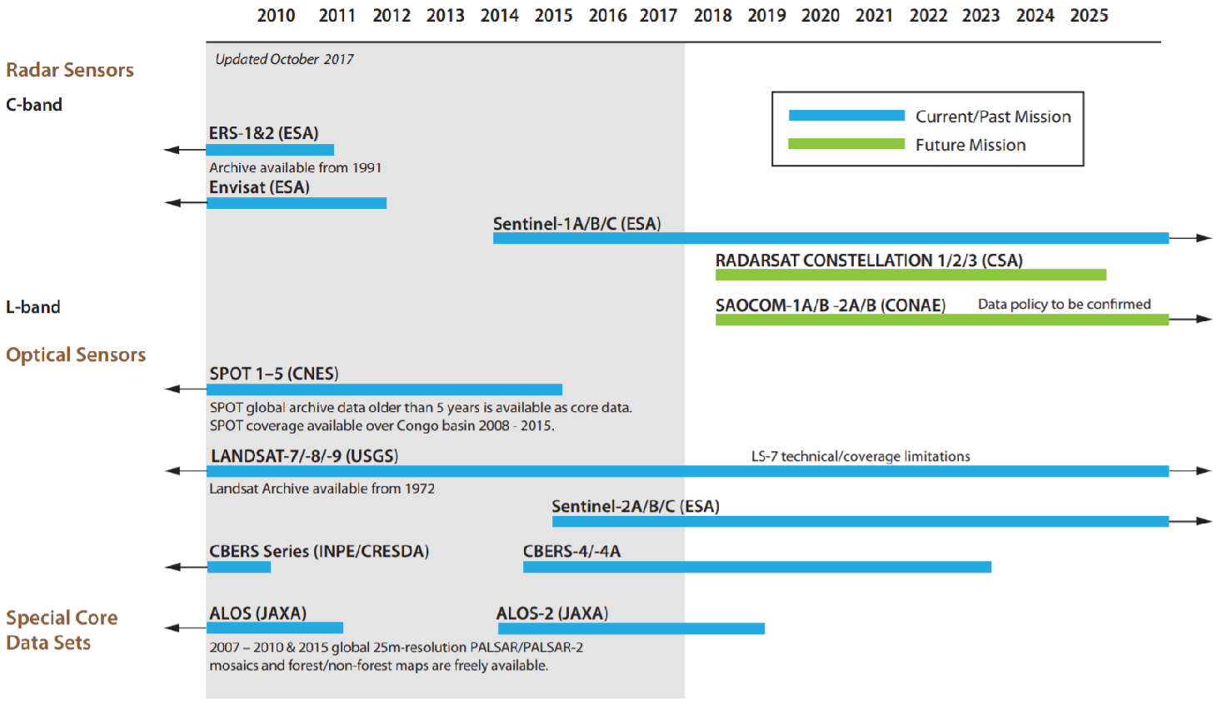
CEOS Achievement Satellite Data Coordination – Core Data Stream

Slide 3
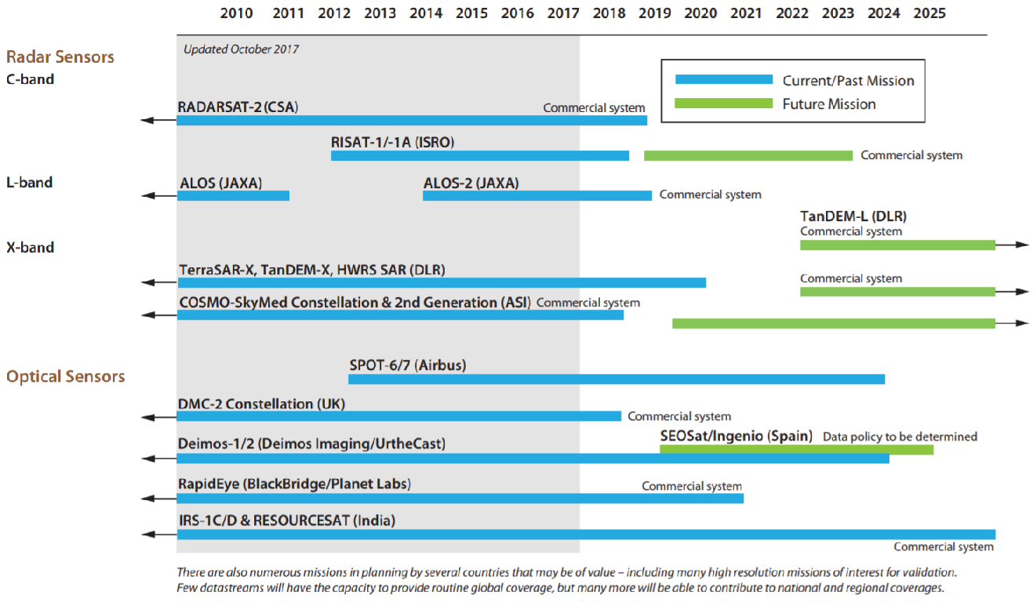
CEOS Achievement Satellite Data Coordination – Future Missions of interest

Slide 4
CEOS Achievement Data Provision
Space Data Services (Element-2)
Objective: To support countries obtaining and handling the core satellite data required as the basis for their national MRV systems consistent with the MGD.
Progress pilots to investigate fundamental issues around the utilisation of new data architectures, such as cloud computing based storage, Data Cubes and CEOS Analysis-Ready Data.
Close ongoing collaboration with Colombia, Vietnam, Honduras/Taiwan and Switzerland
Data support to the GFOI R&D program (Element-3)
Objective: To support GFOI R&D Coordination component with satellite data requited to advance topics that are not yet mature for the MGD (e.g. degradation, above-ground biomass) and to optimise utilisation of existing and new space technology (e.g. LiDAR).
Assuring that the GFOI R&D program has adequate access also to satellite data from CEOS missions of commercial/semi-commercial (PPP) nature. ASI, CNES, CSA, DLR, JAXA are actively contributing with data at no charge to GFOI R&D.
Notes:
ESA BIOMASS mission,

Slide 5
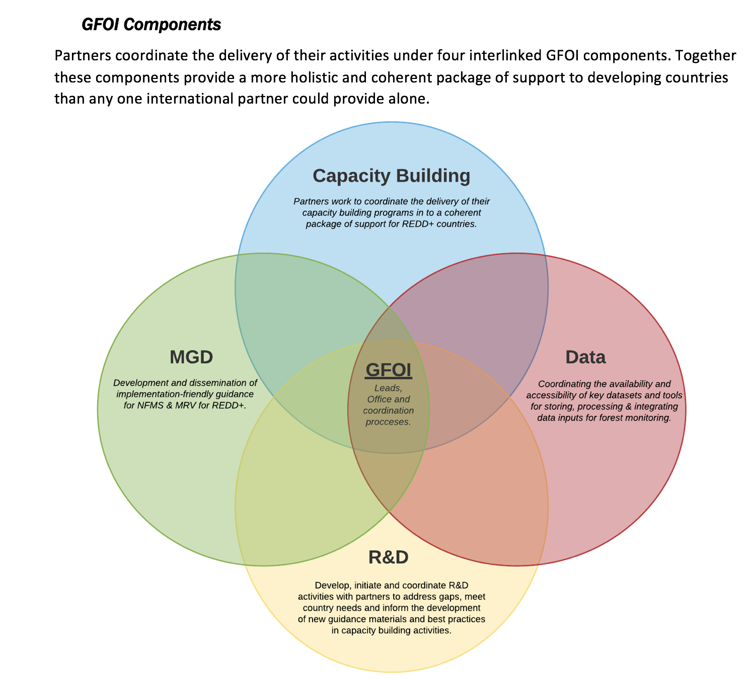
Phase 2 of GFOI
Joint assessments of country needs and collaboration to address them
Complementary and consistent CB activities
IPCC- and UNFCC-compliant country guidance for REDD+ reporting
Expanded data support to put more emphasis on access, uptake and application and the relevant tool.
Coordinated R&D activities to support above
Expanded participation and leadership

Slide 6
CEOS Provisional objectives
CEOS wishes to continue to grow that relationship via the Data Component mechanism – gaps in data and tools. With necessary links to CNA process and the CB, MGD and R&D components. Data component part of GFOI Plenaries.
User feedback and testbeds for CEOS pilots on new data architectures (like GFOICubes) and Analysis Ready Data
Active contribution to GFOI EW activity as unique role for EO, and with specific recommendations to GFOI R&D programme
Expanded participation in GFOI Leads Team brings in
major forest donor governments and provides opportunity to ensure EO aspects benefit (UK and DE both have active space agencies)
World Bank and engagement opportunities related to CEOS IFI strategy
Better ROI for GFOI R&D programme data suppliers. Phase 2 needs more specific, prioritised, focused programme of funded R&D activities – defined top down and from CNA. Proposed strategy note ASAP.
Maintenance and assured continuity of the global baseline coverage, with forthcoming discussion on Space-based Lidar missions which would be complement with In Situ measurement on AGB

Slide 7
CEOS Process
Clarity of requirements from GFOI Leads on CEOS engagement and contribution to Phase 2 (i.e. GFOI expectations to CEOS)
Establishing updated objectives and opinions from active CEOS agencies
And consensus on overall CEOS position from upcoming CEOS SIT meeting (April 24-25 in Boulder US)
SDCG operation and resourcing task underway

