Slide 1
CEOS strategy for GFOI Phase 2
LT-34: Bogota, 12 March, 2018

Slide 2
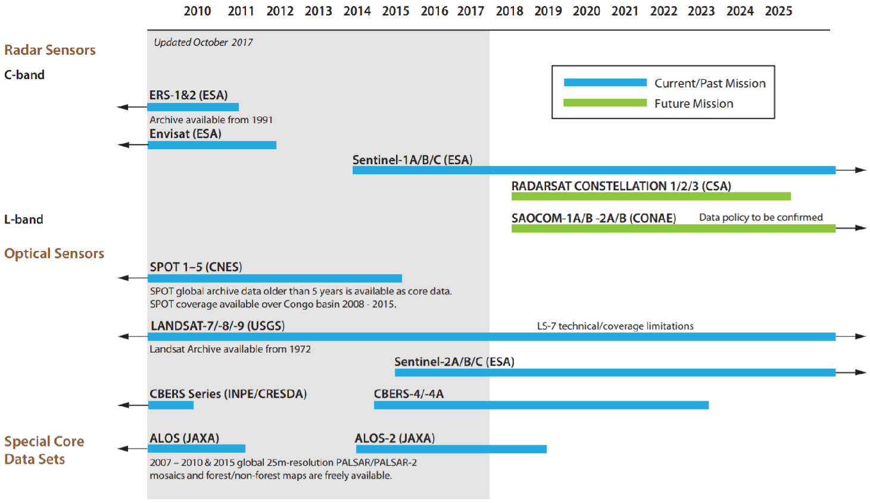
CEOS Achievement Satellite Data Coordination – Core Data Stream

Slide 3
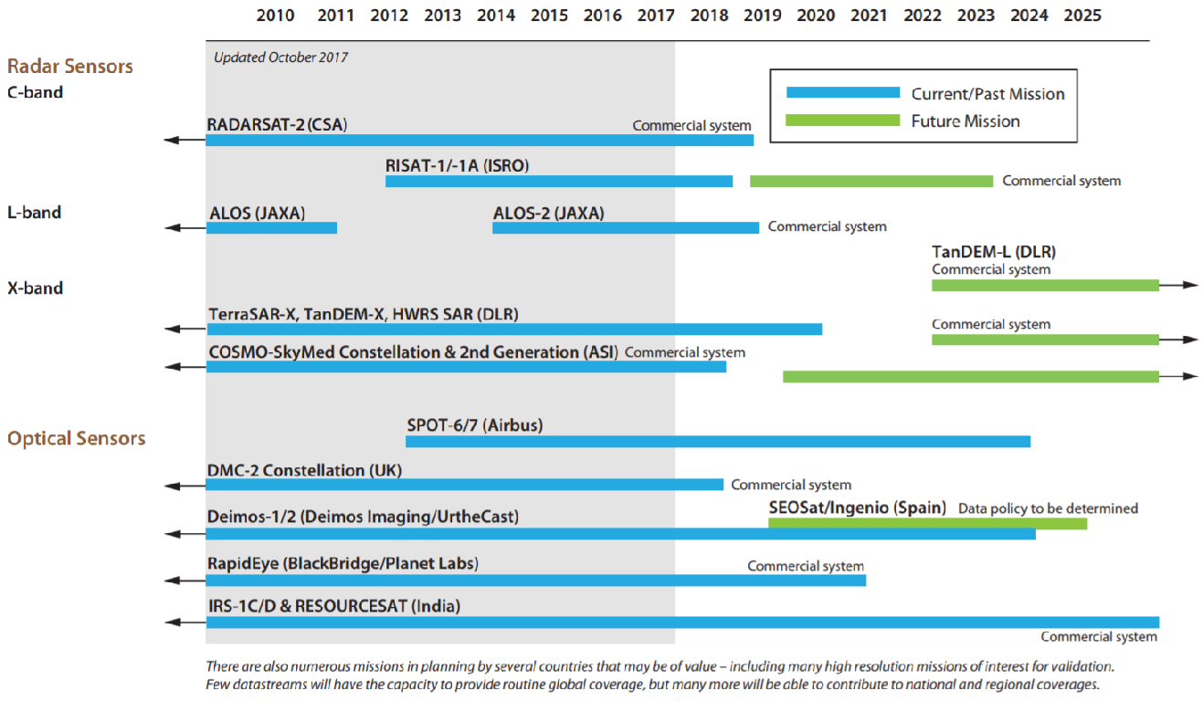
CEOS Achievement Satellite Data Coordination – Future Missions of interest

Slide 4
CEOS Achievement Data Provision
Space Data Services (Element-2)
Objective: To support countries obtaining and handling the core satellite data required as the basis for their national MRV systems consistent with the MGD.
Progress pilots to investigate fundamental issues around the utilisation of new data architectures, such as cloud computing based storage, Data Cubes and CEOS Analysis-Ready Data.
Close ongoing collaboration with Colombia, Vietnam, Honduras/Taiwan and Switzerland
Data support to the GFOI R&D program (Element-3)
Objective: To support GFOI R&D Coordination component with satellite data requited to advance topics that are not yet mature for the MGD (e.g. degradation, above-ground biomass) and to optimise utilisation of existing and new space technology (e.g. LiDAR).
Assuring that the GFOI R&D program has adequate access also to satellite data from CEOS missions of commercial/semi-commercial (PPP) nature. ASI, CNES, CSA, DLR, JAXA are actively contributing with data at no charge to GFOI R&D.
Notes:
ESA BIOMASS mission,

Slide 5
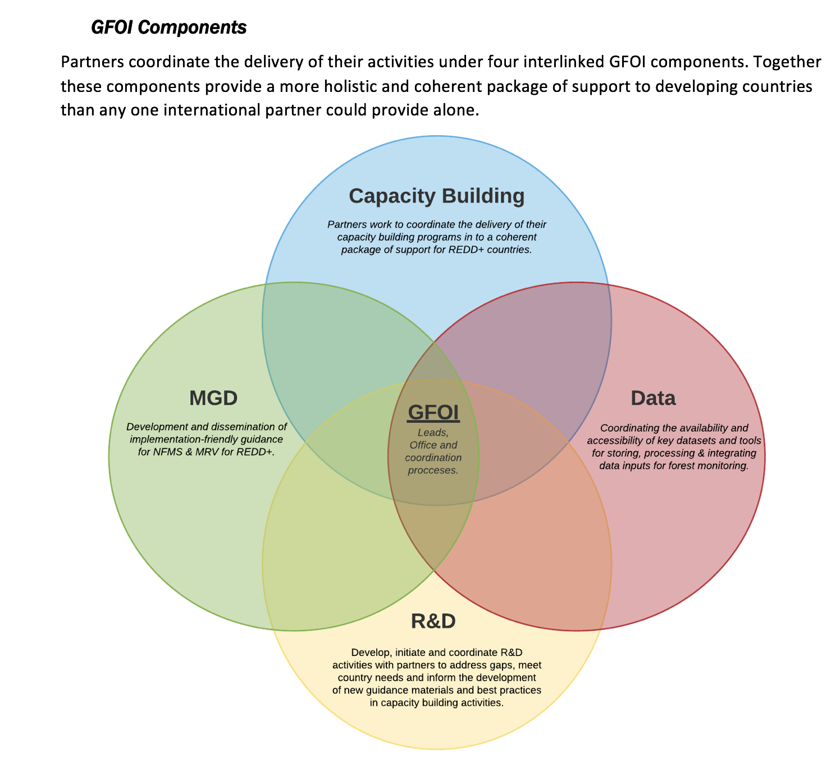
Phase 2 of GFOI
Joint assessments of country needs and collaboration to address them
Complementary and consistent CB activities
IPCC- and UNFCC-compliant country guidance for REDD+ reporting
Expanded data support to put more emphasis on access, uptake and application and the relevant tool.
Coordinated R&D activities to support above
Expanded participation and leadership

Slide 6
CEOS Provisional objectives – Draft “CEOS Position”?
CEOS wishes to continue to grow that relationship via the Data Component mechanism – gaps in data and tools. With necessary links to CNA process and the CB, MGD and R&D components. Data component part of GFOI Plenaries.
User feedback and testbeds for CEOS pilots on new data architectures (like GFOICubes) and Analysis Ready Data
Active contribution to GFOI EW activity as unique role for EO, and with specific recommendations to GFOI R&D programme
Expanded participation in GFOI Leads Team brings in
major forest donor governments and provides opportunity to ensure EO aspects benefit (UK and DE both have active space agencies)
World Bank and engagement opportunities related to CEOS IFI strategy
Better ROI for GFOI R&D programme data suppliers. Phase 2 needs more specific, prioritised, focused programme of funded R&D activities – defined top down and from CNA. Proposed strategy note ASAP.
Maintenance and assured continuity of the global baseline coverage, with forthcoming discussion on Space-based Lidar missions which would be complement with In Situ measurement on AGB

Slide 7
JAXA Strategy towards Forest Observation Architecture
Current Method
Complement
with Optical
Current Method
Complement
With In Situ
Optical
Landsat, Sentinel-2, ALOS-3 etc
SAR
Sentinel-1, ALOS-1/2, etc
In Situ
Forest Height/Diameter/Type
Lidar
Forest Height/Biomass
Tier1. General
Forest Carbon Stock
And Change
(Every 1-5 years)
NFMS
REDD+
MRV
10-30m resolution
Cloud Free Area
10m resolution
Global Coverage
×
＝
Tier2. National/Local
Tier3. Model and Validation
Forest Area
Carbon
(per unit)
Carbon
（National）
Near real time
Data
EW systems
(GFW, JJ-FAST, GLAD, etc)
Forest Change Detection
(Near real time)

Slide 8
GFOI Data Component
CB (User Needs Assessment)
R&D
GFOI Data Component
CEOS
(Lead)
UNs (FAO)
Countries
Commercials
Others
SDCG
SEPAL
Tools/Data
High Res Data
Tools/Data
Architecture Study
Pilot Activities with countries
Workshops?
Acquisition
Pre-Processing
Delivery and Analysis
Land cover
Land use change
Ground data
Integration
Reporting and Verification

Slide 9
CEOS Process
Clarity of requirements from GFOI Leads on CEOS engagement and contribution to Phase 2 (i.e. GFOI expectations to CEOS)
Establishing updated objectives and opinions from active CEOS agencies
And consensus on overall CEOS position from upcoming CEOS SIT meeting (April 24-25 in Boulder US)
SDCG operation and resourcing task underway

Slide 10
CEOS SIT 33
GFOI Side Event, April 23, 15:30-16:30
Introduction of GFOI Phase 2 incl. Data Component
Draft SDCG WP for GFOI Phase 2
Space Agency round table - Perspectives, Positions and Insights for GFOI Phase 2
Discussion on CEOS Position for GFOI Phase 2
Summary
SIT-33 Plenary, April 24-25
6.4 | 9:45 – 10:00 15 min | SDCG: Ad Hoc Space Data Coordination Group for the Global Forest Observations Initiative (SDCG for GFOI) Resourcing action follow-up | Osamu Ochiai, GFOI Lead for CEOS (JAXA) (TBC)

