Slide 1
GFOI Space Data Services
Brian Killough / NASA, CEOS SEO
SDCG-13, March 16, 2018

Slide 2

Agenda
3-Year Work Plan Tasks and Outcomes
  #6: Ensured On-going Coverage
  #7: Interoperable Data Discovery Tools
  #8: Assembly and Delivery of Core Data
  #10: Cloud-Computing Pilot Projects
  #11: Model National GFOI Data Services
Open Data Cube

Slide 3
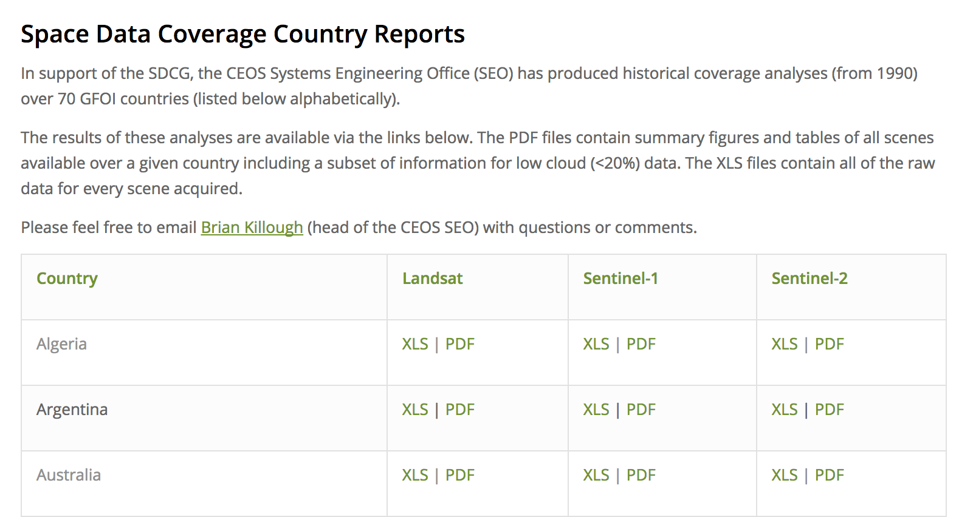
#6: Ensured On-going Coverage
Archive Characterization
The SEO has now automated the production of Landsat, Sentinel-1 and Sentinel-2 country reports and they are posted online for all 70 GFOI countries. The reports are updated on an annual basis.
These reports will be valuable for
countries to assess available scenes
and cloud cover for future data
ordering.

Slide 4
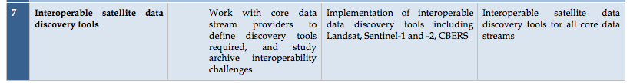
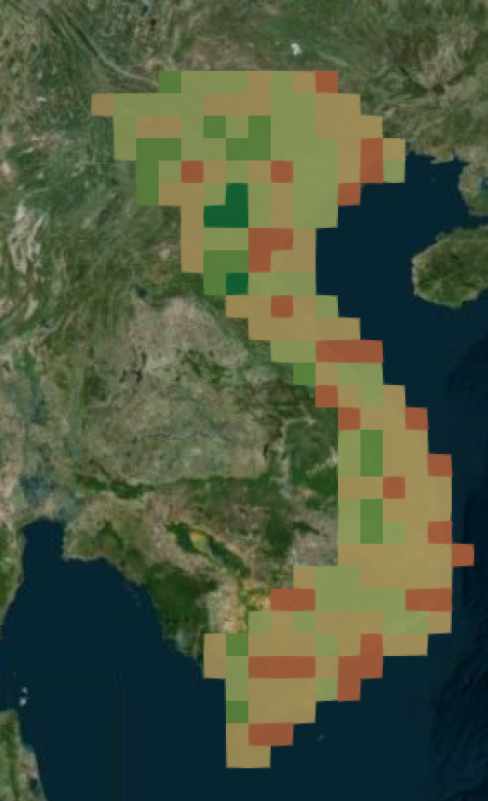
#7: Interoperable Data Discovery Tools
The COVE Tool now includes links to archive databases from: Landsat 7/8, SPOT 1-6, Pleaides-1A/1B, Radarsat-2, TSX, ALOS-1, Sentinel-1A/1B and Sentinel-2A.
The SEO vision is that the COVE tool can provide a “one-stop” location to perform coverage assessments and “discovery” of valid images. It also gives the user direct links to data ordering, when possible.
The new COVE ”Coverage Analyzer” tool can perform country-level and global queries of the Landsat and Sentinel archives in one tool! The new COVE “Data Browser” tool allows detailed browsing of scene information to support data ordering decisions.
Sentinel-1 acquisitions over Vietnam for Jan-Jun 2017 at 0.5 deg

Slide 5
#8: Assembly/Delivery of Core Data
The provision of “core data” for GFOI purposes is in place and there are few issues.
Countries can use the FAO SEPAL tools or the new Open Data Cube tools as methods for data analysis. These tools can be deployed locally, or on data hubs or computing clouds.
The SEO is working with Google to develop a method for “Data Cubes on Demand” using the Google Earth Engine holdings. This has been recently tested for Sentinel-1 radar data cubes.
The move toward sustained Analysis Ready Data (ARD) significantly improves the efficiency and effectiveness of core satellite data. This is being worked within CEOS.

Slide 6
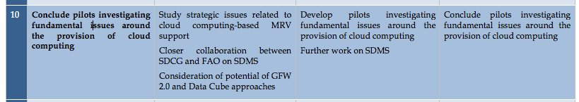
#10: Cloud Computing Pilot Projects
The SEO is working with Amazon to test Data Cube cloud storage and computing.
Most countries prefer local deployment of data for analysis purposes, but there are several countries that desire to use cloud computing (e.g. African Regional Data Cube, Uruguay, Mexico).

Slide 7
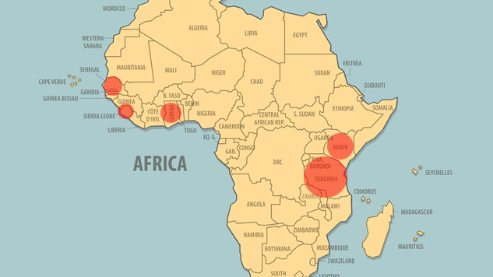
ARDC Countries
Ghana, Kenya, Senegal, Sierra Leone, Tanzania

Slide 8

ARDC Operational Model
Strathmore
University
(Nairobi, Kenya)
Amazon Web Services (AWS) Cloud
S3 Data Storage
(13 to 23 TB)
EC2 Computing
* Data Cube management, new data
ingestion, web-based user interface
* Managed by Strathmore with
support from NASA-SEO
Landsat 7/8
Sentinel-1
Sentinel-2 (year 2)
Kenya
Sierra Leone
Senegal
Ghana
Tanzania
Each country has its own EC2 Computing “instance” for analysis purposes (User Interface
and Jupyter Notebooks), but S3 data storage is shared among countries in the AWS cloud

Slide 9
ARDC Stakeholders
What stakeholder groups can participate in this ARDC project?
GPSDD ... Primary lead and initiator of the ARDC
Strathmore University ... Responsible for core ARDC operations and data management
NASA (CEOS SEO) ... Technical lead for initial deployment, training and implementation
UK-Catapult ... Potential to support Sentinel-2 data acquition, processing (via ARCSI), and ingestion in the cube + capacity building for Strathmore
UK-Rhea ... Potential to merge their Uganda Data Cube with the ARDC and add application algorithms and capacity building for users
GEO ... Promotion of the ARDC among African users and relevant global groups
Radiant Earth ... Interested in using the cube to develop and test algorithms for the region with a focus on agriculture

Slide 10
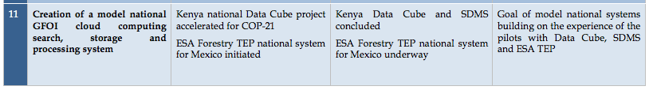
#11: Model National GFOI Data Services
To date, we have not identified a “Model National GFOI Data Services” system.
FAO is continuing to enhance its SEPAL tool and CEOS is working on its Open Data Cube tools.
As these two initiatives progress, the GFOI group should discuss the notion of a “model” system (or systems) and how to serve the community most effectively and efficiently.

Slide 11
The Data Cube Vision
A solution supporting priority objectives …
  Build capacity of users to apply CEOS satellite data
  Support GEO and United Nations agendas
Customer focused …
  Easy to install and maintain with training materials
  A brand that people know and trust
Scalable solution …
  Operational Data Cubes in
  20 countries by 2022
  Partnerships with …
  Google, Amazon

Slide 12
The “Road to 20”
4
5
34
Operational
Under Development
Under Review or Expressed Interest
43 total countries in the first year!

Slide 13
Which have an interest in Forests?
The CDC team is engaging with over 40 different countries to consider the deployment of Data Cubes. Many of those countries have a desire to support forest applications.
We know that these 9 countries have an interest in forest applications, but there may be more: Colombia, Switzerland, Vietnam, Taiwan, Kenya, Hondurus, Canada, Guatemala, Brazil.

Slide 14
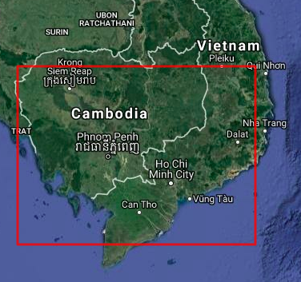
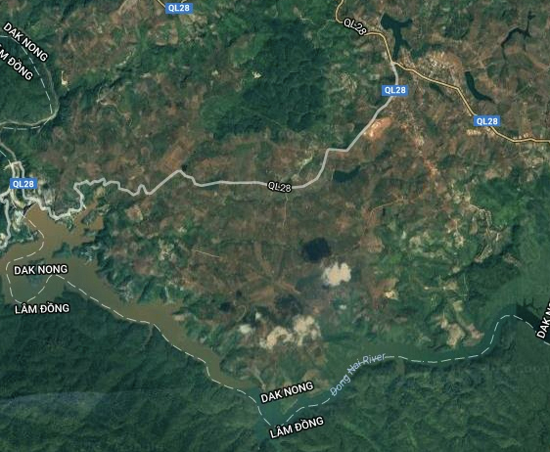
Vietnam Data Cube Example
Land Change Detection using PyCCD with the Open Data Cube
in the Lam Dong Province
of southern Vietnam
Dong Nai River in Lam Dong Province

Slide 15
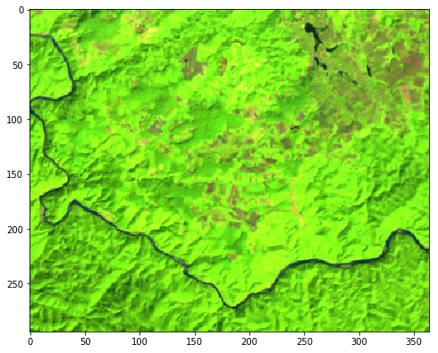
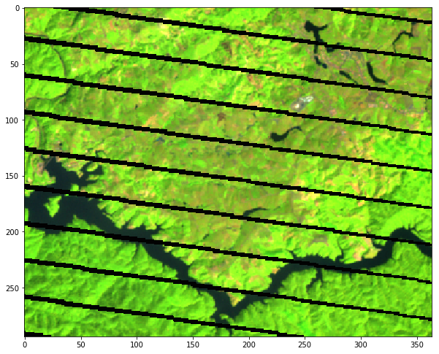
January 2001
January 2015

Slide 16
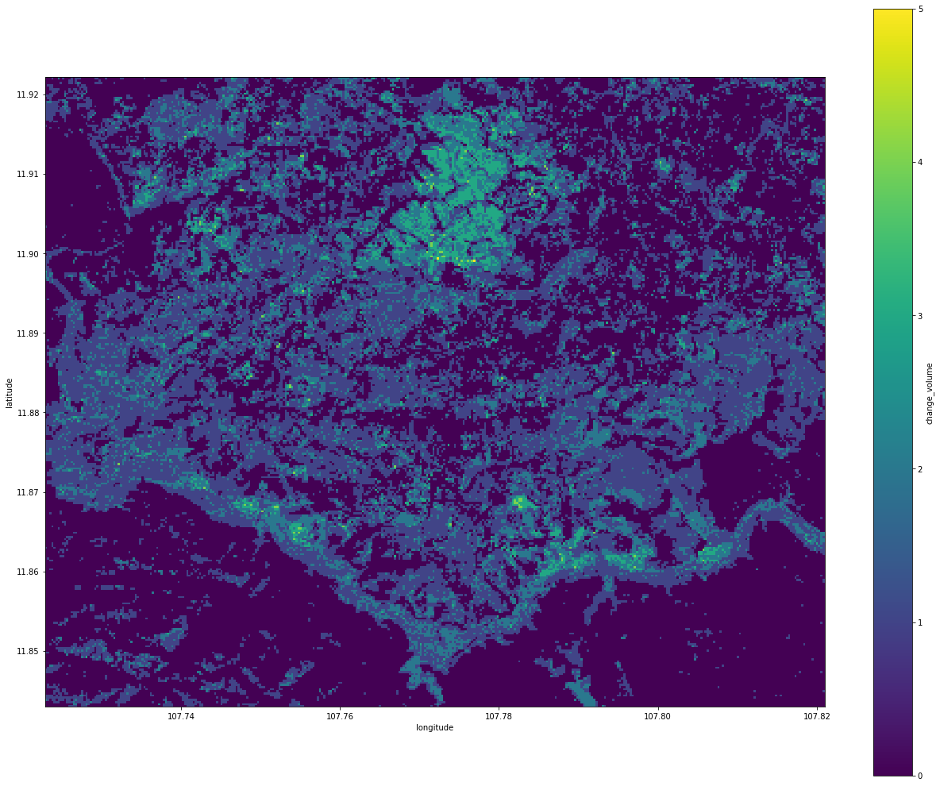
2001 thru 2014 – Number of Land Changes
5
4
3
2
1
PyCCD algorithm: 8 hours execution – 21 million pixels

Slide 17
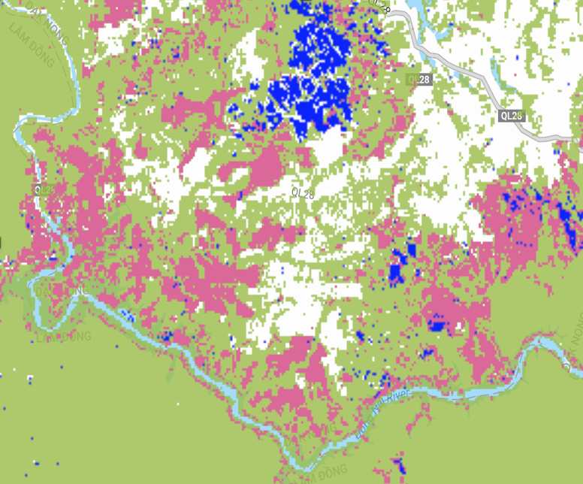
Matt Hansen’s GFW Forest Product
2001 thru 2014 – Forest Loss (red) / Gain (blue)
For comparison with the PyCCD Data Cube result

Slide 18
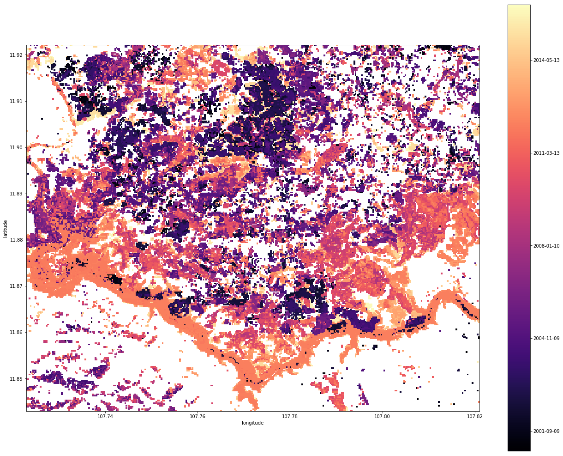
2001 thru 2014 – First Year of Change
2014
2011
2008
2004
2001

Slide 19
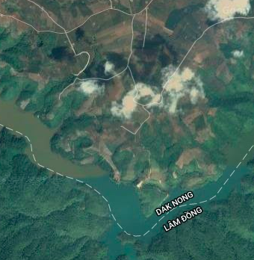
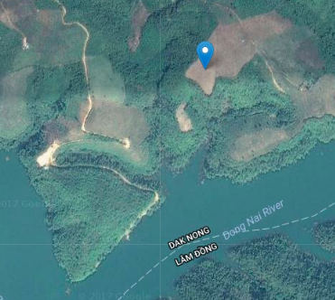

Slide 20
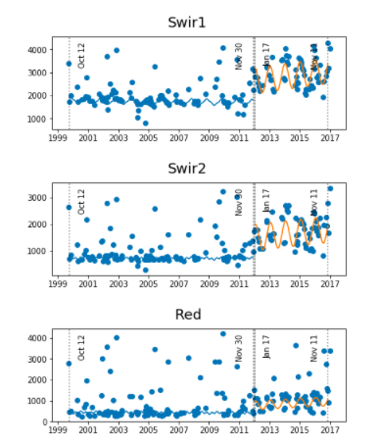
Land Change “break” in 2012 is most evident in the SWIR bands
Likely a change from forest to grassland / agriculture

Slide 21
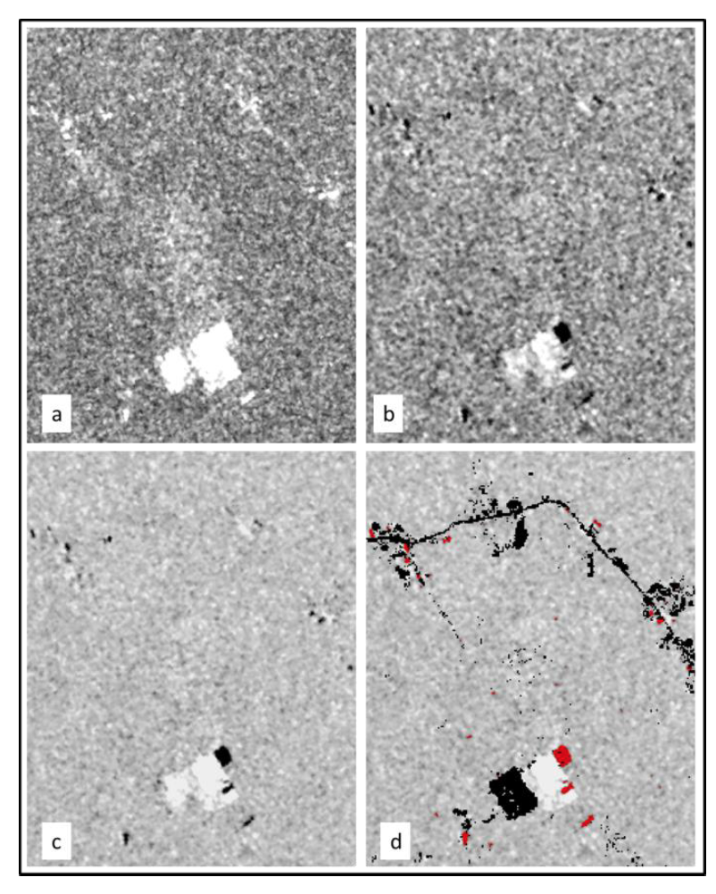
Radar Time Series Forest/Land Change (Deutscher Algorithm)
A new method to find forest/land disturbance using radar time series. Calculations are based on the dual-pol coefficient of variation and backscatter trend.
Sentinel-1 Example (left)
(a) Mean coefficient of variation of entire time series (for both VV and VH)
(b) Backscatter trend: (Mean of recent 3 images) – (Mean of past 3 images) ... for both VV and VH bands
(c) Product of (a)*(b) … for both VV and VH
(d) Disturbance results using a threshold value. RED = deforestation, BLACK = non-forest areas removed using GFW mask
Comments: Vegetation loss (black) and vegetation gain (white) are easily delineated in figure (c). A threshold value could be applied to these results to identify probable forest loss (black) and increased vegetation (white) without applying a forest mask (used to achieve the results in (d)
Under Evaluation ...

Slide 22

What is coming next?
  New Data Cube deployments:
  Vietnam, Taiwan, Uganda and an
  African Regional Data Cube
  Progress collaborations with
  Google (Earth Engine cube export)
  and Amazon (Data Cubes on demand in the cloud)
  IGARSS Conference in Valencia, Spain (July 2018) … dedicated paper session and training course
  New user applications and algorithms: Geomedian mosaic, Land Classification clustering, Sentinel-1 time series land change, NDVI Trend, 3D Hovmoller plots

