Slide 1




CEOS ARD strategy – and SDCG role
SDCG-13: Bogota, 15-16 March, 2018

Slide 2
CEOS ARD Strategy
Part of FDA strategy
Starting with CARD4L technical PFS
With broadened supply outlook, outreach and feedback activities
Led by LSI-VC
  Actions on ARD strategy paper
  ARD communication papers (suppliers, intermediaries, users..)
  Stocktake and supply outlook
  Advocacy letter from ODC (also GFOI? And GEOGLAM)
Competitive move by government programmes to leverage each others programmes and investments

Slide 3











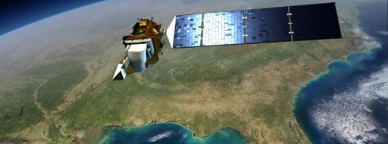
Land imaging … in 2006?
Exploitation Layer
Science
projects
Data
Data Generation Layer
Ground Segment Infrastructure
SPOT
Envisat
ALOS
Terra,
Acqua
……
Landsat
Radarsat

Slide 4

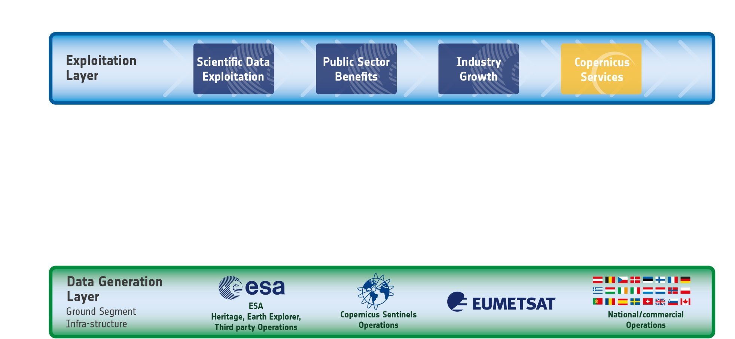











The evolving EO Ecosystem
Many “general
public” users
Complexity
++ less “sophisticated users”
Few sophisticated users
++ missions and ++++ data
“Small” data Big data

Slide 5
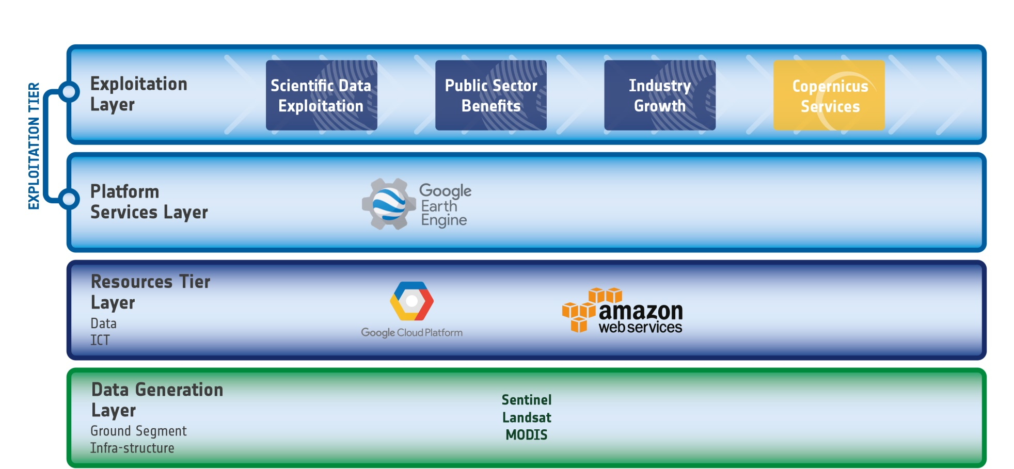
The evolving EO Ecosystem
IT industry starts investing
… Google and Amazon start hosting US public missions and later Sentinel Data
with Google providing a first cross-mission analysis environment

Slide 6
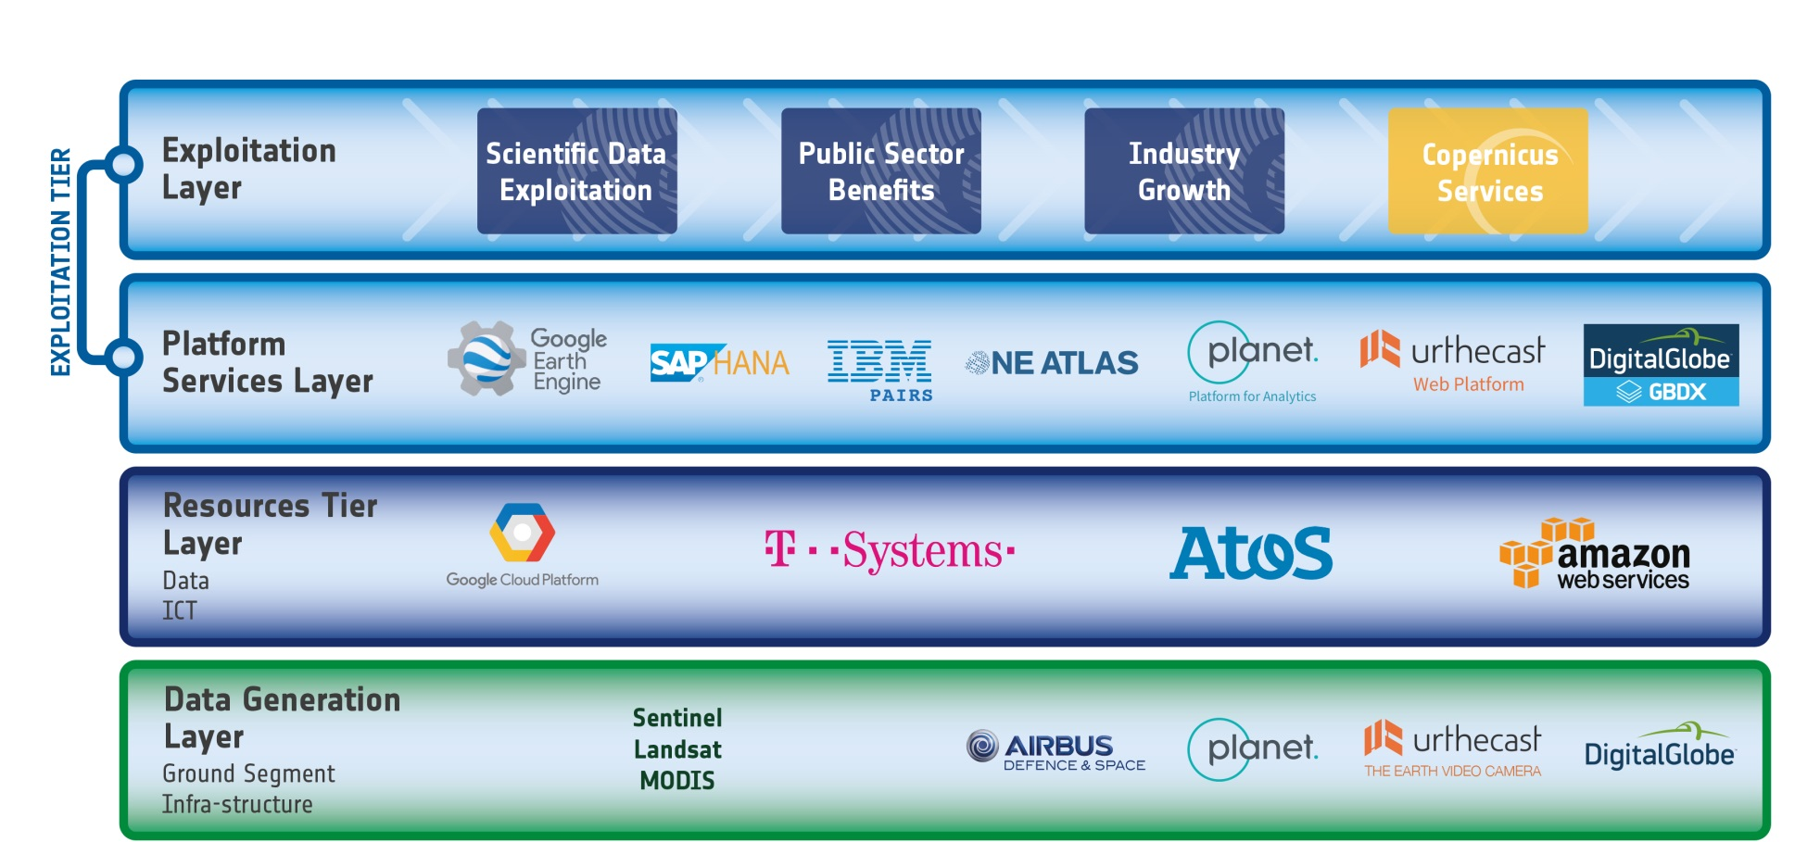




The evolving EO Ecosystem
The Established EO sector reacts …
… and start using the new capabilities, with principally US and European actors addressing the EO market offering new Data Analytics capabilities

Slide 7

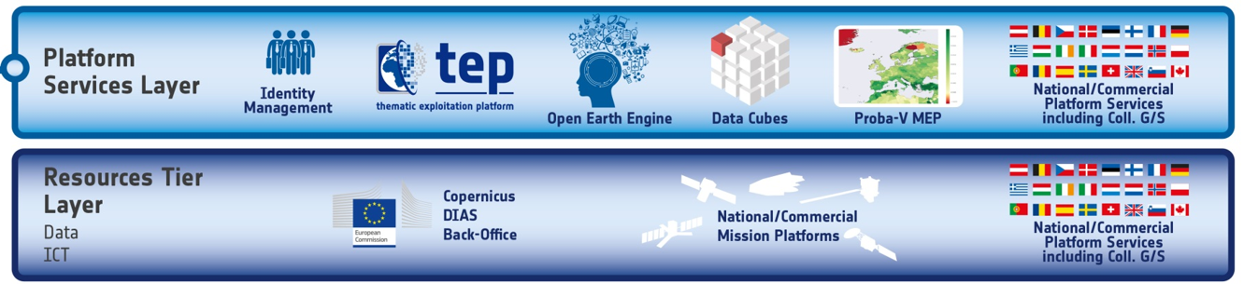

Where does Analysis Ready Data fit in?
ARD
ARD
ARD
ARD
ARD
ARD

Slide 8


Where does Analysis Ready Data fit in?
ARD
ARD
ARD
ARD
ARD
ARD

Slide 9
CEOS ARD for Land
CEOS Analysis Ready Data for Land (CARD4L) definition:
  CARD4L are satellite data that have been processed to a minimum set of requirements and organized into a form that allows immediate analysis with a minimum of additional user effort, and, interoperability both through time and with other datasets
CARD4L is a framework for establishing ‘minimum requirements’ for products that:
  Are ready for ‘immediate analysis’
  Require minimal additional user effort to prepare
  Interoperable with other CARD4L datasets

Slide 10
CARD4L Framework
Definition of CARD4L
Product families with specification (e.g. surface reflectance, surface temperature, SAR backscatter intensity)
Providers self-assess how well their products meet the specifications
Peer review
CARD4L stamp (threshold: immediately useful for scientific analysis or decision-making; target: will reduce the overall product uncertainties and enhance broad-scale applications)

Slide 11
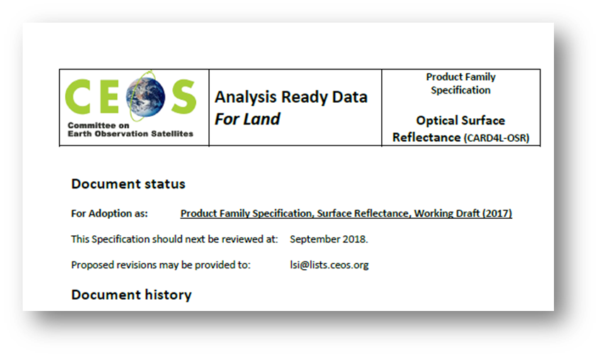
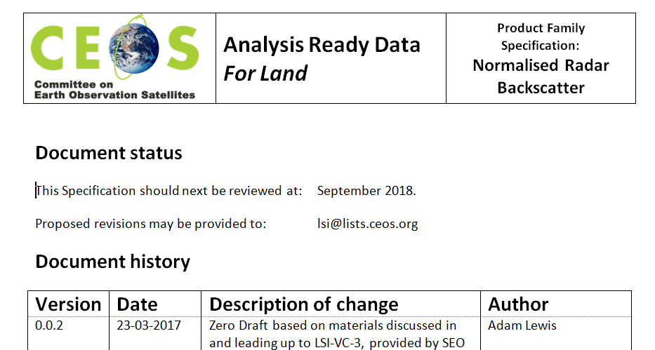
CARD4L Product Family Specifications - Background
Product Family Specifications (PFS) have been first developed (early 2017)
  Surface Reflectance
  Land Surface Temperature
  Radar Backscatter
Product Family Specifications are technical documents
Detailed input to the draft CARD4L specifications was received in June - Sep 2017 and in Dec 2017 (technical teleconferences)
Other PFS will probably emerge, e.g., Radar phase data, water leaving radiance
Very strong support for CARD4L is indicated by a range of experiences and activities (UK, ESA, USGS, NASA, Canada, GA, CNES, etc.).
https://drive.google.com/open?id=1n4C38E-HGdEplxhlHZRIQIStoiHWZ_bI

Slide 12
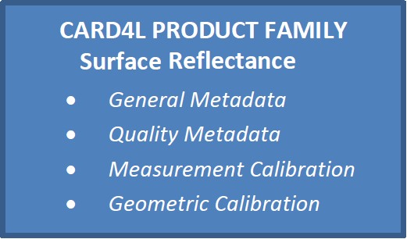
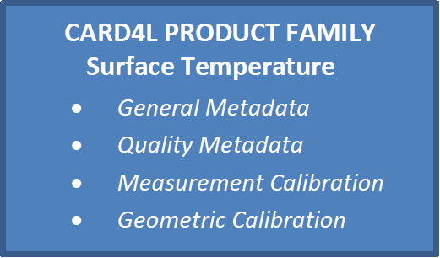
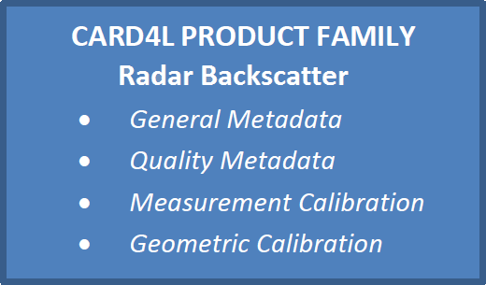
Multiple Sensors & CARD4L products
Sensors
Product Families
ARD products
Landsat OLI
Surface Reflectance - OLI
Landsat ETM+
Surface Reflectance – ETM+
Landsat TM
Surface Reflectance - TM
Landsat TIRS
Surface Reflectance - MSI
Sentinel-2a MSI
Surface Reflectance – Planet.
Sentinel-2b MSI
Surface Temperature - TIRS
ALOS - PALSAR
Backscatter – L band PALSAR
Sentinel-1a,b
Backscatter – C band SAR
… etc.

Slide 13
CARD4L Product Family Specifications - Refinement
PFS may change over time in a controlled process, e.g.:
  Feedback gathered from technical experts
  Proposed changes are collated
  Proposed changes are submitted to CEOS (LSI-VC) for acceptance
Decision at LSI-VC-5:
  Evolutions will be possible when identified as necessary
  However PFS stability is to be prioritised

Slide 14
PFS Current Status
LSI-VC will now move into an implementation phase with several objectives:
  “Road-test” the Product Family Specifications, including through further technical teleconferences
  Develop the process for datasets to be assessed as CARD4L
  Identify data products that are on-track to become CARD4L
  Monitor and communicate progress of individual products toward CARD4L
  The Product Family Specifications will continue to evolve as the LSI-VC gathers feedback in the Alignment Assessments

Slide 15
SDCG and ARD
Advocacy role for CEOS
Thematic community feedback channel
Pilot activities with GFOI user countries and experience
Contact points harvested during Bogota Plenary
Thoughts on optimal approach?

Slide 16
WP: Element 2 – Space Data Services
Ensured on-going coverage customised for all of the priority countries, and the development of semi-automated tools for the generation of national core data stream archive characterisation, as required.
Progress pilots investigating fundamental issues around the provision of cloud computing-based storage, processing and presentation of GFOI products as the basis for national MRV consistent with the Methods and Guidance.
Establish and grow a community of GFOI countries engaged in CEOS pilots for technical exchange of information on use of MGD-compliant Data Cubes, algorithms etc – including Colombia, Switzerland, Vietnam, Honduras/Taiwan and others.
Establish and grow a community of GFOI countries to provide feedback on the utility for the forest monitoring community of CEOS Analysis Ready Data and advocate for the necessary adaptation and supply of data to meet GFOI needs. Establish a programme of application pilots and feedback with volunteer countries and reporting bodies.

Slide 17
WP: Element 3 - R&D Support
Implementation of the Element-3 strategy document endorsed at SIT-30 and SIT-31.
Providing the satellite data required to progress the GFOI priority R&D topics outlined in the GFOI R&D plan to pre-operational or operational status, in coordination with the R&D Coordination component, and in support of improvements to the Methods and Guidance.
Pursuit of a dedicated GFOI R&D fund with the main GFOI donors to address and remove the main technical obstacles to use of EO satellite and other data in reporting of countries.
Maintain engagement with public, hybrid, commercial data providers and NGO brokers, through a management and accountability framework implemented in conjunction with an SDCG mechanism for brokering space data requests in support of GFOI R&D activities.

Slide 18
WP: Country Engagement & Component Coordination
Delivery of a coherent customer experience for GFOI countries via efficient coordination among the GFOI Space Data component, the GFOI Methods and Guidance, Capacity Building, and R&D components, and the GFOI Office.
Space data support and services provided to all priority countries including coordination and integration with the Methods and Guidance and the GFOI Office.

