Slide 1
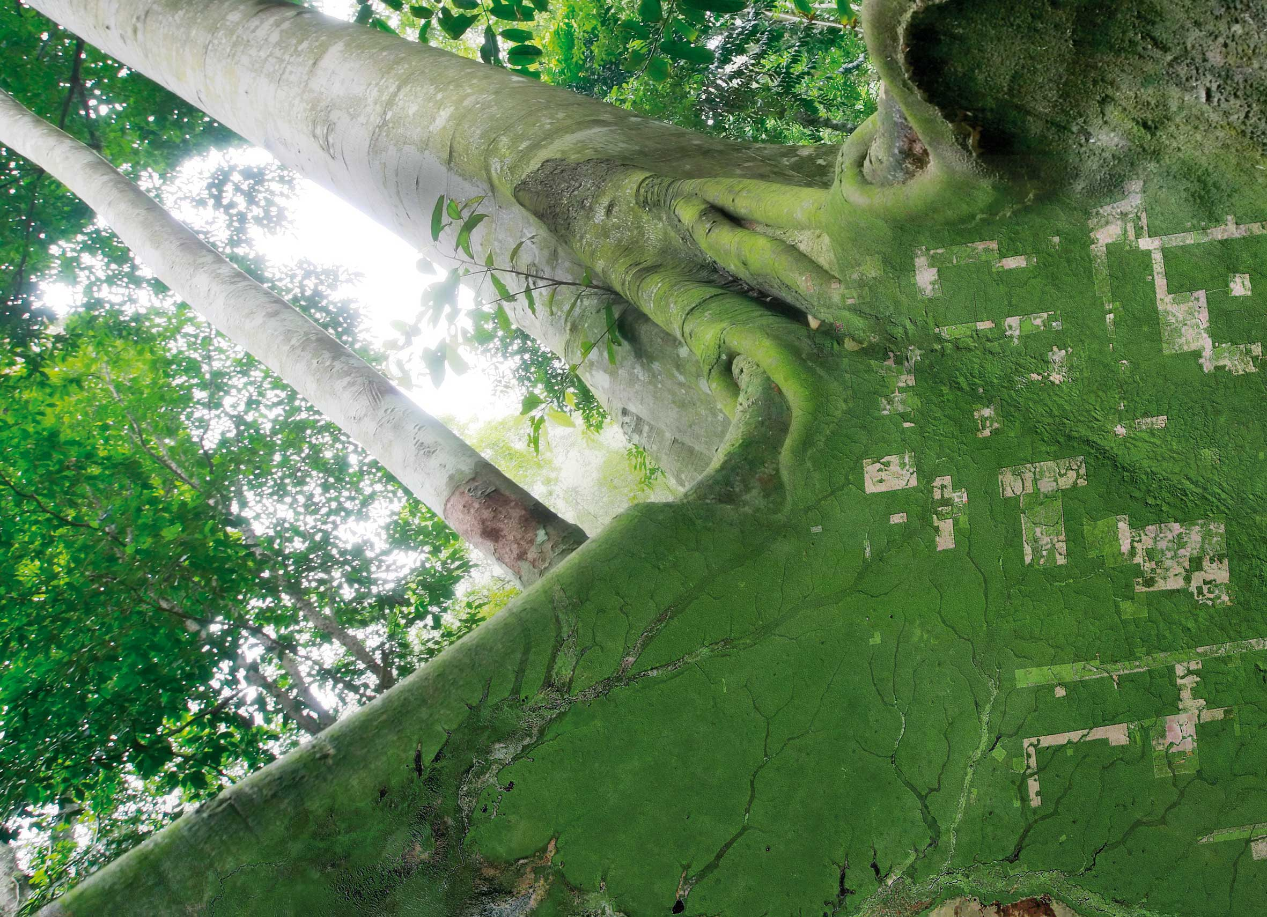
Introduction
SDCG-14: Ispra, 4-6 September, 2018

Slide 2
Week at a glance
Tuesday 4th | Wednesday 5th |  | Thursday 6th | Friday 7th
SDCG-14 | LSI-VC-6 | SDCG-14 | Joint Session | LSI-VC-6 | GEOGLAM
 |  | GEOGLAM |  | Travel

Slide 3
SDCG-14 – Objectives
Update on GFOI Developments and Implications for CEOS engagement & contribution
Finalise the updated SDCG 3-Year Work Plan (our reference & sales pitch)
Update on relevant CEOS agency forest monitoring activities & expectations of GFOI engagement
Prepare the SIT TW discussion on SDCG capacity
CARD4L for Forest Monitoring
GFOI Space Data Strategy Updates

Slide 4
Agenda – Tuesday Morning

Slide 5
Agenda – Tuesday Afternoon

Slide 6
Agenda – Wednesday Morning

