Slide 1
GIZ Forest Monitoring Activities
Slides by Raphael Linzatti, GIZ, from presentation at 39. D-GEO Meeting 28.6.2018, Eschborn (partly translated and modified)
TanDEM-X Data Provision / GFOI R&D Support
DLR SAR Roadmap
14th SDCG Meeting for GFOI, 4.9.18
Michael Bock
Helmut Staudenrausch
DLR Space Administration

Slide 2
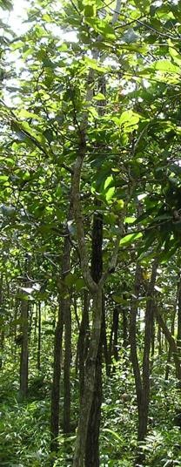
BMZ forest portfolio analysis – Projects
active contracts of 1.531,2 Mio. Euro in 39
countries und 20 regions
3 Main topics:
REDD+ (Reducing Emissions from Deforestation and Forests Degradation) FLR – Forest Landscape Restoration
ELK – Deforestation free delivery chains
63 running project (396,5 Mio. Euro)
Many programms with monitoring component including use of Earth observation – but no programm with strict Earth observation focus

Slide 3



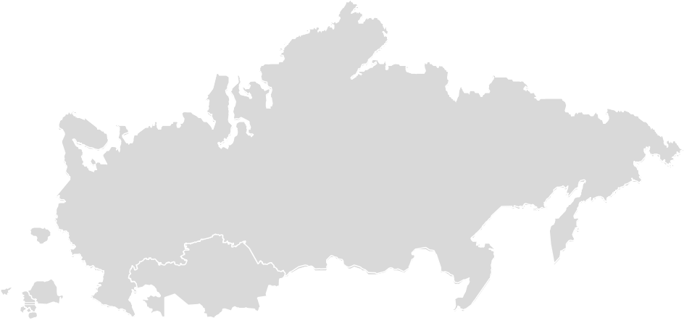








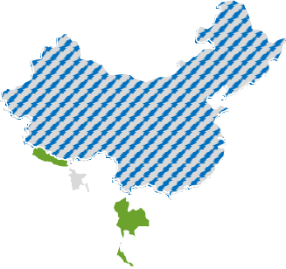































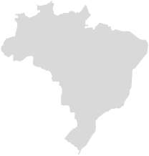

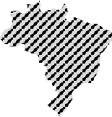



















Worldwide Financing of Forest Programmes by the BMZ
42
36
43
37
38
39
42
41
44
Mongolia
China
Nepal
Bhutan
India
Bangladesh
Cambodia
Thailand
Laos
Vietnam
Indonesia
Philippines
Sri Lanka
Vanuatu
Fiji
40
45
46
48
1
9
47
51
52
5
3
18
50
54
2
4
6
12
20
25
26
55
49
Mexico
Guatemala
Belize
El Salvador
Honduras
Nicaragua
Costa Rica
Chile
Dominican Republic
Colombia
Argentina
Guyana
Bolivia
Ecuador
Peru
Brazil
7
10
27
21 22
23
17
24
29
28
14
30
31
19
Ukraine
Georgia
Armenia
Azerbaijan
Pakistan
Kyrgyzstan
Tajikistan
53
15
16
Benin
Sudan
Kenya
Burkina Faso
Côte d‘Ivoire
Ghana
Togo
Cameroon
Nigeria
Ethiopia
Liberia
Uganda
Central African Rep.
Congo Rep.
Democratic Rep. of Congo
Tanzania
Mozambique
Namibia
Madagascar
32
13
56
57
34
33
35
Countries with bilateral forest programmes supported by the BMZ (both GIZ and KfW programmes)
KfW programmes GIZ programmes
Countries receiving multilateral BMZ support through the FCPF (REDD+)
Bilateral REDD+ programmes
8
11
Please note: not all member states of the BMZ supported regional organizations are shown in this map. The map is for informational purposes only and does not constitute recognition of international boundaries or regions. Database: BMZ Forest Portfolio Analysis by GIZ/IWP (record date: 31.12.2016) and FCPF 2016 Annual Report (Readiness Fund Grant Disbursements).

Slide 4
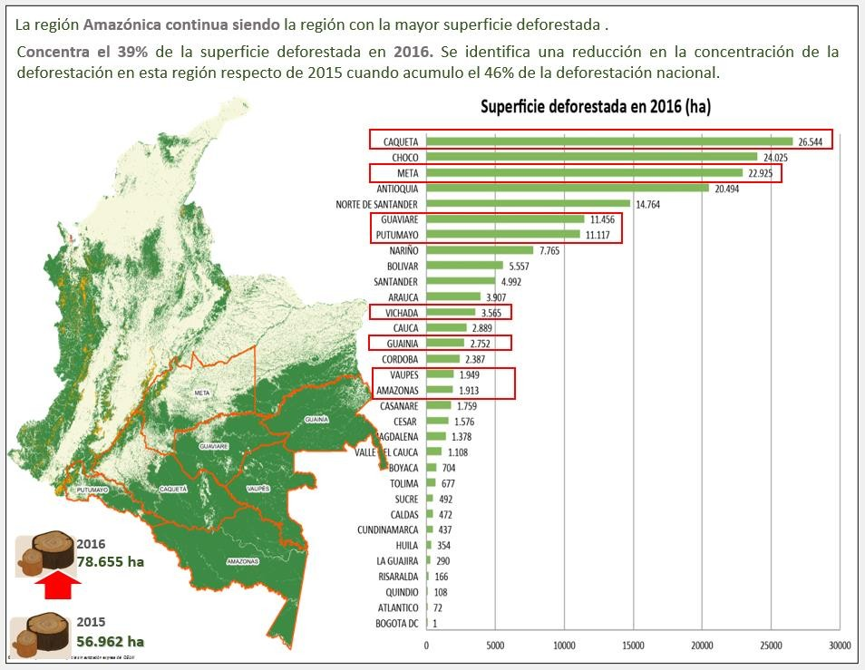
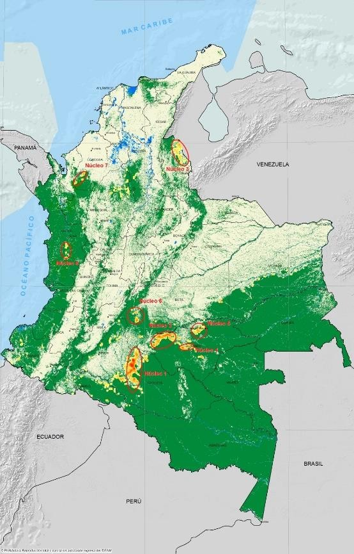
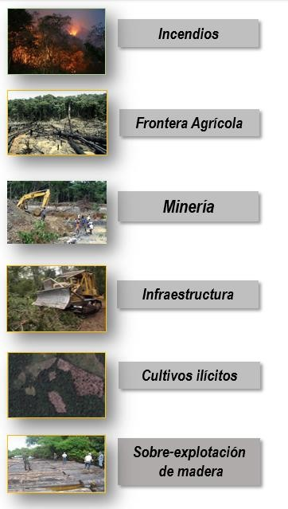
Example Colombia
Detailed analysis of Drivers:
Base for
Programm design
DeforestationEarly warning systems every 3 month Base for project monitoring and control (Steuerung)
Yearly data as base for
Result Bases Payment

Slide 5
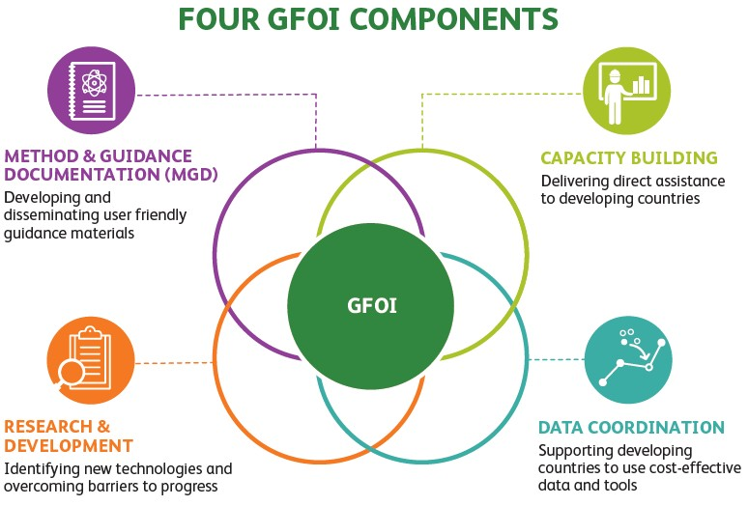
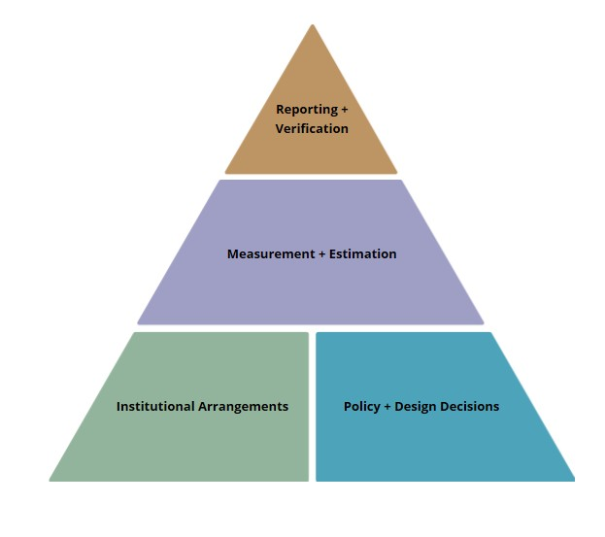
GFOI – A view on sucess by GIZ
Assembled a network of world leading partners who help implementing countries on forest monitoring & MRV issues
Published implementation friendly guidance which comply with the IPCC
Built technical capacity in countries
Facilitated wall-to-wall coverage of the world’s forests from multiple satellite sensors
Established network of experts to address obstacles to progress and build consensus
Country needs are targeted
GIZ / BMZ as observer, stronger Engagement in discussion
DLR Space Agency in support of providung national EO data

Slide 6
Technology developments in Earth observation in the context of forest monitoring: what are the challenges ?
Provide Information about technological und methodological developments to the countries, support Integration in implementation
(Cloud computing – Big data analysis – Data cubes - Sepal)
Capacity Development, within GFOI
Improvement in Monitoring of forest degradation und regeneration
  State of the Art: high ambiguities (Tree Crown Cover Method, Proxys)
  Potential for SAR ?
Improvements in higher frequency of revisits: Potential for SAR ?
Institutional sustainability of MRV Units in the countries
Challenge FLR programms: Complete the LULUCF view
Of Special Interest by GIZ/BMZ: Integration of Monitoring topics in other programms within the forest portfolio as well as in multil-ateral Fonds (FCPF, BioCF, GCF)

Slide 7
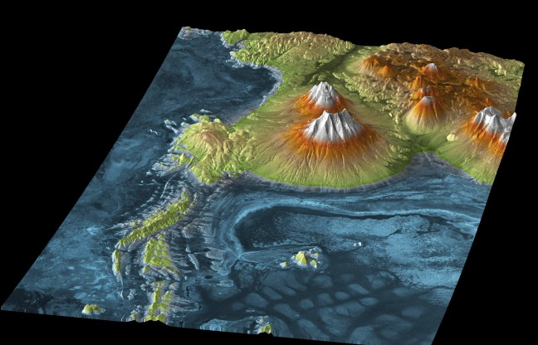
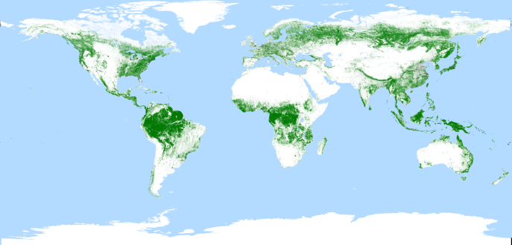
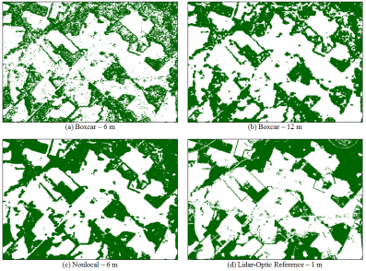
TanDEM-X data provision
TanDEM-X 90 m Global DEM to be released for science use at IAC Congress 2018
TanDEM-X 50 Global Forest map to be released soon (~ October 2018)
TanDEM-X 12m Global Forest production at DLR will begin 2019, first version ~ end of 2019

Slide 8
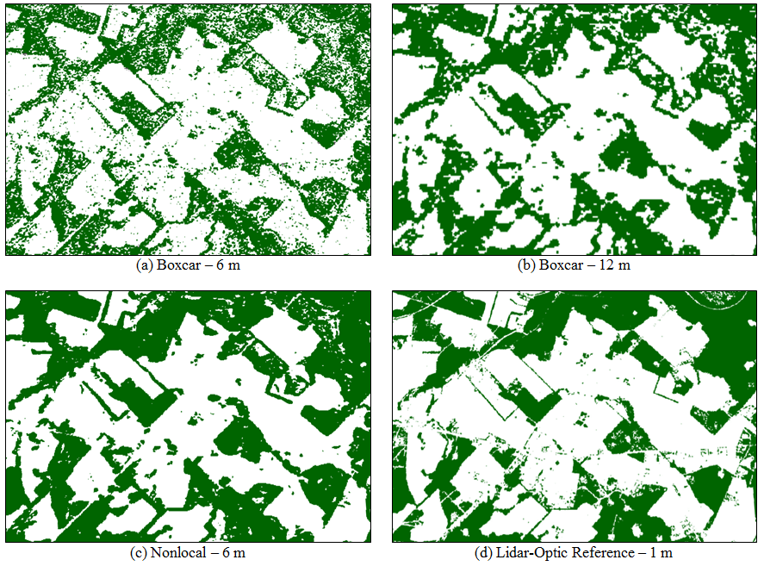
Example TanDEM-X 12m Forestmap
Image provided by Paolla Rizolli, DLR

Slide 9
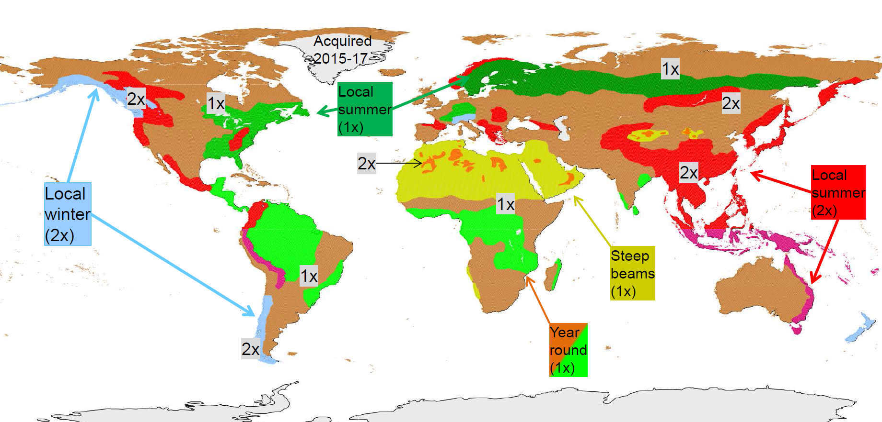
TanDEM-X Change map
Aggreement between DLR and AIRBUS shortly before signing
Change DEM production till Oktober 2019 before change to Mono-Pursuit Mode
TanDEM-X – GEDI Cooperation in discussion

Slide 10
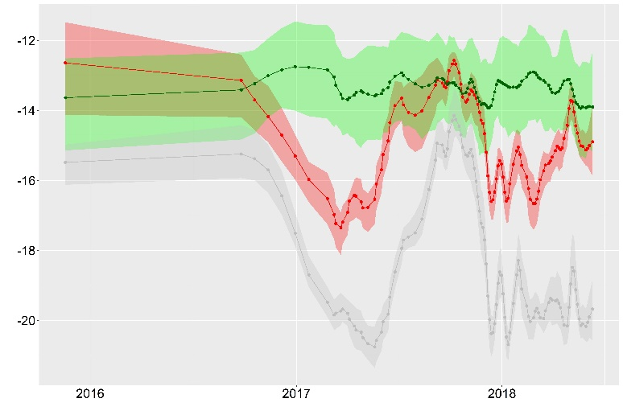
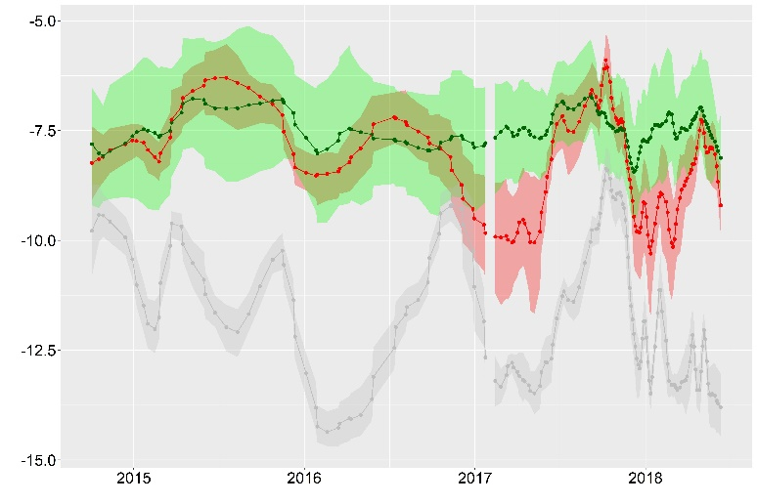

GFOI R&D
Sense Carbon (HU Berlin): Recent paper on 30 years of deforestation dynamics in Mato Grosso and Pará with you. Griffiths, P., Jakimow, B., & Hostert, P. (2018). Reconstructing long term annual deforestation dynamics in Pará and Mato Grosso using the Landsat archive. Remote Sensing of Environment, 216, 497-513
SEN4REDD (FSU Jena): Developing methods for REDD+ using hypertemporal Sentinel-1 and -2 data. New speckle filter (EMD) developed. Test sites in Mexico and South Africa. Capacity building trainings included.
Agriculture
Forest
VH backscatter
VV backscatter
Deforestation

Slide 11
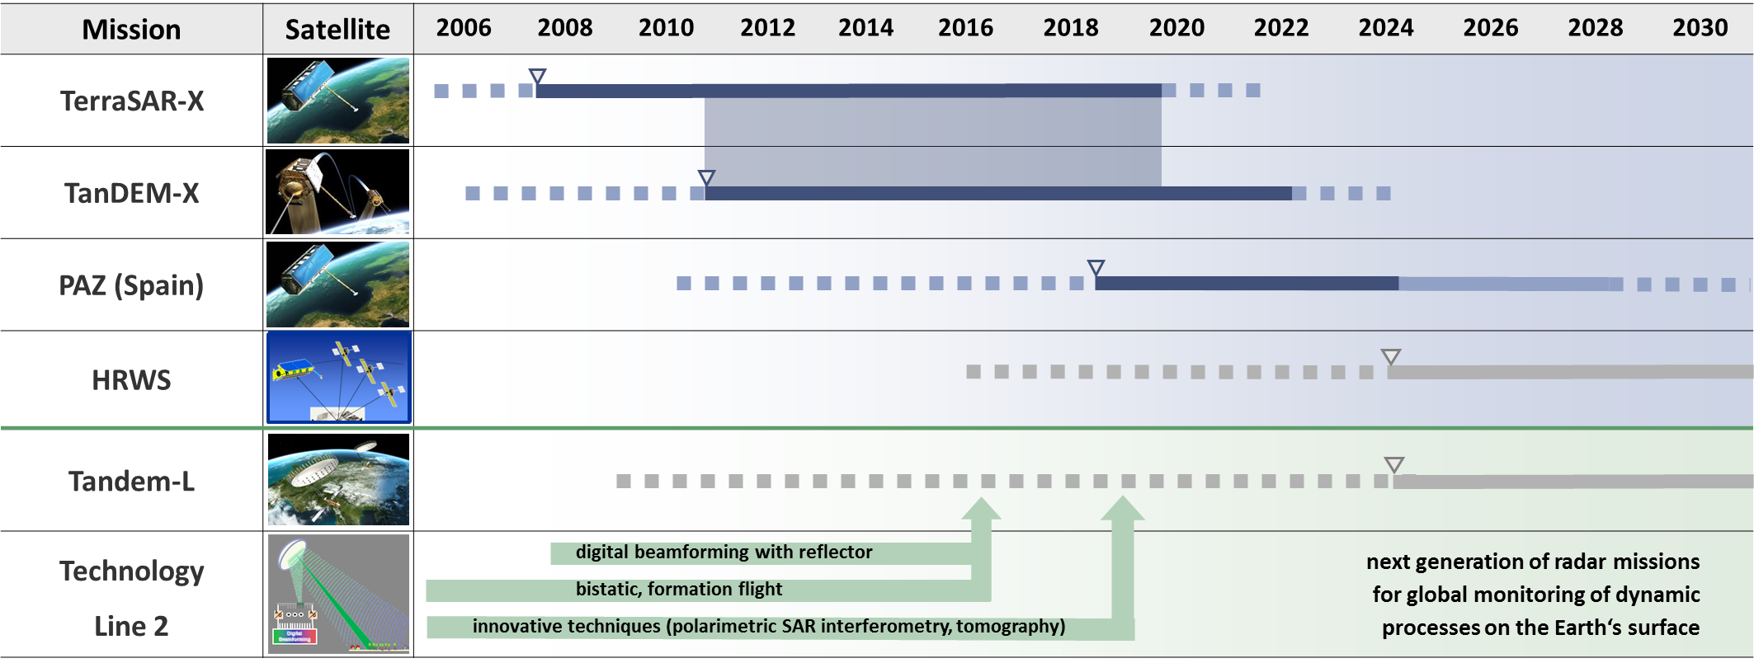

German Spaceborne Radar Roadmap
X-band roadmap with a focus on operational geoinformation services (HRWS)
New line for global monitoring of dynamic processes on the Earth’s surface (Tandem-L)

Slide 12
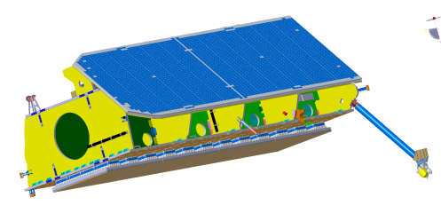
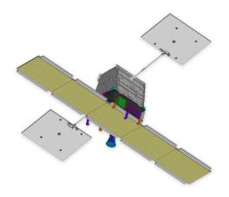

Multi-static High Resolution Wide Swath (HRWS) Mission Mirror SAR Concept
Mirror SAR Rx Signal
& Tx Pulses
SAR
Signal Processing
SAR Rx
Signal
Direct SAR
Tx Pulses
SAR Data
Link to G/S
SAR Rx
Signal
SAR Tx
Pulses
Private Public Partnership Modell envisaged
agile main SAT featuring DBF techniques & full polarimetry
up to 25cm resolution, up to 500km swath width
3 companion SATs for dual-baseline single-pass InSAR
Phase A finalized in Q4 2018
SAR Rx
Signal

Slide 13
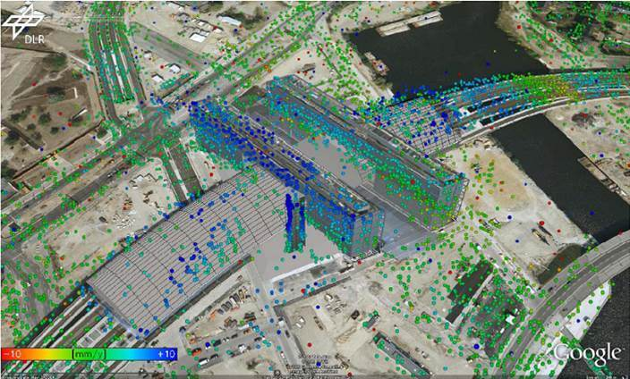
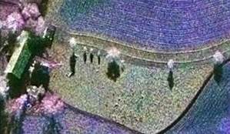
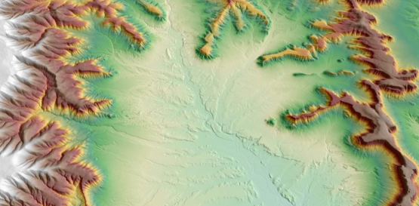
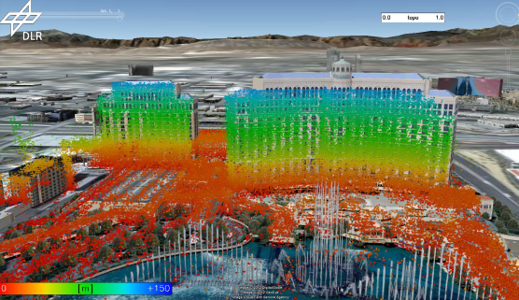
HRWS Application Potential
Mono-static Capabilities:
      High Resolution Infrastructure Integrity Monitoring using Interferometry
      Large Area Maritime Surveillance (Vessel Detection)
      Target Recognition using Quad Polarimetry
      Improved NRT capabilities using Laser Communication Technology
Multi-static Capabilities:
      On-demand regional Digital Elevation Models
      3D Re-construction using SAR Tomography
      3D/4D Change Detection
      Sea Ice Topography
      Ground Moving Target Indication using Along Track Interferometry

Slide 14
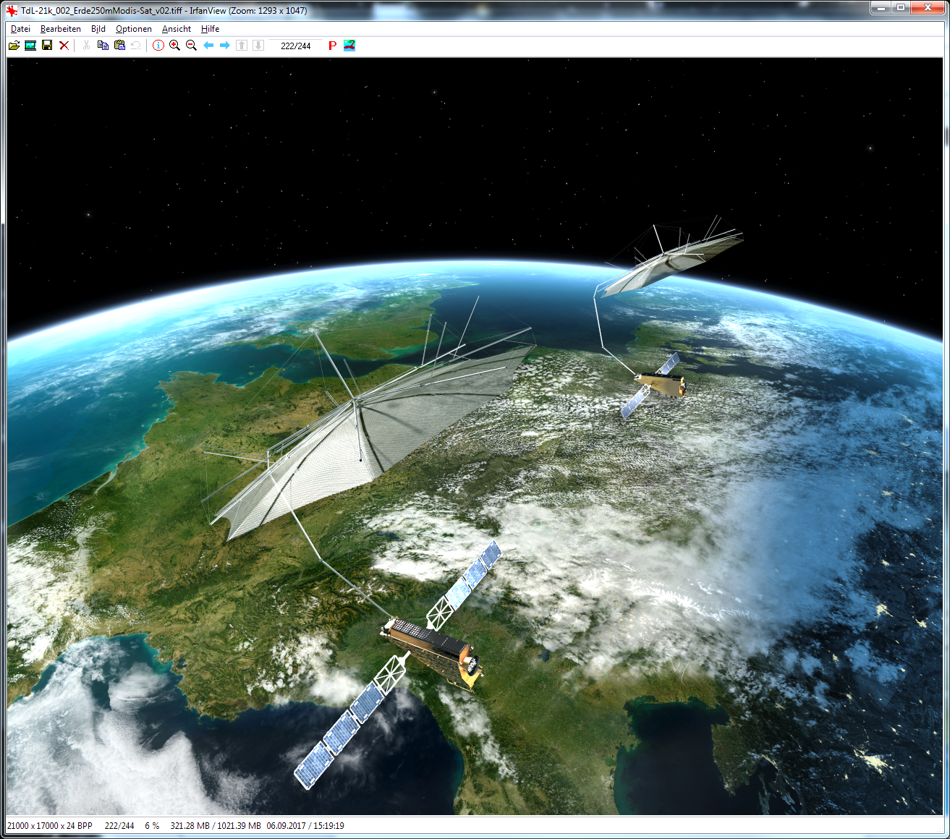
Tandem-L

Slide 15


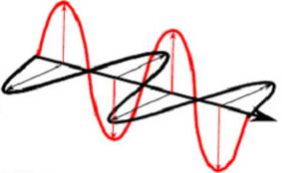
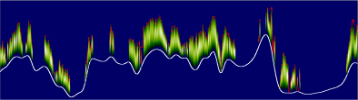
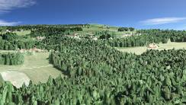
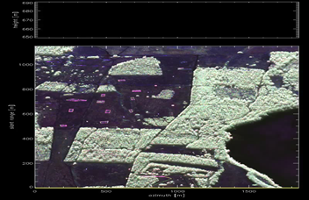
3-D Structure Mode
Polarimetric Backscattering
Polarimetric SAR
Interferometry
(Pol-InSAR)
3-D Forest Structure
Forest Height and Biomass
Tomography

