Slide 1
Canadian Space Agency
SDCG 14
JRC – September 2018
Yves Crevier
A/Head
Earth Observation Applications and Utilization

Slide 2
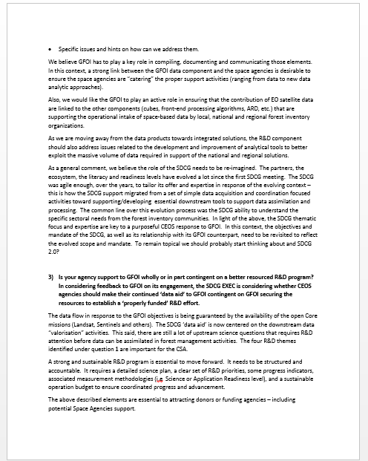

Slide 3
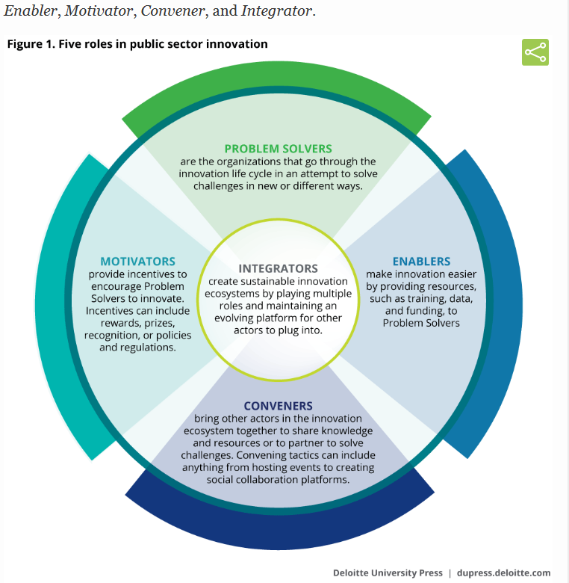
Overarching Roles
Developing innovative solutions
Providing tools or resources to make innovation easier
Creating incentive to spur innovation
Bringing various actors together to collaborate through the innovation process
Establishing and / or sustaining the innovation ecosystem as a whole
*Catalysing public sector innovation
https://www2.deloitte.com/insights/us/en/industry/public-sector/catalyzing-public-sector-innovation-initiatives.html

Slide 4
Early Supporter
Involved in SDCG since 2011
Hosted the first SDCG meeting in March 2012.
Contributed dedicated RADARSAT 2 data since 2009 (GEO FCT national demonstrator countries)
Over 23 years of archive in C-Band
Conducting systematic and coherent Monitoring Background Mission since 2012 over the circum-tropical belt

Slide 5
CSA Main Objectives for Engagement (SDCG)
Early promoter of Science Plan and R&D Agenda
Focused on Element 3 in support of our National Forest community (government, academic and private sectors)
Restricted to supporting science related activities due to the commercial nature of the RADARSAT 2 mission – role tbd under RCM
Support and enable end-users to exploit the large amount of SAR data that are now or will soon be available in support of forest management, ecosystem protection, carbon accounting, etc.
We would like the SDCG / GFOI to be as Global as possible and would foresee the integration of the Boreal Forest as a important component of the global forest inventory.
Favor open dialogue and partnership between SDCG/GFOI on endorsed GFOI science priorities
Structured, sustained, and accountable R&D

Slide 6
Science and Technical Interests
Use of Synthetic Aperture RADAR (SAR) for the monitoring of forest related attributes;
Interoperability and complementarity between SAR and optical datasets;
SAR/SAR mission interoperability;
Development of SAR-based approaches, algorithms, and methods that are viably sustainable to support local, regional, national, continental and global forest monitoring and carbon accounting.

Slide 7
Science and Technical Interests
SAR ARD – addressed under the CARD4L
Data Layer – infrastructure, discovery, sharing, analytics, cloud computing, etc.
AI and Machine Learning process to assess the value of long-term data series
Development of downstream APPLICATIONS/TOOLS at the intersection of Satellite-based EO data and other sources of data (from Space to in-situ)

Slide 8
Expectation from SDCG/GFOI Relationship
Clear definition of respective roles and responsibilities – should help in better defining SDCG sustainability
GFOI | SDCG
Support end-users Clear needs Data type, geographical areas Capacity building Key science questions (vetted by authoritative community) Operational needs Context, methods used to process and assimilate the data, accuracy and uncertainty tolerance on information products, specific issues and hints on how can help | Support needs Clear offer Data layer Support science for enhanced data intake and better understanding of information content Offer support for development of mature Apps using space-based data
Requires an open dialogue

Slide 9
RCM
Evolution of the RADARSAT program
Ensure data continuity and improve system reliability
respond to the Canadian Government needs
Expand the use of RCM Data by Government of Canada
Make RCM Data available, accessible, and affordable to the broadest extent possible
Continue to contribute to international efforts to manage disasters and assist in other international humanitarian efforts
Launch – November 2018

