Slide 1
ESA and Copernicus
Frank Martin Seifert
Earth Observation Directorate ESA-ESRIN, Frascati

Slide 2
Sentinel Mission and Status
Key Features
GFOI
Core
SENTINEL-1:
4-40m resolution, 6 day revisit at equator
2 Sats in orbit
Polar-orbiting, all-weather, day-and-night radar imaging
GFOI
Core
SENTINEL-2:
10-60m resolution, 5 days revisit time
2 Sats in Orbit
Polar-orbiting, multispectral optical, high-res imaging
SENTINEL-3:
300-1200m resolution, <2 days revisit
2 Sats in Orbit
Optical and altimeter mission monitoring sea and land parameters
FULL, FREE AND OPEN
SENTINEL-4:
8km resolution, 60 min revisit time
1st Launch in 2020
Payload for atmosphere chemistry monitoring on MTG-S
SENTINEL-5p:
7-68km resolution, 1 day revisit
Launched Oct 2017
Mission to reduce data gaps between Envisat, and S-5
SENTINEL-5:
7.5-50km resolution, 1 day revisit
1st launch in 2021
Payload for atmosphere chemistry monitoring on MetOp 2ndGen
SENTINEL-6:
10 day revisit time
1st launch in 2020
Radar altimeter to measure sea-surface height globally
Notes:
S3-B launch Q4/2017

Slide 3
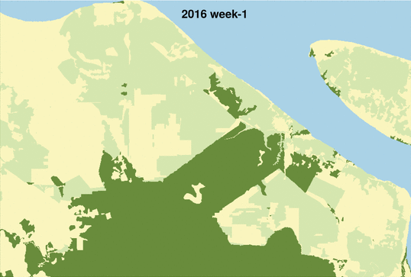
Sentinel-1: mission status
Sentinel-1 Overall Mission Status
Sentinel-1 nominal routine operations on-going
Sentinel-1A and -1B data routinely provided to Copernicus Services and users worldwide
On-going support to various activations from the Copernicus Emergency Management Service and International Charter Space and Major Disasters
Weekly Sentinel-1 Radar alerts 2016-18, in the Province of Riau, Indonesia:
Machine learning method based on Reiche et al. (2015, 2018; RSE)
Gap-free and consistent information in near real-time
Sentinel-1 constellation generates now nearly 12 TB of products daily (against a formal specification of 3 TB)
Sentinel-1 is operated close to its full mission capacity (i.e. difficulty to accommodate additional observations)
© Contains Copernicus Sentinel Data (2017) / WUR
Notes:
Upd –status and picture (Pierre)

Slide 4
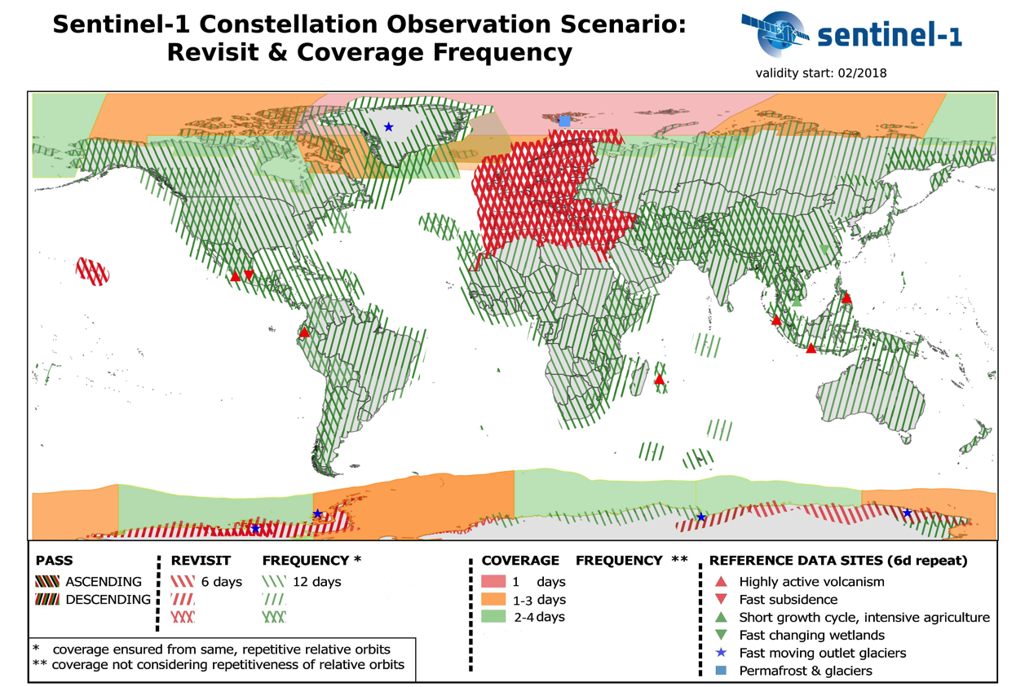
Updated Map
Baseline since
Feb 2018
Notes:
This is achieved using Sentinel-1A + sentinel-1B.
Emphasis puts:
For sea-ice / iceberg monitoring in polar areas, to support the Copernicus marine service
on Europe land and coastal waters: 6 day repeat pass in both asc and desc.
On some supersites (e.g. Hawai): also 6 day repeat pass in both asc and desc
Global land are mapped at least every 12 days in dual-pol (12d repeat pass to allow InSAR), and in both asc and desc for global tectonic mask

Slide 5
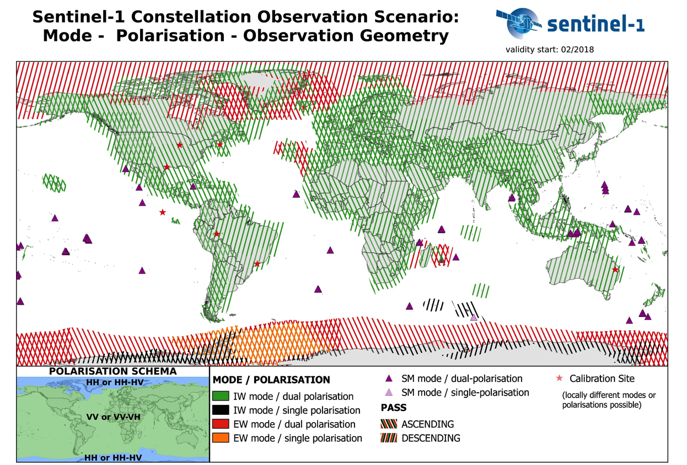
Updated Map
Baseline since
Feb 2018
Notes:
Same SAR mode routinely operated over a given area
Interferometric Wide Swath mode (IW) is the default mode over land and is suitable for InSAR
Extra Wide Swath (EW) mode is used for sea-ice monitoring and maritime surveillance
The asc or desc passes are visible on the map. The global tectonic areas (e.g. West USA) are imaged in both asc and desc passes to support InSAR applications.
The small triangles are where we can image in StripMap mode (SM). SM allows better resolution but smaller swath. This mode is only used to cover in one pass the small isolated volcanic islands…

Slide 6
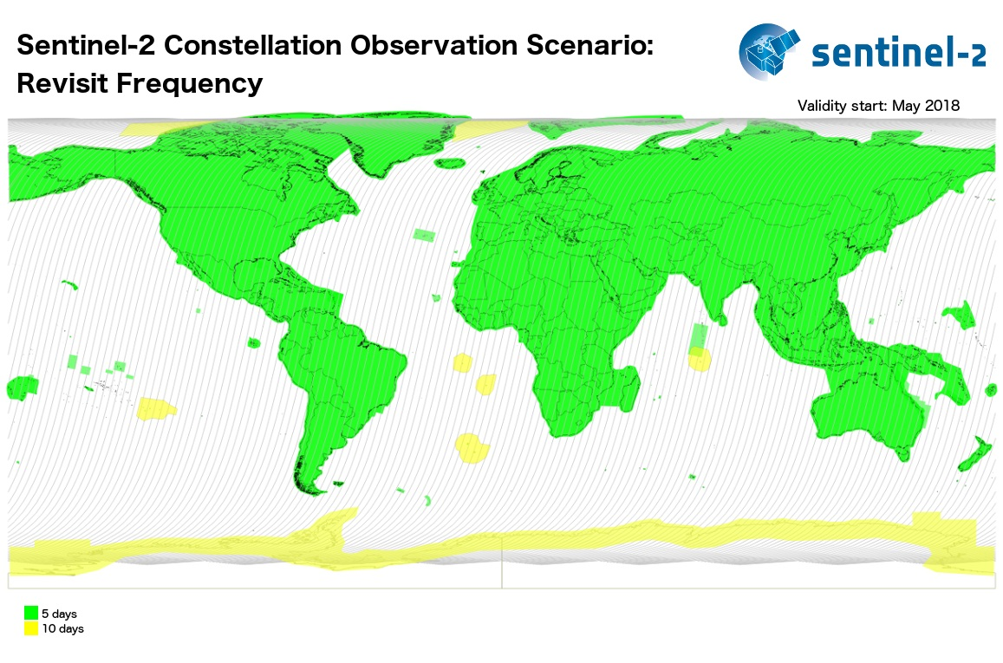
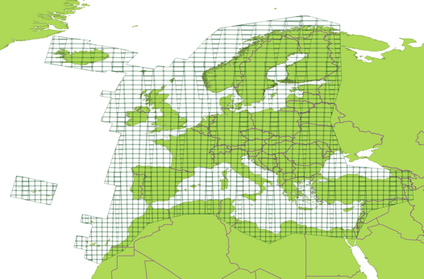
Sentinel-2 Mission Status Highlights
Both Sentinel-2A and -2B operational.
Systematic global coverage every 5 days since 17 Feb 2018 (Antarctica 10 days)
Surface reflectance product (Level-2A) ➔ Q3 / 2018 start of global Level-2A production.
Completion of the conversion of the archive into single-tile format by Q4 2018.
Special issue in the Remote Sensing of Environment journal on "Science and Applications with Sentinel-2” is available online.
B11
Band 11

Slide 7
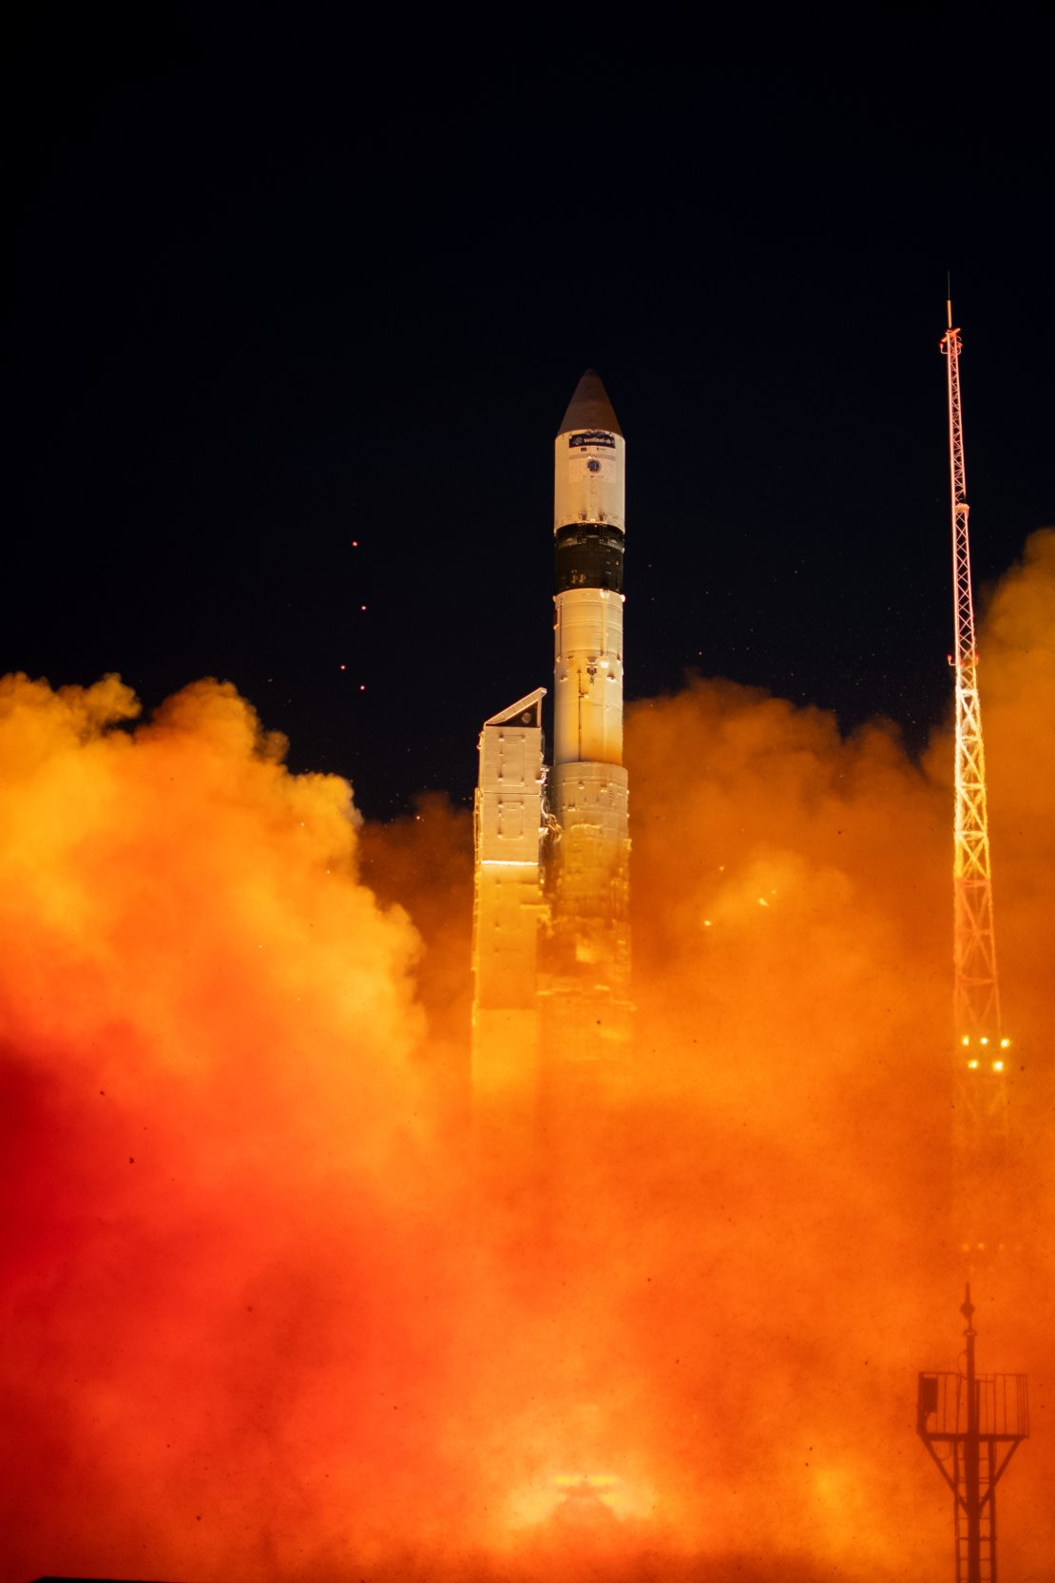
Sentinel-3 mission status
Sentinel-3A is now in routine operations phase and has reached full operational capacity. All Level 1 and Level 2 Land and Marine core data product have been released
Sentinel-3B has been successfully launched on 25 April 2018 and is now in the commissioning phase (sample products are available to expert groups) ➔ routine operations expected beginning of 2019
Status of Sentinel-3A and -3B is nominal, with space and ground subsystems and instruments (OLCI, SLSTR, SRAL, MWR) performing nominally
Since June 2017 Level 2 synergy product are available to expert users, with an official release being planned for Q3 2018
Since 6 June Sentinel-3A and –3B fly tandem, placing Sentinel-3B 30 sec in front of Sentinel-3A.
~30s in time
~210 km
S3B
S3A

Slide 8
https://scihub.copernicus.eu/

Slide 9
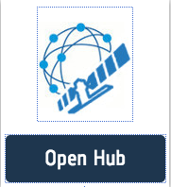
COPERNICUS Open Access Hub - Free and Open Access to Sentinel data (previously called “Scientific” Hub)
Access through self-registration
Automated download scripting capability and dedicated API-Hub
Restriction on concurrent downloads
Overall Statistic of Open Access Hub (Status 03/09/2018)
https://scihub.copernicus.eu/

Slide 10
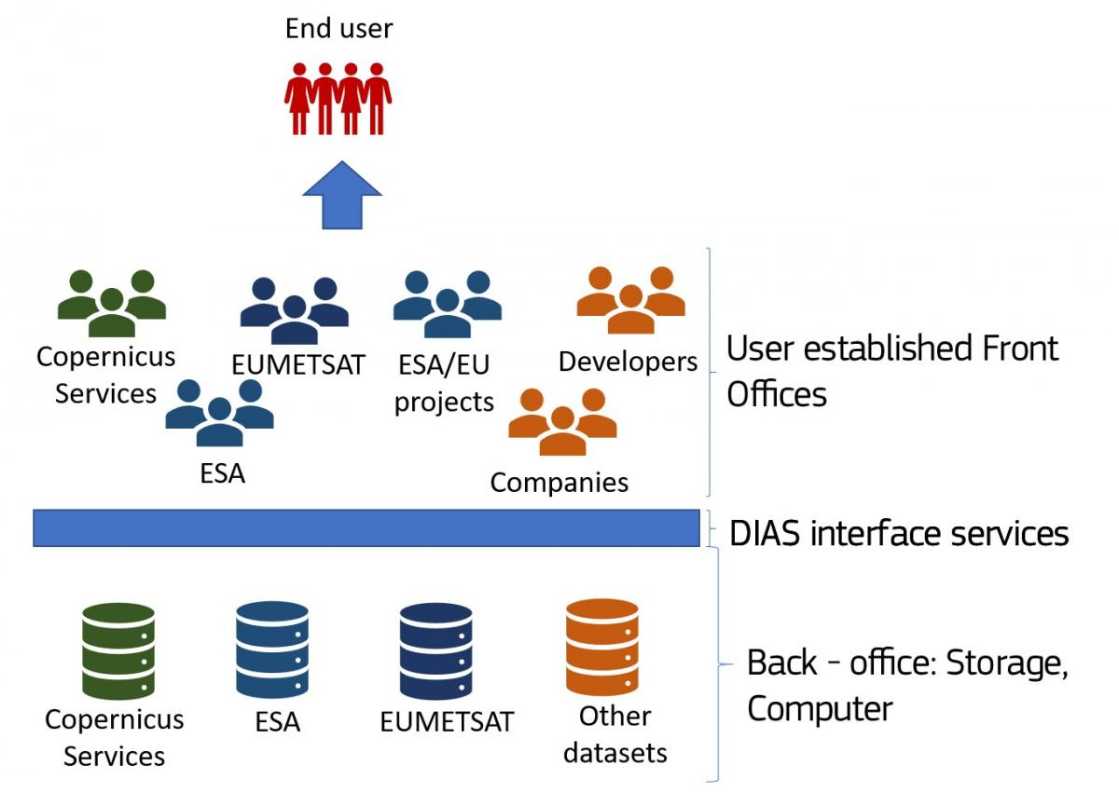
Data and Information Access Services
Creating and enabling a European EO Data ecosystem for research and business.
5 DIAS systems under COPERNICUS (4 managed by ESA, one by Eumetsat)
To facilitate access to Copernicus data and information from the Copernicus services
To discover, manipulate, process and download Copernicus data and information from the Copernicus services.
B11
Band 11

Slide 11
5 Data and Information Access Services
B11
Band 11
Notes:
Creodias (CloudFerro, creoTECH, geomathys, …)
Mundi WebServices (ATOS, T-System, Thales-Alenia, DLR, GAF, Sinergise, …)
Onda (Serco, OVH, Sinergise, GAEL)
Sobloo (Airbus, Orange)
WekEO (EUMETSAT, ECMWF, MERCATOR OCEAN)

Slide 12
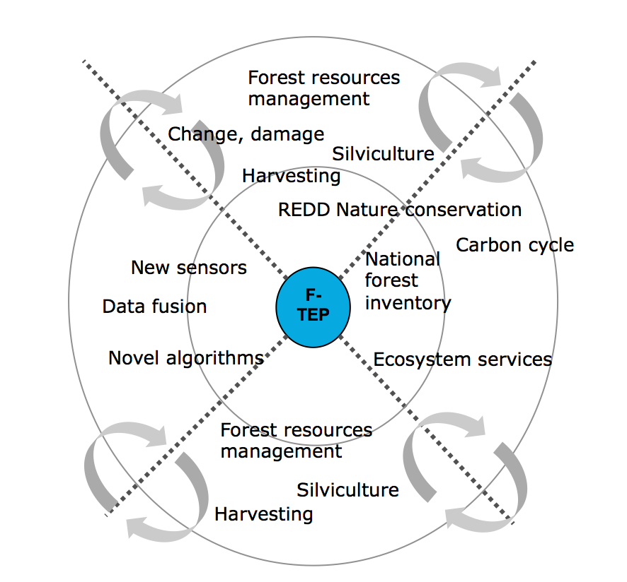
Forestry - Thematic Exploitation Platform
”One-stop shop for forestry remote sensing services for the academic, public and commercial sectors”
Flipping the data access paradigm – from transferring Terabytes of raw data to moving Megabytes of results / products
Moving away from model where each user works in their own ‘silo’
Community centric work environment
Reduce the costs of data acquisition from miscellaneous sources with varying formats and processing levels
Self-service environment with support
➔ https://forestry-tep.eo.esa.int/
Notes:
Platform developed from scratch
EO data: Sentinel-1, S-2, Landsat, Envisat, some ALOS PALSAR, Pleiades, RapidEye… partly commercial
Tools on F-TEP: SNAP - Sentinel toolboxes, Monteverdi / Orfeo toolbox, QGIS, Open Foris (FAO)
Services: Freemium model ➔ basic ones free of charge, higher value commercial
Pre-ops phase finalised

Slide 13
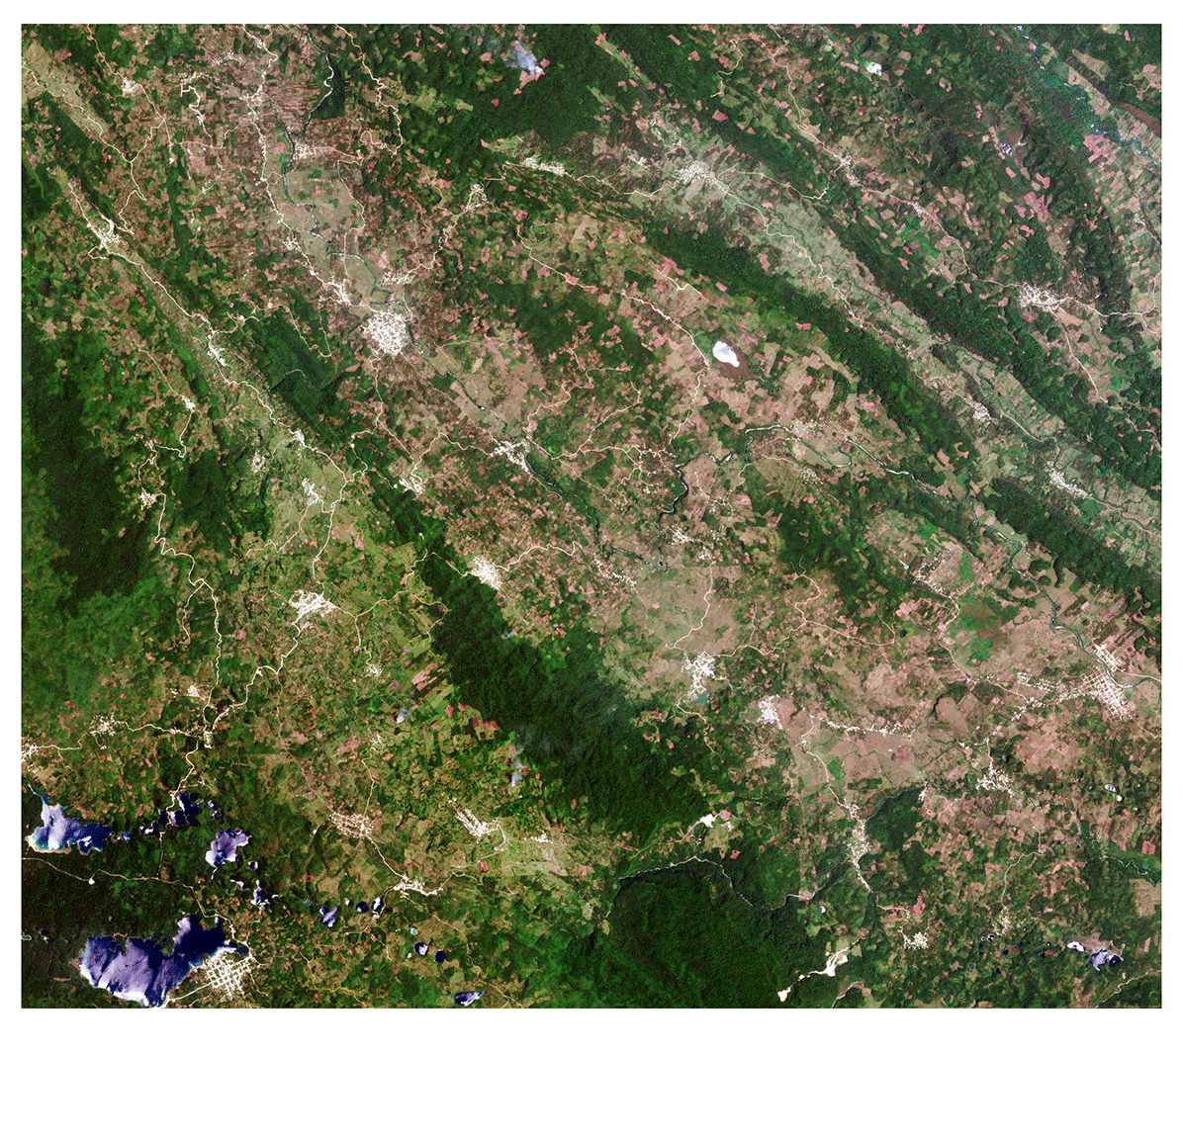
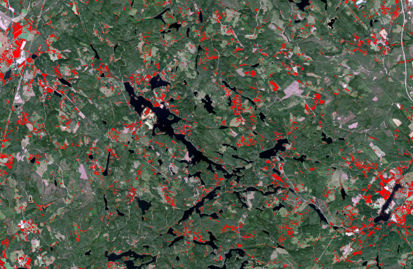
Initial Service Cases for Users
“One-stop-shop for forestry remote sensing services for the academic, public and commercial sectors”
On-going Training and User Expansion
Mapping undesired broadleaved tree shrubs on forest regeneration areas in Finland
Forest monitoring for REDD+ in Chiapas, Mexico
Notes:
User cases in Mexico based on Sentinel-2 and Sentinel-1, in Finnland on Sentinel-2 basis.
3 embedded users => 10 trial users today => needs further expansion in the scientific, commercial and development sector

Slide 14
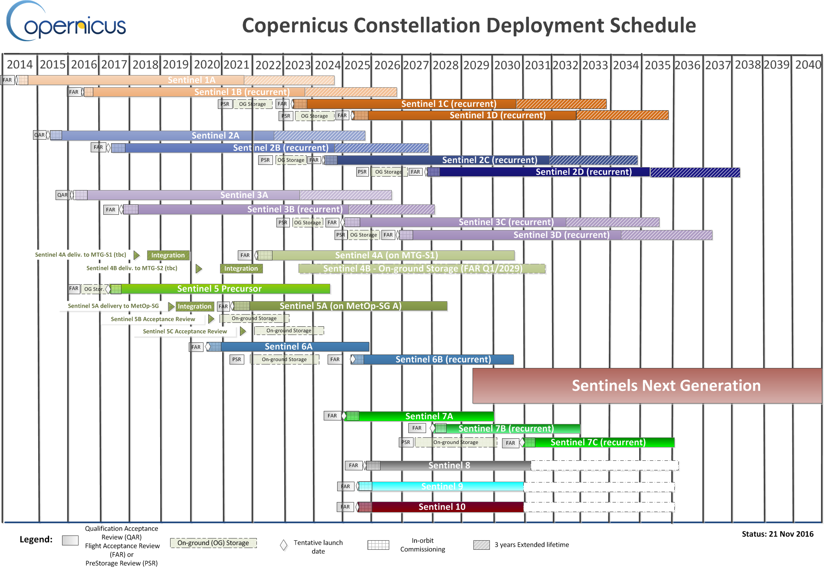
⬅ Potential for CSC Evolution (i.a. L-Band SAR)
Notes:
On 26 October 2016, COM released the “Space Strategy for Europe” communication (COM(2016) 705 final). The communication referred to Copernicus in calling for the strengthening of “….the dissemination of Earth observation data generated by Copernicus …”

Slide 15
Sentinel Expansion
The following Sentinels are confirmed as a result of the
user consultation process and following a gap analysis and are in Phase A feasibility studies:
Sentinel-7: a anthropogenic CO₂ monitoring mission
Sentinel-8: a Thermal Infrared Imager (companion to Sentinel-2 C/D)
Sentinel-9: components:
S-9 ICE: Enhanced Ice and Snow Continuity mission
S-9 HEO: Polar Weather Payload on a Highly Elliptical Orbit
Sentinel-10: a Hyper-spectral mission
Sentinel-11: L-band SAR mission
Candidates
to be verified through
requirements process!
Statistics: 7 February 2017
Notes:
Upd – status> done

Slide 16
Summary
The European Copernicus Programme will secure continuity of observations and data availability for the next 20+ years;
Copernicus Data policy: free and open access for everybody ➔ https://scihub.copernicus.eu/
Sentinel-1 and -2 are core mission for GFOI
Additional potential use of Sentinel-3 in GFOI Early Warning
Growing user community on Open Hub and other distribution channels
5 European DIAS platforms for cloud processing of Sentinel data and info
On-going discussion on extension of the Sentinel family

