Slide 1
JAXA missions and datasets
Status update
A. Rosenqvist, O. Ochiai, T. Tadono, T. Motohka, M. Hayashi (JAXA)
SDCG-14 Session 2 Item#6
JRC, Ispra/Italy, Sept 4-5 2018

Slide 2
ALOS-2
  PALSAR-2 operations nominal
  Major revision of Basic Observation Scenario (BOS) implemented from Jan 2018
    10m dual-pol Fine Beam mode
      Observation windows increased (4 → 6)
      Boreal observations in May-Sept period to reduce seasonal impact on backscatter
      Increased obs frequency in the tropics
    50m ScanSAR
      Staggered observations to improve acq. Success rate
      Every 42-day repeat maintained
    6m Quad-pol
      Global observations discontinued → focus on Super Sites
    3m Ultra-Fine
      Global observation plan completed

Slide 3
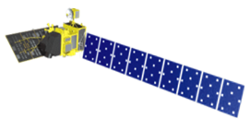

Schedule of ALOS/ALOS-2
Data Processing and Open Free Access
 |  | 2018 |  |  |  | 2019
 |  | 1Q Jan Mar | 2Q Apr Jun | 3Q Jul Sept | 4Q Oct Dec | 1Q Jan Mar | 2Q Apr Jun | 3Q Jul Sept | 4Q Oct Dec
ALOS | AVNIR-2 (10m)
 | PALSAR (10m)
ALOS-2 | ScanSAR (100m)
 | Fine Mode (10m)
Japan Area
±60
Degree Area
Global
Data Processing
Under negotiation with METI
Japan Area
±60
Degree Area
Global
Data Processing
Under negotiation with PD
Under negotiation with PD

Slide 4
  Near-future missions

Slide 5

ALOS series development/operation
2014 | 2015 | 2016 | 2017 | 2018 | 2019 | 2020 | 2021
ALOS-2
(L-SAR)
May 24
Launch
Initial C/O
Initial Cal-Val
Product release
Mission operation (5 years)
Post-mission operation
Development
Launch
ALOS-3
(Optical)
Development
Launch
ALOS-4
(L-SAR)

Slide 6
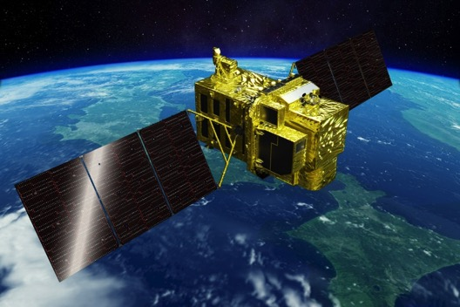
ALOS-3
Items |  | Specifications
Orbit | Type | Sun-synchronous sub-recurrent
 | Altitude | 669 km at the equator
 | Local Sun Time | 10:30 am +/- 15 minutes at the descending node
 | Revisit | 35 days (Sub-cycle 3 days)
Instruments |  | - Wide-swath and high-resolution optical imager (WISH, as a tentative) - Dual-frequencies Infrared sensor (hosted payload)
Ground Sampling Distance (GSD) |  | - Panchromatic band of WISH (Pa): 0.8 m - Multispectral band of WISH (Mu): 3.2 m (6 bands)
Quantization |  | 11 bit / pixel
Swath width |  | 70 km at nadir
Mission data rate |  | Approx. 4 Gbps (after onboard data compression: 1/4 (Pa) and 1/3 (Mu))
Mission data downlink |  | - Direct Transmission: Ka and X-band - via. the Optical Data Relay Satellite
Mass |  | Approx. 3 tons at launch
Size |  | 5 m×16 m×3.5 m on orbit
Duty |  | 10 mins / recurrent
Design life time |  | Over 7 years
Wide-swath and high-resolution optical imager (WISH)
In-orbit configuration

Slide 7
ALOS-3 WISH
Observation channel band allocations among optical satellites (visible to near-infrared).
Wavelength | 400 nm |  |  |  |  |  |  |  |  |  | 500 nm |  |  |  |  |  |  |  |  |  | 600 nm |  |  |  |  |  |  |  |  |  | 700 nm |  |  |  |  |  |  |  |  |  | 800 nm |  |  |  |  |  |  |  |  |  | 900 nm
 | 0 | 1 | 2 | 3 | 4 | 5 | 6 | 7 | 8 | 9 | 0 | 1 | 2 | 3 | 4 | 5 | 6 | 7 | 8 | 9 | 0 | 1 | 2 | 3 | 4 | 5 | 6 | 7 | 8 | 9 | 0 | 1 | 2 | 3 | 4 | 5 | 6 | 7 | 8 | 9 | 0 | 1 | 2 | 3 | 4 | 5 | 6 | 7 | 8 | 9 | 0 | 1 | 2 | 3 | 4 | 5 | 6 | 7 | 8 | 9
ALOS-3 WISH
Blue
Green
Red
Near-IR
Coastal
RedEdge
ALOS PRISM AVNIR-2
Blue
Green
Red
Near-IR

Slide 8
ALOS-3 Observation Modes
1 | Strip-map observation | The satellite can normally perform observation covering 70 km in width and 4,000 km in along-track direction as the strip-map observation mode. To increase the acquisition frequency, the images will be taken by less than 25 deg. pointing angle in cross-track direction (GSD < 1m) when the satellite track is in oceans.
2 | Point observation | If the user has a certain ground point or an area of interest (AOI), the satellite can observe there using pointing capability within 60 deg. This mode will be used for natural disaster monitoring, for example.
3 | Observation direction changing | The satellite can observe any given point by the pointing capability up to 60 deg. in all direction against the satellite nadir. In the case of Japan, it can be activated within 24 hours after receiving the request. This will be used when the large natural disaster happens e.g. the expecting Nankai Trough large earthquake.
4 | Wide-area observation | This mode can cover in wide-ranging area of 200 km (in along-track direction) x 100 km (in cross-track direction) by satellite’s single orbital passage. This will be also used when the large natural disaster happens.
5 | Stereoscopic observation | Two ways proposes to acquire stereo-pair image: 1) in single orbit path, and 2) combining two strip-map observations by nadir view and backward view in neighboring path after three days (sub-cycle revisit orbit). The way 1) will be however not sufficient base-to-height ratio (B/H) to derive terrain information. As the advantages of the way 2), that is possible to set suitable B/H, and can acquire images over large area. However, this will depend on weather conditions i.e. cloud covers, to success stereo image acquisition within short period as a disadvantage.
1 and 5 will be used in the basic observations.

Slide 9
ALOS-4
  Mission Objectives
  Precise monitoring of land deformation and subsidence for detecting anomalies at an early stage
  Continuation and enhancement of the ALOS-2 mission and also exploring new applications
    All-weather disaster monitoring
    Forest monitoring
    Sea ice monitoring
    Large infrastructure monitoring, etc.
  Marine monitoring with AIS (Automatic Identification System)

Slide 10
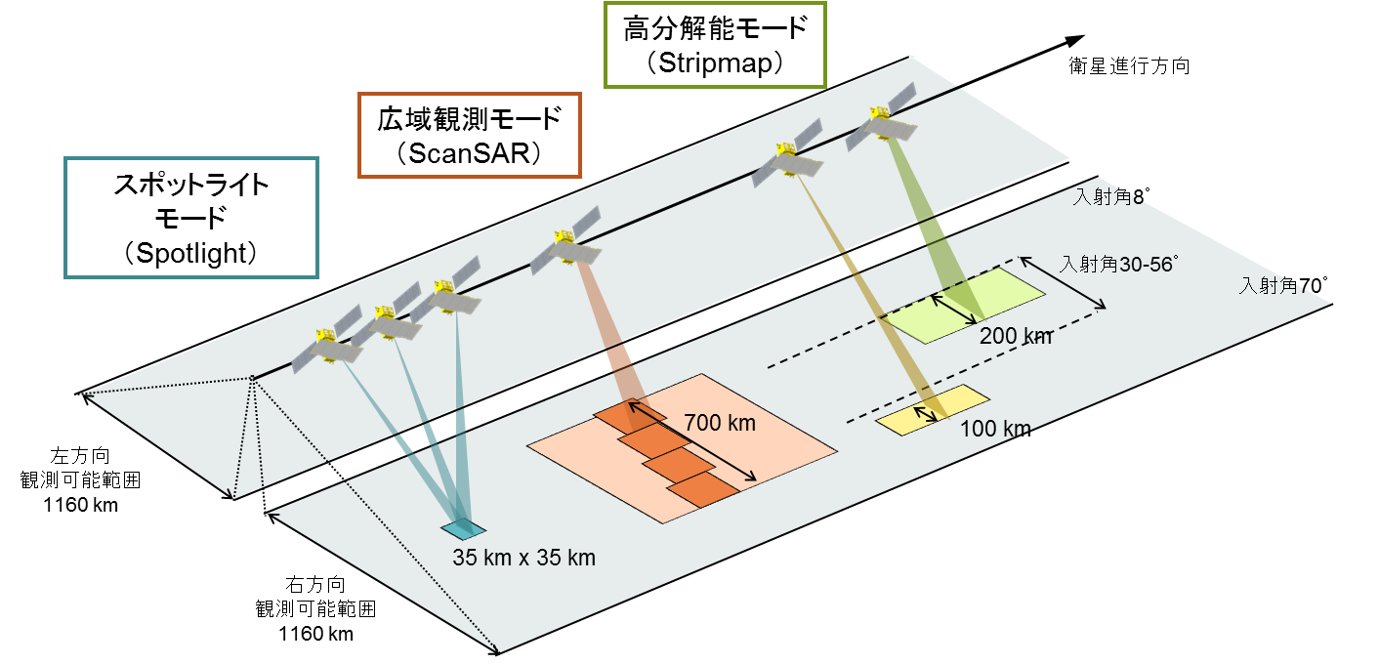
ALOS-4 (PALSAR-3) characteristics
Expanded swath width with maintained spatial resolution and image quality of PALSAR-2 by digital beam forming (DBF).
To guarantee the continuity of ALOS-2 applications, PALSAR-3 will inherit the major function and performance (NESZ, S/A, etc.) of PALSAR-2
 | ALOS-4 | ALOS-2
Stripmap (res. 3/6/10 m) | 100-200 km | 30-70 km
ScanSAR (res. 25m*) | 700 km | 350-490 km
Spotlight (res. 1 x 3 m) | 35km×35km | 25km×25km
*single look

Slide 11
ALOS-4 (PALSAR-3) characteristics
InSAR capability between ALOS-2 and ALOS-4
Master/slave of InSAR pair |  | ALOS-4 |  | ALOS-2
 |  | Stripmap 100/200 km | ScanSAR 700 km | Stripmap 50/70 km | ScanSAR 350/490 km
ALOS-4 | Stripmap 100/200 km | ○ | ○ | ○ | ○
 | ScanSAR 700 km | ○ | ○ | ○ | ×
ALOS-4 reference orbit is the same as ALOS-2
Controlling accuracy is within +/- 500 m (= small baseline)

Slide 12
MOLI
  Multi-footprint Observation LIDAR and Imager (MOLI)
  JAXA LIDAR mission to fly on the International Space Station, Japan Experimental Module (ISS-JEM)
  Mission Design Review completed May 2017
  Operations foreseen from around 2020

Slide 13
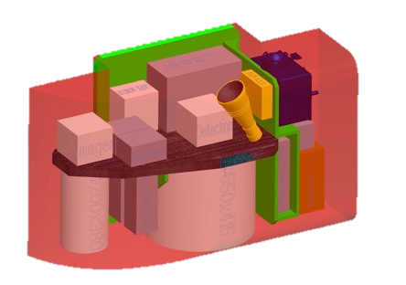
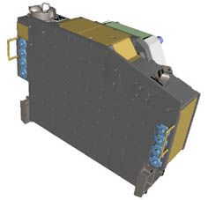
MOLI Overview
MOLI characteristics
Demonstration mission on ISS-JEM
ISS Orbit
  Altitude 400 km, Inclination 51.6 deg
Instruments
  Double beam LIDAR
    Wavelength: 1064nm
    Pulse width: less than 7ns
    PRF: 150 Hz
    Double beam (2 foot prints)
  Multiband Imager
    Resolution: 5 m
    Swath: 1 km
    Band: NIR, R, G
Canopy measurements
  Foot print 25m diameter
  Height accuracy =< 3m
Mission duration; > 1 year
Planned Launch year 2020
+
i-SEEP
(IVA-replaceable Small Exposed Experiment Platform)
Envelope 1600x640x830
MOLI
Schematic diagram of MOLI
Using i-SEEP platform, more flexible environment and services by astronauts are expected.
Laser Transmitter to be returned (post mission) for degradation evaluation on ground.
Notes:
MOLI has LIDAR to measure canopy height and optical imager to understand canopy location and vegetational parameters.
Explaining LIDAR, laser is transmitted to the ground, and reflected signal is received by telescope. Detector Unit detects the signal.
MOLI also has support sensors, STT and GPS to determine footprint positions.

Slide 14
Foot print design for terrain relief calbaration
For calibration of terrain relief:
  Staggered double footprints with the same transmitting timing
For estimation of ground surface slope angle:
  Slope estimation using 3 footprints
  Target slope: ≦30 deg. No snow cover.
50m (PRF 150Hz)
Along track
15 m
15m
25m
in diameter
(beam divergence
62.5mrad )
(n)th pulse
(n+1)th pulse
・・・
Notes:
Next is sampling design.
A lot of sample is needed for measuring accurate biomass,
so MOLI samples 2 lines along track.
It means MOLI must create 2 footprints per 1 laser pulse. by transmitting 2 laser beams.
MOLI can also estimate a slope angle of the ground surface using 3 footprints.
These distance is determined by pixel pitch of array detector.

Slide 15
MOLI data products
Standard Products (quality assured)
level | Product category | Products | Remark
L1 | Lidar footprint products | Full waveforms | including geolocation data
 | Imager product (1km swath) | Image | geometrically corrected
L2 | Lidar footprint products | Canopy heights | including geolocation data
 |  | AGB* | including geolocation data
Research Products (quality evaluated)
*: Above Ground Biomass
level | Product category | Products | Remark
L3 | Synergy products with MOLI Lidar and imager (1km swath) | Tree canopy heights | Line to 2D expansion
 |  | Forest biomass
L4 | Synergy products with MOLI and other satellites Wall-to-Wall map products | Tree canopy height Map | “Wall2Wall” expansion
 |  | Forest biomass map
Notes:
This table shows the tentative list of data products.
In level 1 there are waveforms data and geometrically corrected image data.
In level 2 there are footprint level canopy height, biomass.

Slide 16
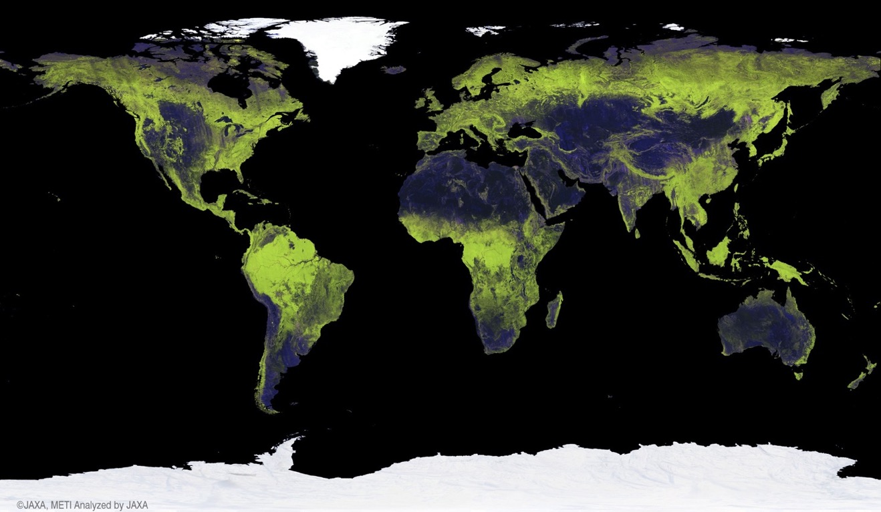
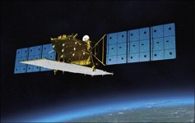
GFOI Core Data Set –
25 m L-band SAR mosaics and Forest/Non-Forest maps
• HH backscatter (gamma-0) 16 bits
• HV backscatter (gamma-0) 16 bits
• Mask image (no-data, water, layover, shadowing.) 8 bits
• Local incidence angle image, 8 bits BYTE
• Observation date image (DN = days after mission launch) 16 bits
16
Open public download at http://www.eorc.jaxa.jp/ALOS/en/palsar_fnf/fnf_index.htm

Slide 17
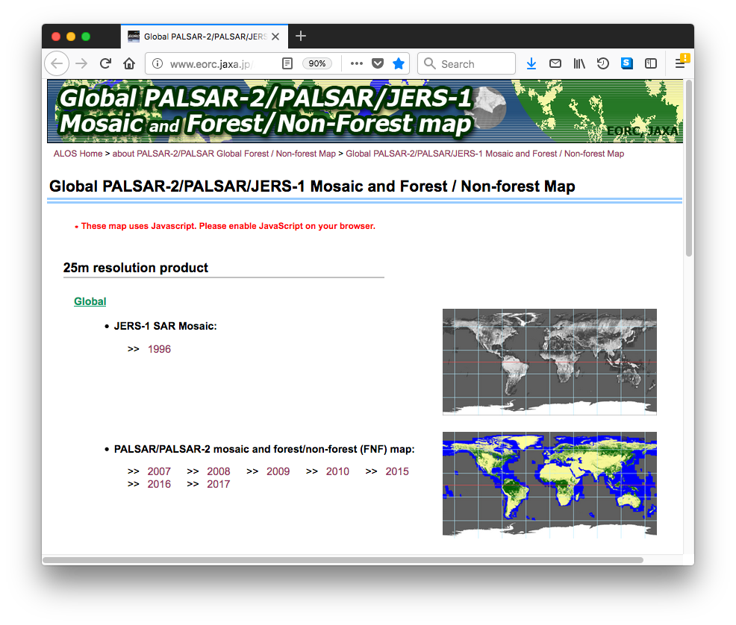
GFOI Core Data Set –
25 m L-band SAR mosaics and Forest/Non-Forest maps
Global coverage
PALSAR-2 2017 (released
May 2018)
PALSAR-2 2016
PALSAR-2 2015
PALSAR 2007 – 2010
JERS-1 ~1996
Free download at:
http://www.eorc.jaxa.jp/ALOS/en/palsar_fnf/fnf_index.htm

Slide 18
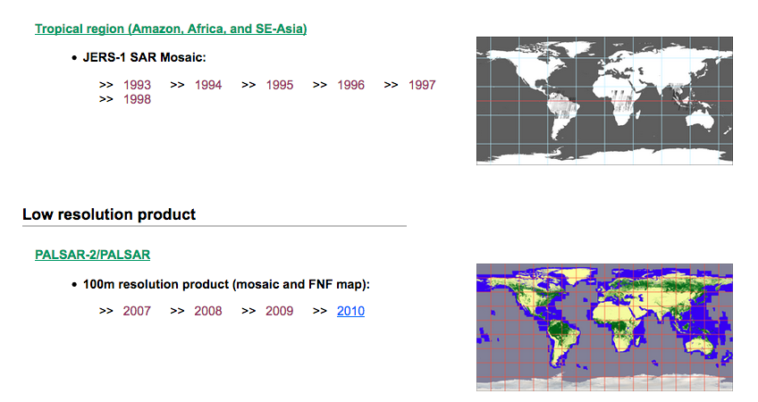

GFOI Core Data Set –
25 m L-band SAR mosaics and Forest/Non-Forest maps
Regional (pan-tropical) coverage (25m)
JERS-1: 1996 – 1998
Global low resolution (100m) coverage
JERS-1: 1996 – 1998
Free download at:
http://www.eorc.jaxa.jp/ALOS/en/palsar_fnf/fnf_index.htm

Slide 19
Global Mangrove Watch
An international collaborative project established as part of JAXA’s Kyoto & Carbon (K&C) Initiative science programme.
  Mapping of extent and changes in global mangrove area
  Thematic Datasets
  Global mangrove baseline extent maps for 2010 (PALSAR + Landsat)
  Global maps of annual changes in the global mangrove extent – public release 2018/Q4
    1996 (JERS-1)
    2007 – 2009 (ALOS PALSAR)
    2015, 2016 & 2017 (ALOS-2 PALSAR-2)

Slide 20
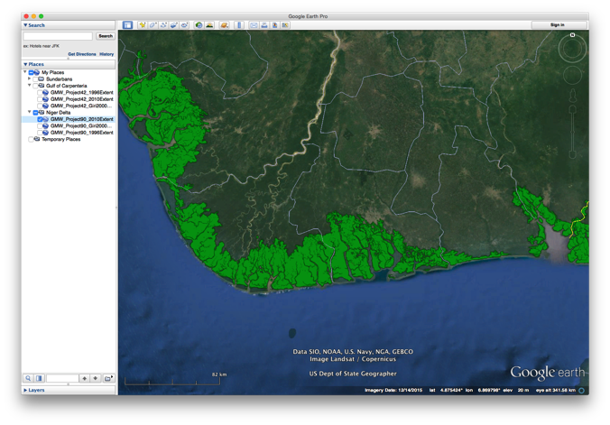
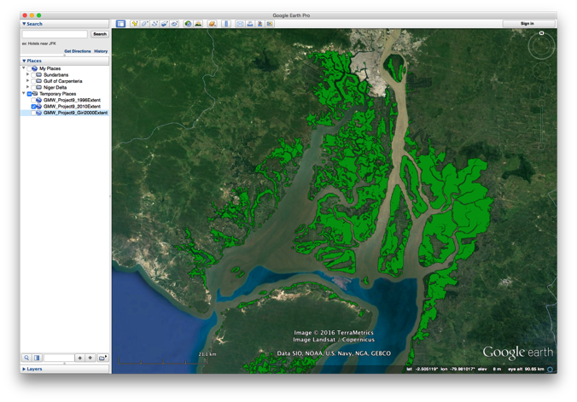
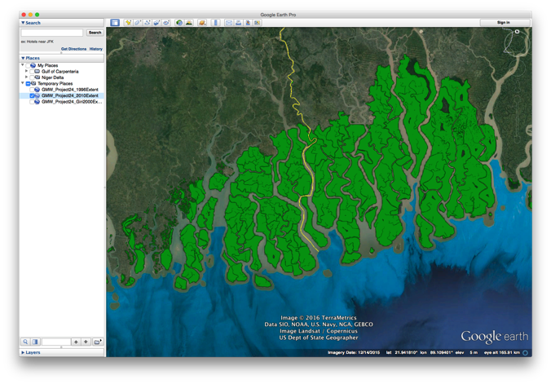
Niger river delta, Nigeria
2010 global mangrove baseline
Guayaquil, Ecuador
Sundarbans, India & Bangladesh

Slide 21
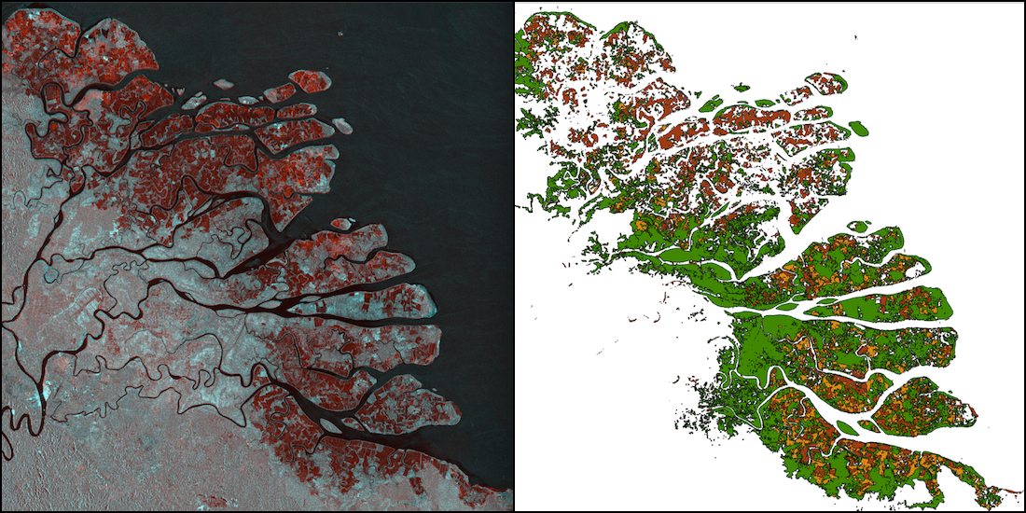
Changes over time (7 epochs)
Kahan river delta, North Kalimantan, Indonesia.
(Left) Multi-temporal SAR composite (1996 JERS-1 SAR and 2016 ALOS-2 PALSAR-2)
(Right) Mangrove extent and changes, Red – mangroves lost 1996-2007, Orange – loss 2007-2016, Green – mangrove cover in 2016.

Slide 22
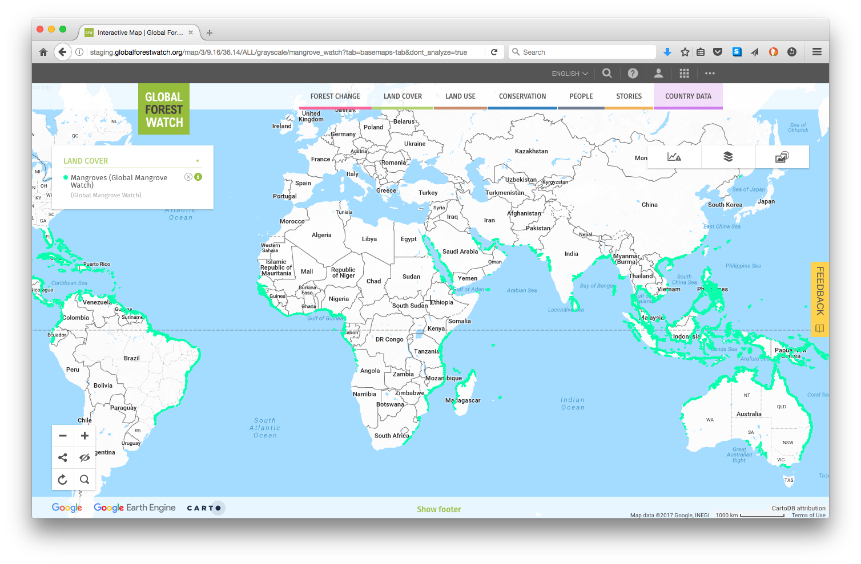
Global 2010 baseline (v2.0) online at www.gfw.org
and for public download at data.unep-wcmc.org/datasets/45

