Slide 1
Joint UK GEO/CEOS Office & UK ICF
Committee on Earth Observation Satellites

Slide 2
People (as of May 2018)
Selina Newell, BEIS

Slide 3
Position | Name and affiliation
GEO EXCOM member | Iain Williams (Defra Deputy Chief Scientific Advisor)
GEO Disasters expert secondment | James Norris (Ordnance Survey)
GEO Data Sharing Working Group (DSWG) (chair) | Miles Gabriel (ESRI UK)
GEO Data Sharing national focal point | Garry Baker (BGS)
CEOS Working Group on Information Systems & Services (WGISS) | Federica Moscato (Catapult) Esther Conway (CEDA)
CEOS WG on Calibration and Validation | Nigel Fox (NPL)
CEOS Ad Hoc Team Space Data Coordination Group (SDCG) for GFOI (co-chair) | Joanne Nightingale (NPL)
GEO Programme board sub-group on Paris Agreement | Marie-Fanny Racault (NCEO-PML)
CEOS WG Climate | Chris Merchant (NCEO-Reading)
CEOS Ad Hoc Team on Future Data Architectures, CEOS LSI-VC | Joao Carrieras (NCEO-Sheffield) and Dan Wicks (Catapult)
GEO GFOI (Leads group) | Selina Newall(BEIS climate team)
CEOS WG Disasters | Dave Hodgson (DMCII)
UK expert reps to GEO and CEOS

Slide 4
Highlights
2014, 2016: Publications of GFOI Methods and Guidance documentation for REDD+: Jim Penman.
Sept 2016: UK hosted the GFOI Policy Forum and the CEOS SDCG-10.
2017: UK invited to join the GFOI leads group (Dan Doherty - Selina Newall, BEIS)
Late 2017: Office support of appointment of Joanne Nightingale to co-chair CEOS SDCG.
Notes:
Aims for Joanne: to identify gaps in data supply chain for GFOI and investigate obstacles to take-up of Methods and Guidance Documentation developed for REDD+ climate finance.

Slide 6
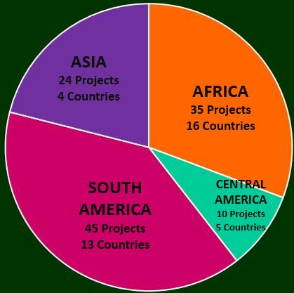
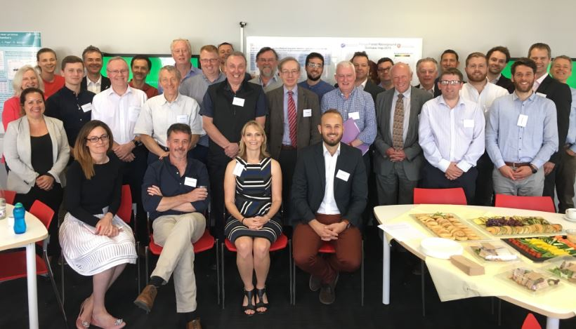
UK Expertise Workshop – tidying our own backyard!
UK Government, Academic and Commercial entities + GFOI/FAO
Key strength in Earth Observation (application and R&D)
Projects widely dispersed but many projects in some countries could potentially be aligned and better coordinated with GFOI

Slide 7
Upcoming contributions
Potential work: Follow-on to World Bank Country Needs Assessments
Evidence gathering to understand the gaps/needs/barriers to countries implementing NFMS are and how these may be overcome through our potential larger TA programme
Development of MRV implementation plans
Implement FLINT (Full Lands Integration Tool) to test how it can be used to enable countries to provide IPCC compliant MRV reporting

Slide 8
Business Case Development
Conservation, sustainable forest management and enhancement
Develop a technical assistance program that incentivises developing countries to implement a flexible and long-term monitoring system to accurately report greenhouse gas emissions from Agriculture, Forestry and Other Land Uses as per the IPCC guidelines, unlocks results based finance, and encourages sustainable forest and land use management practices
Key Features of *Potential* new Programme:
Focus on operational solutions targeting the real barriers to change (Institutional arrangements/management; Data; Capability; Capacity) based on genuine need and sustainable approaches
At scale. Global in reach although country specific.
Long-term. Complementing other efforts but being clear why this is different – focus on reduced emissions and helping support and end to end system.
* Pending internal BEIS process and still subject to ministerial approval*

Slide 9
Business Case Development
Needs driven. Menu of activities that are then chosen from after prioritised needs assessment. Not all activities in all countries. Reflective of UK’s unique selling point and added value in this field – scale, expertise in remote sensing etc, experience in large development and governance programmes.
Beyond Carbon. Always mindful of our high level objectives of reducing emissions and increasing ambition. But to make it sustainable we are looking beyond carbon.
Timings:
Exact scope still being defined.
Delivery model also tbc but will involve a number of different partners with a managing partner.
BC written and approved early 2019 for mid-2019 start….
ODA, Climate Finance, Value for money for the UK taxpayer, free and open procurement.

