Slide 1
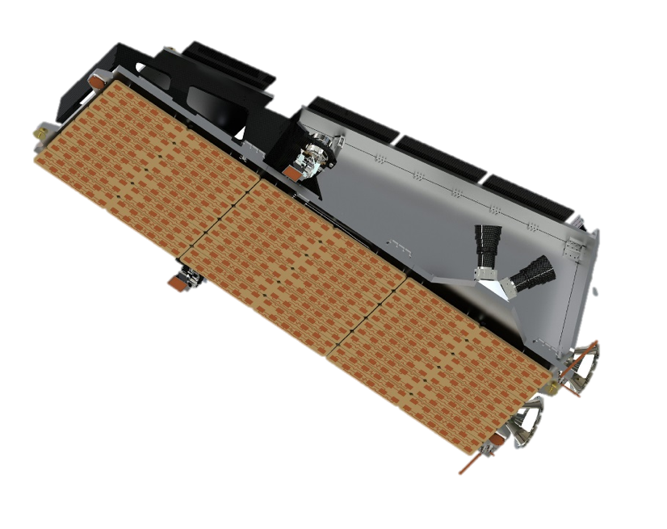
NovaSAR primary payload: SAR
Payload Design &
Build
Parameter | Value
Centre frequency | S-band: 3.2 GHz (9.4 cm)
Bandwidth | 200 MHz
Antenna | Microstrip patch phased array (3m x 1m)
Peak RF power | 1.8kW
Polarisations | HH, HV, VH, VV
Imaging polarization | Single, dual, tri- or quad polar
Design life | 7 years
Mass | <450kg
Orbit | 583 km SSO, 10:30 am LTAN
Propulsion system | Xenon
Payload duty cycle | 2 min per orbit
Payload data memory | Up to 256 GBytes
Downlink rate | 500 Mbps, X-band
Geolocation | <50m

Slide 2
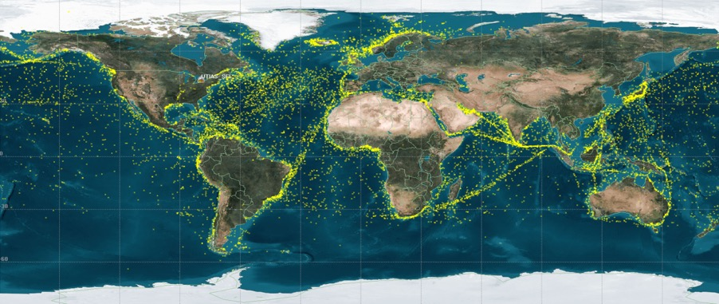
NovaSAR secondary payload: AIS
NovaSAR includes an Automatic Identification System (AIS) for ship identification and tracking
SAR and AIS data from the same platform can help identify ships transmitting false ID information or no ID information.
No AIS
AIS
SAR
False AIS
No AIS
No AIS
No AIS

Slide 3
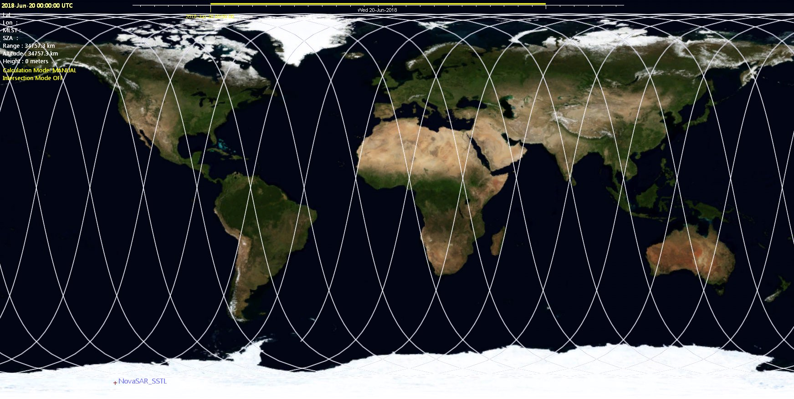
NovaSAR
Orbit
Repeat cycle: 14 days
14.9 rev/day (~97 min/orbit)
209 rev/cycle
192 km ground track distance @ Equator
Observation sequence: adjacent paths on consecutive days
Observation capacity
NovaSAR duty cycle: 2 minutes/orbit

Slide 4
NovaSAR Baseline Modes
Mode | Ground range resolution | Incidence angle range | Swath width | Sensitivity (NEσ0) | Azimuth ambiguity ratio (DTAR) | Range ambiguity ratio (DTAR) | No. of looks
Stripmap (18 beams) | 6m | 16.0 - 31.2° | 13-20 km | <-18.5 ~ -19.5 dB | <-17 ~ -20 dB | <-16.5 ~ -18 dB | 3
ScanSAR (2 beams) | 20m | 15.8 - 25.4° | 100 km | <-18.5 dB | <-17 dB | <-17 dB | 4
 | 20m | 25.0 - 29.4° | 50 km | <-20.0 dB | <-17.5 dB | <-16.5 dB | 4
ScanSAR Wide (2 beams) | 30m | 14.0 - 27.4° | 140 km | <-19.0 dB | <-17 dB | <-15.5 dB | 4
 | 30m | 27.4 - 32.0° | 55 km | <-19.5 dB | <-17.5 dB | <-15.5 dB | 4
Maritime (1 beam) | Rg 6m Az 13.7m | 34.5 - 57.3° | 400 km | <-11.4dB | N/A | <-18 dB | 1

Slide 5
Systematic acquisition strategy
Maximising the Australian investment in NovaSAR
Development of a “Not a lost pass” Strategy
to assure full utilisation of the 10% capacity
Top priority requests (emergencies/disasters, national security)
Calibration & Validation
Top prio during commissioning
Integrated/non-conflicting during operational phase
Strategic observations
DST Maritime Surveillance
Requests from AU stakeholders
R&D
Background mission – building of long-term time-series archive
Australia
SE-Asia & Pacific islands
Antarctica
Others TBD

Slide 6
Data processing and distribution
Data policy: public open
Processing and distribution by CSIRO
Aim to process the data into ARD product(s) right away, as optional delivery to users

